Slide 1
Does wealth affect health?
Niels van Opstal

Slide 2
Introduction
Correlation health wealth has been shown often.
Causality remains unclear in research.
Could be endogeneous:
health → wealth
wealth → health
… → health & wealth
Goals of thesis: to find a causal effect from wealth on health using a difference in differences analysis.

Slide 3
Literature
Pollack et al. (2007)
Analyzed 29 studies on correlation health
Meer, Miller and Rosen (2003), Kim and Ruhm (2012), Apouey and Clark (2015)
IV inheritance (and lottery winnings), no causality
Cai (2009)
Focusses on health transitions, causal effect of wealth on health
Keese and Schmitz (2014)
Indebtedness → worse mental and physical health

Slide 4
Data
Dutch Household Survey
Waves 2007, 2013 and 2017

Slide 5
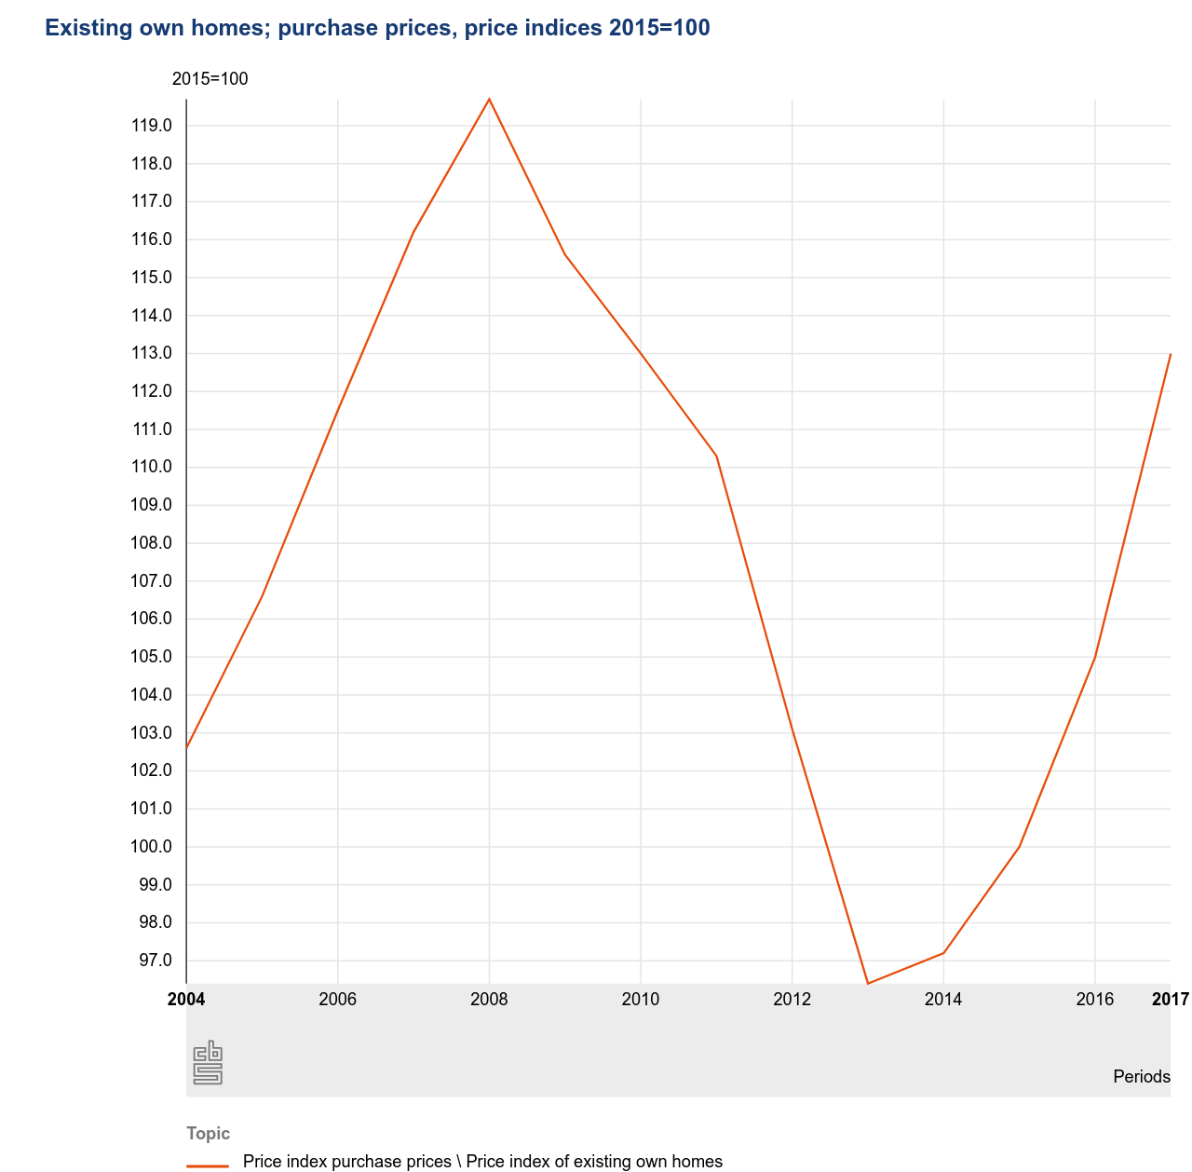
Methods
Difference in differences analysis
Quasi-experiment
Treatment: change in house prices caused by the financial crisis in 2008
Control group: home renters
Treatment group: home owners

Slide 6
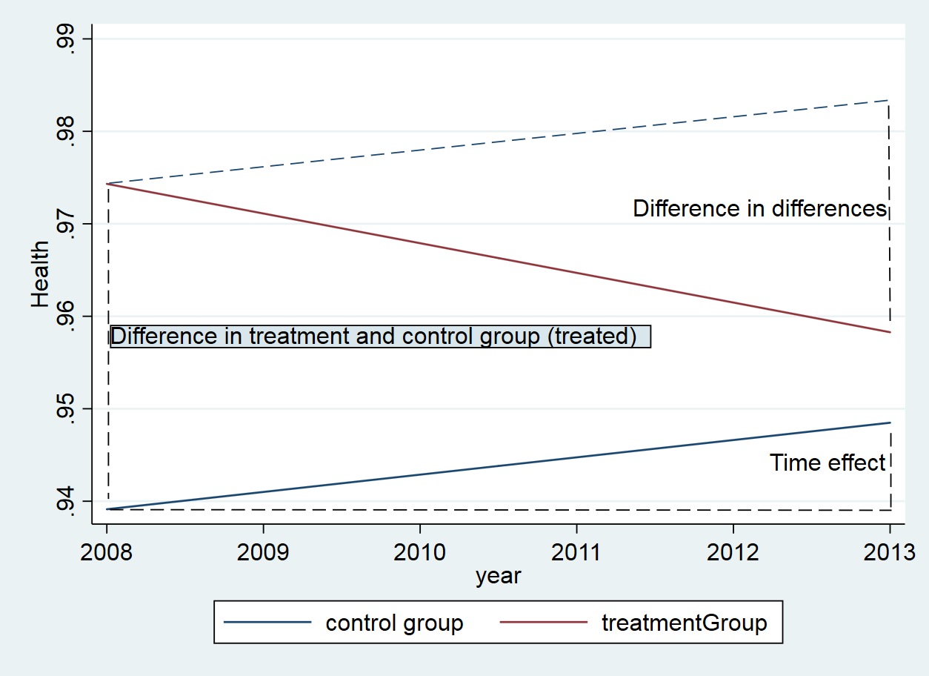

Slide 7
Results
 | without fixed effects |  | with fixed effects
 | 2007 - 2013 | 2013 - 2017 | 2007-2013 | 2013-2017
VARIABLES | health | health | health | health
DID | -0.0104 | 0.0167 | -0.0204 | 0.00884
 | (0.0197) | (0.0199) | (0.0163) | (0.0149)
time | -0.0130 | -0.0155 | -0.00803 | -0.0102
 | (0.0144) | (0.0151) | (0.0116) | (0.0112)
treated | 0.0205 | 0.0243* | 0.0441 | 0.0119
 | (0.0139) | (0.0139) | (0.0276) | (0.0258)
Constant | 0.9595*** | 0.9410*** | 0.947*** | 0.948***
 | (0.0101) | (0.0103) | (0.0153) | (0.0150)
Observations | 1,540 | 1,886 | 1,540 | 1,886
persons |  |  | 770 | 943
R-squared | 0.0040 | 0.0061 | 0.011 | 0.001
Standard errors in parentheses
*** p<0.01, ** p<0.05, * p<0.1

Slide 8
Source list:
Pollack, C. E., Chideya, S., Cubbin, C., Williams, B., Dekker, M., & Braveman, P. (2007). Should health studies measure wealth?: A systematic review. American journal of preventive medicine, 33(3), 250-264.
Meer, J., Miller, D. L., & Rosen, H. S. (2003). Exploring the health–wealth nexus. Journal of health economics, 22(5), 713-730.
Kim, B., & Ruhm, C. J. (2012). Inheritances, health and death. Health Economics, 21(2), 127-144.
Apouey, B., & Clark, A. E. (2015). Winning big but feeling no better? The effect of lottery prizes on physical and mental health. Health economics, 24(5), 516-538.
Cai, L. (2009). Be wealthy to stay healthy: An analysis of older Australians using the HILDA survey. Journal of Sociology, 45(1), 55-70.
Keese, M., & Schmitz, H. (2014). Broke, ill, and obese: is there an effect of household debt on health?. Review of Income and Wealth, 60(3), 525-541.

