Slide 1
Swept rule domain decomposition for 1D PDEs on heterogeneous compute clusters
Daniel J Magee and Kyle E. Niemeyer School of Mechanical, Industrial, and Manufacturing Engineering Oregon State University, Corvallis, Oregon

Slide 2
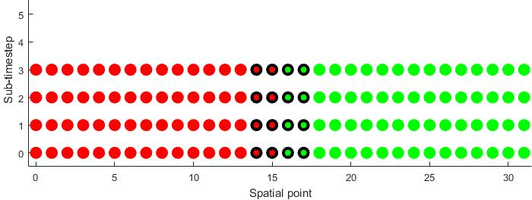
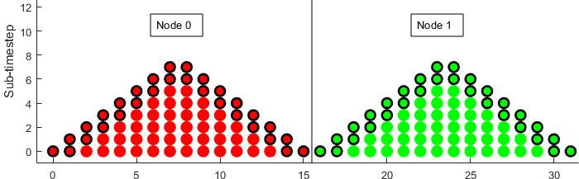
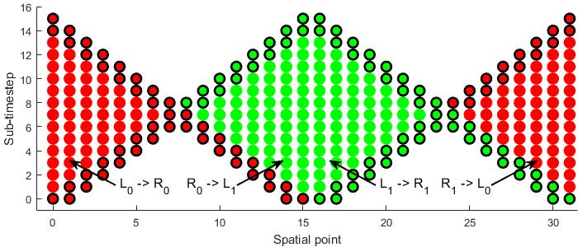
Domain Decomposition
Apportioning the grid of a numerical solution between connected processors
Classic Decomposition
Requires two small data transfers every sub-timestep.
Incurs significant cost from fixed cost of data transfer (latency)
Swept Decomposition
Requires two larger data transfers after a number of sub-timesteps equal to the number of spatial points in a node.
Exhausts domain of dependence before communicating edge values (Circled in black).
Notes:
Explain sub-timestep is some intermediate step of RK scheme etc.

Slide 3

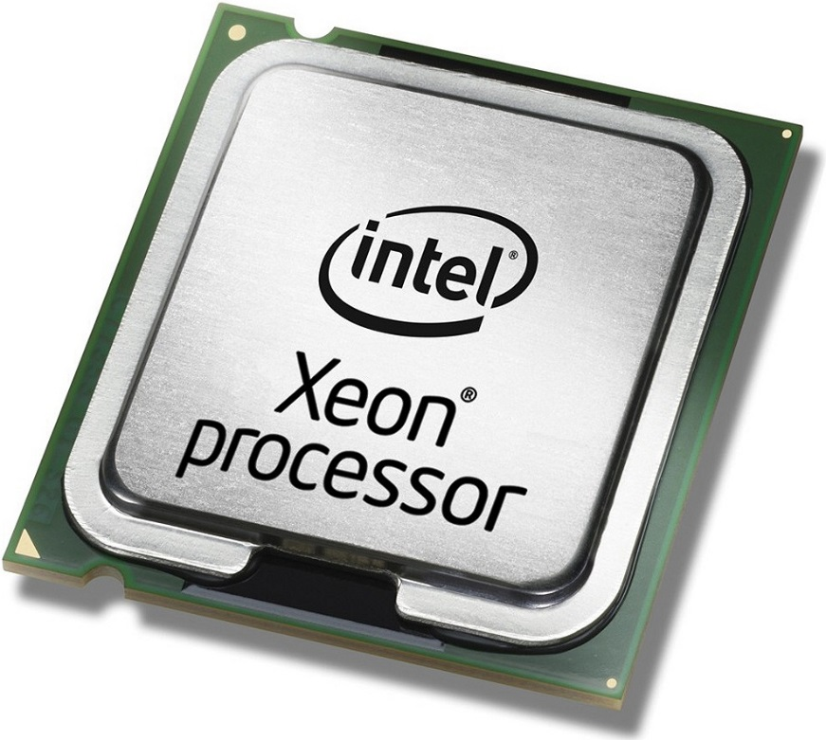
Platforms
Heterogeneous: uses CPUs and GPUs or other accelerators together
GPU
CPU
Specialized, slower
Many cores (300 – 5000)
High Cost
Use CUDA within MPI/C program
General purpose, flexible, fast
Few cores (<16)
Low Cost
Use MPI (Message Passing Interface) to communicate between processes in parallel.
Notes:
https://nvidianews.nvidia.com/news/nvidia-tesla-p100-supercharges-hpc-applications-by-more-than-30x

Slide 4
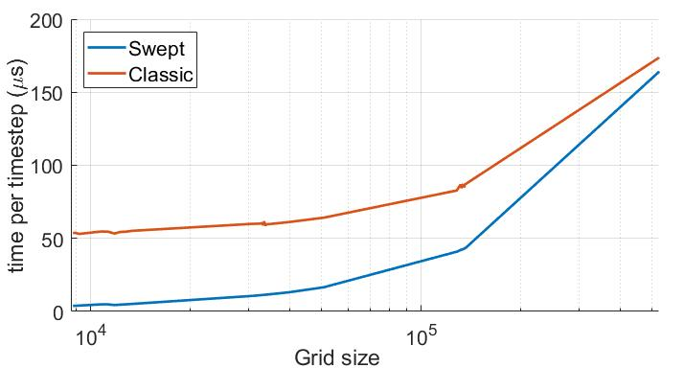
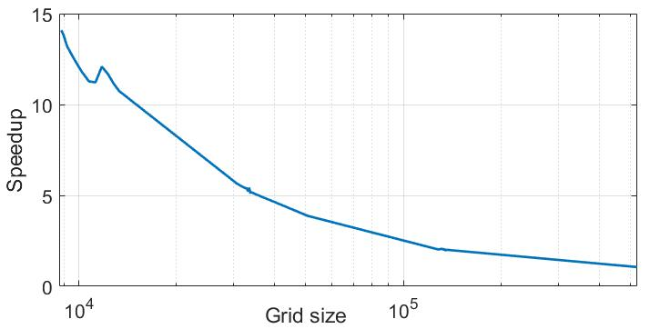
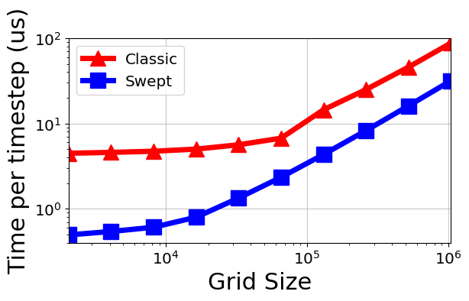
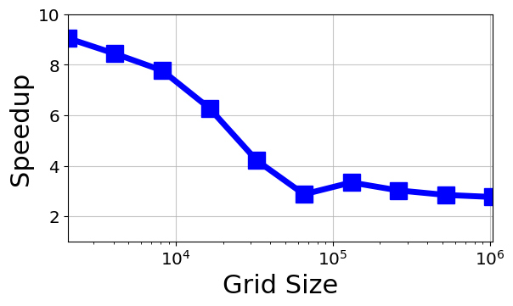
Results
Heat equation on Workstation with Tesla K40 GPU and Intel Xeon CPU
MPI + CUDA
CUDA (GPU only)

