Slide 1

Tuwaiq Academy
Data Science and Machine Learning Bootcamp
Omar Alnasser
Fay Alenezi
Hisham Altayieb
28-5-2023

Slide 2


IMDB 10k Dataset
P2 Data Analysis

Slide 3
Agenda
03
02
01
Steps
Questions
Dataset Overview
06
05
04
Questions
Insights
Code Walkthrough

Slide 4
Dataset Overview

Slide 5
Overview
This data set contains information about 10,000 movies collected from The Movie Database (TMDb), including user ratings and revenue.
Certain columns, like ‘cast’ and ‘genres’, contain multiple values separated by pipe (|) characters.
There are some odd characters in the ‘cast’ column.
The final two columns ending with “_adj” show the budget and revenue of the associated movie in terms of 2010 dollars, accounting for inflation over time.
Columns
['id', 'popularity', 'budget', 'revenue', 'original_title', 'director', 'runtime', 'genres', 'production_companies', 'release_date', 'vote_count', 'vote_average', 'release_year', 'budget_adj', 'revenue_adj']

Slide 6
Questions

Slide 7
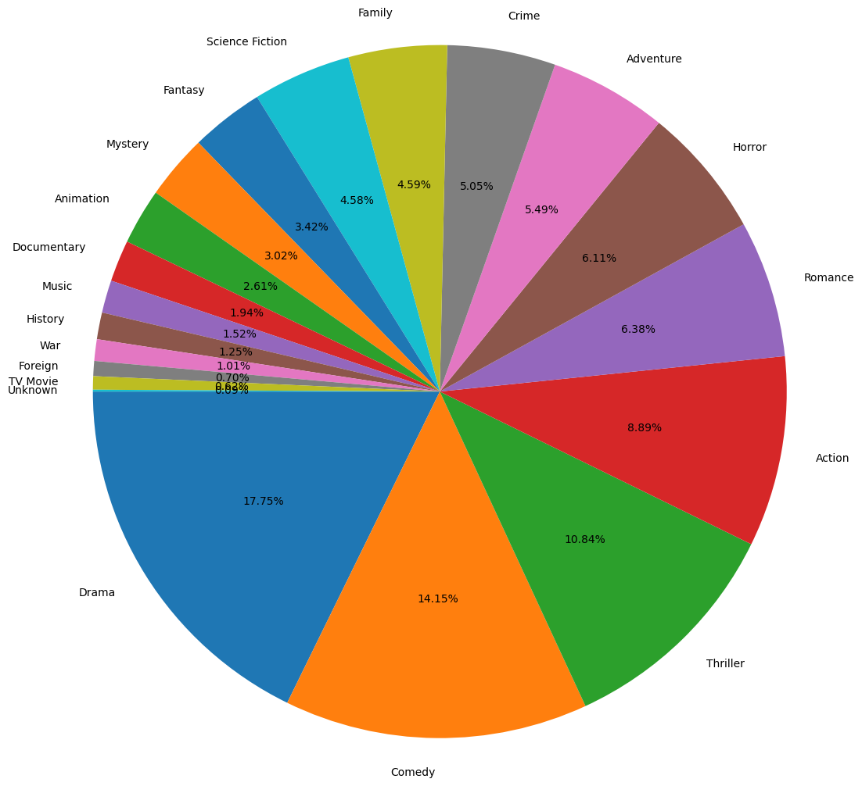
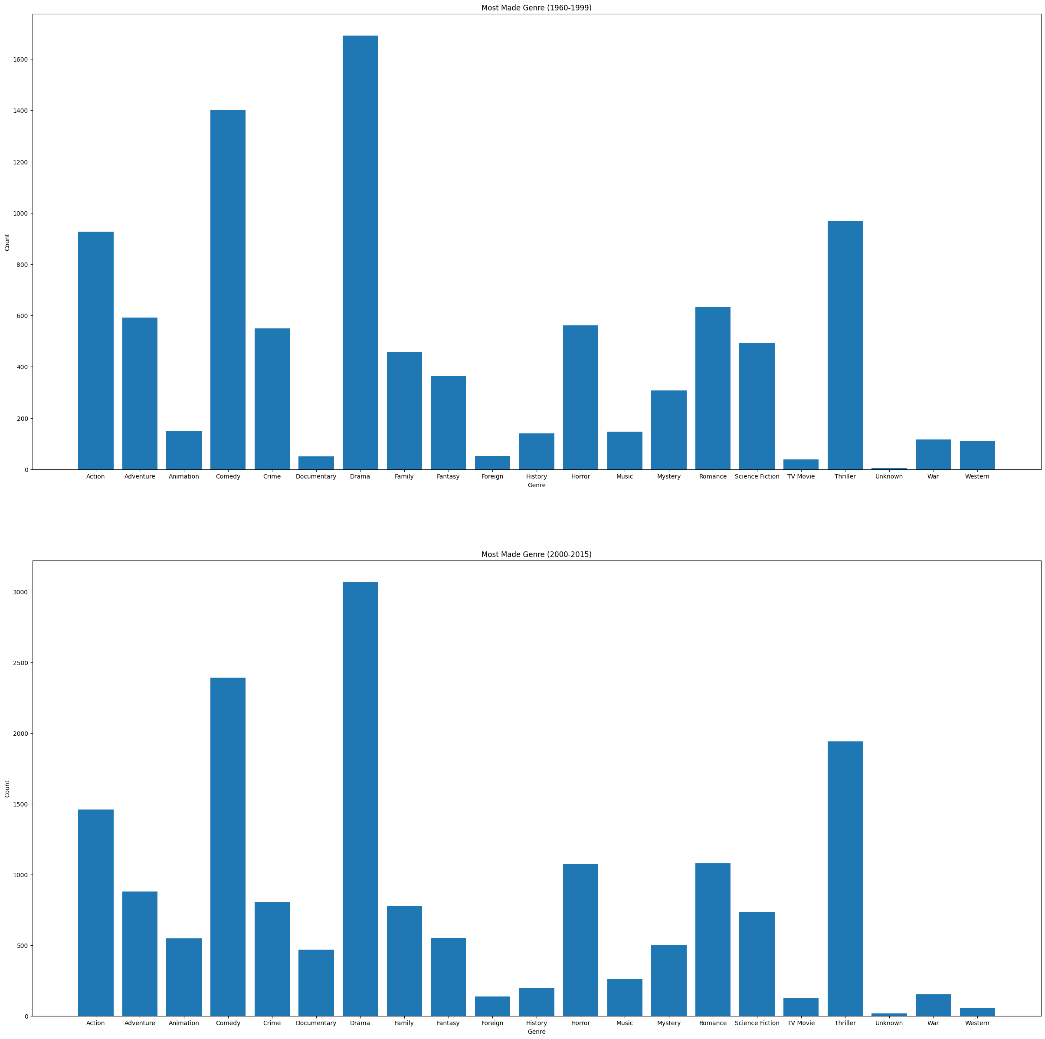
1st : Which genres are most popular from year to year?

Slide 8
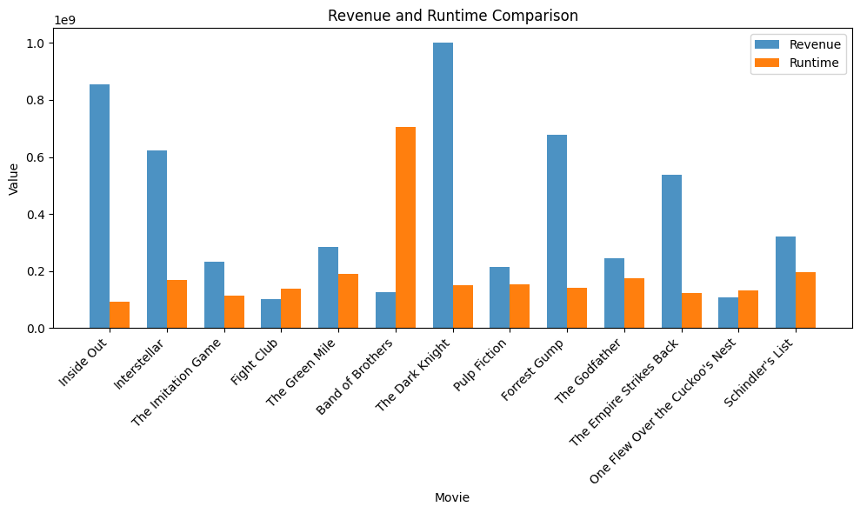
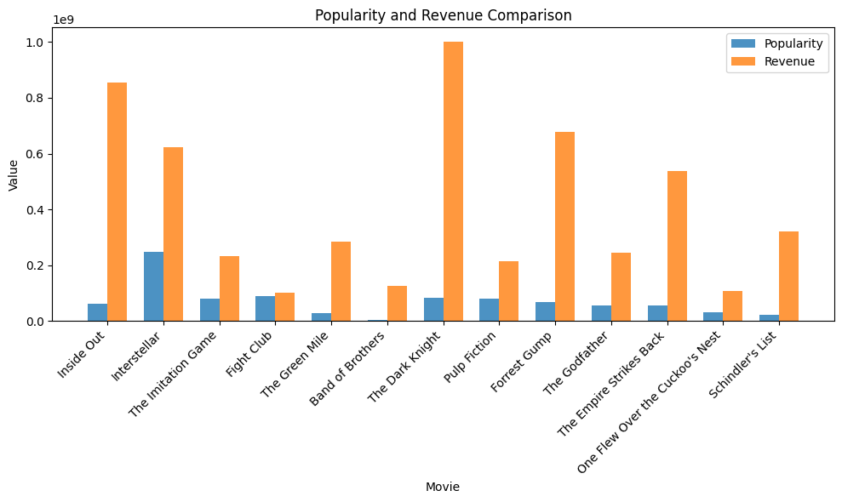
^{2nd} : What kinds of properties are associated with movies that have high revenues?

Slide 9
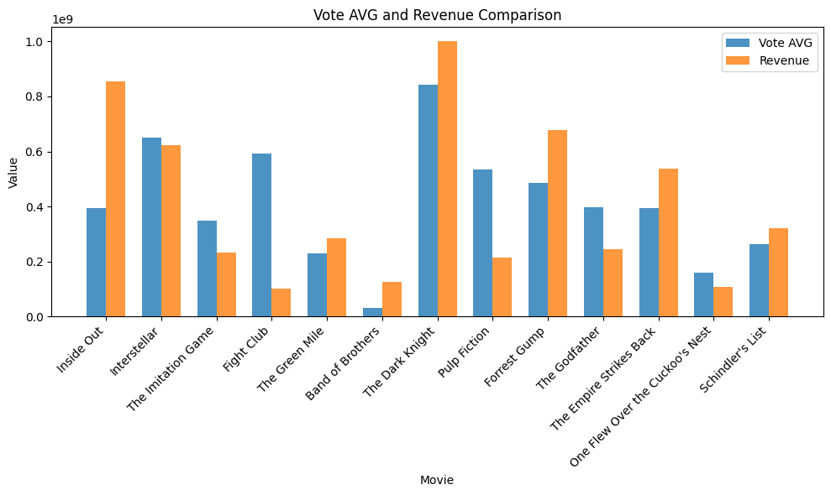
^{2nd} : What kinds of properties are associated with movies that have high revenues?

Slide 10
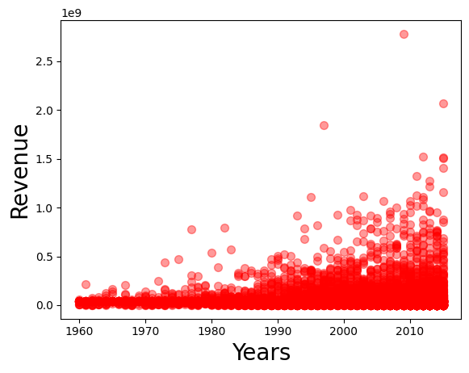
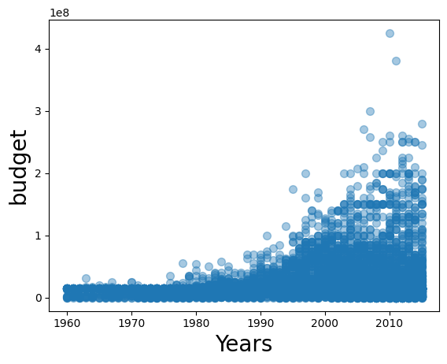
^{3rd}: How much revenue do movies get over the years based on their budget?

Slide 11
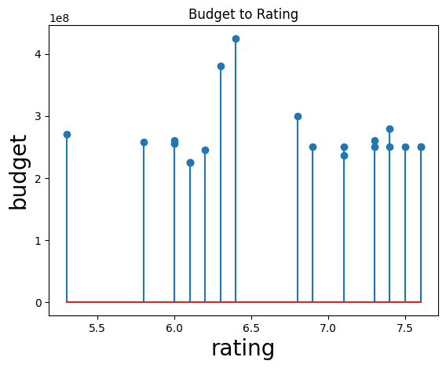
^{4th}: Does the amount of budget spent on a movie affect its rating?

Slide 12
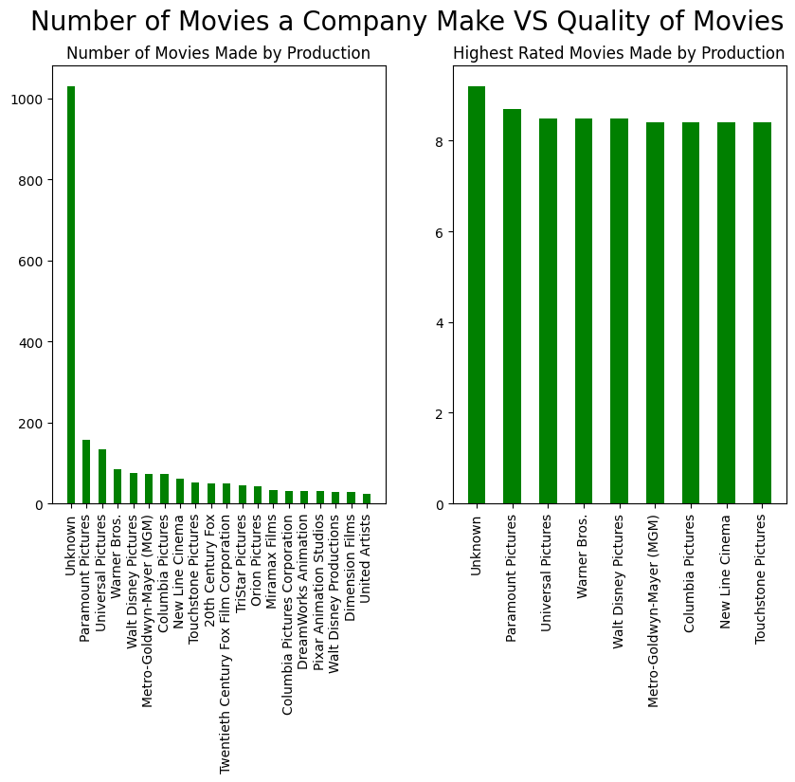
^{5th}: Is there a correlation between the number of movies a production makes and their success?

Slide 13
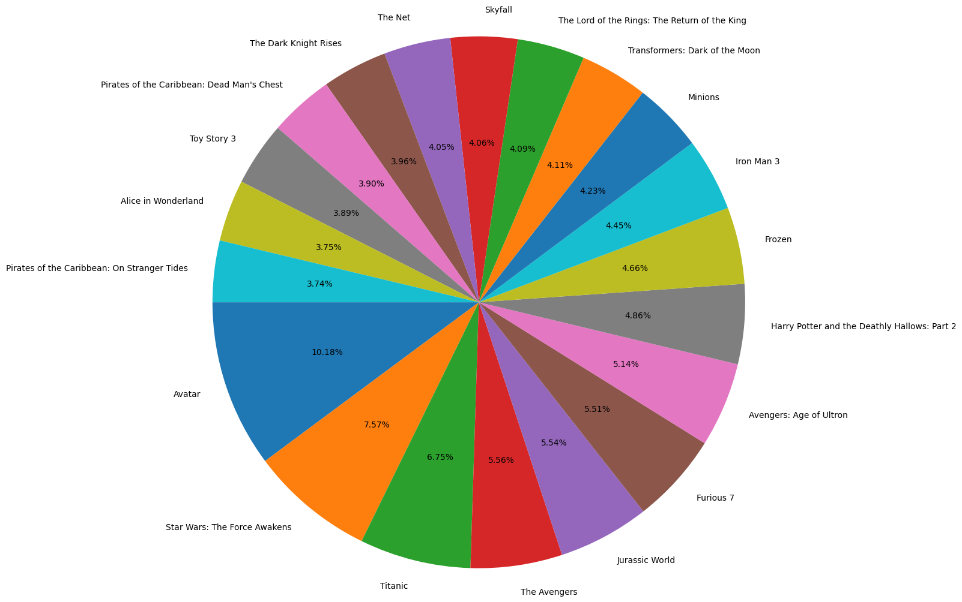
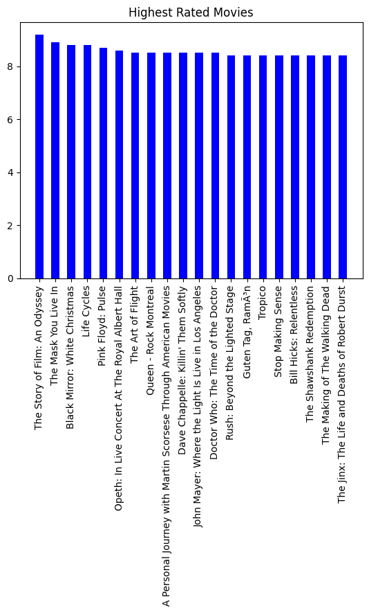
^{6th}: Is there a correlation between the revenue a movie gets and its rating?

Slide 14
Code walkthrough

Slide 15
Steps

Slide 16


Steps
Data Gathering
Data Cleaning
Data Wrangling (EDA _ Exploratory)
Data Visualization
EDA (Explanatory)
Communicate Findings

Slide 17
Insights

Slide 18
Insights
For 48 years, the dominant genre of the list of films was drama, with nearly 20% of the total of 13 genres, 10,000 ratings, and 5,000 films. 1st
One of the most common characteristics associated with high-grossing movies is ratings. 2nd
() 3rd
() 4th
() 5th
() 6th

Slide 19
THANK YOU
شــــــكــــراً لكــــــم

Slide 20
Questions

