Slide 1
Predicting Electric Motor
Winding Temperature
UCS321 - AI FOR ENGINEERS | MST MINI PROJECT
A physics-driven virtual sensor that estimates PMSM stator winding temperature from signals the drive already measures - replacing a thermocouple with software.
1.54 °C
0.9965
104
84.2 %
RMSE on unseen
motor sessions
coefficient of
determination R2
features engineered
from 8 raw channels
of samples within
±2 °C of truth
Problem Statement 6
GE Power Systems - supervised regression for motor temperature
Lohhith Thakur - Roll No. 1025220020 - B.E. Electronics (VLSI Design & Technology)
Thapar Institute of Engineering & Technology, Patiala
Notes:
Virtual sensor for PMSM winding temperature. Headline: 1.54 degrees C RMSE on two entire motor sessions never seen in training. The whole result comes from feature engineering grounded in the thermal physics, not from model selection.

Slide 2
The problem: you cannot measure what matters
Winding temperature bounds how hard a motor may be driven - and it is the one you cannot cheaply measure
A PMSM fails when its stator winding insulation cooks. Class-H insulation is rated to ~180 °C; insulation life halves for every ~10 °C of sustained overtemperature.
Fitting a thermocouple to a varnished, high-voltage winding means extra wiring through a sealed housing, an extra failure mode, and a cost that does not survive a volume BOM.
Test benches have these sensors. Shipped motors do not - so drives must derate conservatively and give up torque the machine could physically deliver.
Every drive already measures, for free, the eight quantities it needs for field-oriented control.
What the drive already measures
ambient
ambient air temperature (°C)
coolant
coolant outlet temp (°C)
u_d , u_q
terminal voltage, dq frame (V)
i_d , i_q
phase current, dq frame (A)
motor_speed
rotor speed (rpm)
torque
shaft torque (N·m)
Objective - estimate stator winding temperature from drive-measurable signals only, accurately enough that a controller can use it as a thermal limit instead of a thermocouple.
TARGET stator_winding
2 / 10
Notes:
Average error is the wrong headline for a safety limit: 1 degree mean error with a 20 degree spike still destroys a motor. That is why we also report max error and the fraction of samples within plus-minus 2 degrees.

Slide 3
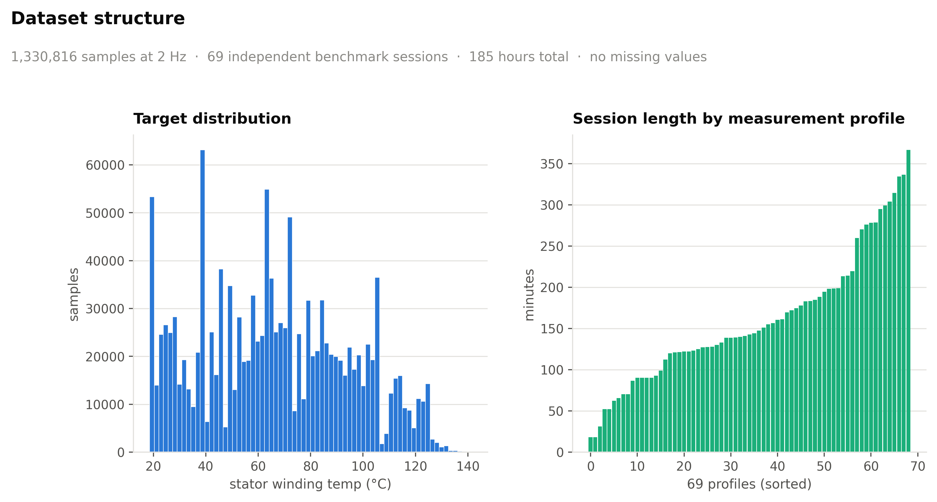
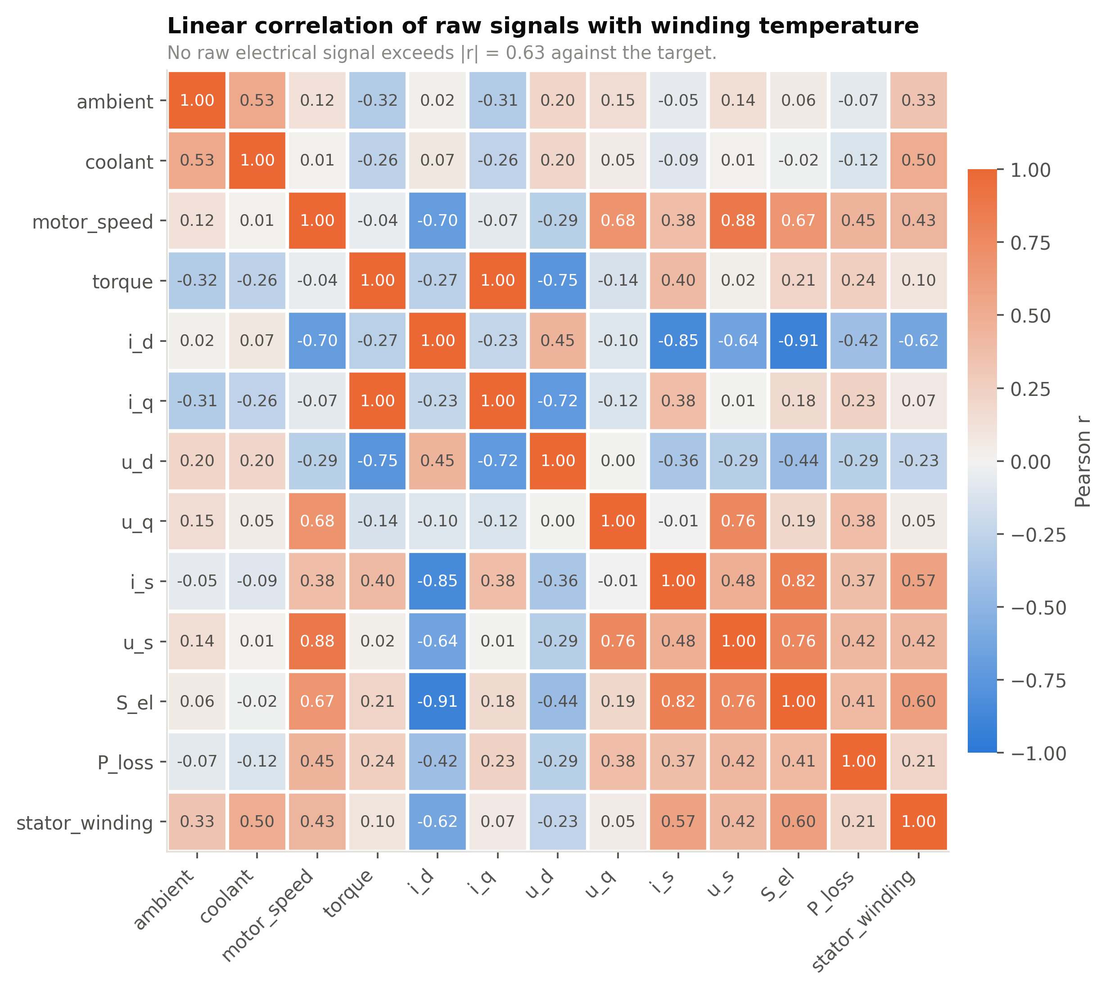
Dataset and exploratory analysis
Electric Motor Temperature (Paderborn University, LEA) - PMSM test-bench telemetry from a dynamometer
1,330,816
69
2 Hz
185 h
0
samples
independent sessions
sampling rate
total running time
missing values
Target distribution (18.6 - 141.4 °C) and session lengths (18 - 366 min)
Correlation of every raw channel with the target
No raw electrical channel exceeds |r| = 0.63 against the target. That ceiling is a property of the representation, not of the information - the physical relationship is not instantaneous.
3 / 10
Notes:
The naive reading of the correlation plot is 'weak signal, hard problem'. The correct reading is that the relationship is not instantaneous - which is what the next slide shows.

Slide 4
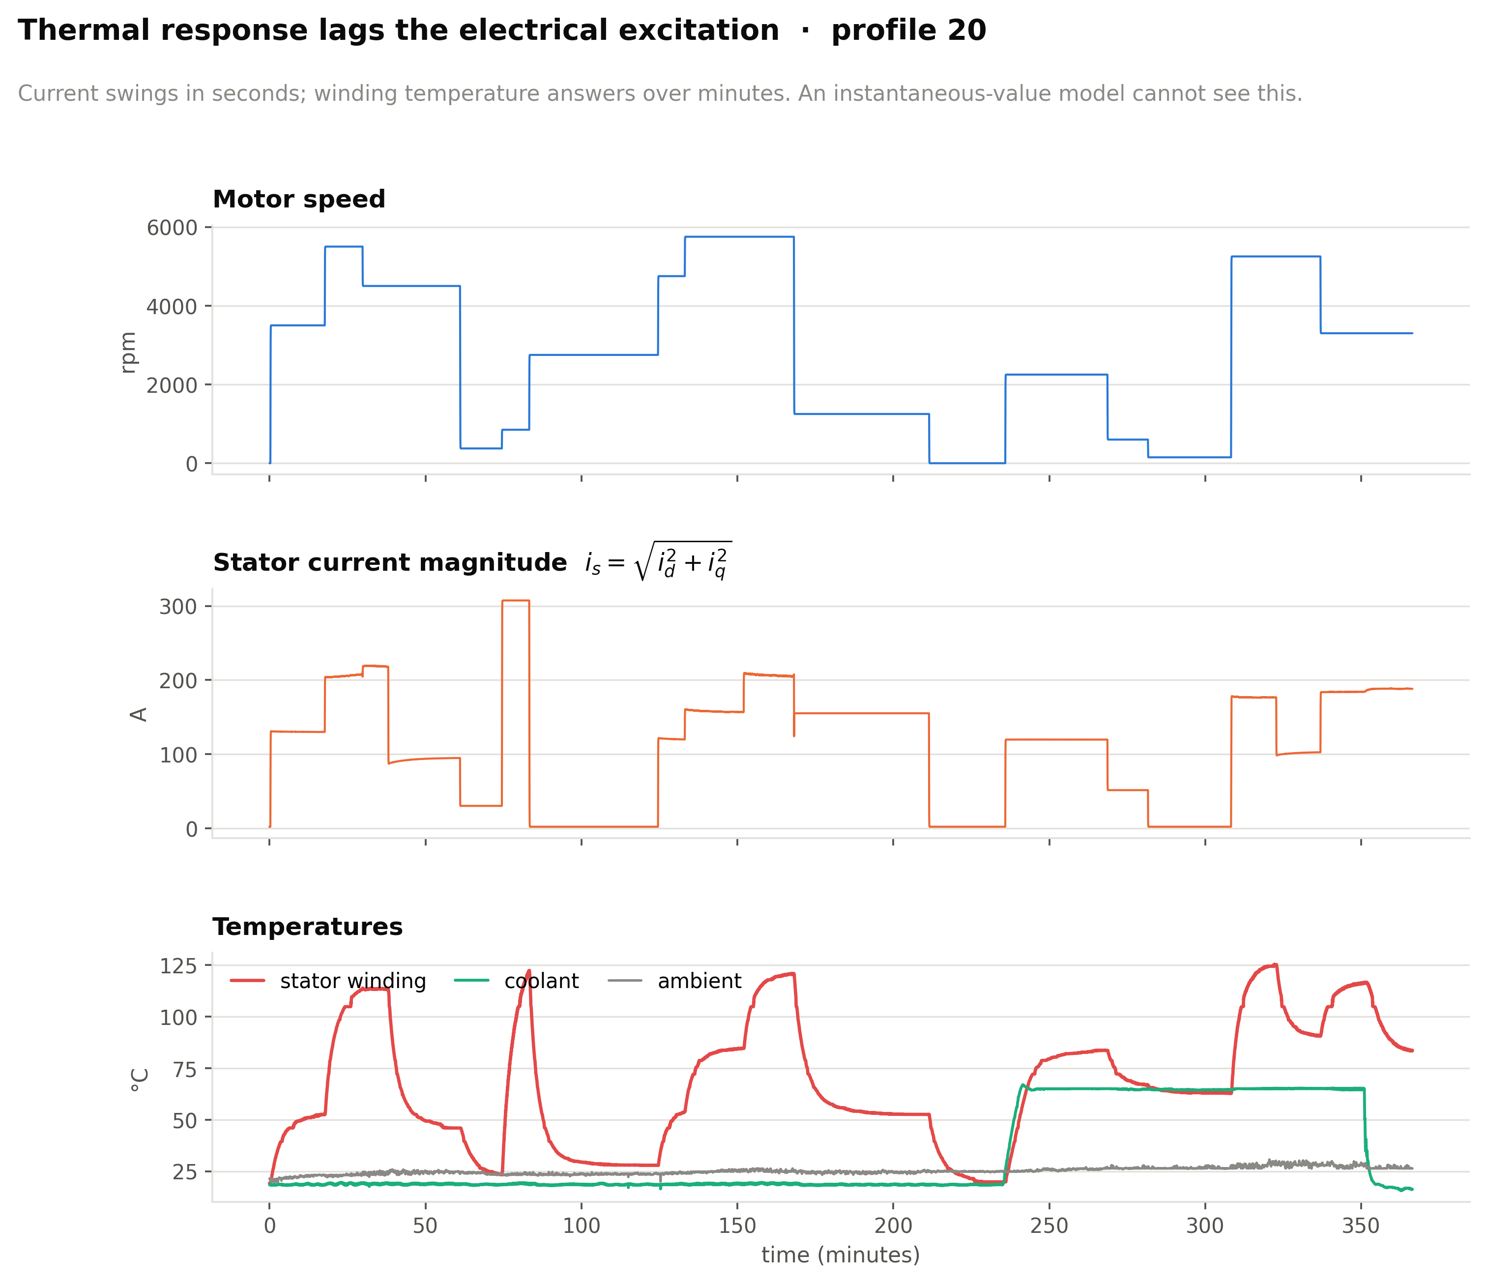
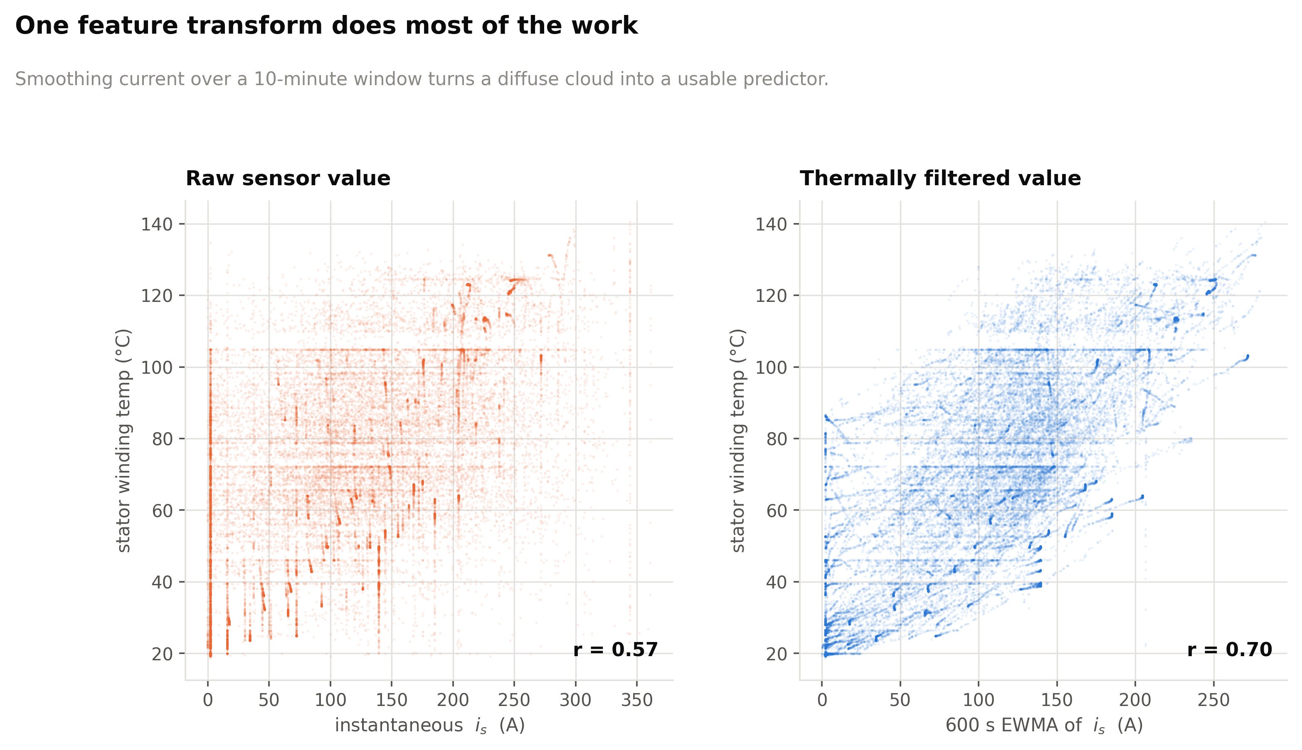
The core insight: thermal inertia
Current changes in seconds, temperature in minutes - the target is a function of history, not of the present sample
One transform lifts i_s from r = 0.57 to r = 0.70
Electrical excitation and thermal response, same time axis, one session
A lumped-parameter thermal model is a first-order system:
Winding responds in tens of seconds, iron in minutes, housing and coolant in tens of minutes.
So EWMAs are computed at five spans - 30, 120, 600, 1800 and 3600 s - and the model weights them.
Exponentially weighted std at each span encodes how volatile the recent duty cycle has been.
C_th · dϑ/dt = P_loss(t) − (ϑ − ϑ_amb) / R_th
ϑ(t) = (1/τ) ∫ exp(−(t−s)/τ) · P_loss(s) ds
That integral is an exponentially weighted moving average. Computing EWMAs does not smooth the data - it hands the model the exact functional form the physics produces.
4 / 10
Notes:
This is the single most important slide. The thermal ODE's solution IS an EWMA, so the feature is not a heuristic - it is the analytical form of the physics. This is why even a linear model reaches R-squared 0.99 once the features exist.

Slide 5
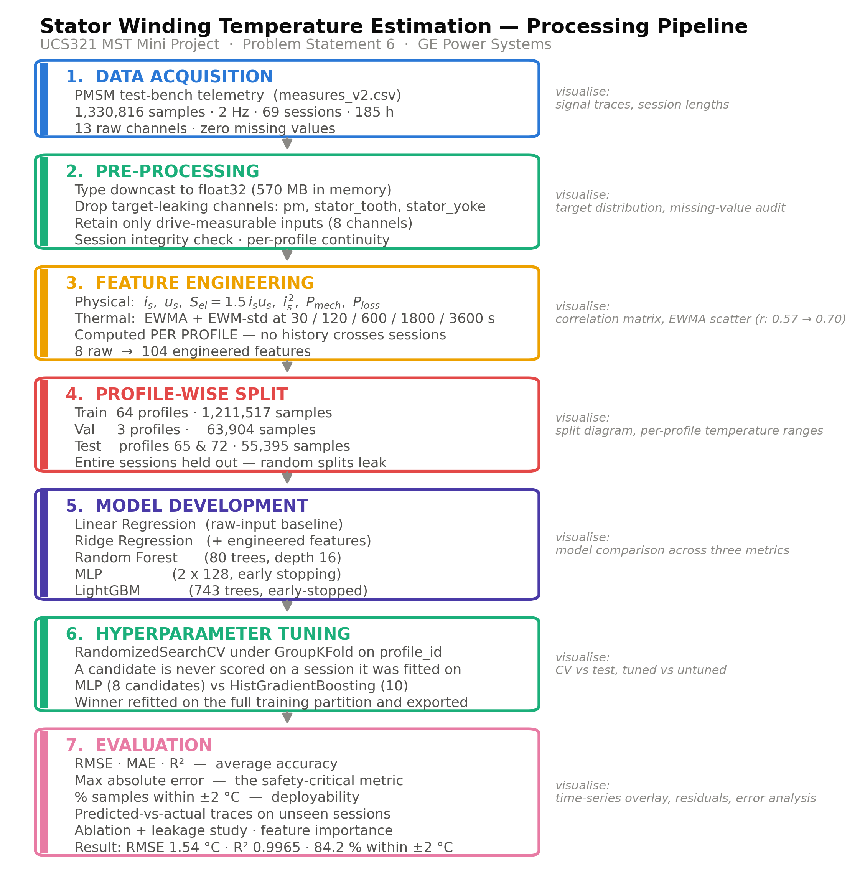
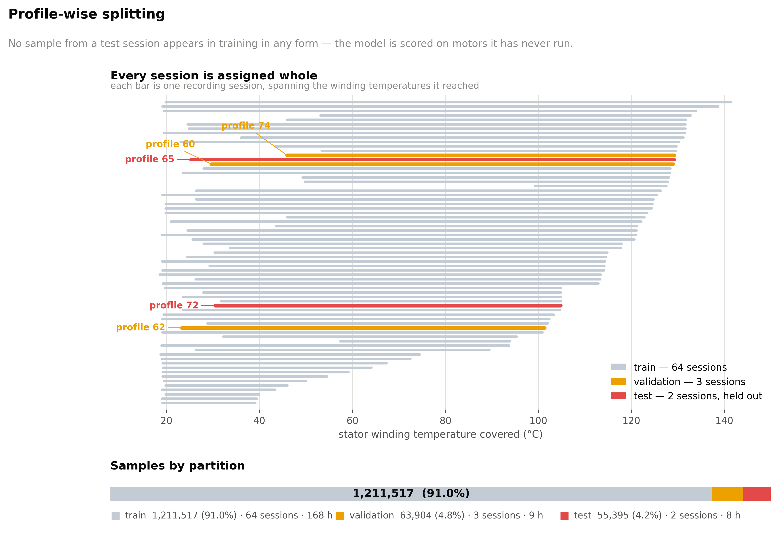
Pipeline and evaluation protocol
Eight raw channels become 104 features; entire measurement sessions are held out for test
Why not a random split?
At 2 Hz, rows are 0.5 s apart and near-identical. A random split scatters near-duplicates across train and test, so the test set is effectively already inside the training set.
TRAIN
1,211,517
64 profiles
VALIDATION
63,904
profiles 60, 62, 74
TEST
55,395
profiles 65, 72
End-to-end pipeline: pre-processing, feature construction, modelling
Profile-wise split - whole sessions held out
Profiles 65 and 72 are the benchmark sessions used in the published literature on this bench, chosen in advance - so the test set cannot have been picked to flatter the result.
5 / 10
Notes:
Every EWMA is computed within a profile_id group. Letting a recursive filter run across a session boundary would import the thermal state of an unrelated recording - silent leakage.

Slide 6
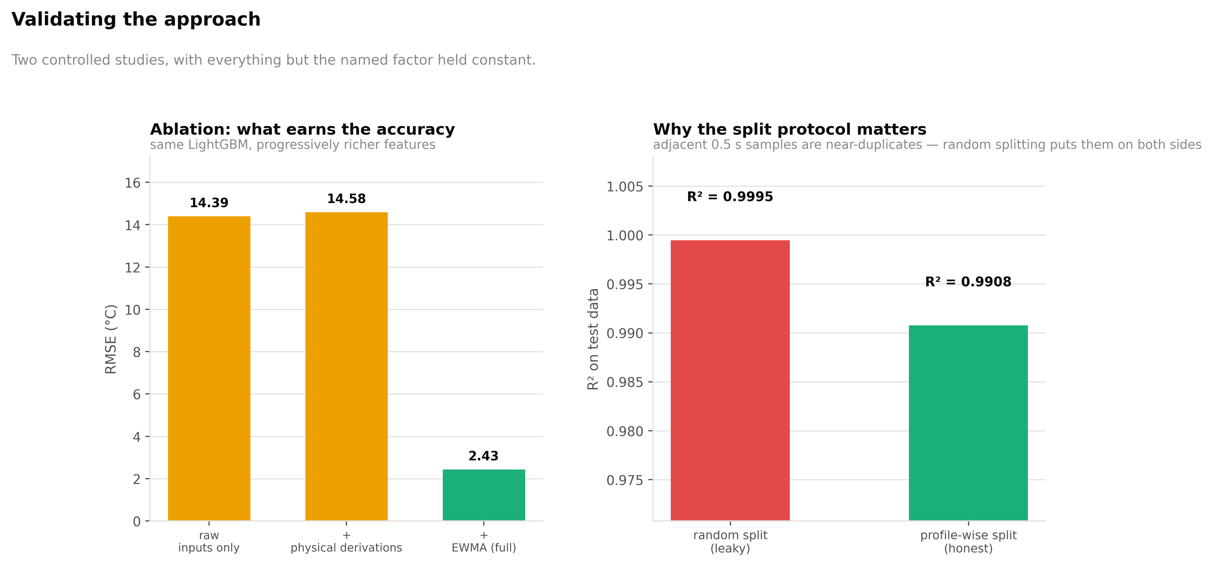
Where the accuracy actually comes from
Two controlled studies: an ablation over feature families, and a leakage study over split protocols
Ablation - identical LightGBM, progressively richer features
Leakage - same model, same features, only the split changes
Feature set | RMSE (°C) | R2
Raw inputs only (8 channels) | 14.39 | 0.6942
+ instantaneous physical derivations | 14.58 | 0.6860
+ EWMA thermal-history features | 2.43 | 0.9913
Split protocol | RMSE (°C) | R2
Random 80/20 over rows (leaky) | 0.66 | 0.9995
Profile-wise, whole sessions (honest) | 2.50 | 0.9908
Random splitting understates error by 3.8x
Instantaneous derivations buy nothing on their own - the entire gain is thermal history. 8 raw channels become 104 features: 8 raw + 6 physical + (9 channels x 2 statistics x 5 spans = 90).
6 / 10
Notes:
The leakage study is deliberate: 0.9995 is the number most projects on this dataset report. We show what it looks like and then report the honest one instead.

Slide 7
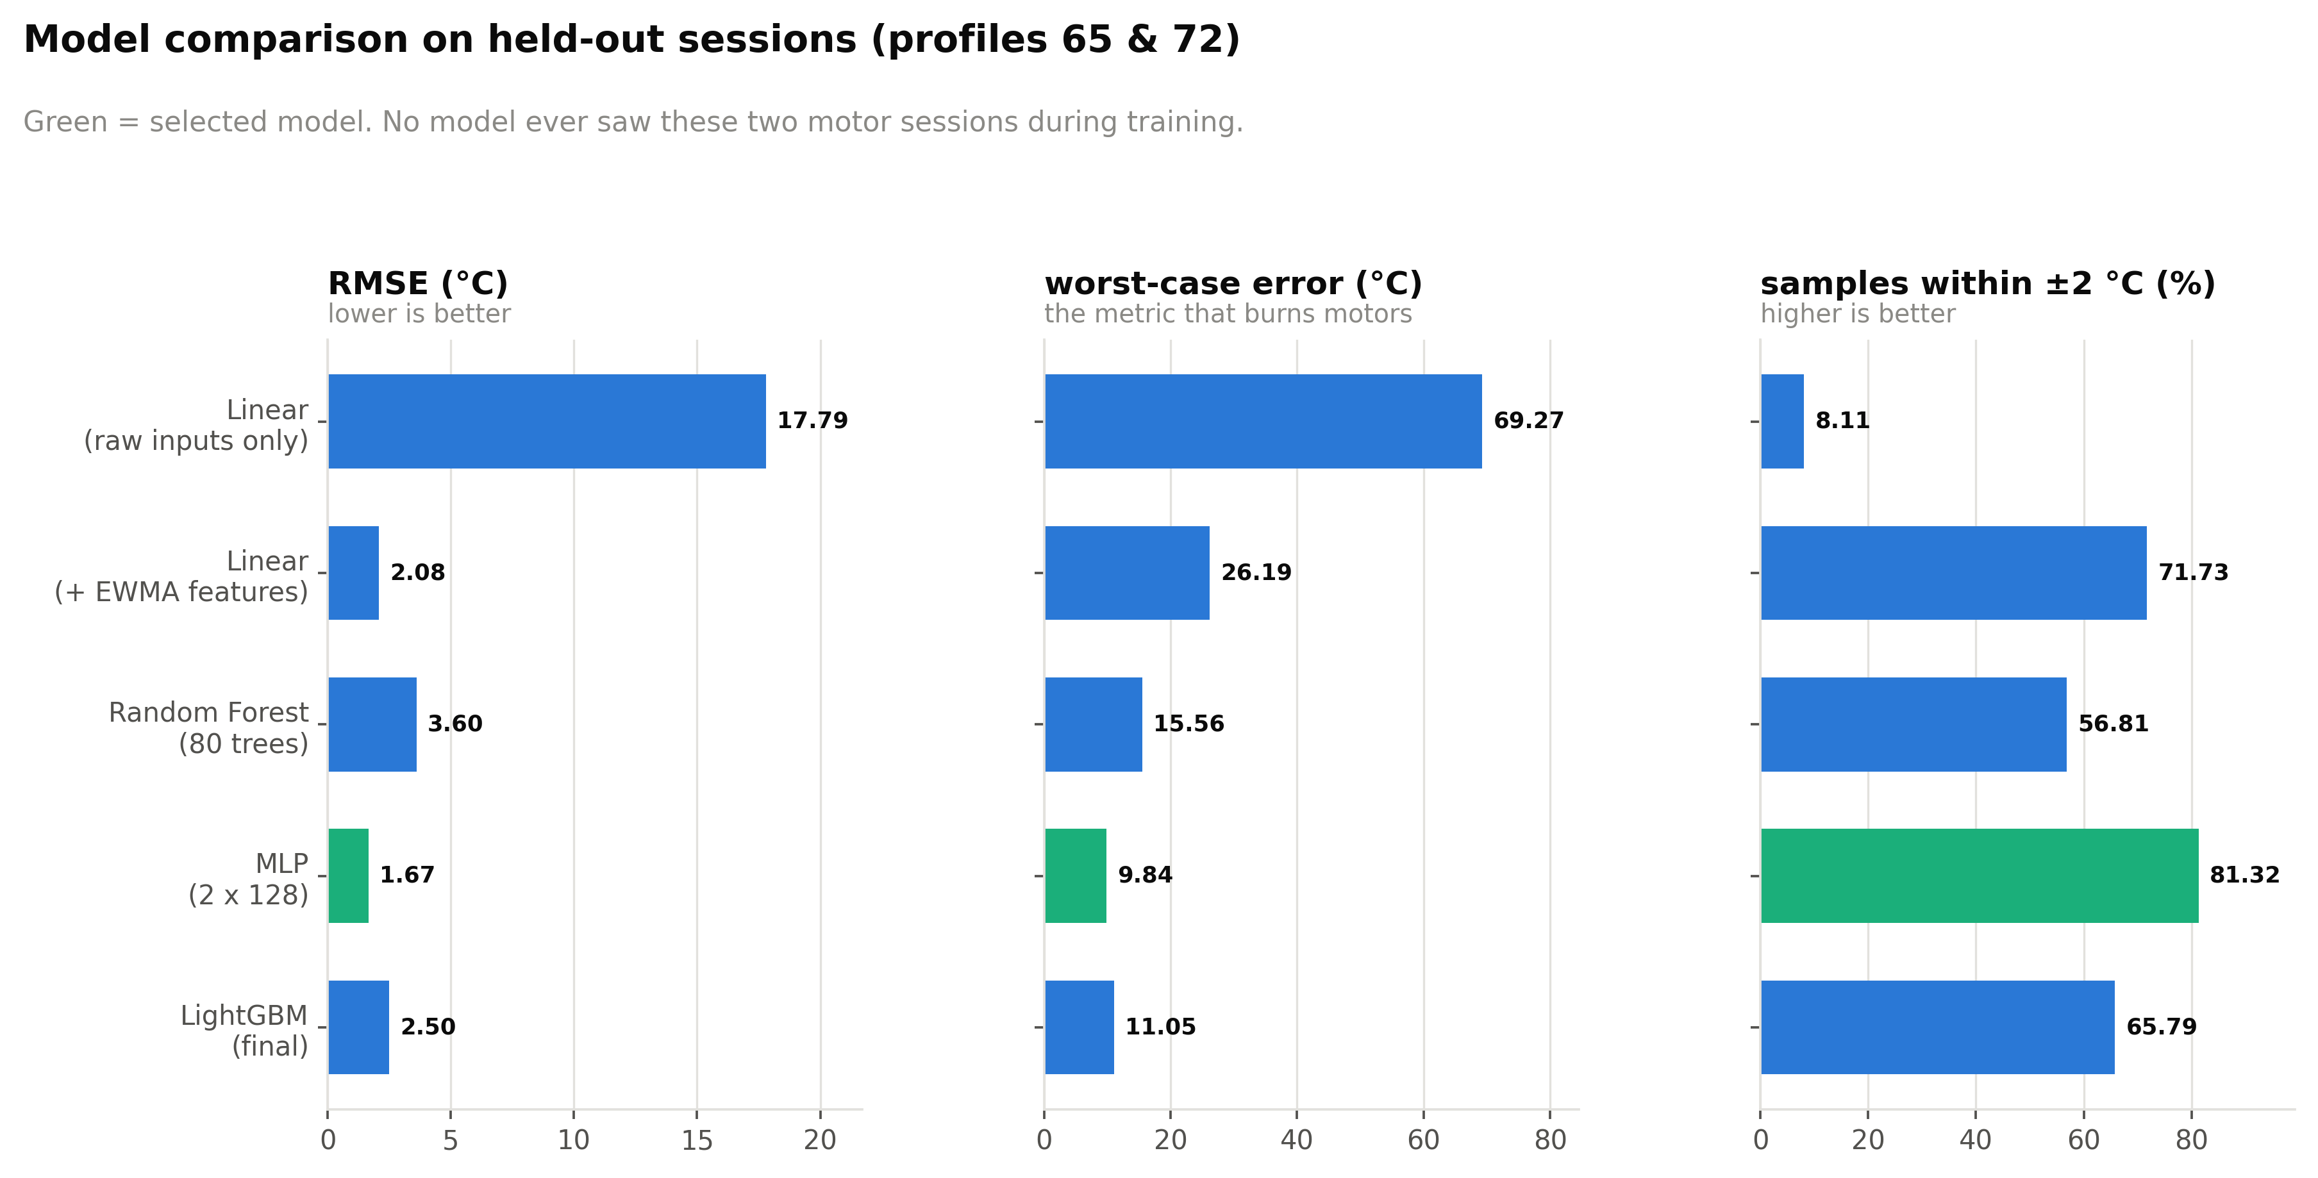
Model development: a ladder of five
From the simplest thing that could work upward - the comparison is the point, not any single number
Model | RMSE | MAE | R2 | MaxAE | ±2 °C
Linear regression, raw inputs | 17.79 | 14.37 | 0.5324 | 69.27 | 8.1 %
Ridge regression, + EWMA | 2.08 | 1.54 | 0.9936 | 26.19 | 71.7 %
Random Forest (80 trees) | 3.60 | 2.49 | 0.9808 | 15.56 | 56.8 %
MLP (2 x 128), untuned | 1.67 | 1.26 | 0.9959 | 9.84 | 81.3 %
LightGBM (743 trees) | 2.50 | 1.85 | 0.9908 | 11.05 | 65.8 %
MLP tuned - SELECTED | 1.54 | 1.10 | 0.9965 | 11.32 | 84.2 %
HistGradientBoosting, tuned | 2.39 | 1.75 | 0.9915 | 9.53 | 65.0 %
Test set = profiles 65 and 72 (55,395 samples), held out entirely
RMSE, R2 and max absolute error across the ladder
Linear regression goes from R2 0.53 to 0.99 with no change of algorithm - only features. Feature engineering beat model sophistication.
The MLP beats both tree ensembles. Trees are piecewise-constant and cannot extrapolate past the training envelope; a smooth model continues the trend.
RMSE and max error do not rank the models identically - tuned HistGradientBoosting has the best worst case at 9.53 °C.
7 / 10
Notes:
If worst-case error were the selection criterion - and for a protection function it arguably should be - tuned HistGradientBoosting would be the better choice. Selecting on RMSE and then disclosing max error is the honest order.

Slide 8
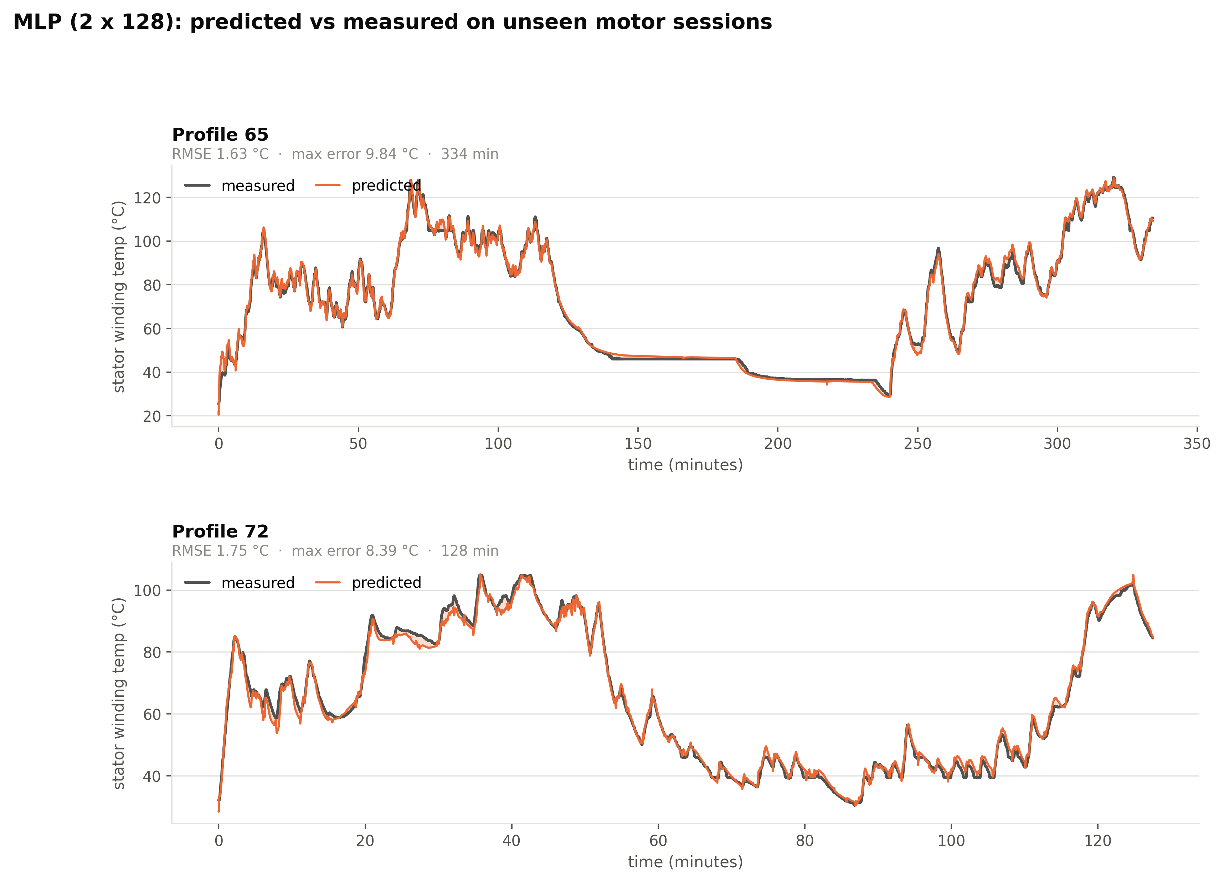
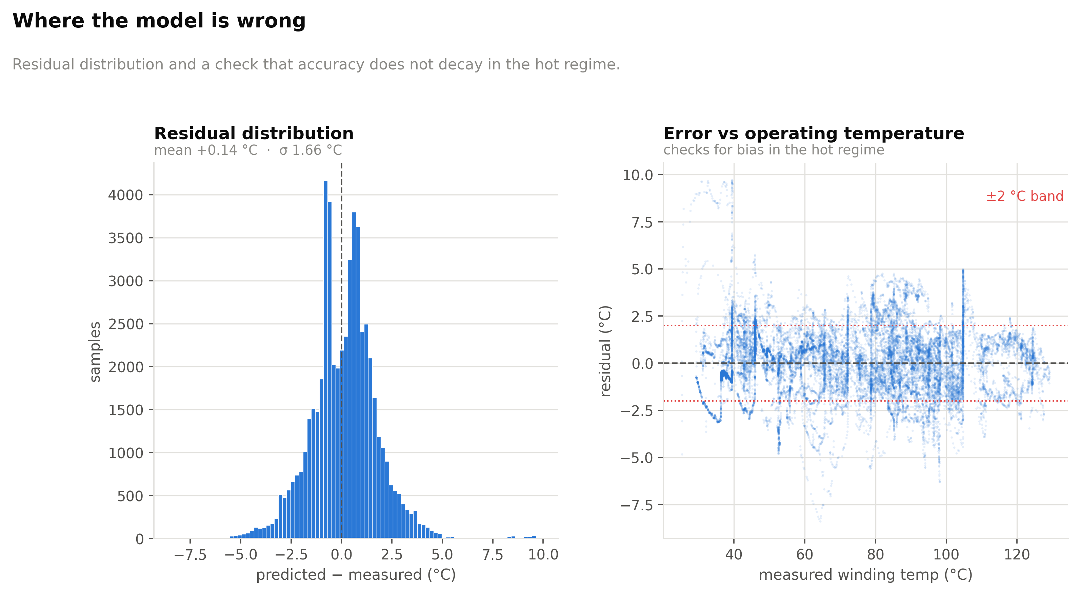
Final result on unseen motor sessions
Tuned MLP - two hidden layers of 128, StandardScaler pipeline, early stopping, 104 inputs
1.54 °C
1.10 °C
0.9965
11.32 °C
84.2 %
RMSE
MAE
R2
max abs error
within ±2 °C
Residual distribution and bias check vs temperature
Residuals are approximately zero-mean and symmetric, with no systematic trend against measured temperature - the error is dispersion, not bias.
Predicted vs measured on profiles 65 and 72 - sessions the model has never seen
8 / 10
Notes:
7.7 hours of running, 55,395 samples, two complete sessions. The estimate tracks every ramp, plateau and cool-down, with visible divergence only in the opening minutes of profile 72 - the warm-up effect.

Slide 9
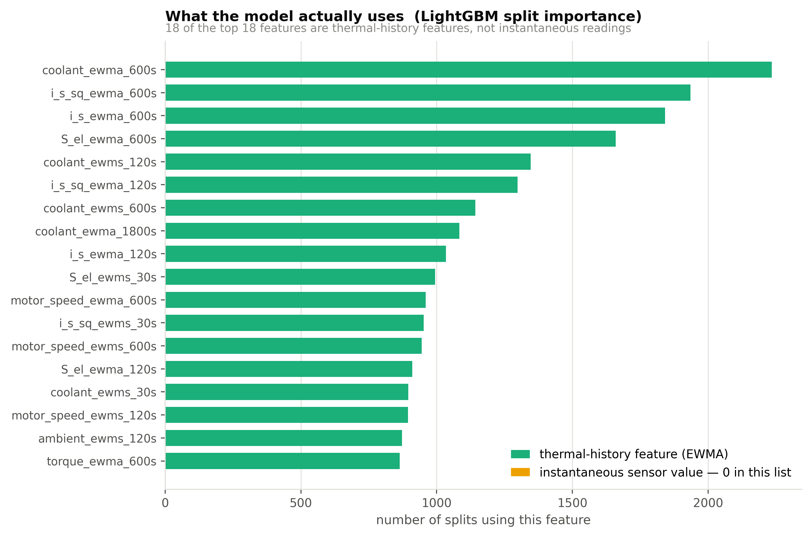
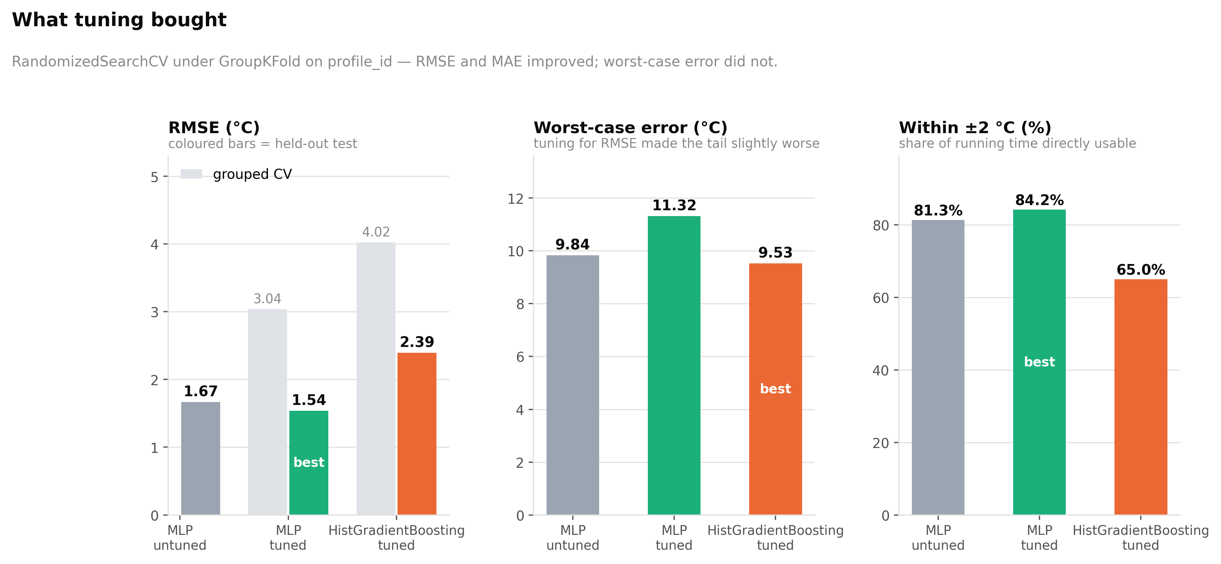
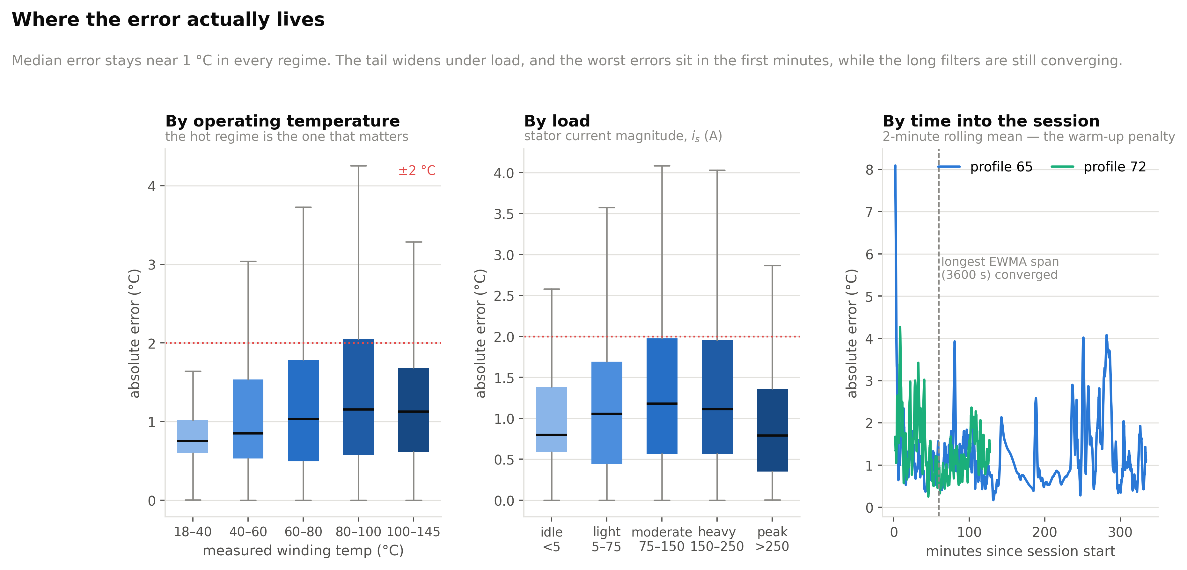
Interpretation: what the model learned, and where it errs
Feature importance, the tuning search, and an error breakdown by regime
LightGBM split counts - top features
Grouped randomised search, two families
Error by temperature, load, and time into session
The model learned the physics
Tuning helped the average, not the tail
Where the error lives
All top-15 features are EWMA-derived. The two strongest are coolant_ewma_600s (2234 splits) and i_s_sq_ewma_600s (1935) - exactly the heat-sink boundary condition and the copper-loss term the thermal ODE names as dominant.
RMSE improved 8 % and MAE 13 %, but max error rose from 9.84 to 11.32 °C because the search optimised RMSE and nothing constrained the tail. Reported, not hidden. CV RMSE (3.04) ranks candidates; it does not estimate deployed accuracy.
Median error holds near 1 °C in every temperature band and every load band - accuracy does not decay when the motor is hot. The largest errors sit in the first minutes of a session, while the 1800 s and 3600 s filters are still converging from zero.
9 / 10
Notes:
The feature-importance result is the strongest available evidence that the result is not an artefact: the model's most-used features are the two terms a lumped thermal model would name.

Slide 10
Conclusions, deployment and limitations
What was achieved, what it would take to ship it, and what this work does not prove
Conclusions
Deployment
Winding temperature is estimable from drive-measurable signals alone to 1.54 °C RMSE and R2 = 0.9965 on unseen sessions.
Feature engineering, not model selection, produced the result - the ablation traces the gain specifically to the EWMA terms.
Evaluation protocol changes the reported number by 3.8x; a result without its protocol is not a result.
A smooth model generalises better than tree ensembles here, because held-out sessions demand extrapolation.
The model learned the intended physics - its dominant features are the coolant boundary condition and the copper-loss term.
~30k multiply-accumulates per inference at 2 Hz - negligible for a motor-control MCU. Each EWMA is one multiply-add and one register, so all 90 cost 90 registers. A hardware-friendly feature extractor is what makes this a thermocouple replacement rather than an offline analysis.
Limitations
Worst case is 11.32 °C, so a deployed limit still needs a safety margin. One machine, one bench - transfer to other geometries is unproven. Warm-up error while the long filters converge. No uncertainty estimate, which a protection function would want.
Next, in order of value
1
2
3
4
Seed EWMA state from the first sample
Physics-informed loss on the thermal ODE
Quantile / conformal prediction
Sequence model (temporal CNN / LSTM)
removes most of the warm-up error - cheapest win
attacks worst-case error specifically
gives the upper bound a protection limit wants
learns time constants instead of fixing five spans
10 / 10
Notes:
Close on the two sentences worth remembering: the result came from understanding the physics rather than trying models, and the evaluation protocol changes the headline by 3.8x.

