Slide 1
UCS321 · AI FOR ENGINEERS · MINI PROJECT
Predicting Electric Motor
Winding Temperature
A machine-learning virtual sensor that replaces a thermocouple
Problem Statement 6 — General Electric (GE) Power Systems
Lohhith Thakur · 1025220020 | [ group members ]
Notes:
Opening line: we picked the problem statement that sits closest to what we already study — electrical machines and sensor data. The framing we chose is a virtual sensor: replace a physical thermocouple with software.

Slide 2
1
Why winding temperature is the number that matters
It is the binding constraint on how hard a motor may be driven
A PMSM converts electrical power to mechanical power efficiently, but the loss appears as heat in the stator copper. The winding's enamel insulation has a finite thermal rating. Exceed it and the enamel degrades chemically until adjacent turns short and the machine is destroyed.
The engineering consequence
A controller that knows this temperature accurately can use the machine's full short-term overload capability.
A controller that does not must apply a fixed conservative derating — and give up torque the motor could physically have delivered.
So the estimate is worth real power density, not just a number on a dashboard.
180 °C
÷ 2
0
Class H insulation rating
insulation life per +10 °C
production motors with a
winding thermocouple
Notes:
Key point to land: this is not an academic regression target. Insulation life halving every 10 degrees is the standard engineering rule of thumb, and it is why the limit is enforced conservatively today.

Slide 3
2
So why not just measure it?
The sensor is practical on a test bench and impractical in a product
ON A TEST BENCH
IN A PRODUCTION MOTOR
Thermocouples bonded directly to the winding
Cost and fragility are acceptable — it is one machine
Gives us ground truth to learn from
Sensor must survive winding potential, vibration, thermal cycling
Leads must exit a sealed housing — a new failure mode
Cost does not survive a volume bill of materials
This dataset comes from exactly such a bench.
So production motors simply do not have one.
Notes:
The gap between these two columns is the entire business case for the project. Examiner may ask: why not a thermal model instead of ML? Answer — lumped-parameter models exist and need per-machine parameter identification; we get comparable accuracy straight from logged data.

Slide 4
OBJECTIVE
Estimate stator winding temperature from the signals a motor drive already measures — accurately enough to use as a thermal protection limit in place of a physical sensor.
Success is defined by
deployment, not by a
leaderboard.
A model with 1 °C mean error and one 20 °C underestimate still destroys the motor.
So we report max absolute error and % within ±2 °C, not just RMSE.
Every one of these is already measured for field-oriented control — at zero marginal cost.
i_d , i_q
u_d , u_q
speed
torque
coolant
ambient
Notes:
This slide is where the marks for problem understanding are won. The last box is the one to emphasise: choosing the right success metric is itself an engineering decision.

Slide 5
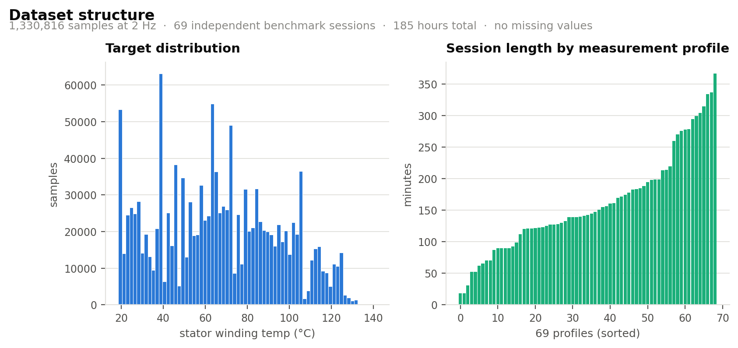
3
The dataset
PMSM dynamometer telemetry — Paderborn University (LEA), via Kaggle
1.33 M
2 Hz
69
185 h
0
samples
sampling rate
independent sessions
total recording
missing values
Eight inputs retained
i_d, i_q · u_d, u_q · motor speed · torque · coolant · ambient
Three channels discarded
stator_tooth · stator_yoke · pm
Correlated r > 0.95 with the target — and dropped anyway. Next slide explains why.
Notes:
69 sessions, each a continuous recording with its own excitation schedule. The session is the natural unit for splitting — that becomes important three slides from now.

Slide 6
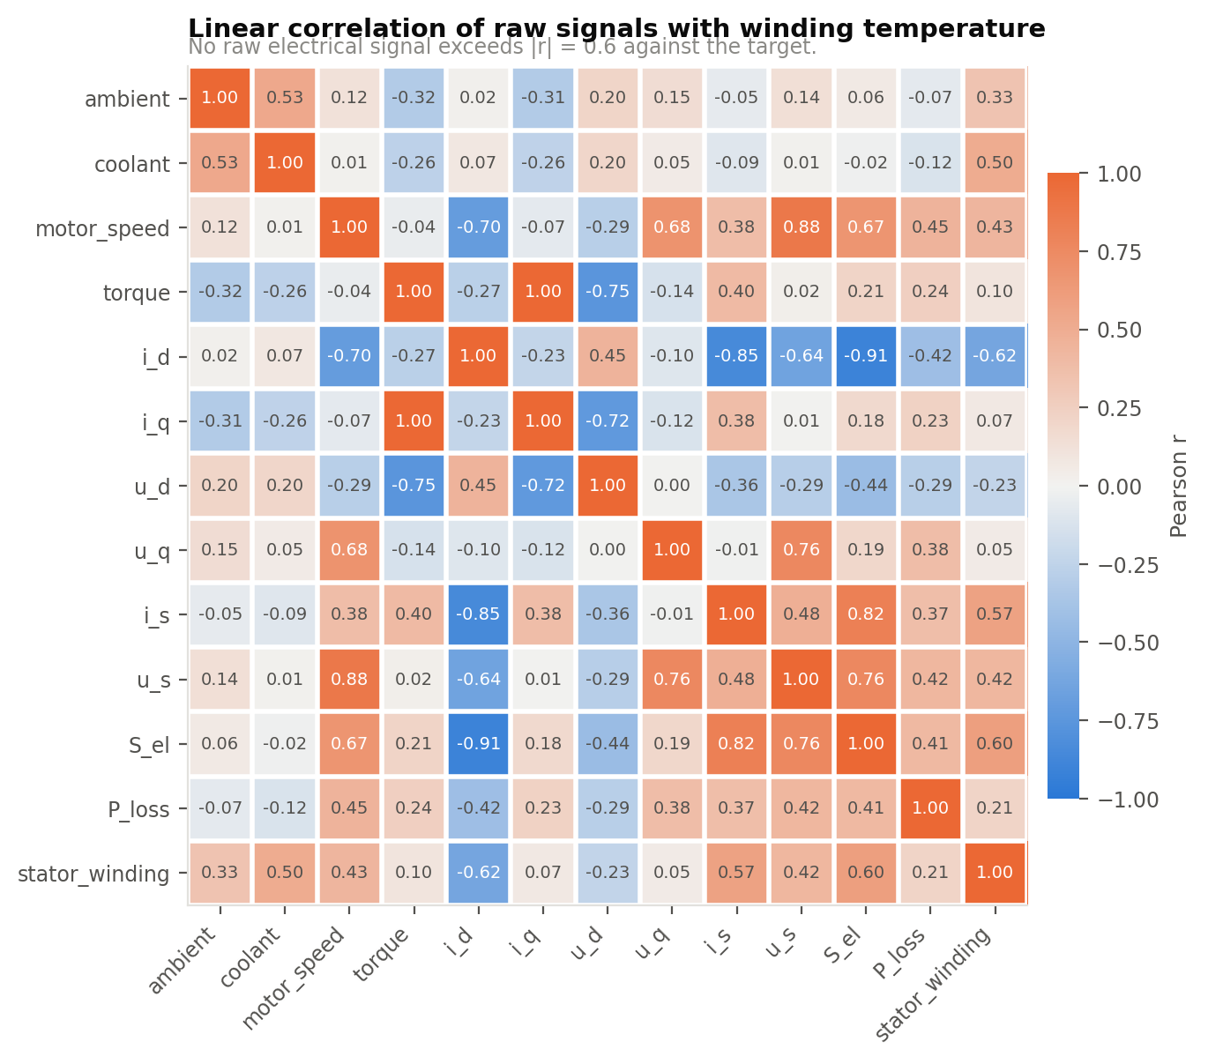
4
The most important decision we made
Throwing away the three features that would have scored best
stator_tooth · stator_yoke · pm
What the numbers look like without them
correlate with the target at r > 0.95
No raw electrical channel exceeds |r| = 0.63.
That ceiling is thermal inertia showing up numerically — and it is what the next slide is about.
Including them yields a spectacular R². We dropped all three.
It defeats the objective. Those sensors are exactly the hardware we are trying to remove. A model that needs stator_tooth cannot run on a motor that has neither.
It is target leakage. Tooth and yoke sit millimetres from the winding in the same iron. The model would be interpolating between adjacent thermocouples — not learning thermodynamics.
Notes:
Expect a question here: 'wouldn't your accuracy be higher if you kept them?' Yes — and the result would be worthless, because the deployment target has none of those sensors. This is the slide that shows we understood the problem rather than the dataset.

Slide 7
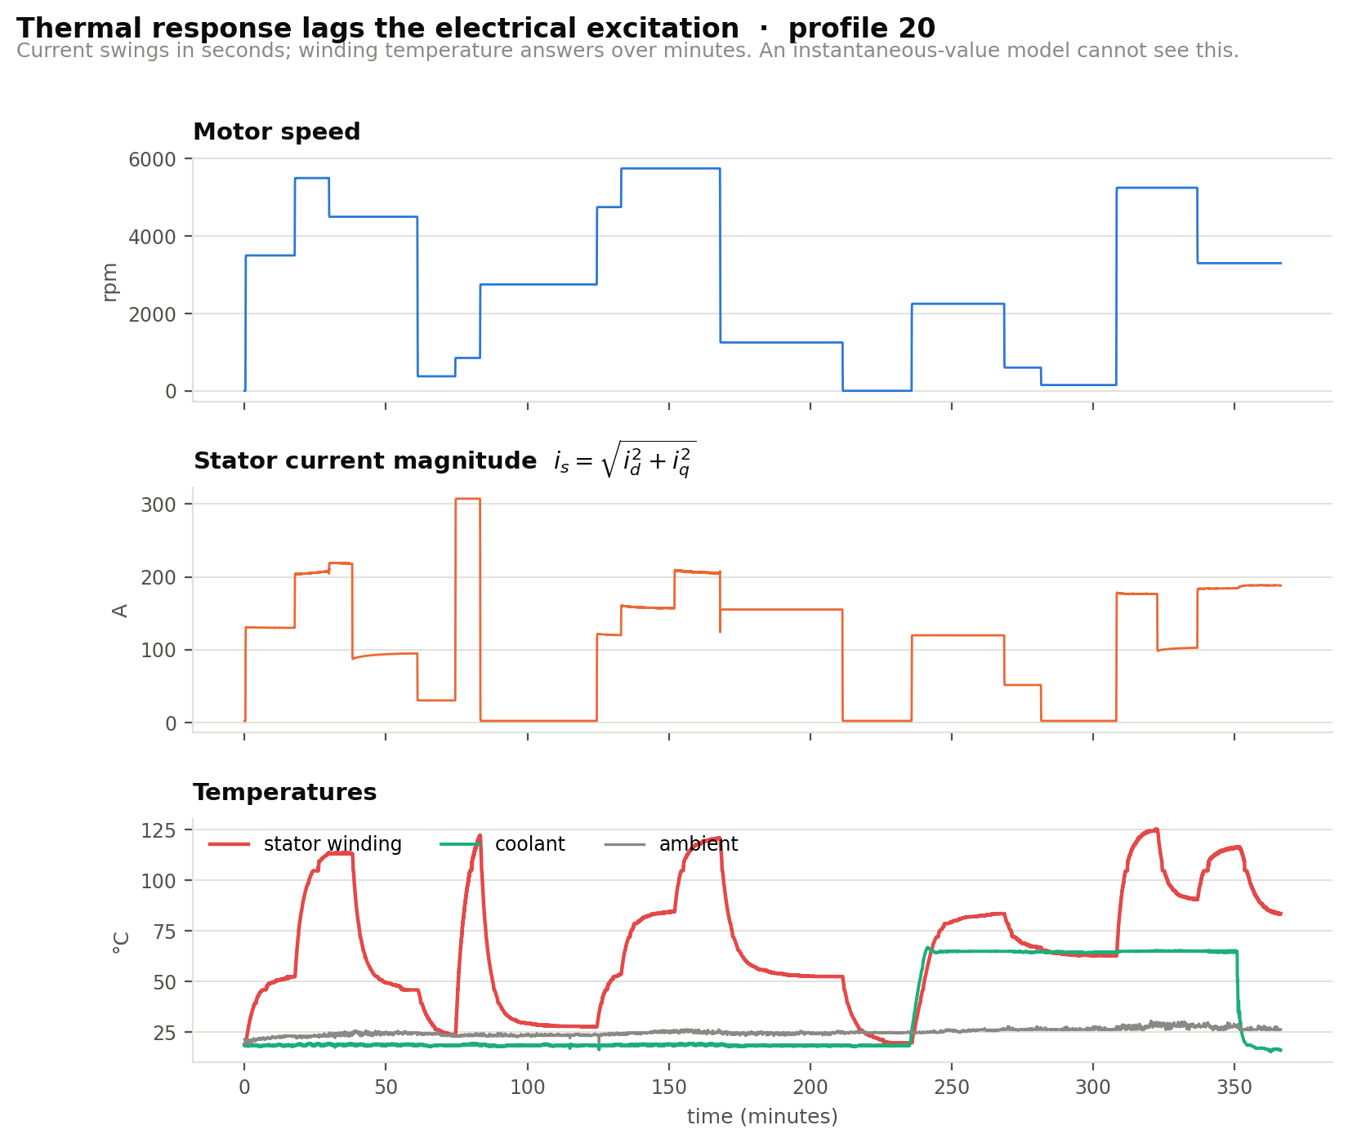
5
The observation the whole project rests on
Current changes in seconds. Temperature answers in minutes.
Why this breaks a naive model
Winding temperature is not a function of the present current. It is a function of the accumulated loss over the recent past.
A model given only instantaneous values is being asked to infer a state variable from its input — which for a system with memory is impossible in principle, not merely hard in practice.
Notes:
Point at the bottom panel against the middle one. Temperature keeps rising after current has already stepped down. Everything that follows is a response to this one picture.

Slide 8
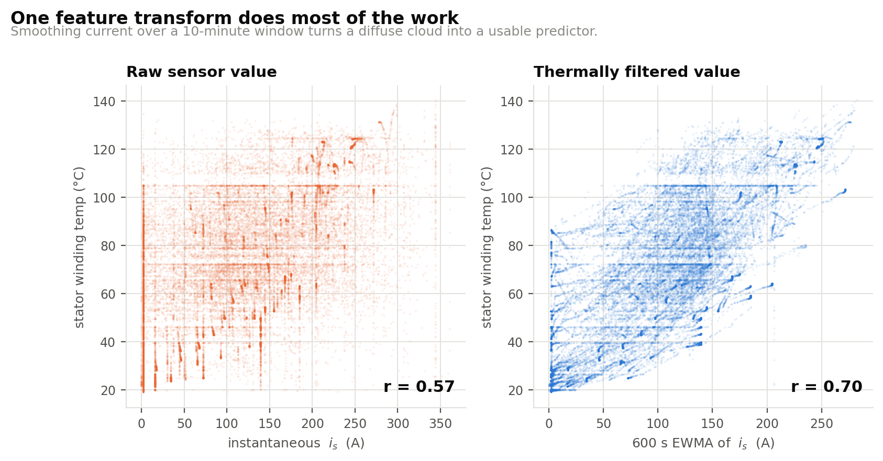
6
From physics to features
The thermal model tells us exactly what transform to apply
LUMPED-PARAMETER THERMAL MODEL
Does one transform actually help?
C_th · dϑ/dt = P_loss(t) − (ϑ − ϑ_amb) / R_th
solving gives
ϑ(t) = (1/τ) ∫ exp(−(t−s)/τ) · P_loss(s) ds
— an exponentially weighted integral of past losses.
which in discrete time is exactly an EWMA: y[k] = α·x[k] + (1−α)·y[k−1]
So we compute EWMAs of the loss-related signals at five thermal time constants — 30 s, 120 s, 600 s, 1800 s, 3600 s — because copper, iron and housing respond on different scales.
Same signal. One 10-minute exponential filter. A diffuse cloud becomes a structured relationship — before any model has been fitted.
8
→
104
raw channels
engineered features
Notes:
This is the innovation slide. The claim to make explicitly: we did not pick EWMA by trial and error — the analytical solution of the thermal ODE IS an exponentially weighted integral, so the feature is the physics written down.

Slide 9
7
Why we did not use train_test_split
On 2 Hz data, a random split measures memorisation
THE TRAP
The cost of getting this wrong
Samples are 0.5 s apart. A motor's temperature cannot change in half a second, so consecutive rows are near-duplicates. A random split scatters near-identical samples across both sides — the test set is effectively inside the training set.
Same model. Same features. Only the split changes.
Random 80/20 over rows
R² = 0.9995
RMSE 0.66 °C
WHAT WE DID INSTEAD
Whole sessions held out
Hold out entire measurement sessions. The model is evaluated the way it would be used: on a motor run it has never seen.
R² = 0.9908
RMSE 2.50 °C
Train
64 profiles
1,211,517 samples
Validation
3 profiles
63,904 samples
Random splitting understates RMSE by ~3.8×. That first number describes nothing.
Test
profiles 65 & 72
55,395 samples
Notes:
Strongest viva moment in the deck. Most teams working on time-series data will report the 0.9995 figure. Being able to say why it is wrong, and quantify it, is the differentiator.

Slide 10
8
The model ladder
Every increase in complexity has to justify itself against the rung below
1
Linear regression
8 raw inputs, OLS
the honest floor
Same data.
Same split.
Same metrics.
2
Ridge regression
104 engineered features
isolates the feature work
All five fitted on the identical training partition and scored on the identical held-out sessions, so the comparison isolates the model and nothing else.
3
Random Forest
80 trees, depth 16
non-parametric reference
4
MLP
2 × 128, early stopping
smooth approximator
5
LightGBM
743 trees, early-stopped
strong tabular baseline
Highlighted rung wins →
Notes:
Mention the subsampling: RF and MLP were fitted on every 10th training sample. At 2 Hz the data is so autocorrelated that this costs essentially no information and saves an order of magnitude of compute.

Slide 11
THE CENTRAL FINDING
Feature engineering beat every model we tried
Same algorithm. Same data. Same training procedure. Only the inputs changed.
Linear regression
on 8 raw inputs
Linear regression
+ EWMA features
0.5324
17.79 °C
0.9936
2.08 °C
→
R²
RMSE
R²
RMSE
8.1 % of samples within ±2 °C
81.3 % of samples within ±2 °C
Domain-informed feature engineering outperformed every increase in model sophistication attempted in this project.
Notes:
Pause on this slide. If the examiner remembers one thing, it should be this pair of numbers. It also answers 'did you just throw XGBoost at it' — no, the physics did the work.

Slide 12
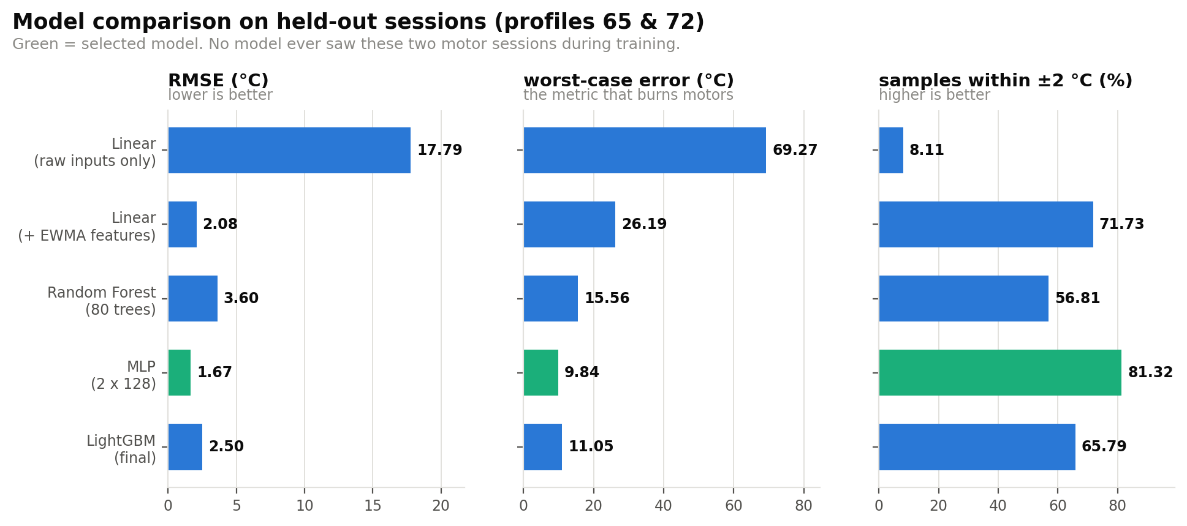
9
Full model comparison
Held-out sessions only — profiles 65 and 72, 55,395 samples
Model | RMSE | MAE | R² | Max err | ±2 °C
Linear (raw inputs) | 17.79 | 14.37 | 0.5324 | 69.27 | 8.1 %
Ridge (+ EWMA) | 2.08 | 1.54 | 0.9936 | 26.19 | 71.7 %
Random Forest | 3.60 | 2.49 | 0.9808 | 15.56 | 56.8 %
MLP (2 × 128) | 1.67 | 1.26 | 0.9959 | 9.84 | 81.3 %
LightGBM | 2.50 | 1.85 | 0.9908 | 11.05 | 65.8 %
Selected model
MLP 2 × 128
1.67 °C
RMSE
0.9959
The three metrics do not rank the models identically — see the next slide.
R²
9.84 °C
worst-case error
81.3 %
within ±2 °C
Notes:
Worth flagging: Ridge beats LightGBM on RMSE but has a 26 degree worst case versus LightGBM's 11. Selecting on RMSE alone would have picked the wrong model for a protection function.

Slide 13
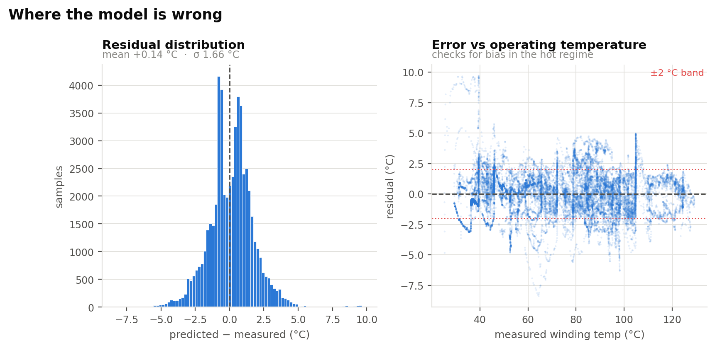
10
Three results worth explaining
The interpretation matters more than the table
1
The neural net beat both tree ensembles.
Residual check
Tree ensembles are piecewise-constant — a prediction is the mean of the training samples in a leaf, so they cannot produce a value outside the range they saw. Held-out sessions contain operating points the 64 training profiles never visit. An MLP is smooth and continues the trend. Under genuine extrapolation, smoothness is the decisive property.
2
Ridge regression beat LightGBM.
Once the features encode the thermal physics, the residual relationship is close to linear. A low-variance estimator then generalises across sessions better than a high-capacity one, which fits session-specific structure that does not transfer.
Error does not grow with operating temperature.
That is the check that matters: a model accurate when cool and poor when hot would be useless, because the hot regime is the only one where the estimate is consulted.
3
RMSE and worst-case error disagree.
Ridge attains RMSE 2.08 °C — better than LightGBM's 2.50 °C — yet its worst case is 26.19 °C against 11.05 °C. For a thermal limit the second column governs. A model chosen on RMSE alone would have been the wrong choice.
Notes:
Result 1 is the one examiners find most interesting — it is counter to the usual assumption that gradient boosting always wins on tabular data. Be ready to explain leaf-wise constant prediction.

Slide 14
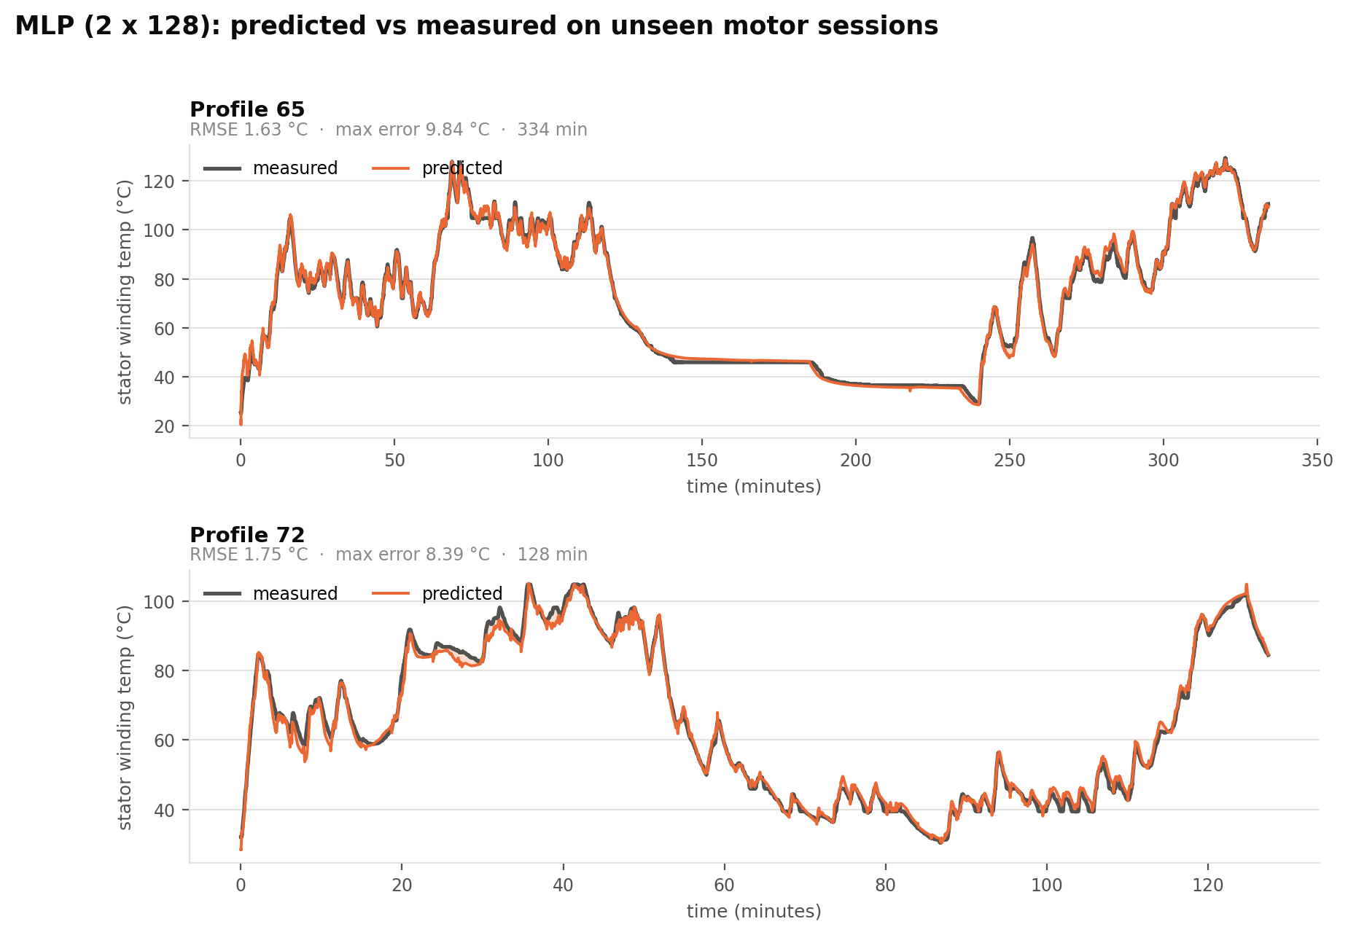
11
Tracking on motors the model has never seen
Neither session appeared in training in any form
What to look at
Rapid transients under aggressive load cycling are tracked
Slow exponential cool-down is tracked
Largest deviations sit at sharp transitions
That lag at step changes is the expected signature of a filter-based feature set meeting a change faster than its shortest time constant.
Notes:
If asked how to fix the transition lag: add a shorter EWMA span, or move to a sequence model that learns the time constants rather than having them fixed.

Slide 15
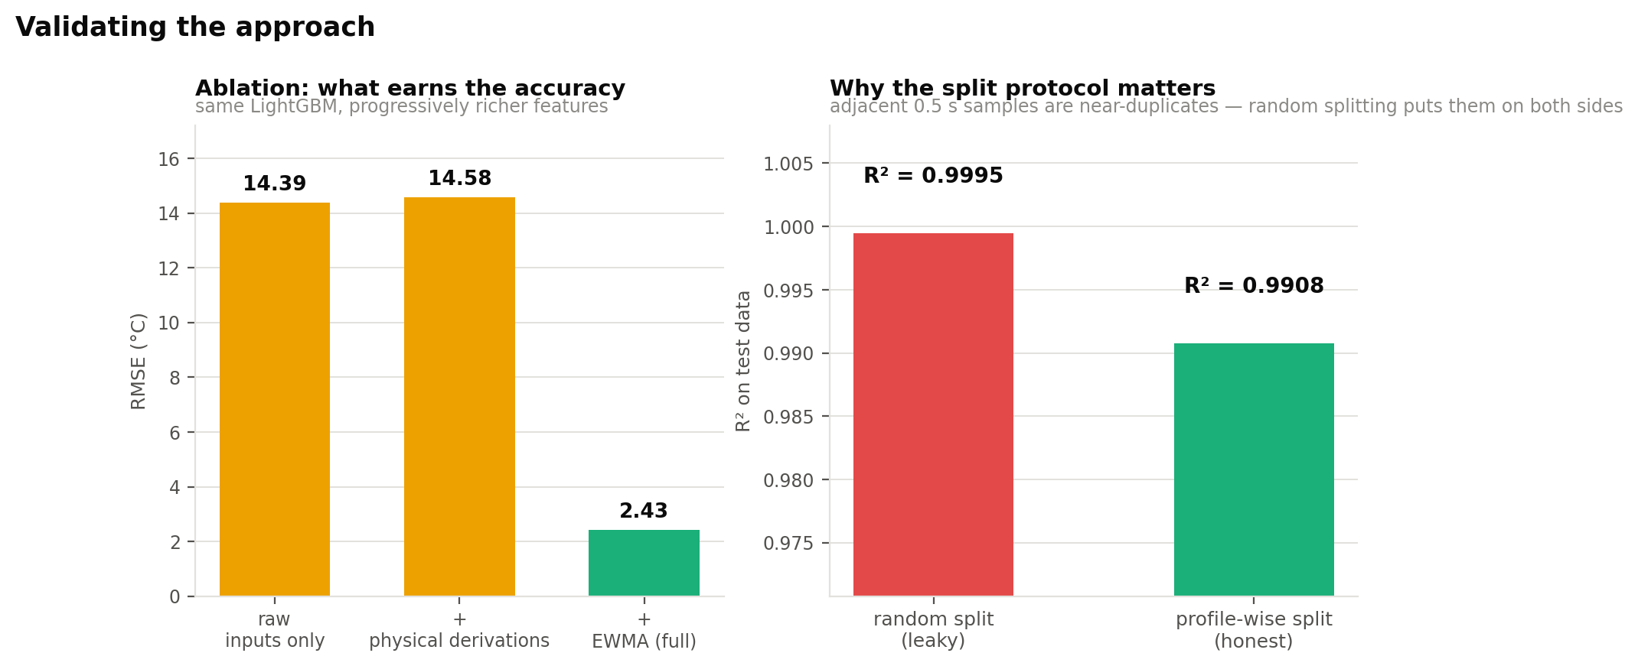
12
Two studies that test whether the result is real
Ablation and leakage — both with everything else held constant
ABLATION — where does the accuracy come from?
LEAKAGE — the cost of the wrong split
RMSE R²
8 raw input channels
14.39
0.6942
+ instantaneous physical terms
14.58
0.6860
+ EWMA thermal history
2.43
0.9913
Instantaneous physical terms buy nothing on their own — the small regression is within run-to-run variation. Only thermal history moves the result. The gain is not from having more columns.
Same model, same features, only the partitioning changes. Random splitting reports R² = 0.9995 — a figure describing the model's ability to reproduce samples it has already seen in near-identical form.
For time-series sampled faster than the system's dynamics, grouped splitting is a correctness requirement, not a refinement.
Notes:
These two studies are what turn a result into evidence. Without the ablation we could not claim the EWMAs specifically caused the gain rather than the feature count.

Slide 16
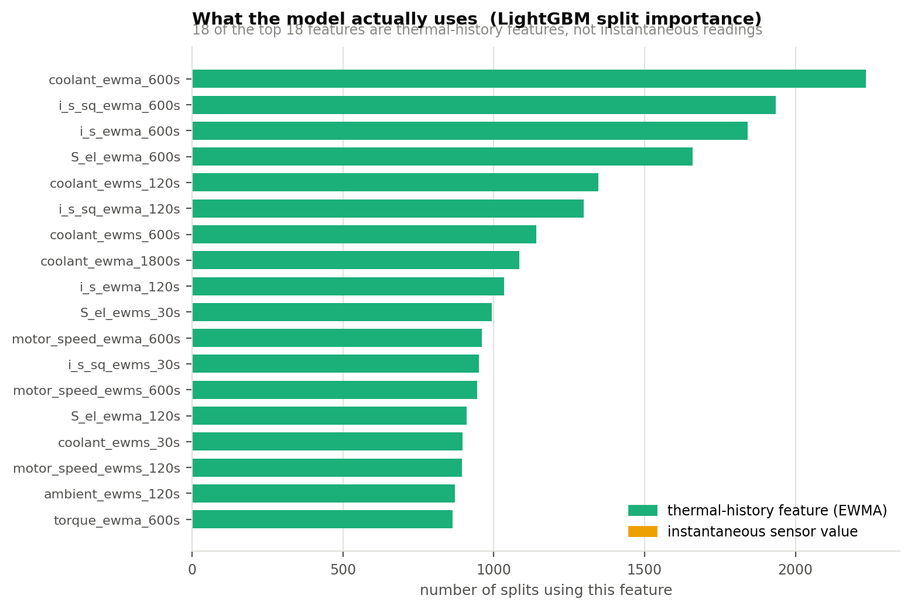
13
The model learned the physics we designed for
Strongest evidence that the result is not an artefact
All top-15 features are thermal history
coolant_ewma_600s
the heat-sink boundary condition
i_s²_ewma_600s
the copper-loss term, P = I²R
These are exactly the two terms the lumped-parameter thermal model on slide 8 identifies as dominant.
Given no information about motor thermodynamics beyond which signals to filter, the model independently concentrated on them.
Notes:
This is the interpretability slide. It closes the loop: we derived the features from physics, and the trained model independently ranked the physically dominant terms highest.

Slide 17
14
It is cheap enough to run on the drive
Which is what makes it a replacement for a thermocouple, not an offline analysis
~60 k
90
1
16-bit
MAC/s at the 2 Hz
update rate
state registers for the
entire feature extractor
multiply-add per
EWMA feature
sufficient output precision
(Q16.16 accumulators)
WHY THE FEATURE EXTRACTOR IS HARDWARE-FRIENDLY
HONEST LIMITATIONS
Each EWMA is a single-pole IIR filter: one multiply, one add, one register. No windowing buffer, no stored history.
A conventional one-hour sliding-window statistic at 2 Hz would need 7,200 buffered samples per signal. The recursive form needs one.
Worst case is still 9.84 °C — a deployed limit needs a margin, just a smaller one than a fixed derating
Trained on one machine on one bench; a different design needs retraining or transfer learning
Error is largest at sharp load transitions
Notes:
Tie this back to our own background — this is the slide where the VLSI angle pays off. The EWMA recurrence maps directly to a small fixed-point datapath; an RTL implementation is listed as future work.

Slide 18
CONCLUSIONS
What we take away
1
The objective was met.
RMSE 1.67 °C, R² 0.9959, 81.3 % within ±2 °C on motor sessions never seen during training.
2
Feature engineering, not model selection, produced the result.
An unchanged linear regression improves from R² 0.53 to 0.99 once its inputs encode thermal history.
3
The evaluation protocol changes the answer by 4×.
Profile-wise splitting is a correctness requirement on data of this kind, not a refinement.
4
A smooth model generalises better than tree ensembles here.
Held-out sessions demand extrapolation, and piecewise-constant models cannot extrapolate.
5
The model learned the intended physics.
Its dominant features are the coolant boundary condition and the copper-loss term.
Future work: sequence models that learn the time constants · multi-output prediction of all four temperatures · physics-informed loss · fixed-point RTL implementation of the EWMA extractor
Notes:
Close on point 2 — it is the transferable lesson, not just a result about motors.

Slide 19
?
Anticipated questions
Backup slide — not presented unless asked
Why not just use a lumped-parameter thermal model?
Wouldn't keeping stator_tooth give better accuracy?
They exist and work, but need per-machine parameter identification on a bench. We reach comparable accuracy directly from logged data, and our features are that model's analytical solution anyway.
Yes — and the result would be worthless. Those sensors are the hardware we are replacing; a production motor has none of them.
Why does the MLP beat gradient boosting?
Is R² = 0.996 not suspiciously high?
Trees predict the mean of a leaf, so they cannot output values beyond the training range. Held-out sessions require extrapolation; a smooth model handles it.
It would be under a random split — we show that gives 0.9995 and is meaningless. Ours is on entirely held-out sessions, and we report the 9.84 °C worst case alongside it.
How did you choose the five EWMA spans?
What would you do with more time?
From the physical time constants: copper responds in tens of seconds, iron in minutes, housing and coolant in tens of minutes. We bracketed that range and let the model weight them.
A temporal CNN or LSTM that learns the time constants instead of having them fixed, and a physics-informed loss enforcing the thermal ODE.
Notes:
Keep this slide hidden during the talk; jump to it only if one of these comes up.

