Slide 1



Webservices Project
By Saurabh Kumar Singh
USING

Slide 2
Objective
What : Test the functionality and performance of the ShopperStack API using Postman.
Why : Ensure that the API functions correctly and reliably according to its specifications, provided in
Swagger Documentation present on the website.
Gaining practical experience with API testing tools and methodologies.
Understanding the process of testing and validating web services in a real-world scenario

Slide 3
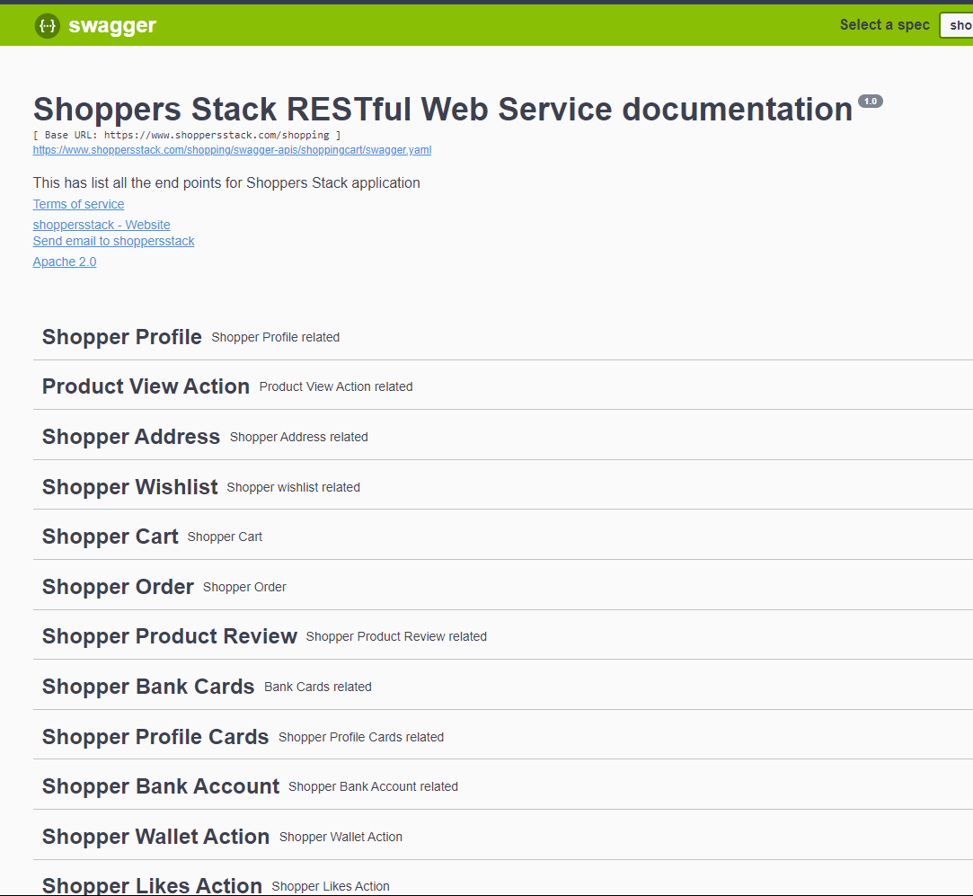

Domain
ShoppersStack Website

Slide 4
Used the above data from swagger documentation to create API requests.
Used the response data to create responses for tests.

Slide 5
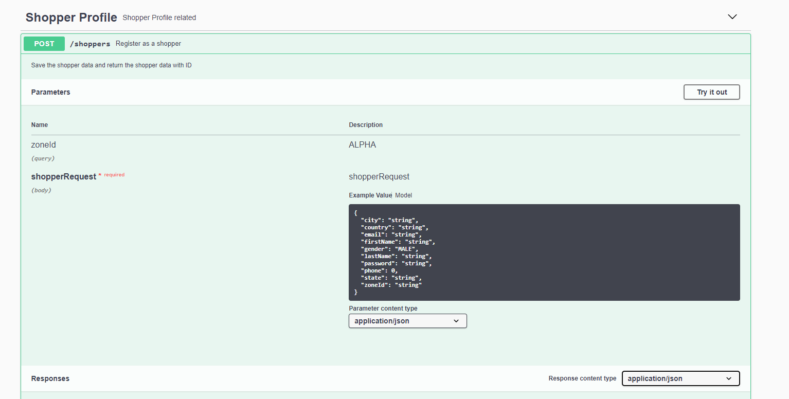

Slide 6
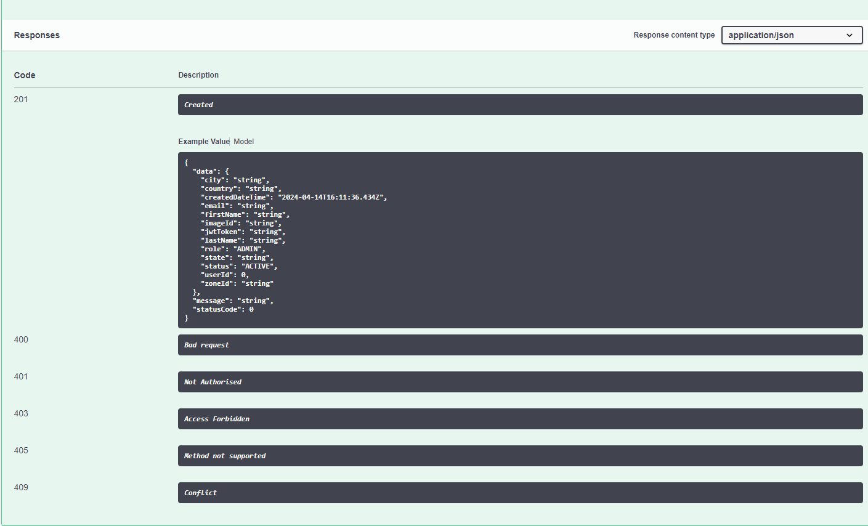

Slide 7
Tools and Environments
Postman used as the primary tool used for testing the ShopperStack API.
Postman is a popular API development and testing platform that provides a user-friendly interface for designing, testing, and debugging APIs.
Key features of Postman that were utilized in your testing process, such as:
Creating and sending HTTP requests (GET, POST, PUT, DELETE, etc.).
Writing and executing test scripts to automate validation and verification.
There are others features provided by postman as well, but I used only these two.

Slide 8
Flow Chart
Creating a request
Base URL from Swagger
Method (POST, GET, DELETE etc)
Response
Verify the status code
Tests
Automate the response verification using tests
Add data- Body(JSON), Params, Headers
Add Authentication(if req)
Send request
Verify the status message
Use Postman module pm.tests
API Chaining
Gather data from response using variables
Use the variables to create the next request

Slide 9
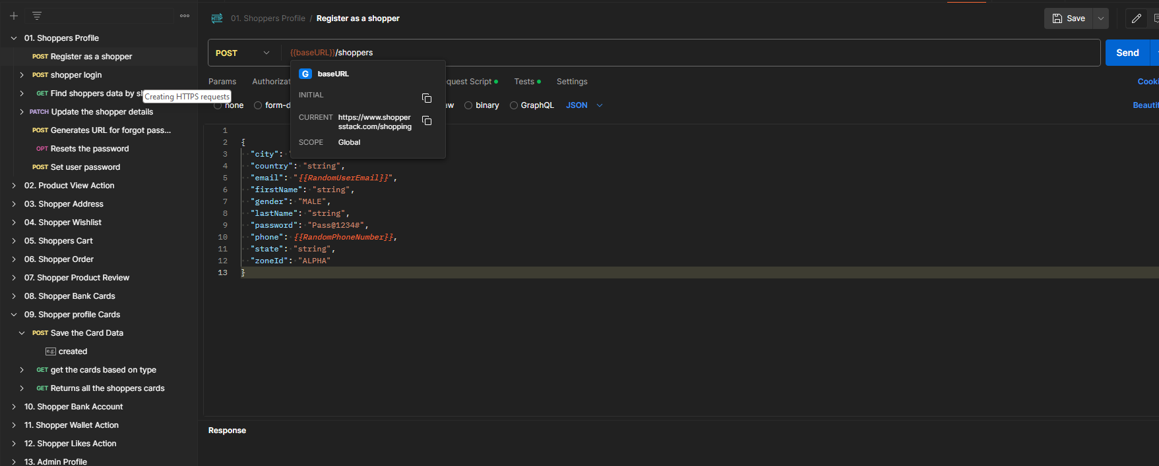
Creating HTTPS requests

Slide 10
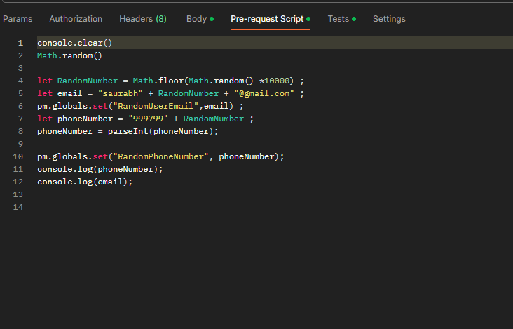
Automation using pre-request script

Slide 11
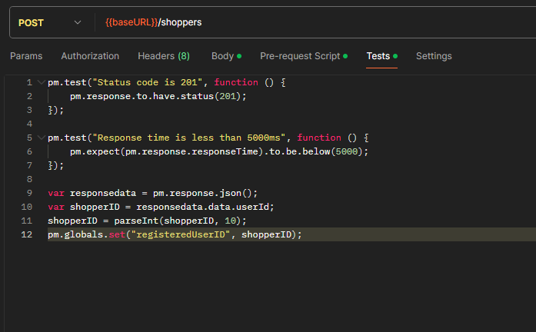
Testing using post response test

Slide 12
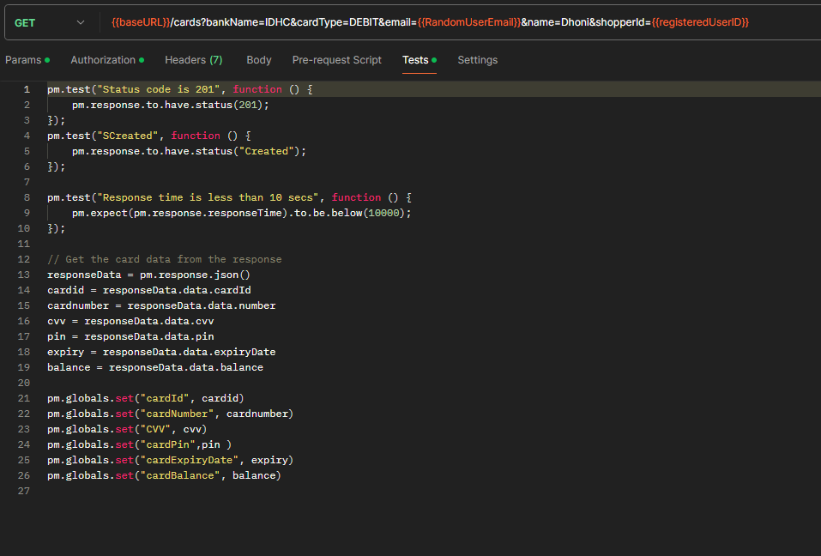
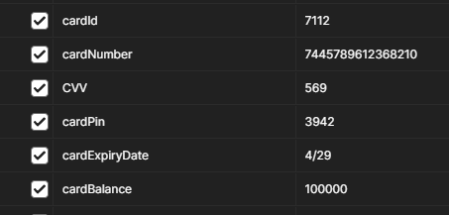
Gathering data to be used in next request

Slide 13
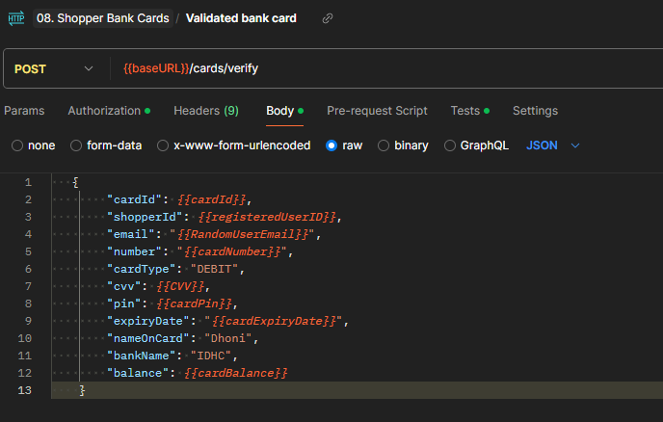
Chaining

Slide 14
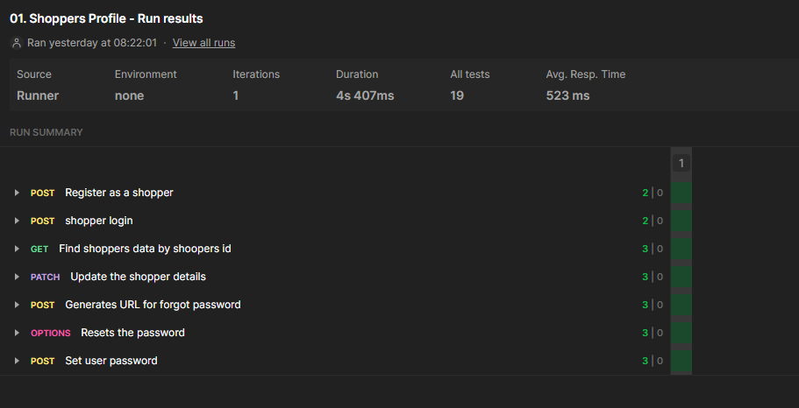
Automation and results

Slide 15
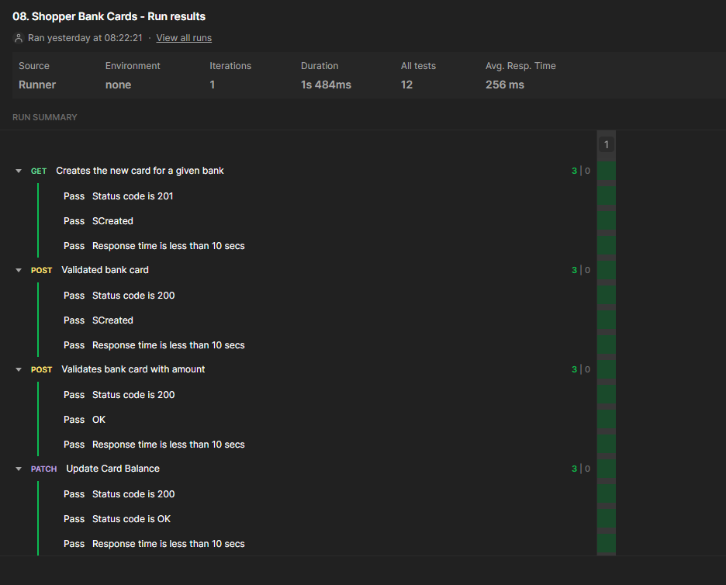

Slide 16
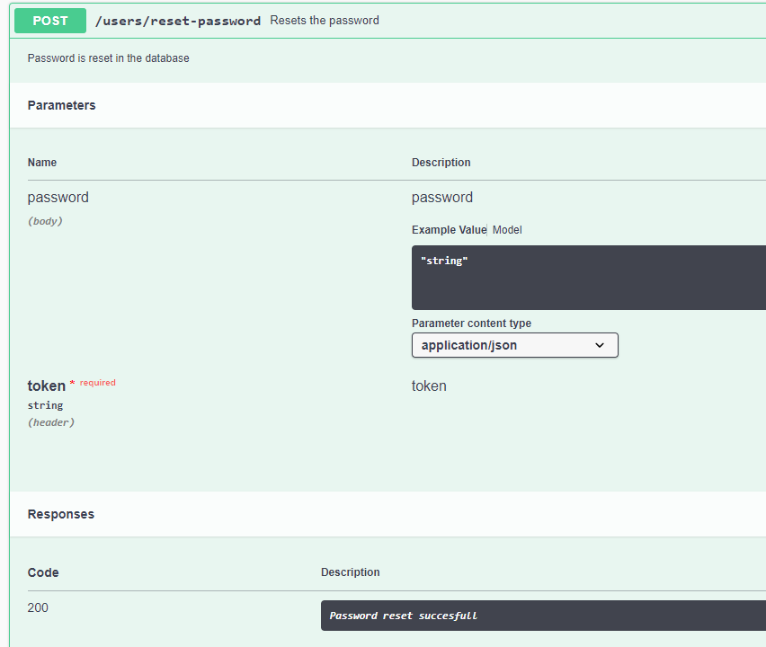
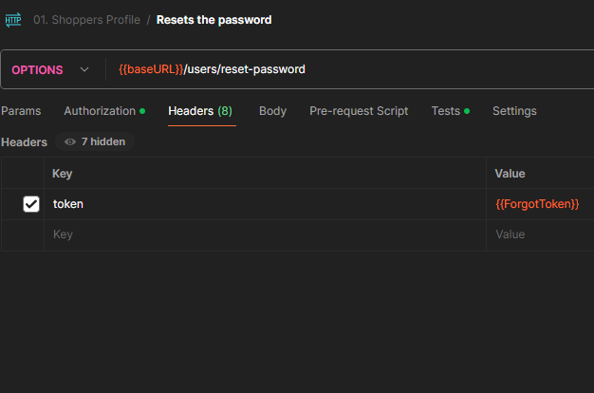
Analysis
2 Defects found
D1 : Wrong method used at backed which is not mentioned in the Swagger document

Slide 17
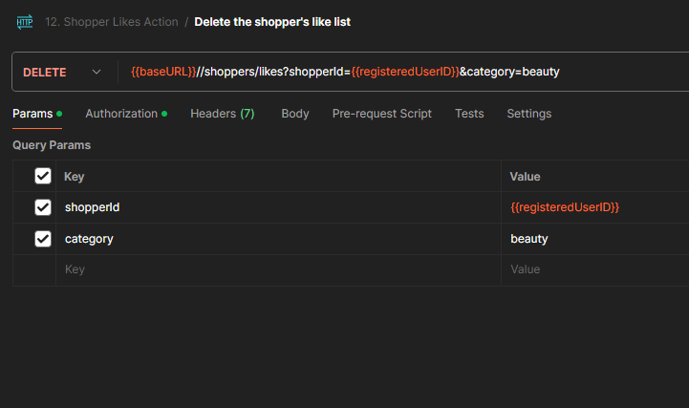
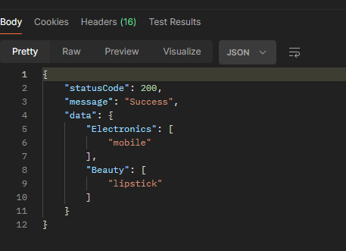
D2(?) : The category is case sensitive, so deleting beauty doesn’t work, but deleting Beauty does.

Slide 18

Thanks !!!

