Slide 1
Shining light on the Black Box Image classifier for MNIST dataset using Occlusion Sensitivity Maps
Members'
25-27-05 Saurabh Kumar Singh
25-27-14 Singh Yash Mane
25-14-10 Aditya Manish Shrikhande

Slide 2
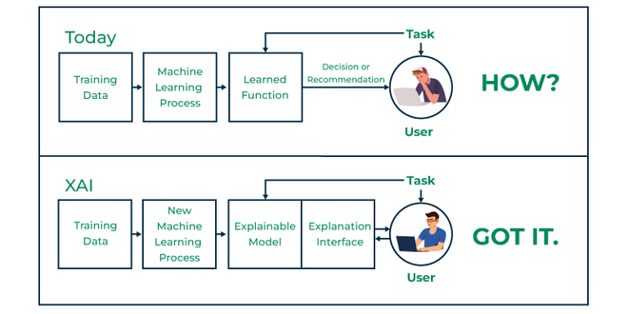
Introduction

Slide 3
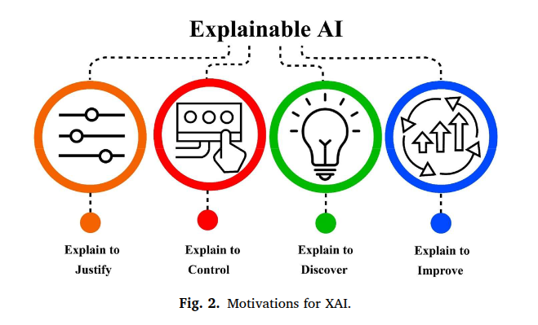
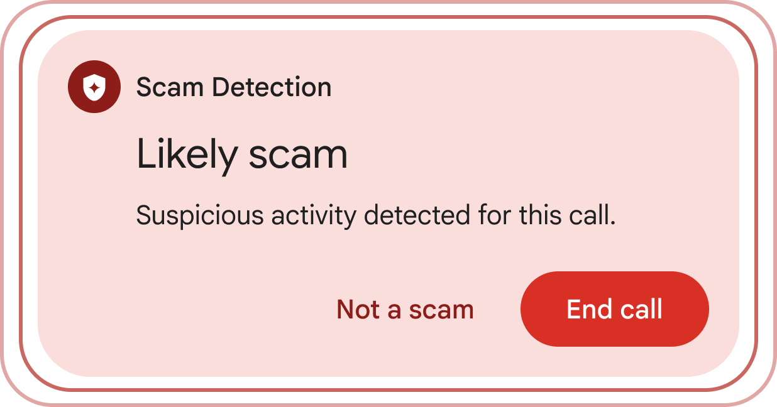
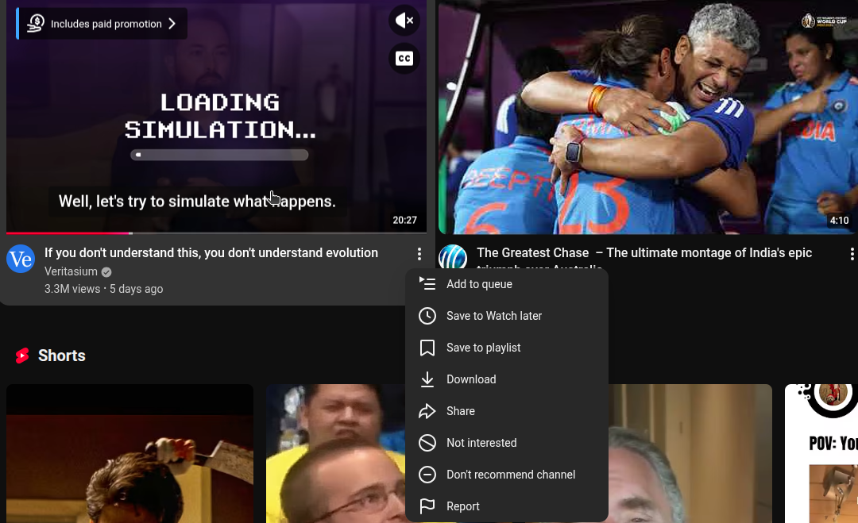
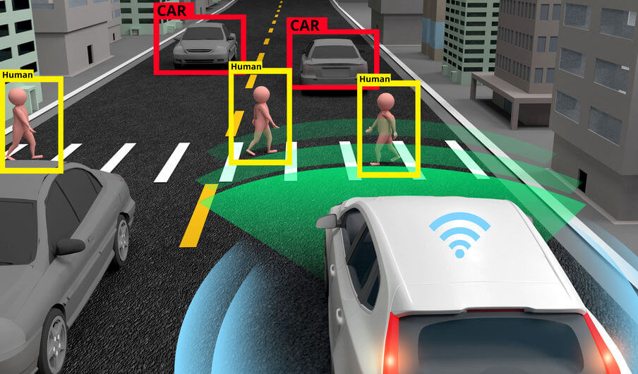
Why xAI ?

Slide 4
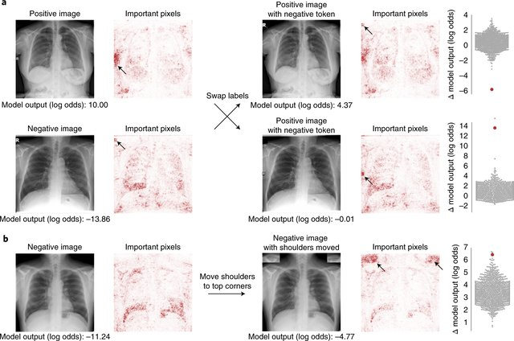
xAI In Medicine
AI for radiographic COVID-19 detection
J. DeGrave , Joseph D. Janizek and Su-In Lee

Slide 5
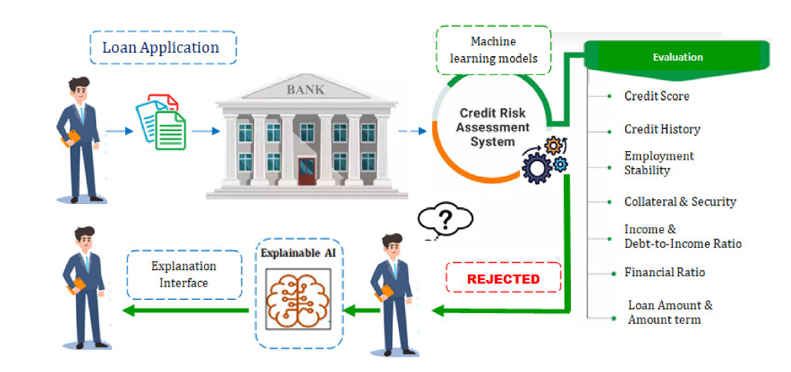


xAI in Finance
An Explainable AI framework for credit evaluation and analysis
M.K. Nallakaruppan , Balamurugan Balusamy , M. Lawanya Shri , V. Malathi c, Siddhartha Bhattacharyya d,e,∗

Slide 6
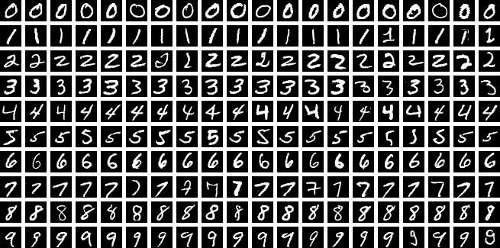
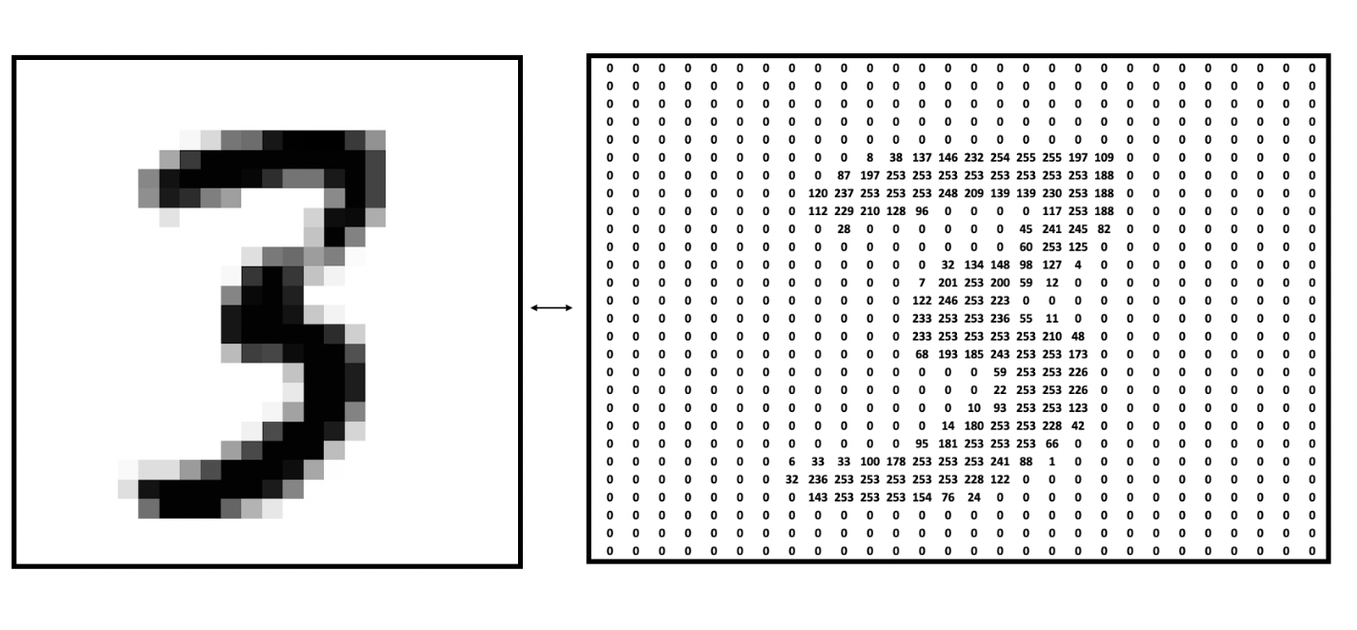
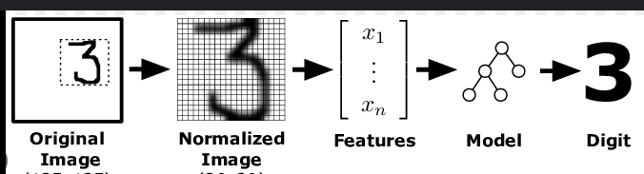
MNIST – Handwritten Digits
70K images, 60k+10k split
28x28, single channel, grey scale

Slide 7
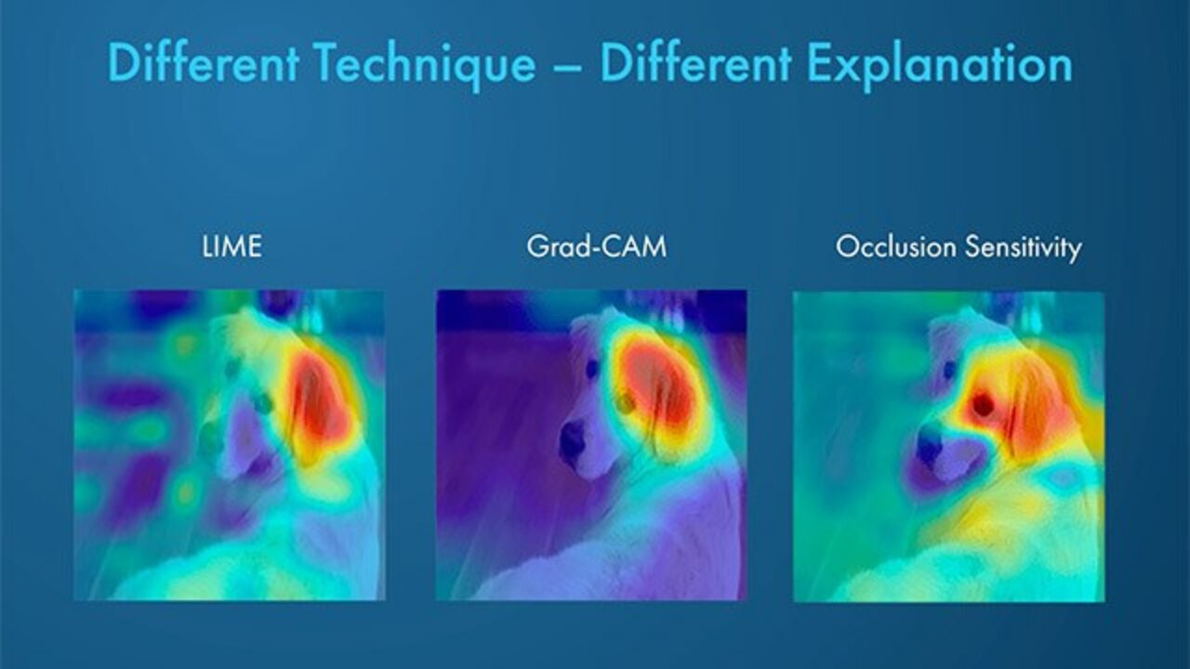
Occlusion Sensitivity
“How much does the model’s confidence in its predicted class drop when I hide this region?”​
SOTA : SHAP – Shapley Additive Explanations
LIME – Local Interpretable Model Agnostic Explanations
GradCAM – Gradient Weighted Class Activation Mapping

Slide 8
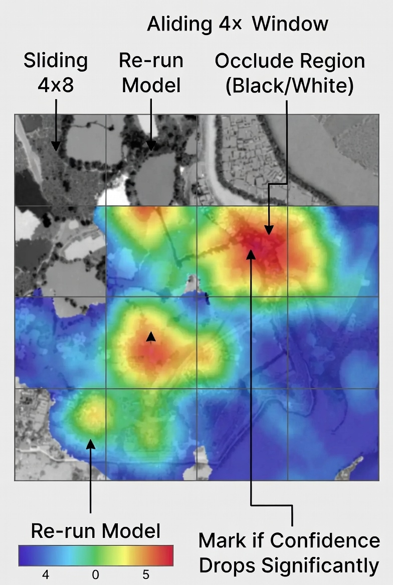
“For each test image, we slide a small window (4×4) across it. We occlude that region — turn it black or white — and re-run the model. If the model’s confidence in its predicted class drops significantly, we mark that region as important. Doing this for every position gives us a heatmap of importance.
In this way, we visualize which parts of the image the model actually relied on to make its decision.”
Grad-CAM and Integrated Gradients are faster but only work for CNNs. LIME and SHAP are more sophisticated but slower for images. So for a fair comparison across CNN, MLP, KNN, and DecisionTree, occlusion sensitivity is ideal.”

Slide 9
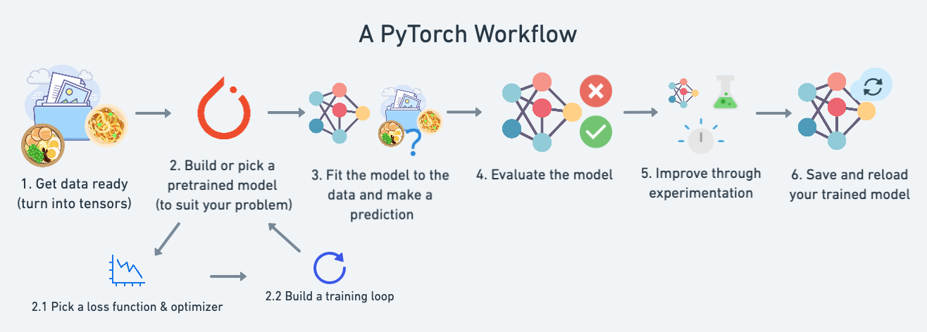
ML Workflow

Slide 10
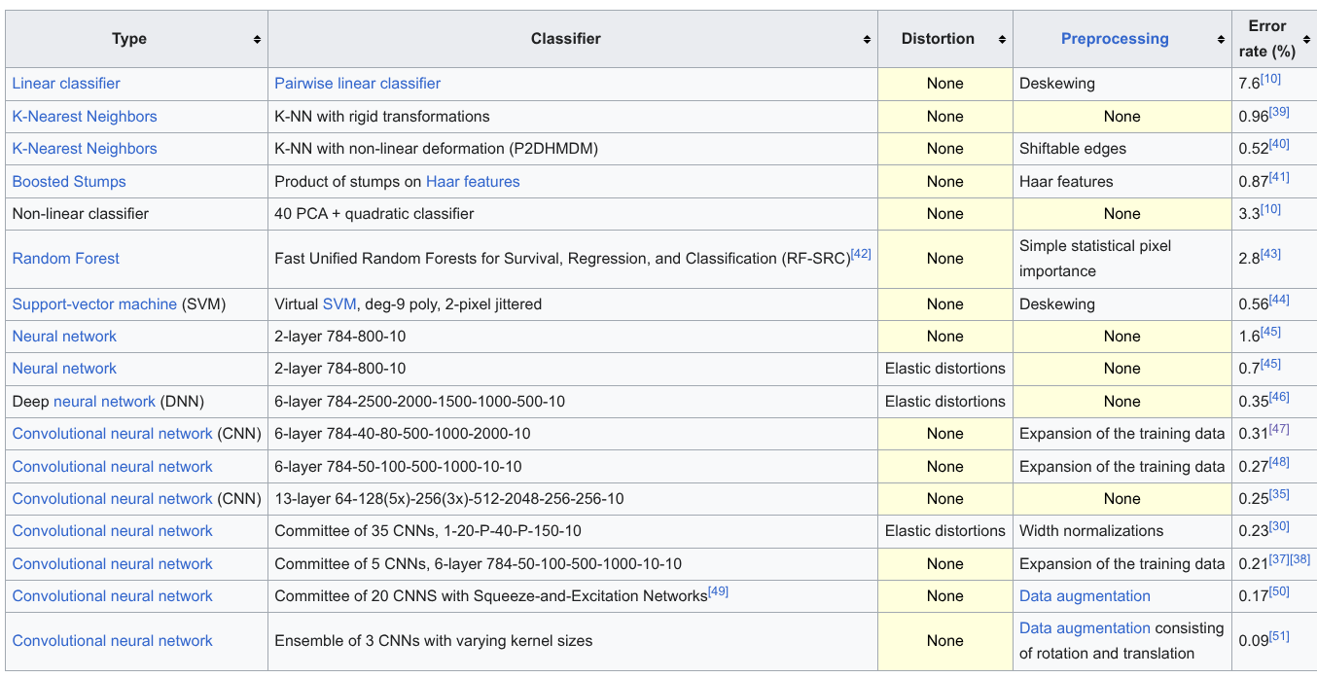

Slide 11

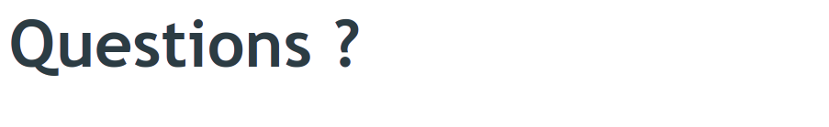

Slide 12

Questions

