Slide 1
Shining light on the Black Box Image classifier for MNIST dataset using Occlusion Sensitivity Maps
Members'
25-27-05 Saurabh Kumar Singh
25-27-14 Yash Mane
25-14-10 Aditya Manish Shrikhande

Slide 2
Project Proposal

Slide 3
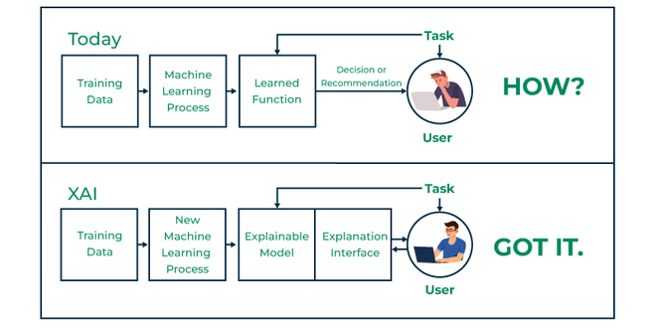
Introduction

Slide 4
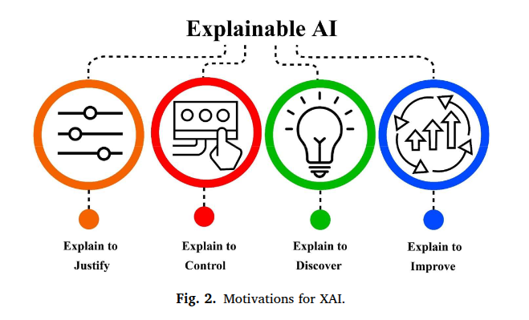
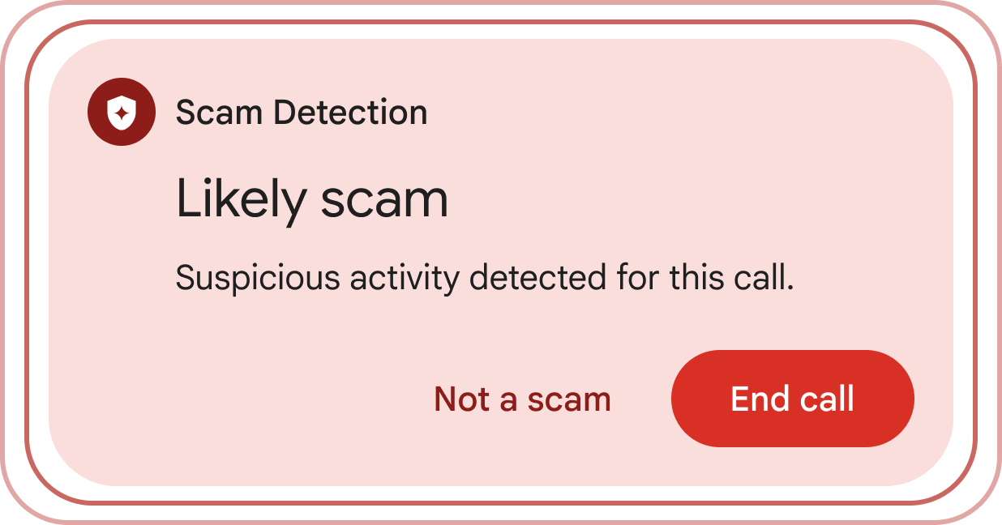

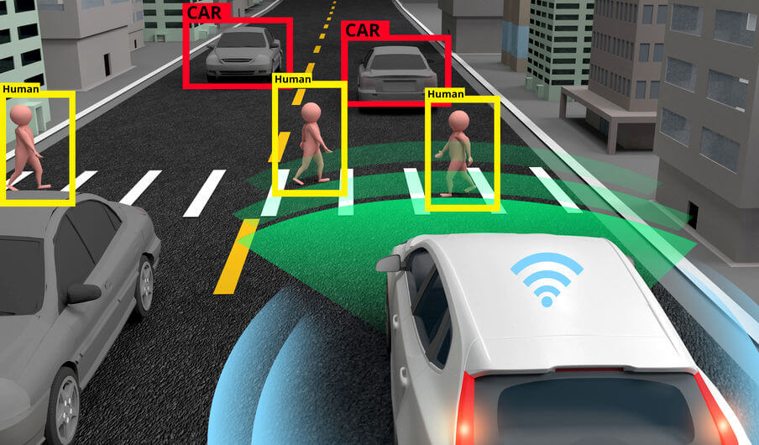
Why xAI ?

Slide 5
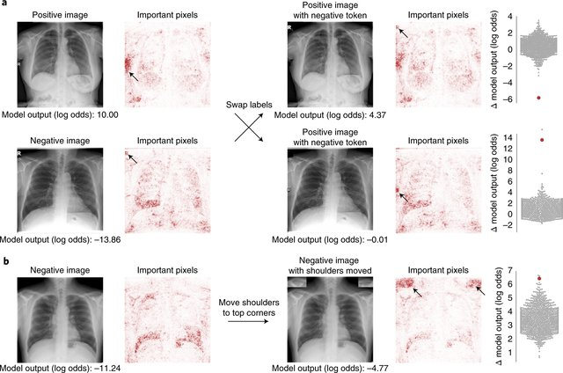
xAI In Medicine
AI for radiographic COVID-19 detection
J. DeGrave , Joseph D. Janizek and Su-In Lee

Slide 6
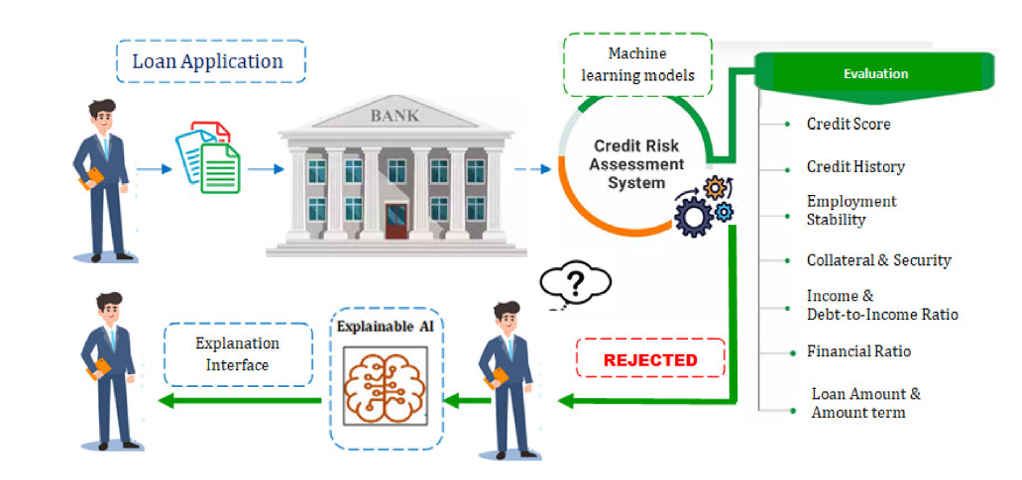


xAI in Finance
An Explainable AI framework for credit evaluation and analysis
M.K. Nallakaruppan , Balamurugan Balusamy , M. Lawanya Shri , V. Malathi c, Siddhartha Bhattacharyya d,e,∗

Slide 7
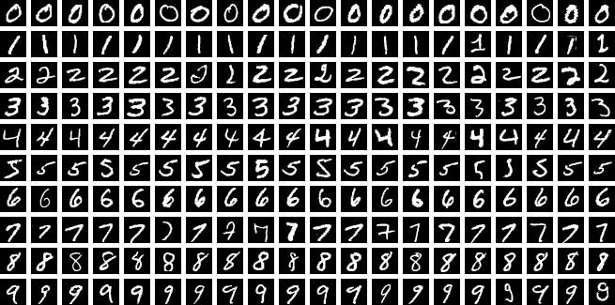
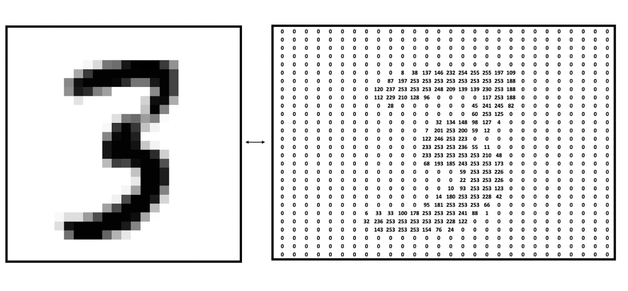
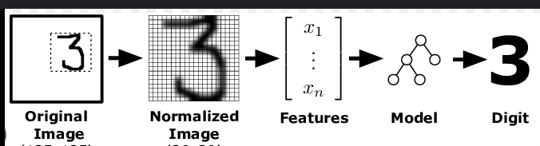
MNIST – Handwritten Digits
70K images, 60k+10k split
28x28, single channel, grey scale

Slide 8
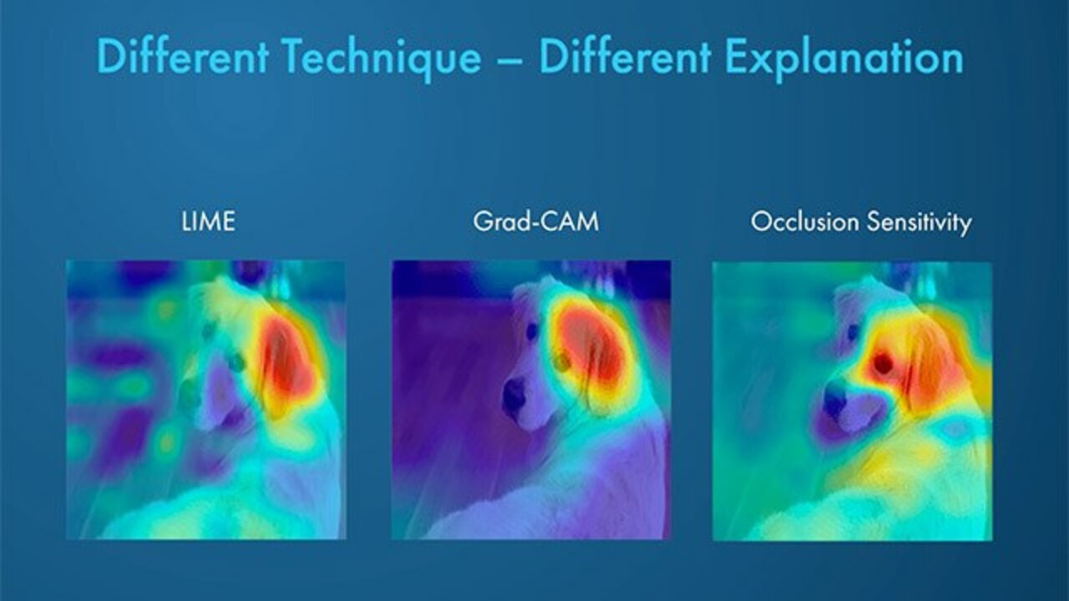
Occlusion Sensitivity
“How much does the model’s confidence in its predicted class drop when I hide this region?”​
SOTA : SHAP – Shapley Additive Explanations
LIME – Local Interpretable Model Agnostic Explanations
GradCAM – Gradient Weighted Class Activation Mapping

Slide 9
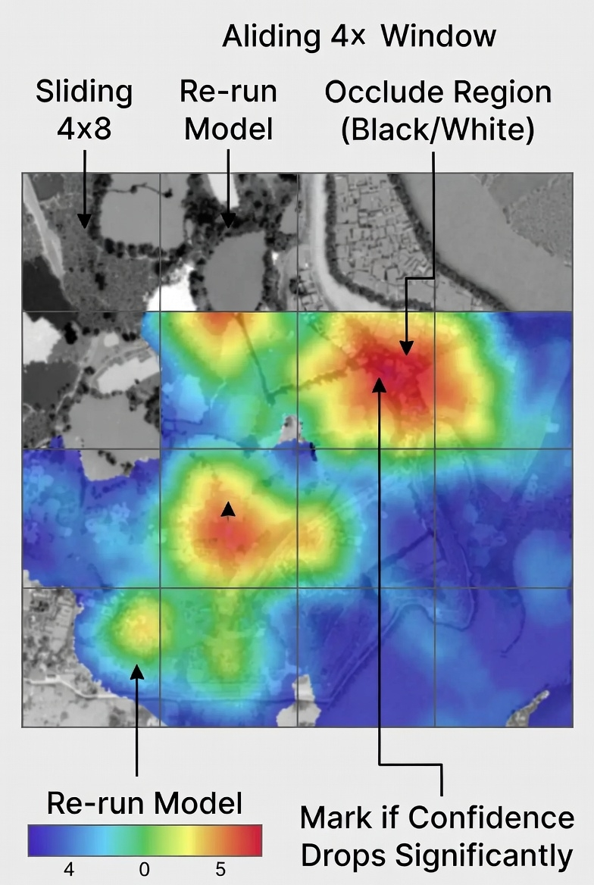
“For each test image, we slide a small window (4×4) across it. We occlude that region — turn it black or white — and re-run the model. If the model’s confidence in its predicted class drops significantly, we mark that region as important. Doing this for every position gives us a heatmap of importance.
In this way, we visualize which parts of the image the model actually relied on to make its decision.”
Grad-CAM and Integrated Gradients are faster but only work for CNNs. LIME and SHAP are more sophisticated but slower for images. So for a fair comparison across CNN, MLP, KNN, and DecisionTree, occlusion sensitivity is ideal.”

Slide 10
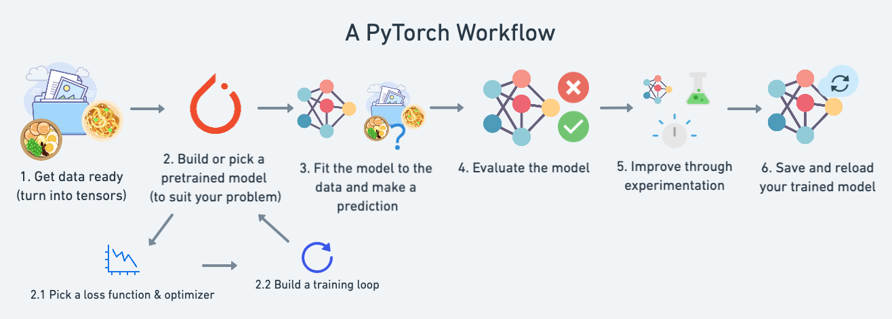
ML Workflow

Slide 11
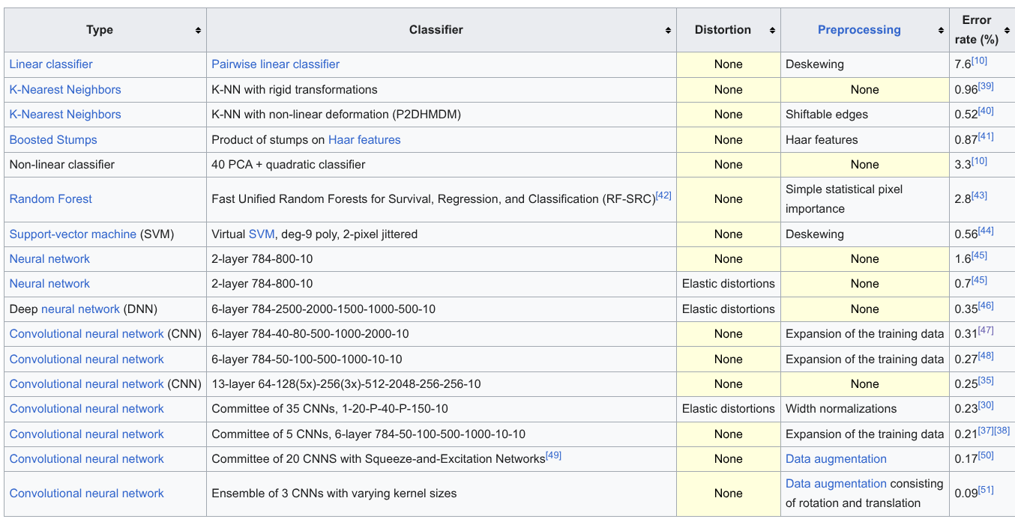

Slide 12

Project Execution

Slide 13
Goal : Compare 5 different classifiers on MNIST handwritten dataset
To show where each model "LOOKED" to make it's decision.
Brighter - mattered more in the decision.
Two cases –
Where SOTA CNN is right, and other models fail.
Ambiguous digits where all models struggle.
brighter areas on the explanation image meant those pixels mattered more to the model

Slide 14
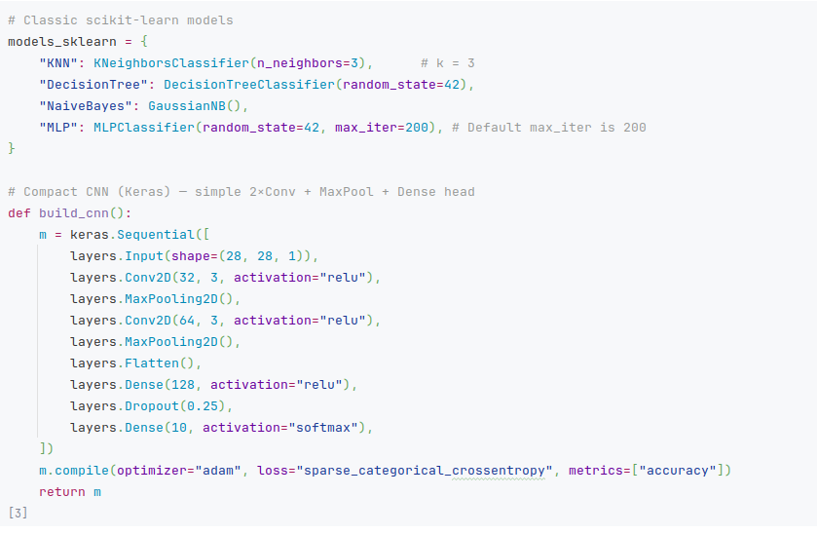
Models
Using sklearn -
KNN
Decision Tree
Naïve Bayes
MLP
Using Keras framework in tensorflow.
CNN

Slide 15
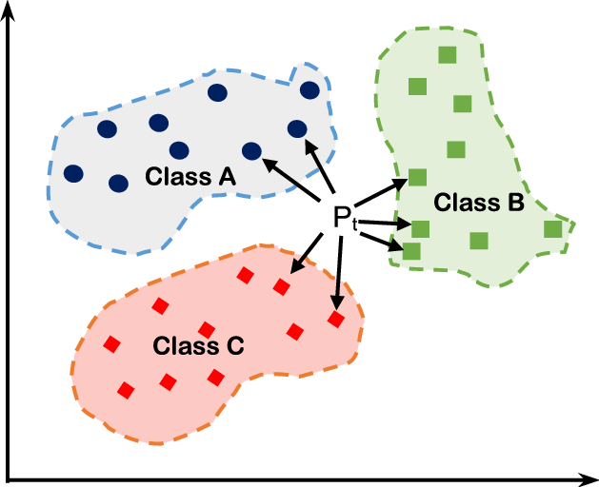
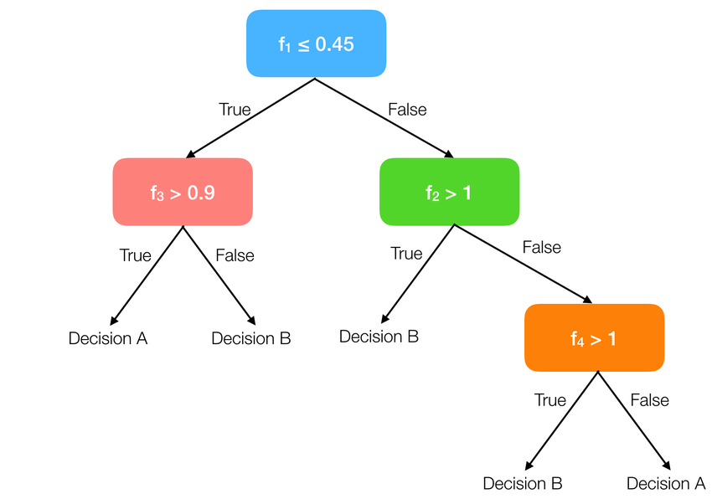
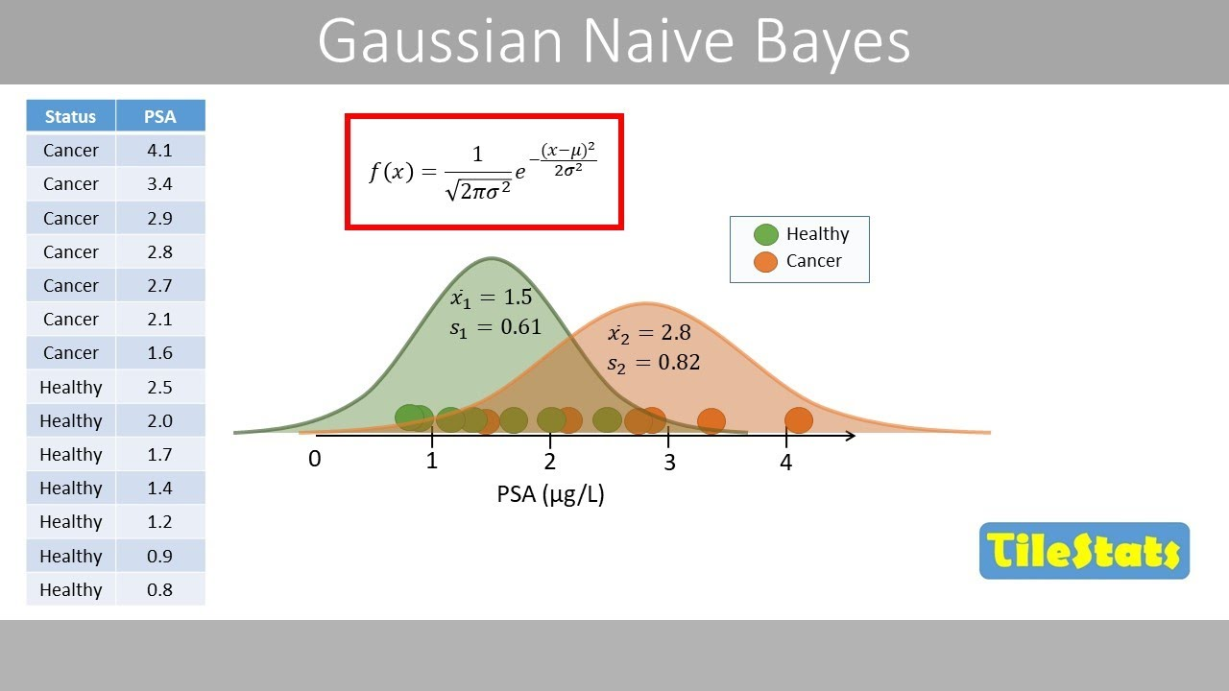
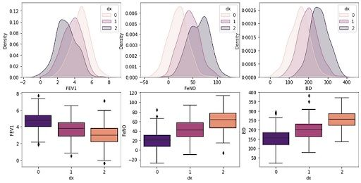
About Models
KNeighborsClassifier(n_neighbors=3) (KNN): This is an instance-based, non-parametric classifier. It classifies a data point based on the majority class among its 'k' nearest neighbors in the training data.
Here, n_neighbors=3 means it considers the 3 closest data points.
DecisionTreeClassifier(random_state=42) (Decision Tree): A tree-like model that makes decisions by splitting data based on feature values.
random_state=42 ensures reproducibility in the tree-building process.
GaussianNB() (Naive Bayes): A probabilistic classifier based on Bayes' theorem, assuming features are conditionally independent given the class. Gaussian refers to the assumption that continuous features follow a Gaussian (normal) distribution.

Slide 16
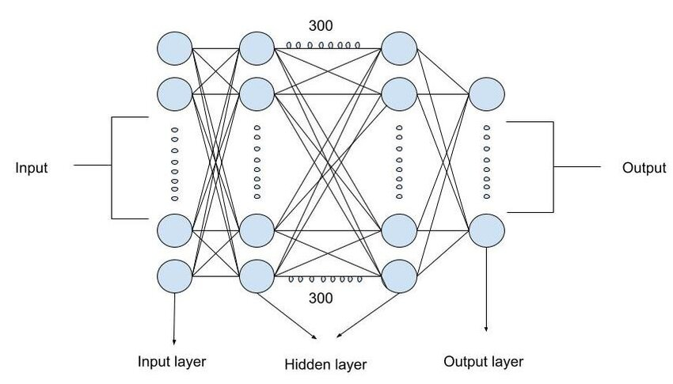

MLPClassifier(random_state=42, max_iter=200) (MLP): A Multi-Layer Perceptron, which is a basic feedforward artificial neural network. It has an input layer, one or more hidden layers, and an output layer. max_iter=200 sets the maximum number of iterations (epochs) for the solver to converge, and random_state=42 ensures reproducible weight initialization.
CNN: Convolutional Neural Networks,

Slide 17
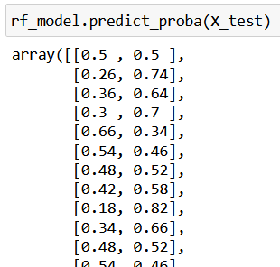
What is Prediction change and Model's confidence in prediction?
model's confidence in prediction
the probability score that the model assigns to the class it ultimately predicts.
Classification models like the CNN, KNN, MLP, and Naive Bayes, output a probability distribution over all possible classes
(e.g., '90% sure it's a 5, 5% sure it's a 3, 3% sure it's an 8, etc.').
The 'confidence' is simply the highest probability in this distribution, corresponding to the class the model predicts.
In Scikit-learn, the predict_proba() method is a function available in certain classification estimators that returns probability estimates for each class for a given input.

Slide 18
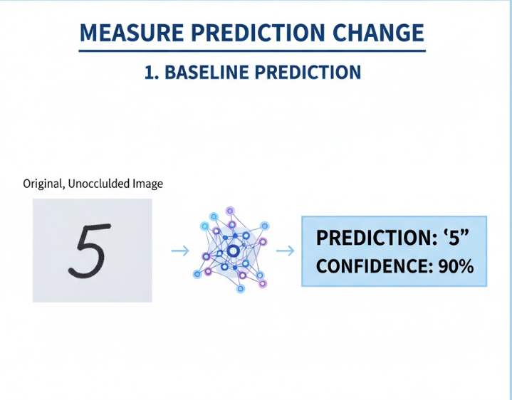
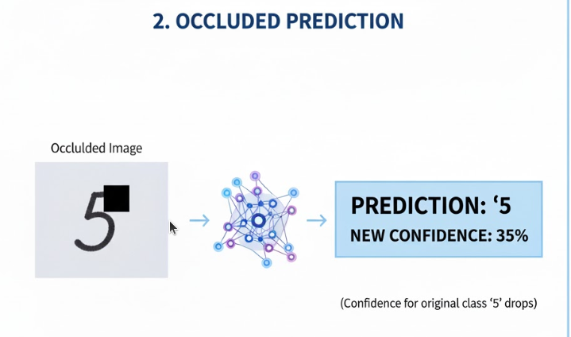
measure prediction change​
Baseline Prediction: First, we take the original, unoccluded image and feed it to the model. Weget its prediction (e.g., '5') and its associated confidence (e.g., 90%). ​
Occluded Prediction: Next, we take the same image, but we hide a small patch of it (e.g., replacea 4x4 pixel area with black or white). We then feed this occluded image to the model again.​
Measuring the Drop: We observe the model's new confidence for the original predicted class. So,if the original predicted class was '5' with 90% confidence, we now check what the model'sconfidence for '5' is with the patch hidden. ​

Slide 19
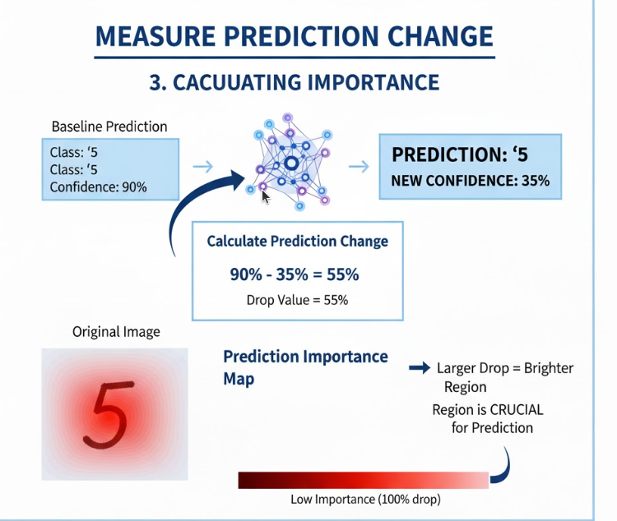
Importance of a region
Calculating Importance:
The prediction change is then calculated as the base_confidence - the occluded_confidence forthe same original predicted class.
This drop value is what gets mapped to the "brighter = mattered more" visual. The larger thedrop, the brighter the region will be in the explanation overlay, showing where the model wasrelying most heavily for its decision.

Slide 20
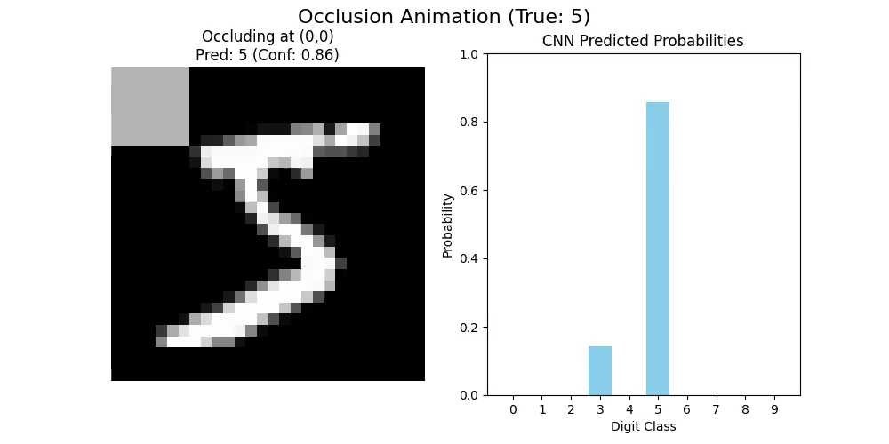
Occlusion working

Slide 21
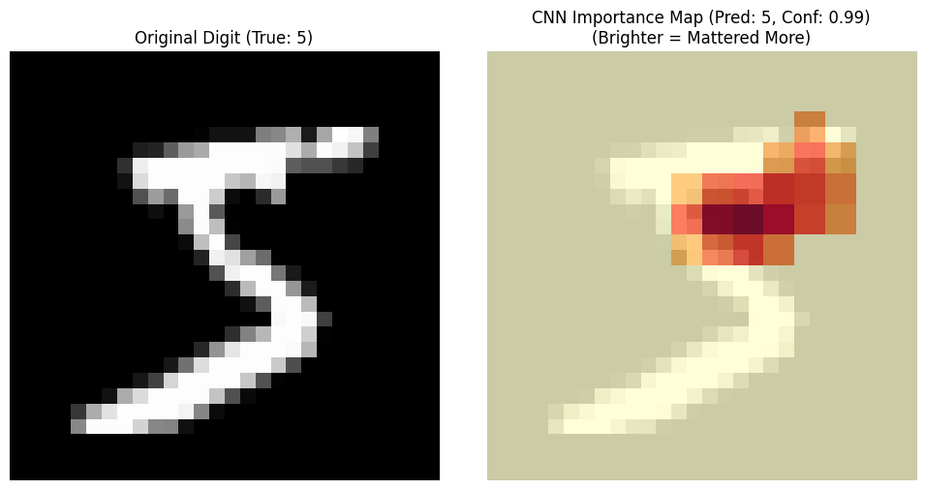

Slide 22
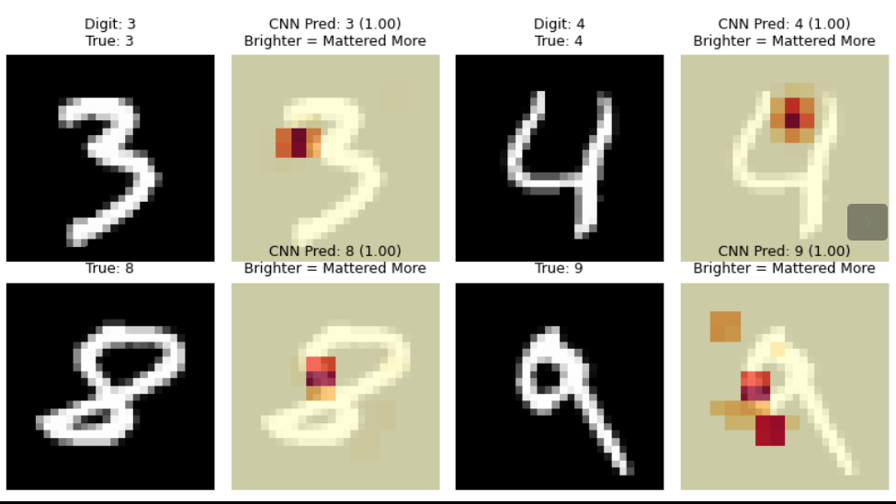
Occlusion sensitivity Maps for one example of each digit by CNN classifier

Slide 23
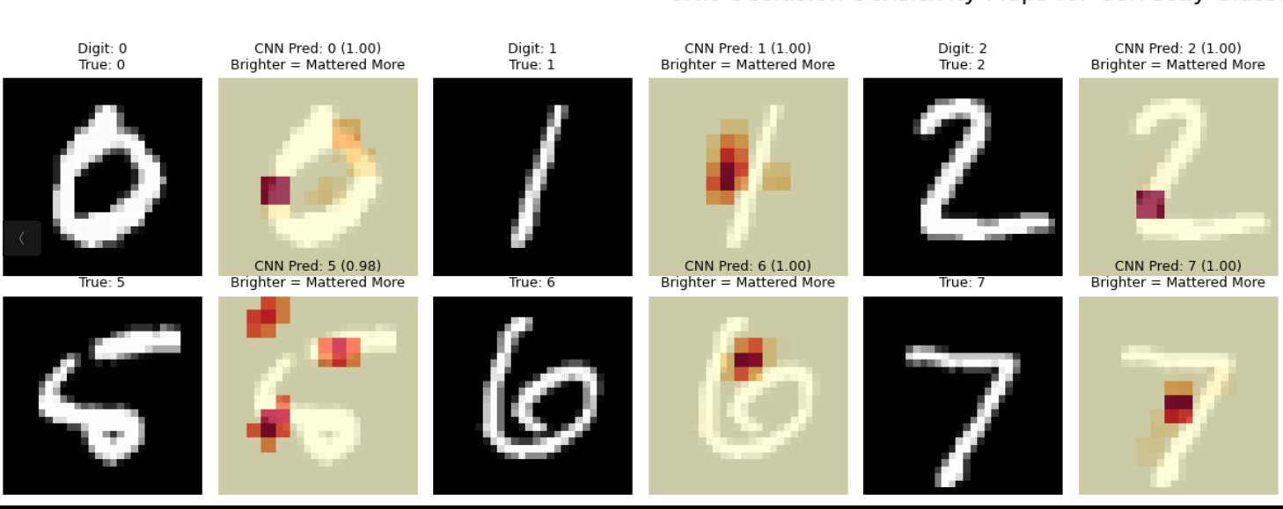

Slide 24
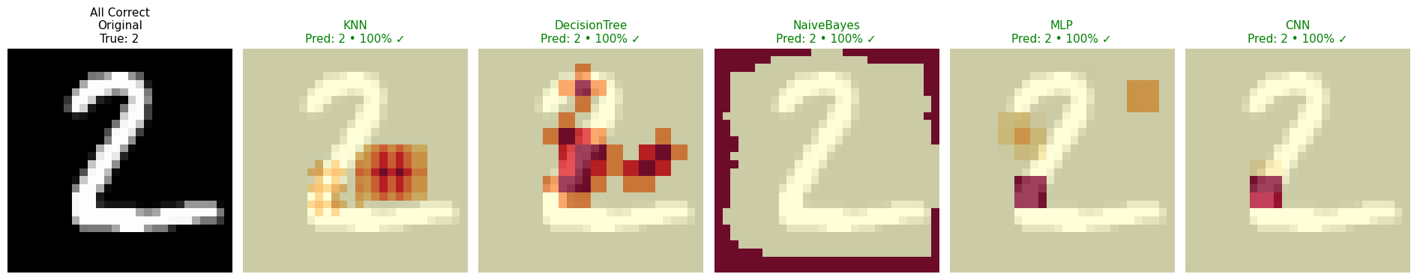
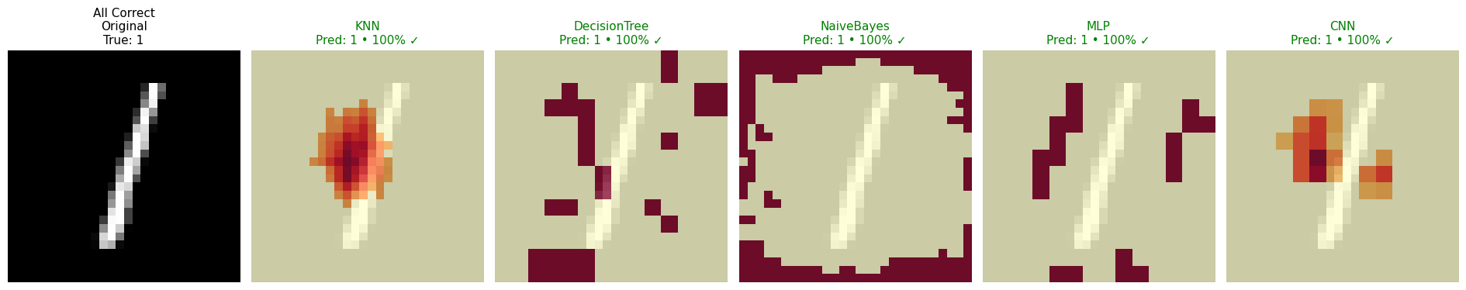
All Correct Predictions

Slide 25
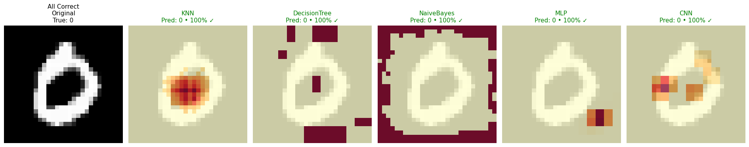
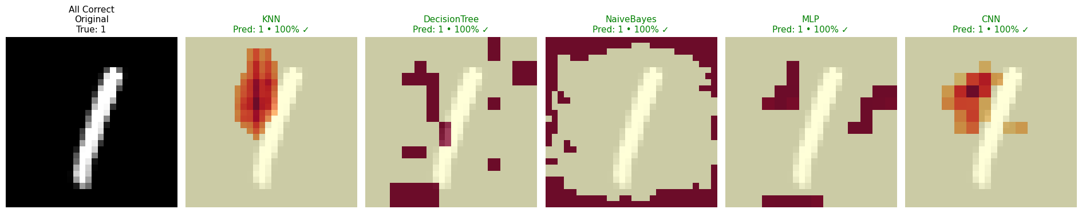
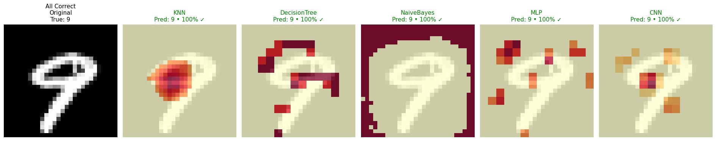

Slide 26
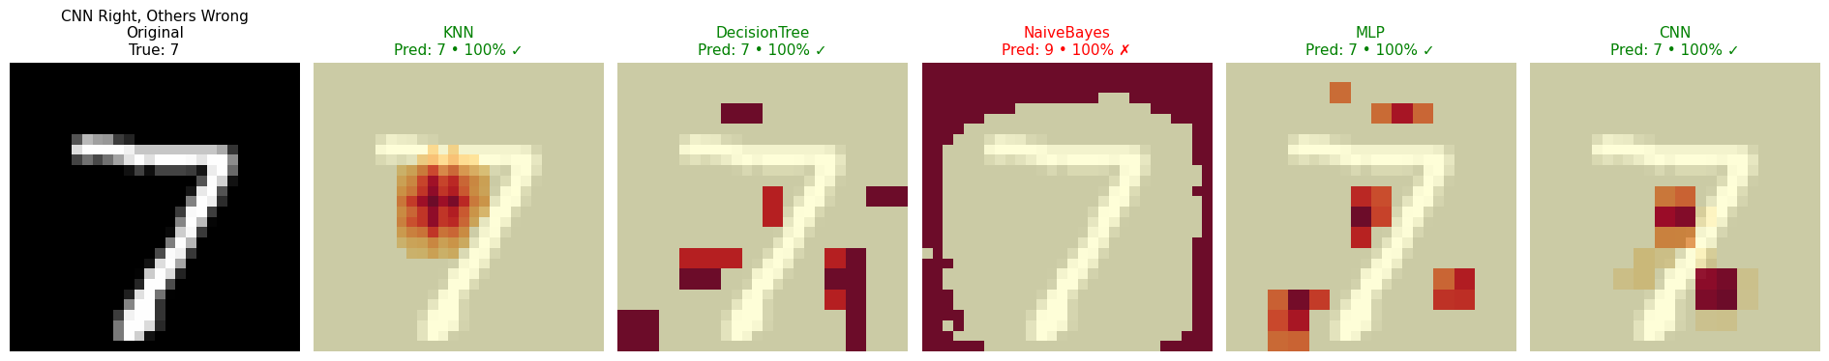
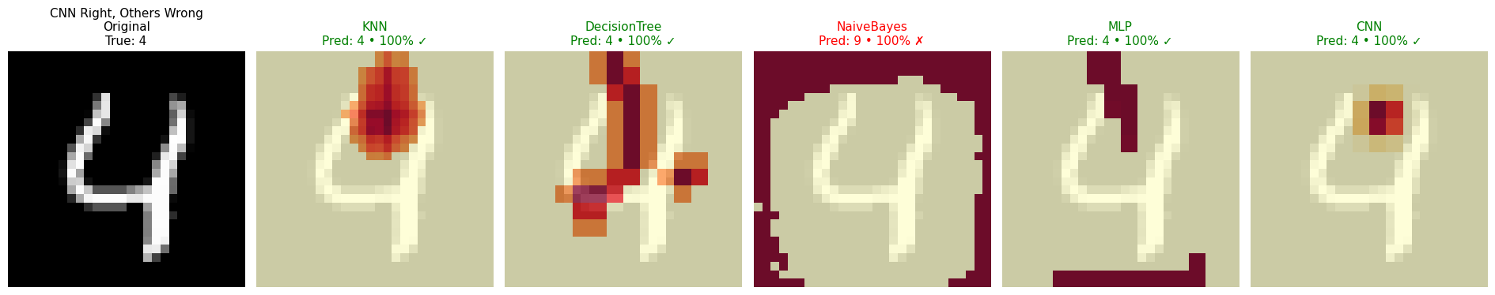
CNN Right, Other's wrong

Slide 27
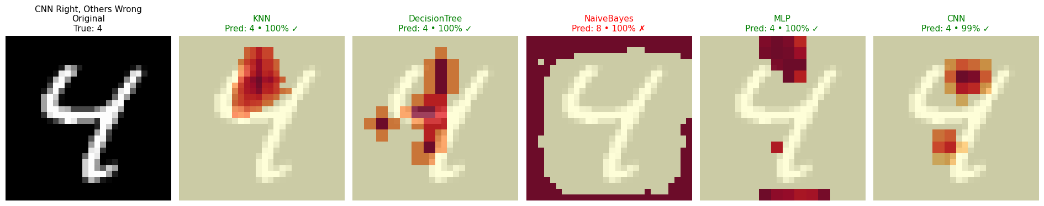
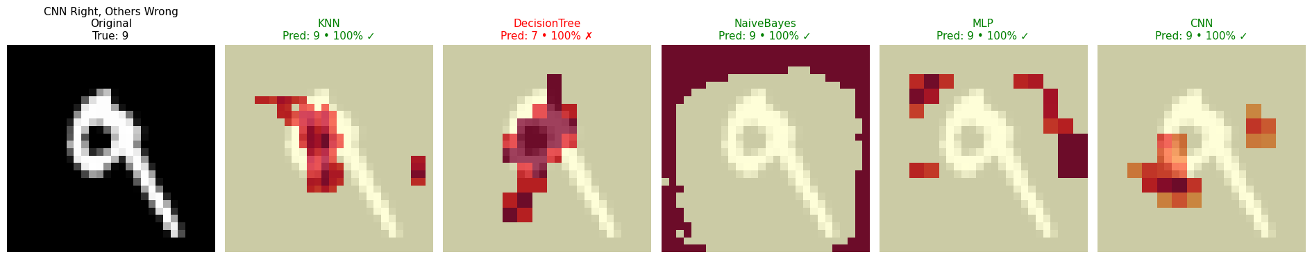
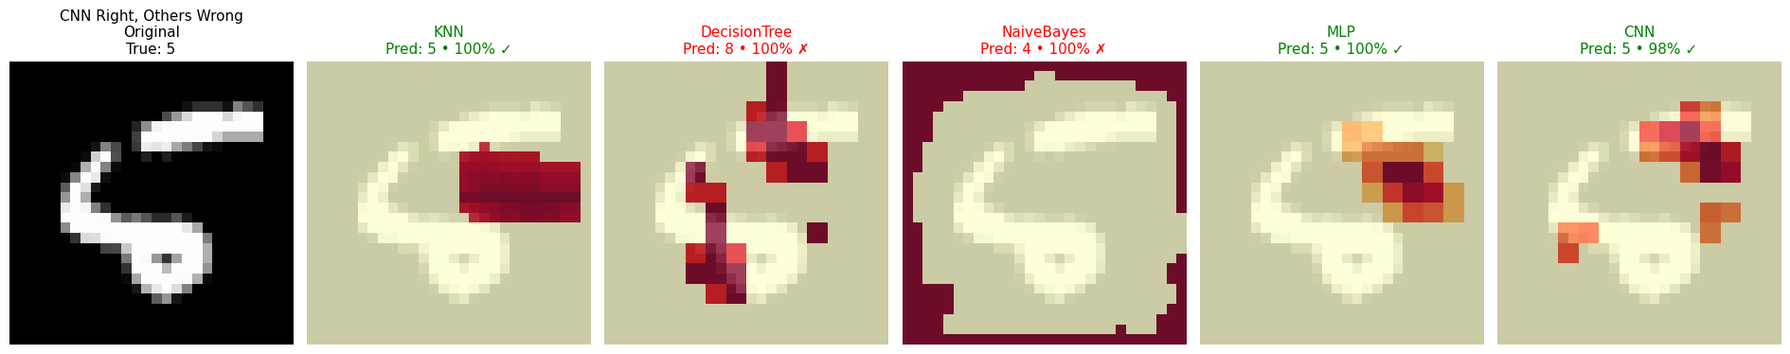

Slide 28
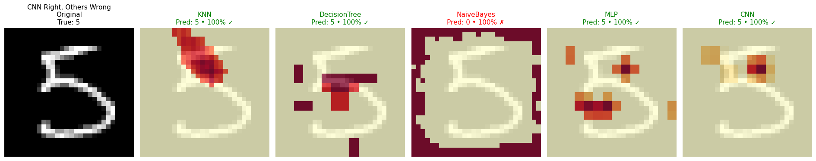
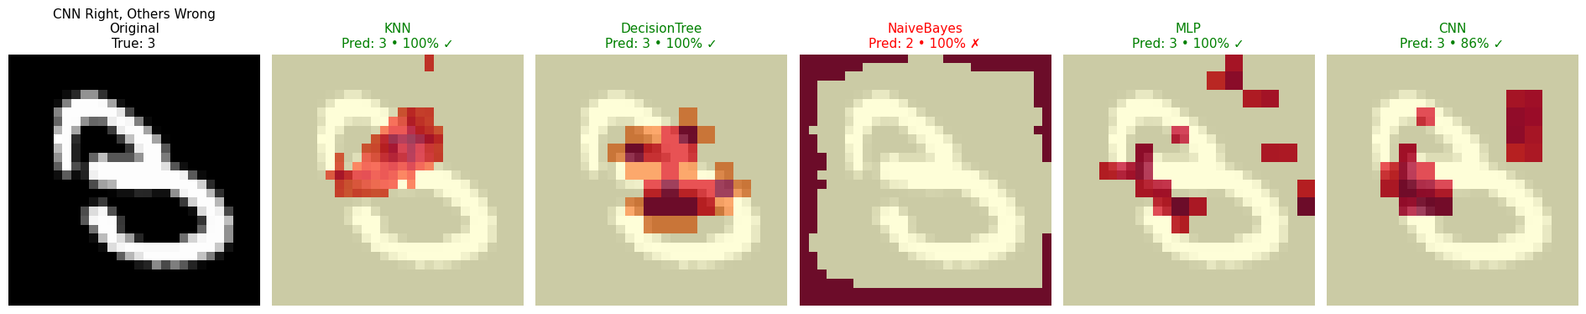
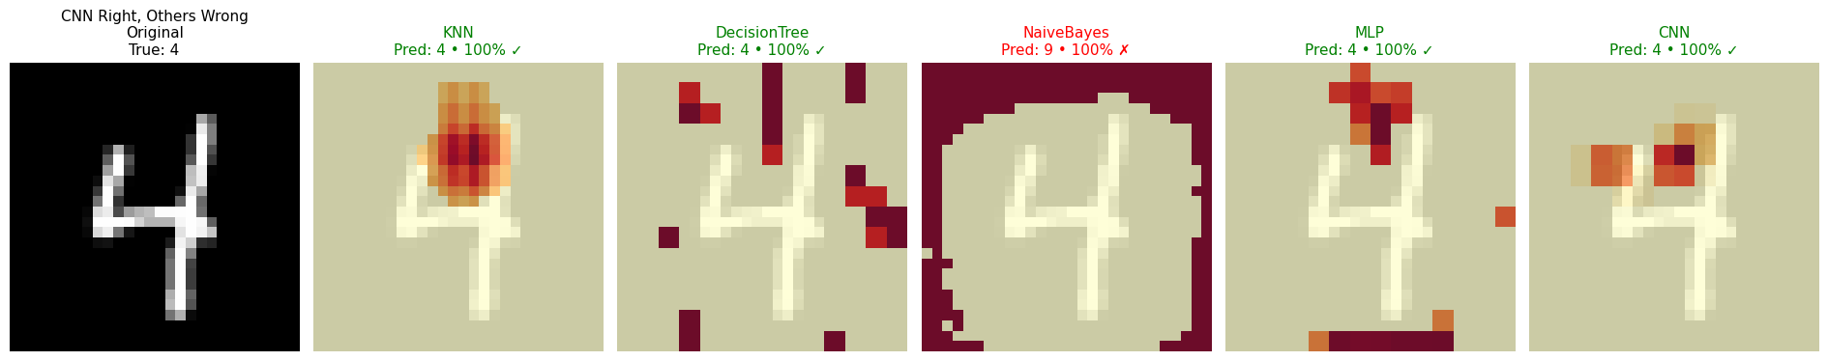

Slide 29
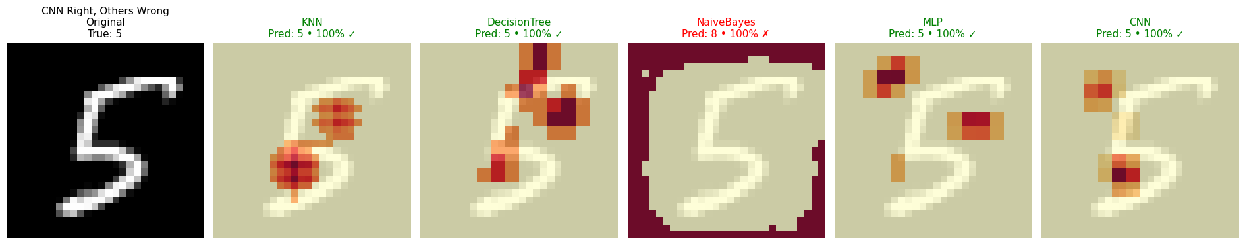
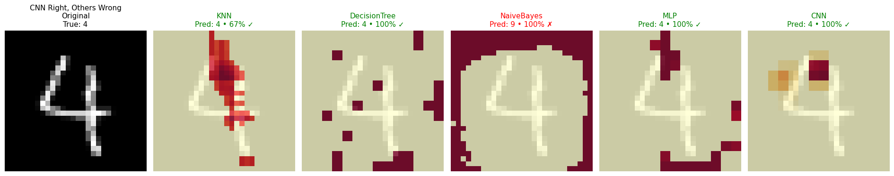

Slide 30
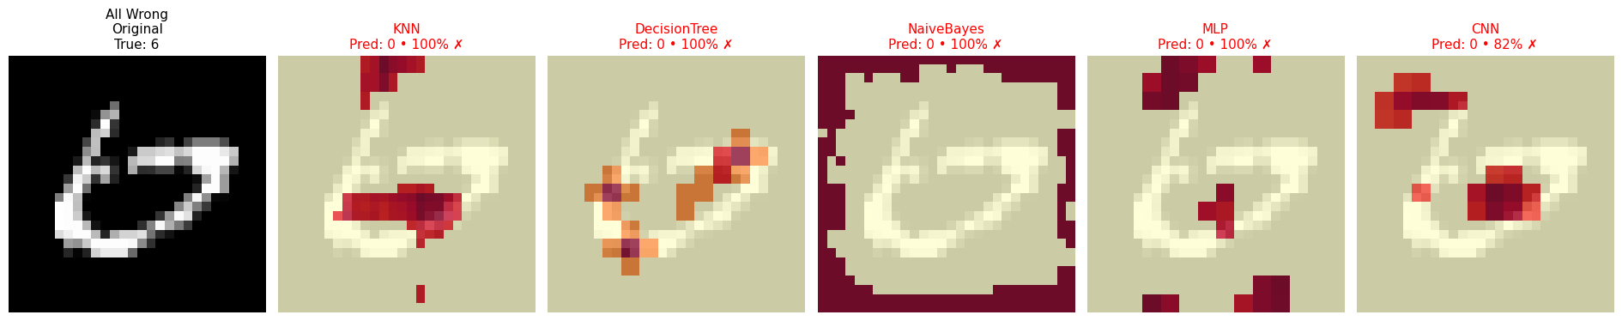
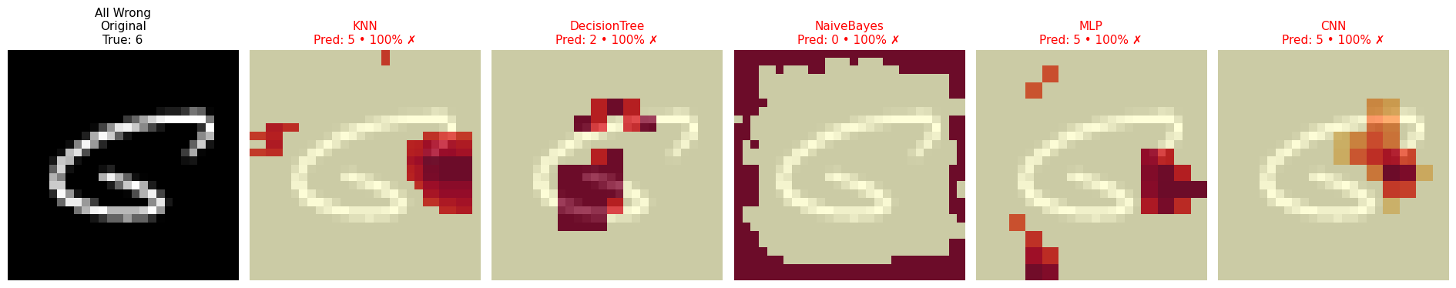
All Wrong

Slide 31
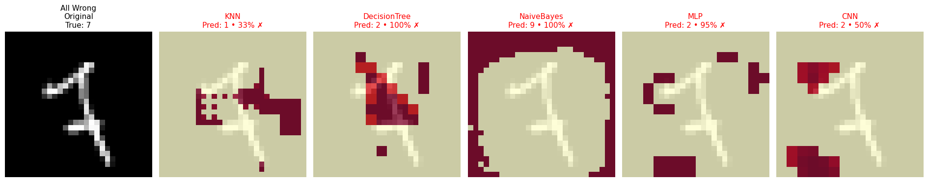
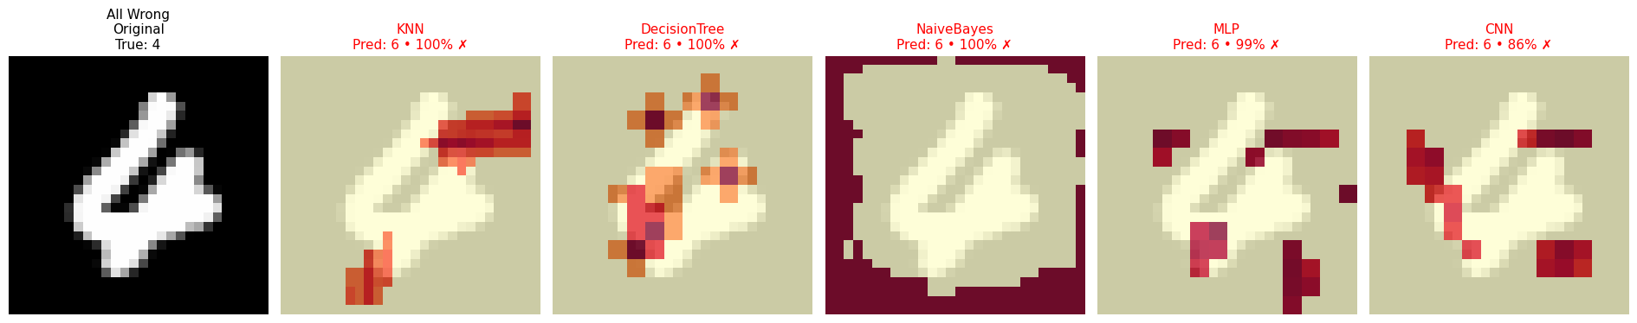

Slide 32
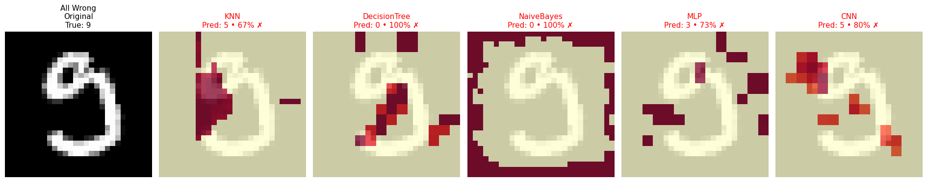
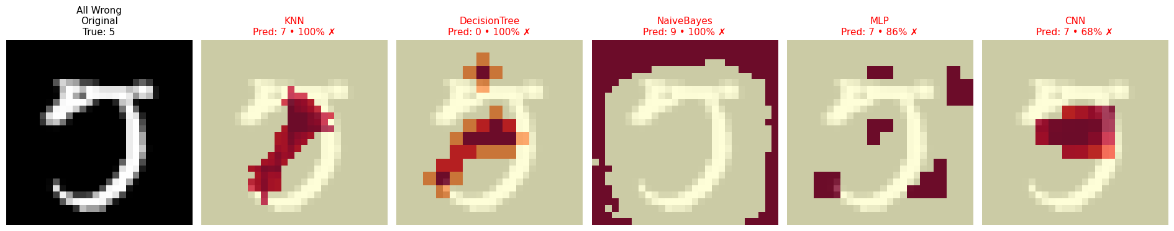

Slide 33
Interpretation Limitations: Non-spatial Models under Occlusion - Key Limitation
Occlusion sensitivity assumes the model uses spatial structure.
It hides a region of the image and measures how the model’s confidence changes. This only has true visual meaning if the model treats nearby pixels as related.
What works well
CNNs: spatially structured — occlusion reveals where the network looks. → Heatmaps correspond to meaningful digit regions/strokes.
Where meaning breaks down
Models like KNN, Decision Trees, Naive Bayes, MLP treat the image as a flat 784-dimensional vector:
No local receptive fields
No concept of “patch”, “neighborhood”, or spatial continuity
Occlusion = just changing some feature values, not hiding a region
So the heatmaps are valid sensitivity maps, but not true spatial saliency maps.

Slide 34
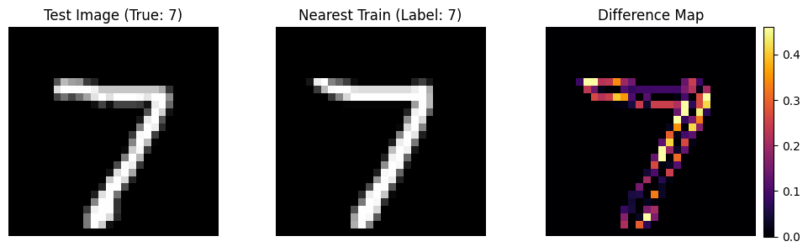
k-NN and Learning examples
nearest training image and a difference map (test image minus nearest-train)
k-NN matches the exact examples

Slide 35
Future directions and Demo
Beyond Occlusion:
Exploring Modern Explainability: While occlusion sensitivity provides intuitive local explanations, it's just one method. Future explorations could delve into more advanced techniques like SHAP, LIME, or Grad-CAM, which offer different perspectives on model interpretability and often richer insights into complex deep learning architectures.

Slide 36
https://www.siliconbrain.in/handwritten-digit-recognizer

Slide 37
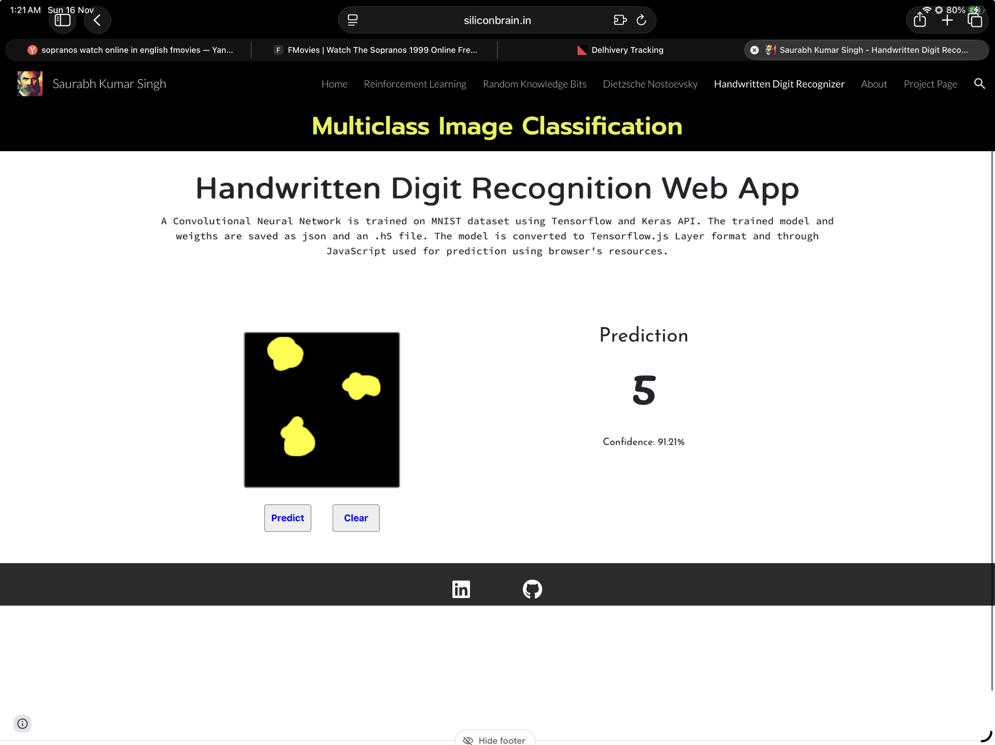

Using Occlusion sensitivity to trick the classifier into recognizing a wrong digit

Slide 38


Slide 39
This project aimed to compare five different classification models on the MNIST handwritten digit dataset and, crucially, to illustrate how each model arrived at its decision. The central, intuitive explanation principle used was: 'brighter areas on the explanation image meant those pixels mattered more to the model.'
1. Setup and Data Loading: * The notebook began by importing essential libraries like NumPy, Matplotlib, scikit-learn modules (for KNN, Decision Tree, Gaussian Naive Bayes, MLP), and TensorFlow/Keras (for the CNN). * The MNIST dataset (70,000 grayscale 28x28 pixel images) was loaded, pixel values were normalized to [0, 1], and it was split into standard 60,000 training and 10,000 testing examples.
2. Model Definition and Training: * Four scikit-learn models were defined: K-Nearest Neighbors (KNN), Decision Tree, Gaussian Naive Bayes, and a Multi-layer Perceptron (MLP). * A Compact Convolutional Neural Network (CNN) was built using Keras, featuring convolutional, pooling, flatten, dense, and dropout layers. * All five models were trained on the X_train and y_train data.
3. Accuracy Evaluation: * The models were evaluated on the test set (X_test, y_test). As expected, the CNN achieved the highest accuracy (around 99%), significantly outperforming the other models, while Naive Bayes performed the worst.

Slide 40
4. Explanation Methodology (Occlusion): * To explain model decisions, asimple occlusion method was employed: a small patch of the image was temporarilyhidden (occluded), and the drop in the model's prediction confidence for the original classwas measured. A larger drop indicated higher importance for that occluded region, whichwas then visually represented as 'brighter' in the importance maps. * For Naive Bayes, aspecific per-pixel contribution map was calculated based on its probabilistic structure, asocclusion isn't effective for this model. * An interactive animation was generated tovisually demonstrate this occlusion process, showing a moving patch and thecorresponding real-time changes in the CNN's probability scores.​
5. Cohort Selection for Analysis: * Test set examples were grouped into three insightfulcohorts: * All Correct: Examples where all five models made the correct prediction. * CNNRight, Others Wrong: Examples where the CNN was correct, but at least one other modelfailed. * All Wrong: Ambiguous examples where all five models failed.​
6. Visual Comparisons and Deep Dive: * The core of the analysis involved rendering visualcomparison rows for selected examples from these cohorts. Each row displayed theoriginal image alongside five panels, one for each model, showing its prediction,confidence, correctness, and the 'brighter = mattered more' importance map. * Adedicated KNN Deep Dive section illustrated KNN's decision by showing a test image, itssingle nearest neighbor from the training set, and a difference map between the two. Thisclarified KNN's instance-based reasoning. * A compact panel summarizing the CNN'socclusion sensitivity for one correctly classified example of each digit (0-9) was alsogenerated, allowing for a quick overview of how the CNN recognizes different numbers.​

Slide 41
7. Key Takeaways: * The CNN proved superior due to its ability to learn local, generalizedstroke features.
* KNN performed well on MNIST's often 'similar' examples but relied onmemorized instances, not learned features. * Decision Trees and Naive Bayes served assimpler baselines, often struggling due to their reliance on per-pixel rules orindependence assumptions.​​
In essence, the notebook successfully demonstrated the comparative performance ofvarious classifiers on MNIST and, more importantly, provided an intuitive, visualexplanation of why each model made its predictions, making complex machine learningconcepts accessible.​​

