Slide 1

A Supervised Framework for Recognition of Liquid Rocket Engine Health State Without Fault Samples
settings_suggest
PROJECT TEAM
SAURABH KUMAR SINGH // 25-27-05
SHAURYA VARDHAN SINGH KARAKOTI // 25-27-06
ARPITA DAS // 25-27-07
SACHIN // 25-27-08

Slide 2
A conceptual reproduction of novelty introduced in the article
Using ECG data

Slide 3
Bridging the data gap:
Faults are Rare
Engines work so well that we have almost no real failure data to study.
Safety Risks
Intentionally breaking an engine is dangerous and costs millions of dollars.
Synthetic Solution
We "warp" healthy signals to create fake faults, teaching the AI the danger zone.

Slide 4
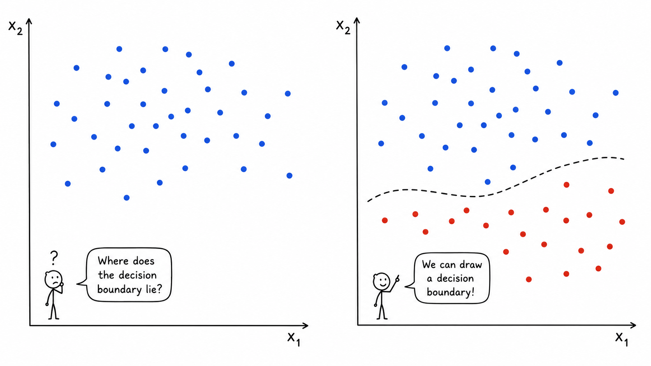

Slide 5
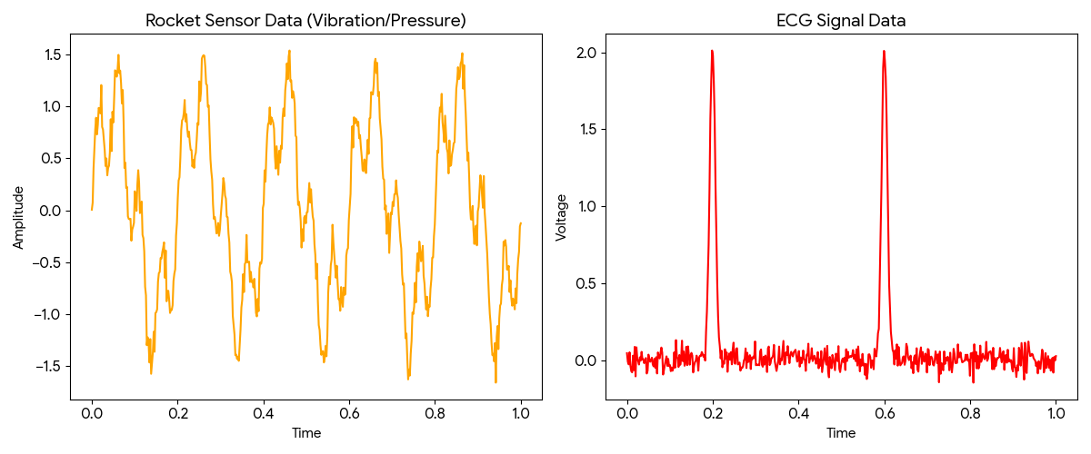
We use ECG data because it mimics the complex, rhythmic signals of a rocket engine.
It allows us to demonstrate how our model learns a Decision Boundary using synthetic faults in a controlled, data-rich environment before applying it to high-stakes aerospace hardware.

Slide 6
The Core Novelty – Three Pillars of the Framework
Novelty 1: Artificial Negative Samples: Instead of waiting for real faults, the framework generates its own "artificial" fault data from healthy signals.
Novelty 2: Supervised Deep Learning: It uses a Fusion Recurrent -CNN-Network (FRCNN) trained on a mix of real normal data and these generated abnormal samples.
Novelty 3: Multi-Sensor Fusion: The model uses LSTM to learn temporal sequence dependencies and CNN to extract local patterns from multiple sensor channels (vibration, pressure, etc.) simultaneously.
The Basic Logic:
Normal Data → Generate Abnormal Samples → Train Supervised Model → Learn the Boundary.

Slide 7
Model Architecture
Key Topics:
Negative Sample Generation
FRCNN Architecture
Working Mechanism
Advantages of the Framework

Slide 8
Basic Idea
Normal Engine Data
↓
Generate Artificial Abnormal Samples
↓
Train Supervised Deep Learning Model
↓
Learn Boundary Between Healthy & Faulty States

Slide 9
Negative Sample Generation
Core Idea:
Artificial abnormal samples are generated from healthy engine signals.
These generated samples are called: “Negative Samples”
Why Generate Negative Samples?
Real fault data are limited
Fault types are unknown and diverse
Supervised learning performs better than unsupervised learning
Generated samples help the model learn abnormal boundaries

Slide 10

Two Techniques Used
1. Vibration Sharpening (Time-Domain Modification)
Modifies vibration waveform characteristics
Simulates:
sudden peaks
stronger oscillations
abnormal vibration energy
Changes local rise/fall gradients of the signal

Slide 11
XG: Original healthy signal
Where XG​=[x1​,x2​,x3​,...,xN​]
XA: Generated abnormal signal
ηA: Scaling factor
λA: Mixing factor
γ: Sharpening factor

Slide 12
2. Resampling Superposition (Frequency-Domain Modification)
Resamples the original signal at a different frequency
Superimposes it with the original signal
Introduces:
new spectral peaks
frequency disturbances
abnormal frequency components

Slide 13
XG: Original healthy signal
XF: Generated abnormal signal
fs: Original sampling frequency
fs​ is the frequency at which the sensor originally collected data.
ft: Target sampling frequency
ft​ is an artificially chosen frequency used during resampling. It is selected randomly to imitate abnormal behaviour.
ηF: Scaling factor
λF: Mixing factor

Slide 14
Full Generation Flow
Healthy Sample ↓ Random Channel Selection ↓ Apply Vibration Sharpening ↓ Intermediate Abnormal Sample ↓ Random Channel Selection ↓ Apply Resampling Superposition ↓ Final Negative Sample

Slide 15
What are Random Transformations?
The abnormal transformations use randomly selected parameters during sample generation.
Parameters Randomly Changed:
In Vibration Sharpening
Scaling factor ηA​
Mixing factor λA
Sharpening factor γ
In Resampling Superposition
Target frequency ft​
Scaling factor ηF
Mixing factor λF
Due to these random samplings, different generated samples may contain: weak abnormalities, strong abnormalities, different spectral distortions, different vibration patterns

Slide 16
What Does “Infinite Negative Samples” Mean?
The framework can continuously generate new abnormal samples dynamically.
It does NOT store infinite data.
Instead: new samples are created every training epoch.
How Is This Achieved?
Through randomness in:
channel selection
sharpening factors
scaling factors
resampling frequencies
mixing ratios

Slide 17
Full Generation Flow
Healthy Sample ↓ Random Channel Selection ↓ Apply Vibration Sharpening ↓ Intermediate Abnormal Sample ↓ Random Channel Selection ↓ Apply Resampling Superposition ↓ Final Negative Sample

Slide 18
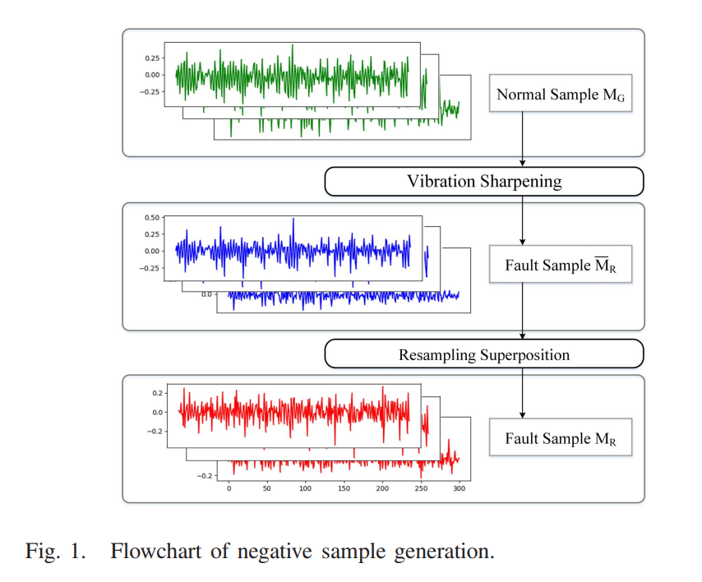
Flowchart of Negative Sample Generation

Slide 19
Key Insight:
The framework combines BOTH techniques sequentially:
first vibration sharpening
then resampling superposition
This creates:
diverse abnormalities
multi-channel disturbances
realistic anomaly boundaries

Slide 20
FRCNN Architecture

Slide 21
Input Multi-Channel Sensor Data
↓
LSTM Layer
↓
Convolutional Layers
↓
Max Pooling Layer
↓
Dense / Fully Connected Layer
↓
Output Classification

Slide 22
Step-by-Step Working
1. Input Layer
Receives multi-channel LRE sensor data
Includes vibration, pressure, temperature, and flow signals
Input shape contains temporal sequence information
2. LSTM Layer (Recurrent Layer)
Purpose: Capture temporal dependencies in engine signals.
Function
Learns sequential behavior over time
Stores previous time-step information
Detects temporal abnormal patterns

Slide 23
Why LSTM?
Engine faults evolve gradually over time, so temporal learning is critical.
3. Convolutional Layers (CNN)
Purpose: Extract important local features from sensor signals.
Function:
Detects local signal patterns
Learns abnormal feature representations
Extracts high-level features automatically
What CNN Captures:
waveform characteristics
vibration patterns
local anomalies
spectral signatures

Slide 24
4. Max Pooling Layer
Purpose: Reduce feature dimensionality.
Function
keeps dominant features
removes redundant information
improves computational efficiency
5. Dense / Fully Connected Layer
Purpose: Perform final classification.
Function
Maps extracted features into:
normal state
abnormal state

Slide 25
Why LSTM + CNN Together?
Component | Role
LSTM | Learns temporal sequence dependencies in engine signals
CNN | Extracts important local features and abnormal patterns
Fusion Mechanism | Integrates information from multiple sensor channels

Slide 26
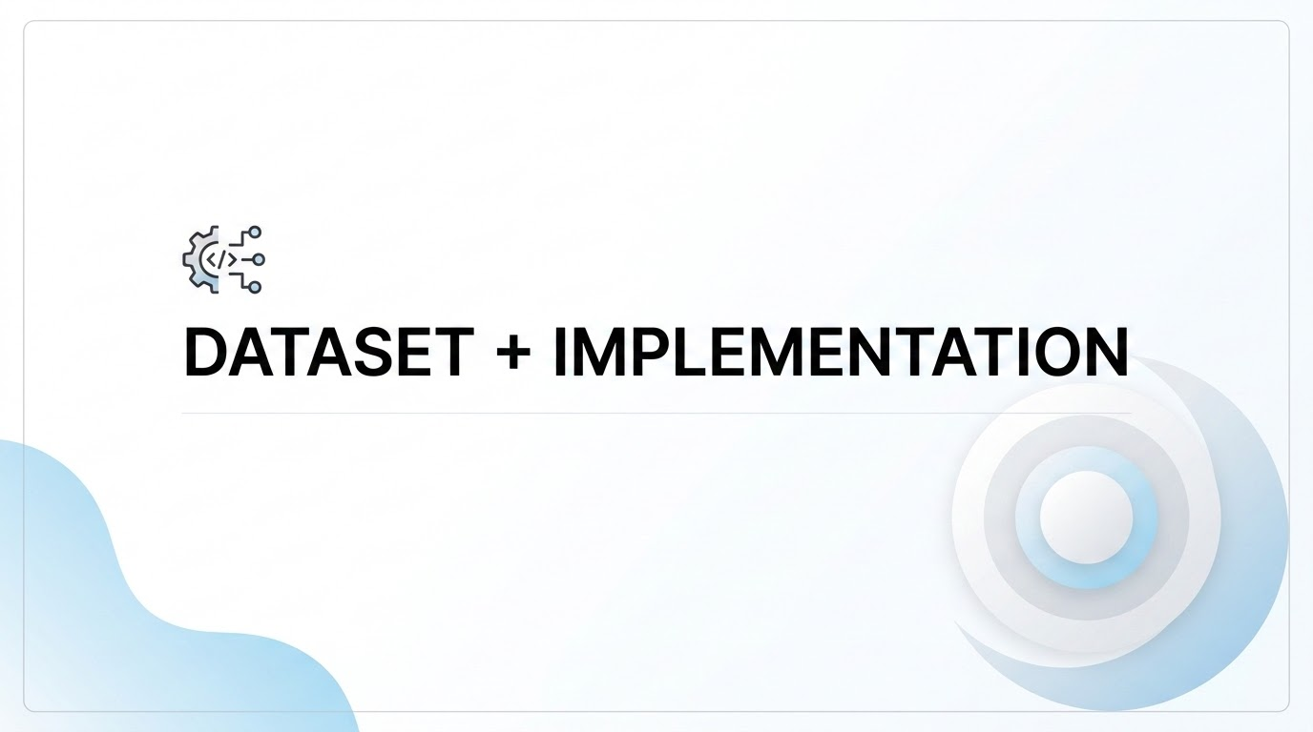

Slide 27
ECG DATASET
Records Used
NORMAL_RECORDS = ["100", "101", "103", "115", "117", "122", "123"]
ANOMALY_RECORDS = ["108", "200"]
Records 100-series: Predominantly normal sinus rhythm — used to train the model on normal patterns only.
Record 108: 96.1% normal beats, 3.9% arrhythmia — provides realistic test windows
Record 200: 67% normal beats, 33% arrhythmia — higher anomaly density for robust evaluation
Sampling rate: MIT-BIH uses 360 Hz (360 samples per second), hence window_size=720 = exactly 2 seconds of signal.
Conclusion : Both problems share the core challenge: time-series anomaly detection where fault samples are scarce or unavailable during training.
LRE | ECG
Multi-channel vibration/pressure signals | Single-lead ECG signal
Steady-state engine operation | Normal sinus rhythm segments
Fault = mechanical anomaly in engine | Fault = arrhythmia beat (PVC, etc.)
19 sensor channels | 1 channel (single-lead)
2048-point samples at unknown fs | 720-point windows at 360 Hz = 2 seconds
Fault data is rare | Arrhythmia beats are rare in most records
Static firing test data | 30-minute ECG recording data

Slide 28
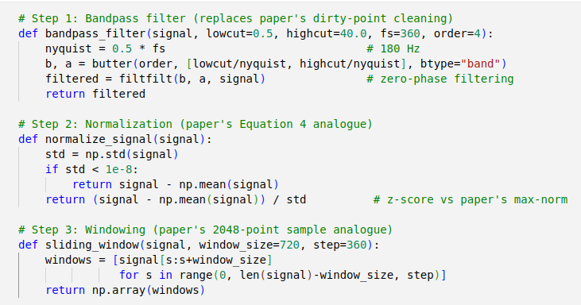

IMPLEMENTATION
Preprocessing Pipeline
Paper says (Section IV-A-2): "intercept the steady-state stage data, clean dirty points, then jointly normalize by channel maximum."
ECG equivalent of removing dirty points — removes baseline wander (<0.5 Hz) and high-frequency muscle noise (>40 Hz).
Paper uses max normalization.
Our code uses z-score normalization — making all channels/windows comparable in scale.
Paper: 2048-point non-overlapping samples, 100 per group. Our code: 720-point overlapping windows with 50% overlap (step=360). Overlap increases data volume and captures transitions between normal and anomalous regions.

Slide 29
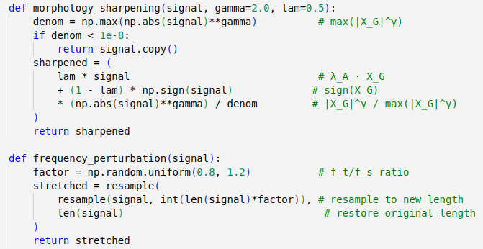

IMPLEMENTATION
Negative Sample Generation (Paper's Core Novelty)
Paper's Vibration Sharpening
Paper's Resampling Superposition

Slide 30
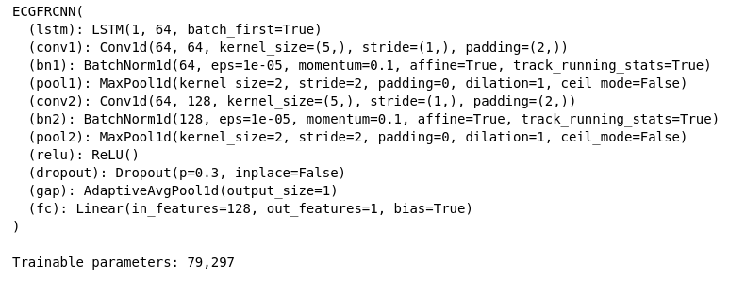
IMPLEMENTATION
Paper | Code Implementation
200 epochs | 10 epochs
Batch size 16 | Batch size 32
Adam optimizer | Adam optimizer
Learning rate 5×10⁻³ | Learning rate 1×10⁻³
No explicit grad clipping | clip_grad_norm_(max_norm=1.0) added
Checkpoint on accuracy | Checkpoint on val F1 (more meaningful)
Training Pipeline
Model Summary

Slide 31
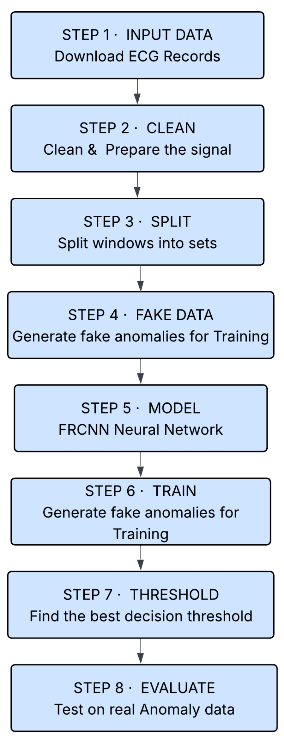
IMPLEMENTATION ARCHITECTURE
Libraries Used | Purpose
wfdb | Download and read PhysioNet ECG records + annotations
scipy.signal | Butterworth filter design + zero-phase filtering + resample
numpy | Array operations, FFT, statistics
torch / torch.nn | FRCNN model, training loop, loss, optimizer
sklearn | train_test_split, F1, confusion matrix, ROC/AUC
matplotlib / seaborn | All visualizations

Slide 32
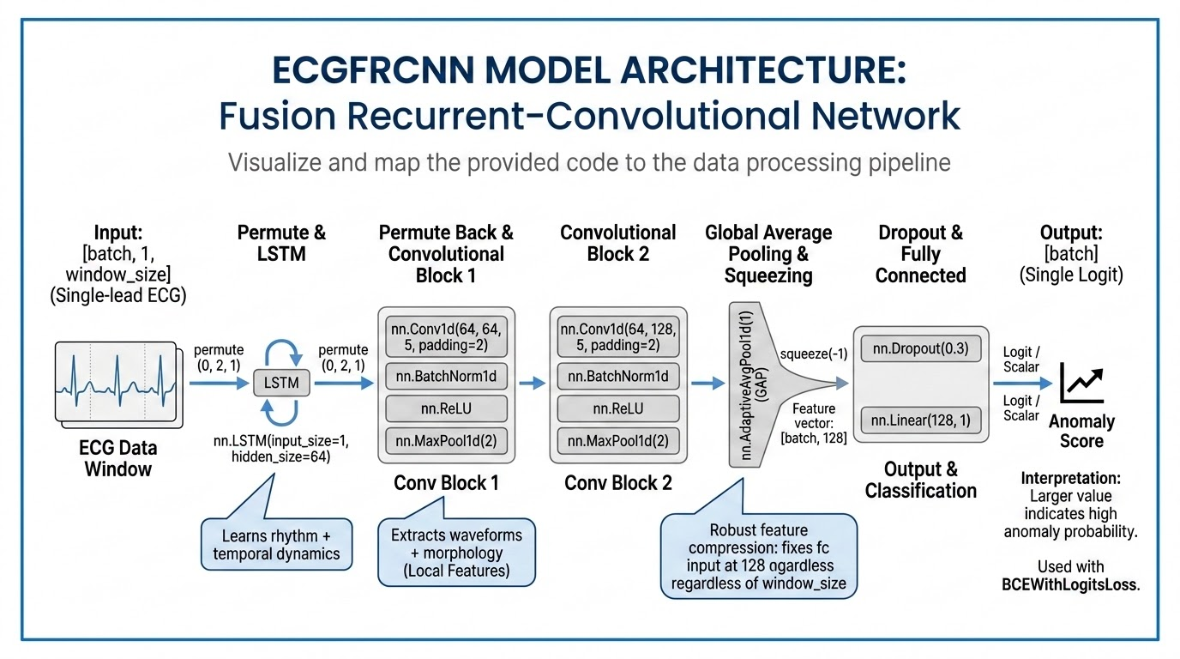

Slide 33
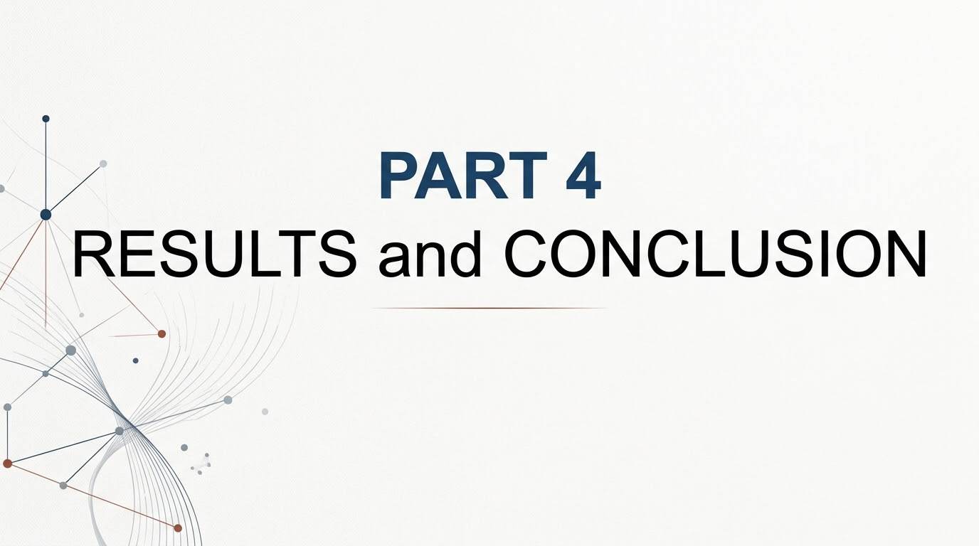

Slide 34

Solving the Core Problem
Overcoming the scarcity of real fault data in ECG analysis
"Very few real fault samples exist."
The Alternative Approach
fitness_center
Train
Utilize high-volume, readily available normal ECGs.
auto_awesome
Generate
Synthesize fake abnormal beats through data augmentation.
insights
Learn
Define the boundary between healthy and unhealthy states.

Slide 35
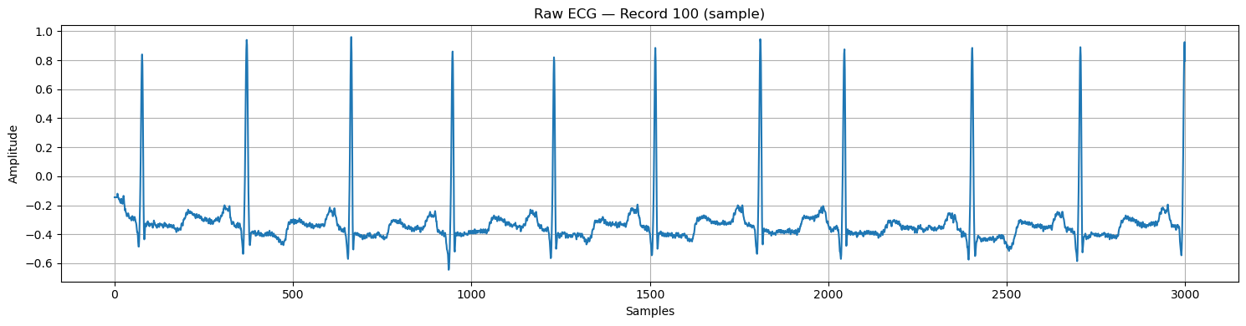
RAW ECG Data

Slide 36
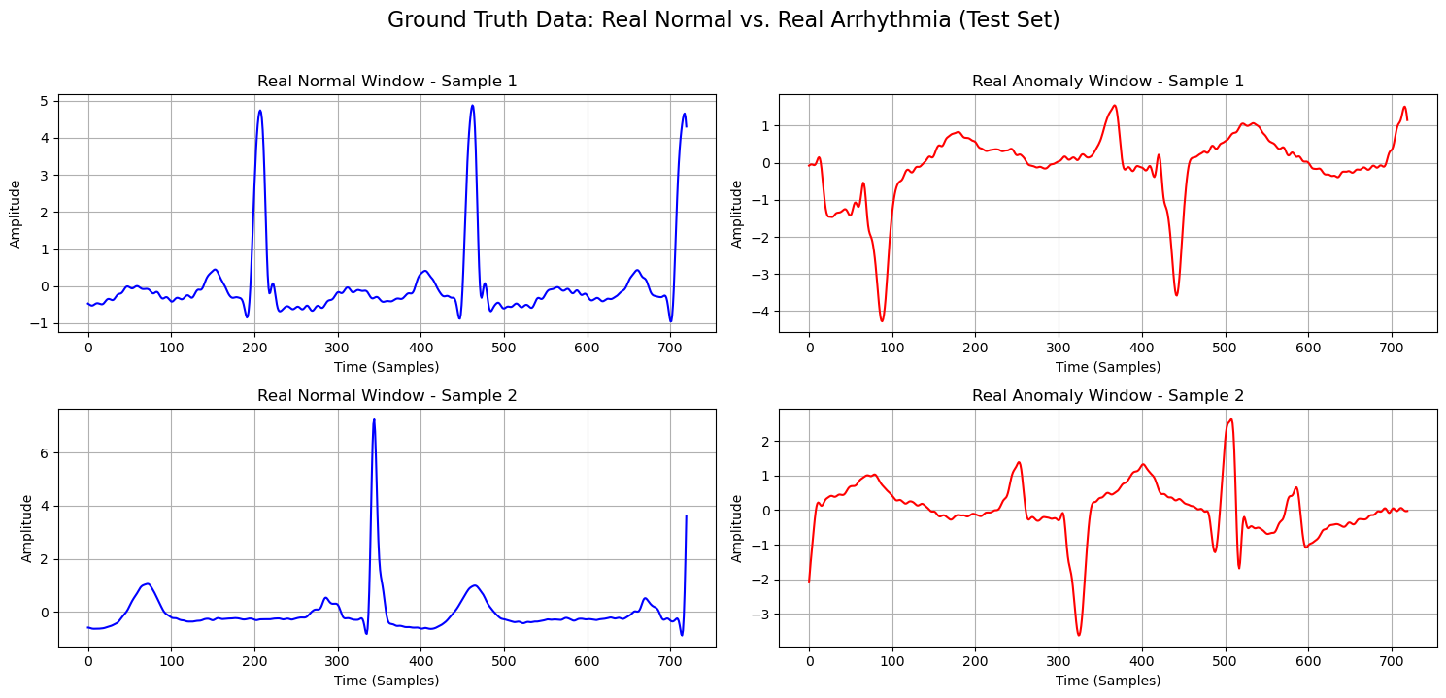

Slide 37
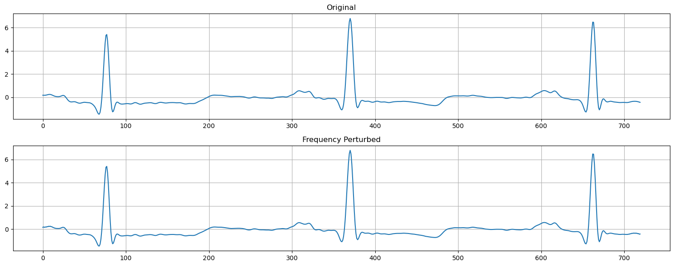
Frequency Perturbed Samples

Slide 38
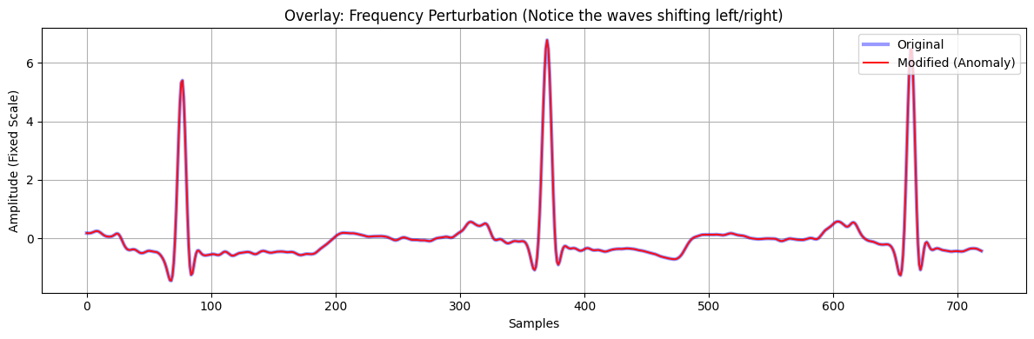

Slide 39
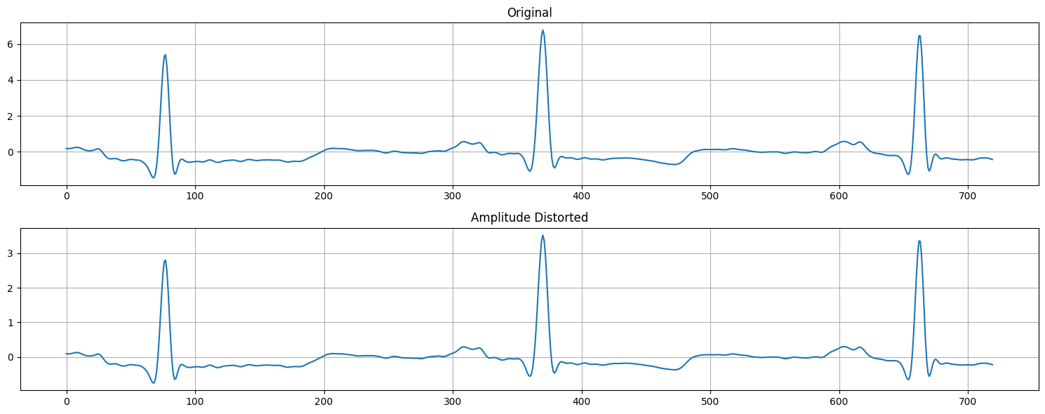
Amplitude Distorted Samples

Slide 40
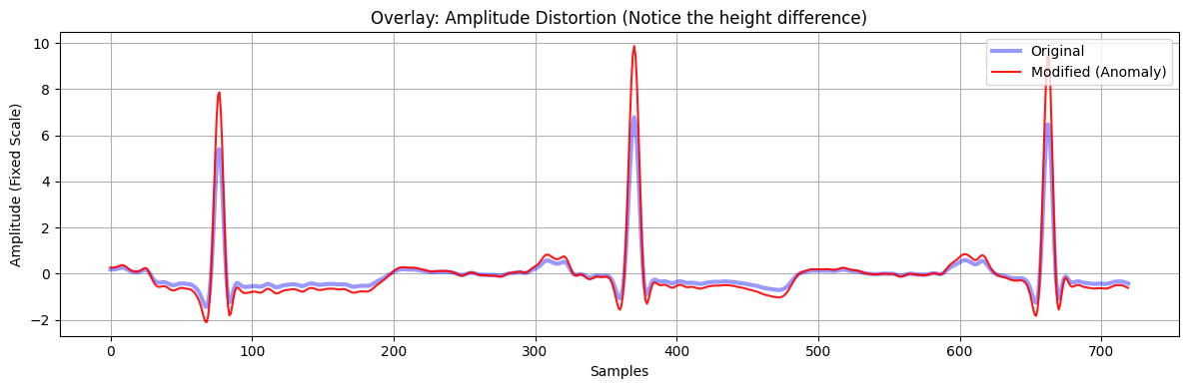

Slide 41
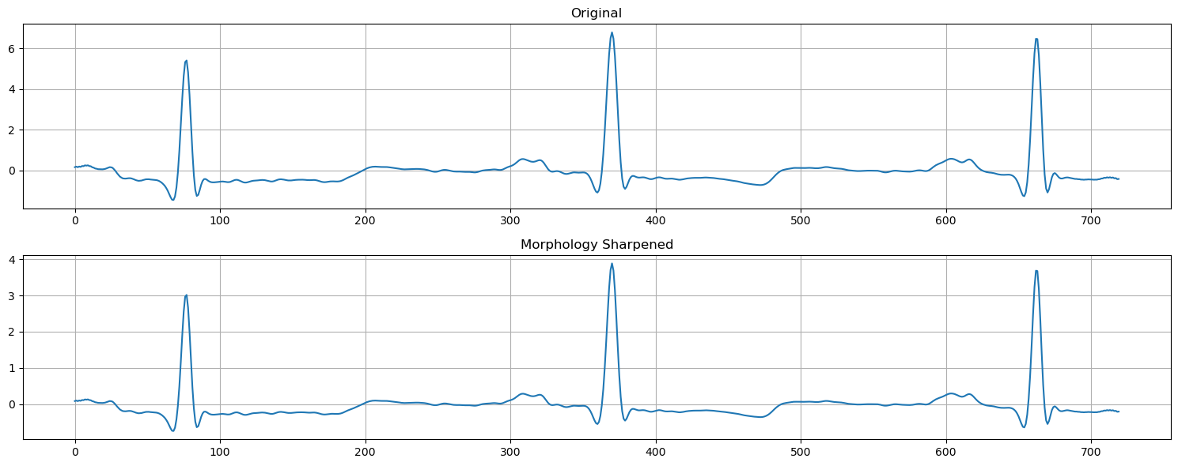

Slide 42
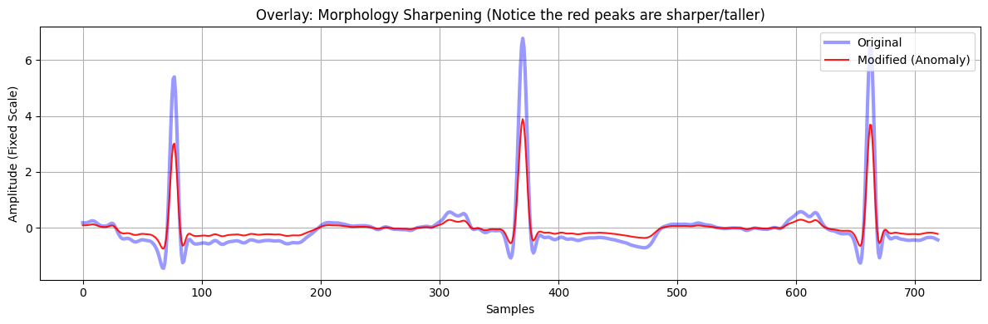

Slide 43
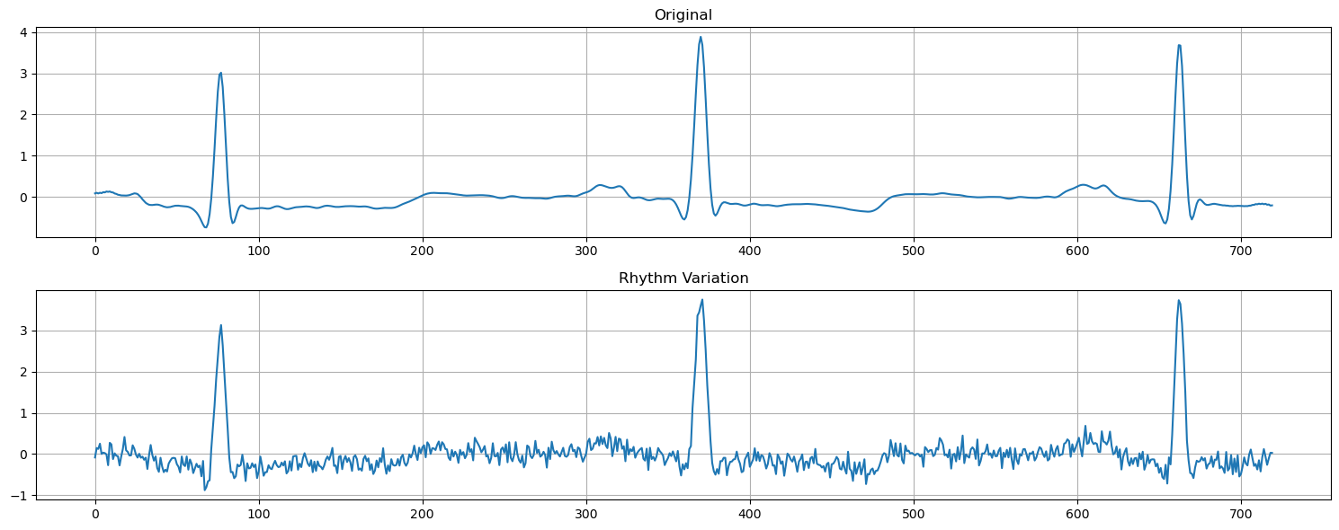
Training data for negative sample

Slide 44
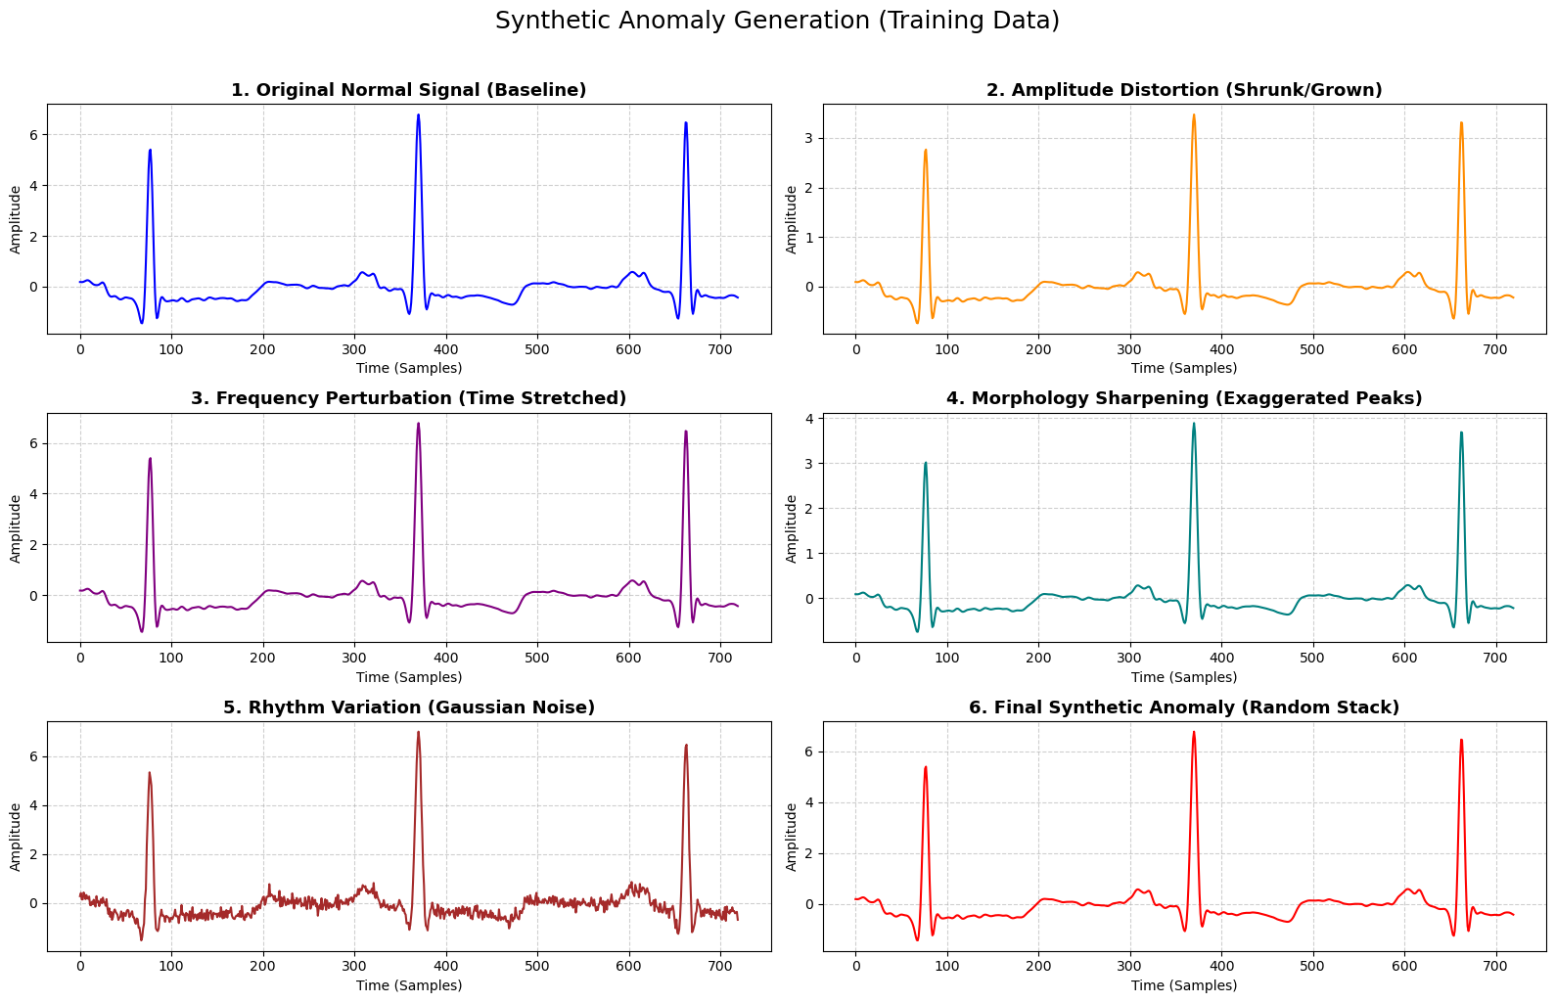

Slide 45
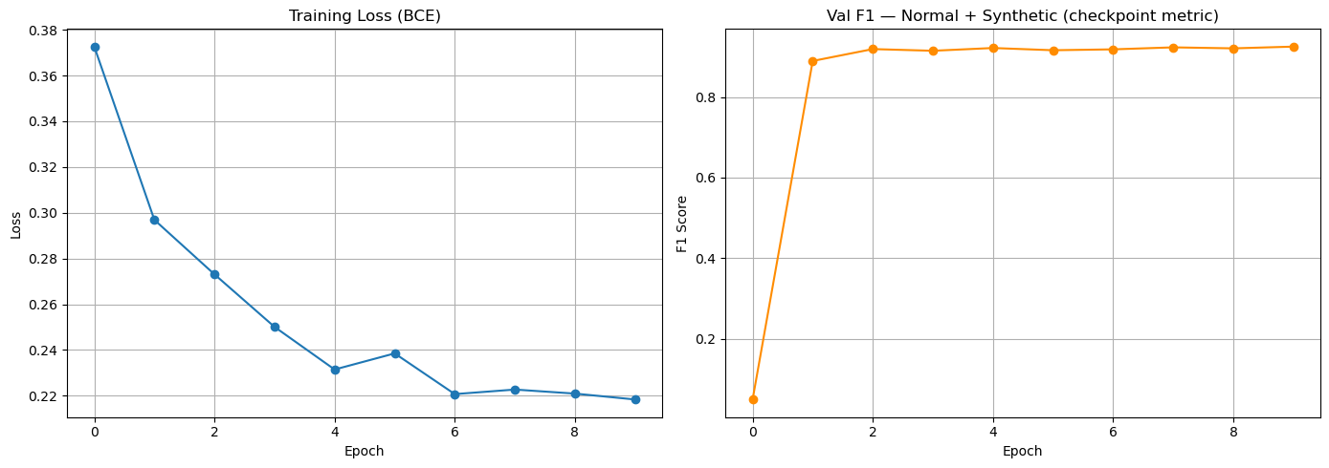
Training curves

Slide 46
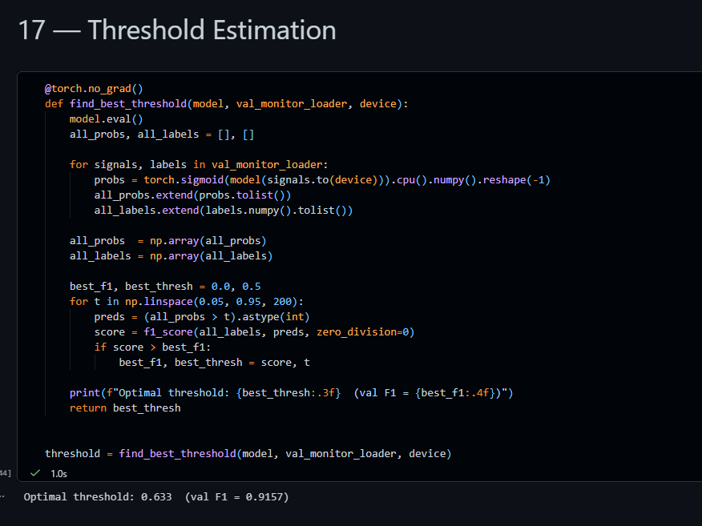

Slide 47
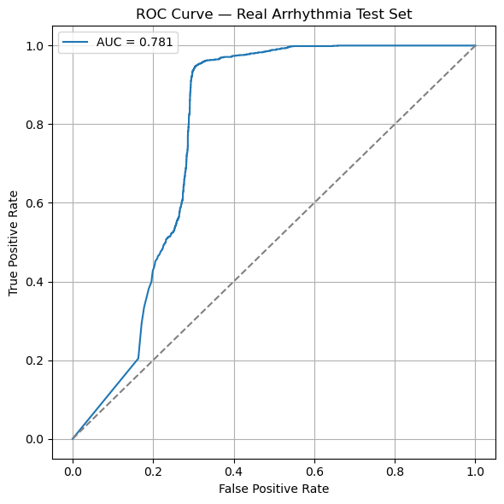

Slide 48
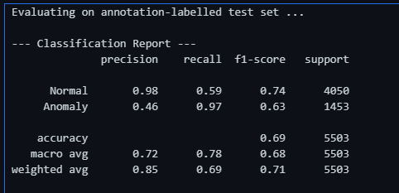
Anomalies
Recall: 0.97 (97%) — Out of all 1,453 real anomalies in the test set, the model successfully caught 97% of them It only missed a tiny fraction.It means if something is actually broken, the model will catch it.
Precision: 0.46 (46%) — However, because the model is trying so hard not to miss any anomalies, it is incredibly jumpy. When the alarm bell rings, there is only a 46% chance it’s a real anomaly.
The other 54% of the time, it’s just a false alarm.
Normal
Precision: 0.98 (98%) — When the model says a heartbeat is "Normal", we can trust it almost perfectly. It only says "Normal" when it is absolutely sure.
Recall: 0.59 (59%) — Out of all 4,050 perfectly normal heartbeats, the model only confidently labeled 59% of them as Normal. What happened to the other 41%? The model got scared by them and threw them into the "Anomaly" bucket (which caused the massive amount of false alarms we saw in Anomalies).

Slide 49
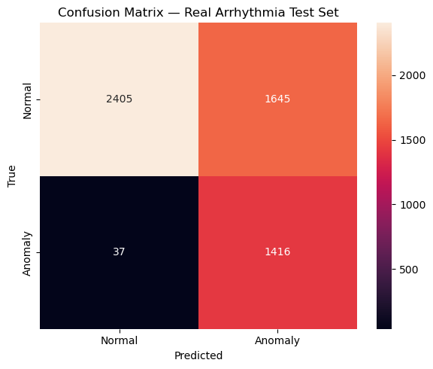
More misclassifications of True Normal as anomaly in order to not miss true anomalies

Slide 50
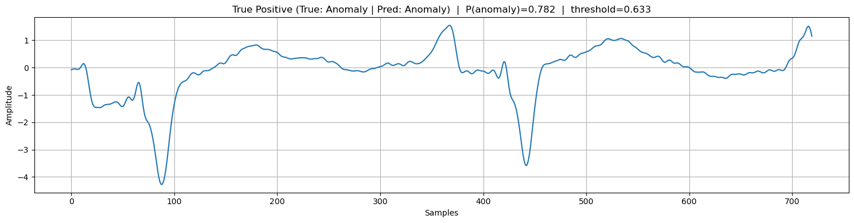
True Positive - Anomalous ECG

Slide 51
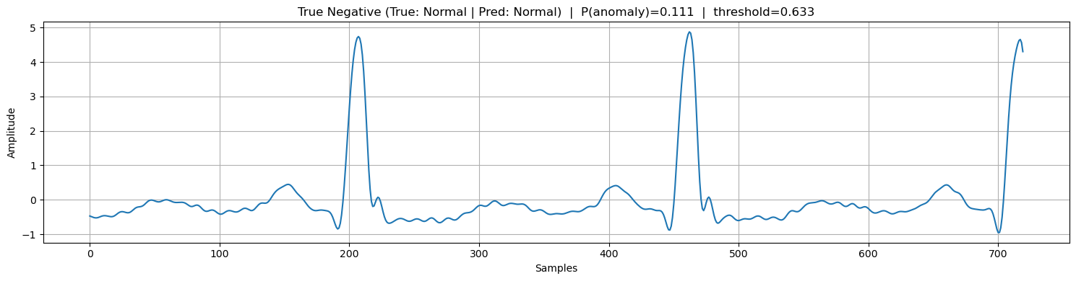
True Negative - Normal ECG

Slide 52
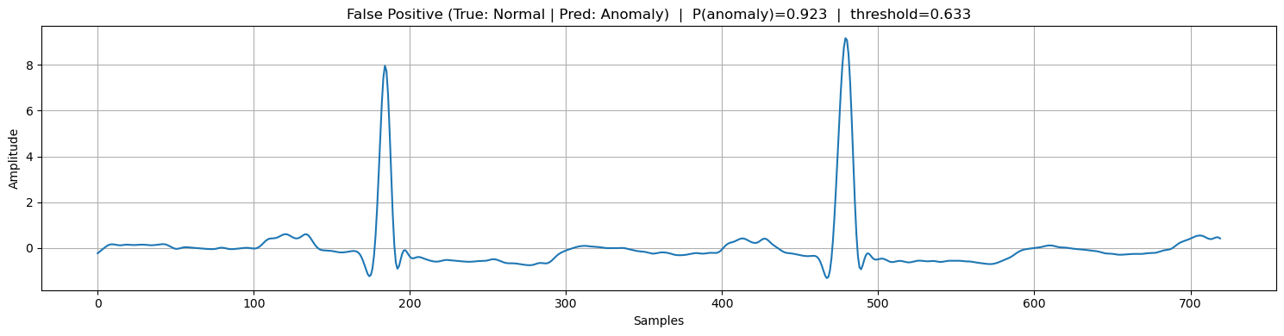
False Positive - Falsely predicted as Anomaly - False Alarms

Slide 53
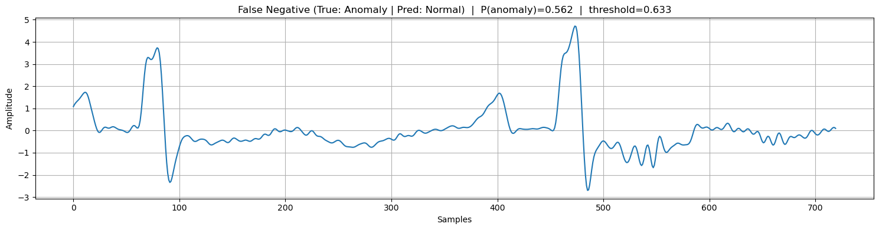
False Negative - Falsely predicted as normal - Misses by model
We want this to be minimized.
False Alarm (False Positive): Annoying, but safe.
Missed Anomaly (False Negative): The rocket explodes, or the patient dies.

Slide 54
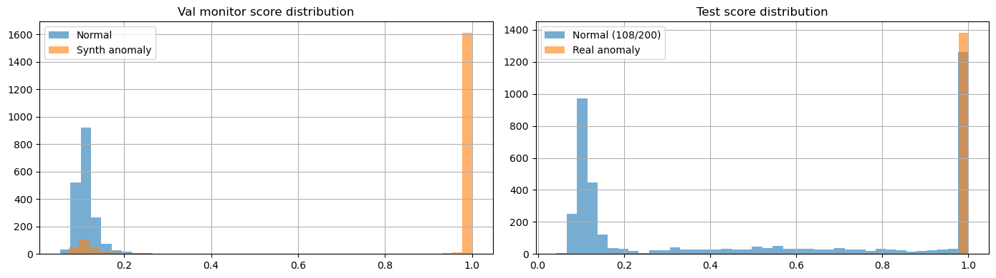
If you look at the left graph, you can see our model perfectly separated the normal data from our fake, synthetic anomalies. However, the right graph is the real test. Even though the model was never trained on real disease data, it still successfully pushed the vast majority of real arrhythmias to the right side of the graph, proving our synthetic training method actually works for real-world anomalies!

Slide 55
That’s it!
THANK YOU

