Slide 1
Why Hyperbola Appears in B-scan
Surface ──────────────────── ● Buried object
Now the antenna moves:
x1 → x2 → x3 → x4 → x5
At each position:
wave travels to object
reflects back
returns to antenna

Slide 2
Important Physical Idea
The travel distance changes with antenna position.
At center position
Antenna directly above object
Distance is shortest. So: minimum travel time
Away from center
Antenna moves sideways
Distance increases. So: travel time increases
When plotted:
______/____\______
Hyperbola forms.

Slide 3
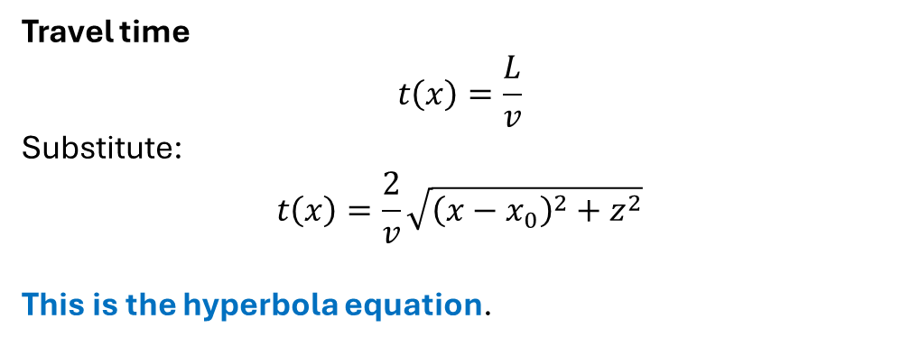
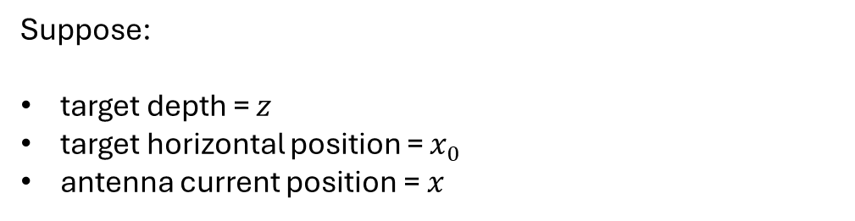
Geometry Behind the Formula
Suppose:
target depth = $z$
target horizontal position = $x_{0}$
antenna current position = $x$
Parameter | Meaning
(x) | antenna position
(x_0) | target position
(z) | target depth
(v) | wave velocity
(t(x)) | reflection arrival time
Travel time
$$t\left(x\right)=\frac{L}{v}$$
Substitute:
$$t\left(x\right)=\frac{2}{v}\sqrt{{\left(x−x_{0}\right)}^{2}+z^{2}}$$
This is the hyperbola equation.

Slide 4


Physical Interpretation
At center
When:
$$x=x_{0}$$
Then:
$$t_{min}=\frac{2z}{v}$$
This is the top of hyperbola.
Away from center
$${\left(x−x_{0}\right)}^{2}$$
increases.
Therefore:
travel time increases
hyperbola curves downward

Slide 5
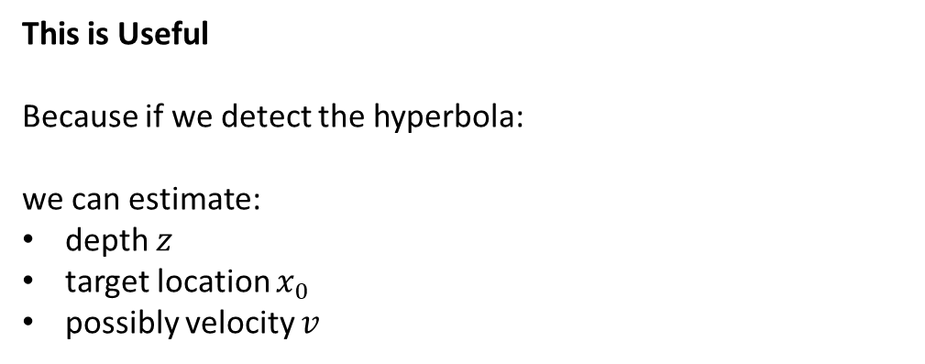
This is Useful
Because if we detect the hyperbola:
we can estimate:
depth $z$
target location $x_{0}$
possibly velocity $v$
Known B-scan
↓
Fit hyperbola
↓
Estimate target depth

Slide 6
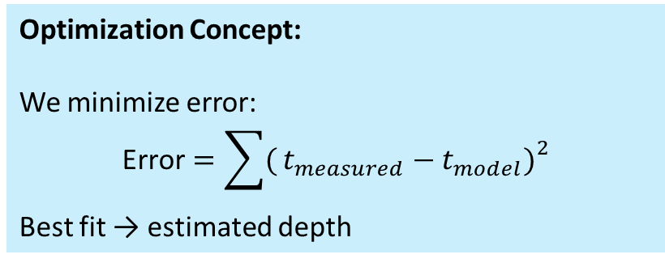
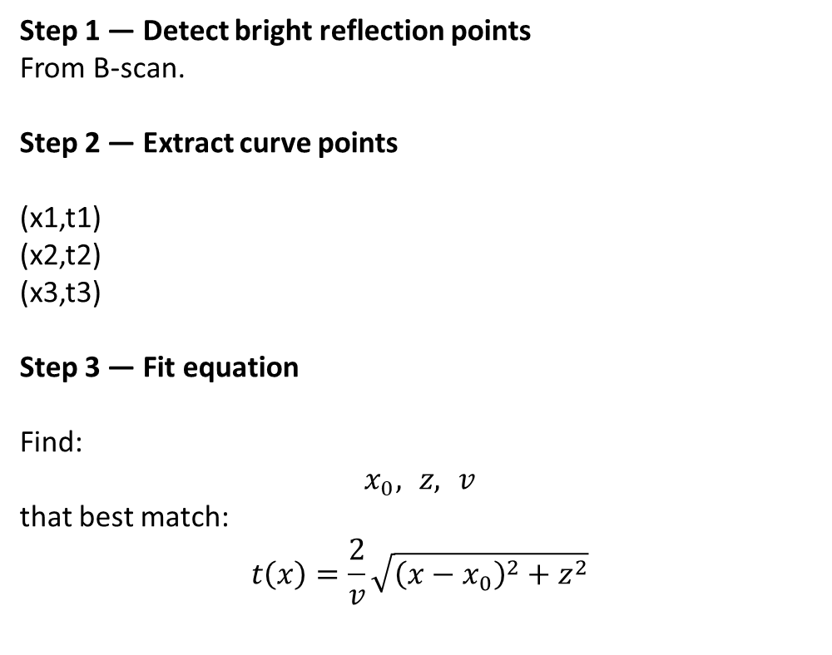
How Hyperbola Fitting Works
Step 1 — Detect bright reflection points
From B-scan.
Step 2 — Extract curve points
(x1,t1) (x2,t2) (x3,t3)
Step 3 — Fit equation
Find:
$$x_{0}, z, v$$
that best match:
$$t\left(x\right)=\frac{2}{v}\sqrt{{\left(x−x_{0}\right)}^{2}+z^{2}}$$
Optimization Concept:
We minimize error:
$$\text{Error}=\sum{(}\left.t_{measured}−t_{model}{\left.)\right.}^{2}\right.$$
Best fit → estimated depth

Slide 7
Real Physical Meaning
The hyperbola contains hidden information about:
Object depth
Propagation velocity
Dielectric properties
“The hyperbolic response in the B-scan arises because the propagation distance between the antenna and buried object changes with antenna position. By fitting the analytical hyperbola equation to the measured B-scan response, the target depth and position can be estimated

