Slide 1
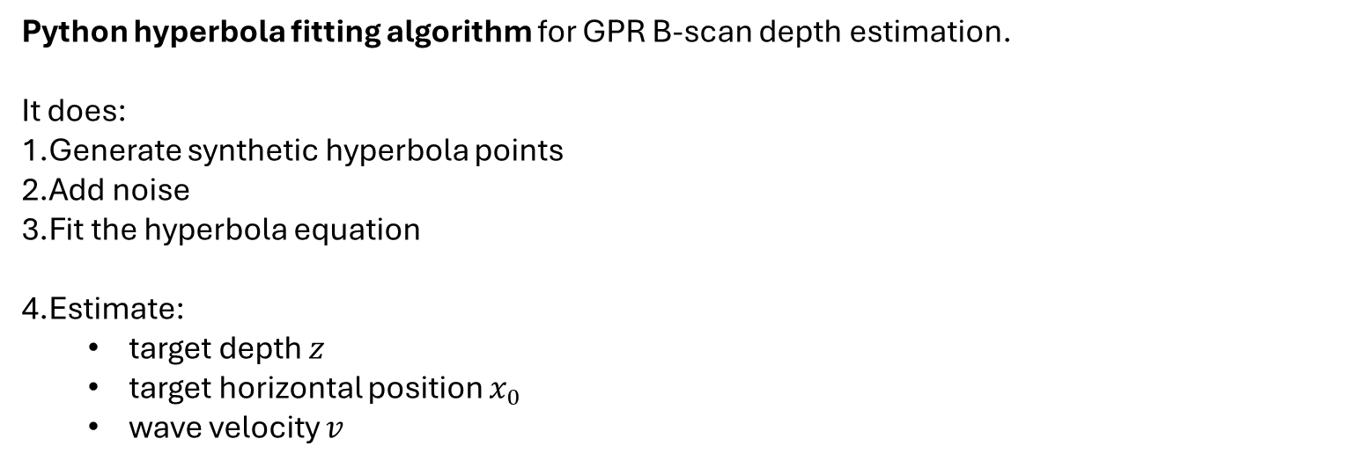
Python hyperbola fitting algorithm
Python hyperbola fitting algorithm for GPR B-scan depth estimation.
It does:
Generate synthetic hyperbola points
Add noise
Fit the hyperbola equation
Estimate:
target depth $z$
target horizontal position $x_{0}$
wave velocity $v$

Slide 2
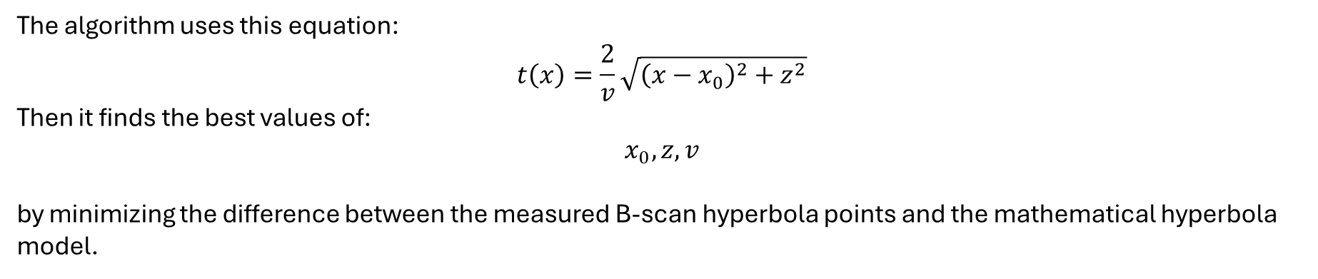
The algorithm uses this equation:
$$t\left(x\right)=\frac{2}{v}\sqrt{{\left(x−x_{0}\right)}^{2}+z^{2}}$$
Then it finds the best values of:
$$x_{0}, z, v$$
by minimizing the difference between the measured B-scan hyperbola points and the mathematical hyperbola model.
“The algorithm fits the theoretical GPR hyperbola equation to the detected reflection curve in the B-scan. From the best-fitting curve, it estimates the target depth, lateral position, and wave velocity.”
This is the key upgrade from forward simulation to inverse depth estimation.

Slide 3
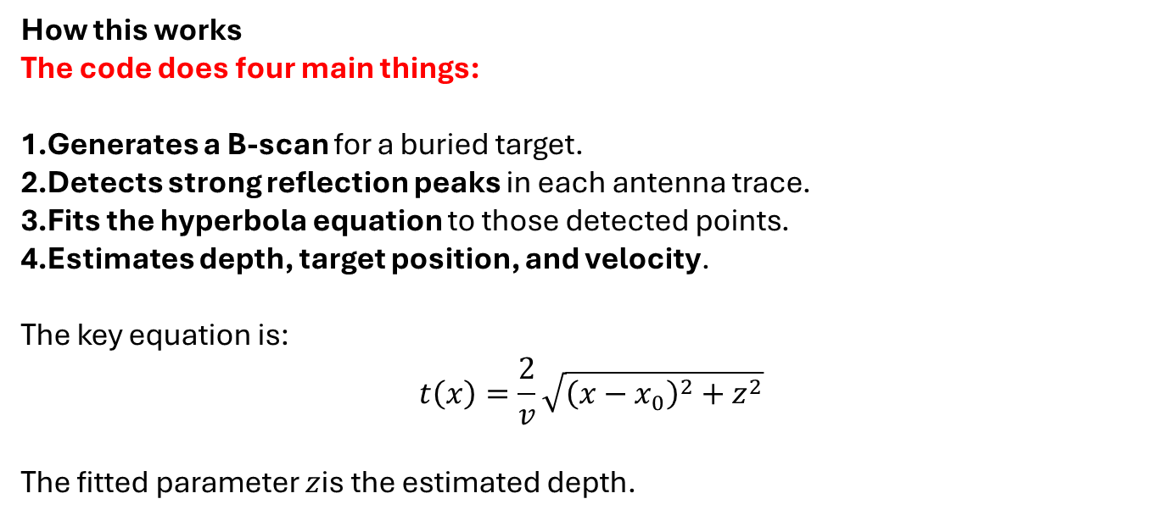
Automatic depth estimation code
Automatic depth estimation code. It generates a synthetic B-scan, automatically detects the hyperbola peak points, fits the hyperbola, and estimates depth
How this works
The code does four main things:
Generates a B-scan for a buried target.
Detects strong reflection peaks in each antenna trace.
Fits the hyperbola equation to those detected points.
Estimates depth, target position, and velocity.
The key equation is:
$$t\left(x\right)=\frac{2}{v}\sqrt{{\left(x−x_{0}\right)}^{2}+z^{2}}$$
The fitted parameter $z$is the estimated depth.

Slide 4
B-scan interpretation methodology
The objective of the B-scan interpretation stage is to extract meaningful subsurface information from the generated or measured B-scan image.
Overall Workflow
Specifically, the methodology aims to estimate:
buried object depth
buried object lateral position
propagation velocity
potential layer boundaries
from the observed hyperbolic signatures.
B-Scan Image
↓
Preprocessing
↓
Hyperbola Detection
↓
Feature Extraction
↓
Hyperbola Fitting
↓
Depth Estimation
↓
Target Localization

