Slide 1
Book Your ShareTrip

Slide 2
Our Group Member
011191022 Mohammad Iqbal Hossain Emon
011201056 Md. Mushfikur Talukdar
011191215 Sadia Hassan
011191016 Sanjida Yesmin Ritu
011181081 Tishme Hasan
011192048 SK. Aftab Ali Snigdho

Slide 3

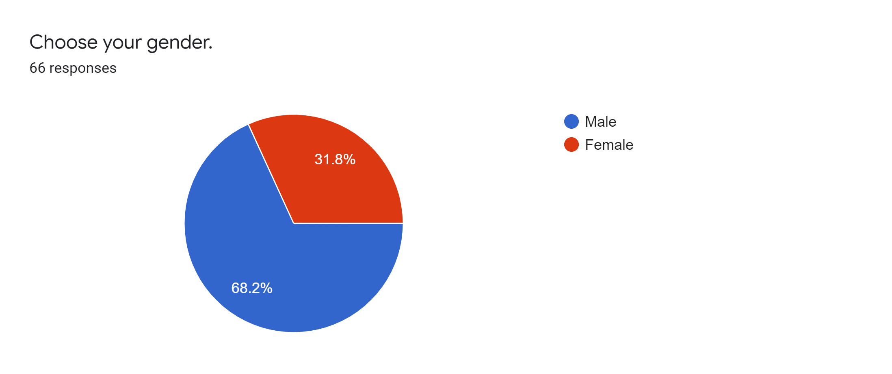
Gender

Slide 4
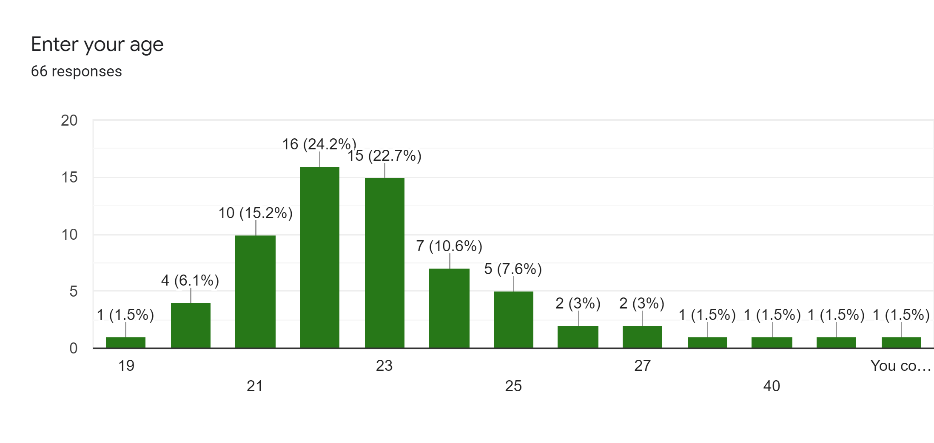
Age

Slide 5
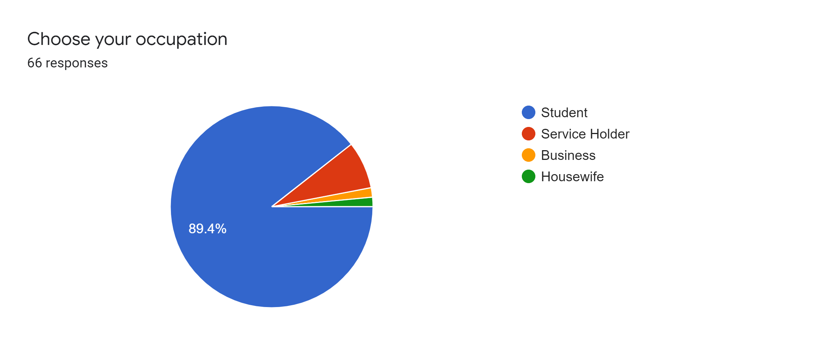
Occupation

Slide 6
Discussion on Survey

Slide 7
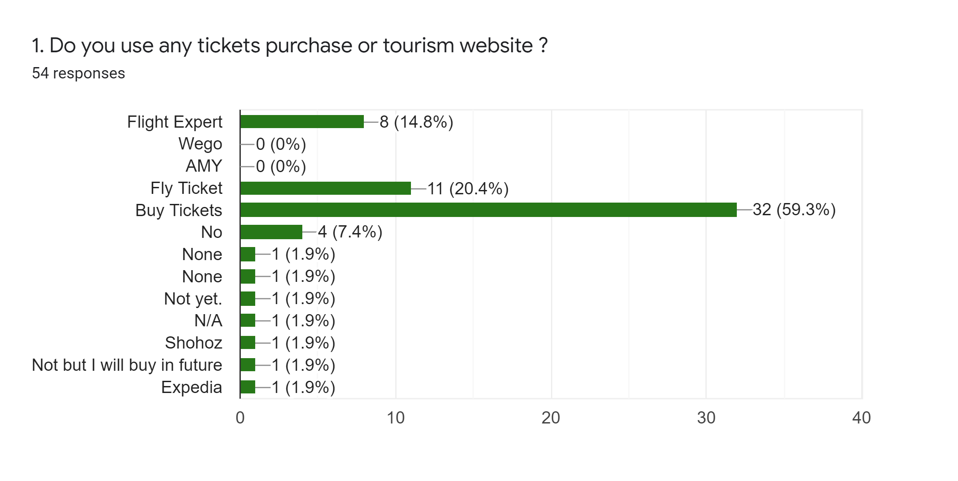
Survey Analysis (1)
Question | Decision
 | We will follow Fly Ticket and Buy Tickets System. Because people are convenient to those system.

Slide 8
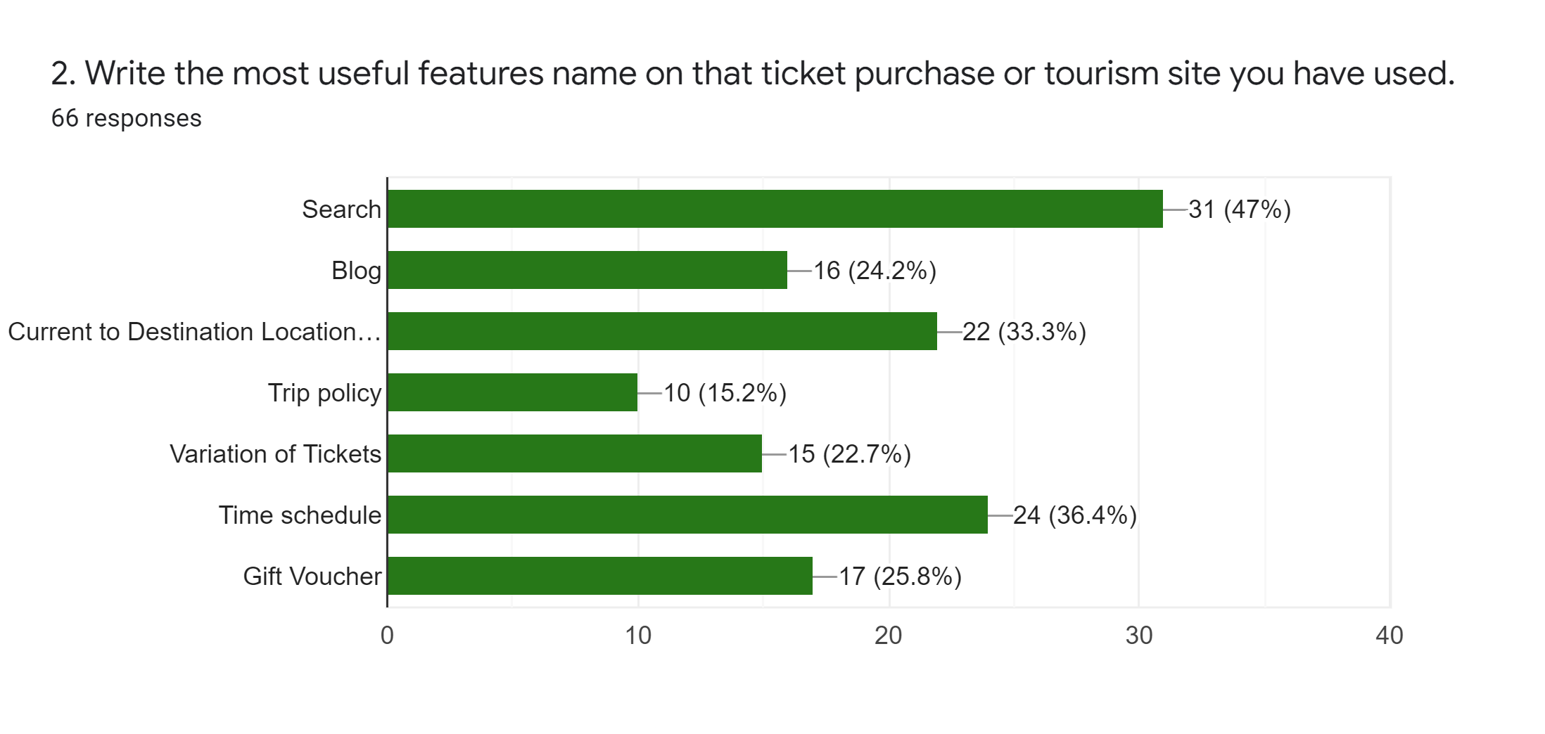
Survey Analysis (2)
Question | Decision
 | From the Survey, most popular features are Search, Current to Destination Location, Time Schedule and Blog. So we will implement those features in our system.

Slide 9
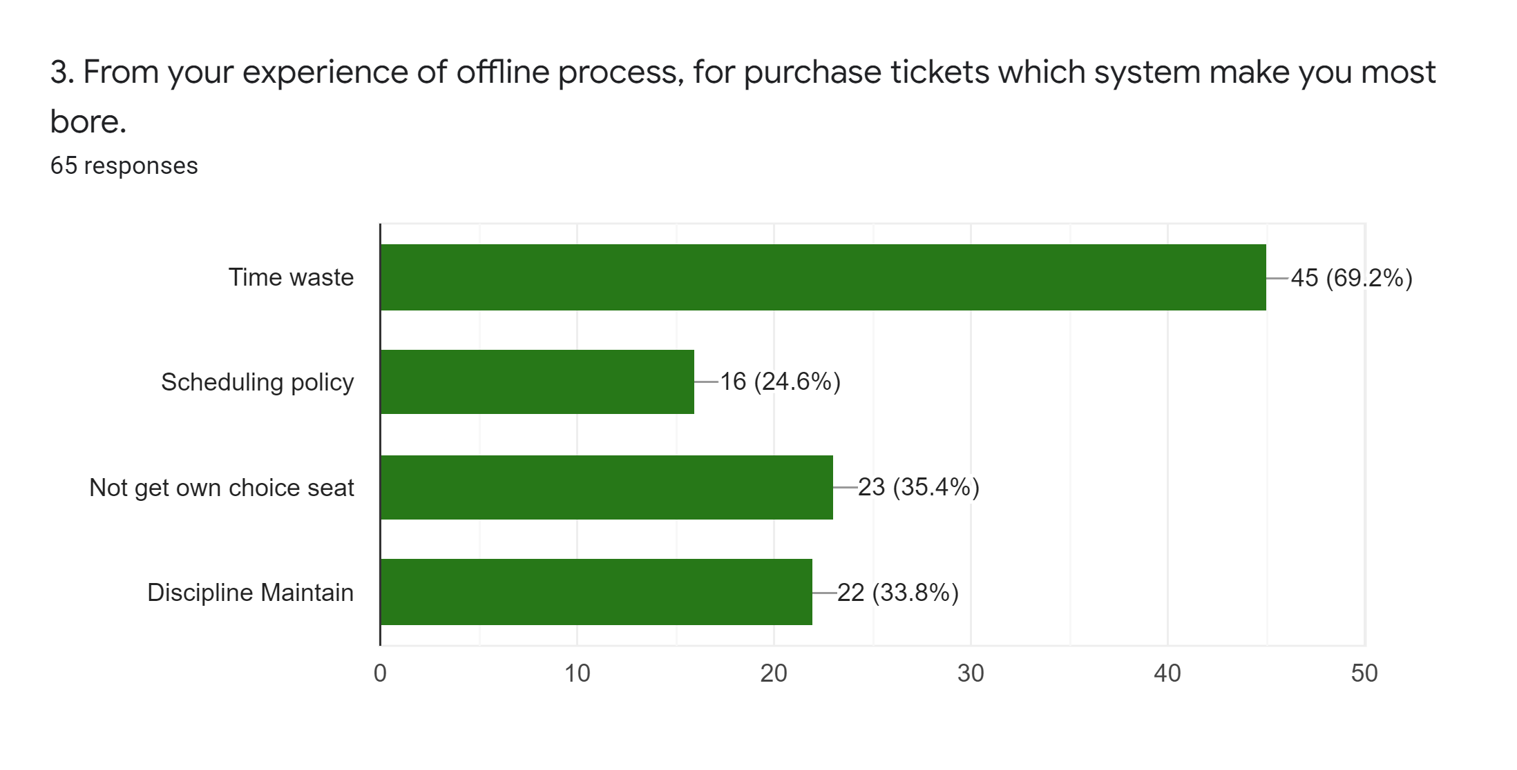
Survey Analysis (3)
Question | Decision
 | Our system will have tight schedule and proper seat plan. So that no one will suffer.

Slide 10
Survey Analysis (4)
Question | Decision
4. Mention a process or features which maybe not exist in online tickets selling sites but you think that every tickets selling site should improve or add those things. | People gives many kinds of idea but we will decide that implement this two unique and helpful feature for our system. Inner view of individual sits and transport vehicle Live location mapping
Return policy
Inner view of individual sits and transport vehicle
Live location mapping
Availability of foods during journey
Reserve some seats for physically challenged people
Gift voucher

Slide 11
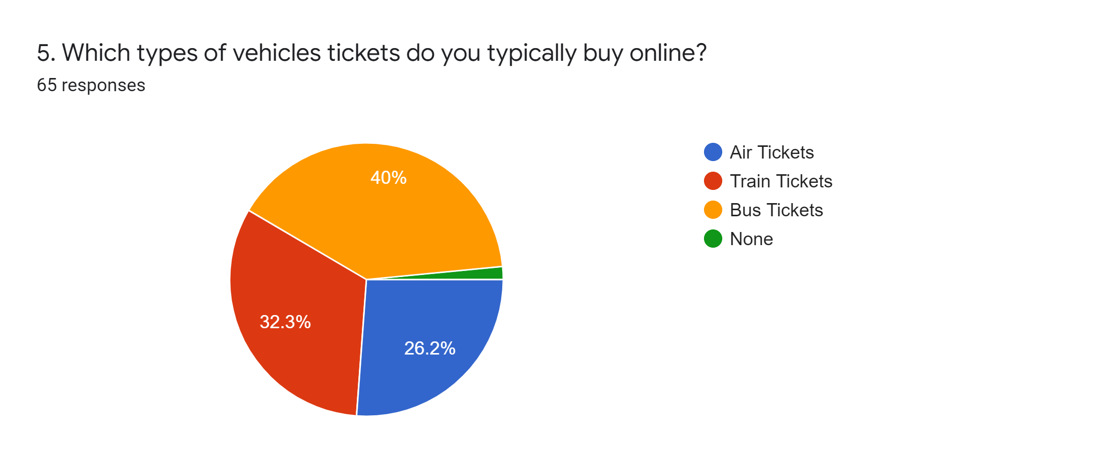
Survey Analysis (5)
Question | Decision
 | We will provide all types of ticket equivalently.

Slide 12
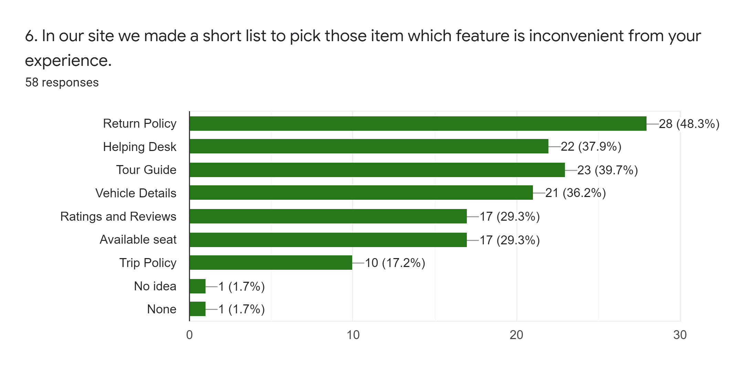
Survey Analysis (6)
Question | Decision
 | We think, people don’t understand our purpose of this question.So we can’t make any decision with this question.

Slide 13
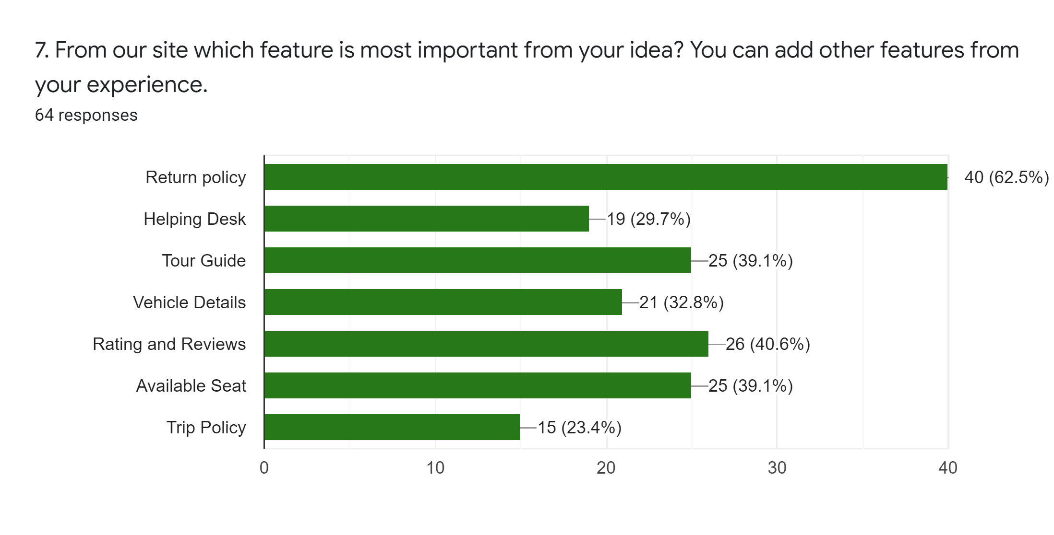
Survey Analysis (7)
Question | Decision
 | We must have return policy. Besides we will be careful to ratings and reviews and have experienced tour guide.

Slide 14
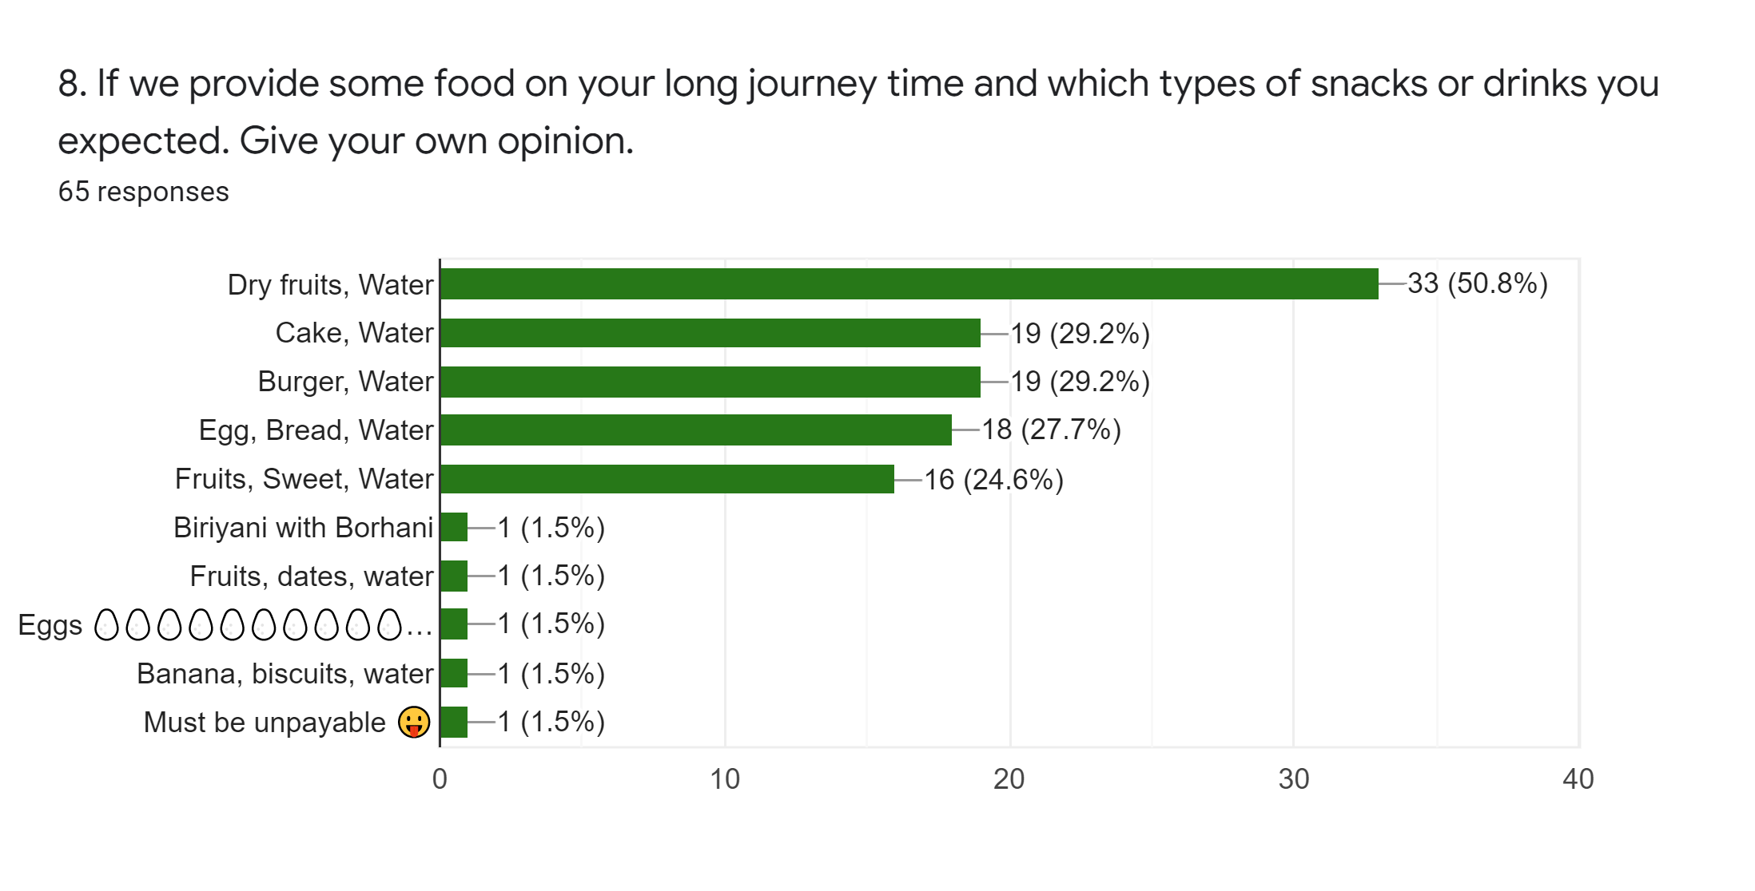
Survey Analysis (8)
Question | Decision
 | We will provide : Dry fruits and water Cake and water Burger and water Egg, bread and water Fruits, sweet and water

Slide 15
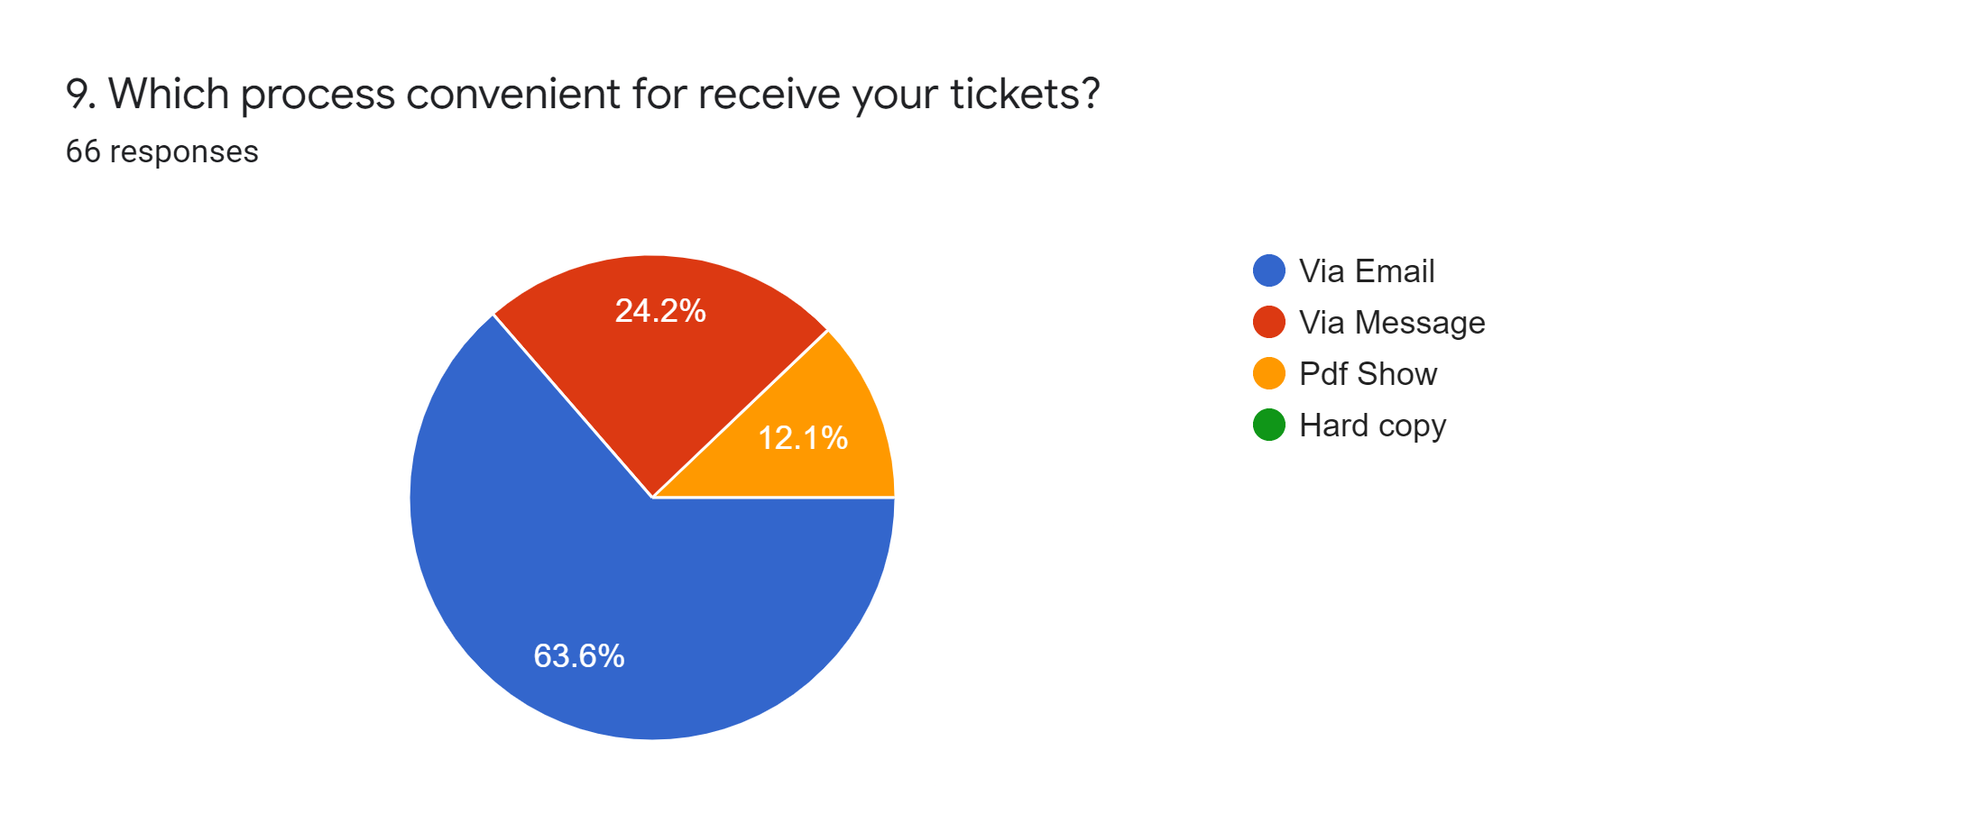
Survey Analysis (9)
Question | Decision
 | We will send tickets via email.

Slide 16
Survey Analysis (10)
Question | Decision
10. You can give any kind of feedback/advice/tips for our site. Be well mannered Provide good food & wifi connection for the passengers Please make yours services as fast as you can. Make sure that physically challenged people won't be ignored.. Your site Should have users friendly. If you add your site or apps bilingual system that is better for our country I will travel first and then I will let you know. | We will do our best to have good manners, will provide good food, will helpful to physically challenged people and have Bangla and English both to our site.

Slide 17
Features Selected
From Survey Analysis:
From Benchmark Table:
Search
Ticket sent via Email
Live location mapping
Supply Food
Rating and Review
Time schedule
Current to Destination Location
Inner view of individual sits and transport vehicle
Availability Tickets
Variation of Tickets
Return policy
Tour Guide
Payment
Blog
Helping Desk

Slide 18


Slide 19
SWOT Analysis
Strength Have ticket return policy Have experienced tour guide Have multiple payment option Availability of tickets | Weakness Delay in reply Limited time to implement Limited Resources
Opportunity We will make it International platform Others countries people can enjoy our tour Have partnership with big companies We will develop an mobile app | Threats Environmental issue Highly competitive Any kind of pandemic
Strategy We will advertise our system in different site. Make it more visible to people so that people can know about us. Provide different type offer to attract people.

Slide 20
Thank you

