Slide 1

QuickCash
Welcome to
Online survey system DBMS ERD presentation

Slide 2

Why this project is important?
Earning source
Base decisions on objective information
Compare results
Evoke discussion

Slide 3
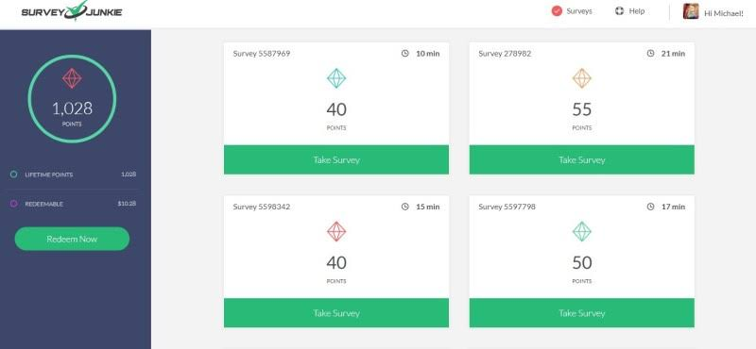
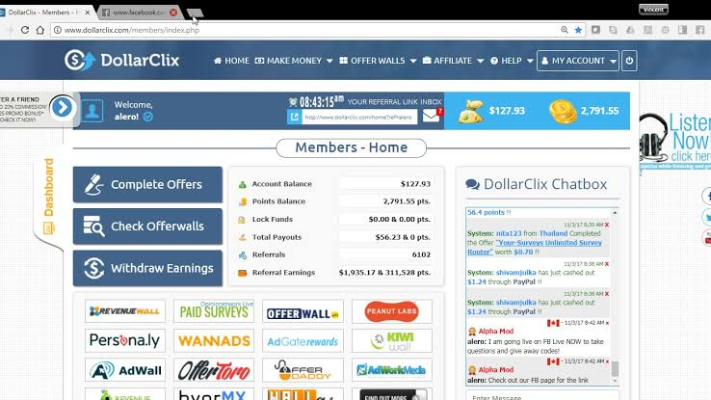
Existing Websites
1. Survey Junkie
2.DollarClix
Features:
Features:
Beginner friendly
Minimum payout at $10
Accepts PayPal, Payoneer
Redeemable Gift cards
Lots of Subsites to earn
Minimum payout at $1
Accepts PayPal
Redeemable Gift cards

Slide 4

Project’s Features
★ Main Features:
Targeted audience
Age
Gender
Social Status
Nationality
Download Survey History
★ Other Features:
Pay Per Audience
Sort Q/A
MCQ
Authentic Respondent (verified by NID)
Reviews

Slide 5
Flow Diagram
Profile
Do survey
History
Log out
Recharge
Download
Log In
Researcher
Home
Respondent
Sign up
Withdraw
Profile
Surveys for you
History
Log out

Slide 6

Technology Used
HTML
CSS
PHP
MySQL

Slide 7
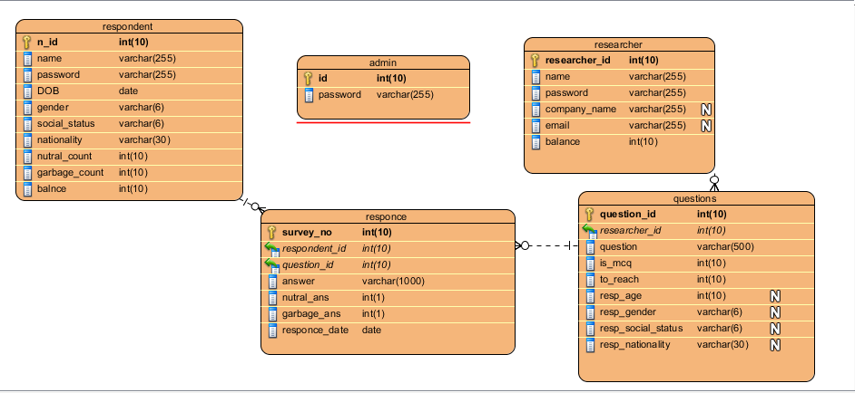
Project ERD

Slide 8

Future Plans
Paid access to old surveys by others
Advertising

