Slide 1
BUDT 704: Data Processing and Analysis in Python
Team BUDT704_0506_01:
Runtime Terror
2021.12.9
Nigam Shah
Hsin Chen(Vicky)
Antara Kumar
Yu-Shiang Liao(Shawn)

Slide 2
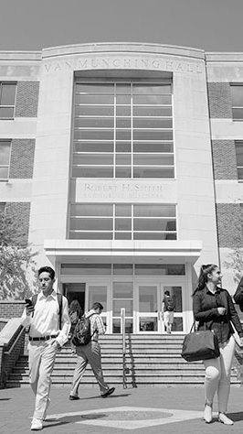
01
Introduction
Agenda
02
Methods
03
Findings
04
Recommendations
05
Future Work
https://www.rhsmith.umd.edu/sites/default/files/front/undergraduate.jpg

Slide 3
Introduction
Mission Statement:
Runtime Terror is an Analytical firm providing valuable insights to the UMD Alumni Association in order to streamline their future events regarding increasing the number of first time attendees and major gift prospects.
Mission Objective:
There are two primary objectives to achieve:
To attract more First Time Attendees to attend the events
To attract more Major Gift Prospects to attend the events

Slide 4
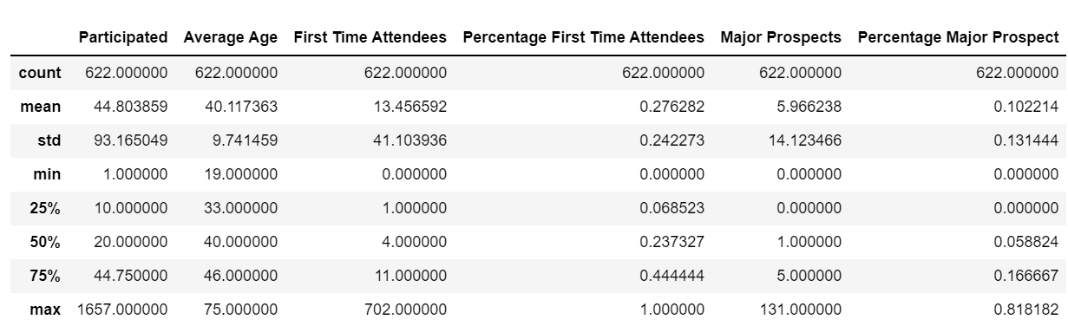
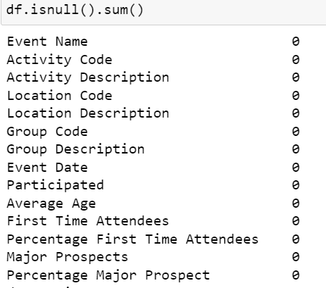
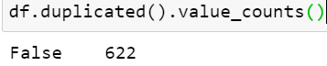
Exploratory Data Analysis
Overall Statistics of each column
Checking for Null values in each column
Checking for duplicate row entries

Slide 5
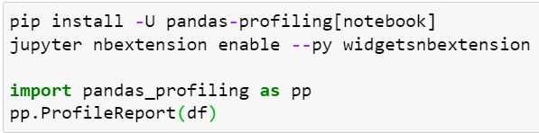
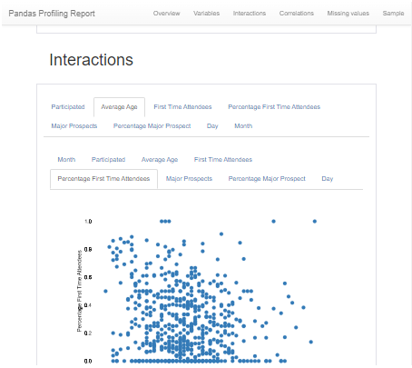
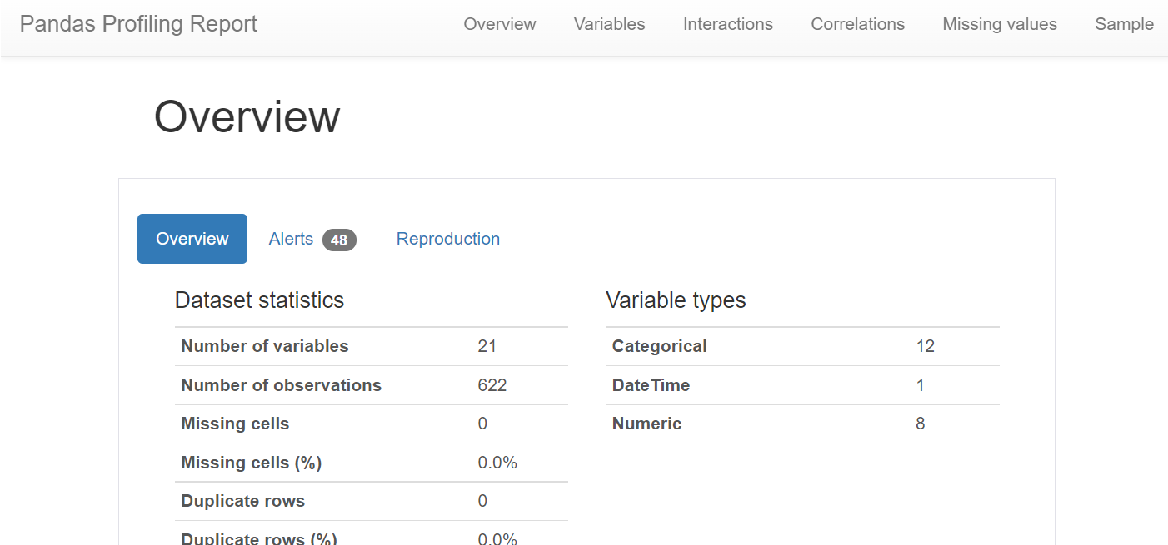
Exploratory Data Analysis
Generate an analysis report on the dataframe
Provides correlations and other statistical data very quickly.
Serves as a great head-start

Slide 6
Methods
Group Code
Location Code
Activity Code
Age
Event (Day)
Event (Month)

Slide 7
Methods & Findings
Group Code (① PS9 / CP Social- General) (② PS9 / CP Social- General)
Second digits: events’ purpose Third digits: events’ audience Method: Assign codes to two different smaller groups
Location Code (PDNA / CP DMV- General )
Second digit: event’s location Method: Find where the event was held and assign codes to smaller groups
Notes:
Analyzing Group Code
Checked the third digit of Group Code to receive the category of the group and turned them into categorical values to assign each category in group column
Found the percentage of first-time attendees and major prospects for all the groups.
Used bar graphs for visualizations
Checked the second digit of Group Code and turned them into categorical values to receive the event contents of the group and assigned each contents in Group Contents column
Found the percentage of first-time attendees and major prospects for all the different types of content.
Used bar graphs for visualizations.
Analyzing Location Code
We checked the second digit of location code to receive the location where the event was held
and turned them into categorical values to assign each category a Location group column.
Found the percentage of first-time attendees and major prospects for all the locations.
Used bar graphs for visualizations.

Slide 8
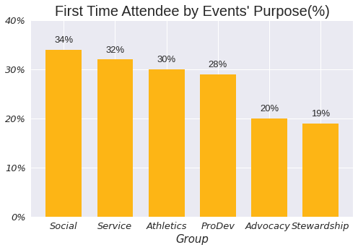
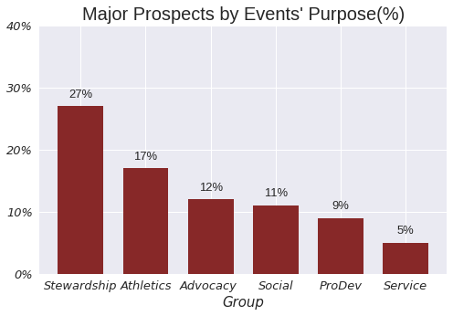
Analyzing the Group Code - Event’s Purpose
Socializing & Service events
Stewardship events
Notes:
The maximum percentage of major prospects are Members whereas the least are Student and Alumni and vice versa for percentage of first-time attendees.
The maximum major prospects are in the groups with ‘Stewardship’ content and least in the groups with ‘Service’ content.

Slide 9
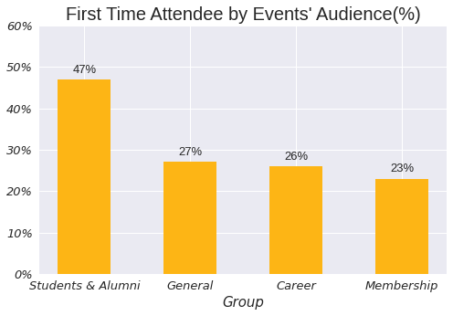
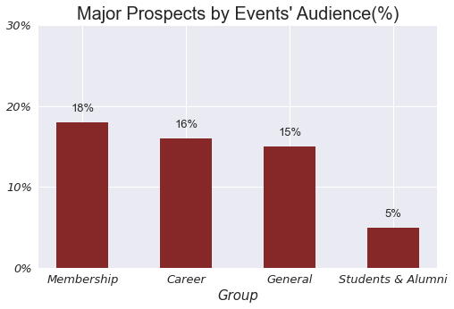
Analyzing the Group Code - Events’ Audience
Students and Alumni
Membership

Slide 10
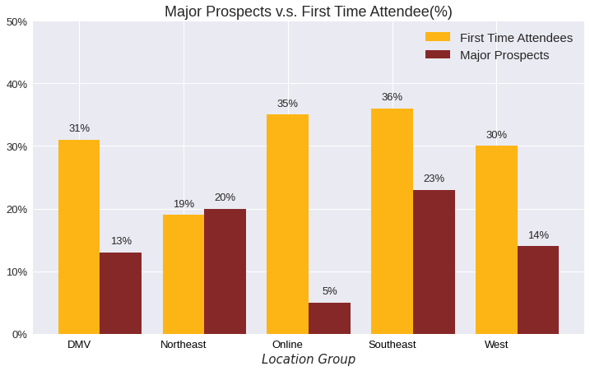
Analyzing the Location Code - Events’ Location
Locations in Southeast & Online attract more first time attendee
Locations at Southeast & Northeast appeal to alumni of major prospects
*DMV(Washington DC, Maryland, and Virginia)
Notes:
The maximum percentage of major prospects is for the events at location ‘Southeast’, closely followed by the events held ‘Online’.
The percentage of first-time attendees is the least at location Northeast.
The maximum percentage of major prospects is at the location ‘Southeast’ whereas the least percentage is at events held ‘Online’.

Slide 11
Methods & Findings
Activity Code
Grouped the Activity Code and calculated the number of first time attendees and major prospects to obtain each activity’s popularity.
Average Age
Assigned the Average age to five groups and named the columns based on the age group to get the first time attendees and major prospects in each age group.
Notes:
Analyzing Age
Assigned the Average age to three groups and name the column "Age Group” to get the number of people in each age group
Found the number of first-time attendees and major prospects for all the age groups and used bar graph for visualizations.

Slide 12
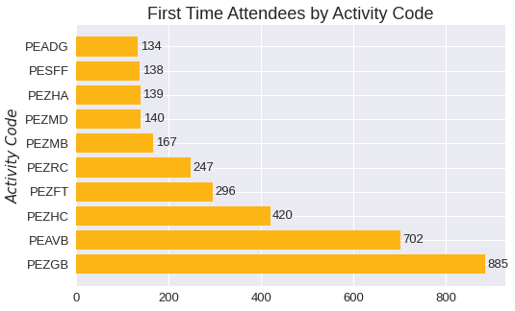
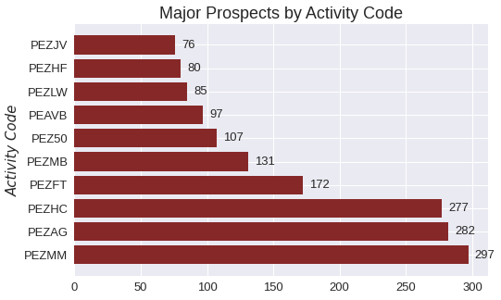
Analyzing the Activity Code
PEZGB - GradBash
PEZMM - Maryland in Manhattan

Slide 13
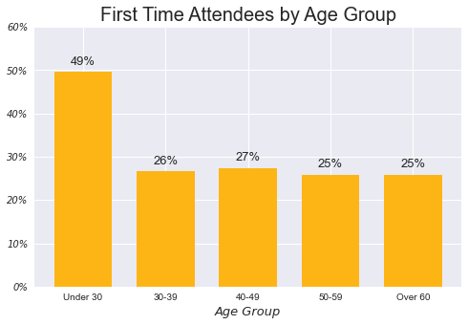
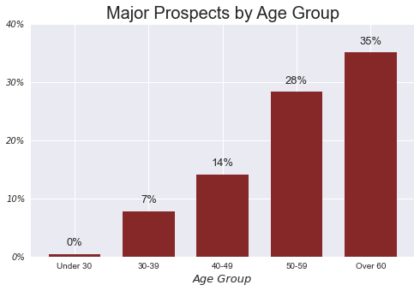
Analyzing the Age Group
Under 30
Over 60

Slide 14
Methods & Findings
Event Date (Day)
Applied dt.weekday and dt.month to extract weekday and month for the event
Analyzed which days or months have the maximum number of major prospects and first-time attendees.
Event Date (Month)

Slide 15
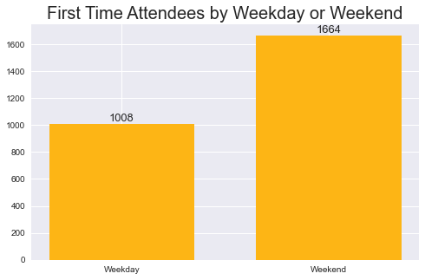
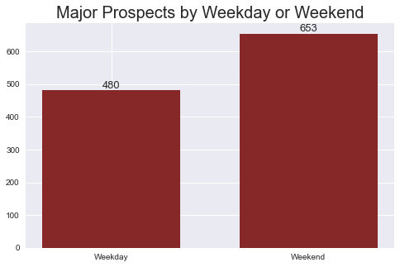
Analyzing the Day of Event
For events held on weekends, the average number of first-time attendees and
major prospects are higher.

Slide 16
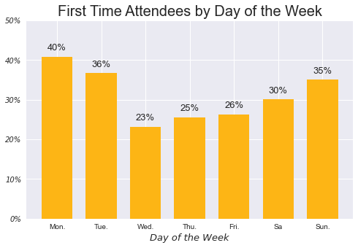
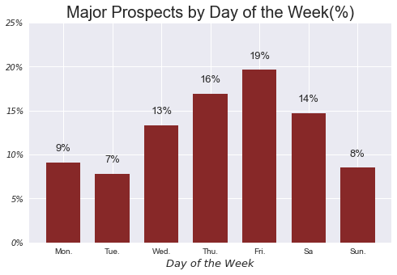
Analyzing the Day of Event(cont.)
Sunday to Tuesday
Friday

Slide 17
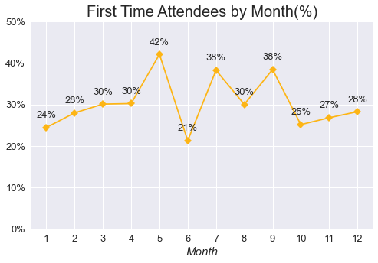
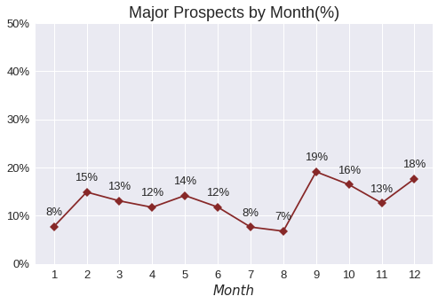
Analyzing the Month of the Event
May, July, September
September

Slide 18
Recommendations
 | First Time Attendees | Major Prospects
Event Purpose | Socializing & Service | Stewardship
Event Audience | Students and Alumni | Membership
Location | Southeast & Online | Southeast & Northeast
Activity | PEZGB - GradBash | PEZMM - Maryland in Manhattan
Age | Under 30 | Over 60
Event Time | May, July, and September | September
Event Day | Sunday - Tuesday | Friday
The location Southeast contributes significantly to the percentage of first-time attendees as well as major prospects. Therefore, more events should be held at this location.
The events with group contents ‘Social’ and ‘Stewardship’ should be increased as they have the maximum percentages of first-time attendees and major prospects, respectively.
Members should be invited more to the events as they compromise the maximum percentage of major prospects but least of first-time attendees.
People under 35 are contributing neither to the percentage of first-time attendees and nor to the percentage of major prospects. Therefore, people under the age group of 35 and over should be targeted instead.
More events should be held through Friday-Monday as events on these days have the maximum participation.
Events should be organized in May instead of June to increase the first-time attendees. Also, more events should be organized in September instead of August to increase the major prospects.
Notes:
The location Southeast contributes significantly to the percentage of first-time attendees as well as major prospects. Therefore, more events should be held at this location.
The events with group contents ‘Social’ and ‘Stewardship’ should be increased as they have the maximum percentages of first-time attendees and major prospects, respectively.
Members should be invited more to the events as they compromise the maximum percentage of major prospects but least of first-time attendees.
People under 30 are contributing to the percentage of first-time attendees, but not to the percentage of major prospects. People over the age group of 60 are majorly contributing to the % of major prospects.
More events should be held through Friday-Monday as events on these days have the maximum participation.

Slide 19
Future Work
Explore more data inputs
Variables like Alumni Salary, Married or not might provide interesting insights.
Categorize Activity Codes
Categorize activity codes into the smaller group by understanding the encode logic behind.
Build Regression Models
Build explanatory model to estimate which variables have best effect on the number of first time attendees and major prospects
Use different transformations on the variables to find the best model and get better prediction accuracy.

Slide 20
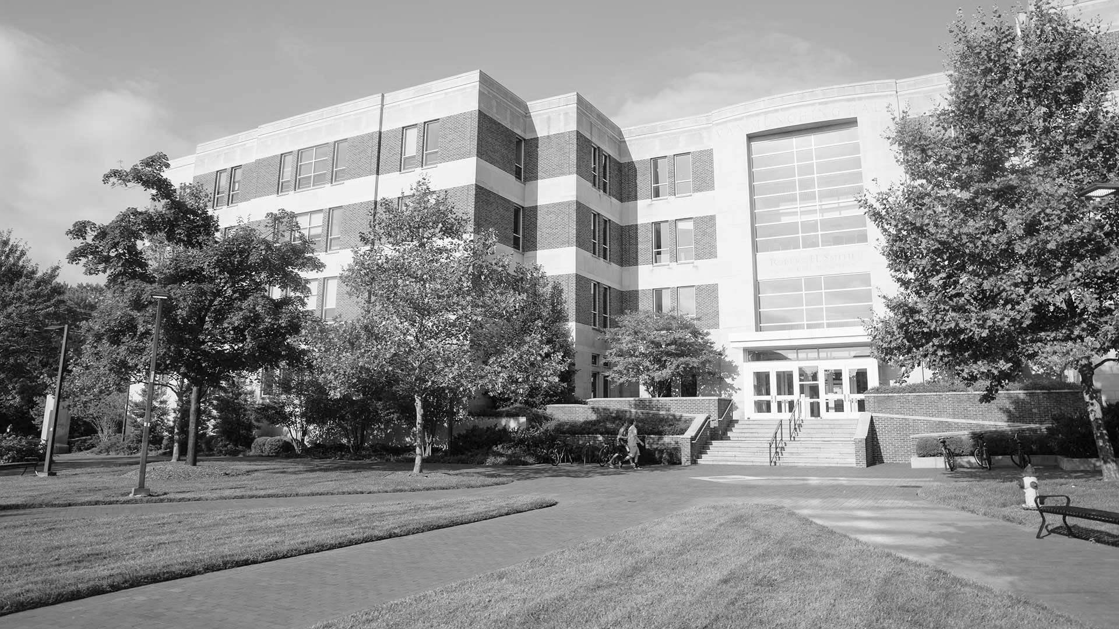
Thank You Questions?
rhsmith.umd.edu/sites/default/files/programs/programs--hero.jpg

