Slide 1
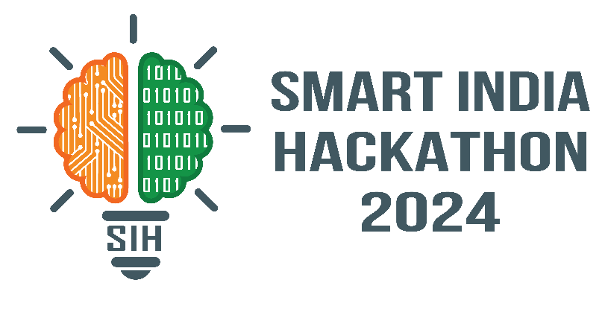
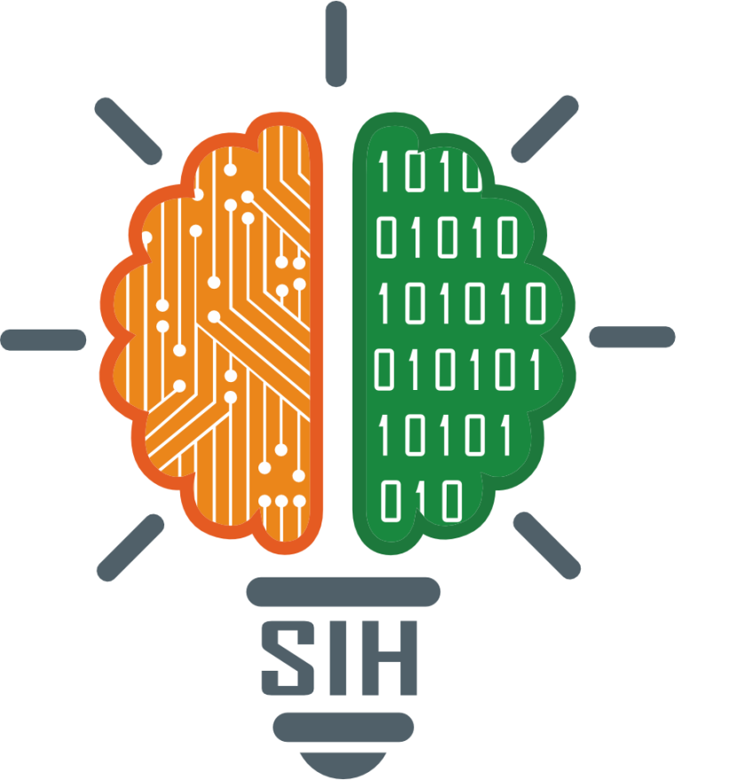
SMART INDIA HACKATHON 2024
TITLE PAGE
Problem Statement ID – 1703
Problem Statement Title- Let’s Learn
Constitution in a Simpler Manner-Citizen
Perspective
Theme- Smart Education
PS Category- Software
Team ID-
Team Name (Registered on portal) - SamvidhanSarthi

Slide 2
IDEA TITLE
Samvidhan
Sarthi
IDEA/SOLUTION Nagrik Aur Samvidhan (Citizen & Constitution) platform simplifying the Indian Constitution with easy language, quizzes, games, and regional translations. Addressing the Problem: The website simplifies the Constitution's complicated wording so that everyone can understand it and find it interesting, including those with no background in law. Makes the Constitution accessible and engaging for all citizens.
INNOVATION AND UNIQUENESS Personalized Learning Paths: Tailored content based on user interests and progress. Constitutional Timeline: Interactive history of key amendments and court cases by visualizing it with graph and diagram for user to easy understand the constitution. Scenario-Based Learning: Real-life scenarios to apply constitutional knowledge. Educational Partnerships: Collaboration with schools/universities for curriculum integration. Regional language support. Interactive quizzes and games. Community connection: provide a connection to the people to authority for guidance.

Slide 3
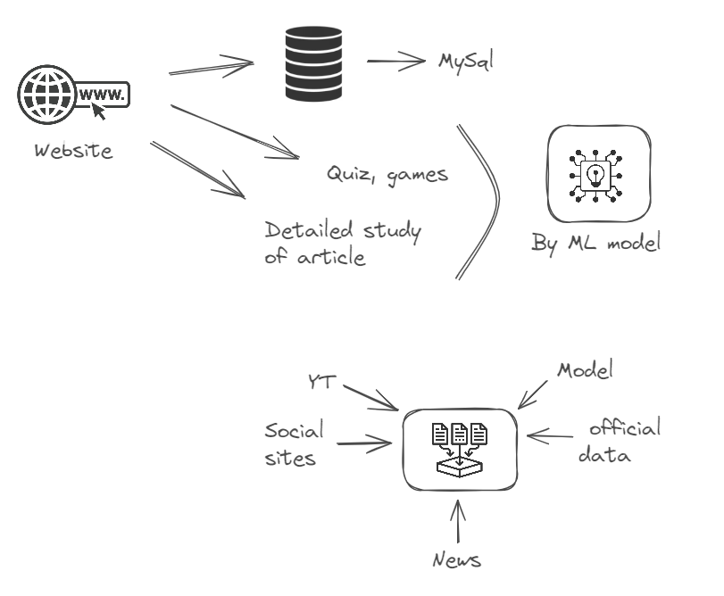
TECHNICAL APPROACH
Samvidhan
Sarthi
Technologies Frontend: HTML, CSS, Bootstrap,JavaScript Backend: Flask Database: MySQL Machine Learning: ML models Multimedia: Videos and infographics Localization: Regional language translations

Slide 4
FEASIBILITY AND VIABILITY
Samvidhan
Sarthi
Feasibility:
Technical: Flask and ML ensure scalability; multimedia and localization enhance accessibility.
User Adoption: Personalized paths and scenario-based learning increase engagement
Challenges:
Localization: Ensuring accurate regional translations.
Technical Complexity: Integrating diverse features.
Strategies:
Modular Development: Test features individually.
Educational Partnerships: Leverage institutions for broader adoption.

Slide 5
IMPACT AND BENEFITS
Samvidhan
Sarthi
Benefits:
Localized Content: By offering translations in regional languages, the platform ensures that language is not a barrier to understanding the Constitution.
Interactive Learning: Engaging multimedia and gamified content (quizzes, storytelling) makes learning enjoyable, increasing user retention.
Community Engagement: Social media outreach and offline campaigns will foster a community interested in constitutional literacy.
Potential Impact:
Social: Enhances constitutional literacy and awareness among citizens, promoting a more informed society.
Educational: Provides a valuable resource for students, teachers, and legal professionals.
Political Awareness: Empowers citizens to actively participate in governance by understanding their rights and duties.

Slide 6
RESEARCH AND REFERENCES
Samvidhan
Sarthi
Research on personalized learning and multimedia engagement.
Research on The society condition according to Indian constitution.
Research on What is actually problem?
References
https://legislative.gov.in/constitution-of-india/ -> constitution of india
https://youtube.com/playlist?list=PLAa8vphOlKtCIgxQ5E0abnO_esick1qYn&si=alxWCBBh_X_3DOB2 -> YT
https://constitutionsimplified.in/ -> simplified constitution

