Slide 1
AWS CLOUD COMPUTING — FINAL PROJECT
DevOps Pipeline with Container Orchestration
Dockerized Node.js Application on Amazon ECS Fargate
Prepared by
Nigatie Sahlie & Solomon Tibebu
Instructor
Mr. Anteneh Alemu
AWS Region: us-east-1 | July 2026
Notes:
Title slide. Introduce the project team, the instructor, and the one-line project scope: a containerized Node.js app deployed on ECS Fargate with a fully automated CI/CD pipeline.

Slide 2
What We'll Cover
01
Project Overview
02
System Architecture
Goals, scope, and the technology stack we used
How CodePipeline, ECS Fargate, and the ALB fit together
03
Implementation Highlights
04
Monitoring & Observability
Key steps: container → registry → compute → automation
CloudWatch dashboards, alarms, and X-Ray tracing
05
Challenges & Solutions
06
Live Results & Lessons Learned
Real issues we hit and how we resolved them
The working app, cost, and what we'd do next
DevOps Pipeline on AWS ECS Fargate
2
Notes:
Quick roadmap of the presentation so the audience knows what's coming.

Slide 3
Core Objectives
1
Containerize a Node.js/Express app with Docker and a working health check
2
Store versioned images in Amazon ECR
Project
Overview
3
Run the app serverlessly on ECS Fargate — no EC2 management
4
Expose it securely via an Application Load Balancer
Option 3 — DevOps Pipeline
with Container Orchestration
5
Automate build & deploy: CodeCommit → CodeBuild → CodePipeline
6
Add observability with CloudWatch and AWS X-Ray
DevOps Pipeline on AWS ECS Fargate
3
Notes:
Explain the project follows Option 3 of the course brief. Walk through the six objectives quickly — these map directly to the grading rubric.

Slide 4
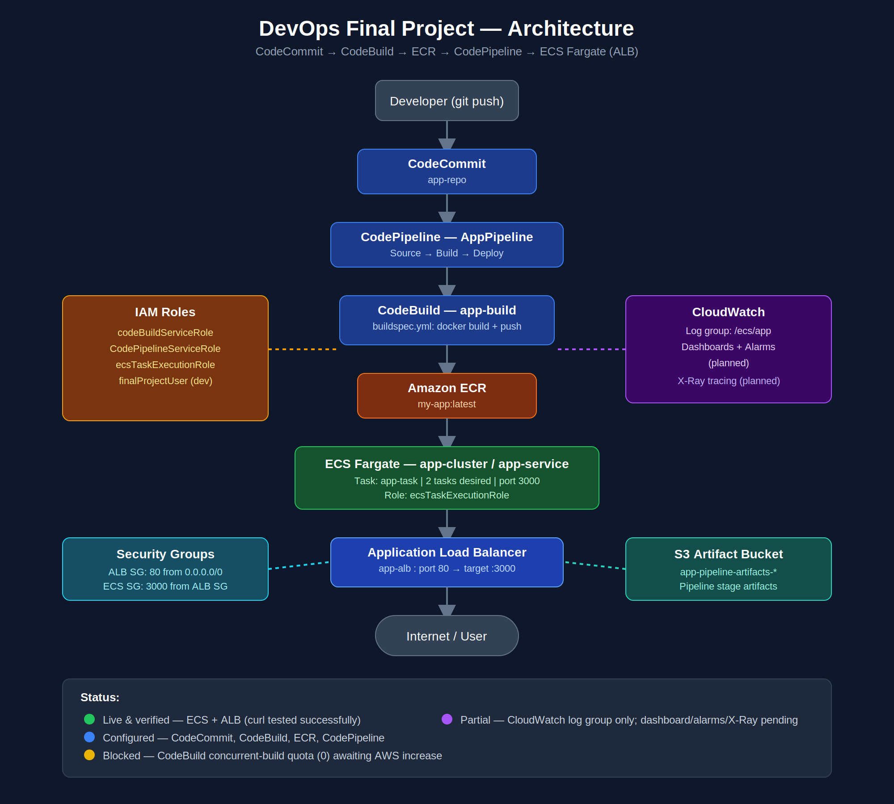
System Architecture
CodeCommit → CodePipeline → CodeBuild → ECR → ECS Fargate → ALB
DevOps Pipeline on AWS ECS Fargate
4
Notes:
Walk through the diagram top to bottom: developer push → CodeCommit → CodePipeline orchestrates Build (CodeBuild → ECR) then Deploy (ECS Fargate service behind the ALB). Point out the supporting IAM, security group, S3, and CloudWatch/X-Ray boxes on the sides.

Slide 5
CI/CD Pipeline Flow
Every git push triggers an automated build and a zero-downtime rolling deployment
Developer
→
CodeCommit
→
CodePipeline
→
CodeBuild
→
Amazon ECR
→
ECS Fargate
git push
app-repo
Orchestrates
docker build + push
image registry
rolling deploy
Result: 2 Fargate tasks running behind the ALB, updated automatically with zero downtime on every merge to main.
buildspec.yml (excerpt)
docker build -t $REPO_URI:latest -f docker/Dockerfile .
docker push $REPO_URI:latest
printf '[{"name":"app","imageUri":"%s"}]' $REPO_URI:latest > imagedefinitions.json
DevOps Pipeline on AWS ECS Fargate
5
Notes:
This slide shows the exact automation chain. Emphasize: source.type and artifacts.type both had to be CODEPIPELINE for CodeBuild to integrate correctly — a lesson learned. The imagedefinitions.json file is what tells the ECS deploy stage which new image to roll out.

Slide 6
Implementation Highlights
Containerization
IAM Roles
Networking
node:18-alpine base image with a Docker HEALTHCHECK hitting /health every 30s.
Least-privilege roles for ECS task execution, CodeBuild, and CodePipeline — permissions added only as needed.
ALB in public subnets (port 80 open); ECS tasks reachable only from the ALB security group (port 3000).
ECS Service
Load Balancing
Automation
app-cluster running app-task on Fargate — 256 CPU / 512 MB, 2 desired tasks, logs to CloudWatch.
app-alb + target group (IP target type) health-checking /health before routing traffic.
CodePipeline: Source (CodeCommit) → Build (CodeBuild) → Deploy (ECS), triggered on every push.
DevOps Pipeline on AWS ECS Fargate
6
Notes:
Six-card summary of the build. Mention this was all done via AWS CLI, not the console, with configuration files committed to CodeCommit for reproducibility.

Slide 7
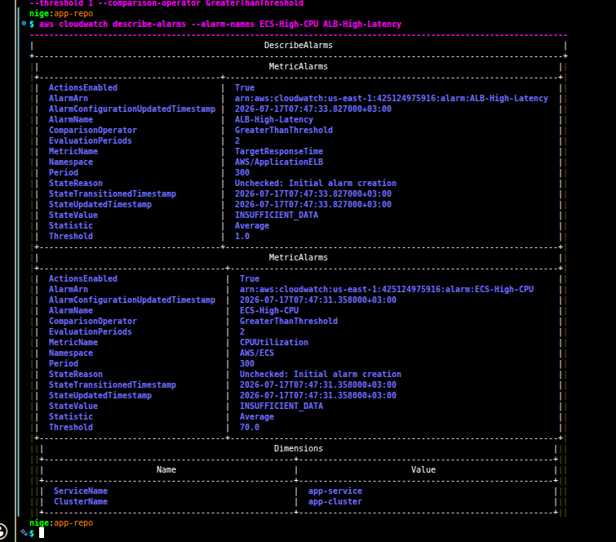
Monitoring & Observability
CloudWatch
✓
Log group /ecs/app — centralized container stdout/stderr
✓
App-Dashboard — ECS CPU/memory + ALB latency & error widgets
✓
Alarm: ECS-High-CPU — triggers above 70% (2 periods)
✓
Alarm: ALB-High-Latency — triggers above 1s (2 periods)
AWS X-Ray
✓
aws-xray-sdk Express middleware wraps every request
✓
X-Ray daemon sidecar container in the task (UDP :2000)
✓
Service map + per-request traces in the X-Ray console
DevOps Pipeline on AWS ECS Fargate
7
Notes:
Show the live CloudWatch dashboard screenshot. Mention both alarms are showing INSUFFICIENT_DATA at rest — that's expected, they'll evaluate as real traffic flows. X-Ray gives us a foundation for tracing that becomes more valuable as the app grows more complex (e.g., adding a database).

Slide 8
Challenges & Solutions
Real issues encountered during the build — and how each was resolved
Issue
Root Cause
Resolution
ECS tasks failed to launch
ecsTaskExecutionRole didn't exist
Created role with correct trust policy
ResourceInitializationError
CloudWatch log group /ecs/app missing
Created log group before redeploying
ALB URL timed out
No inbound rule for port 80 on ALB security group
Authorized TCP 80 from 0.0.0.0/0
CodeBuild create-project failed
source.type and artifacts.type mismatched
Set both to CODEPIPELINE
Pipeline Build stage failed
CodeBuild concurrent-build quota was 0
Requested a Service Quotas increase
DevOps Pipeline on AWS ECS Fargate
8
Notes:
Each of these was diagnosed from the actual AWS error message — ECS deployment events, CodeBuild logs, or CLI error text — rather than guessed. The full troubleshooting log with commands is in the written report's Section 6.

Slide 9
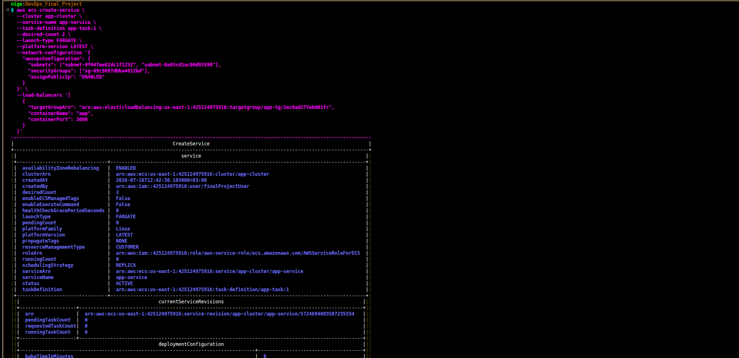
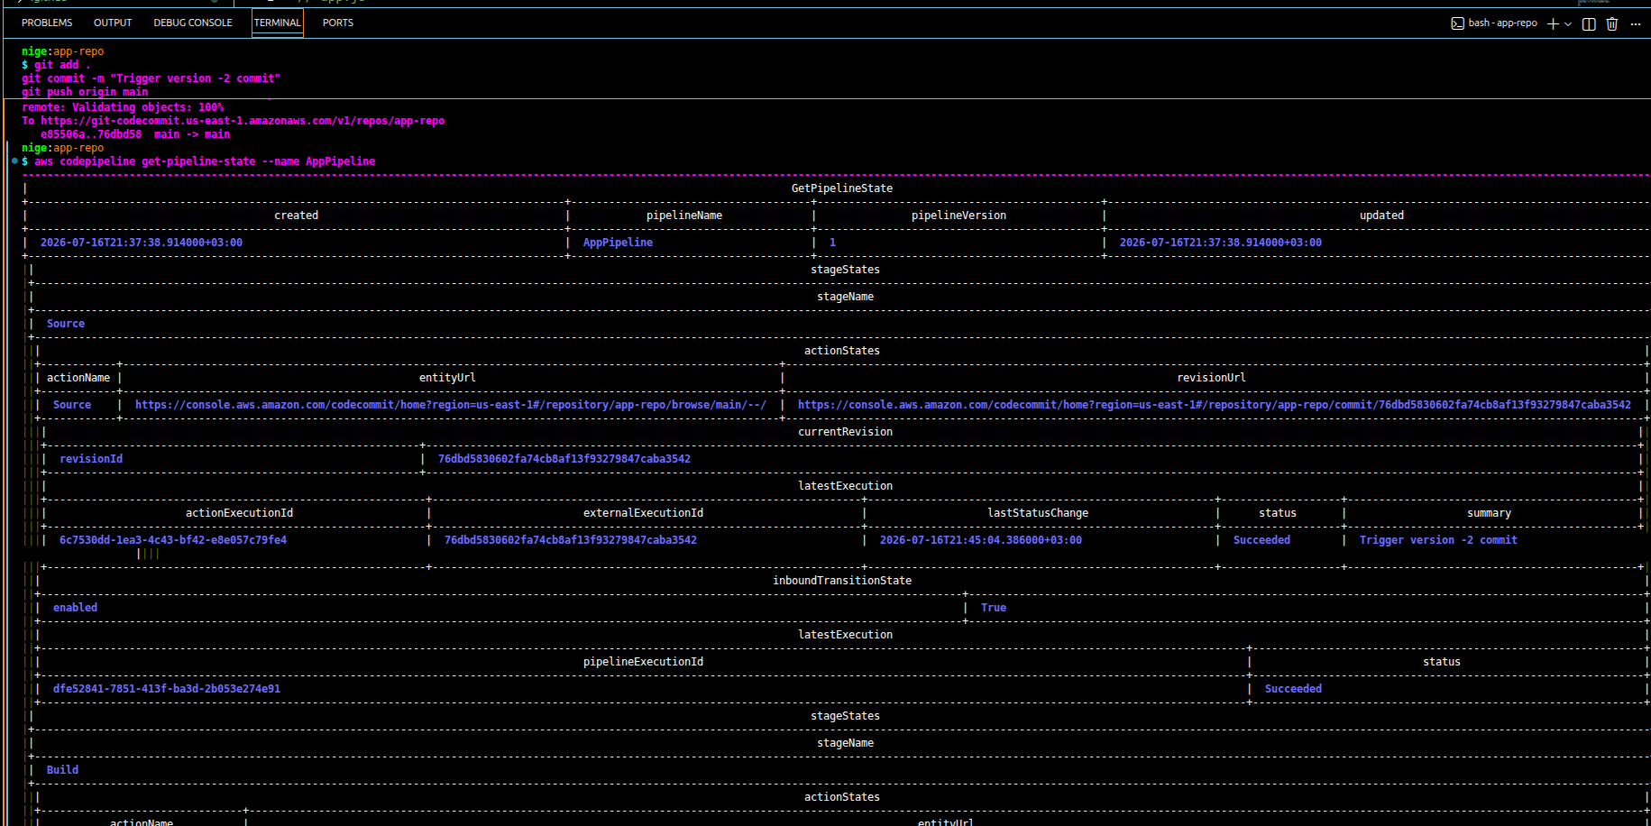
Live Results
Verified end-to-end via the ALB's public DNS name
$ curl http://app-alb-*.us-east-1.elb.amazonaws.com/
{"message":"Hello from ECS Fargate!",
"containerId":"ip-172-31-...",
"timestamp":"2026-07-16T18:18:06Z"}
2/2
100%
~$41
Tasks Running
Targets Healthy
Est. / Month
DevOps Pipeline on AWS ECS Fargate
9
Notes:
Show the curl output live if possible. Point out the container ID and timestamp prove the response is coming from a real running task, not a cached page. The right-hand screenshot shows the ECS service with 2/2 tasks healthy and 'Success' deployment status.

Slide 10
Conclusion & Lessons Learned
•
IAM least-privilege works best iteratively — grant only what the current error requires
•
ECS deployment events point directly at the fix — missing roles, missing log groups
•
CodeBuild + CodePipeline requires matching source/artifact types (CODEPIPELINE)
•
New AWS accounts often start with service quotas at 0 — separate from IAM permissions
•
Verifying each layer independently made root-causing failures fast, not overwhelming
Thank you — Questions?
Nigatie Sahlie & Solomon Tibebu | Instructor: Mr. Anteneh Alemu
Notes:
Close with the five key lessons learned, then open the floor for questions. Thank the instructor by name.

