Slide 1
UK Dynamo User Group
South
Venue
24/07/2017

Slide 2
Dynamo Workshop
Intermediate Edition

Slide 3
What are we going to do?
Agenda
Intermediate Session Breakdown
09:00 – 10:00 | Arrival + Registration
10:00 – 11:30 | Session 1
11:30 – 11:45 | Tea and Coffee
11:45 – 01:15 | Session 2
01:15 – 02:15 | Lunch (3rd Floor)
02:15 – 03:45 | Session 3 (4th Floor)
03:45 – 04:00 | Tea and Coffee
04:00 – 06:00 | User Group (3rd Floor)
06:00 - ???? | breakout and drinks
Session 1
Introductions
Getting Crazy with Dynamo Player
Session 2
List Efficiency
Custom Package Creation
Session 3
Data Visualization
Animation Strategies

Slide 4
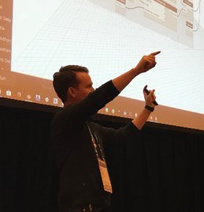

Your Presenters for Today
John Pierson
Mike Turpin
@60secondrevit
sixtysecondrevit.com
parallaxteam.com
@ThatBIMthing
http://www.southbim.com/

Slide 5
What is an intermediate/advanced Dynamo user?

Slide 6

Can Dynamo do [fill in the blank]?

Slide 7
What is an intermediate/advanced Dynamo user?
Intermediate
Advanced
Have built a few working graphs and used on more than one project.
Awareness of custom packages available.
Conscious of annotating their graphs.
Starting to get over the “I don’t do geometry in Dynamo” phase.
Annotates their code!
Other thoughts?
Have made many working graphs .
May have dabbled in Python, (or at least aware that it exists).
Successfully deployed graphs firmwide.
Considered the “Dynamo Champion” of an office.
Annotating code is second nature.
Other thoughts?

Slide 8

Getting Crazy with Dynamo Player

Slide 9
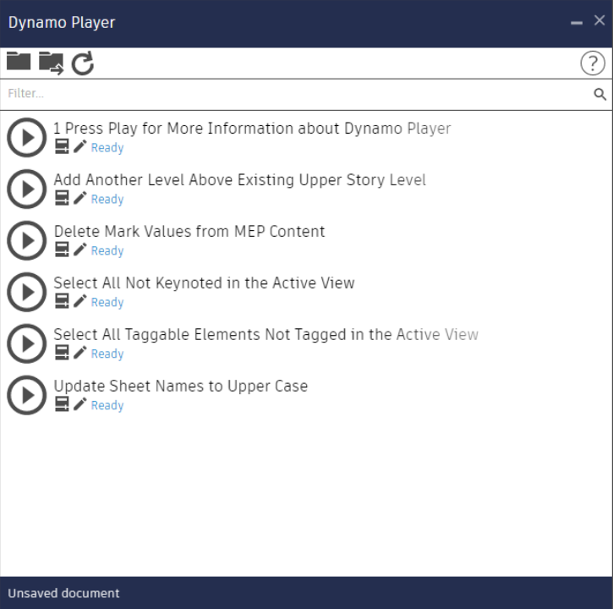
Dynamo Player Allows Us To..
Deploy graphs in a manageable way.
Introduce beginners to computational workflows.
Pretty much make our own Revit addins. (Shh… don’t tell the addin creators)
Have awesome inputs in Revit 2018.1+
User custom packages to create slick user interfaces

Slide 10
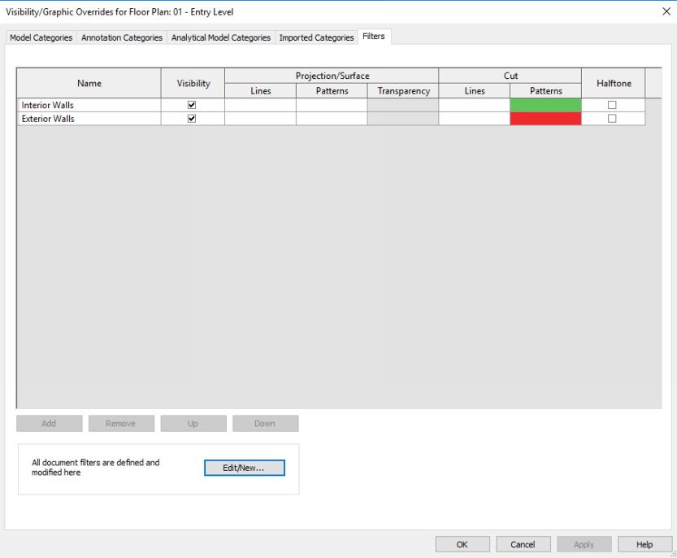
Copy View Filters from One View to Another
Do something not possible through the UI.
Filters are great, but take a while to set up.
Also make this work on unopened files.

Slide 11
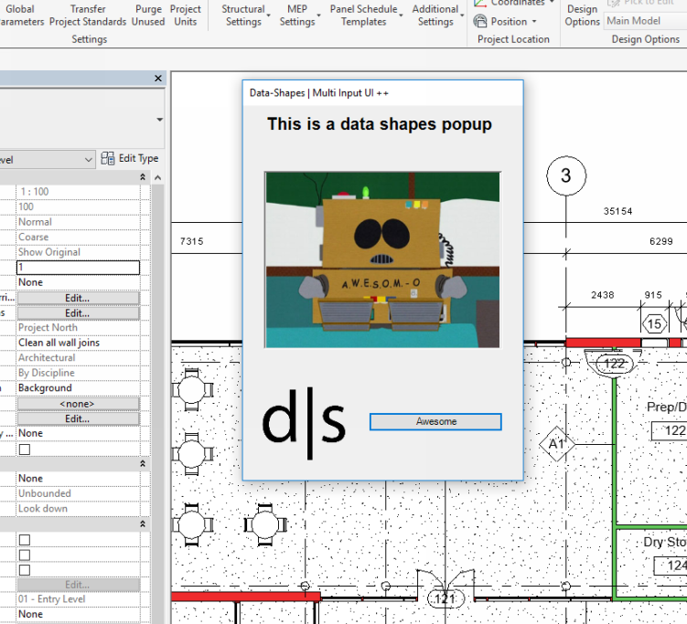
OOTB Dynamo Player is Awesome but..
Popups are even awesome-er.
Build a UI with custom package Data-Shapes to provide this functionality to those without Dynamo player.
Ability to build really reusable workflows for your firm!

Slide 12

List Efficiency (based on content from Andrew Heumann’s AU2017 presentation, “Dynamo List Masterclass”)

Slide 13
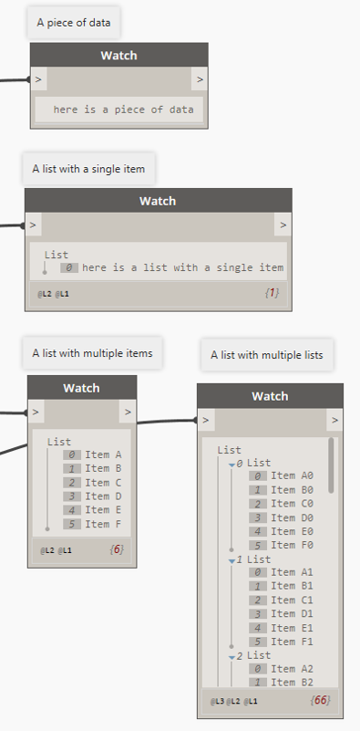
List Basics
Different kinds of lists
Single Items
List of single item
List with multiple
List of lists

Slide 14
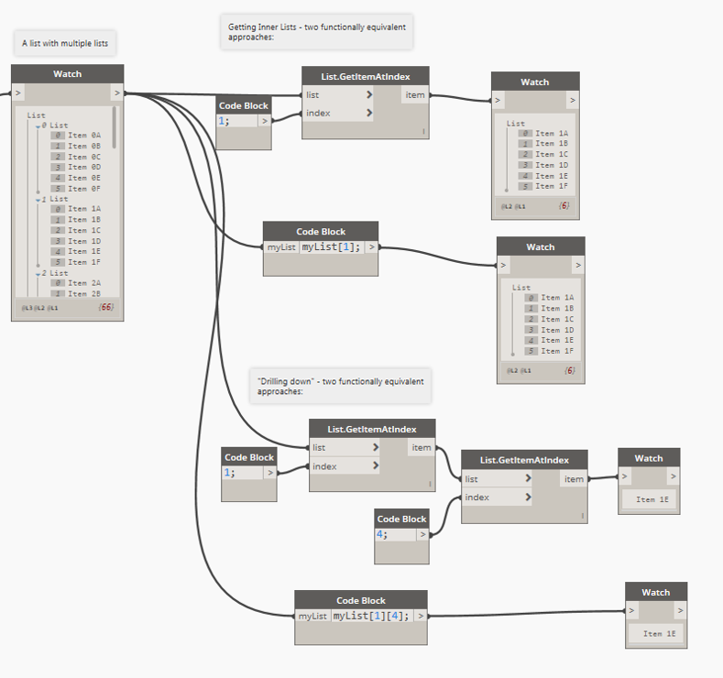
List Basics
Index Access

Slide 15
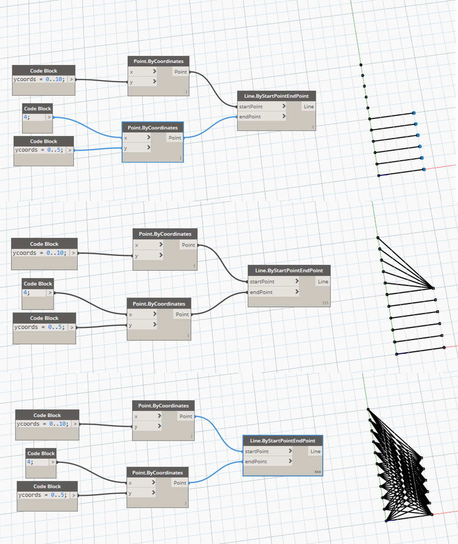
List Lacing
Lacing determines how lists of different lengths match up with each other.
Three Methods:
Shortest
Longest
Cross Product

Slide 16
List@Level
Allows you to select the level on which you want your function to operate – and “replicates” over the rest
“Keep List Structure” will keep results organized by the designated input’s data structure
Eliminates most of the need for List.Map, List.Combine, etc.

Slide 17

I Shipped My Nodes

Slide 18
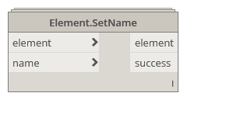
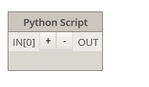
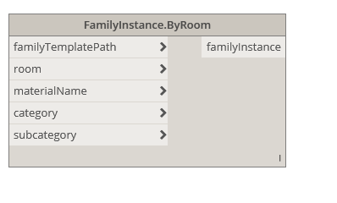
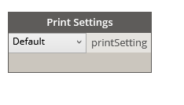
Deploying Dynamo Workflows
Bundling OOTB nodes to form custom nodes.
Python scripting with Python nodes.
ZeroTouch imports using .NET libraries (C#, VB.NET)
Full Blown C# Development for Custom UI and More, (Way out of the scope of this class).
Custom Node - Clockwork
Python Script
“ZeroTouch” node made in C# - Rhythm
UI nodemade in C# - archilab

Slide 19





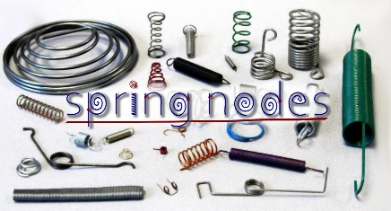




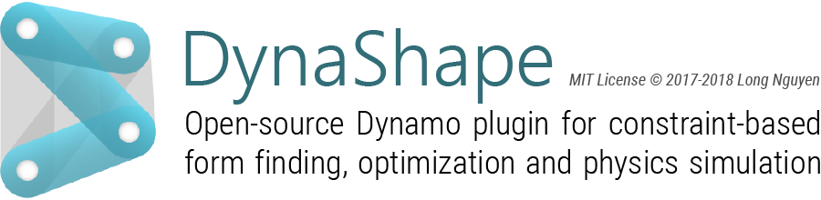

Essential Dynamo Packages
Revit Related
Lunchbox
Archi-lab.net
Clockwork
Springnodes
Rhythm
Steamnodes
Data-Shapes
Designtech
Mandrill
Bumblebee
Additional Awesomeness
Ladybug
Energy Analysis for Dynamo
Dynashape
Firefly
Mantis Shrimp
Rhynamo

Slide 20
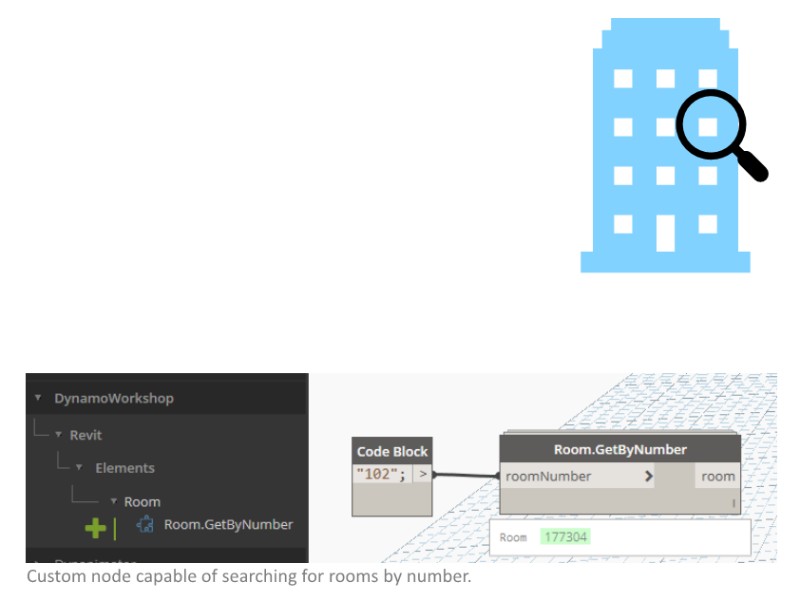
Building a Custom Lookup Node
Retrieve rooms by number
Bundle as a custom node
Distribute for reuse
Using a tool called a dictionary

Slide 21
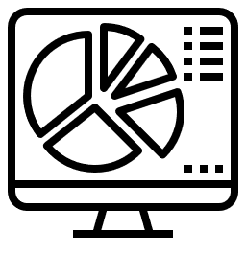
Data Visualization

Slide 22

Animation Strategies in Dynamo

Slide 23
Animation Strategies in Dynamo
Using Dynanimator from the Bad Monkeys.
Using Rhythm, (with inspiration from the Bad Monkeys).
Using Firefly for rapid iteration.
Using current system time to iterate.
Sliders with filename replacement.

