Slide 2

Software Testing Project CA267
Members: Daniel Holton
Kevin Sweeney
Nigel Guven
Elton Babela

Slide 3
Table Of Contents
Page | Description | Page | Description
4 | Introduction |  | Data Dependence
5 | Requirements/Design |  | Integration
6-9 | Boundary Values |  | Coverage Analysis
10-14 | Decision Tables |  | Evaluation
15-18 | Equivalences |  | References
19-23 | Structure |  | Questions

Slide 4
Intro to Ladder Solution
We analysed the program specifications at our first meeting and decided how we would go about solving the problem and how we would implement software testing into our program.
We made a quick draft of the program on our first meeting. Despite completion, there were still bugs to be weaned out.
And so we made changes to the program as we went through the testing process.

Slide 5
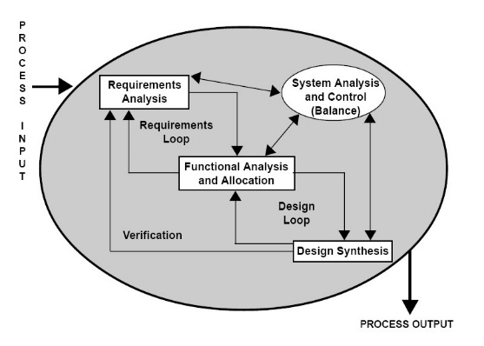
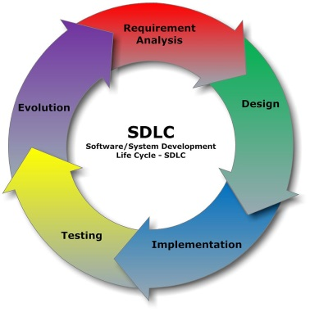
Requirements And Design Analysis
Requirements
We must apply Software Testing methods to the program.
The SDLC must be adhered to, i.e. Design , Implementation, Testing, Evolution.
The instructions laid out on the project guidelines must be followed.
We must choose a language to perform the program.
There must be a space to write up the blog.
Design
We will use Java to perform the program specifications.
We should utilise the Java library where necessary.
We must implement good programming techniques.
Methods to shorten the main program.
Loops and Catch statements
Minimize bugs!
Efficient yet human readable would be best.

Slide 6
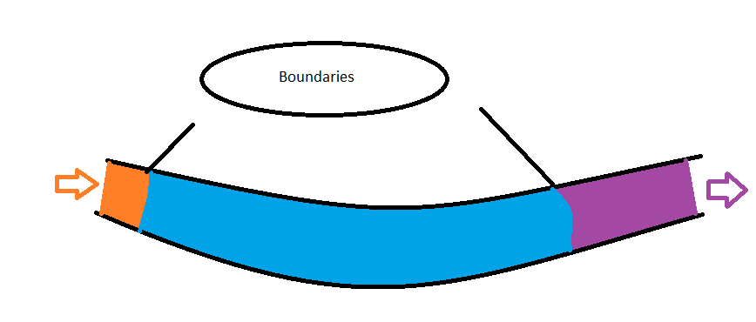
Boundary Value Testing
First identified through research the boundaries of the program.
(2^31)-1 for ints
(2^31)-5 for arrays
Ran a few sample tests to see if this held true
True for integers
Not for arrays

Slide 7
Boundary Value Testing
Since I had no max value for the array I had to run multiple tests to find the max, quite tedious
Then it was time to run multiple tests based on these findings and record the results
I used a spreadsheet to record the input variables and the results of each test
When I had an appropriate amount done I transferred the info into organized tables

Slide 8
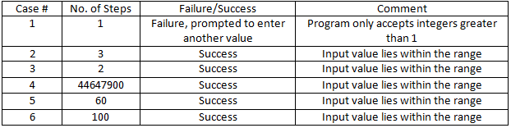
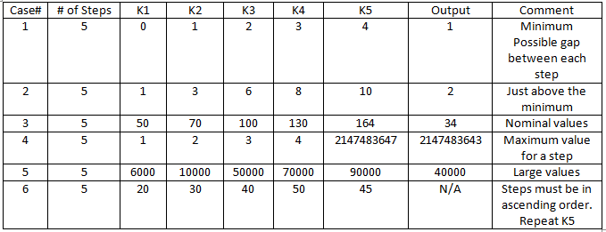
Boundary Value Testing
Boundary Value Analysis Tables

Slide 9
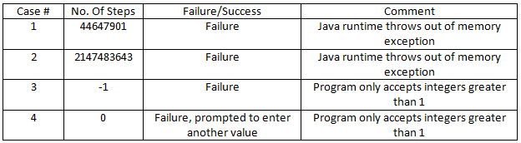
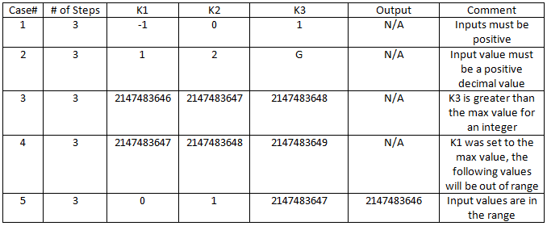
Boundary Value Testing
Robustness Testing Tables

Slide 10
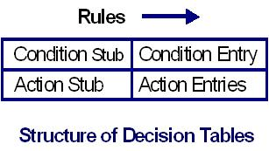
Decision Table Testing
Identifying inputs(conditions) and outputs(actions) :
Condition(Inputs)
less than 1 step
non numeric characters
Steps must be in ascending order. A_{k} < A_{k1} < … < A_{kt.}
All gaps are equal
A negative number entered as a step
Actions(Outputs)
Too few steps.
Not a number.
Negative number.
If A_{k} < Ak1 < … < Akt…………..Then step sequence valid, otherwise it’s not.
If A_{k1}-A_{k} = { (Ak2 -Ak1) &… & (A_{kt} – A_{kt-1})} gaps are equal
If A_{k1}-A_{k} > { (Ak2 -Ak1) & … & (A_{kt} – A_{kt-1})} then A_{k1}-A_{k} is the biggest gap
The Biggest gap

Slide 11
Decision Tables
Conditions
Number Of Steps <= 1 | T |  | F | F | F | F | F | F
User Enters non numbers |  | T | F | T | F | F | F | F
A_{k} < Ak1 < ... < A_{kt} |  |  | T |  | F | T | T
A_{k1}-A_{k} > { (Ak2 -Ak1) & ... & (A_{kt} - A_{kt-1})} |  |  |  |  |  | T | F
A_{k1}-A_{k} = { (Ak2 -Ak1) &... & (A_{kt} - A_{kt-1})} |  |  |  |  |  |  | T
Negative No. for a step |  |  |  |  |  |  |  | T
Actions
Too little steps | X
Impossible, Steps Ascending Order |  |  |  |  | X
Not a number |  | X |  | X
The Biggest Gap |  |  | X |  |  | X | X
Negative Number |  |  |  |  |  |  |  | X

Slide 12
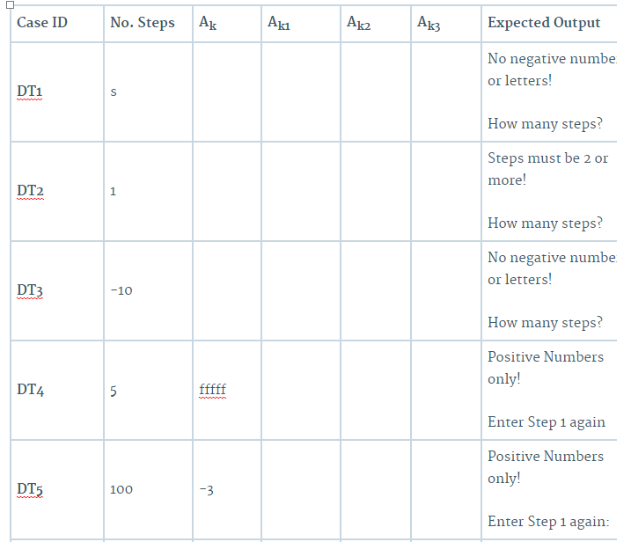
Decision Table Tests

Slide 13
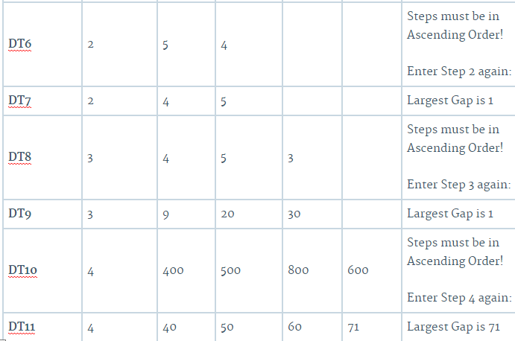


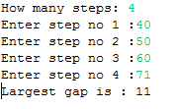
Decision Table Tests (cont.)
Decision Table test 1
Decision Table test 2
Decision Table test 11

Slide 14
Evaluation of DT testing
Very thorough testing process
Changes made to program can result in something else not working properly
Always re-test after changes
Re-testing can be very laborious

Slide 15
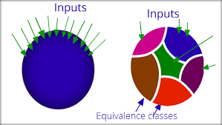
Equivalence Class Testing
Very Cost and time effective method of testing so it’s very popular.
You identify Each class and test one type of input from each class.
You assume that the test result will hold true for all input within the class.
First task is to identify the different classes.

Slide 16
Equivalence Class Testing-Partitions
The partitions for the first part of the program are:
N1= 2 ≤ Number of Steps ≤ 44647900 ...valid partition
N2= Number of Steps ≤ 1 ...invalid partition
N3= Number of Steps ≥ 44647901 ...invalid partition
The partitions for the second part of the program are:
S1= K(n-1) ≤ Kn ≤ 2147483647 ...valid partition
S2= Kn ≤ K(n-1) ...invalid partition
S3= Kn < 0 ...invalid partition
S4= Kn ≥ 2147483648 ...invalid partition
n= The number step we are currently on. For example n=1 would be the first step n=2 is the second and so on.
Kn = The Height of the step we are currently on

Slide 17
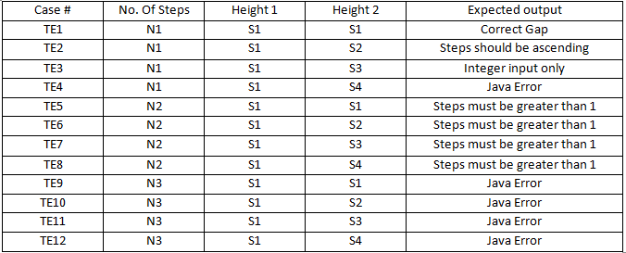
Equivalence Class Testing-Test Cases
Performed 12 different Tests
Didn’t think more were necessary because BVT covered a lot of test cases

Slide 18
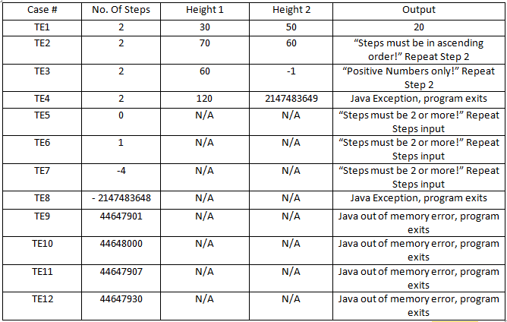
Equivalence Class Testing-Test Cases

Slide 19
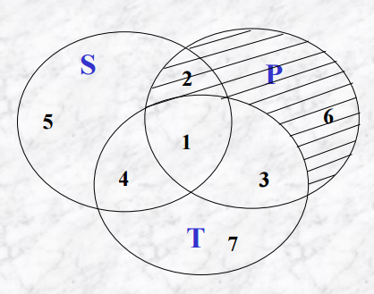
Structural Testing
Structural Testing refers to the path of the program. It is a prime example of White Box Testing.
Covered:
Basic Blocks
Logical Flow Diagram
Methods Flow Graph
DD Path
Topologies
Prior Evaluation
We utilise structural testing to reduce the amount of errors and to make an efficient program.
It can be viewed as a stockpile of information about how the program works.

Slide 20
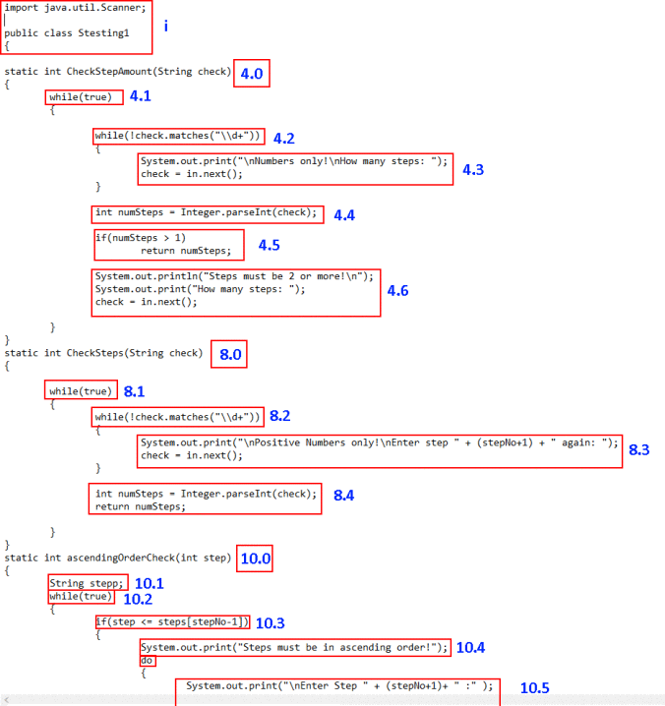
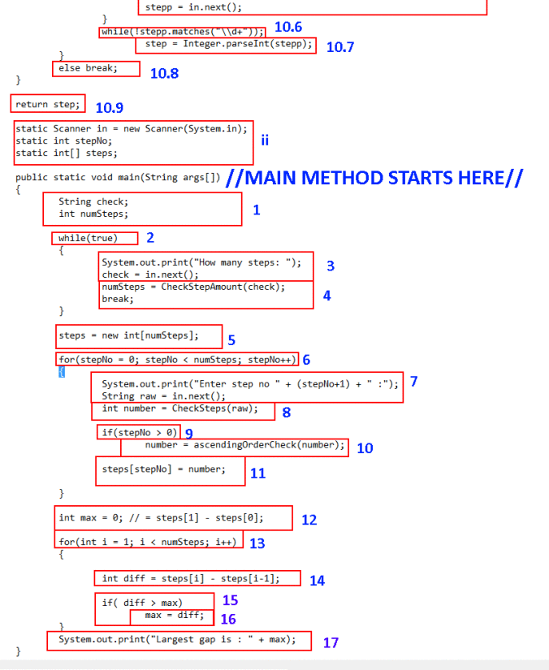
Basic Blocks

Slide 21
Basic Blocks (cont.)
The Basic Blocks structure is the first step of Structural testing. Each instruction is examined and given a reference number.
Methods are seen as subsection. We constructed flow graphs for each diagram.
From this, the Logical Flow diagram is created and used as a testing interface.

Slide 22
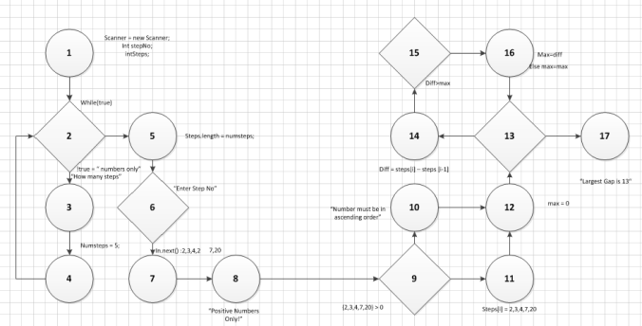
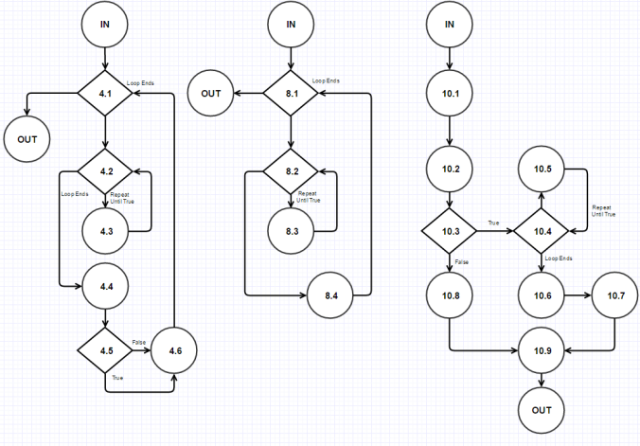
Logical Flow Diagrams
Logical Flow Diagram with sample testing
The Logical flow Diagram is necessary to show the processes, and via testing how the program can evolve and be improved upon.
Method Flow Diagrams.

Slide 23
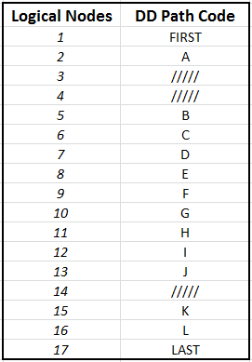
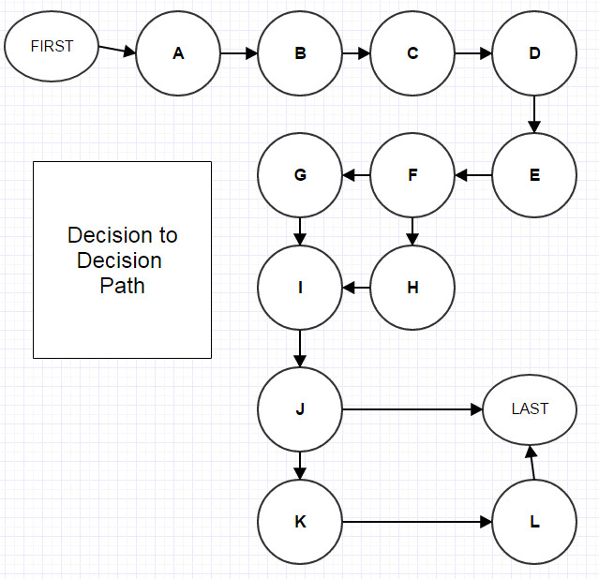
DD Paths And Topology
DD Path Diagram
The DD Path is converted from the logical flow diagram.
It is used to wean out loops and unnecessary nodes so that the set of all topologies can be created.
It is beneficial too in that it is human readable unlike the basic block structure which is far too much detail.
Topologies
FIRST-A-B-C-D-E-F-G-I-J-K-L-LAST
FIRST-A-B-C-D-E-F-H-I-J-K-L-LAST
FIRST-A-B-C-D-E-F-G-I-J-LAST
FIRST-A-B-C-D-E-F-H-I-J-LAST

Slide 24
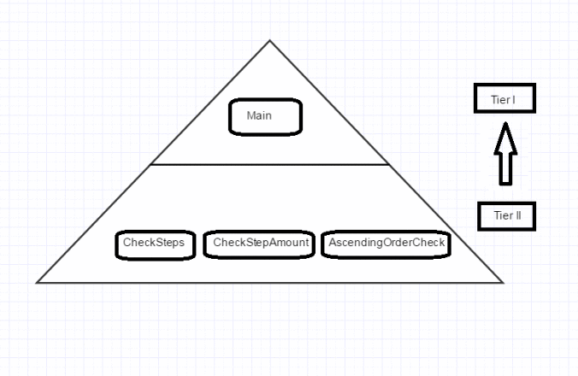
Integration Testing
Integration testing is where every module is combined and tested as a whole unit. Modules are tested and gradually added together until the program is being fully tested in its entirety.
Data is tested as flow procedures with inputs and outputs to stub methods.
We divided the program into two levels of Integration according to priority.
Assumptions
We assumed that each module refers to a method for which there are 3 static method and one main method.
We assumed that Integration Testing is for large programs so we will test according to the CA267 website rubric.
Although there are many types of Integration Testing, we will utilise three specific examinations:
Big Bang Testing
Top-Down Testing
Bottom-up Testing

Slide 25
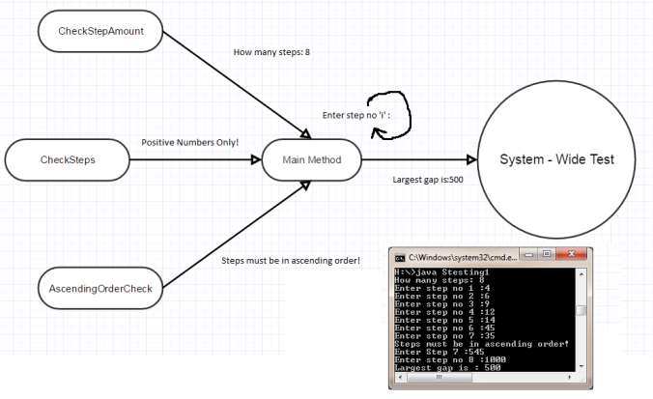
Big Bang Testing
Big Bang Testing is where the entire program is tested as an individual system. Integration of each module is done simultaneously.

Slide 26
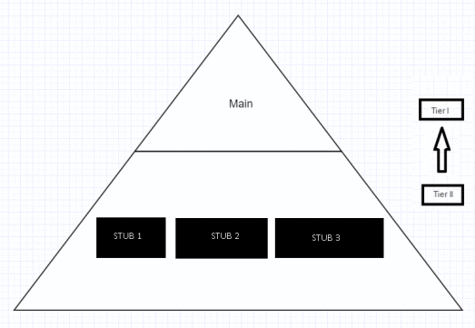
Top-Down Testing
The program is tested by first experimenting on the versatility of the higher level modules.
We created stubs methods for the lower level modules and they are gradually integrated until all modules are being used.
Stubs are replaced by the actual methods until all modules are being utilised.

Slide 27
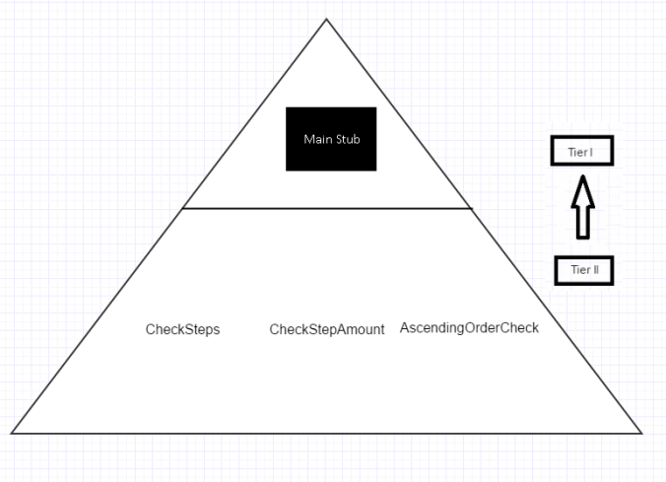
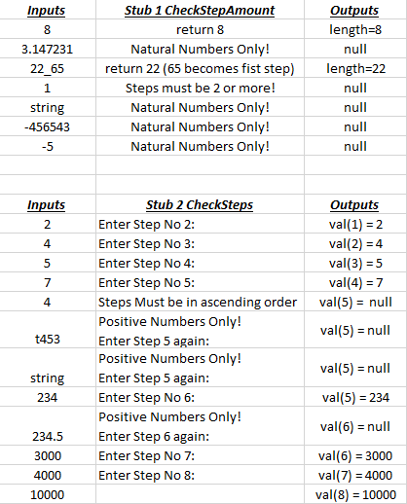
Bottom-Up Testing
We created a stub method for the tier I module to test the flow of data between each method.
Then when each method is tested and works they are integrated
Finally the main method is replanted and the modules are all working as normal.

Slide 28
Coverage Analysis Part I
This section incorporates the post analysis of testing that our team undertook.
Coverage Analysis is used to determine our efficiency when it comes to testing. Three guidelines were followed
Determine gaps in test cases.
Establish a quantitative measure for the efficiency of your tests.
Help Identify any other tests to include.
Examination Metrics
Statement Coverage
Tested by Decision Table Testing, Boundary Value Testing and Integration Testing in Big Bang and Bottom-Up Testing.
Multi[ple Condition Coverage
Also covered by Decision Table Testing.
Condition/Decision Coverage
Covered by all possible decisions through DTT Testing and structurally, by
Decision to Decision Path Conversion.Also utilised by data dependencies.

Slide 29
Coverage Analysis Part II
Modified Condition/Decision Coverage
Not included as we did not use logical operators in our program.
Path Coverage
Flow Graph implemented from Structural Testing. Data dependencies implements this coverage.
Function Coverage
Flow Graph covers each method as well as main method.
Boundary Value Testing covered inputs and outputs.
Decision Table Testing covers all the functions inputs and outputs.
Data dependencies show functions are dependent on some variable.
Loop Coverage
Loops were covered thoroughly in DTT Testing. While loops were tested in this method as well. For-Loops were also tested via DTT testing.

Slide 30
Evaluation of Project
We finished the assignment on time and wanted to comment on how we fared as a group with the entirety of the module project.
We believe we could have been better with timekeeping and could have set dates to finish each method of testing.
We used WordPress to write up our blog because we felt it matched the needs of the program as we could show the evolution of the various testing processes with ease.
We felt that because we had to cover each lecture weekly, we were pushed for time by the due date and date of presentation.
For some testing methods, we believed that the program was not advanced enough to be test upon although we still made great effort in implementing such methods.
Overall we believe that we showed favourable qualities when it came to testing our program.

Slide 31
References
Pictures
http://testingsaraswat.blogspot.ie/2011/10/boundary-value-analysis.html
http://seanheritage.com/wp-content/uploads/2014/01/questions.jpg
http://edumuch.com/wp-content/uploads/2015/10/Best-Software-Development-Strategies-3.png
http://www.stylusinc.com/BI/wp-content/uploads/2007/12/SDLC.jpg
https://upload.wikimedia.org/wikipedia/commons/thumb/a/a1/SE_Process.jpg/320px-SE_Process.jpg
http://www.softwaretestinggenius.com/photos/bbt9.JPG
http://www.computing.dcu.ie/~ray/teaching/CA267/notes.html
Diagrams
https://www.gliffy.com/
Microsoft Visio
Microsoft Excel
Microsoft Word
Paint
Paint.NET
Snipping Tool
Information Gathering
http://www.computing.dcu.ie/~ray/teaching/CA267/notes.html
http://stackoverflow.com/questions/7686494/software-testing-approach
http://www.tutorialspoint.com/software_testing/

Slide 32

Link to our Blog: https://softwaretestingca267.wordpress.com/

