Slide 1

Innovative Cinema Listings
Nigel Guven & Shaun Carey

Slide 2

The Problem We’re Tackling
As it stands, at least for Irish cinemas, if you want the full list of films currently in theatres and their times, you have to navigate through each cinema’s individual website or through Google’s less optimised user interface.
Furthermore, if you want the film’s rating and reviews, you have to navigate yet another website (IMDb, or similar).
We felt that we wanted to develop an app that allowed users to get all this information in an clear cut user interface which is informative and useful.

Slide 3
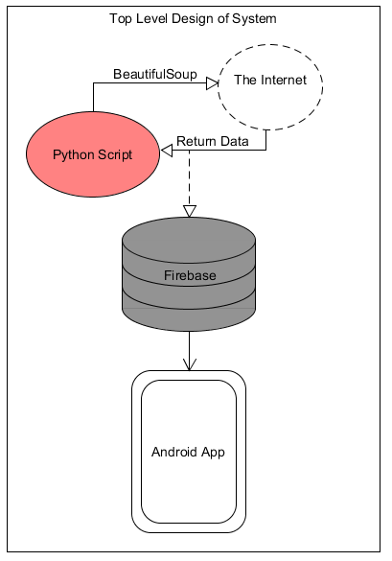
Description
It will be an Android application which focuses on displaying cinema information both near and far to its users, depending on their location and distance preferences.
It will involve scraping HTML from multiple cinema websites and displaying all relevant data and information to the user depending on their input.
The user will be able to select films with options for time, genre, review rating and preferred maximum distance and the application will display all cinemas within those parameters.
The application will have Google maps embedded into it with the location of all the nearby films with attached times based on the parameters provided by the user.

Slide 4
Main Challenges
How to scrape data and make it dynamic.
Furthermore, how to scrape AJAX (Asynchronous Javascript and XML).
What happens if a Cinema or branch of Cinemas shut down? – How to remove these from the database.
Learning how to utilise Python with Android Studio which is a primarily Java/Kotlin IDE.

Slide 5
What We Hope To Learn
Android Studio
Incorporating Python into Android Studio
Beautiful Soup
Firebase
Incorporating information on the following:
AJAX
Requests
Overall Mobile OS Development
Google Maps API

Slide 6
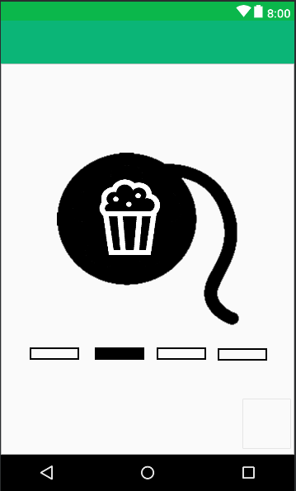
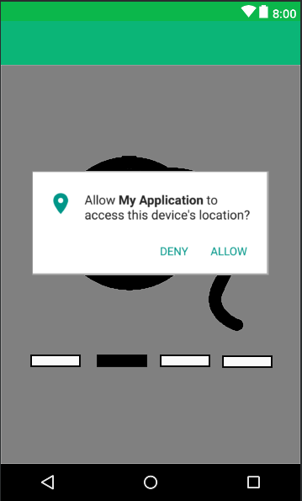
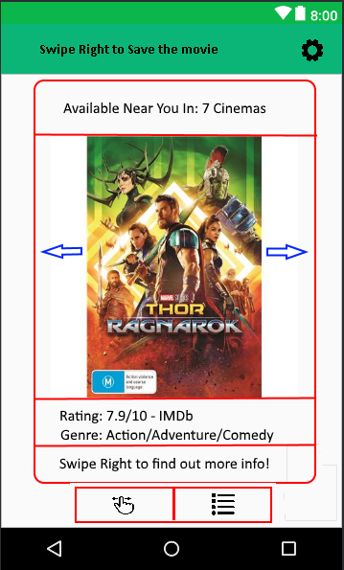
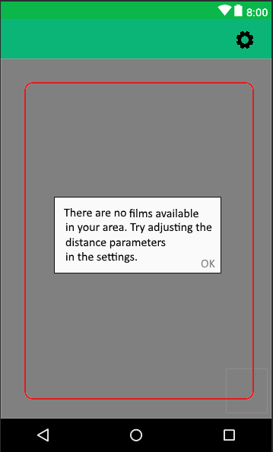
Draft User Interface
Loading Screen
Film Swipe/Location Error

Slide 7
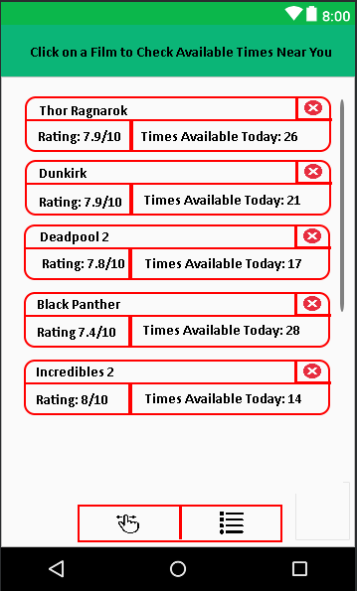
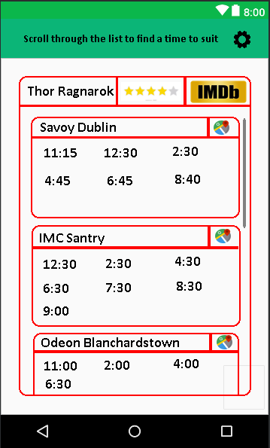
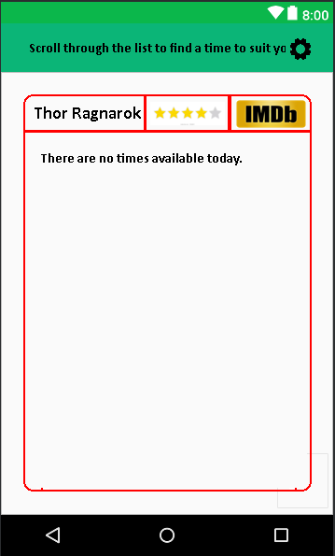
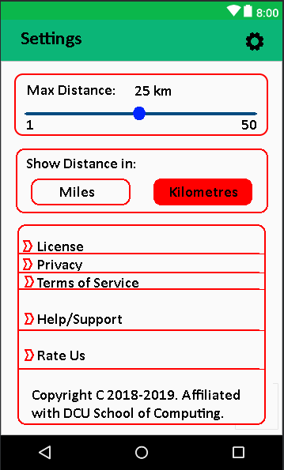
Draft User Interface
Selected/Favourite Films
Film Info
App Settings

