Slide 1
appliedOrNot – Prediction of Applications at MoreJobs4You
Seunghwan (Nigel) Kim

Slide 2
Workflow
users.csv
job_desc.csv
Binary Prediction
1 key: user_id
56 features: v1-v9
1 binary label: has_applied
Size: 2000
1 key: user_id
3 features: job_title_full, company, salary
Size: 2000
Target: has_applied
Preprocessing
Missing value imputation
5-fold Cross Validation
Multiple ML model comparison

Slide 3
Dataset Exploration – users.csv
users.csv
Key: user_id
Features: 56 continuous features (anonymized)
Range: 8e-6 – 0.999…
Label: Binary (has_applied)
Size: 2000
Positive label frequency: 0.576
Each row represents a unique user.

Slide 4
Dataset Exploration – job_desc.csv
job_desc.csv
Key: user_id
Features: 3 in total
job_title_full: text
salary: continuous
Range: 50000 – 70000
company: categorical character
8 unique companies in total
Size: 2000
Each row represents a unique user.

Slide 5
Preprocessing
Merging two datasets on the shared key: user_id
Text feature (job_title_full) is removed
Categorical character feature (company) is encoded into numerical labels using sklearn.preprocessing module
Missing values are imputed by the feature’s average value
Median
Cannot use forward/backward imputation because of missing context

Slide 6
Model 1: Logistic Regression
Most basic binary classification algorithm.
Computes log-odds for each label.
Combination of predictive features
It can predict the probability of each label’s occurrence using a logit function (sigmoid).

Slide 7
Model 1: Results I
Performed 5-fold cross validation with random shuffling
Solver: L-BFGS-B, LIBLINEAR
Mean AUROC: 0.51 ± 0.02
Mean F1 score: 0.576
Runtime: 0.4 seconds
Quick Analysis: Logistic Regression model is no better than random guessing

Slide 8
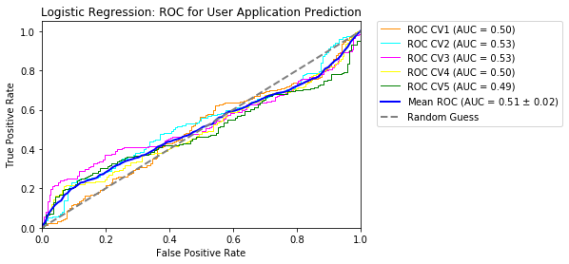
Model 1: Results II

Slide 9
Model 1: Results III
Feature Importance: obtained by analyzing the model coefficients
Top 10 Predictive Features
 | raw_coeff | abs_coeff | sign
salary | 5.14E-06 | 5.14E-06 | 1
company_encoded | 3.29E-10 | 3.29E-10 | 1
v3 | 5.76E-11 | 5.76E-11 | 1
v56 | 5.37E-11 | 5.37E-11 | 1
v27 | 5.21E-11 | 5.21E-11 | 1
v38 | 5.11E-11 | 5.11E-11 | 1
v24 | 5.08E-11 | 5.08E-11 | 1
v1 | 4.97E-11 | 4.97E-11 | 1
v43 | 4.97E-11 | 4.97E-11 | 1
v13 | 4.91E-11 | 4.91E-11 | 1

Slide 10
Model 2: Support Vector Machine
Conceptually similar to a binary classifier.
Transforms the original data points into a higher dimension using a designated kernel function before the separation.
It is able to capture more complex relationships between the data points, thereby allowing us to expand the classifier in a non-linear form.

Slide 11
Model 2: Results I
Performed 5-fold cross validation with random shuffling
Kernel: RBF
Mean AUROC: 0.57 ± 0.04
Mean F1 score: 0. 56
Runtime: 8.6 seconds
Quick Analysis: Performs poorly, no better than random guessing. Non-linear kernels don’t do better. Kernel computation increases the runtime.

Slide 12
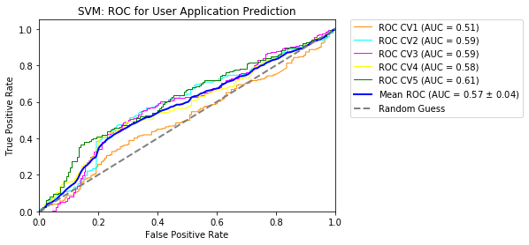
Model 2: Results II

Slide 13
Model 2: Results III
Feature Importance: obtained by analyzing the model coefficients, using linear kernel.
Top 10 Predictive Features
 | raw_coeff | abs_coeff | sign
company_encoded | -93.445983 | 93.4459826 | -1
v45 | -22.756038 | 22.7560378 | -1
v5 | -21.240102 | 21.2401023 | -1
v3 | 19.4250541 | 19.4250541 | 1
v27 | 18.2865045 | 18.2865045 | 1
v51 | -17.505668 | 17.5056676 | -1
v37 | -14.894874 | 14.8948741 | -1
v13 | 14.7573814 | 14.7573814 | 1
v55 | -14.752735 | 14.752735 | -1
v56 | 14.6790168 | 14.6790168 | 1

Slide 14
Model 3: Random Forest
Essentially a multiple bootstrap aggregated decision tree.
Produces a separation using a subset of features in each split of nodes.
Multiple trees train on different components of the training set to reduce the variance and prevent overfitting.
Trade-off between bias & variance.
Notes:
Overfitting occurs when there’s low bias and high variance.

Slide 15
Model 3: Results I
Performed 5-fold cross validation with random shuffling
Number of trees (weak learners): 200
Minimum samples in leaf: 10
Number of features to consider: 25
Maximum depth of the tree to expand: 50
Label class weights are balanced (inversely proportional to class frequencies)
Mean AUROC: 0.74 ± 0.04
Mean F1 score: 0.688
Runtime: 30.3 seconds

Slide 16
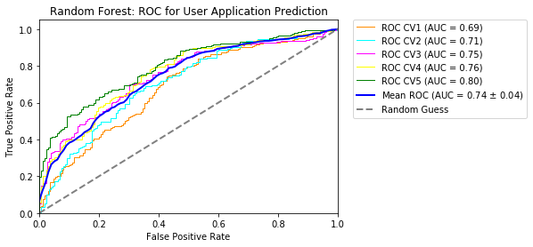
Model 3: Results II

Slide 17
Model 3: Results III
Feature Importance: obtained by analyzing how much each feature contributes to decreasing Gini impurity.
Top 10 Predictive Features: All features have similar power
 | raw_coeff | abs_coeff | sign
company_encoded | 0.01220697 | 0.01220697 | 1
v5 | 0.01220697 | 0.01220697 | 1
v37 | 0.01220697 | 0.01220697 | 1
v9 | 0.01220697 | 0.01220697 | 1
v8 | 0.01220697 | 0.01220697 | 1
v7 | 0.01220697 | 0.01220697 | 1
v6 | 0.01220697 | 0.01220697 | 1
v56 | 0.01220697 | 0.01220697 | 1
v55 | 0.01220697 | 0.01220697 | 1
v54 | 0.01220697 | 0.01220697 | 1

Slide 18
Model 4: Gradient Boosting Machine
Ensemble method similar to random forest model.
Builds trees sequentially, thereby allowing each new tree to take the previous tree into account for enhanced learning.
Instead of conventional weight adjusting process in most boosting algorithms, this model uses gradients in the loss function to assign the weights.
Notes:
Sequential tree building allows us to build on top of each previous tree, and the final ensemble model will take the weighted sum of previous trees’ predictions.

Slide 19
Model 4: Results I
Performed 5-fold cross validation with random shuffling
Loss function: Binomial deviance loss function (logistic regression)
Number of trees: 200
Minimum samples in leaf: 10
Number of features to consider: 25
Maximum depth of the tree to expand: 50
Mean AUROC: 0.74 ± 0.02
Mean F1 score: 0.683
Runtime: 20.7 seconds

Slide 20
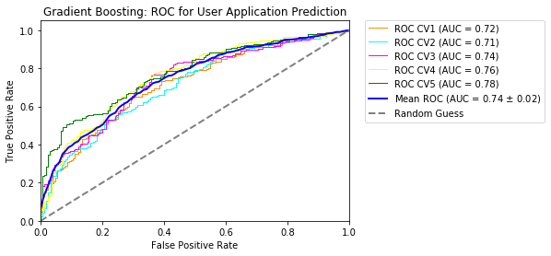
Model 3: Results II

Slide 21
Model 3: Results III
Feature Importance: obtained by analyzing how much each feature contributes to decreasing Gini impurity.
Top 10 Predictive Features: All features have similar power
 | raw_coeff | abs_coeff | sign
company_encoded | 0.01115396 | 0.01115396 | 1
v5 | 0.01115396 | 0.01115396 | 1
v37 | 0.01115396 | 0.01115396 | 1
v9 | 0.01115396 | 0.01115396 | 1
v8 | 0.01115396 | 0.01115396 | 1
v7 | 0.01115396 | 0.01115396 | 1
v6 | 0.01115396 | 0.01115396 | 1
v56 | 0.01115396 | 0.01115396 | 1
v55 | 0.01115396 | 0.01115396 | 1
v54 | 0.01115396 | 0.01115396 | 1

Slide 22
Thoughts
Other imputation methods should be explored to handle missing values.
Linear classifiers do not perform well on this prediction task.
Non-linear kernel in SVM did not perform well either. The problem may not lie in the data separability.
Ensemble models perform much better, as expected.
More hyperparameter optimization in the ensemble models will be required to fine-tune the model and increase performance.

Slide 23
Future Steps - I
What other features can we use for a next step?
We can parse the text feature (job_title_full) to extract job category information and construct a categorical feature. Similarly, we can extract job seniority level and construct a continuous feature.
We can request information such as age, speciality, previous salary, and previous job seniority level, which are common features that we consider when we apply for a new job.

Slide 24
Future Steps - II
Do we need to reframe the problem to make the project more successful?
Instead of blindly predicting whether a user will apply for a job posting based on the trained model, we can reframe it to predict the probability of a user applying to the job. This would not be a big difference in terms of work on the product owner’s side, but it will allow for a more detailed analyses of users’ behaviors.

Slide 25
Future Steps - III
Is my model prescriptive?
By direct observation, no. My models only give a prediction estimate of whether a user will apply to the job. However, it can be prescriptive in the sense that the product owner can tailor the job description to lean towards the already-applied users’ features. This will garner more similar users to apply.
Also, we can analyze the positive datapoint and the negative datapoint with similar feature values to extract subset of features that makes a difference in users’ decision making process.

