Slide 1
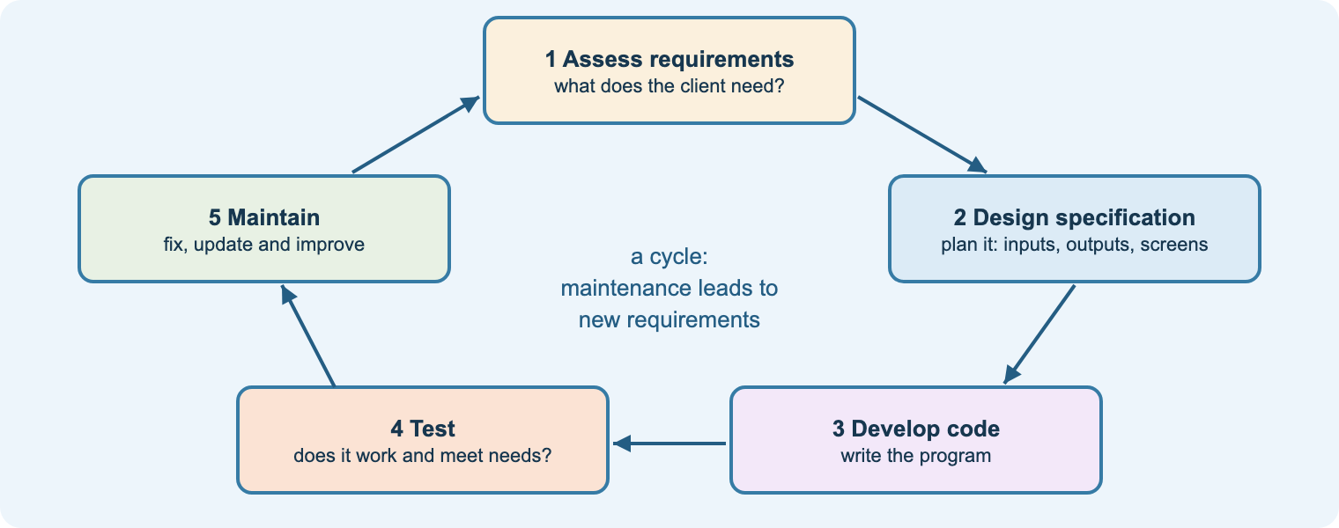
Unit 12
Software Development
Teacher delivery deck · BTEC First in Information and Creative Technology
Understand it · Design it · Build it · Test it · Review it
Notes:
Purpose: this deck supports delivery of Unit 12 alongside the student course site (nigeriastudentcenter.github.io/btech/unit12/start.html).
Lesson slides follow the college routine: starter, aim, teach, practical, task, check, flipped homework.
The scheme of work has 20 three-hour lessons and three assignments; the speaker notes link each slide to the workbook section, practical and quiz.

Slide 2
How each lesson runs
1
2
3
4
5
6
7
Starter
predict-the-output or recap quiz
Aim
share the aim and the criteria it builds
Teach
live-code or diagram-led explanation
Practical
build it in Visual Studio
Task
workbook activity on the site
Check
quiz or exit question
Homework
flipped: preview the next lesson
Live coding works best
Type the example in front of the class, make a deliberate mistake, and let students spot it. Then they build their own version in the practical.
Three-hour lessons
Roughly: 20 min teach, 90 min practical, 40 min workbook and quiz, with breaks. Practicals are on the site so students can catch up.
Notes:
Students who miss a lesson can follow the Learn page and practical at home; console versions run at dotnetfiddle.net.

Slide 3
Unit 12 at a glance
60
3
4
18
10
guided learning hours
assignments
learning aims: A–D
lessons on the site
programming practicals
Learning aim A
Understand the characteristics and uses of a software program
Learning aim B
Design a software program
Learning aim C
Develop and test a software program
Learning aim D
Review the finished software program
Level 1 and Level 2 · internally assessed · mandatory in the Computer Science pathway · links to Unit 2 Technology Systems and Unit 8 Mobile Apps Development.
Notes:
Unit 12 builds on Unit 2 (software types) and complements Unit 8 (mobile apps).
Maths opportunities are flagged on 1C.4, 2C.P4, 2C.M3, 2C.D3 (calculations in programs).

Slide 4
Assessment map
Assignment | Level 1 / Pass | Merit | Distinction
1 · Characteristics of programs (aim A) | 1A.1 / 2A.P1 Identify / explain the purpose and characteristics of two programs | 2A.M1 Comment on quality, suggest improvements, flowchart | 2A.D1 Discuss strengths and weaknesses
2 · Design, develop, test (aims B, C) | 1B.2 / 2B.P2 Purpose and user requirements 1B.3 / 2B.P3 Design: problem definition, solution, predefined functions, test plan 1C.4 / 2C.P4 Develop: UI, constructs, commentary 1C.5 / 2C.P5 Test and repair | 2B.M2 Detailed design with alternatives and test data 2C.M3 Functional program meets the brief 2C.M4 Feedback used to improve | 2B.D2 Justify design decisions 2C.D3 Refine for code quality and user feedback
3 · Review (aim D) | 1D.6 / 2D.P6 How the program suits requirements and purpose | 2D.M5 Review the extent requirements are met, with feedback and constraints | 2D.D4 Evaluate against designs and code quality; justify changes; recommend
The Assignment guide on the site restates every criterion in plain English with a success checklist; the same data drives the builder and the AI coach.
Notes:
The scheme of work schedules Assignment 1 in lesson 5, Assignment 2 in lessons 17–18 and Assignment 3 in lesson 20. Use centre-devised briefs or Pearson’s authorised assignment briefs.
Choose an Assignment 2 client different from the leisure-centre example used in the lessons.

Slide 5
The student course site
1. Assignment guide
Three assignments in plain English; Level 1 to Distinction explained; checklists
2. Learn
18 lessons with original diagrams, flowcharts and Visual Basic examples
3. Workbook + tutor
Activity and quick check per lesson; AI study tutor; saves on device
4. Practicals
10 labs: forms, calculator, selection, loops, arrays, files, debugging, quiz project
5. Assignment builder
Analysis, design, test plan, changes, feedback and review tables; AI coach; AI-use log
6. Quizzes
Five instant-marked quizzes, including predict-the-output
Plus 7. Videos: 22 embedded videos (MrBrownCS, TED-Ed, Computerphile, freeCodeCamp). Link for Teams: nigeriastudentcenter.github.io/btech/unit12/start.html
Notes:
Tour the site in lesson 1 and show the backup download button on shared PCs.

Slide 6
AI tutor and assignment coach: used properly
The AI will…
• explain programming concepts in plain English
• say what a task and command word ask for
• help students plan with headings and questions
• review the student’s own draft against the checklist
• point to a line of their code and ask a question about it
• use short examples from a different problem
The AI will not…
• write code for the student’s brief
• paste back corrected code
• write pseudocode, flowcharts, screen designs or test plans for the brief
• write justifications, reviews or evaluations
• predict grades or accept instructions to break these rules
AI-use log
Every coach question is saved with date, task and a reply extract. Students download it and submit it with each assignment, so AI use is acknowledged in line with JCQ and Pearson guidance.
Notes:
Make the declaration explicit: the program must be the student’s own code.
The coach receives only the task ID; the brief, checklist and rules are held on the server.

Slide 7
Delivery plan (20 × 3-hour lessons)
Lessons 1–5
Lessons 6–10
Lessons 11–16
Lessons 17–18
Lessons 19–20
Aim A: why software, languages, constructs, quality; Assignment 1
Aim B: SDLC, requirements, design specs, screens, pseudocode, flowcharts, test plans
Aim C: Visual Basic, data types, constructs, events, data structures, testing
Assignment 2: design, develop, test, refine
Aim D: reviewing software; Assignment 3
Based on the Pearson BTEC First ICT Unit 12 scheme of work. Practical 10 (quiz project) is a full rehearsal before Assignment 2.
Notes:
Learners should spend lesson time and non-supervised time on assignments (scheme of work).

Slide 8
Learning aim A
Understand the characteristics and uses of a software program · Assignment 1

Slide 9
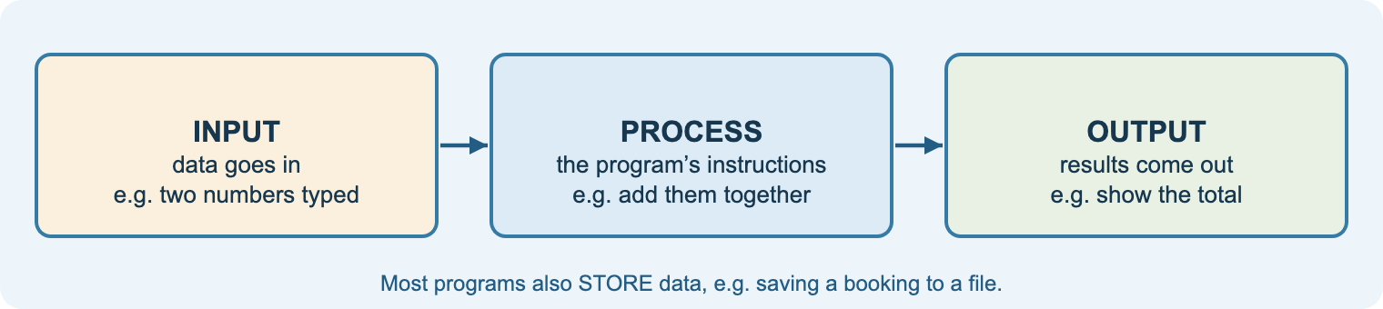
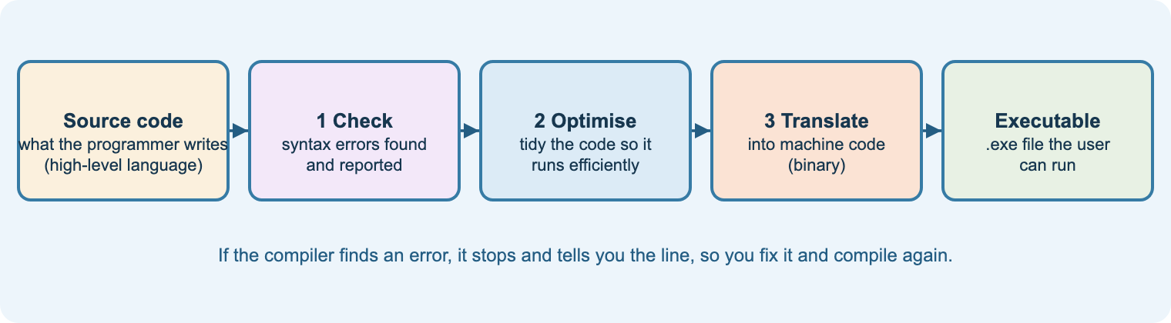
A1–A2
Why software? Languages and compiling
Aim: explain uses of software, types of language and why programs are compiled
Inputs, processing, outputs, storage
Uses: games, productivity, information, repetitive/dangerous tasks, complex problems
Low-level vs high-level
Procedural vs event-driven
Compiler: check, optimise, translate
Starter
Write instructions to make a cup of tea; swap and follow them literally.
Practical
Practical 1: your first Windows Forms program.
Check
Quiz 1.
Notes:
Demonstrate a centre-devised Hello World program, then a game, a web app and a desktop app, asking which language each might use.
Question: why can the CPU not run Visual Basic directly?
Videos (A1, A2): TED-Ed What’s an algorithm?; MrBrownCS high/low-level languages and translators.

Slide 10
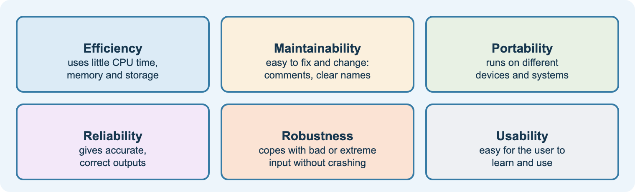
A3–A4
Constructs, techniques and quality
Aim: identify constructs and techniques in a program and comment on its quality
Command words, subroutines, strings, files, data structures, events
Annotate someone else’s code
Six quality measures
Evidence from the code, then a specific improvement
Starter
Spot five problems in a badly written program.
Task
Workbook A3 and A4.
Link
Assignment 1: 2A.P1, 2A.M1, 2A.D1.
Notes:
Model a quality comment: measure → evidence → improvement.
Support: the six-box quality diagram. Stretch: discuss trade-offs (efficiency vs readability).
Video (A4): MrBrownCS Testing and defensive programming.

Slide 11
ASG 1
Assignment 1: Characteristics of software programs
Scenario: work experience at a software company; explain and assess two simple programs supplied by the teacher.
1A.1 / 2A.P1 · Pass
Identify / explain the purpose and characteristics of two programs, including tools and techniques used.
2A.M1 · Merit
Comment on the quality of one program, suggest improvements, and draw a flowchart of the improved processing.
2A.D1 · Distinction
Discuss the strengths and weaknesses of the program and reach a conclusion.
Tools for students
Assignment builder: program analysis table, quality review table · AI coach (explain, plan, review, accuracy) · AI-use log · tip: run the programs, or dry-run them with a trace table
Notes:
Supply two short, different programs (e.g. one with selection, one with a loop). Do not use the examples from the Learn page.
Collect the AI-use log with submissions.

Slide 12
Learning aim B
Design a software program

Slide 13
B1–B2
Life cycle, requirements and design specification
Aim: describe the SDLC and turn a brief into requirements and a design specification
Assess requirements → design → develop → test → maintain
Waterfall, iterative/agile, RAD
Purpose vs user requirements
Problem definition statement
Scope, inputs, outputs, processing, UI, constraints
Starter
Getting ready for college: what are your stages?
Task
Workbook B1 and B2: café ordering brief.
Check
Quiz 2a.
Notes:
Use a short sample brief and have pairs extract requirements.
Video (B1): AltexSoft, Software development life cycle explained.

Slide 14
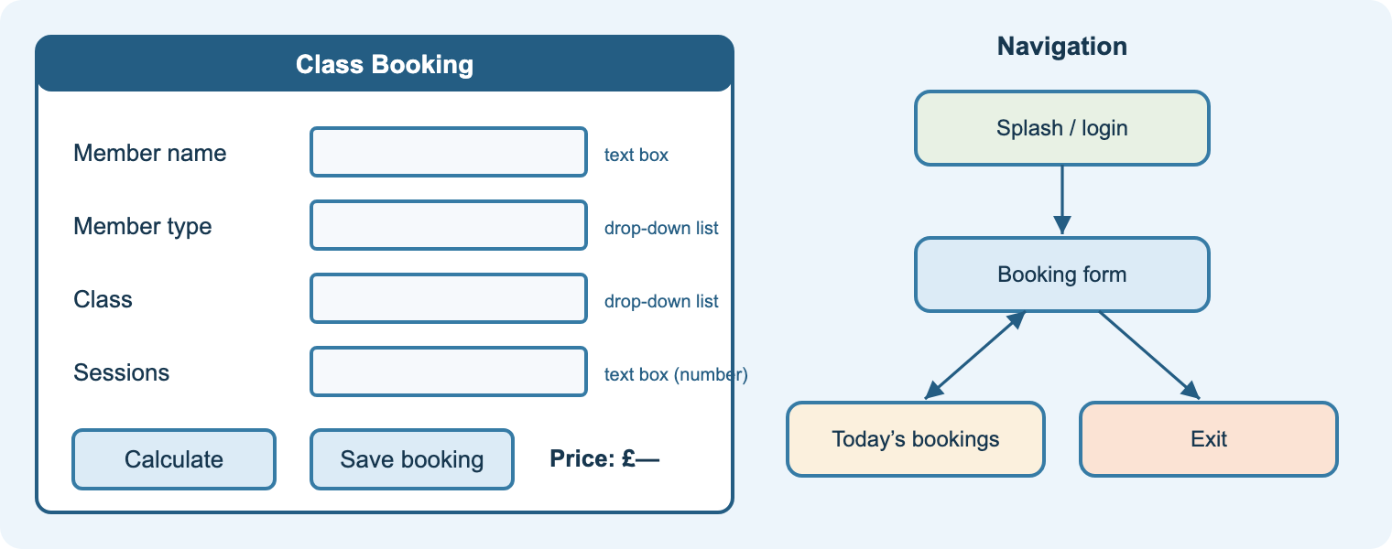
B3
Screens, navigation and alternatives
Aim: design screen layouts and navigation and compare alternative solutions
Main tasks as input, processing, output
Annotate every control
Navigation diagrams
Two alternatives, compared
Justify against requirements and constraints
Starter
Rate three real app screens for usability.
Practical
Quiz screen design (scheme of work lesson 7).
Link
2B.M2 alternatives; 2B.D2 justification.
Notes:
Students design the quiz screen: question, four answers A–D, Submit, Quit, feedback area.
Stretch: prototype it in Visual Studio without code.

Slide 15
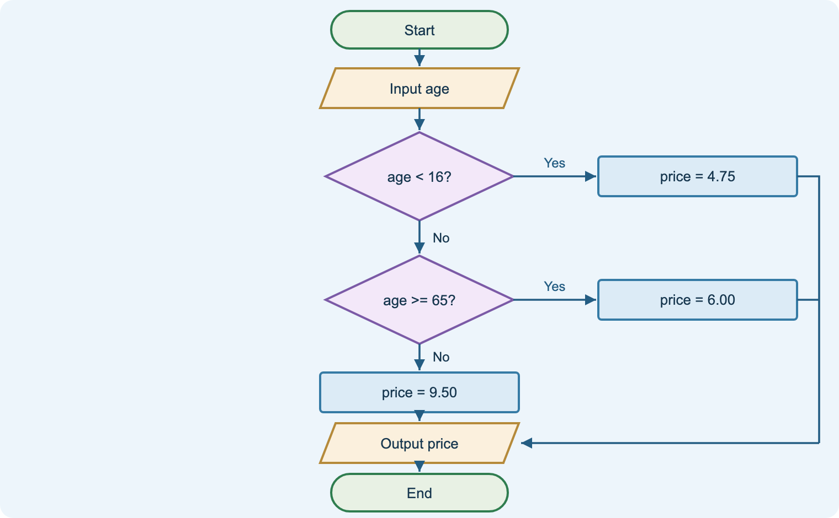
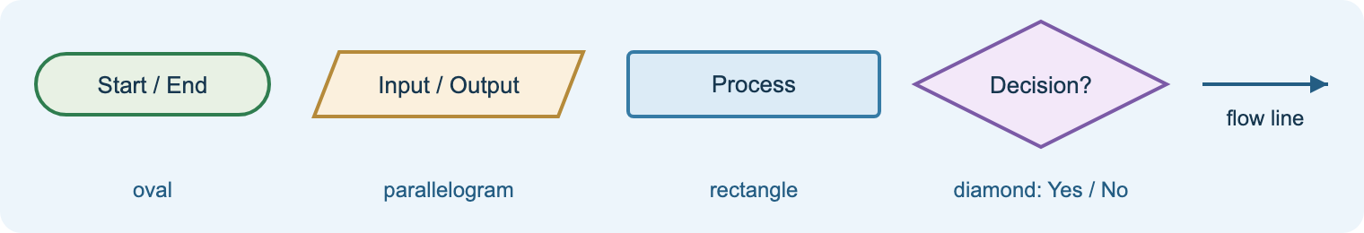
B4
Algorithms: pseudocode, flowcharts, trace tables
Aim: write algorithms as pseudocode and flowcharts and dry-run them
Five flowchart symbols
Pseudocode: structured English
Every decision has Yes and No exits
Trace tables to dry-run
Design before code
Starter
Robot making tea: pseudocode in pairs.
Practical
Practical 3: temperature converter from design to code.
Check
Quiz 2b.
Notes:
Scheme of work lesson 10 tasks: multiply two numbers; °C to °F using F = C × 9 / 5 + 32.
Videos (B4): MrBrownCS Flowcharts; trace tables tutorial; pseudocode (stretch).

Slide 16
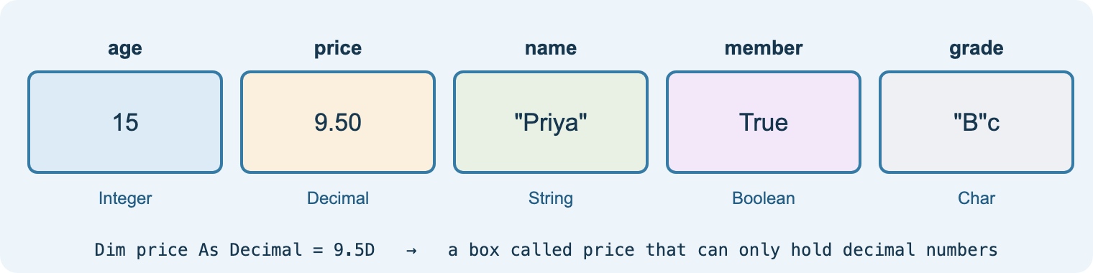
B5
Data, validation, predefined code and test plans
Aim: plan data, validation, error handling, predefined code and a test plan
Data structures and storage
Presence, type, range, length, lookup checks
Error handling and reporting
List predefined code and its source
Test plan: normal, boundary, erroneous
Starter
Break this form: what could a user type?
Task
Workbook B5: marks program test plan.
Link
2B.P3 design and test plan.
Notes:
Model a test plan with boundary data around 1–10.
Video (B5): MrBrownCS Data assurance considerations.

Slide 17
Learning aim C
Develop and test a software program in Visual Basic

Slide 18
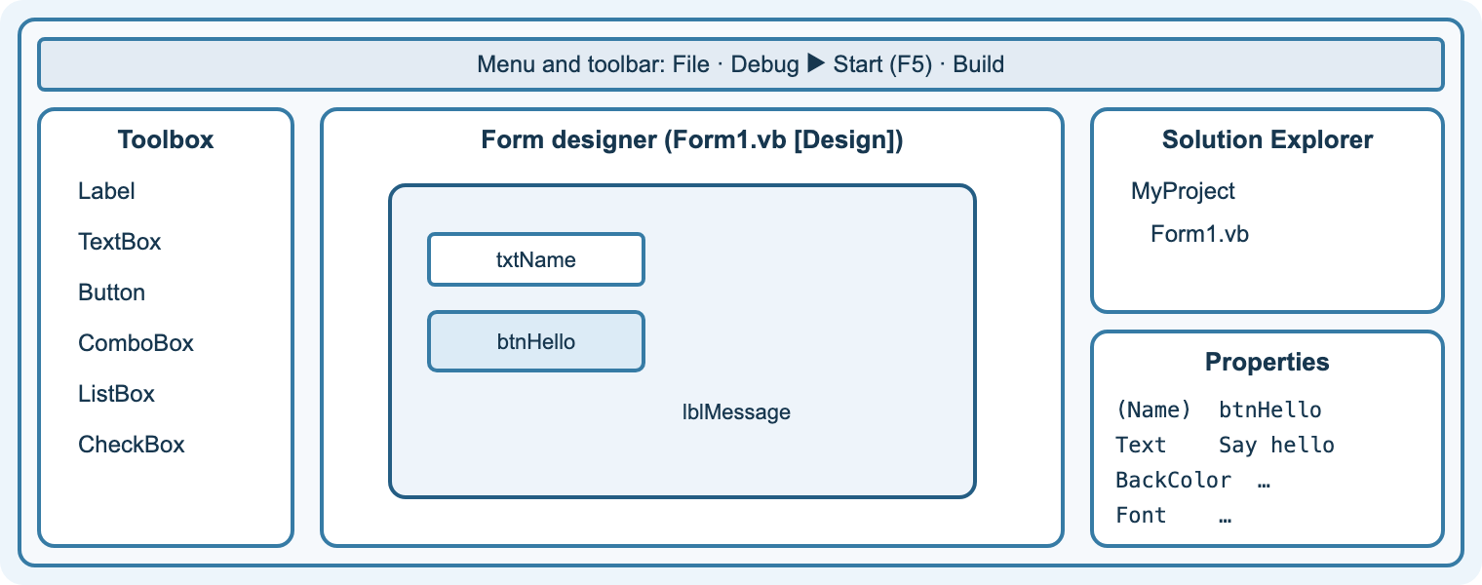
C1
The IDE, forms and events
Aim: use Visual Studio to build a form and write event handlers
Toolbox, designer, Properties, Solution Explorer
Name controls with prefixes
Double-click → event handler
Input from TextBox.Text; output to Label.Text
F5 to run; Build for an .exe
Practical
Practical 1 and 2: first form; calculator.
Task
Workbook C1.
Check
Quiz 3a.
Notes:
Scheme of work lessons 11 and 15. Show properties changing live.
Videos (C1): MrBrownCS IDEs; freeCodeCamp VB.NET full course for reference.

Slide 19
C2–C3
Variables, operators and selection
Aim: use data types, constants, operators and If/ElseIf/Select Case
Integer, Decimal, String, Char, Boolean, Date
Constants; local vs global
+ − * / \ Mod; comparison; And/Or/Not
If … ElseIf … Else; Select Case
Order of conditions matters
Starter
Predict: 17 Mod 5 and 17 \ 5.
Practical
Practical 4: login and grade calculator.
Check
Quiz 3b.
Notes:
Scheme of work lessons 12–14.
Videos (C2, C3): MrBrownCS Data types, variables and constants; 3 basic constructs; VB.NET If statements.

Slide 20
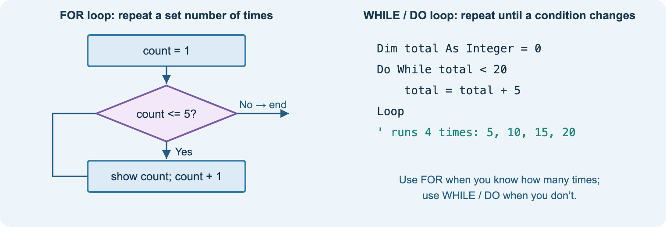
C4–C5
Loops and subroutines
Aim: use For, Do While, Do … Loop Until, procedures and functions
For … Next for a known number of times
Do While / Loop Until for conditions
Recursion needs a base case
Sub vs Function; parameters; Return
Reuse and maintainability
Starter
Trace a For loop on the board.
Practical
Practical 5: loops and guessing game.
Check
Quiz 3b.
Notes:
Refactor the calculator into functions to show the benefit.
Videos (C4, C5): Computerphile recursion (stretch); MrBrownCS subprograms and functions.

Slide 21
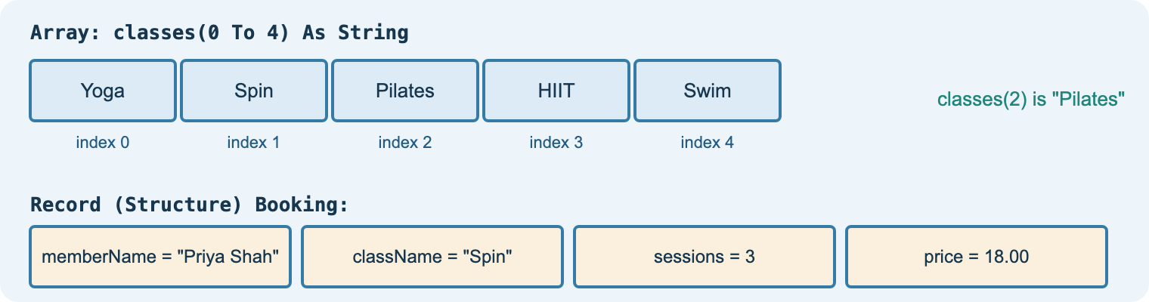
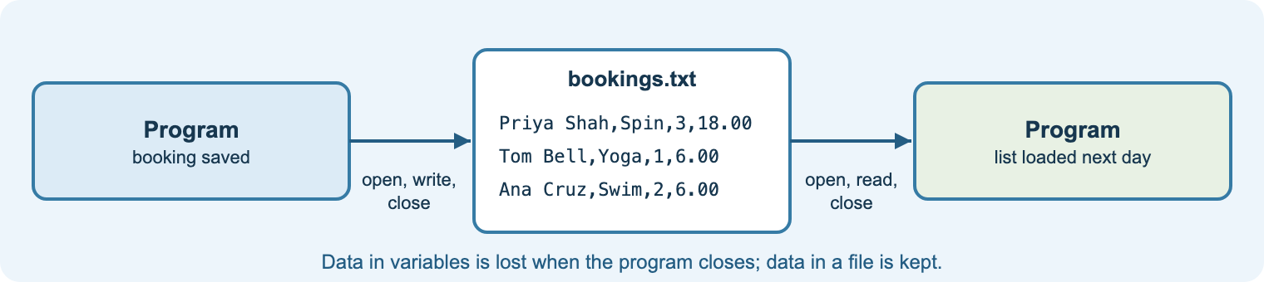
C6–C7
Arrays, strings, files and robustness
Aim: use arrays, records, string handling and files, with validation and error handling
Arrays start at index 0
Structure for records
Length, Substring, ToUpper, IndexOf, Split
StreamWriter / StreamReader: open, read, write, close
TryParse, Try … Catch, comments, Build
Practical
Practicals 6, 7 and 8.
Task
Workbook C6 and C7.
Check
Quiz 4.
Notes:
Scheme of work lesson 16.
Videos (C6, C7): MrBrownCS arrays, string handling, text files.

Slide 22
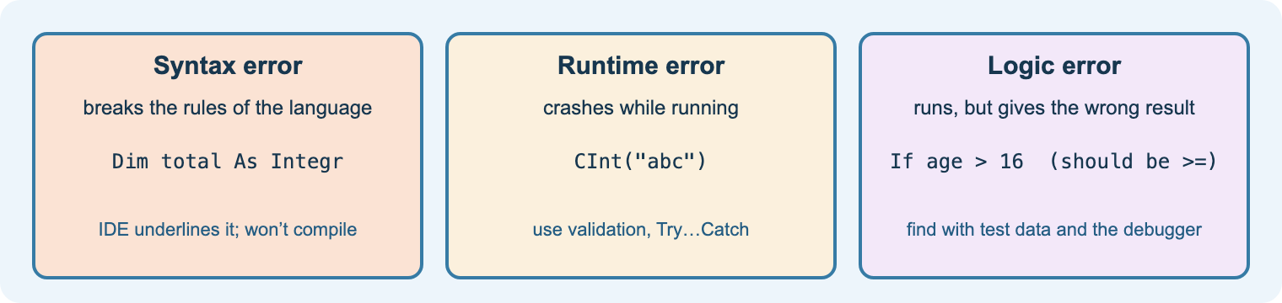
C8
Testing, debugging and refining
Aim: test against a plan, debug, gather feedback and refine
Syntax, runtime and logic errors
Breakpoints (F9), stepping (F10/F11), Locals
Record expected vs actual, with screenshots
Feedback on usability and quality
Refine, re-test, update the design
Practical
Practical 9: debugging challenge.
Task
Workbook C8.
Check
Quiz 4.
Notes:
Case study: cash machines paying out too much because of a software fault.
Videos (C8): MrBrownCS testing approaches; syntax and logic errors.

Slide 23
ASG 2
Assignment 2: Design, develop and test
Scenario: a client brief describing a problem software could solve (e.g. replacing a paper booking or ordering system).
1B.2 / 2B.P2
purpose and user requirements
In the Assignment builder
• requirements table
• IPO tasks, alternatives, data and validation, predefined code sources
• test plan with normal / boundary / erroneous types
• development and changes log
• feedback log
• AI coach that will not write their code
• AI-use log to hand in
1B.3 / 2B.P3
design and test plan
2B.M2 · 2B.D2
alternatives; justified decisions
1C.4 / 2C.P4
develop: UI, constructs, comments
2C.M3
functional program meets brief
1C.5 / 2C.P5
test and repair
2C.M4 · 2C.D3
feedback; refine for quality
Notes:
Lessons 17–18 plus non-supervised time. Check source code includes commentary throughout (2C.P4).
For 2C.D3, look for refinements to code quality, not just new features.

Slide 24
Learning aim D
Review the finished software program · Assignment 3

Slide 25
D1
Reviewing the finished program
Aim: review a program against requirements, purpose, user experience, constraints and quality
Requirements: fully, partly, not met
Fitness for purpose
User experience from feedback
Constraints and workarounds
Strengths, improvements, recommendations
Practical
Review the Practical 10 quiz program.
Task
Workbook D1: evaluation grid.
Check
Quiz 5.
Notes:
Learners review software they wrote in the course, not their assignment work (scheme of work lesson 19).
Distinction: compare with the initial design and justify every change.

Slide 26
ASG 3
Assignment 3: Review the finished program
1D.6 / 2D.P6 · Pass
Identify / explain how the final program is suitable for the original requirements and purpose.
2D.M5 · Merit
Review the extent to which it meets the requirements, considering feedback from others and constraints.
2D.D4 · Distinction
Evaluate against the initial designs and code quality, justify changes, recommend further improvements.
Evidence to use
Test plan results and screenshots · feedback log · development and changes log · the review grid in the Assignment builder · the original design documents
Notes:
Lesson 20. Format can be a report or a presentation to the client.

Slide 27
Ten practicals on the student site
1
2
3
4
5
First Windows Forms program
Two-number calculator
Temperature converter
Login and grades
Loops and guessing game
6
7
8
9
10
Arrays and strings
Save and load a file
Validation and errors
Debugging challenge
Quiz program project
Visual Studio Community (Windows Forms, Visual Basic). Console versions run at dotnetfiddle.net. Practical 9 needs a teacher-prepared program with three faults.
Notes:
Map: 1 C1 · 2 C2 · 3 B4 · 4 C3 · 5 C4 · 6 C6 · 7–8 C7 · 9 C8 · 10 B3–D1.

Slide 28
Ready to deliver
Share the start page link in Teams
Lesson 1: tour the site and the Assignment guide
Install Visual Studio Community on lab PCs
Agree AI rules; collect AI-use logs
Use the quizzes as starters and exit checks
Notes:
Site: nigeriastudentcenter.github.io/btech/unit12/start.html
The AI tutor and coach depend on the college Azure subscription being active; the rest of the site works without it.

