Slide 1
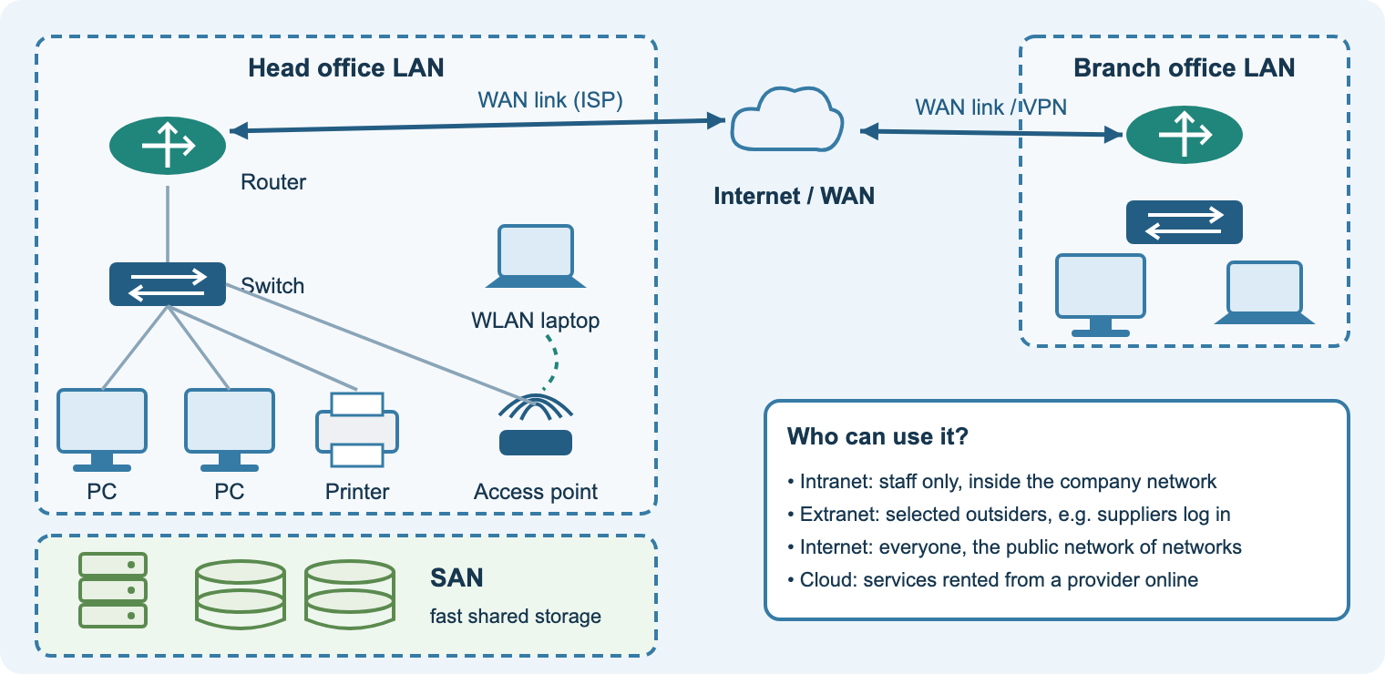
Unit 19
Computer Networking
Teacher delivery deck · BTEC Level 3 Nationals in Computing
Learn it · Build it · Test it · Evaluate it
Notes:
Purpose: this deck launches and supports delivery of Unit 19 alongside the student course site (/btech/unit19/start.html).
Every lesson slide follows the college lesson structure: starter, aim, teach, practical, task, check, homework (flipped).
Speaker notes on each slide give teaching points, questions, differentiation and the matching workbook section and lab.

Slide 2
How each lesson runs
1
2
3
4
5
6
7
Starter
5 min hook or recap quiz
Aim
share the learning aim and the criteria it builds
Teach
diagram-led explanation with questioning
Practical
Packet Tracer or Linux lab
Task
workbook activity linked to the assignment
Check
quiz or exit question
Homework
flipped: preview the next lesson
On the student site
Each lesson has a matching Learn page section, workbook activity (with AI tutor), Packet Tracer lab and quiz. Students can revisit everything outside class.
In the speaker notes
Teaching points, questions to ask, stretch and support ideas, the workbook section and lab to use, and the flipped homework.
Notes:
Mirror the existing Unit 19 PowerPoint structure so students recognise the routine.
Starters from the department bank (Millionaire, catchphrase, Hollywood Squares) still work well here.
End every lesson with the online test or the site quiz and the lesson feedback form.

Slide 3
Unit 19 at a glance
60
2
3
16
10
guided learning hours
internally assessed assignments
learning aims: A, B, C
lessons on the student site
hands-on labs
Learning aim A
Investigate how networks use communication protocols to give effective, secure access to services and resources.
Assignment 1 · report
Learning aim B
Investigate network design to meet client requirements.
Assignment 2 · design documents
Learning aim C
Develop a network to meet client requirements.
Assignment 2 · build, test, evaluate, portfolio
Notes:
Unit type: internal. Maximum of two summative assignments: A (A.P1, A.P2, A.M1, A.D1) and B+C (B.P3, B.P4, C.P5, C.P6, C.P7, B.M2, C.M3, BC.D2, BC.D3).
Resource requirement: a physical or virtual networking environment. Packet Tracer covers this safely; Linux VMs cover users, groups and permissions.
Links: Unit 20 Managing and Supporting Systems, Unit 21 Virtualisation, Unit 29 Network Operating Systems, Unit 30 Communication Technologies.

Slide 4
Assessment map
Assignment | Pass | Merit | Distinction
1 · Investigating computer networks (aim A) | A.P1 Explain the need for network types and models A.P2 Explain characteristics and functions of components | A.M1 Analyse the functions of components needed to build different network types | A.D1 Evaluate network models and their suitability for different client requirements
2 · Design, build, test, evaluate (aims B and C) | B.P3 Explain the need for design and planning B.P4 Design a network to meet client requirements C.P5 Develop and configure it C.P6 Test it C.P7 Review it against requirements | B.M2 Justify design decisions C.M3 Optimise the network | BC.D2 Evaluate the design and the optimised network against requirements BC.D3 Demonstrate individual responsibility and self-management
Grading reminder
Pass: accurate, complete explanations and working evidence. Merit: analyse, justify, optimise (how and why). Distinction: evaluate with evidence and reasoned examples to justified conclusions; BC.D3 needs a portfolio kept throughout.
Notes:
The student Assignment guide page restates every criterion in plain English with a success checklist; it is generated from the same data the AI coach uses.
Assignment 2 specification must be complex enough: more than one network type (wired and wireless) plus user requirements such as shared folders, printers, email and intranet access (Pearson guidance).
For C.M3, optimisation should follow from testing: performance, security loopholes or usability.

Slide 5
The student course site
1. Assignment guide
Both assignments in plain English, P/M/D explained, success checklists, AI rules
2. Learn
16 lessons with original diagrams, key terms, real-world examples and Packet Tracer tasks
3. Workbook + tutor
Practice activity and quick check per lesson; AI study tutor; saves on device
4. Practicals
10 labs: LANs, wireless, servers, IOS security, routing, VLANs, Linux, troubleshooting
5. Assignment builder
Checklists, planning tables (IP plan, test plan, permissions, evaluation, diary), AI coach, AI-use log
6. Quizzes
Instant-marked checks: types, OSI and ports, subnetting, devices, configuration
Link for Teams: nigeriastudentcenter.github.io/btech/unit19/start.html · No student accounts; work saves in the browser with download backups.
Notes:
Walk students through the site in lesson 1. Show the download backup button on shared machines.
Nothing is stored centrally: students must download backups before changing computers.
The Teachers page links to this deck and explains how the AI tutor and coach are configured.

Slide 6
AI tutor and assignment coach: used properly
The AI will…
• explain concepts in plain English
• say what a task and command word ask for
• help students plan with headings and questions
• review the student’s own draft against the checklist
• point out missing, thin or inaccurate points
• use different examples, never the client’s
The AI will not…
• write paragraphs, tables, emails or evaluations
• rewrite or “improve the wording” of student work
• produce the client’s IP scheme, configs or test plan
• predict or promise grades
• accept instructions to break these rules
AI-use log
Every coach question is saved with date, task and a reply extract. Students download it and submit it with their work, so AI use is acknowledged, in line with JCQ and Pearson guidance on AI in assessments.
Notes:
Stress the student declaration: work must be their own. Using AI to generate assessed content is malpractice.
Ask students to hand in the AI-use log with each assignment; spot-check logs against drafts.
The coach receives only the task ID from the page; the brief, checklist and rules are held on the server so students cannot alter them.
The tutor runs on the college Azure service with daily usage limits; if it is offline the pages still work.

Slide 7
Suggested delivery plan
Weeks 2–8
Weeks 10–13
Weeks 14–18
Weeks 19–26
Weeks 27–33
Aim A: types, topologies, IP basics, OSI/TCP-IP, components, trends
Aim A: protocols, infrastructure services, software tools
Assignment 1 issued; aim B: design strategies, logical design, planning, access
Aim C practicals: configure, secure, route, VLANs, Linux, troubleshooting
Assignment 2: design, build, test, optimise, evaluate; portfolio throughout
Based on the 2025–26 Unit 19 scheme of work (33 weeks). Adjust to your calendar and assignment dates.
Notes:
Assignment 1 was issued mid-December with a late-January deadline in 2025–26; Assignment 2 runs after Easter.
Keep one practical per week so Packet Tracer skills are secure before Assignment 2.
Use the Cisco NetAcad Packet Tracer course early (digital badge) as a flipped task.

Slide 8
Learning aim A
How networks use communication protocols to give effective and secure access to services and resources · Assignment 1

Slide 9
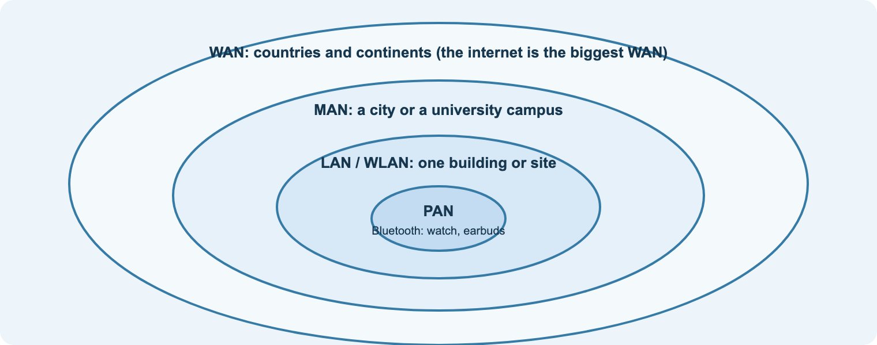
A1
Why do we need different networks?
Aim: identify network types and their characteristics
Starter
List every network you used today, from earbuds to the internet.
Task
Network types and models matrix: match LAN, WLAN, WAN, SAN, cloud to seven organisations.
Check
Exit question: intranet vs extranet, one example each.
Notes:
Teach: PAN, LAN, WLAN, MAN, WAN, SAN by scale and by who manages them. Emphasise the NEED: communicate, share data, share resources, collaborate.
Question: why would a listed building choose a WLAN? Why does a hospital data centre use a SAN?
Support: give students the types table on the Learn page (A1a). Stretch: add the cost and security implications of each choice.
Workbook A1a. Practical: Lab 1 Packet Tracer tour. Homework: complete the NetAcad Packet Tracer short course.

Slide 10
A1
One organisation, many network types
Aim: explain intranet, extranet, internet, cloud and wired–wireless integration
Intranet: private services for staff
Extranet: part of the intranet opened to trusted outsiders
Internet: the public network of networks
Cloud: computing and storage rented over the internet
Wired for speed and reliability; wireless for mobility; access points join them
Practical
Lab 3: wired and wireless integration with WPA2.
Task
Write a short explanation of why we need wired and wireless integration.
Link
A.P1 website pages: need and choice of each type.
Notes:
Use the diagram to trace who can reach what. Ask: where would the suppliers’ extranet live? What happens to the branch if the WAN link fails?
This builds directly into Assignment 1 Task 1 (A.P1).
Stretch: introduce VPNs as a way to reach the intranet securely from home.

Slide 11
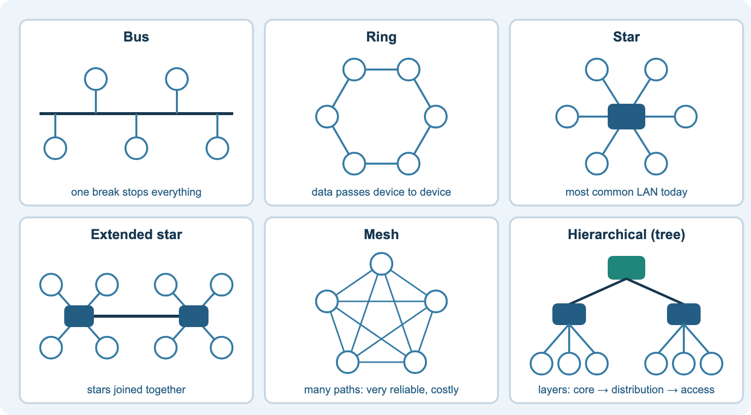
A1
Topologies and Ethernet standards
Aim: identify physical and logical topologies and the IEEE 802 family
Starter
What topology do we use in college? At home? What equipment does it need?
Task
Complete the topology comparison table: routing, complexity, scalability, reliability, cost.
Check
Quiz 1 on the site: topology questions.
Notes:
Teach: bus and ring as legacy, star and extended star as the norm, mesh for resilience, hierarchical for enterprise.
Physical vs logical diagrams: students need both for Assignment 2.
IEEE 802.3 (Ethernet) and 802.11 (Wi-Fi); 2.4 GHz range vs 5 GHz speed; the Wi-Fi Alliance.
Workbook A1b. Stretch: why do data-centre and internet backbones use partial mesh?

Slide 12
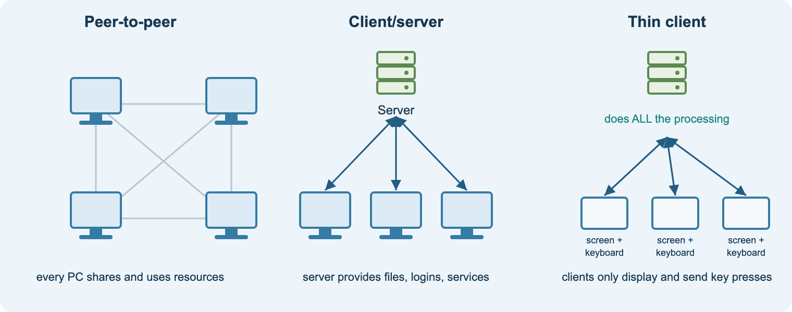
A1
Network models
Aim: describe peer-to-peer, client/server and thin client models and evaluate their suitability
Peer-to-peer: cheap, simple, hard to manage beyond ~10 PCs
Client/server: central logins, files, backups; costs more, scales well
Thin client: server does the work; cheap, secure, network-dependent
Evaluate on ease of use, set-up, performance and suitability for applications
Starter
Thin client video clip: what is actually on the desk?
Task
Workbook A1c: choose a model for a hairdresser, a college and a call centre.
Link
Prepares A.D1: balanced evaluation with reasoned examples.
Notes:
A.D1 needs benefits AND drawbacks for all three models, tested against the four factors, each backed by a realistic example, leading to a justified conclusion.
Model the difference between describing and evaluating with one worked paragraph using a different client (not the assignment wording).
Support: sentence stems (because… therefore… however…). Stretch: hybrid models, e.g. client/server plus cloud SaaS.

Slide 13
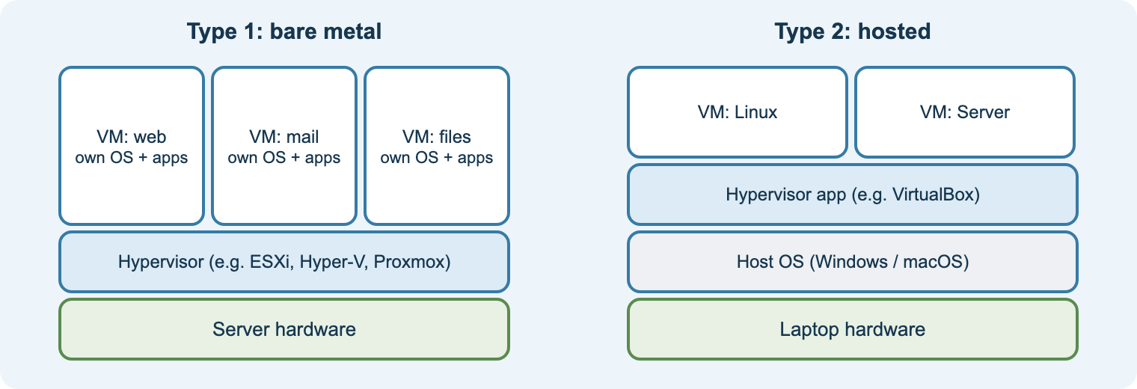
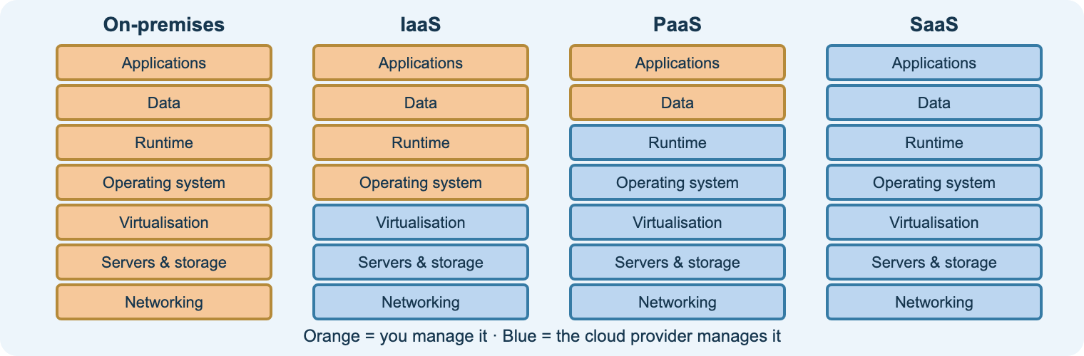
A1
Modern trends: virtualisation, cloud, BYOD, SDN
Aim: explain modern networking trends and their challenges
Server sprawl and virtualisation: Type 1 vs Type 2 hypervisors
Cloud: public, private, hybrid, edge; IaaS, PaaS, SaaS
BYOD: flexibility vs security and support
SDN and software-defined storage: central control by software
Practical
Install VirtualBox and create a Linux VM (Type 2 hypervisor).
Task
Research SDN: one benefit, one challenge, one real example.
Check
Workbook A1d quick check: IaaS vs SaaS.
Notes:
Show the cloud responsibility chart: the further right, the less the customer manages.
Ask: what is the noisy neighbour problem in public cloud?
Link BYOD to Cyber Essentials (employer feedback on the brief) and to guest VLANs later in B1.
Homework: Assignment 1 trends section research.

Slide 14
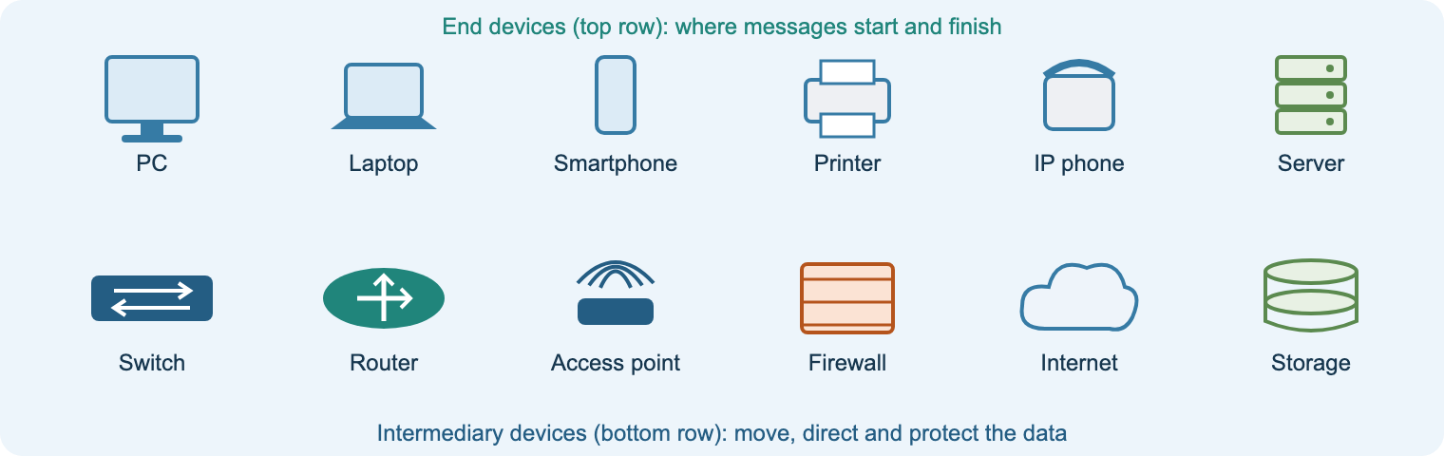
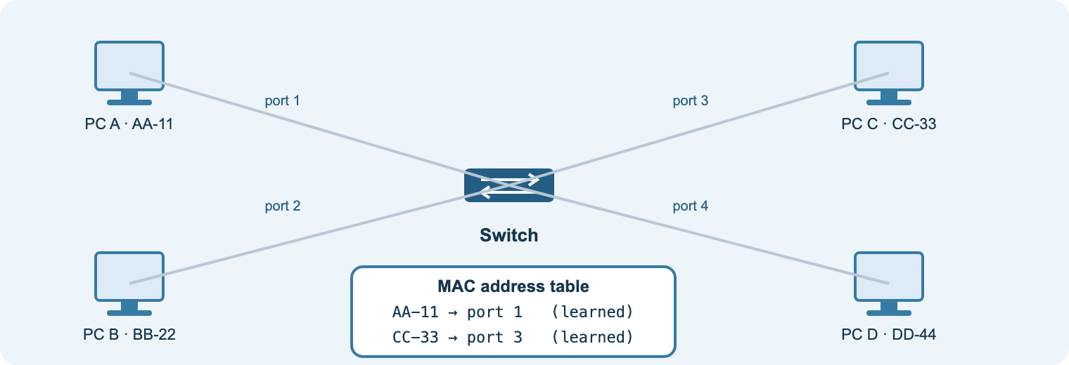
A2
Network hardware
Aim: identify the function and characteristics of network hardware
End devices create and use data; each NIC has a MAC address
Switch: layer 2, learns MACs, forwards frames to one port
Router: layer 3, routing table, static or dynamic routes
Access point: SSID, 802.11 standard, WPA2/WPA3
Media: UTP 100 m, fibre for distance and speed, wireless for mobility
Starter
How many end devices can you name in 60 seconds?
Practical
Lab 2 and show mac address-table: watch a switch learn.
Task
Component table rows: function + characteristics (A.P2 practice).
Notes:
Characteristics to compare: switches (ports, speed, PoE, managed, layer 3); routers (interfaces, routing protocols, VPN, firewall); APs (standard, range, users, management); media (distance, speed, noise, cost).
Question: why is a hub legacy? What changes when a switch is managed?
Stretch: switching methods (store-and-forward vs cut-through) for the Merit analysis.

Slide 15
A2
Network software and tools
Aim: identify networking software, monitoring and troubleshooting tools, and network applications
Tool | What it tells you | Classroom use
ping | can a device be reached, and how fast | test gateway, server, other site
tracert / traceroute | the routers a packet passes through | find where a route breaks
ipconfig / ip a | address, mask, gateway, DNS | did DHCP work?
nslookup | name to IP resolution | is DNS working?
Wireshark | captured and decoded packets | watch DHCP, see unencrypted data
Event Viewer / logs | errors, logins, security events | investigate failed logins
Performance Monitor | CPU, memory, disk, network over time | build a baseline
Systems software
Network operating systems (Windows Server, Linux), Cisco IOS, firewall and security software, virtualisation and cloud management.
Network applications
Email, web, VoIP and video, shared databases, document management, remote access, cloud storage.
Notes:
Demonstrate ping, tracert, ipconfig and nslookup live, then in Packet Tracer.
Ethics: packet sniffers and Nmap only on networks you own or have permission to test (Computer Misuse Act). The Nmap practical should run on the isolated lab network only.
Workbook A2b activity: order of tools for "cannot open the intranet".

Slide 16
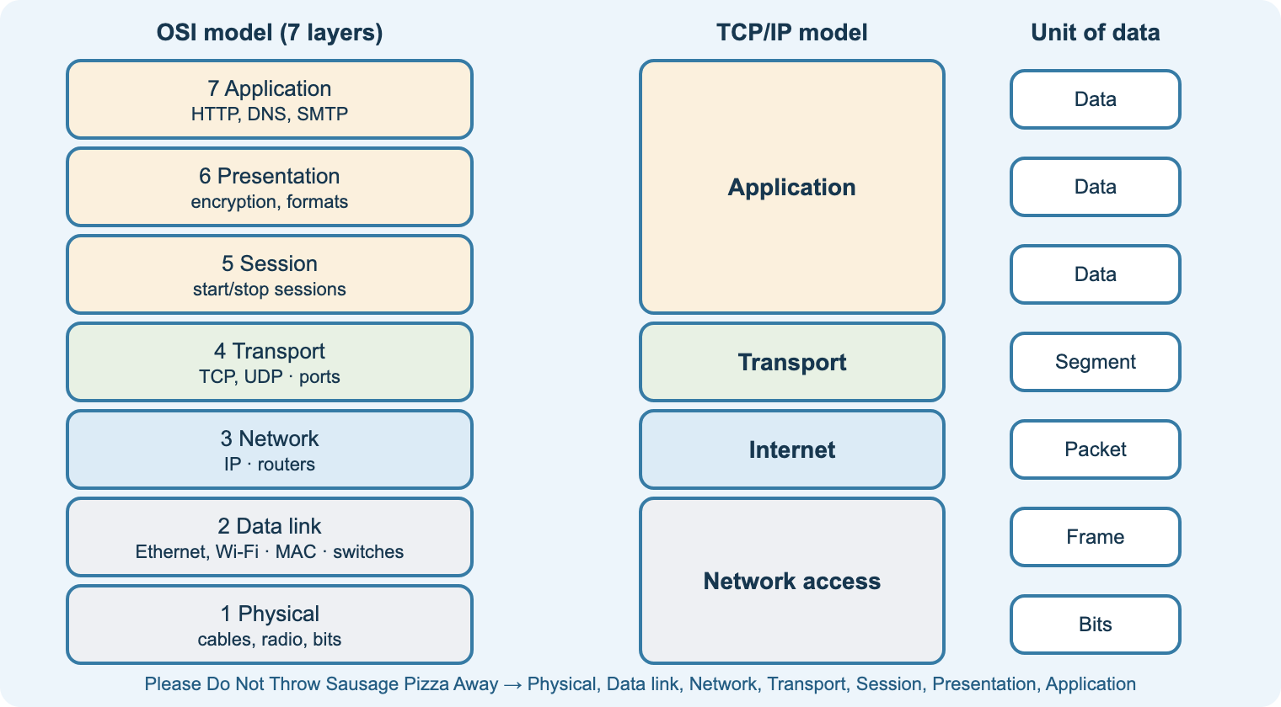
A3
OSI and TCP/IP models
Aim: identify the OSI layers, the TCP/IP stack and the units of data
Starter
Mnemonic race: seven layers in order, top to bottom and bottom to top.
Task
OSI table test: layer, function, protocol, device, PDU.
Check
Quiz 2 on the site.
Notes:
Teach the purpose of layering: modular design, interoperability, troubleshooting.
Map devices to layers: hub/cable (1), switch (2), router (3); ports at layer 4.
TCP vs UDP: handshake, acknowledgements, re-sending vs speed.
Stretch: why the session and presentation functions sit inside the TCP/IP application layer.

Slide 17
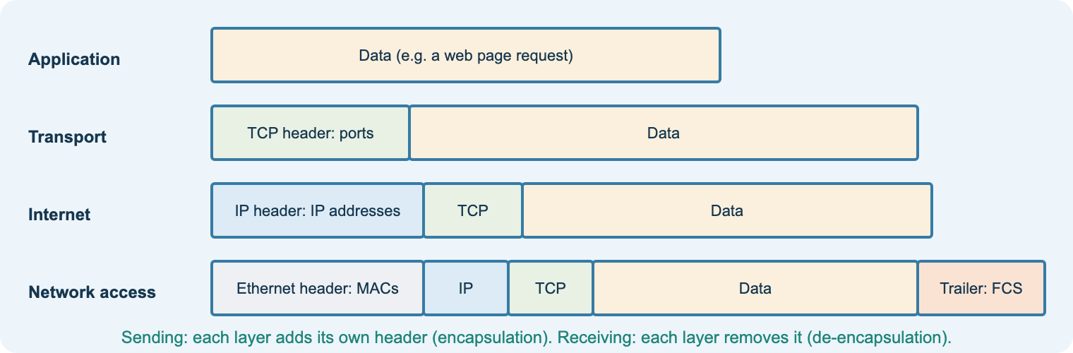
A3
Encapsulation, ports and sockets
Aim: explain encapsulation, ports and sockets
Each layer adds a header going down; removes it going up
Port numbers deliver data to the right service
IP address + port = socket (e.g. 192.168.1.10:443)
Key ports: 80, 443, 53, 67/68, 25, 110, 143, 20-21, 22, 23, 3389
Practical
Packet Tracer simulation: open each PDU and inspect the headers.
Task
Complete the protocol and port table (HTTP to NTP).
Link
A.M1: how data transfers within and between networks.
Notes:
Encapsulation is the core of the A.M1 “how data gets transferred” illustration: switch reads MAC (frame), router reads IP (packet), service chosen by port (segment).
Question: why can one server host web and email at the same time?
Support: envelope-in-parcel analogy.

Slide 18
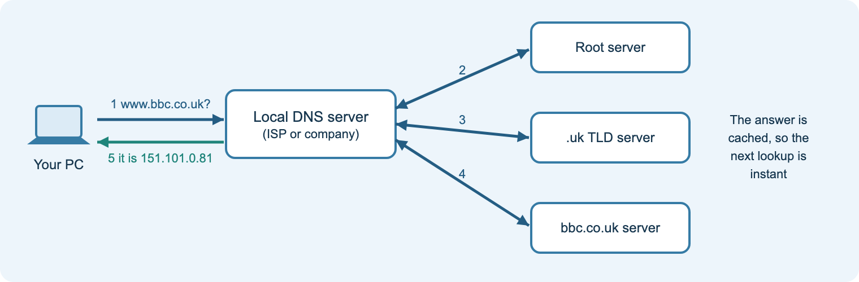
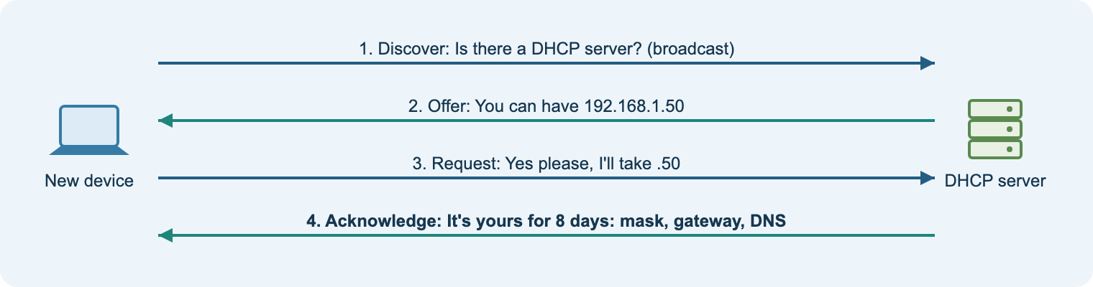
A4
Infrastructure services: DNS and DHCP
Aim: explain infrastructure services and their operation
DNS: names to IP addresses, hierarchy and caching
DHCP: Discover, Offer, Request, Acknowledge; scope and lease
Directory services and authentication (AAA, RADIUS)
Routing and remote access, NAT, VPN
File, print, web, mail (SMTP, IMAP/POP3) and VoIP
Practical
Lab 4: DHCP, DNS, web and email servers in Packet Tracer.
Task
Workbook A4: services for a web-design office.
Check
Why do printers get static addresses?
Notes:
A 169.254.x.x address means DHCP failed: a great diagnostic question.
Ask: what would break first if DNS failed? (Everything that uses names.)
These services reappear in Assignment 2 Appendix A (server with DHCP, DNS and web).
Stretch: DHCP relay across routers; DNS record types (A, MX, CNAME).

Slide 19
ASG 1
Assignment 1: Investigating computer networks
Scenario: junior network technician writing technical pages for the company website. Evidence: a report.
A.P1 · Pass
Website pages: need and choice of network types and models, topologies, standards, trends (BYOD, cloud).
A.P2 · Pass
Table: functions and characteristics of hardware, media and software components.
A.M1 · Merit
Report analysing how components work together in LAN, WAN and wireless; protocols and data transfer with illustrations.
A.D1 · Distinction
Balanced evaluation of peer-to-peer, client/server and thin client for different clients, with a justified conclusion.
Tools for students
Assignment guide checklists · Assignment builder component table · AI coach (explain, plan, review, accuracy) · AI-use log to submit
Notes:
Issue with the official brief. Walk through the plain-English guide and the checklists together.
Show the Assignment builder: students paste a section of their own draft for coach feedback; the coach will not write content.
Require the AI-use log with submission. Internal verification: sample logs alongside scripts.

Slide 20
Learning aims B and C
Design, build, test and evaluate a network for a client · Assignment 2

Slide 21
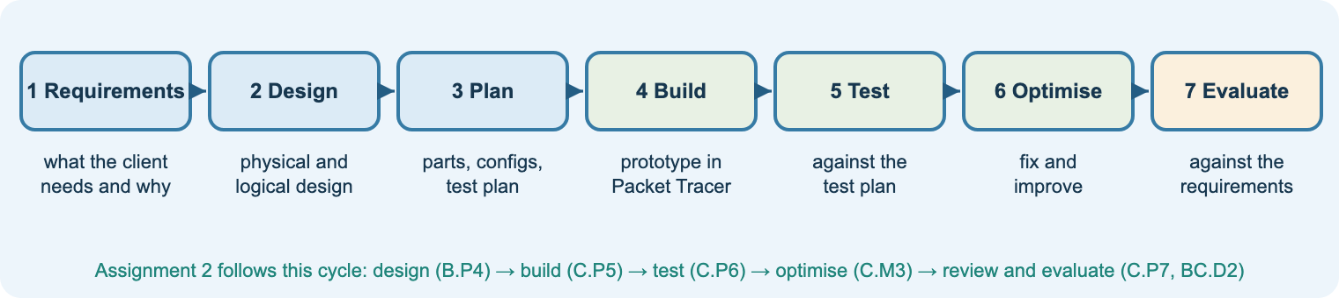
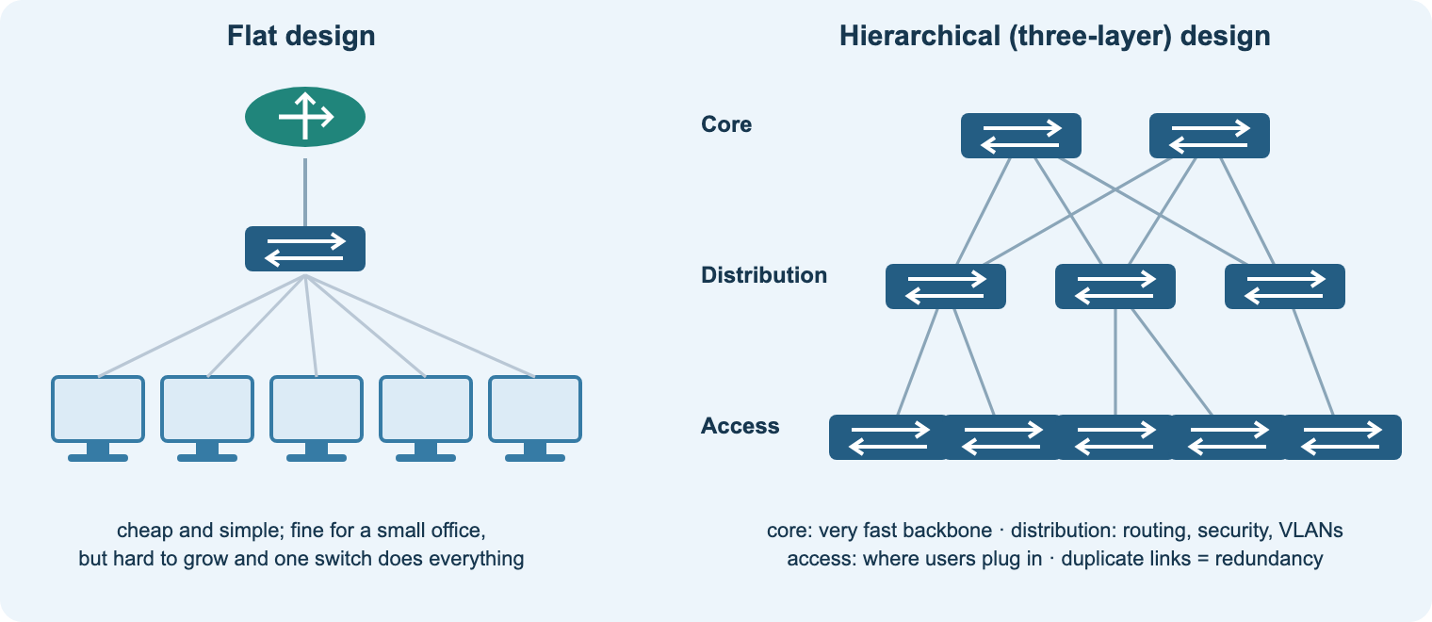
B1
Design strategies
Aim: explain why networks need design and planning strategies
Business goals become technical requirements
SOHO, SMB and enterprise designs differ
Aims: scalability, availability, redundancy, performance, security, manageability, adaptability, affordability
Constraints and trade-offs: budget, time, environment
Flat vs hierarchical (core, distribution, access)
Starter
Why do we need a network design and planning strategies? Think-pair-share.
Task
Workbook B1a: goals, requirements and constraints for a gym.
Link
B.P3 customer email and B.M2 justification.
Notes:
Use the dental practice example on the Learn page (a different client from the assignment).
Discuss trade-offs explicitly: redundancy costs money; security affects ease of use.
Stretch: failure domains and link aggregation (EtherChannel) in hierarchical designs.

Slide 22
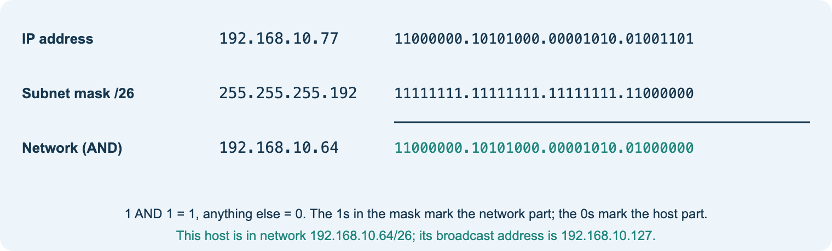
B1
Logical design: IP addressing
Aim: plan IP addressing, subnets, private and public addresses, and IPv6
Network and host portions; the subnet mask and prefix
ANDing finds the network address
Usable hosts = 2^host bits − 2
Private ranges, loopback, APIPA; NAT at the edge
IPv6: 128-bit hex; drop leading zeros; :: once
Starter
Binary to decimal warm-up (maths link).
Practical
Lab 6: two LANs and a router; test gateways.
Check
Quiz 3: subnet 192.168.5.130/26.
Notes:
Worked example on the Learn page: 192.168.10.0/24 into four /26 subnets.
Common errors: gateway outside the subnet; wrong mask on one host; giving a host the network or broadcast address.
Support: subnet table with blocks of 64/32/16. Stretch: VLSM for subnets of different sizes.

Slide 23
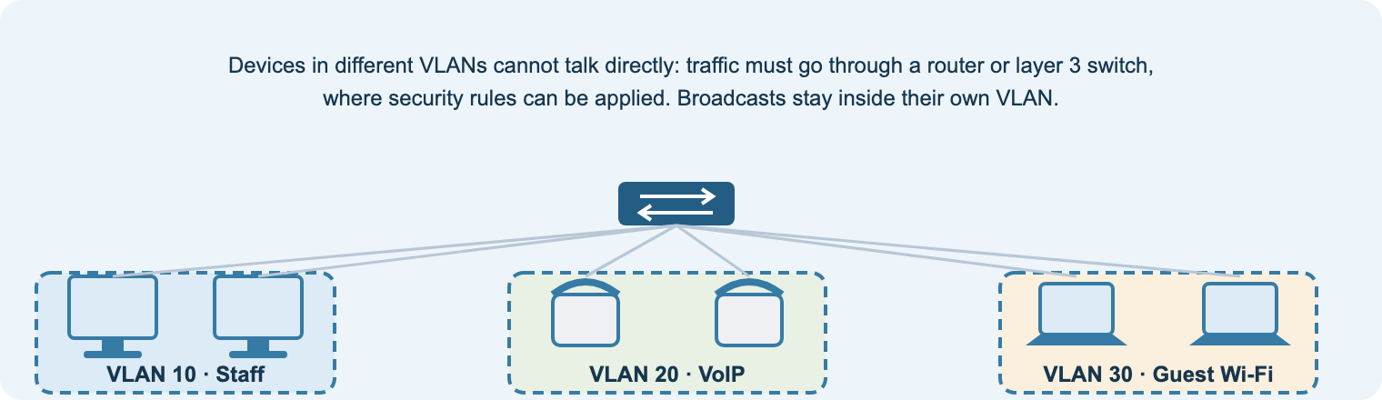
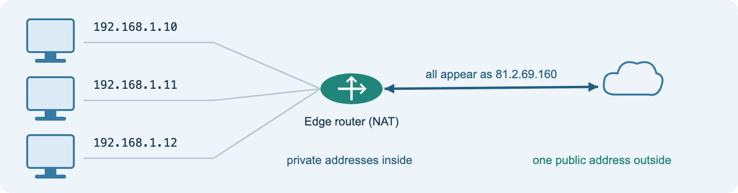
B1
NAT, naming and VLANs
Aim: use naming schemes and VLANs in a logical design
Naming scheme: site-floor-type-number (e.g. LDN-FL2-SW01)
VLANs: separate logical networks on one switch
Benefits: security, smaller broadcast domains, easier management
Issues: complexity, managed switches, inter-VLAN routing, misconfiguration risk
Voice VLAN with QoS for VoIP
Practical
Lab 8: VLANs, show vlan brief, test pings.
Task
Design a naming scheme for a two-site office.
Link
B.P4 logical design: addressing table and naming.
Notes:
Show the NAT diagram first: why a whole office appears as one public address.
VLANs support Appendix A requirements such as secure Wi-Fi and VoIP; students must decide and justify.

Slide 24
B2
Planning: components, configuration and tests
Aim: select components, plan device configuration and write a test plan before building
Select
Servers, storage, switches, APs, router/WAN, OS and applications. Record a reason for every choice.
No. | What is tested | How | Expected | Actual | Pass/fail
1 | PC to gateway | ping 192.168.20.1 | 4 replies
2 | DHCP address | ipconfig | .100–.150
3 | DNS | browse intranet.local | page loads
4 | Folder permission | log in as other group | access denied
5 | Device password | console login | prompt shown
Configure (plan first)
Names, passwords, addresses, VLANs, routes, SSIDs and security, DHCP scopes, DNS records. Prototype in Packet Tracer.
Write the expected result before testing. Record failures, the cause, the fix and the re-test.
Notes:
The Assignment builder has inventory, IP plan, naming, access and test plan tables that export to CSV for Word or Excel.
Example rows use the dental practice, not the assignment client.
Stretch: layer 2 vs layer 3 vs layer 4 switching requirements; SAN vs NAS storage decisions.

Slide 25
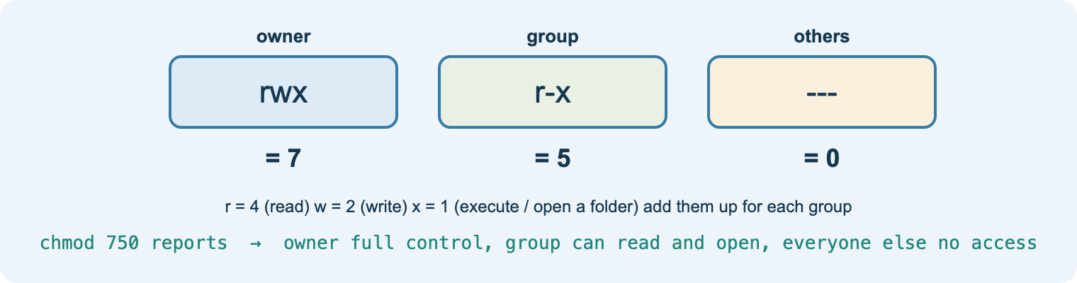
B3
Access: users, groups and permissions
Aim: plan authentication, users, groups and permissions
Password policy: NCSC guidance, passphrases, MFA, block common passwords
Audit policy: what gets logged and reviewed
Permissions to groups, not individuals; least privilege
Linux: owner/group/others, r=4 w=2 x=1 (e.g. chmod 750)
Windows NTFS permissions; printer permissions
Practical
Lab 9: Linux groupadd, useradd, chown, chmod, access tests.
Task
Workbook B3: access plan for a shop (MANAGERS, STAFF).
Check
Quiz 5: chmod numbers.
Notes:
Appendix A needs users, groups and folder permissions with different access for others: students must work out their own numbers.
Use the college policies pack (password, remote access, network security) as real examples of policy documents.
Stretch: sticky bit and setgid for shared folders.

Slide 26
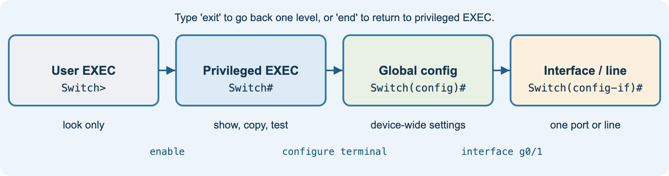
C1
Configuration with Cisco IOS
Aim: configure and secure switches, routers, wireless and servers
Modes: user EXEC, privileged EXEC, global config, interface/line
Secure: hostname, enable secret, console and vty passwords, service password-encryption, banner
Router: interface addresses, no shutdown, DHCP pool, static routes
Switch: VLANs, access ports, shut unused ports
Save: copy running-config startup-config
Practical
Labs 5–7: secure a switch, two LANs, two sites with static routes.
Task
Workbook C1: commands for BRANCH-R1 in order.
Evidence
show running-config and screenshots with captions.
Notes:
Cover the Cisco device password setup handout. Emphasise that every device in Appendix A must be password protected.
Version your Packet Tracer files: v1-cabled, v2-addressed, v3-services.
Stretch: SSH instead of Telnet; RIPv2 or OSPF instead of static routes.

Slide 27
C2
Testing and troubleshooting
Aim: test methodically, fix faults and document the results
1 Identify
2 Theory
3 Test
4 Fix
5 Verify
6 Document
Symptom | Likely cause | Check with
Red link light | interface shut down or wrong cable | show ip interface brief
Local pings work, remote fail | wrong gateway or missing route | ipconfig; show ip route
169.254.x.x address | DHCP unreachable or off | server Services tab; ipconfig /renew
IP works, name fails | DNS record or server wrong | nslookup
Laptop won’t join Wi-Fi | SSID or passphrase mismatch | AP and laptop wireless settings
Optimise (C.M3)
Base changes on test results: voice VLAN, shut unused ports, SSH not Telnet, extra AP for weak signal, reserved printer addresses. Re-test to prove the gain.
Notes:
Lab 10: pairs break each other’s networks with the listed faults; the completed fault table is strong C.P6 practice.
Start at the bottom of the OSI model: physical, then addressing, then services.
Change one thing at a time; never delete failed tests from the plan.

Slide 28
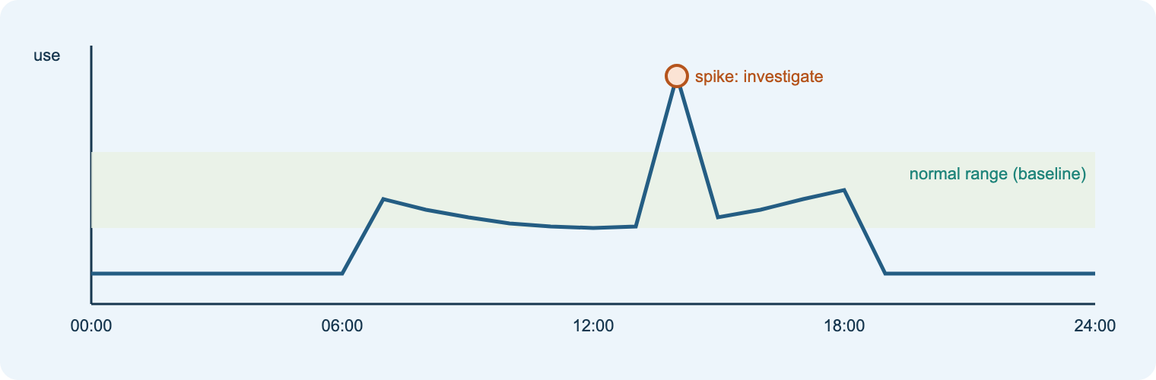
C3
Monitoring, evaluation and self-management
Aim: baseline and monitor the network, evaluate it against requirements, and evidence self-management
Baseline: normal bandwidth, latency, CPU, memory, disk
Monitor and review event logs regularly
Review: how far each requirement is met (C.P7)
Evaluate: strengths and weaknesses with evidence from every stage, conclusions, future work (BC.D2)
Portfolio: plan, diary, peer feedback, witness statement (BC.D3)
Task
One row of an evaluation grid for a practice network.
Tool
Builder evaluation grid is pre-filled with every client requirement.
Habit
Diary entry at the end of every Assignment 2 lesson.
Notes:
BC.D3 cannot be written at the end: it needs dated evidence throughout. Check diaries weekly.
Model a strong diary entry (see the Learn page C4 example).
Distinction evaluations synthesise across design, build, test and optimisation; weaker ones only restate test results.

Slide 29
ASG 2
Assignment 2: Design, build, test and evaluate
Scenario: junior network engineer; branch office of a web-design customer, with one off-site office.
Client requirements (Appendix A)
• Server: DHCP, DNS, web
• 10+ workstations; wired plus secure Wi-Fi
• Wireless laptops at both sites
• Internet and router link between sites
• Users, groups and folder permissions
• VoIP, antivirus, e-commerce facilities
• All devices password protected
• Scalable, secure, low cost
• Full documentation with test plans and results
B.P3
customer email
B.P4 · B.M2
design + justification
C.P5
build and configure
C.P6 · C.M3
test and optimise
C.P7 · BC.D2
review and evaluate
BC.D3
portfolio throughout
Notes:
Issue the official brief with Appendix B (office layout) and Appendix C (skills, knowledge and behaviours).
Students plan in the Assignment builder: inventory, IP plan, naming, permissions, test plan, evaluation grid, targets, diary and feedback log.
Build in Packet Tracer; Linux VM for users, groups and permissions. Witness statements for professional behaviour and communication.
Remind students: the AI coach reviews their own drafts but will not design the network for them; submit the AI-use log.

Slide 30
Ten labs on the student site
1
2
3
4
5
Packet Tracer tour
Build and test a LAN
Wired + wireless
DHCP, DNS, web, email
Secure a switch (IOS)
6
7
8
9
10
Two LANs and a router
Two sites, static routes
VLANs
Linux users and permissions
Troubleshooting challenge
Each lab lists steps, commands, how to check it works and the evidence to capture. Teacher .pkt files (switch working, Two LANs, Three router design, dns) can extend the labs via Teams.
Notes:
Labs map to lessons: 1 A1a · 2 A1b/A2a · 3 A1a · 4 A4 · 5 C1 · 6 B1b/C1 · 7 B1b/C1 · 8 B1b · 9 B3 · 10 C2.
Cisco NetAcad .pka activities remain on Teams; they are Cisco content and are not published on the public site.

Slide 31
Ready to deliver
Share the start page link in Teams
Lesson 1: tour the site and the Assignment guide
Enrol students on NetAcad Packet Tracer
Agree AI rules; collect AI-use logs with each assignment
Use the quizzes as starters and exit checks
Notes:
Site: nigeriastudentcenter.github.io/btech/unit19/start.html
The AI tutor and coach depend on the college Azure subscription being active; the rest of the site works without it.

