Slide 1
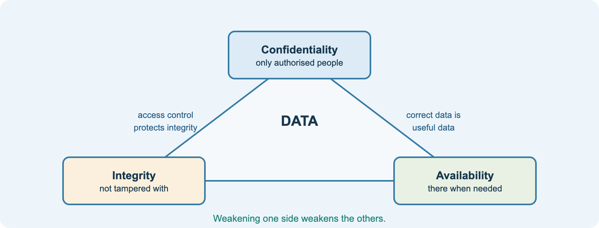
Content area 8
Security
Teacher delivery deck · T Level Digital Production, Design and Development (core)
Risks · Threats · Vulnerabilities · Mitigation · CIA · IAAA
Notes:
Purpose: this deck supports delivery of content area 8 alongside the student course site (nigeriastudentcenter.github.io/btech/unit8/start.html).
Every lesson slide follows the college routine: starter, aim, teach, practical, task, check, flipped homework.
Speaker notes give teaching points, questions, differentiation, and the matching workbook section, practical and quiz.

Slide 2
How each lesson runs
1
2
3
4
5
6
7
Starter
real incident or recap quiz
Aim
share the aim and the spec point
Teach
diagram-led explanation with questioning
Practical
lab task or scenario activity
Task
workbook activity on the site
Check
quiz or exam-style exit question
Homework
flipped: preview the next lesson
On the student site
Each lesson has a Learn page section with diagrams, a real case and exam tips, a workbook activity with the AI tutor, videos, a practical where relevant, and a quiz.
Start with a real incident
Security lands best with a current news story: a breach, a ransomware outage or a scam text. Ask: which information, which threat, which control?
Notes:
Keep your existing starters and the 8.1 eLearning module on Teams.
End each lesson with a site quiz question or an exam-style exit question.

Slide 3
Content area 8 at a glance
4
12
15
10
1
topic areas: 8.1–8.4
specification points
lessons on the student site
practical tasks
written core exam
8.1 Security risks
confidential information, reasons, impact
8.2 Threats and vulnerabilities
technical, human and physical; impact
8.3 Threat mitigation
techniques; firewalls, segregation, monitoring
8.4 Effective security
CIA triad; IAAA model
8.2.1 (technical threats) and 8.3.1 (mitigation techniques) are the two largest points: each is split across several lessons on the site.
Notes:
Content area 8 is part of the T Level core, assessed in the written examination (Paper 2 in the 2025–26 plan). Check current arrangements with the awarding organisation.
The specification repeatedly asks for impacts, prevention AND mitigation, and benefits AND drawbacks: build these pairs into every lesson.

Slide 4
How it is assessed: exam technique
Command word | What students must do | Typical marks
State / identify | short fact or name, e.g. a type of malware | 1
Describe | features or steps; one mark per accurate point | 2–4
Explain | point + why/how, applied to the scenario | 2–6
Discuss | benefits, drawbacks and what it depends on | 6–9
Evaluate / justify | weigh controls against risk and cost; supported judgement | 9–12
The winning pattern
Threat → impact on THIS organisation → prevention → mitigation → drawback of the control. Name the business in every point.
On the site
Exam practice has two scenario papers (a dental practice, an online shop, a hospital) with self-marking checklists and level descriptors.
Notes:
Common weakness: listing controls without saying which threat each one stops.
Use official sample assessment materials for timed mocks; the site’s exam practice is original.

Slide 5
The student course site
1. Course guide
Exam overview and a red/amber/green checklist of all 12 spec points
2. Learn
15 lessons with original diagrams, real cases and exam tips
3. Workbook + tutor
An activity and quick check per lesson; AI study tutor; saves on device
4. Practicals
10 tasks: phishing, passwords, Diffie-Hellman, hashing, Linux, Nmap, firewall
5. Exam practice
Scenario papers with command-word guide and level marking
6. Quizzes
Five instant-marked quizzes, one per topic block
Plus 7. Videos: 35 embedded videos (MrBrownCS, Computerphile, TED, Cisco, IBM). Link for Teams: nigeriastudentcenter.github.io/btech/unit8/start.html
Notes:
Tour the site in the first lesson and show the RAG checklist.
Work saves in the browser only: remind students to download backups on shared PCs.

Slide 6
Ethics, the law and the AI tutor
Teach attack to teach defence
• every attack is paired with prevention and mitigation
• Nmap, Kali and cracking only on the isolated lab network
• written permission and scope = ethical hacking
• unauthorised access is a criminal offence
• consider a signed lab acceptable-use agreement
The AI tutor is set up to…
• explain, hint and quiz on the chosen lesson
• not give the workbook answers
• refuse exploit code, attack commands, malware or phishing templates
• remind students that unauthorised access is illegal
• store nothing on the server; no names
Exam-assessed, so no assignment coach
Students can use the tutor freely for revision and to check practice answers. It runs on the college Azure service; if it is offline every other page still works.
Notes:
Discuss the Computer Misuse Act before the first practical and refer back to it in M4 (penetration testing).
The security rule is held on the server, so students cannot remove it from the page.

Slide 7
Delivery plan (2025–26)
Week 11
Weeks 12–17
Weeks 18–21
Weeks 22–26
Weeks 27–29
8.1 confidential information, reasons, impact
8.2 threats, vulnerabilities (technical, human, physical) and impact
8.3 mitigation techniques; firewalls, segregation, monitoring
8.4 CIA triad and IAAA model
Revision and exam
Based on the 2025–26 Unit 8 teaching outline (January to June, exam in June). The Teachers page maps each week to its lesson, practical and quiz.
Notes:
Half term and Easter fall inside 8.2 and 8.3: use the site quizzes as holiday retrieval practice.

Slide 8
8.1 Security risks
The information organisations hold, why it must stay confidential, and what happens when it does not

Slide 9
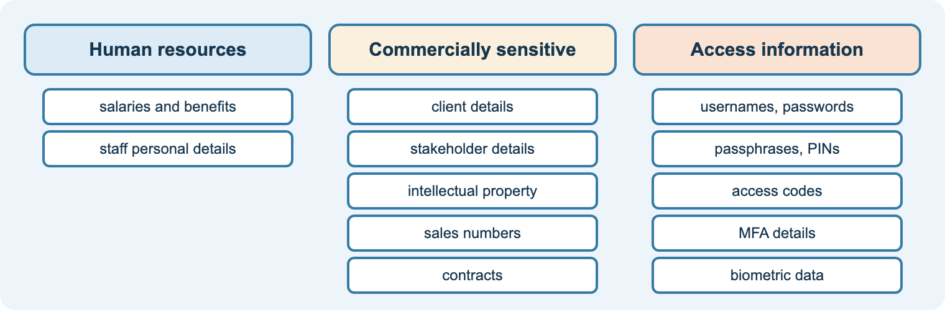
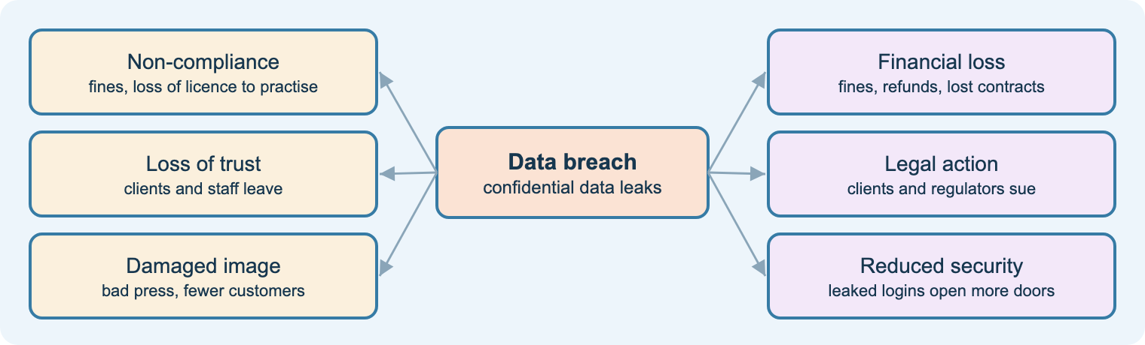
8.1
Confidential information and its impact
Aim: identify confidential information, explain why it must be kept confidential and the impact of failure
HR: salaries, staff details
Commercial: clients, stakeholders, IP, sales, contracts
Access: passwords, PINs, MFA, biometrics
Reasons: competitors, privacy, unauthorised access
Impacts: fines, licence, trust, image, legal action
Starter
News story: a recent data breach. What leaked? Who was harmed?
Task
Workbook S1: a dental practice’s information.
Check
Quiz 1.
Notes:
Use the 8.1 eLearning module from Teams as a flipped task before this lesson.
Question: why is access information the most dangerous to lose?
Stretch: which impacts are regulatory, reputational, financial or legal?
Video (S1): Cyber threats and why cyber attacks happen (MrBrownCS).

Slide 10
8.2 Threats and vulnerabilities
Technical threats · technical, human and physical vulnerabilities · impact

Slide 11
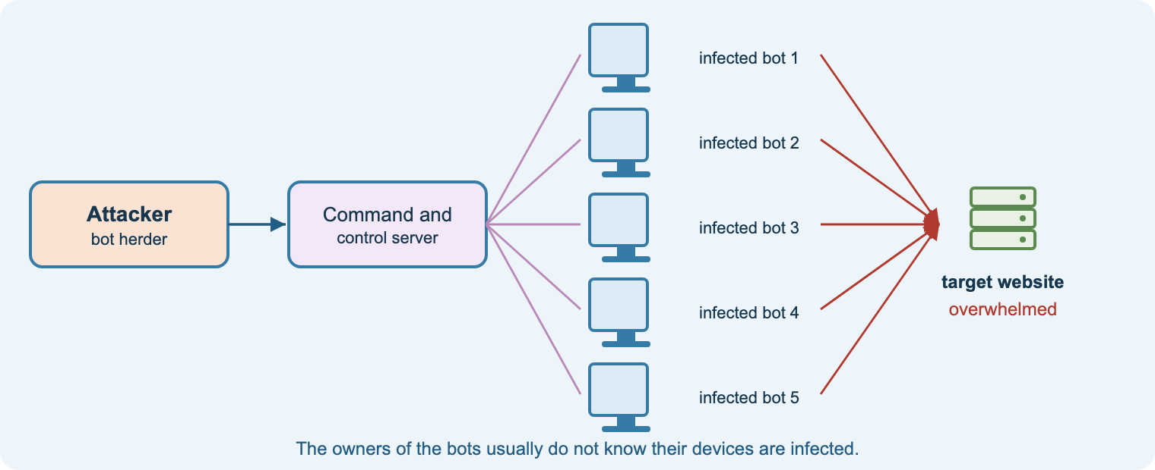
8.2.1
Malware, botnets and denial of service
Aim: explain malware types, botnets and DoS/DDoS with prevention and mitigation
Virus, worm, keylogger, ransomware, spyware, RAT
Botnet: bots controlled via a C&C server
DoS vs DDoS: one source vs thousands
Prevent: anti-malware, patching, trusted sources
Mitigate: offline backups, DDoS protection
Starter
WannaCry in 60 seconds: what stopped hospitals working?
Task
Workbook T1: three malware threats to a school.
Check
Quiz 2a.
Notes:
Emphasise prevention vs mitigation: backups do not stop ransomware but limit its damage.
Question: why is a worm more dangerous on an unpatched network?
Videos (T1): Types of malware; Botnets & DDoS; Computerphile WannaCry (stretch).

Slide 12
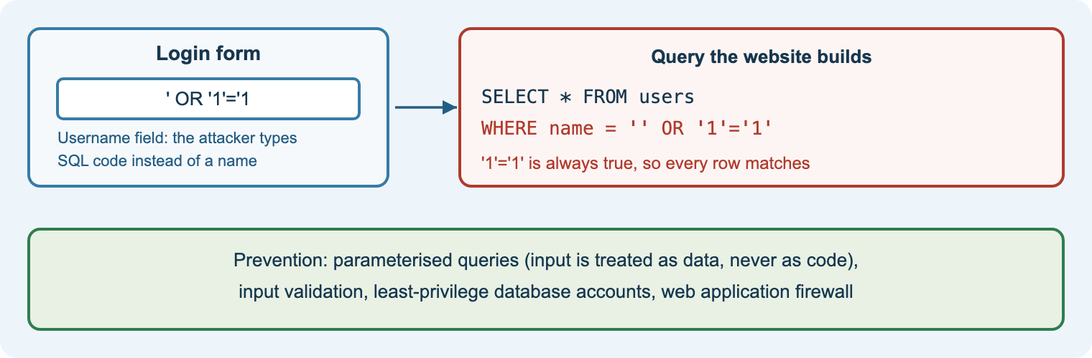
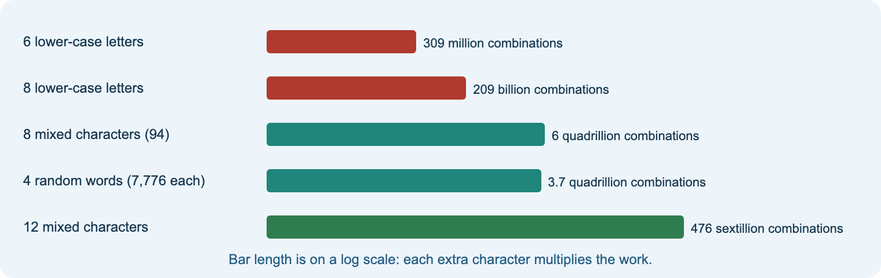
8.2.1
Malicious hacking
Aim: explain hackers’ motives and brute force, XSS, SQL injection and buffer overflow attacks
Hacktivists, nation states, organised crime, individuals
Brute force: length beats complexity
SQL injection → parameterised queries
XSS → output encoding
Buffer overflow → bounds checking, patches
Starter
Which hacker group is behind each headline?
Practical
Practical 2: how strong is that password?
Task
Workbook T2: an online shop’s weak points.
Notes:
Demonstrate SQL injection only with the diagram or a local test page, never a live site.
Link to Unit 12 (software development): secure coding.
Videos (T2): MrBrownCS attacks; Computerphile SQL injection, XSS and password cracking (stretch).

Slide 13
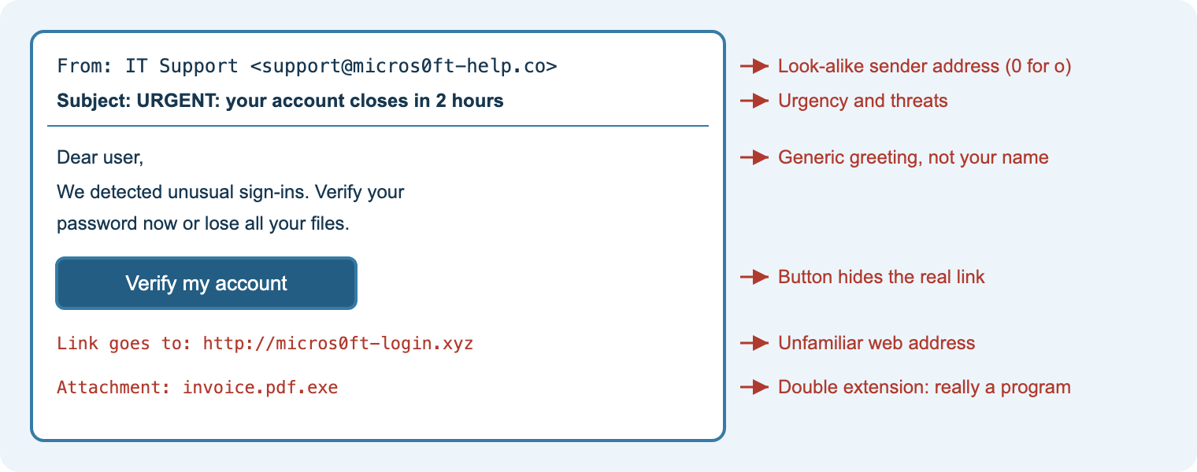
8.2.1
Social engineering
Aim: explain phishing, spear phishing, smishing, vishing, pharming, watering hole and USB baiting
Exploits trust, fear, curiosity, urgency
Phishing vs spear phishing
Smishing (SMS), vishing (voice)
Pharming redirects the real address
Watering hole; USB baiting
Practical
Practical 1: spot the phish.
Task
Workbook T3: a staff guide for a bank.
Check
Quiz 2b.
Notes:
Collect real (sanitised) scam texts and emails from staff for the practical.
Question: why does MFA help even when training fails?
Videos (T3): MrBrownCS social engineering (two videos).

Slide 14
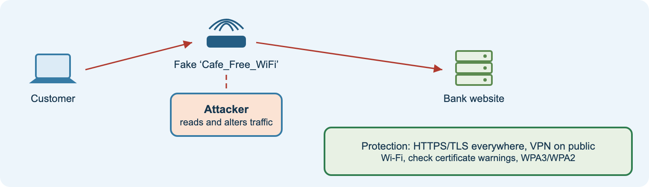
8.2.1
DNS, APIs, man-in-the-middle and open Wi-Fi
Aim: explain network-based threats and their prevention
DNS attack/redirection → DNSSEC, registrar MFA
Insecure APIs → authentication, authorisation, rate limits
Man-in-the-middle → HTTPS/TLS, VPN
Open Wi-Fi → VPN, HTTPS, WPA2/3
Starter
Which Wi-Fi networks can you see from this room? Which are open?
Task
Workbook T4: staff on hotel Wi-Fi.
Check
Exit: why does a VPN help?
Notes:
Link APIs to the Postman demo from content area 7.
Videos (T4): Computerphile man-in-the-middle; DNS cache poisoning and KRACK (stretch).

Slide 15
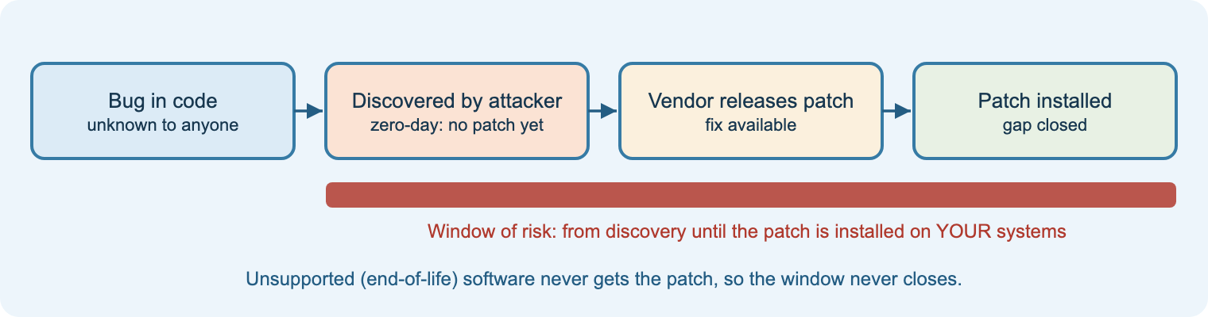
8.2.2–3
Technical vulnerabilities and human threats
Aim: explain technical vulnerabilities and human threats with prevention
Weak encryption, poor password policy, no MFA
Out-of-date hardware, software, firmware
Zero-day and legacy systems
Human error, malicious employee
Disguised criminal, poor cyber hygiene
Starter
An unlocked PC: what could a visitor do in 30 seconds?
Task
Workbook V1 and V2.
Check
Quiz 3.
Notes:
Order of actions when dismissing staff: suspend accounts, remove from premises, recover devices.
Videos (V1, V2): Vulnerabilities; Avi Rubin TED talk; Cisco Anatomy of an IoT Attack; Internal threats.

Slide 16
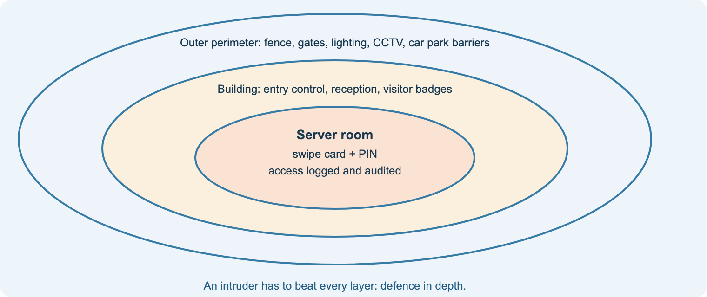
8.2.4–5
Physical vulnerabilities and impact
Aim: explain physical vulnerabilities, their prevention, and the impact of threats
Entry control systems
No tailgating; complex, changed codes; monitoring; audits
Shoulder surfing, environment, vandalism
Rugged machines; natural disasters
Impacts: data loss, access, corruption, disruption
Practical
Practical 8: perimeter security proposal (worksheet on Teams).
Task
Workbook V3.
Check
Quiz 3.
Notes:
Walk the college perimeter (or use a floor plan) and spot vulnerabilities layer by layer.
Videos (V3): Physical security measures & biometrics; Physical security methods.

Slide 17
8.3 Threat mitigation
Techniques, their purposes, benefits and drawbacks · processes that assure internet security

Slide 18
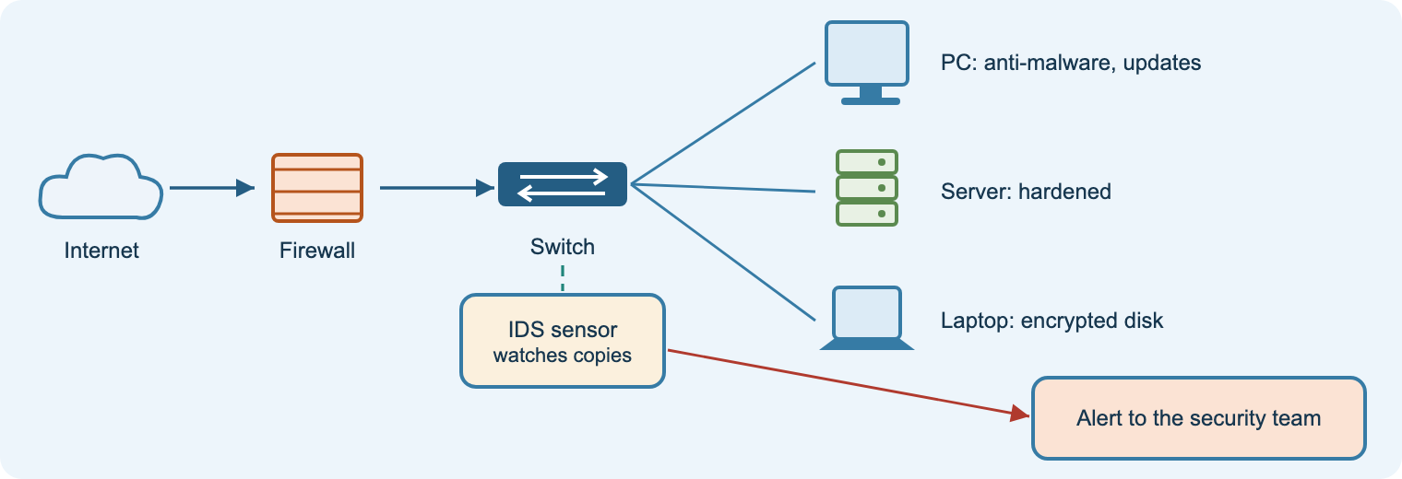
8.3.1
Technical defences
Aim: explain security settings, anti-malware, IDS, hardening, updates and air gaps
Security settings (hardware, software)
Anti-malware: function and actions
Intrusion detection
Device hardening; updates; firmware
Air gaps
Starter
Open Windows Security: what is it protecting?
Task
Workbook M1: four defences for a charity.
Check
Quiz 4a.
Notes:
For every technique, insist on one benefit and one drawback.
Videos (M1): Protecting against malware; Detection and prevention; Prevention measures.

Slide 19
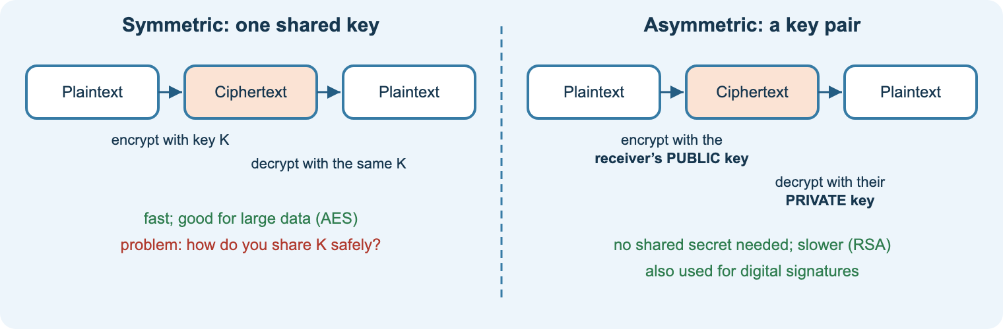
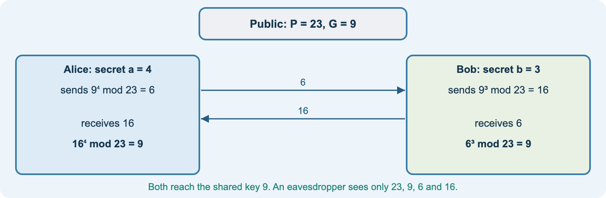
8.3.1
Encryption
Aim: explain hashing, symmetric and asymmetric encryption
Hashing: one-way; passwords, integrity
Symmetric: one key; fast; key sharing problem
Asymmetric: public/private keys; slower
HTTPS uses both
Diffie-Hellman: agree a key in public
Practical
Practicals 3 and 4: Diffie-Hellman and hashing.
Task
Workbook M2: a surgery’s three needs.
Check
Quiz 4a.
Notes:
Use the teacher’s dh.xlsx spreadsheet (P = 23, G = 9, a = 4, b = 3 → shared key 9).
Videos (M2): Symmetric and asymmetric encryption; Computerphile hashing and Diffie-Hellman.

Slide 20
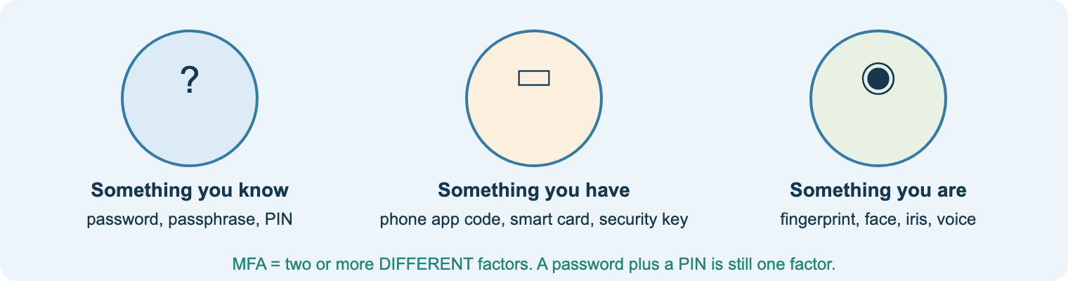
8.3.1
People and access controls
Aim: explain policies, vetting, training, access control, MFA, password managers, VPNs and API certification
User access policies; staff vetting
Staff training
Software-based access control
MFA: know, have, are
Password managers; VPNs; API certification
Starter
Is password + security question MFA? Vote and justify.
Task
Workbook M3.
Check
Quiz 4a.
Notes:
Use the NCSC password guidance PDF on Teams.
Videos (M3): Computerphile 2FA; Tom Scott on 2FA; password managers.

Slide 21
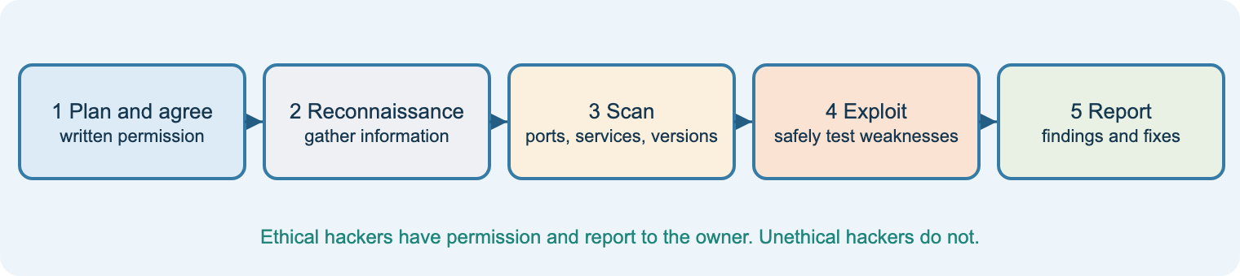
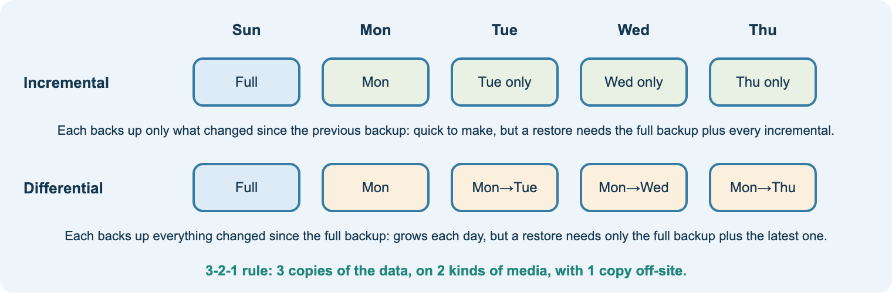
8.3.1
Backups, port scanning and penetration testing
Aim: explain backup types and storage, port scanning and ethical vs unethical hacking
Full, incremental, differential
Safe storage: offsite, offline, encrypted, tested
Port scanning finds open services
Penetration test: plan, recon, scan, exploit, report
Ethical = permission + scope
Practical
Practical 6: Nmap on the lab network only.
Task
Workbook M4: a backup plan.
Check
Quiz 4a.
Notes:
Students’ John the Ripper presentations (Teams) fit here as a discussion of password auditing.
Videos (M4): Backup policies; Ethical hacking and penetration testing.

Slide 22
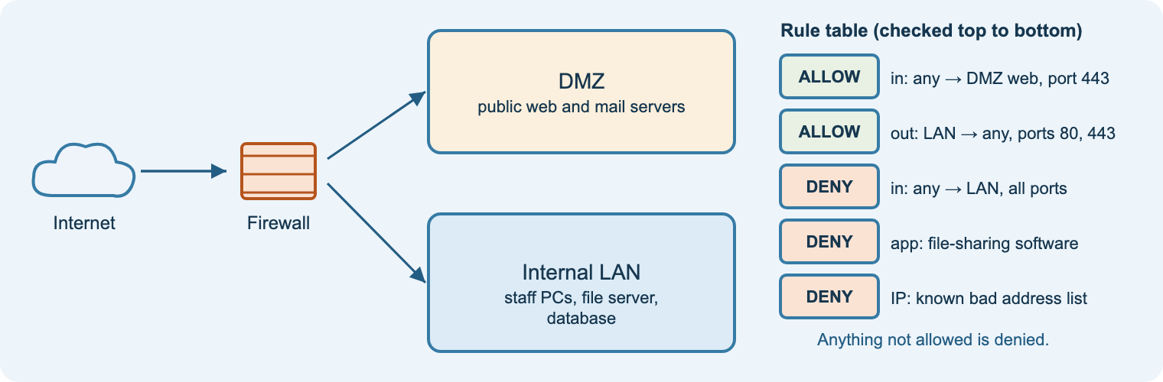
8.3.2
Firewalls, segregation and monitoring
Aim: explain firewall configuration, network segregation, monitoring and port scanning
Inbound and outbound rules
Traffic type, application and IP rules
Default deny
Segregation: virtual, physical, offline; DMZ
Network monitoring; regular port scans
Practical
Practical 7: firewall in Packet Tracer.
Task
Workbook M5: a hotel network.
Check
Quiz 4b.
Notes:
Revisit VLANs from content area 7 as virtual segregation.
Videos (M5): Firewalls; Cisco Anatomy of an Attack.

Slide 23
8.4 Effective security
How confidentiality, integrity and availability interrelate · the IAAA model

Slide 24
8.4.1
The CIA triad
Aim: explain confidentiality, integrity and availability and how they interrelate
Starter
Sort five incidents by the element they hit.
Practical
Practical 9: a security policy mapped to CIA.
Check
Quiz 5a.
Notes:
Specification wording: confidentiality controls access; integrity is supported by confidentiality; availability is only useful with integrity.
Question: how can too much confidentiality harm availability?
Video (C1): IBM Technology, What is the CIA triad.

Slide 25
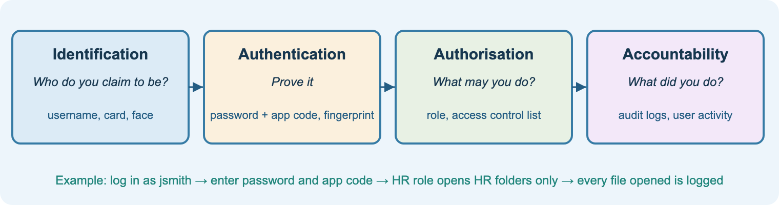
8.4.2
The IAAA model
Aim: explain identification, authentication, authorisation and accountability, with techniques, benefits and drawbacks
Practical
Practical 5: Linux users, groups and permissions.
Task
Workbook C2: the shared till login.
Check
Quiz 5b.
Notes:
Authentication proves who you are; authorisation decides what you may do. Students confuse these every year.
Shared logins break accountability: a common scenario question.
Video (C2): Professor Messer, AAA (stretch).

Slide 26
Ten practicals on the student site
1
2
3
4
5
Spot the phish
How strong is that password?
Diffie-Hellman key exchange
Hashing and integrity
Linux users and permissions
6
7
8
9
10
Nmap in the lab network
Firewall in Packet Tracer
Perimeter security proposal
Security policy
Cisco Cybersecurity Essentials
Scanning and cracking only on the isolated lab network, with permission. Cisco activity files and Pearson worksheets stay on Teams.
Notes:
Map: 1 T3 · 2 T2 · 3–4 M2 · 5 C2 · 6 M4 · 7 M5 · 8 V3 · 9 C1 · 10 T1.

Slide 27
Revision and exam technique
RAG the spec
Re-learn reds
Quiz
Exam practice
Mark with levels
Re-do
Pair everything
Threat ↔ control. Benefit ↔ drawback. Prevention ↔ mitigation. The specification asks for pairs.
Weak → strong
“Use a firewall.”
→ “A default-deny inbound rule stops attackers reaching StitchBox’s staff PCs from the internet.”
Timing
About 1 minute per mark. Plan long answers for 2–3 minutes: risks, controls, judgement.
Notes:
Revision weeks: target red spec points from the Course guide checklist, then Exam practice 1 and 2 before a timed official sample paper.

Slide 28
Ready to deliver
Share the start page link in Teams
Lesson 1: ethics, the law and the RAG checklist
Start each lesson with a real incident
Pair every threat with a control
Exam practice from spring term
Notes:
Site: nigeriastudentcenter.github.io/btech/unit8/start.html
The AI tutor depends on the college Azure subscription being active; the rest of the site works without it.

