Slide 1
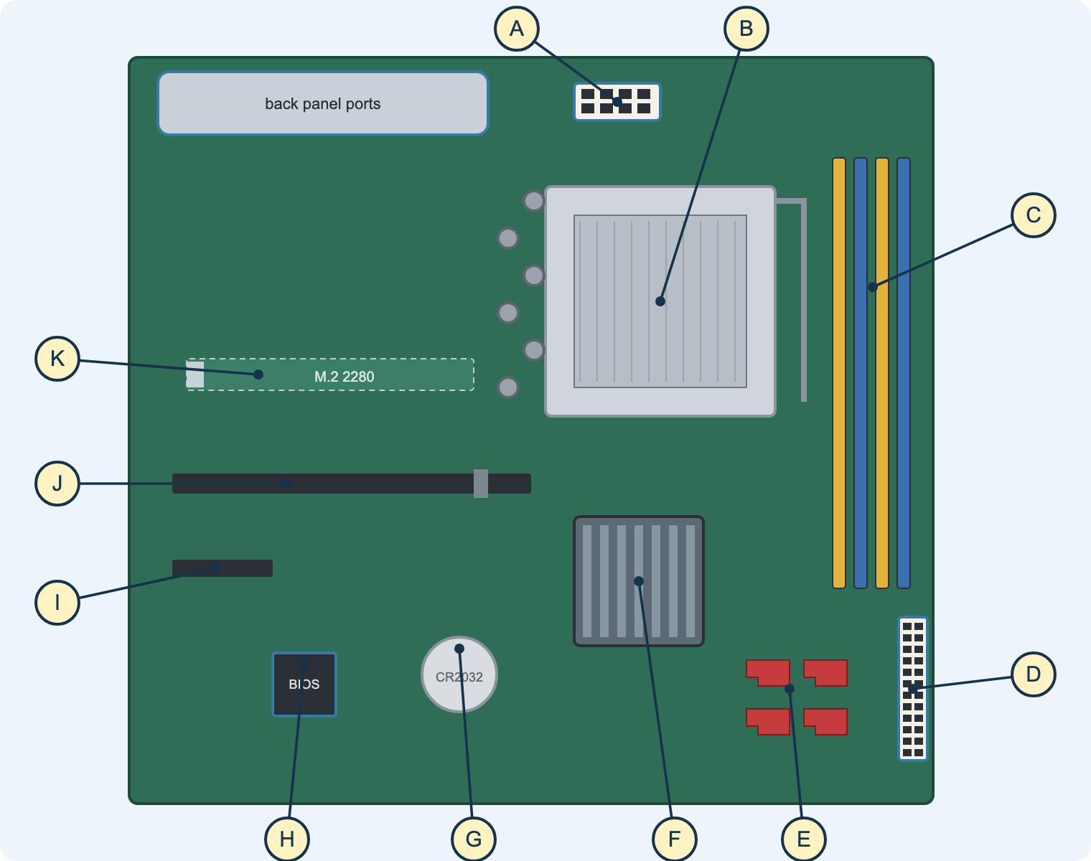
Unit 2
Fundamentals of Computer Systems
Teacher delivery deck · BTEC Level 3 Nationals in Computing
Hardware · Software · Architecture · Data · Transmission · Logic
Notes:
Purpose: this deck supports delivery of Unit 2 alongside the student pack (nigeriastudentcenter.github.io/btech/start.html).
Lesson slides follow the college routine: starter, aim, teach, practical, task, check, flipped homework.
Each slide points to the matching Learn section, diagram task, video and revision test.

Slide 2
How each lesson runs
1
2
3
4
5
6
7
Starter
Millionaire, matching game or recap quiz
Aim
share the aim and spec point
Teach
diagram-led explanation
Practical
diagram task, hands-on or worked example
Task
workbook activity with the AI tutor
Check
exam-style question
Homework
flipped: preview the next deck
Keep your starters
The Millionaire, Hollywood Squares and matching-game starters, quiz QR codes and cheat sheets stay on Teams and work alongside the site.
End with exam practice
Finish each topic with an exam-style question from the Revision tests or the Past Exam Papers page, where the tutor gives hints without writing answers.
Notes:
The revision and past-paper pages mirror the external exam, so use them weekly rather than only at the end.

Slide 3
Unit 2 at a glance
90
1
6
16
9
guided learning hours
external written exam
topic areas: A–F
Learn sections
diagram tasks
Topic A
Hardware and software
Topic B
Computer architecture
Topic C
Data representation
Topic D
Data organisation
Topic E
Data transmission
Topic F
Logic and data flow
Externally assessed. Check the current exam length, marks and dates with Pearson; examiner reports since 2017 are in the unit folder on Teams.
Notes:
Use the examiner reports to pick out recurring weaknesses: generic answers not applied to the scenario, confusing similar terms (RAM/ROM, serial/parallel), and incomplete working in number questions.

Slide 4
Exam technique from the examiner reports
Command word | What students must do
State / identify / give | a short, precise fact
Describe | features or steps, one mark per accurate point
Explain | a point plus why/how, linked to the scenario
Calculate / convert | show every step of working
Discuss / evaluate | both sides, applied to the scenario, with a supported judgement
Recurring weaknesses
• answers not applied to the scenario
• mixing up similar terms
• missing working in conversions
• lists instead of developed points
In the pack
Revision tests 1–4 (guided to long answers) and five past papers with tutor help modes: start, check and plan.
Notes:
Model one developed point per lesson: point, explain, apply to the scenario.

Slide 5
The student pack
1. Brief
the practice brief and success criteria
2. Learn
16 sections, ‘Go deeper’ diagrams, ‘From your lessons’ blocks and videos
3. Workbook + tutor
an activity per section with the AI tutor
4. Revision
four tests: guided, independent, deeper, long answers
5. Past Exam Papers
five Pearson papers with tutor help
6. Diagram tasks
your labelling worksheets as drop-down tasks
7. Videos
57 videos including the MrBrownCS revision series
Teachers
this deck, the topic map, tutor notes
Link for Teams: nigeriastudentcenter.github.io/btech/start.html · No accounts; work saves in the browser.
Notes:
Tour the pack in the first lesson. Show the backup download on shared PCs.

Slide 6
The AI study tutor
Students can ask it to…
• explain a topic another way
• diagnose a misunderstanding with one question
• give one hint at a time
• set new practice questions
• help start, check or plan a past-paper answer
It is set up to…
• not give answers to the workbook’s own activities
• use different numbers from the activity
• never invent official mark schemes
• reply in plain English
• store nothing on the server; no names
Live now
The tutor runs on the college Azure AI service with shared usage limits. If it is ever offline, every page still works.
Notes:
Encourage “Hint” mode during lessons and “Practice” mode for homework.

Slide 7
Delivery plan by topic
A1–A3
B1–B3
C1–C3
D1–D2
E1–E3
F1–F2
hardware, software, data processing
architecture, CPU, registers, interrupts
numbers, text, images
data structures, matrices
transmission, encryption, errors
logic, flowcharts, system diagrams
Follow your scheme of work dates; leave the final weeks for revision tests, past papers and the sample assessment material.
Notes:
The Unit 2 scheme of work and outline are in the unit management folder on Teams.

Slide 8
A · Hardware and software
Computer types, components, connectors and ports, servers, storage, operating systems and data processing

Slide 9
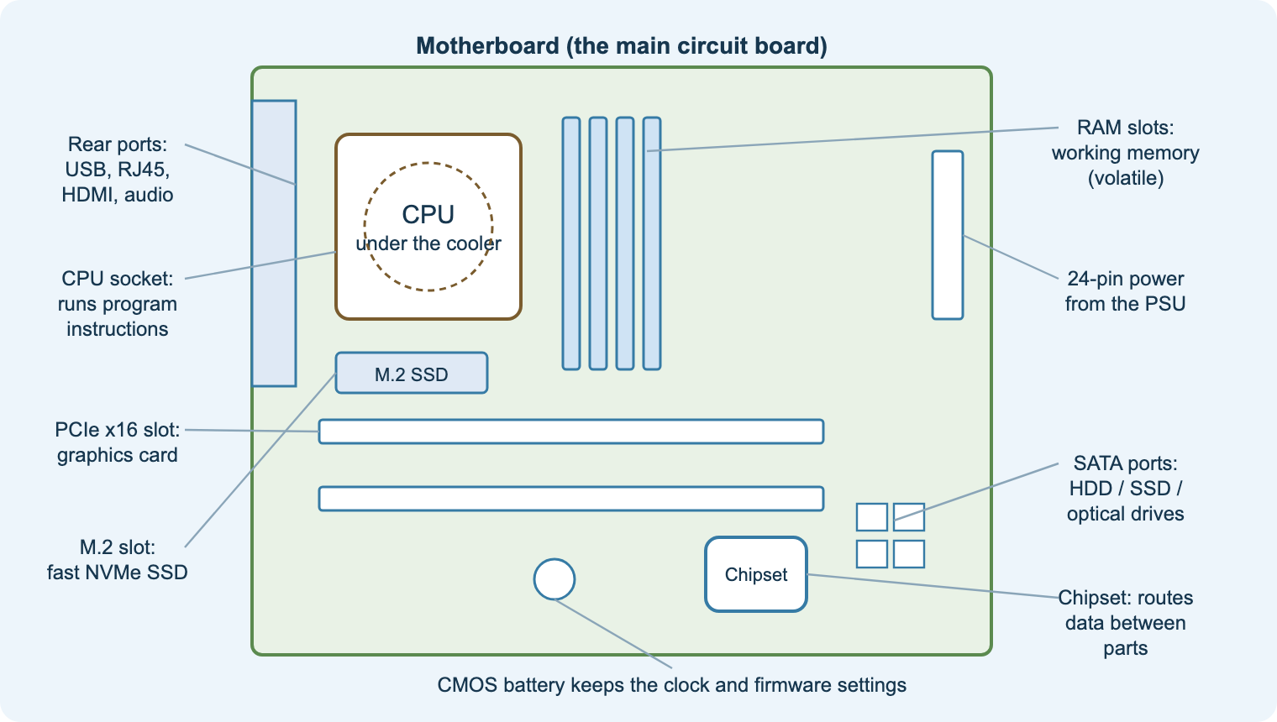
A1
Inside a computer system
Aim: identify internal components and explain their purpose, features and uses
Motherboard, CPU, RAM, ROM, storage, PSU, GPU
Purpose + feature + use for each component
Types of computer and mobile devices
Factors affecting the choice of hardware
Practical
PC disassembly; Diagram tasks 1, 4 and 5.
Task
Workbook A1; PC component selection task.
Check
Exam question on choosing hardware.
Notes:
Use the Motherboard ID task (now Diagram task 1 on the site) after the disassembly practical.
Videos (A1): Main memory; Secondary storage; Embedded systems.

Slide 10
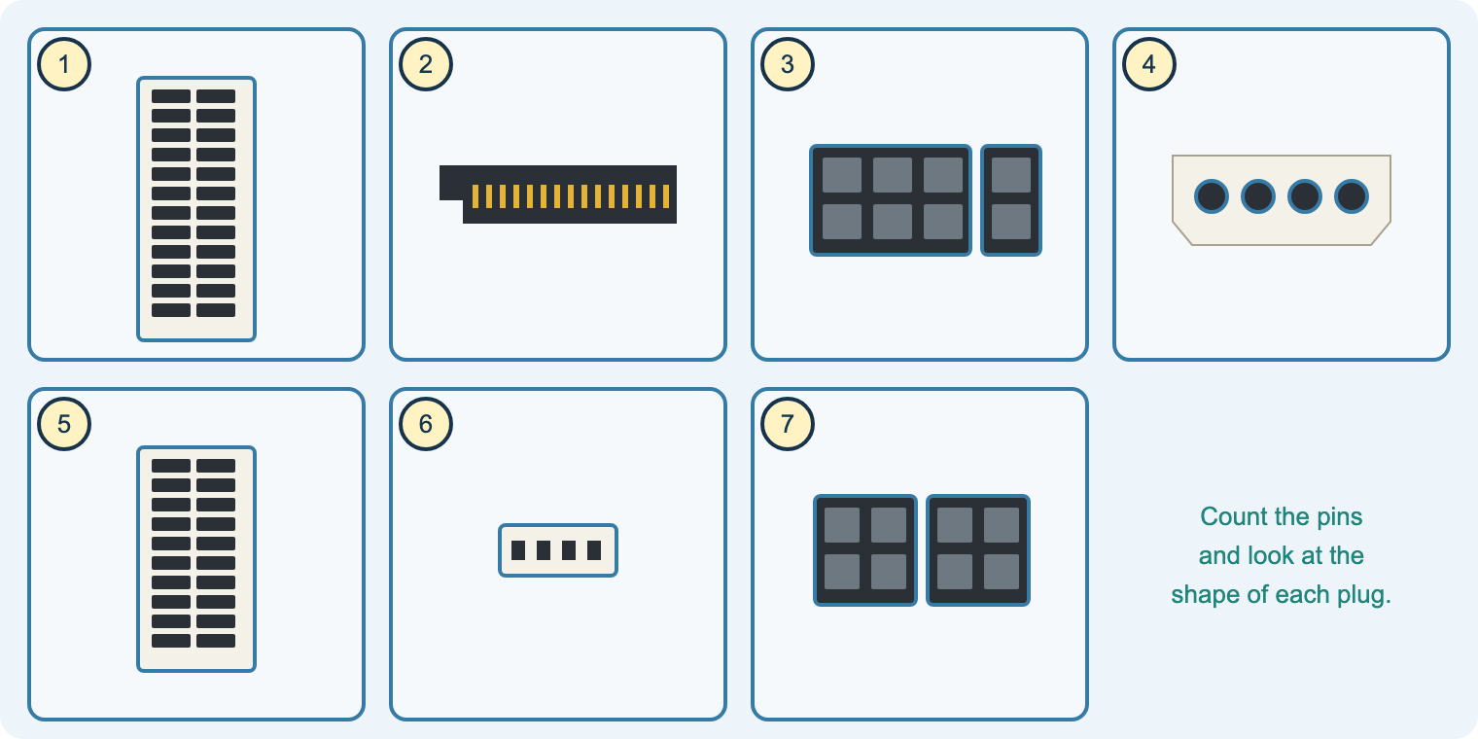
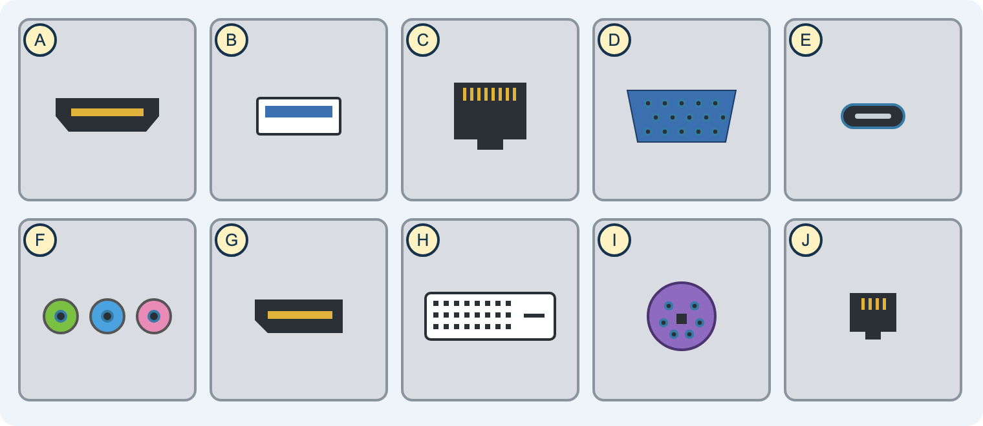
A1
Connectors, ports and servers
Aim: identify connectors and ports and explain the functions of servers
ATX 24/20-pin, EPS 4/8-pin, PCIe 6/8-pin
SATA, Molex, Berg
USB-A/C, HDMI, DisplayPort, VGA, DVI, RJ45
File, print, web, mail, database, authentication servers
Practical
Diagram tasks 2 and 3.
Task
‘From your lessons · A1’ tables.
Check
Name the server for each scenario.
Notes:
The connectors and ports tasks redraw your Word worksheets as drop-down tasks with instant marking.
Video (A1): Network hardware.

Slide 11
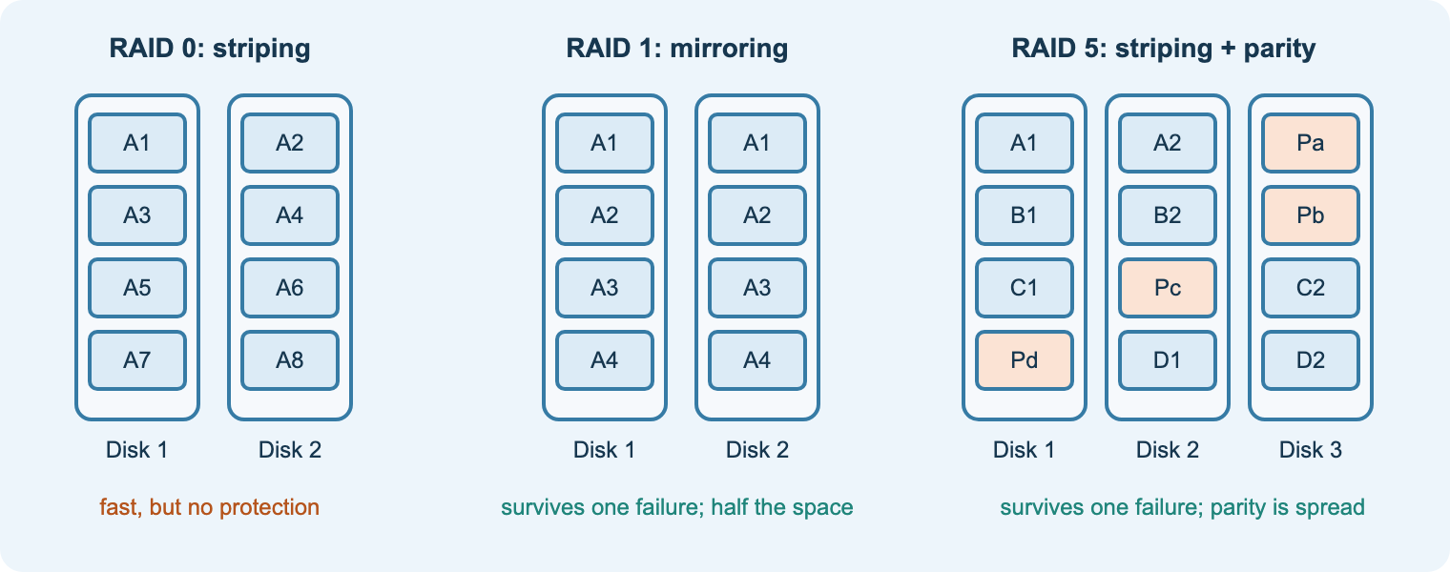
A1
Storage, RAID, NAS and SAN
Aim: compare storage and explain RAID, NAS and SAN
Memory and storage hierarchy
HDD vs SSD
RAID 0, 1, 5 (and 10)
NAS vs SAN; cluster storage
Practical
Diagram task 9: RAID levels.
Task
Workbook A1 storage activity.
Check
RAID choice for a scenario.
Notes:
Use the NAS and RAID notes from Teams.
Video (A1): PowerCert, What is RAID 0, 1, 5 and 10?

Slide 12
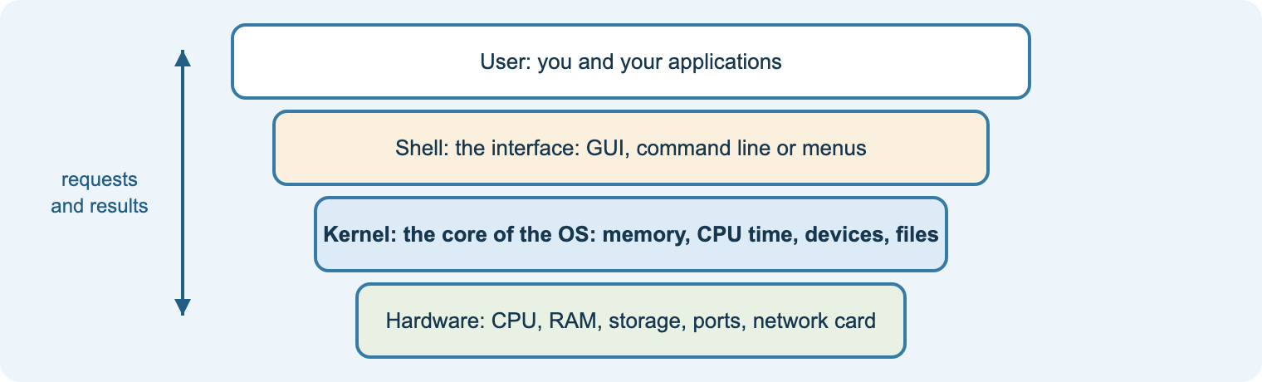
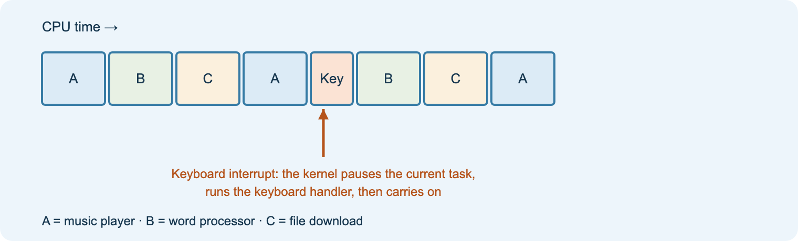
A2
Operating systems and the kernel
Aim: explain the role of the OS and kernel, interfaces, utilities and open source
Kernel: execution, interrupts, memory, scheduling, devices
OS networking and security: home vs organisation
GUI, CLI, menu, voice: choosing an interface
Utilities, applications, open source, disk cache
Starter
Kernel crossword (link on Teams).
Task
Workbook A2.
Check
Open source vs proprietary exam question.
Notes:
Decks 1–10 in Presentations Software map to Learn A2 and its ‘From your lessons’ block.
Videos (A2): Operating System; What is a kernel?; Utility software; Open source explained.

Slide 13
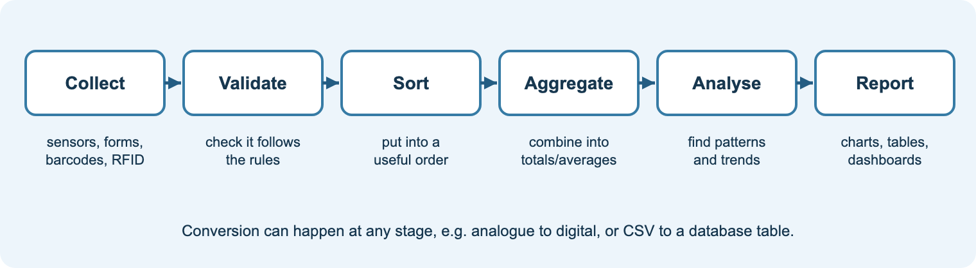
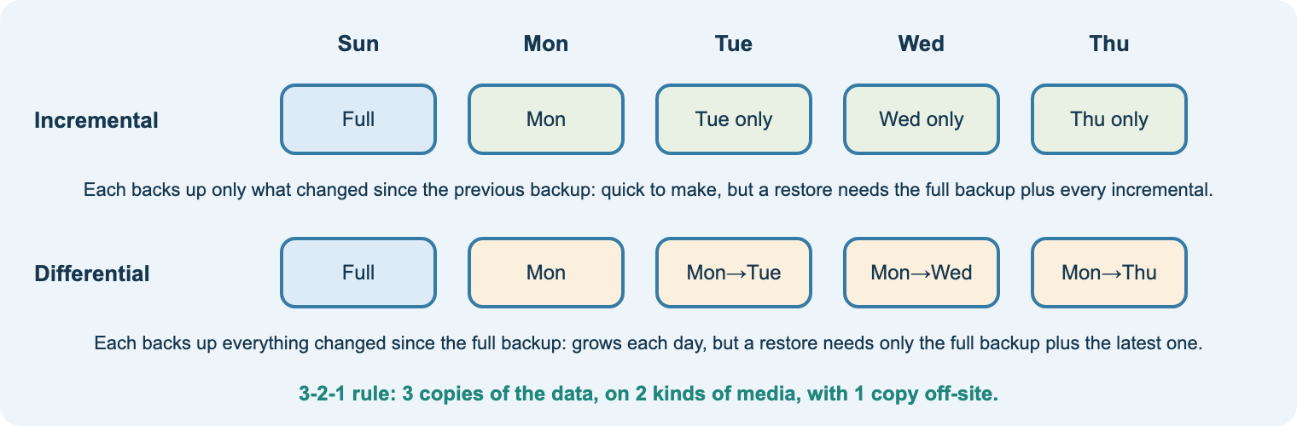
A3
Data processing
Aim: explain how data is collected, processed, shared and backed up
Collection methods and validation
Processing: sort, search, aggregate, calculate
Data across multiple systems
Backups: full, incremental, differential
Task
Workbook A3.
Practical
Data processing homework (Teams).
Check
Revision test question on processing.
Notes:
Videos (A3): Databases; Client–server and peer-to-peer networks.

Slide 14
B · Computer architecture
Von Neumann and Harvard, the fetch–decode–execute cycle, pipelining, registers and interrupts

Slide 15
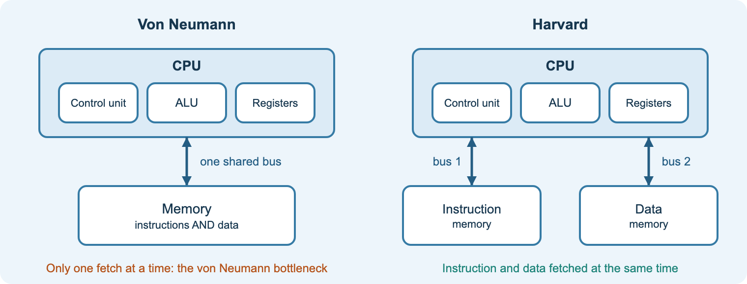
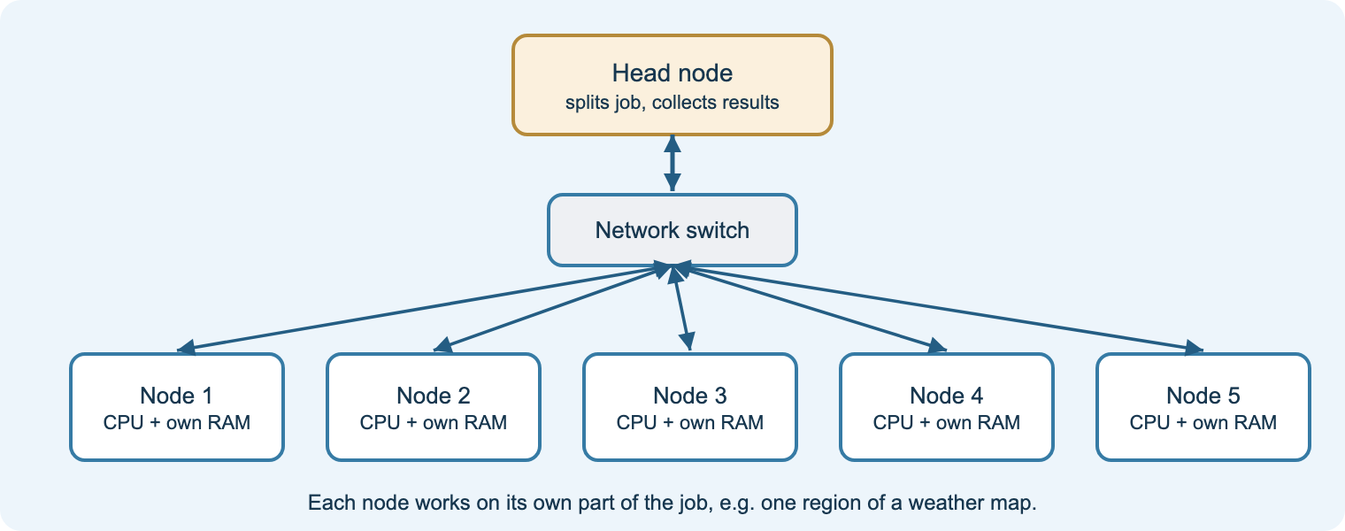
B1
Approaches to architecture
Aim: compare Von Neumann, Harvard, clusters and NUMA
Stored-program concept
Separate instruction and data memories
Clusters and parallel processing
Uniform vs non-uniform memory access
Task
Workbook B1.
Check
Revision test 3 (deeper) B1 set.
Homework
Preview B2 deck.
Notes:
Videos (B1): CPU and Von Neumann; Harvard vs Von Neumann; contemporary CPUs.

Slide 16
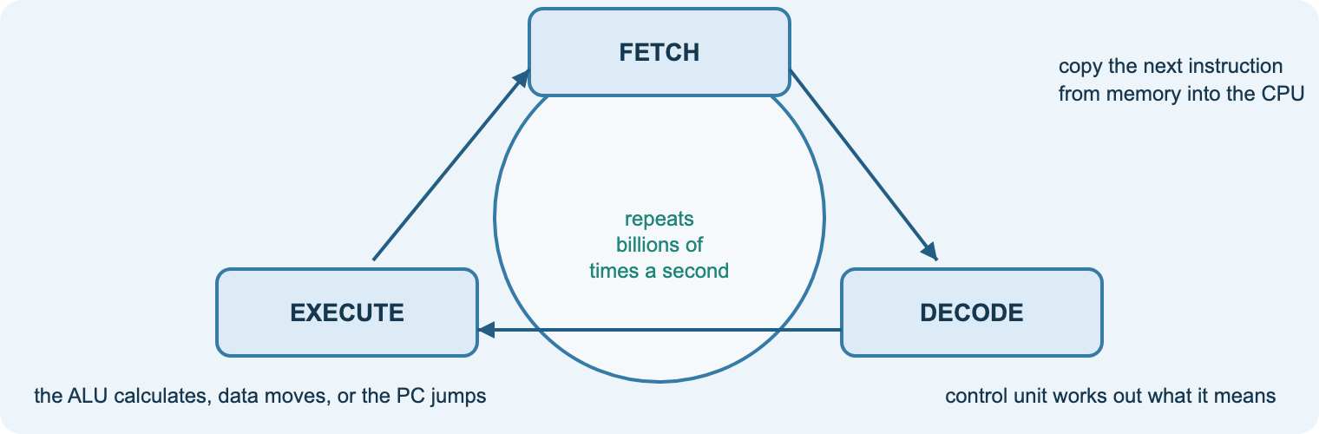
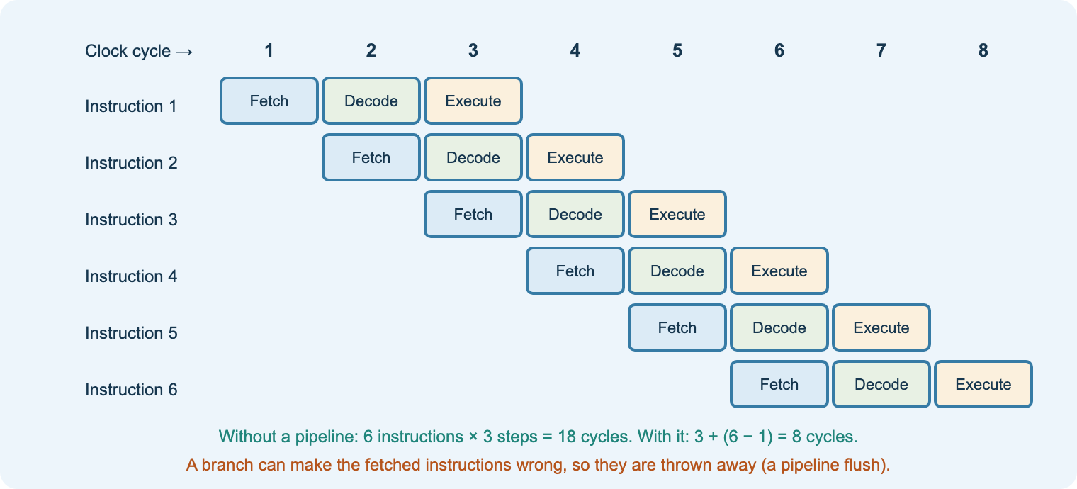
B2
Microarchitecture: FDE and pipelining
Aim: explain the fetch–decode–execute cycle, pipelining, cores and cache
Fetch, decode, execute
Pipelining overlaps stages
Cores, threads and cache
Why 4 cores ≠ 4× faster
Starter
Act out the FDE cycle with students as registers.
Task
Workbook B2.
Check
Exam question on CPU performance.
Notes:
Videos (B2): Purpose of the CPU; Factors affecting CPU performance; Computerphile CPU pipeline (stretch).

Slide 17
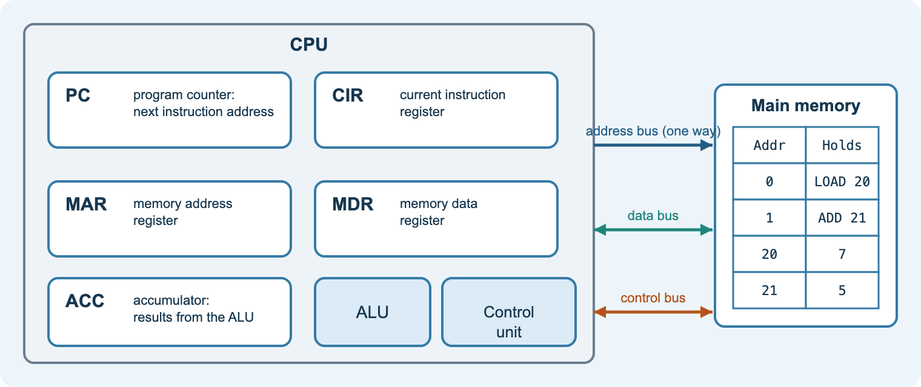
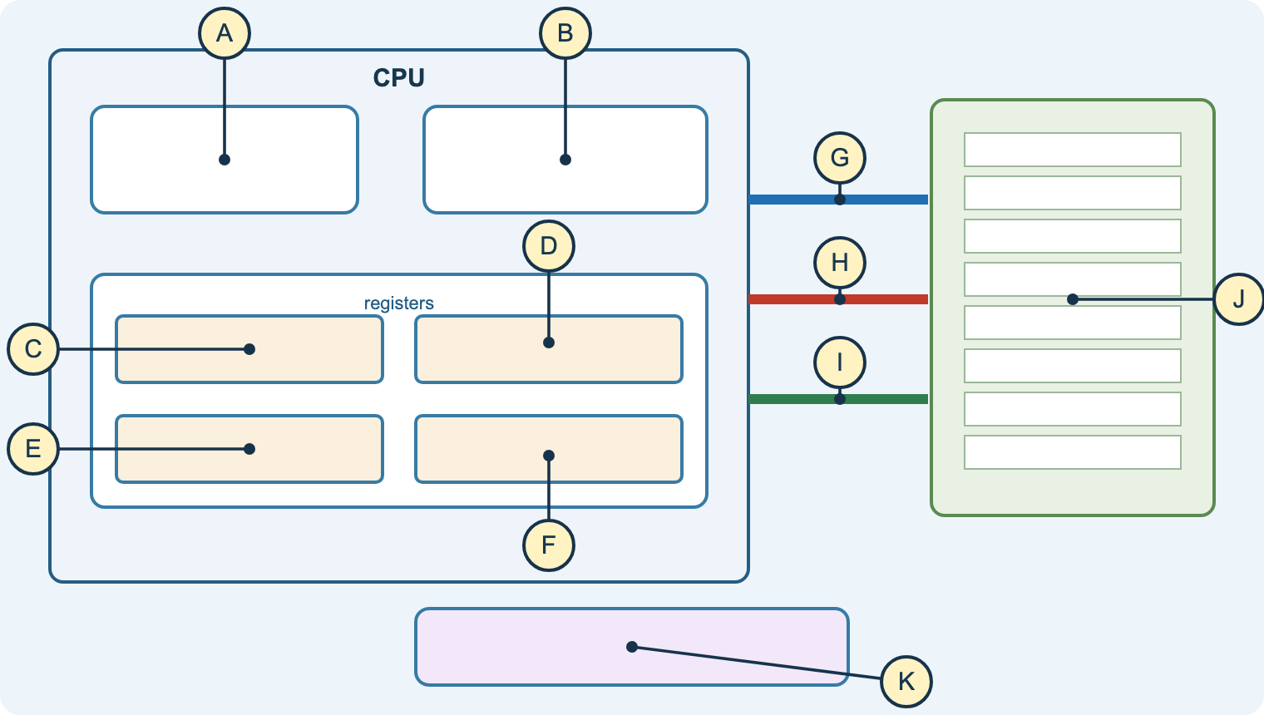
B3
Registers, buses and interrupts
Aim: trace registers through a fetch and explain interrupts
PC, MAR, MDR, CIR, ACC
Address, data and control buses
Interrupt handling and priorities
Saving and restoring registers
Practical
Diagram task 7: Von Neumann computer.
Task
Workbook B3 register trace.
Check
Revision test question on registers.
Notes:
Videos (B3): Special-purpose registers; Address, data and control buses; how interrupts work (stretch).

Slide 18
C and D · Data
Number systems, text, images, data structures and matrices

Slide 19
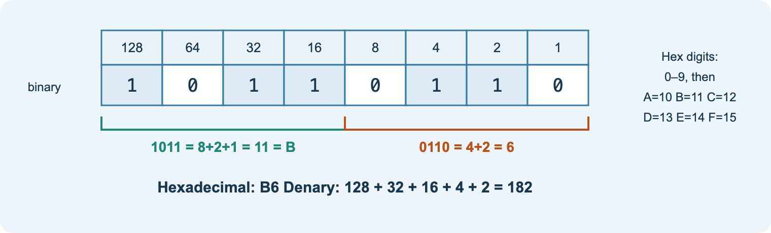
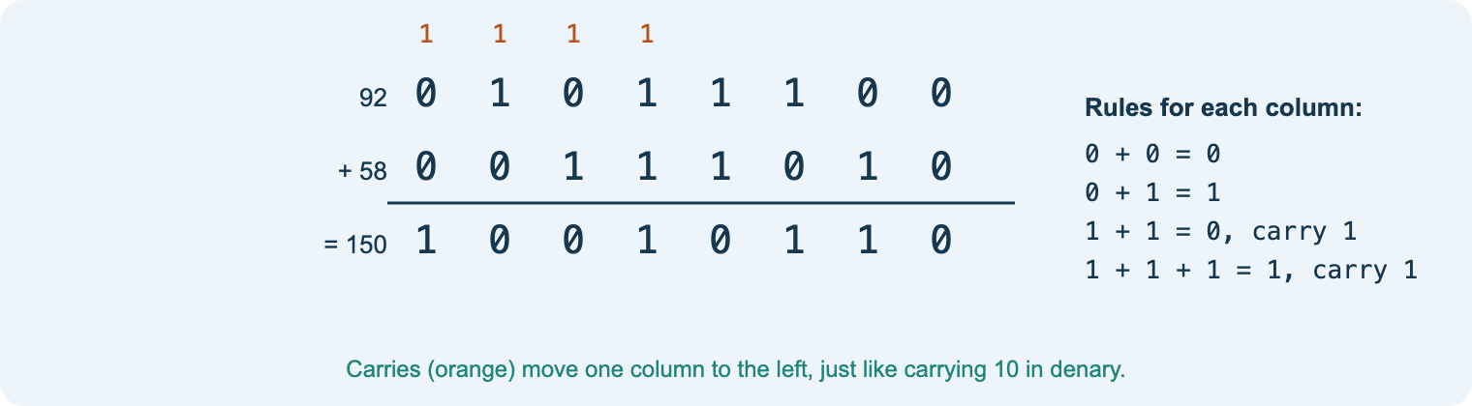
C1
Number systems and arithmetic
Aim: convert between bases, use BCD and do binary arithmetic
Binary, octal, decimal, hexadecimal
Recognising a base from its digits
BCD
Addition, subtraction, shifts
Starter
Cisco Binary Game / number systems quiz.
Practical
Diagram task 6: which number base?
Check
Numbers competence test.
Notes:
Use the numbers booklet and binary mathematics end test on Teams.
Videos (C1): Introduction to binary; conversions; addition; hex and binary; shifts.

Slide 20
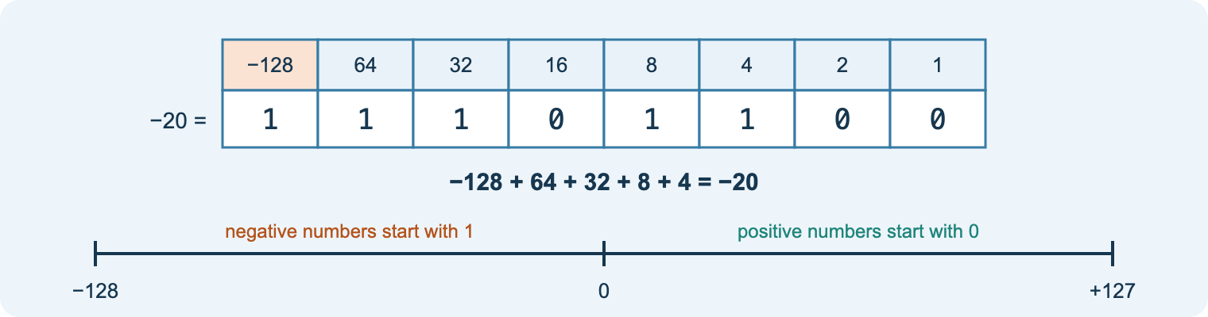
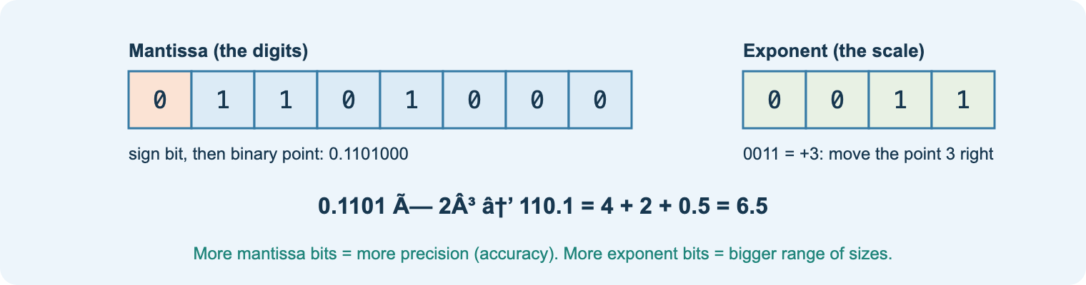
C1
Negative numbers and floating point
Aim: represent negative numbers and real numbers in binary
Sign and magnitude
Two’s complement and range
Mantissa and exponent
Precision vs range
Task
Signed binary worksheet (Teams).
Check
Revision test 3 C1 set.
Homework
Floating point deck.
Notes:
Videos (C1): Signed binary; floating point (stretch); BCD.

Slide 21
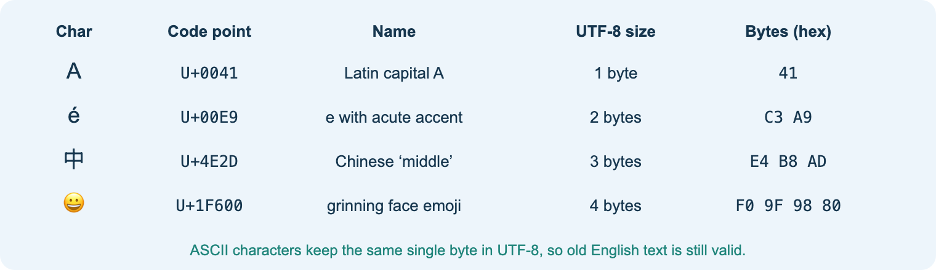
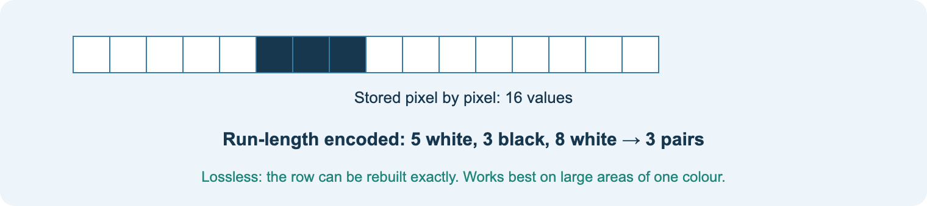
C2–C3
Text and images
Aim: explain ASCII, Unicode, bitmap images and compression
ASCII and extended ASCII
Unicode and UTF-8
Pixels, resolution, colour depth
File size; RLE compression
Task
Workbook C2 and C3.
Check
Image file size calculation.
Homework
Image representation deck.
Notes:
Videos (C2, C3): Text in binary; images in binary; sound; lossy and lossless compression.

Slide 22
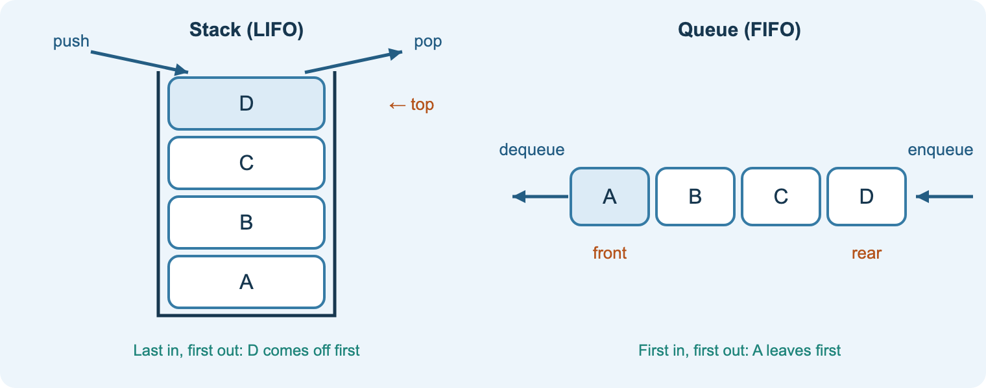
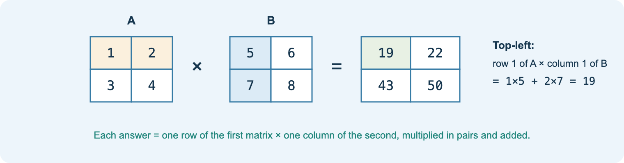
D1–D2
Data structures and matrices
Aim: use stacks, queues, arrays, lists and matrices
Stack (LIFO), queue (FIFO)
Arrays and linked lists
Row-major storage
Matrix addition, multiplication, transformations
Task
Workbook D1 and D2; matrices worksheet.
Check
Indices and matrices questions.
Homework
D revision questions.
Notes:
Videos (D1, D2): Data structures; stacks and queues; how to multiply matrices.

Slide 23
E and F · Transmission and logic
Channels, encryption, VoIP, error detection and correction, logic gates and data flow

Slide 24
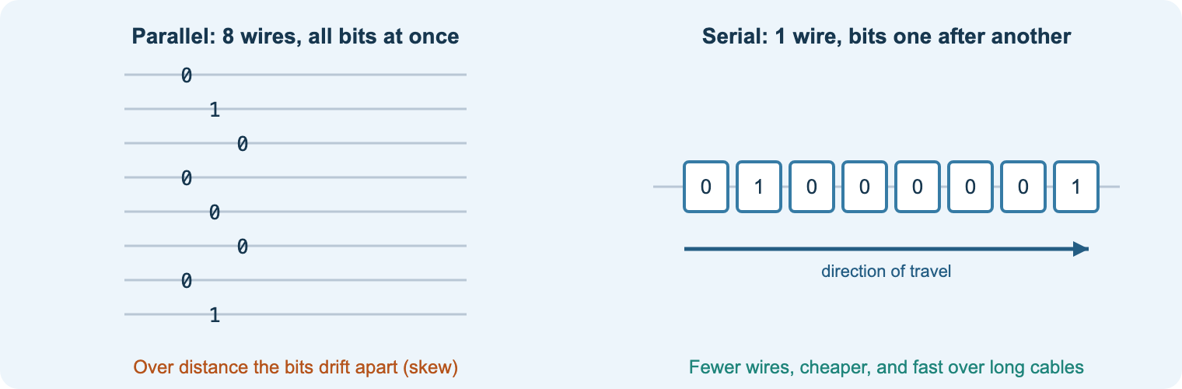
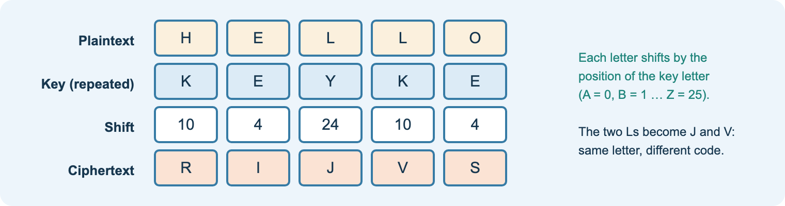
E1
Transmitting data and encryption
Aim: explain transmission methods, protocols, encryption and VoIP
Simplex, half and full duplex
Serial vs parallel; synchronous vs asynchronous
Caesar, Vigenère, public key
VoIP: codecs, packets, jitter
Practical
Vigenère cipher worksheet (Teams).
Task
Workbook E1.
Check
E revision questions.
Notes:
Videos (E1): Serial and parallel; synchronous and asynchronous; encryption; Vigenère.

Slide 25
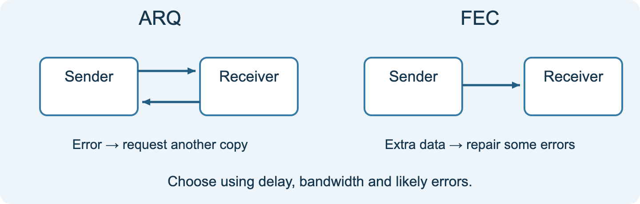
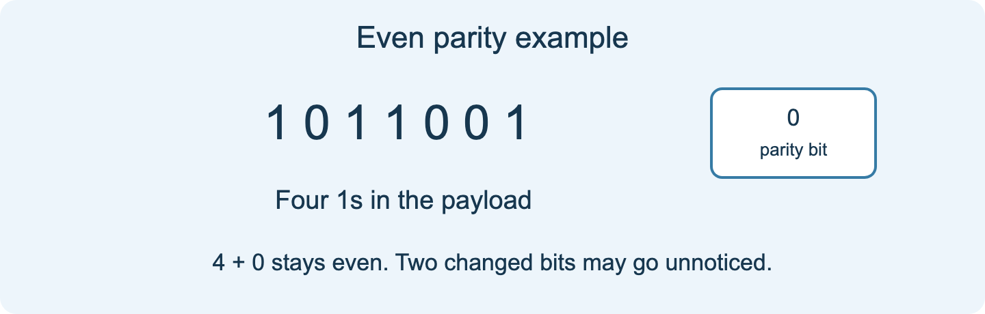
E2–E3
Detecting and correcting errors
Aim: explain parity, checksums, CRC, ARQ and FEC
Causes of errors
Parity and checksums
CRC
ARQ vs FEC: when to use each
Task
Workbook E2 and E3.
Check
Error correction exam question.
Homework
Error correction deck.
Notes:
Videos (E2, E3): Check digits and parity; Computerphile CRC and error correction; Hamming codes (stretch).

Slide 26
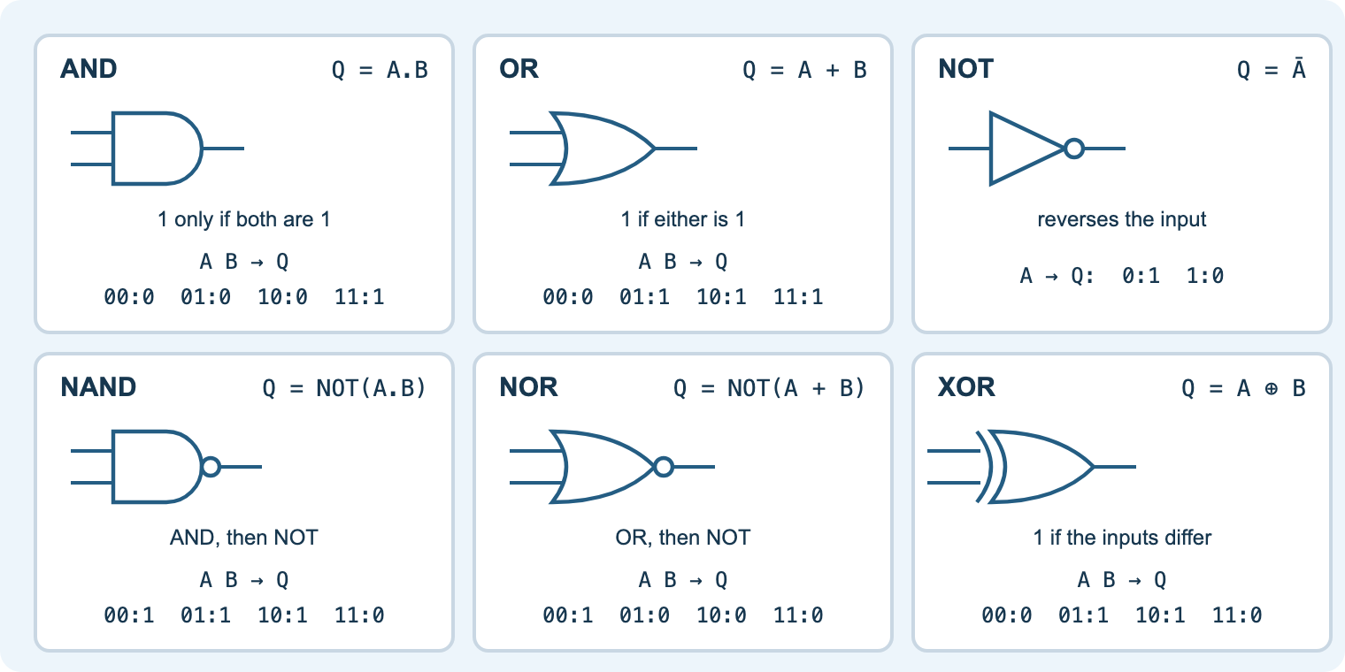
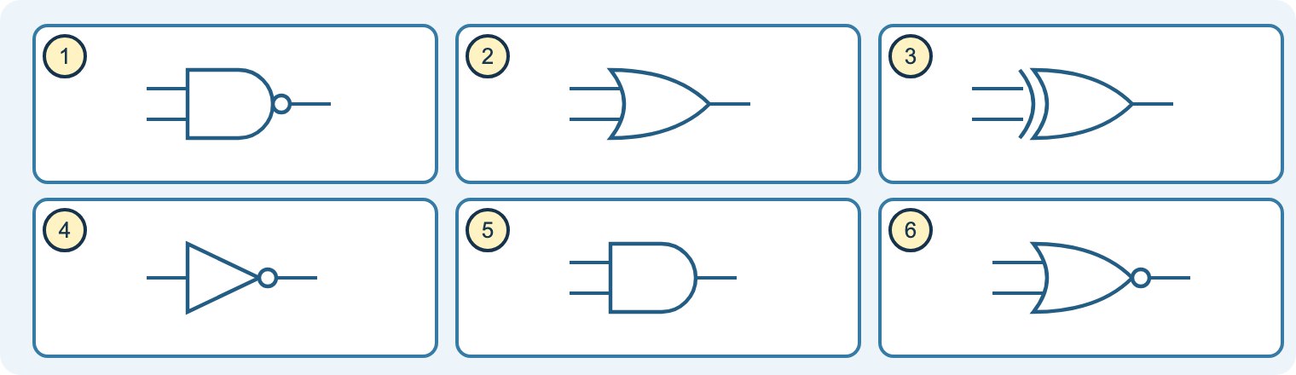
F1
Logic gates and Boolean logic
Aim: use gates, truth tables, expressions and adders
AND, OR, NOT, NAND, NOR, XOR
Truth tables and expressions
Half and full adders
Universal gates; three-state logic
Practical
Diagram task 8: logic gate symbols.
Task
Logic questions (Teams); Workbook F1.
Check
Dog day-care truth table question.
Notes:
Use the logic booklet with the site’s gate gallery.
Videos (F1): Logic gates; half and full adder; Boolean algebra (stretch).

Slide 27
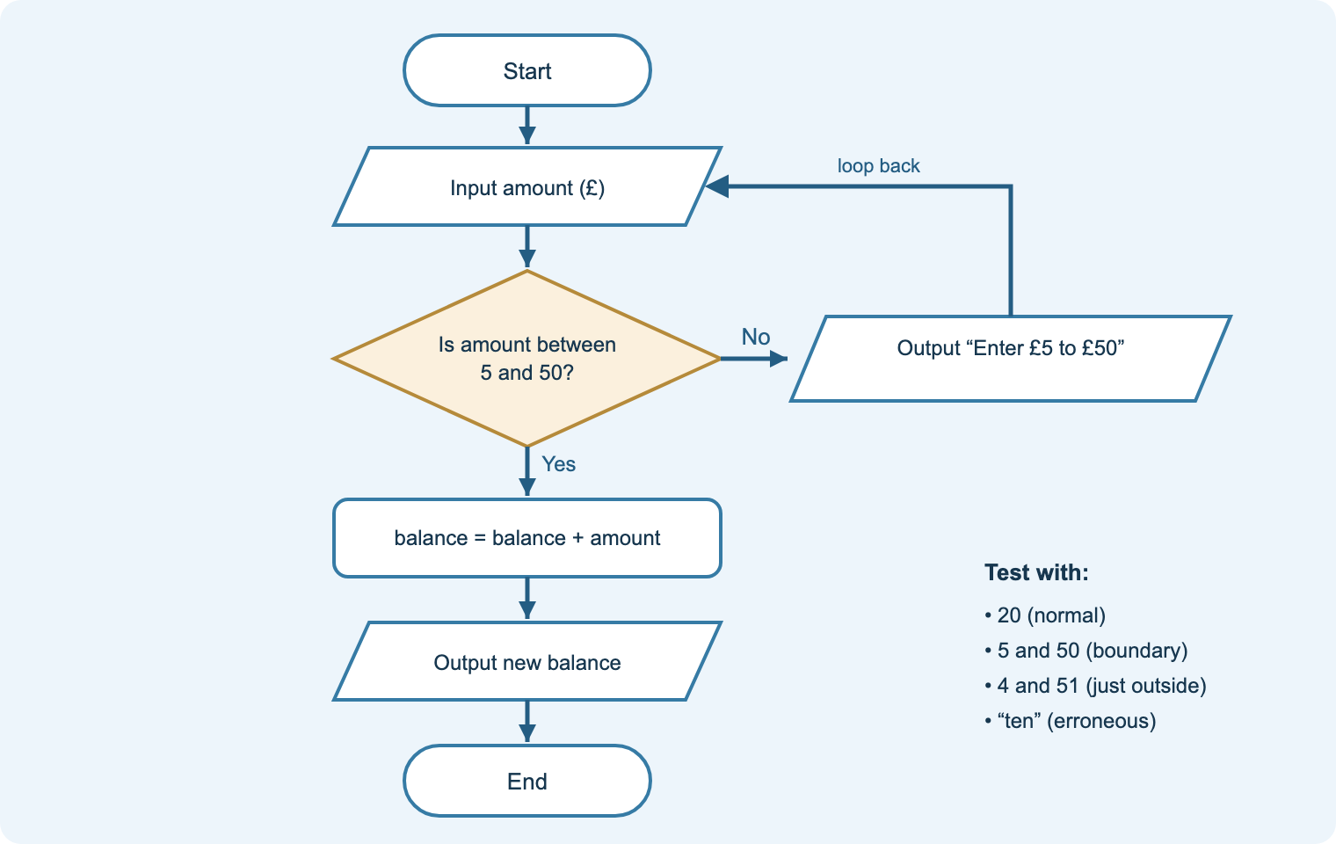
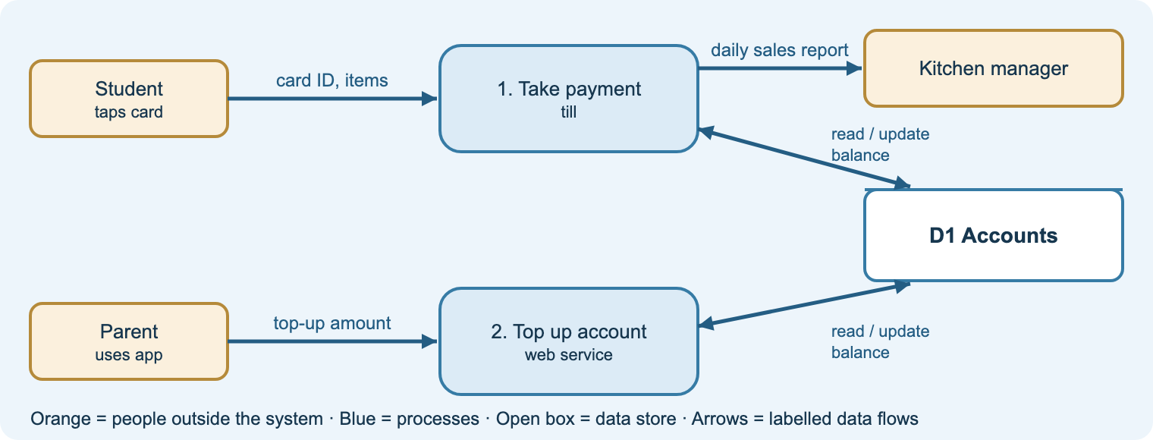
F2
Flowcharts and system diagrams
Aim: read and draw flowcharts and system diagrams
Flowchart symbols
Tracing with normal and edge cases
System diagrams: inputs, processes, outputs, storage
Explaining a diagram in words
Task
Workbook F2.
Check
Reward-system flowchart question.
Homework
Revision test 2.
Notes:
Videos (F2): Flowcharts; Data flow diagrams.

Slide 28
Nine diagram tasks on the site
1
2
3
4
5
Motherboard ID
Power connectors
Ports
Mobile devices
Internal components
6
7
8
9
Which number base?
Von Neumann computer
Logic gate symbols
RAID levels
Your Word labelling worksheets, redrawn as original diagrams with drop-down answers, instant marking and links to the lesson and tutor.
Notes:
Tasks 1–6 come from the Hardware and Number Systems worksheets; 7–9 are new, from the architecture, logic and RAID lessons.
Use them as starters, plenaries or homework; choices save on the student’s device.

Slide 29
Revision and the exam
Learn section
Diagram task
Workbook + tutor
Revision tests
Past papers
Examiner tips
Four revision tests
Guided, independent, deeper understanding and long 6–12 mark answers with level marking.
Five past papers
Real Pearson papers with tutor modes: start, check and plan. The official mark schemes are linked.
Exam questions by topic
The A–F question banks and answers on Teams pair with each Learn section.
Notes:
Set one revision test and one past-paper question per week in the final half term.

Slide 30
Ready to deliver
Share the start page link in Teams
Lesson 1: tour the pack and the tutor
Use a diagram task in every hardware lesson
Set workbook activities as homework
Revision tests and past papers every week
Notes:
Site: nigeriastudentcenter.github.io/btech/start.html
The AI tutor is live on the college Azure subscription.

