Slide 1
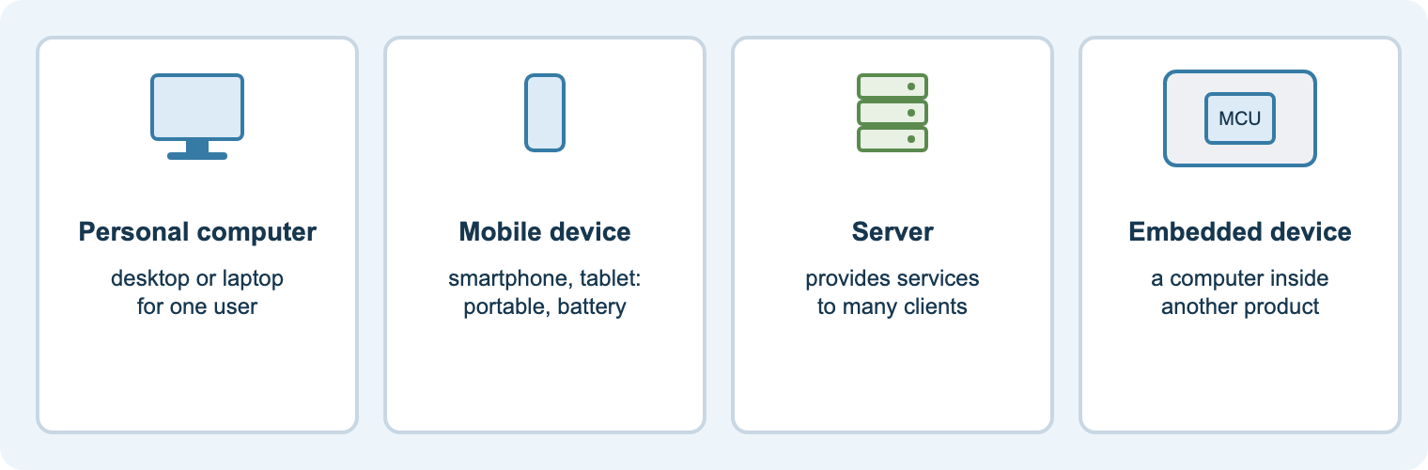
Content area 7
Digital environments
Teacher delivery deck · T Level Digital Production, Design and Development (core)
Hardware · Software · Networks · Virtual · Cloud · Resilience
Notes:
Purpose: this deck supports delivery of content area 7 alongside the student course site (nigeriastudentcenter.github.io/btech/unit7/start.html).
Every lesson slide follows the college routine: starter, aim, teach, practical, task, check, flipped homework.
Speaker notes give teaching points, questions, differentiation, and the matching workbook section, practical and quiz.

Slide 2
How each lesson runs
1
2
3
4
5
6
7
Starter
5 min hook or recap quiz
Aim
share the aim and the spec point
Teach
diagram-led explanation with questioning
Practical
hands-on task or Packet Tracer
Task
workbook activity on the site
Check
quiz or exam-style exit question
Homework
flipped: preview the next lesson
On the student site
Each lesson has a Learn page section with diagrams and exam tips, a workbook activity with the AI tutor, a video, a practical where relevant, and a quiz.
In the speaker notes
Teaching points, questions to ask, stretch and support, the matching workbook section, practical and quiz, and the flipped homework.
Notes:
Keep the existing starters from Teams (Millionaire, Hollywood Squares, catchphrase, IP quiz).
Keep using the Microsoft Forms end-of-lesson checks from the detailed SOW; the site quizzes work as extra starters or homework.

Slide 3
Content area 7 at a glance
6
26
18
12
1
topic areas: 7.1–7.6
specification points
lessons on the student site
practical tasks
written core exam
7.1 Hardware
physical systems, devices
7.2 Software
OS, utilities, dev tools, apps
7.3 Networks
types to protocols, 11 points
7.4 Virtual
VMs and hypervisors
7.5 Cloud
types, benefits, IaaS/PaaS/SaaS
7.6 Resilience
benefits and methods
Number systems (binary, denary, hexadecimal, units) are taught first as a foundation for addressing, storage and data representation.
Notes:
Content area 7 is part of the T Level core, assessed by written examination together with other core content areas. Check the current specification and exam timetable with your awarding organisation.
7.3 Networks is the largest block (11 of 26 points) and takes roughly half the teaching weeks.

Slide 4
How it is assessed: exam technique
Command word | What students must do | Typical marks
State / identify | short fact or name, no explanation | 1
Describe | features or steps; one mark per accurate point | 2–4
Explain | point + why/how (“because”, “so that”), applied to the scenario | 2–6
Discuss | different sides: how it works, benefits, drawbacks, depends on | 6–9
Evaluate / justify | weigh strengths against weaknesses; supported judgement | 9–12
Level-marked answers
Long answers are judged as a whole. Reward developed points linked to the scenario, not lists. About 1 minute per mark.
On the site
Exam practice has two scenario papers (short and extended) with self-marking checklists and level descriptors. Every question links to its lesson and the AI tutor.
Notes:
Model the PEEL-style developed point: point, explain, example/apply, link back.
Use the awarding organisation’s sample assessment materials and past papers for timed mocks; the site’s exam practice is original, not official.
Most common weakness: generic answers that ignore the scenario. Insist on naming the business in every point.

Slide 5
The student course site
1. Course guide
How the exam works and a red/amber/green checklist of all 26 spec points
2. Learn
18 lessons with original diagrams, key terms, exam tips and questions
3. Workbook + tutor
An activity and quick check per lesson; AI study tutor; saves on device
4. Practicals
12 tasks: motherboard, command line, Packet Tracer, VMs, resilience plan
5. Exam practice
Scenario papers with command-word guide and level marking
6. Quizzes
Five instant-marked quizzes, one per topic block
Plus 7. Videos: 30 embedded videos (MrBrownCS series, TED, Cisco). Link for Teams: nigeriastudentcenter.github.io/btech/unit7/start.html · No accounts; work saves in the browser.
Notes:
Tour the site in the first lesson. Show the download backup button on shared machines.
Ask students to complete the RAG checklist in the Course guide after each topic and screenshot it before one-to-ones.

Slide 6
The AI study tutor: used well
Encourage students to…
• ask for a concept explained another way
• ask it to quiz them on a lesson
• get one hint when stuck, then try again
• check a practice answer and ask what is missing
• use Practice mode for new questions
It is set up to…
• stay on the lesson they chose
• give hints, not the workbook answers
• use different numbers from the activity
• reply in plain English for 16–18 year olds
• ignore attempts to change its rules
Exam-assessed, so no assignment coach
There is no coursework in this content area, so students can use the tutor freely for revision. No names or accounts; nothing is stored on the server.
Notes:
The page sends only the lesson ID; the notes and rules are held on the server.
The tutor runs on the college Azure service with usage limits. If it is offline, every other page still works.

Slide 7
Delivery plan (2025–26 SOW)
Weeks 2–7
Weeks 8–10
Weeks 11–24
Weeks 25–31
Weeks 32–33
Number systems; 7.1 hardware; PC practical; IoT; Raspberry Pi
7.2 software: OS, utilities, dev tools, applications
7.3 networks: types to protocols, bandwidth and latency; practicals
7.4 virtual, 7.5 cloud, 7.6 resilience
Revision and exam practice
Based on the 2025–26 Digital environments scheme of work (35 weeks). The Teachers page on the site maps each week to its lesson, practical and quiz.
Notes:
Networks take about 14 weeks: keep one hands-on session every week or two so the theory stays concrete.
Cisco Academy weeks (IoT, week 4; week 14) can use the NetAcad courses as flipped or catch-up work.

Slide 8
Number systems and 7.1 Hardware
Binary, denary and hex · physical computer systems · hardware devices

Slide 9
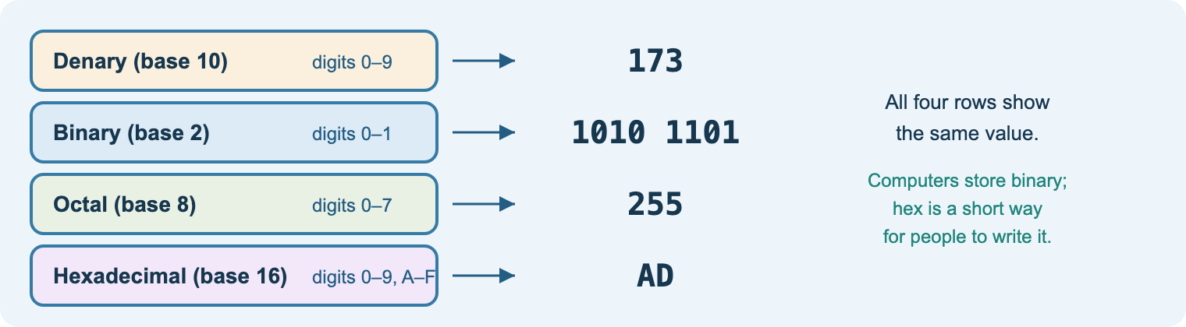
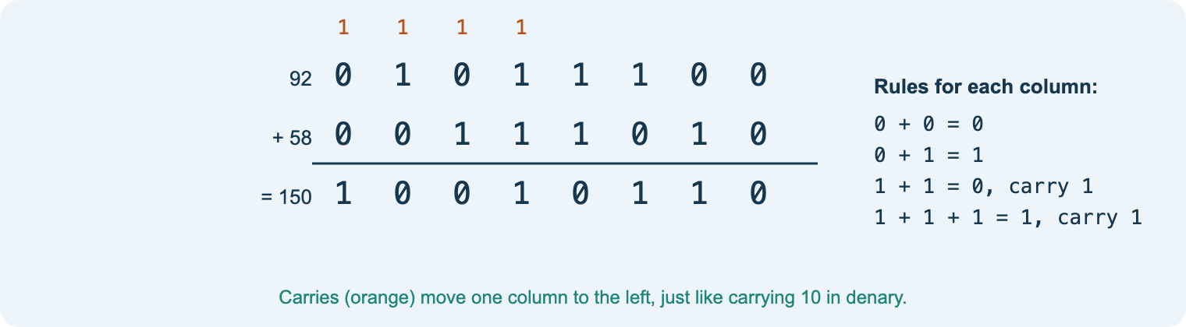
NS
Number systems
Aim: convert between binary, denary and hexadecimal, add binary and use units of data
Place values: 128 64 32 16 8 4 2 1
Hex: one digit = 4 bits (a nibble)
Binary addition and overflow
Units: bit, nibble, byte; kB vs KiB (1000 vs 1024)
Why it matters: addresses, colours, storage sizes
Starter
Hold up cards 128…1: make your age in binary.
Task
Workbook NS and Practical 4 (numbers booklet).
Check
Quiz 1: conversions, units, two’s complement.
Notes:
Teach the column method first, then repeated division by 2 for denary to binary.
Question: why does a 1 TB drive show about 931 GiB in Windows?
Support: printed place-value grid. Stretch: two’s complement and binary shifts.
Videos (lesson NS): MrBrownCS Introduction to Binary, Binary–Decimal Conversions, Binary Addition, Signed Binary.

Slide 10
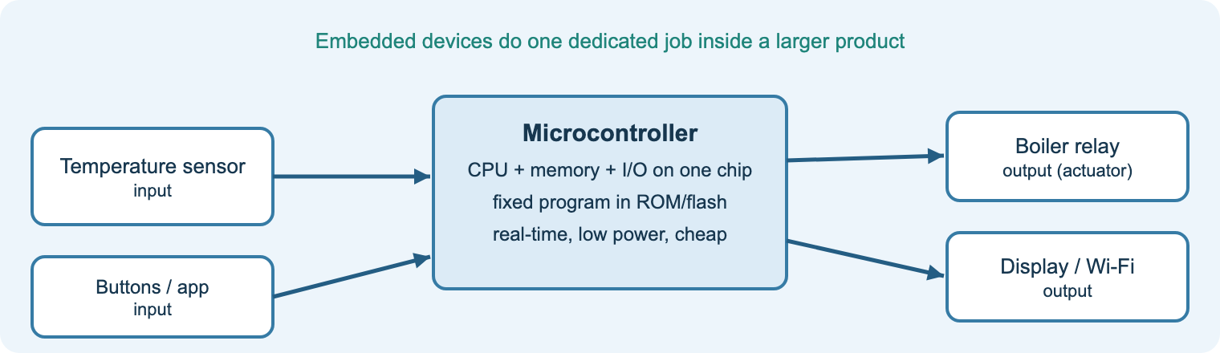
7.1.1
Types of physical computer system
Aim: describe the features and uses of personal computers, servers, mainframes, supercomputers and embedded systems
Personal: desktop, laptop, tablet, phone
Servers: services for clients; redundant parts
Mainframes: huge transaction volumes, reliability
Supercomputers: parallel science and simulation
Embedded: dedicated, low power, real-time; IoT
Starter
Count the computers you used before college today.
Practical
Practical 1: PC disassemble and reassemble.
Task
Workbook H1: match systems to organisations.
Notes:
Emphasise features AND use: the exam asks why a system suits a scenario.
Question: why do embedded devices often go unpatched? (link to 7.6 resilience).
Stretch: quantum computers as an emerging type.
Videos (lesson H1): Embedded systems (MrBrownCS), Cisco Internet of Everything, Avi Rubin TED talk on hacking devices.

Slide 11
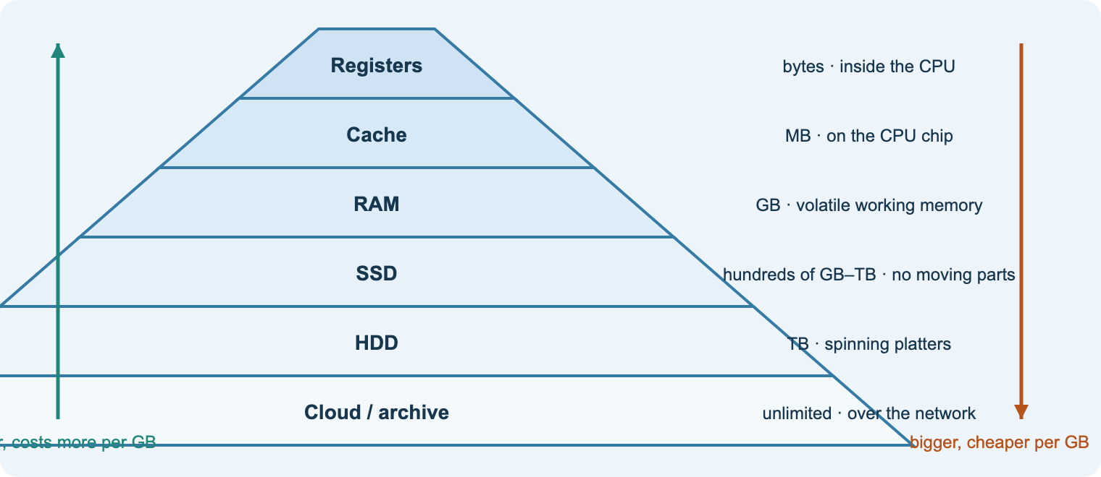
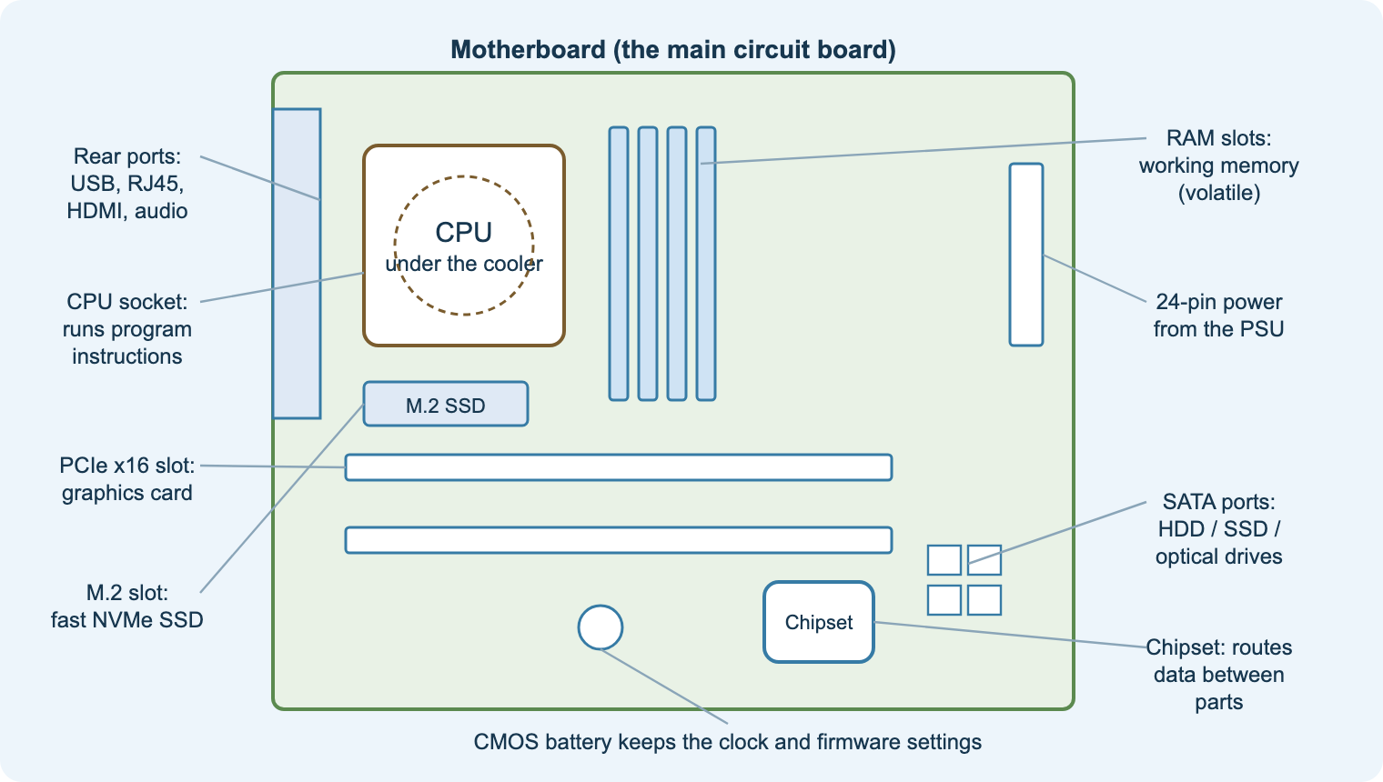
7.1.2
Hardware devices: memory and storage
Aim: explain the features and use of memory, storage, motherboards and interfaces
Input, output and sensors
RAM (volatile) vs ROM (firmware)
Cache: small, fast, close to the CPU
Storage: magnetic, solid state, optical
Motherboard: socket, slots, chipset, buses; PCIe, USB, NIC
Starter
Which is faster: RAM or SSD? Why do we need both?
Practical
Practical 2: Motherboard ID and connectors.
Homework
Practical 3: hardware spider diagram.
Notes:
Use the hierarchy: speed and cost per GB fall as capacity rises.
Question: a school laptop has 4 GB RAM and slows with many tabs. Why?
Support: labelled motherboard handout. Stretch: NVMe vs SATA SSD.
Videos (lesson H2): Main memory; Secondary storage; Buses; Registers.

Slide 12
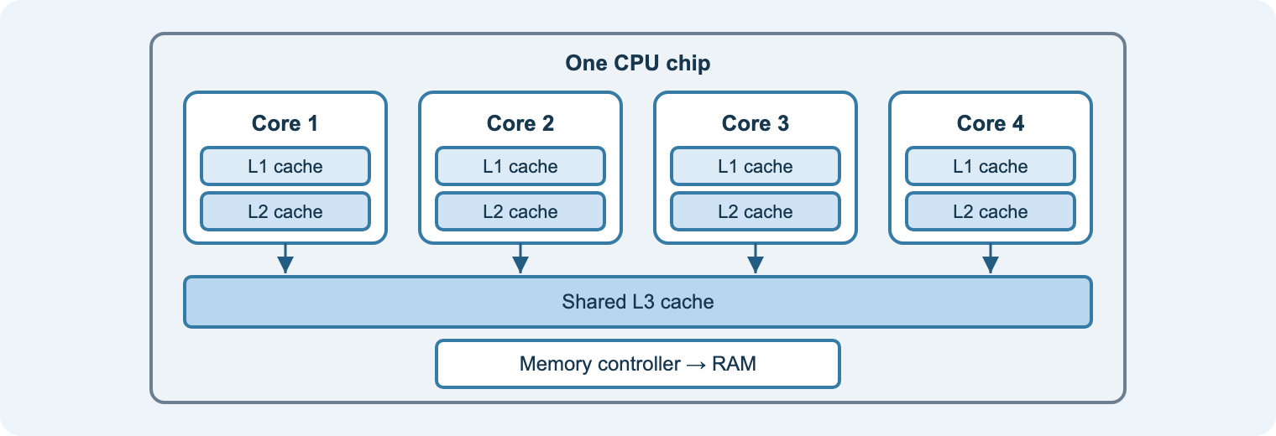
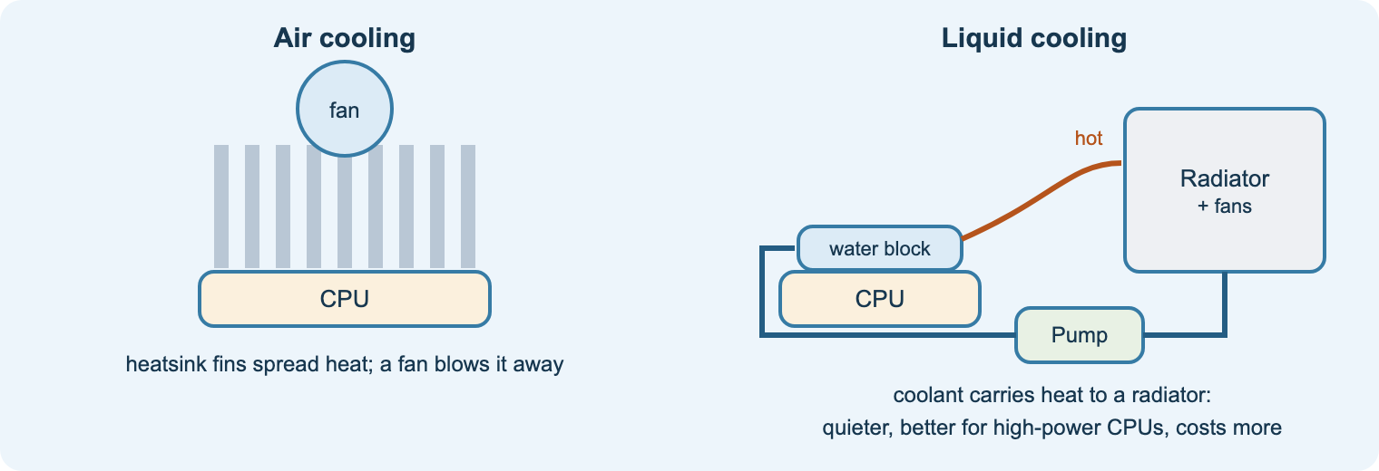
7.1.2
Processors, GPUs and cooling
Aim: explain processor features and why cooling is needed
Cores, clock speed and cache set performance
Mobile processors: low power, less heat
GPU: thousands of cores for parallel graphics and AI
Air cooling: heatsink and fan
Liquid cooling: quieter, handles more heat, costs more
Starter
Why doesn’t an 8-core CPU run a game twice as fast as a 4-core?
Task
Spec a PC for a video editor and justify each part.
Check
Quiz 2: hardware.
Notes:
Link features to effect: more cores help only when software is multi-threaded.
Thermal throttling: why laptops slow down when hot.
Raspberry Pi practical (week 7) is a good embedded-system bridge.
Video (lesson H2): Factors affecting CPU performance (MrBrownCS).

Slide 13
7.2 Software
Operating systems · utilities · code development tools · applications

Slide 14
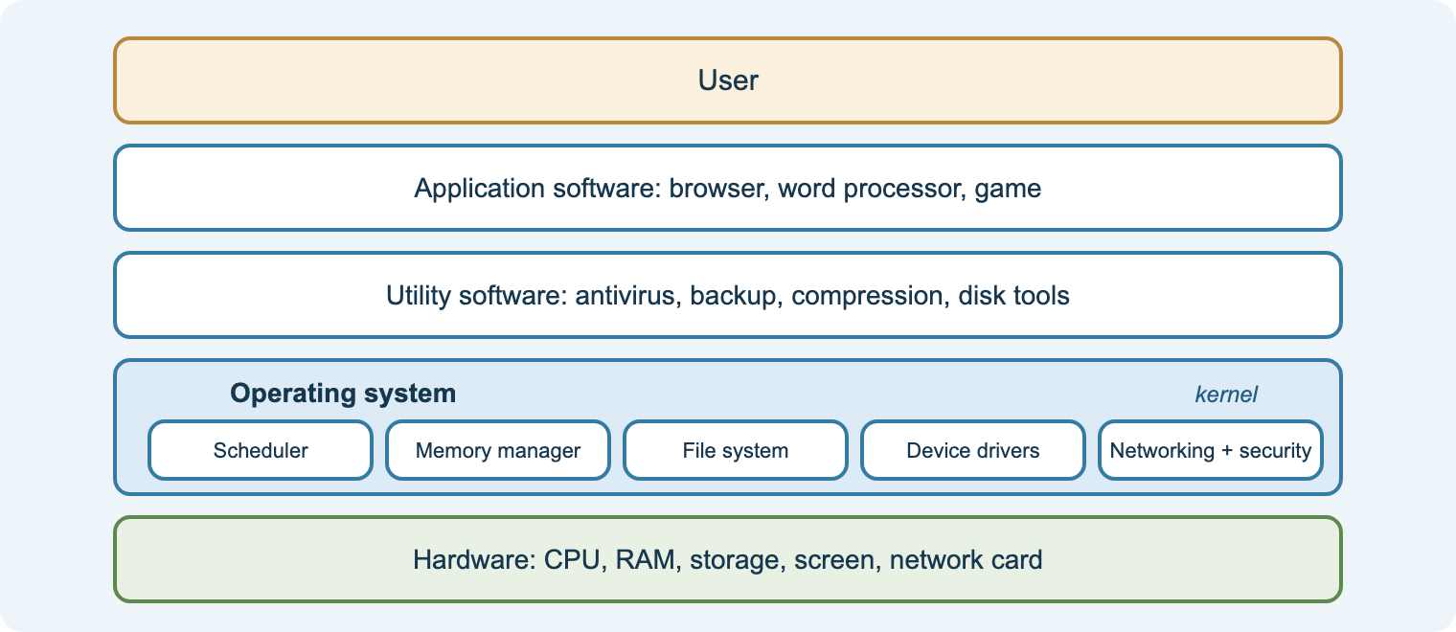
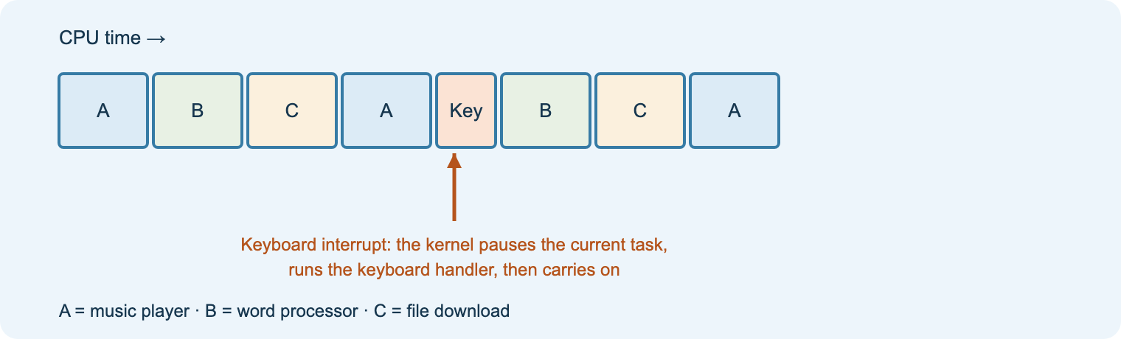
7.2.1
Operating systems
Aim: explain the features and uses of different types of operating system
Functions: memory, processes, files, devices, security, UI
Single-user single-task and multi-tasking
Multi-user and network operating systems
Real-time: guaranteed response (airbags, robots)
Batch vs real-time processing
Starter
What does Task Manager show? Open it and explain one column.
Task
Workbook SW1: match OS types to devices.
Check
Exit: two functions of an OS.
Notes:
Show time slicing to explain multitasking on one core.
Question: why must a pacemaker use a real-time OS?
Stretch: kernel vs user mode; device drivers.
Video (lesson SW1): Operating System (MrBrownCS).

Slide 15
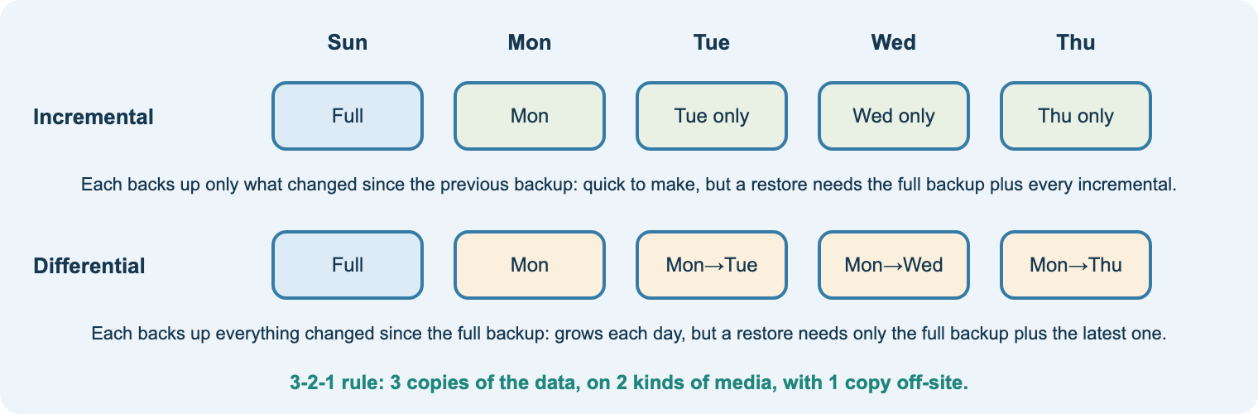
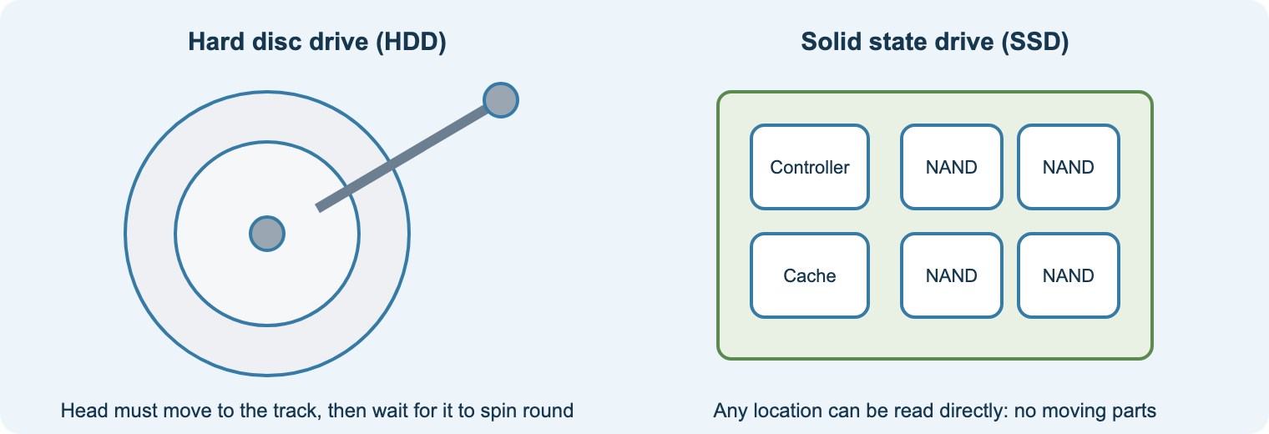
7.2.2
Utilities
Aim: explain the purpose of common utilities
Antivirus and firewall
Backup: full, incremental, differential
Compression: lossy vs lossless
Disk defragmenter (not for SSDs) and disk clean-up
Encryption and file management tools
Starter
You deleted your coursework. Which utility would have saved you?
Task
Workbook SW2: choose a backup type for a café.
Check
Quiz 3: utilities.
Notes:
Walk through restoring from each backup type: full + last incremental chain vs full + one differential.
Question: why not defragment an SSD?
Links to 7.6 resilience (backup and recovery procedures).
Videos (lesson SW2): Utility software; Lossy and lossless compression.

Slide 16
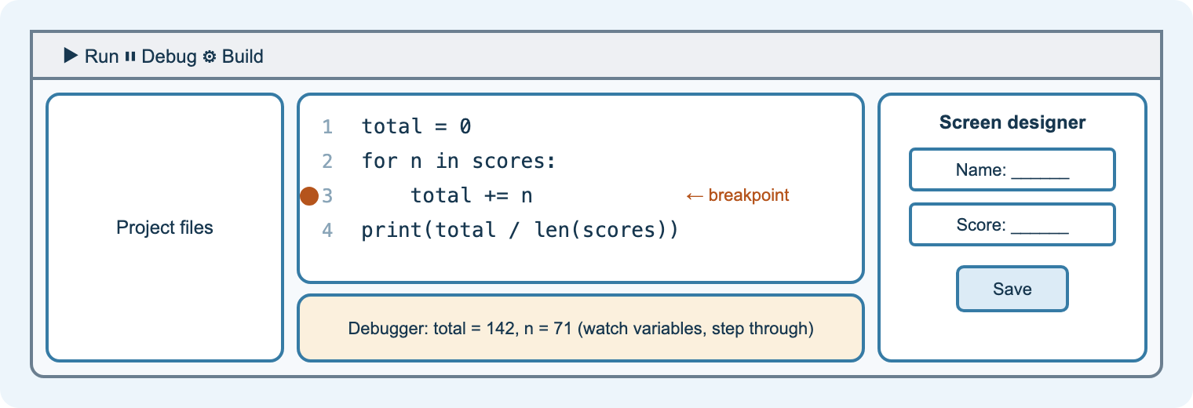
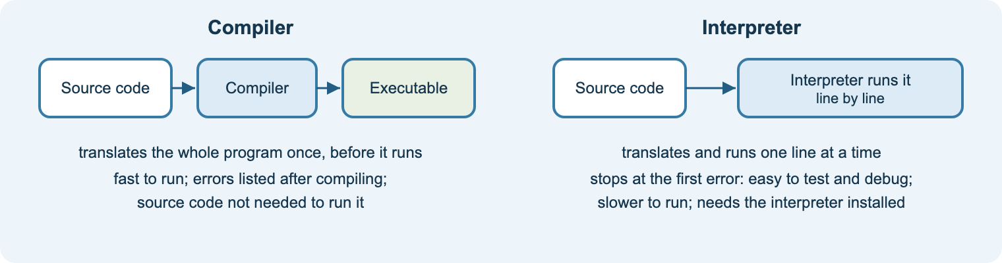
7.2.3
Code development tools
Aim: explain the features and uses of IDEs, translators and version control
IDE: editor, highlighting, auto-complete, debugger
Breakpoints and stepping find logic errors
Compiler vs interpreter; assembler
Version control (Git): history, branches, roll back
Libraries, frameworks and APIs
Starter
Spot the syntax error on the board in 30 seconds.
Practical
Set a breakpoint in a short Python program.
Task
Workbook SW3: compiler or interpreter?
Notes:
Demonstrate in VS Code or Thonny: highlight, error squiggle, breakpoint.
Question: why would a games studio ship compiled code?
API extension: the Postman slides on Teams show how apps call cloud services.

Slide 17
7.2.4
Application software
Aim: explain the features and uses of common application software for organisations
Application | Used for | Example organisation
Productivity (word processor, spreadsheet, presentation) | documents, budgets, reports | any office
Database / DBMS | store and query structured data | a library catalogue
CRM | customer records, sales, follow-ups | a car dealer
Collaboration and communication | chat, video calls, shared files | a remote team
Graphics, video and design | images, video editing, CAD | a marketing agency
Web browser and web apps | online services and SaaS | every user
Exam angle
Pick software for a scenario and justify it by the organisation’s needs, cost, licensing and compatibility.
Task
Workbook SW4: choose three applications for a small charity and justify each. Check: Quiz 3.
Notes:
Discuss licensing models: perpetual, subscription, open source, freeware.
Stretch: off-the-shelf vs bespoke software.

Slide 18
7.3 Networks
Why network · types · connectivity · topologies · models · components · OSI and TCP/IP · packets · protocols · bandwidth and latency

Slide 19
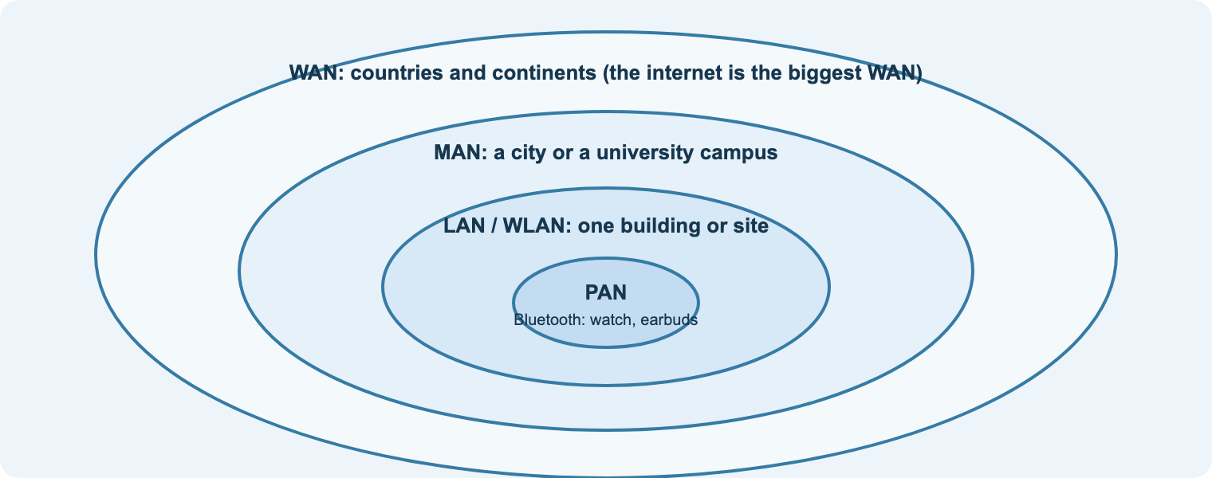
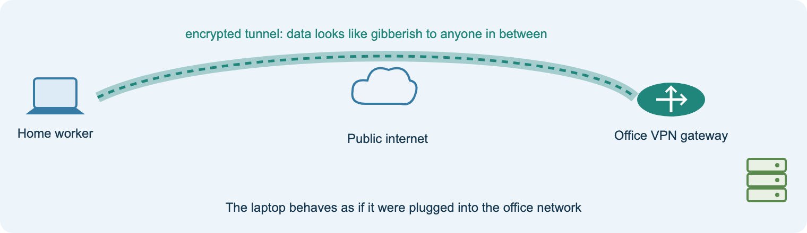
7.3.1–2
Why network, and network types
Aim: explain the benefits and drawbacks of networks and the features of PAN, LAN, WLAN, MAN, WAN, VPN
Benefits: share resources, data, communication, central management
Drawbacks: cost, security risk, single points of failure, needs skills
Types by scale: PAN, LAN, WLAN, MAN, WAN
VPN: an encrypted tunnel across the internet
Starter
List every network you used today, from earbuds to the internet.
Task
Workbook N1: pick network types for five organisations.
Check
Quiz 4a.
Notes:
Question: why would a council use a MAN rather than leased WAN links?
Support: types table on the Learn page. Stretch: SAN and the difference from NAS.
Video (lesson N1): Network types and performance.

Slide 20
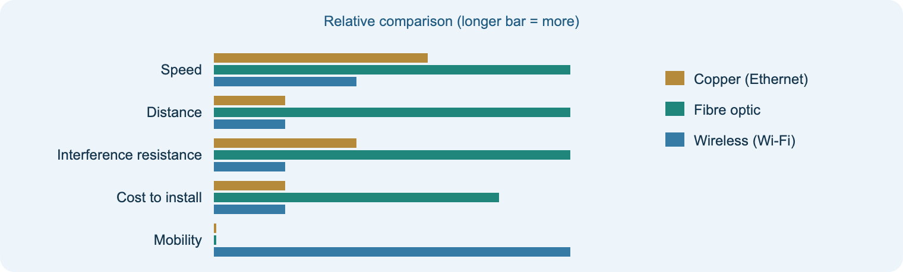
7.3.3
Connectivity methods
Aim: compare wired and wireless connectivity methods
Copper twisted pair: cheap, 100 m, interference
Fibre: fast, long distance, immune to EMI, costly
Wi-Fi: mobility; range, interference, security
Bluetooth, NFC, cellular 4G/5G, satellite
Choose by speed, distance, cost, security, mobility
Starter
Why is the college backbone fibre but your desk copper?
Practical
Packet Tracer: wired and wireless with WPA2 (Learn page N2).
Task
Workbook N2.
Notes:
Use real examples: rural broadband by 4G/satellite; undersea fibre.
Question: when would you choose wired over Wi-Fi in an office?
Video (lesson N2): The Ethernet and Wi-Fi protocols.

Slide 21
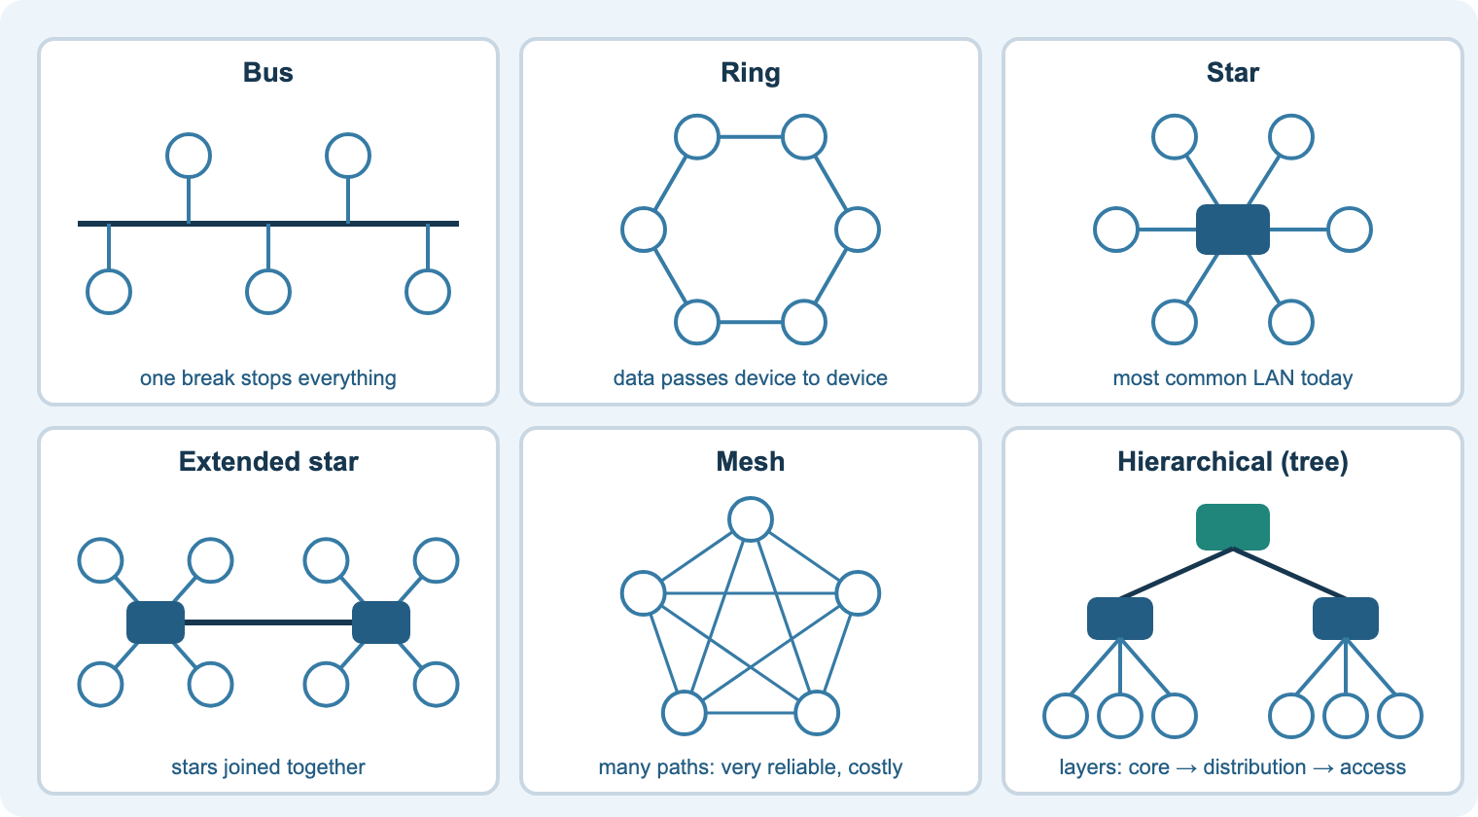
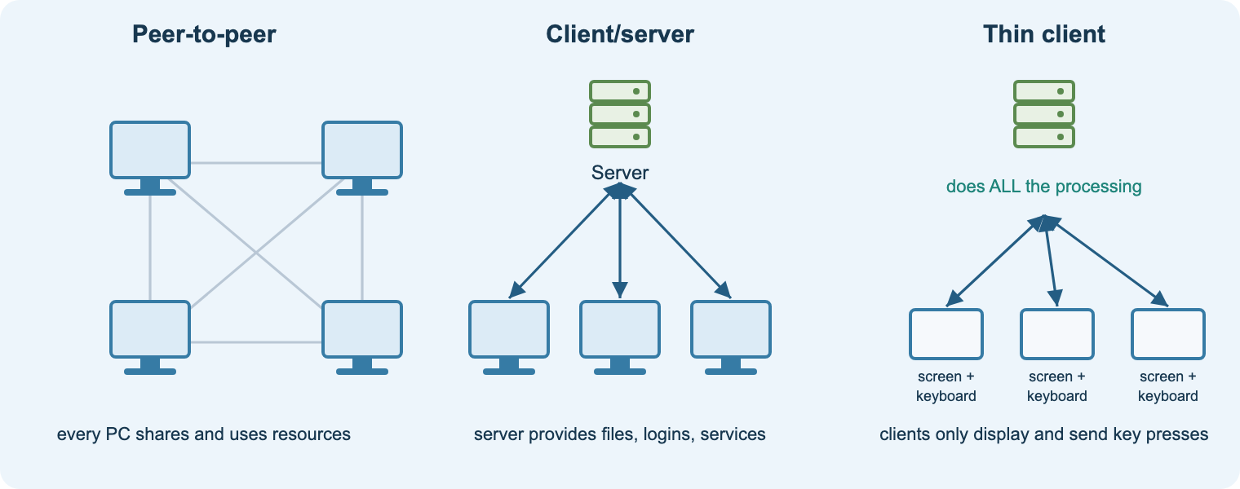
7.3.4–5
Topologies and network models
Aim: compare topologies and the peer-to-peer, client–server and thin client models
Bus, ring, star, extended star, mesh, hybrid
Star: faults isolated; switch is a single point of failure
Mesh: many paths, resilient, costly
Peer-to-peer vs client–server vs thin client
Starter
Which topology does the classroom use? Draw it.
Practical
Practical 6: build and test a LAN.
Task
Workbook N3: choose a model for a hairdresser and a college.
Notes:
Exam angle: benefits and drawbacks for a named organisation.
Question: why does a thin client model suit a call centre?
Stretch: logical vs physical topology.

Slide 22
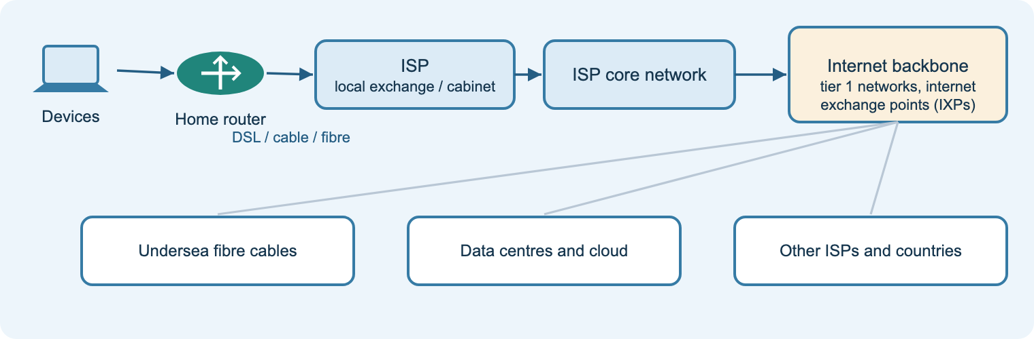
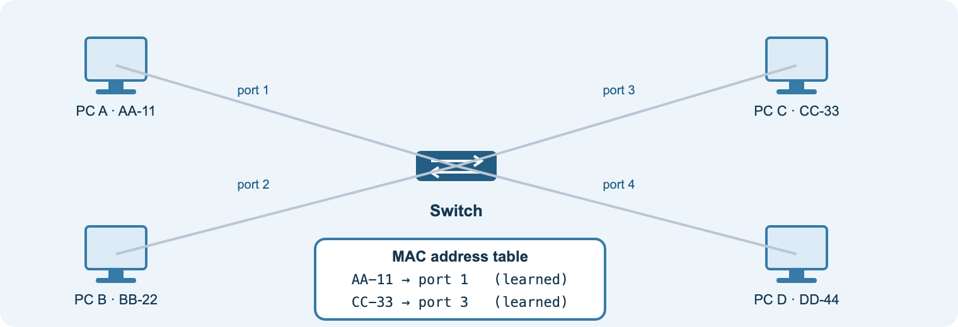
7.3.6
Network components and the backbone
Aim: explain the roles of servers, clients, switches, routers, the internet connection and backbone
Server vs client; common server types
Switch: LAN, MAC addresses
Router: between networks, IP addresses
Internet connection to an ISP
Backbone: tier 1 networks, IXPs, undersea cables
Practical
Practical 7: home network to the internet via cable and DSL.
Task
Workbook N4.
Check
Exit: switch vs router in two sentences.
Notes:
Use the teacher’s cloud-with-cable-and-modem.pkt file for the practical.
Question: what happens to your traffic between your router and a US website?
Starter idea: the submarine cable map.

Slide 23
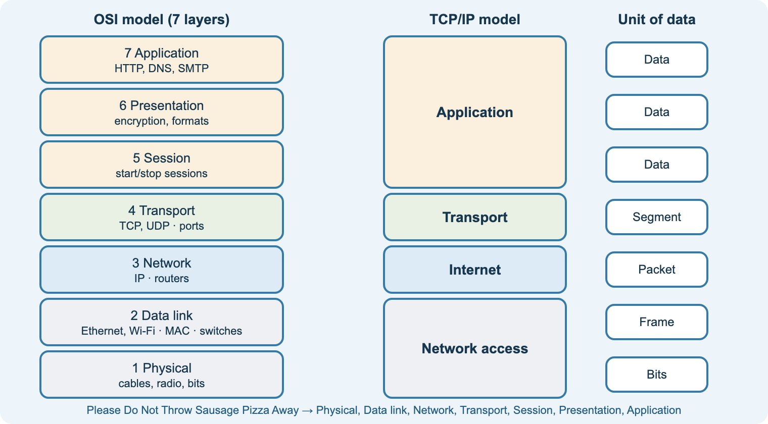
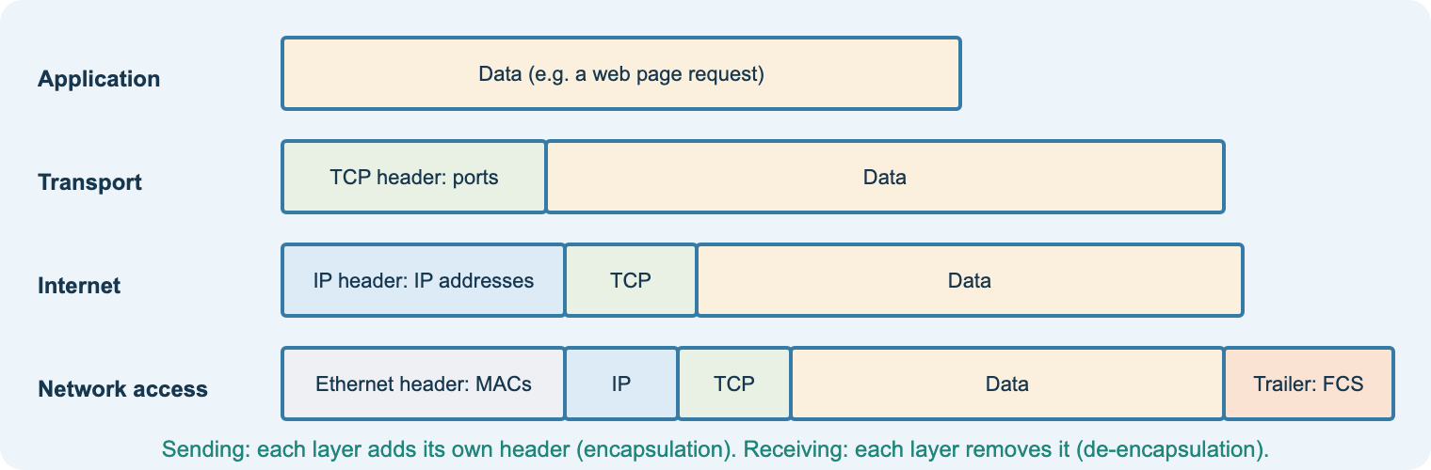
7.3.7–8
The OSI and TCP/IP models
Aim: describe the layers, functions and related protocols of the OSI and TCP/IP models
OSI: 7 layers; mnemonic
TCP/IP: application, transport, internet, network access
Encapsulation adds a header at each layer
Devices by layer: switch 2, router 3
Why layers: standards, interoperability, troubleshooting
Starter
Mnemonic race: seven layers both ways.
Task
Workbook N5: place protocols in layers.
Check
Quiz 4b.
Notes:
Build the envelope-in-a-parcel analogy for encapsulation.
Question: at which layer does a web browser work? A cable?
Video (lesson N5): Network protocols and the 4-layer model.

Slide 24
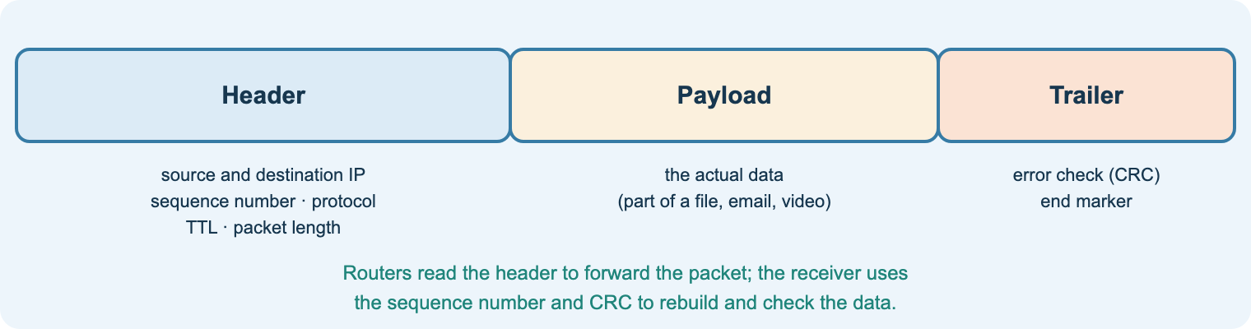
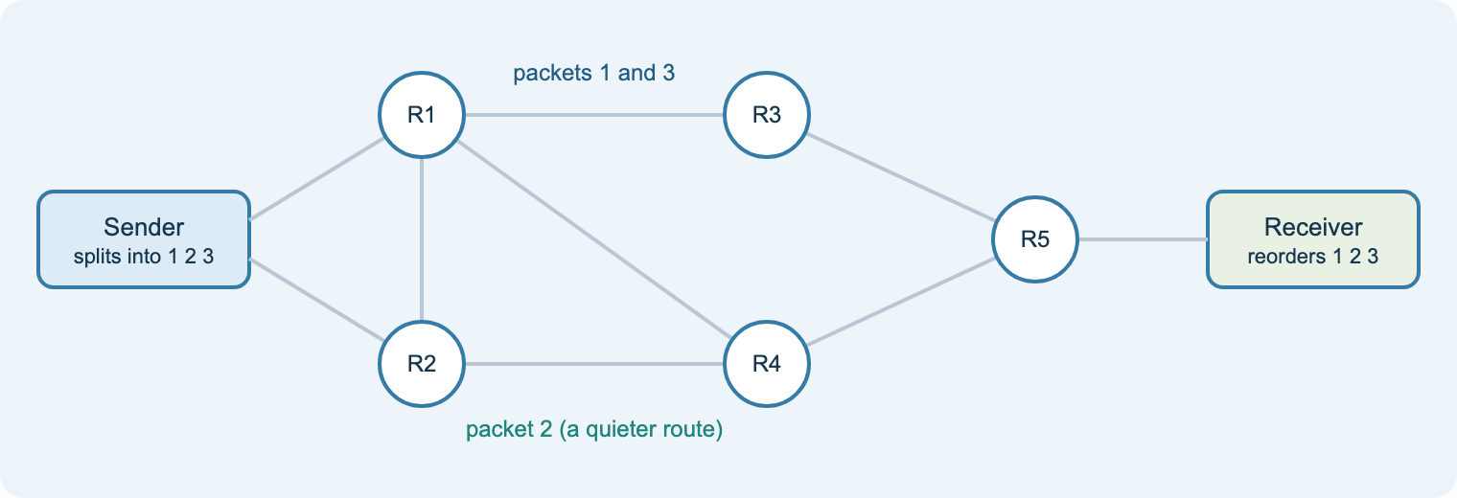
7.3.9
Data packets
Aim: describe packet structure, packet switching, packet loss and CRC
Header: source/destination IP, sequence number, TTL
Payload: the data; trailer: CRC
Packet switching: independent routes, reassembly
Loss: congestion, faults, interference, TTL expiry
CRC detects corruption; TCP re-sends
Starter
Tear a message into numbered strips, pass by different routes.
Practical
Packet Tracer simulation: open a PDU.
Task
Workbook N6.
Notes:
The packet-strip starter makes sequence numbers and loss memorable.
Question: why can packets arrive out of order?
Video (lesson N6): Check digits and parity bits.

Slide 25
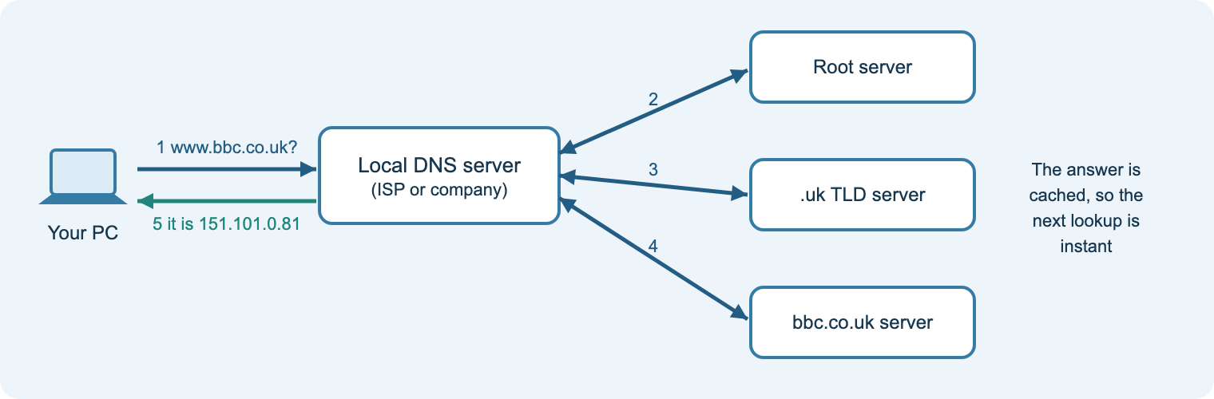
7.3.10
Network protocols
Aim: explain the role of common network, routing and application protocols
Protocol | Role | Port
TCP / UDP | reliable, ordered delivery / fast, no re-sending | –
IP | addressing and routing packets | –
HTTP / HTTPS | web pages / encrypted with TLS | 80 / 443
FTP / SFTP | file transfer / secure file transfer | 21 / 22
SMTP · POP · IMAP | send mail · download mail · sync mail | 25 · 110 · 143
DHCP · DNS | automatic addresses · names to IP addresses | 67/68 · 53
RIP · OSPF | routing protocols: share routes between routers | –
Practicals
Practical 5: command-line tools (ipconfig, ping, arp, netstat, tracert). Practical 8: routing with RIP.
Notes:
Run the command-line practical live first: students record their own IP, gateway, DHCP and DNS servers.
Question: which email protocol suits someone with a phone and a laptop? (IMAP)
Videos (lesson N7): TCP, IP, HTTP/S and FTP; Email protocols.

Slide 26
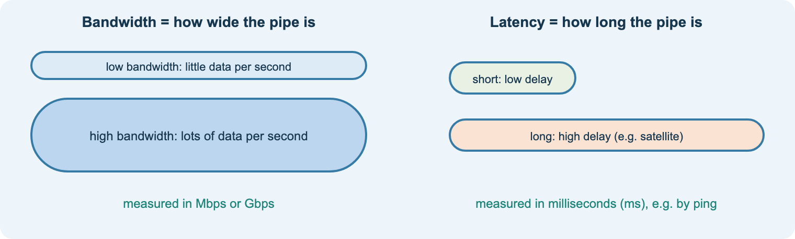
7.3.11
Bandwidth and latency
Aim: explain bandwidth and latency and their effect on performance
Bandwidth: maximum data rate (Mbps)
Latency: delay (ms); jitter: variation
Throughput: what you actually get
Real-time services need low latency
Time = size ÷ speed (same units)
Starter
Why does an online game lag with fast broadband?
Task
Workbook N8: download-time calculations.
Check
Quiz 4c.
Notes:
Worked example: 400 Mb at 50 Mbps = 8 s; watch bits vs bytes.
Use tracert and ping times from Practical 5 to show latency.
Stretch: QoS prioritising voice and video.

Slide 27
7.4 Virtual · 7.5 Cloud · 7.6 Resilience
Virtual machines and hypervisors · cloud types and delivery models · keeping digital environments working

Slide 28
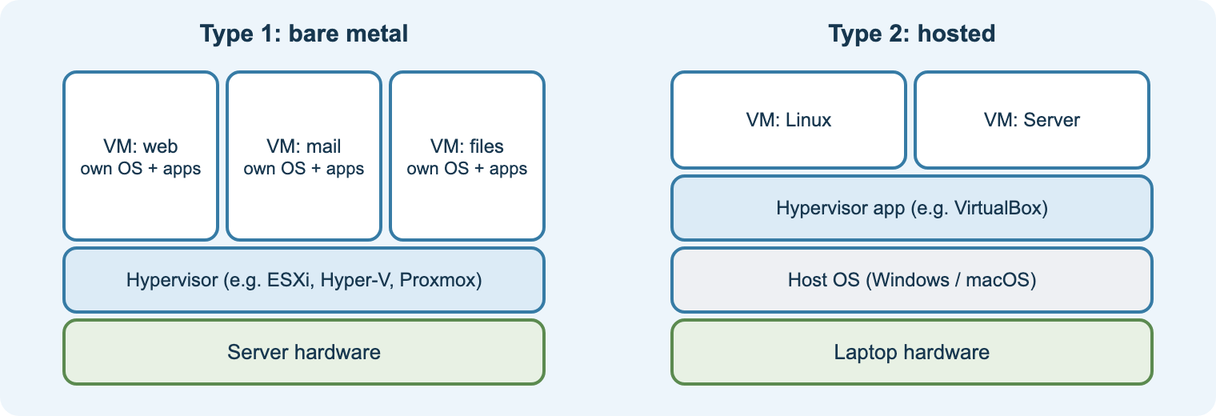
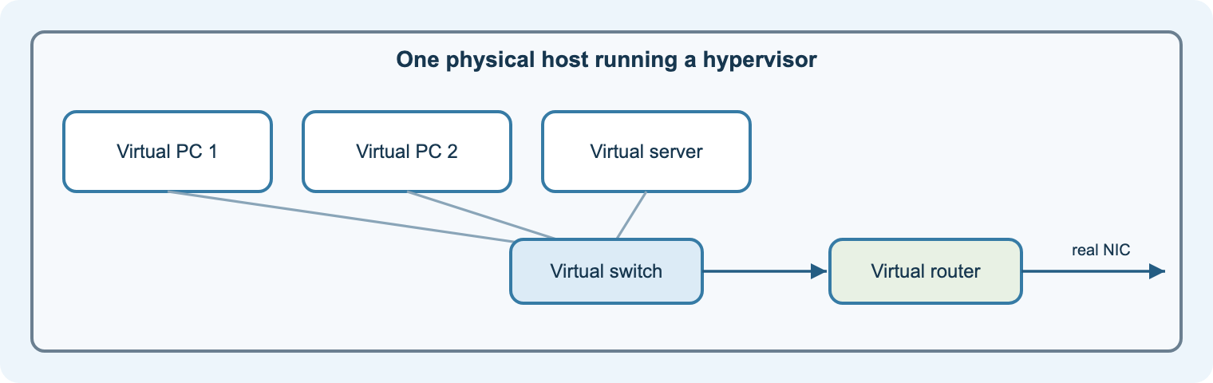
7.4
Virtual environments
Aim: explain VMs, hypervisors, key features, benefits and drawbacks
VM clients and servers; virtual switches and routers
Type 1 (bare metal) vs type 2 (hosted)
Features: security, managed execution, sharing, aggregation, emulation, isolation, portability
Benefits vs drawbacks (host load, slower, misleading performance)
Practical
Practical 9: create a VM and restore a snapshot.
Task
Workbook V1.
Check
Quiz 5a.
Notes:
The spec lists seven key features by name: students should learn them all.
Question: why do schools virtualise their test servers?
Exam practice 2 has a 9-mark virtualisation question.

Slide 29
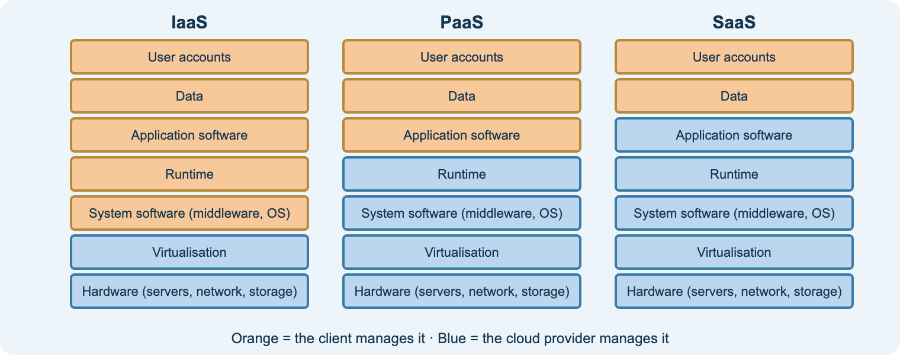
7.5
Cloud environments
Aim: compare private and public clouds, explain the benefits, and the IaaS, PaaS, SaaS responsibility split
Starter
Which cloud services have you used today?
Practical
Practical 10: responsibility card sort; API demo with Postman.
Check
Quiz 5b and Exam practice 2, question 2.
Notes:
Teach the split exactly as the specification: IaaS client manages application software, system software, runtime, data and user accounts; PaaS client manages application software, data and user accounts; SaaS client manages user accounts and data.
Benefits: portability, elasticity, fewer storage limits, cost effectiveness.
Question: which model for a developer who does not want to patch servers? (PaaS)

Slide 30
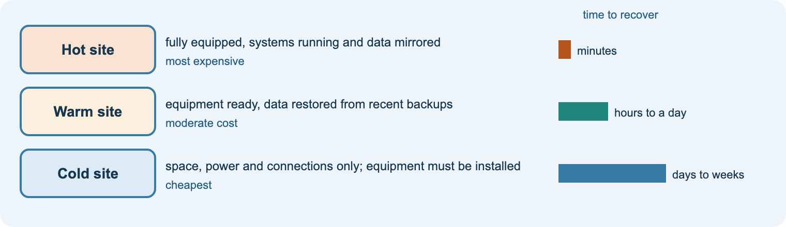
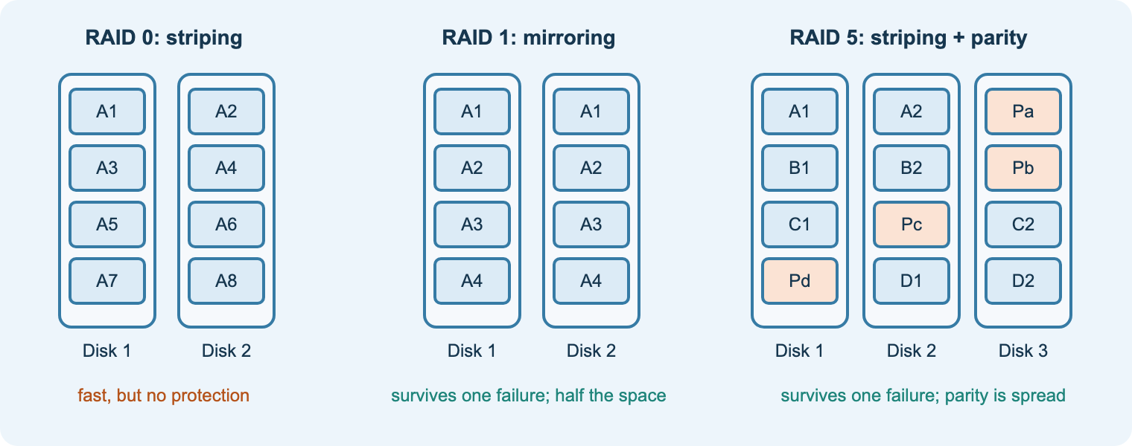
7.6
Resilient digital environments
Aim: explain the benefits of resilience and the methods used to improve it
Benefits: security, reputation, reduced downtime
Updates, patches and hardware replacement; secure disposal
Redundancy (RAID, dual power, links); device hardening
Backups onsite, offsite, cloud; tested recovery
Hot, warm and cold sites; SOPs and staff training
Practical
Practical 11: a resilience plan for a small business.
Task
Workbook R1.
Check
Quiz 5c.
Notes:
Evaluate by cost vs risk: a hospital needs a hot site; a café may rely on cloud backups.
Videos (lesson R1): Cisco Anatomy of an IoT Attack; Anatomy of an Attack; Port of Long Beach automated terminal.

Slide 31
Twelve practicals on the student site
1
2
3
4
5
6
PC disassemble and reassemble
Motherboard ID and connectors
Hardware spider diagram
Number systems practice
Command-line network tools
Build and test a LAN
7
8
9
10
11
12
Home network to the internet
Routing with RIP
Create a virtual machine
Cloud responsibilities and APIs
Resilience plan
Cisco Intro to IoT badge
Each practical lists steps, how to check it works and what to keep for revision. Teacher .pkt files and task sheets stay on Teams.
Notes:
Map: 1–3 lesson H1/H2 · 4 NS · 5 N7 · 6–7 N4 · 8 N7 · 9 V1 · 10 C1 · 11 R1 · 12 H1.
Anti-static precautions and unplugging are essential for Practical 1.
Only run network commands on the college lab network.

Slide 32
Revision and exam technique
RAG the spec
Re-learn reds
Quiz
Exam practice
Mark with levels
Re-do
Developed points
Point → because → so for this business → link to the question. One developed point beats three listed ones.
Weak → strong
“Cloud is cheaper.”
→ “The shop avoids buying servers and pays only for what it uses, so its costs fall in quiet months.”
Timing
About 1 minute per mark. Plan long answers for 2–3 minutes: for, against, judgement.
Notes:
Weeks 32–33: use the Course guide RAG checklist to target revision; students re-take quizzes until green.
Exam practice 1 and 2 on the site, then an official sample paper under timed conditions.

Slide 33
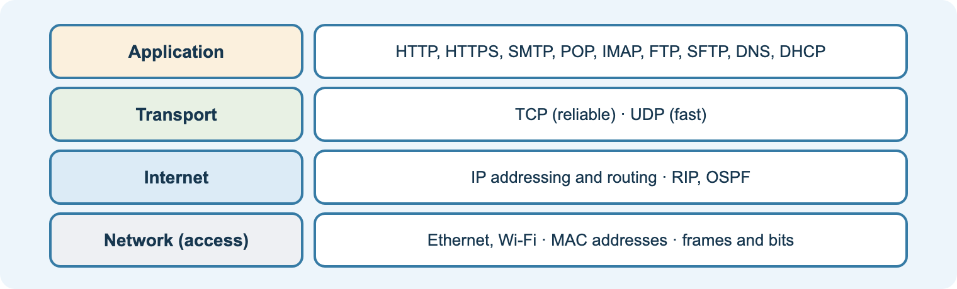
Ready to deliver
Share the start page link in Teams
Lesson 1: tour the site and the RAG checklist
One practical every week or two
Quizzes as starters and exit checks
Exam practice from spring term
Notes:
Site: nigeriastudentcenter.github.io/btech/unit7/start.html
The AI tutor depends on the college Azure subscription being active; the rest of the site works without it.

