Slide 1
Design and Implementation of a Control Agent for a Manufacturing Plant
Lecture: Discrete Simulation and Reinforcement Learning
Prof. Dr. Jonas Ide and Prof. Dr. Christian Schwede
Name: Niko Kläsener
Matr.-Nr: 1314104

Slide 2
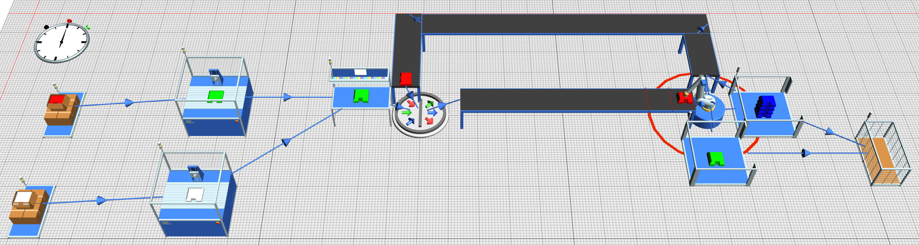
Project Description
Autonomous RL agent controlling a Pick-and-Place robot
Sorting 3 language variants using 2 limited buffers
Minimizing total time for 1,000 completed games

Slide 3
PEAS framework
Dimension | Specification
Performance (P) | Minimize throughput time and operational steps for 1.000games.
Environment (E) | Discrete-event simulation deterministic mechanics stochastic arrivals fully observable
Actuators (A) | Pick-and-place robot: Buffer1 Buffer 2 Returnloop
Sensors (S) | Incomming workpiece type buffer workpiece types buffer filllevels

Slide 4
RL approach Q-Lerning Agent
Decision | Reason
Modelfree TD-lerning | deterministic mechanics
Manageable Q-table dimension | States: incTyp[3]; buffer1Typ[4]; buffer2Typ [4]; buffer1cnt[10]; buffer2cnt[10] Action: buffer1; buffer2; returnloop Dimension: 4800x3
GLIE-Schema | explortation
Advantages compared Deep Q-Learning:
Convergence guarantee for finite MDPs
No forgetting of past conditions
100% transparency

Slide 5

Reward-Design
$R_{(s,a,s′)}=−1+\left\{\begin{aligned}n \\ 100 \\ (−n)\end{aligned}\right.$ $\begin{matrix}for matching store (fill level n < 10) \\ for 10th matching part (batch drain) \\ for mismatch part (flushes n parts)\end{matrix}$
fixed penalty for each required step
Individual reward/punishment for the outcome of an action

Slide 6
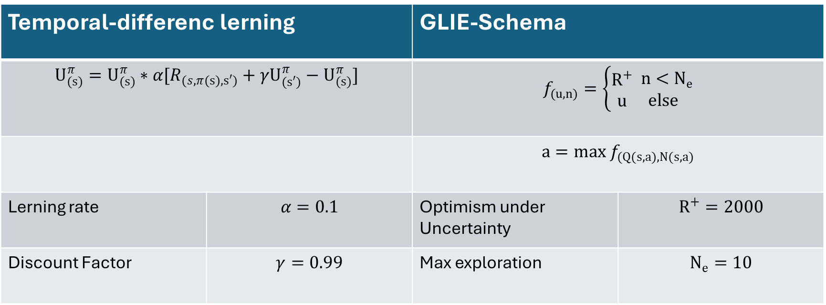
Parameterization TD and GLIE
Temporal-differenc lerning |  | GLIE-Schema
$$U_{(s)}^{π}=U_{(s)}^{π}∗α[R_{(s,π(s),s′)}+γU_{(s′)}^{π}−U_{(s)}^{π}]$$ |  | $$f_{(u,n)}=\left\{\begin{aligned}R^{+} \\ u\end{aligned}\begin{matrix} n<N_{e} \\ else\end{matrix}\right.$$
 |  | $$a=max f_{(Q(s,a),N(s,a)}$$
Lerning rate | $$α=0.1$$ | Optimism under Uncertainty | $$R^{+}=2000$$
Discount Factor | $$γ=0.99$$ | Max exploration | $$N_{e}=10$$

Slide 7
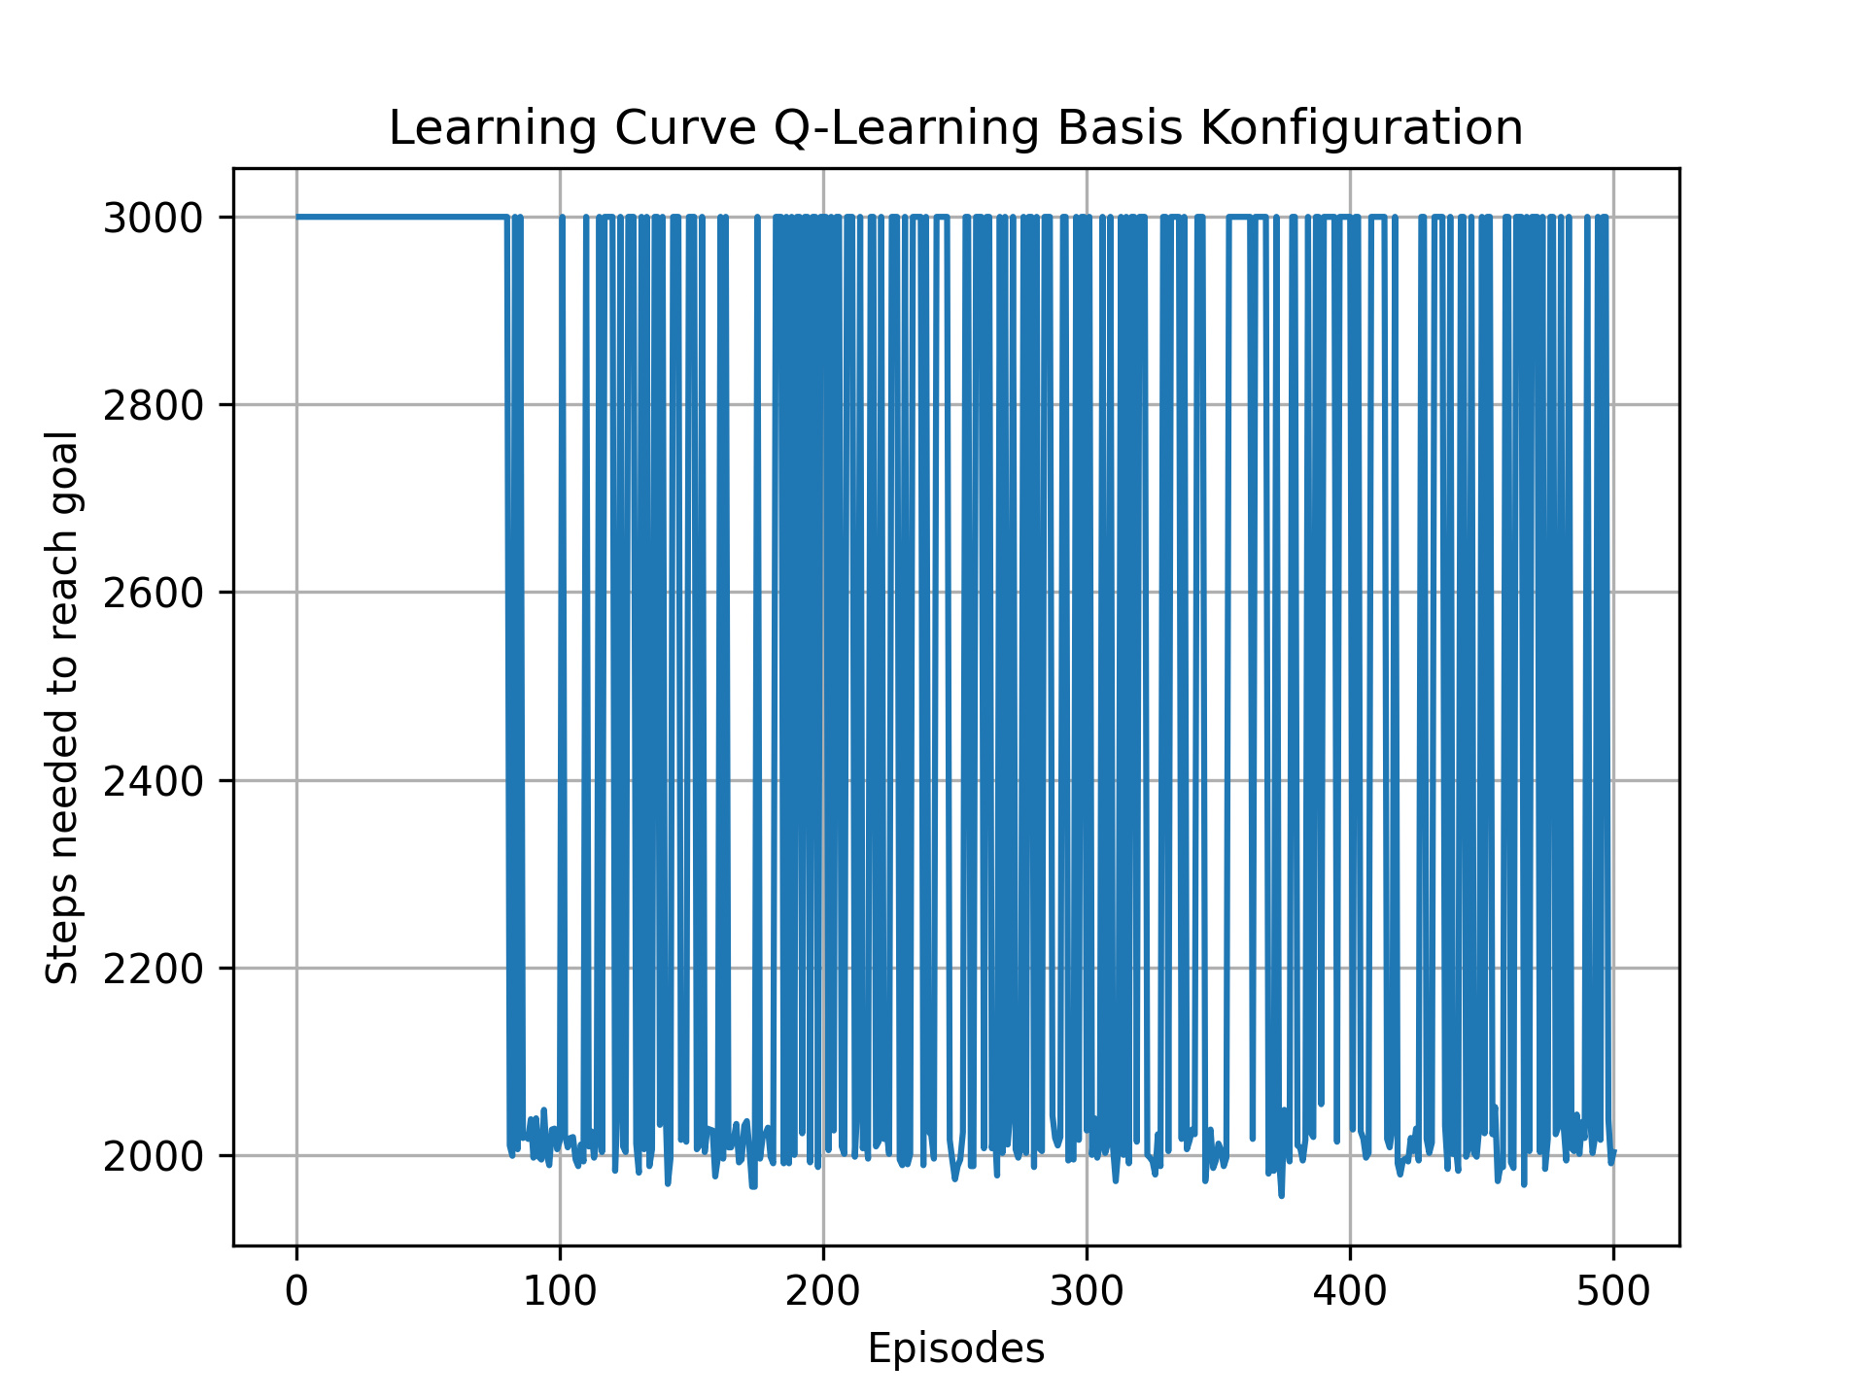
Learning Basic Konfiguration
State Design:
incTyp: 3 [EN; DE; ES]
Buffer1Typ: 4 [empty; EN; DE; ES]
Buffer2Typ: 4 [empty; EN; DE; ES]
Buffer1cnt: 3 [(0-2); (3-6); (7-9)]
Buffer2cnt: 3 [(0-2); (3-6); (7-9)]
Learning status | Number of states | Percent
Fully explored | 216 | 72%
Partially explored | 52 | 17,3%
Not explored | 32 | 10,7%
physically possible | 300 | 100%

Slide 8
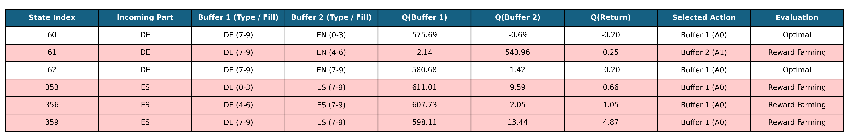
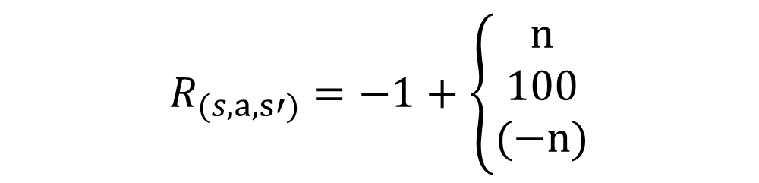
Reward farming
Start
Collect 2
Collect 3
Collect 4
Flush
-1 step
+1 for collect
Total: 0
-1 step
+2 for collect
Total : +1
-1 step
+3 for collect
Total: +3
+4 for collect
Total +6
-1 step
-1 step
-4 for flush
Collect 1
Total: +1
$$R_{(s,a,s′)}=−1+\left\{\begin{aligned}n \\ 100 \\ (−n)\end{aligned}\right.$$

Slide 9

New Reward-Design
$R_{(s,a,s′)}=−1+\left\{\begin{aligned}n \\ 100 \\ −\frac{(1+n)∗n}{2}\end{aligned}\right.$ $\begin{matrix}for matching store (fill level n < 10) \\ for 10th matching part (batch drain) \\ for mismatch part (flushes n parts)\end{matrix}$
fixed penalty for each required step
Individual reward/punishment for the outcome of an action
Gauss's summation formula

Slide 10
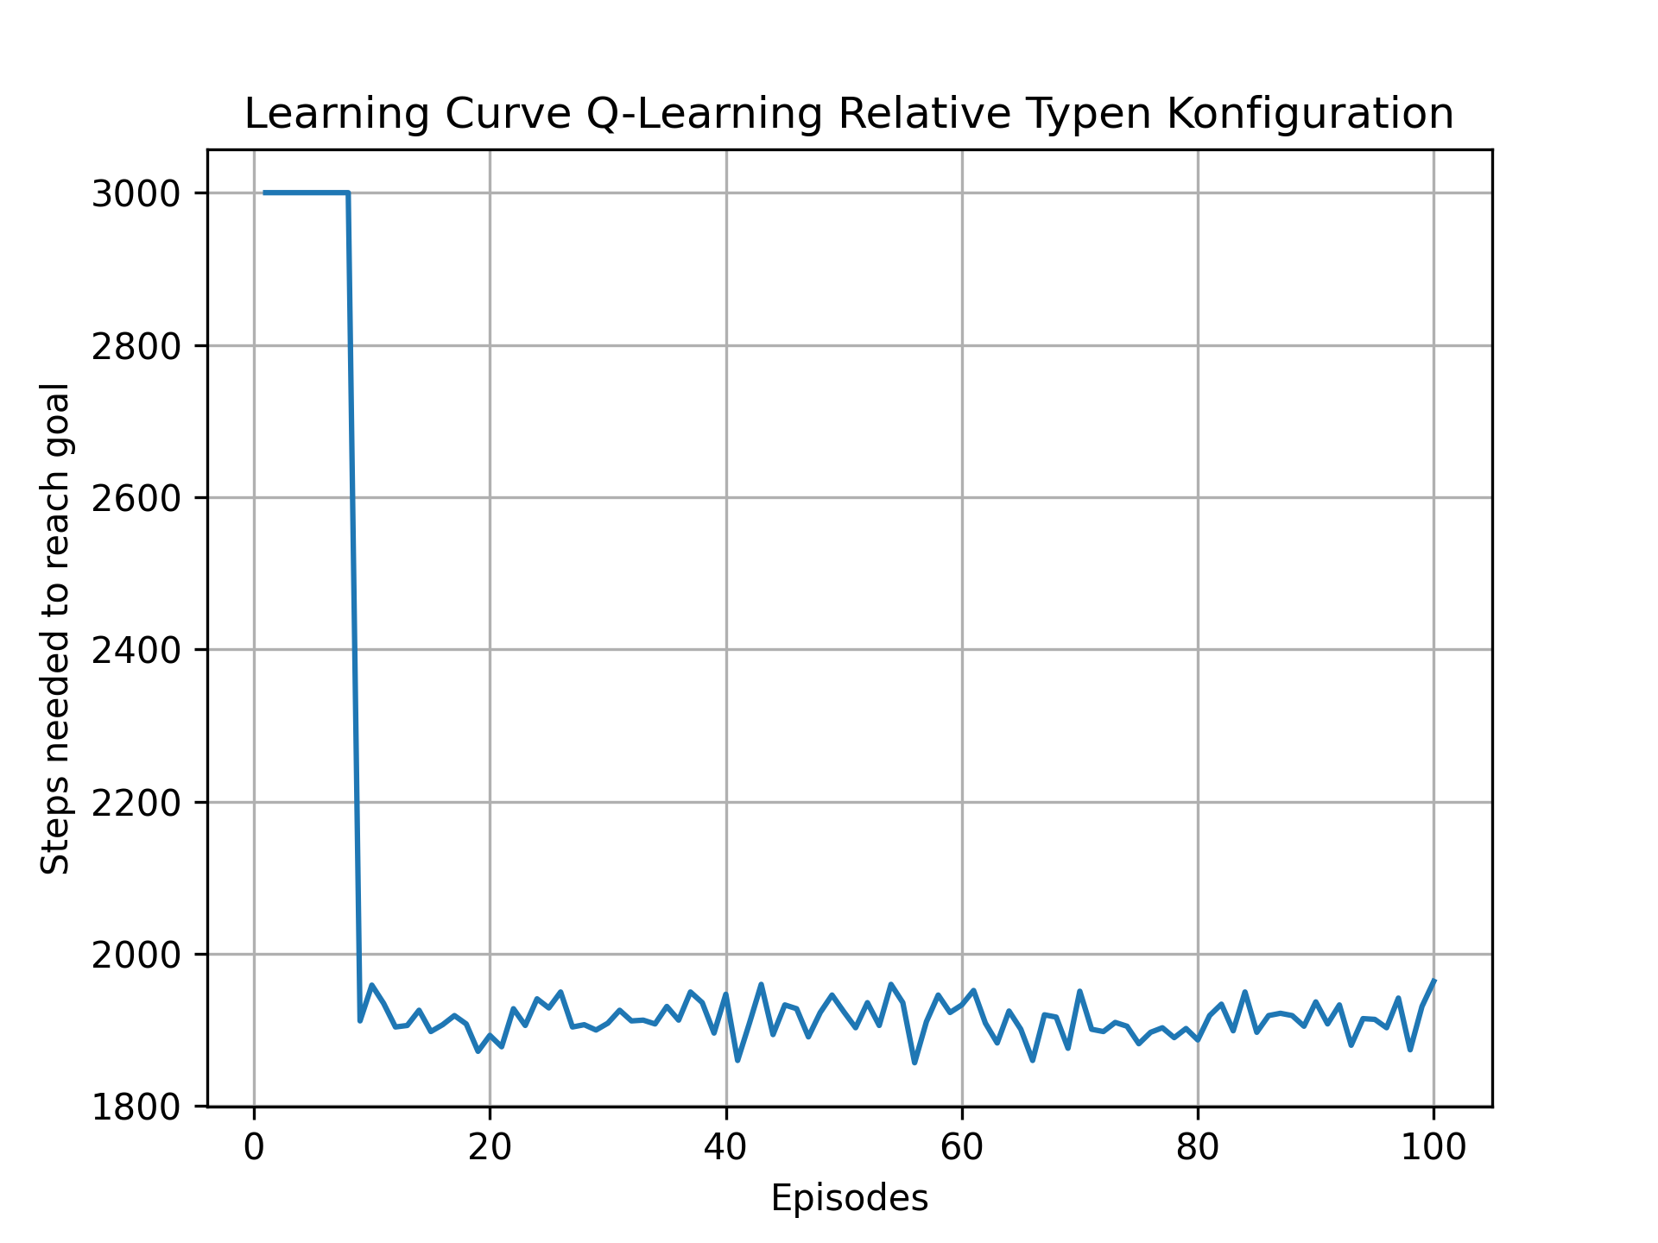
Learning Relative State Konfiguration
State Design:
Buffer1Typ: 3 [empty; match; dismatch]
Buffer1Typ: 3 [empty; match; dismatch]
Buffer1cnt: 3 [(0-2); (3-6); (7-9)]
Buffer2cnt: 3 [(0-2); (3-6); (7-9)]
Learning status | Number of states | Percent
Fully explored | 49 | 100%
Partially explored | 0 | 0%
Not explored | 0 | 0%
physically possible | 49 | 100%

Slide 11
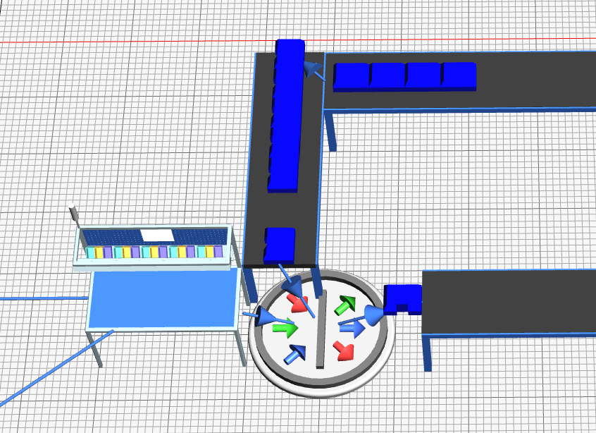
Memory State
Items not currently being collected accumulate on the return loop.
Once the agent switches to this type after flushing a buffer, it can refill empty buffers rapidly.
State LastCollected:
keeps track of which type were collected last
3 [Warm-Up, Collected, NotCollected]

Slide 12
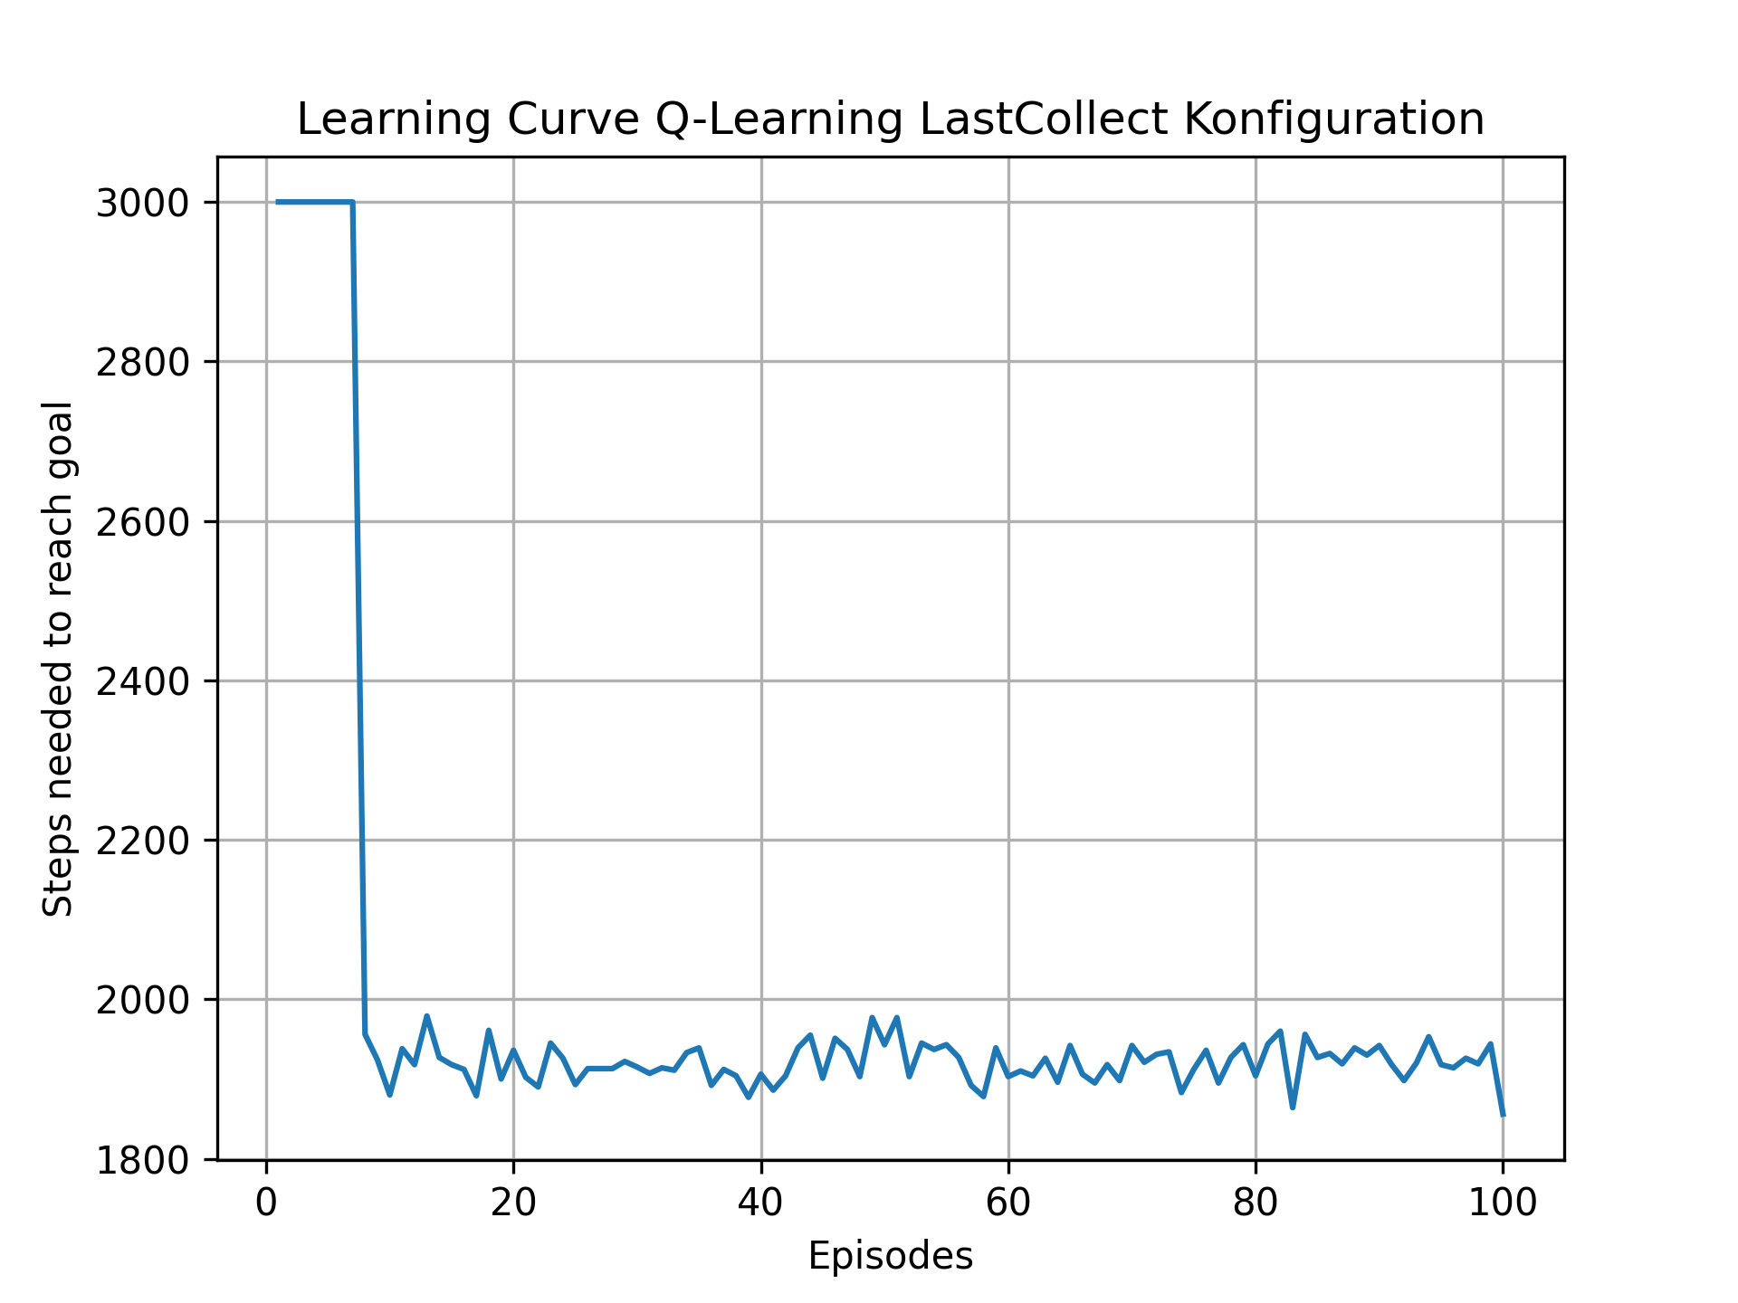
Learning Last Collected Konfiguration
State Design:
Buffer1Typ: 3 [empty; match; dismatch]
Buffer1Typ: 3 [empty; match; dismatch]
Buffer1cnt: 3 [(0-2); (3-6); (7-9)]
Buffer2cnt: 3 [(0-2); (3-6); (7-9)]
LastCollected: 3 [Warm-Up, Collected, NotCollected]
Learning status | Number of states | Percent
Fully explored | 51 | 89%
Partially explored | 2 | 4%
Not explored | 4 | 7%
physically possible | 57 | 100%

Slide 13
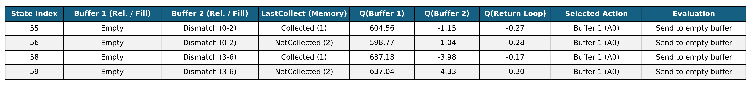
Analysed Last Collected Konfiguration
The agent does not differentiate between a part that was collected last and one that was not collected last.

Slide 14
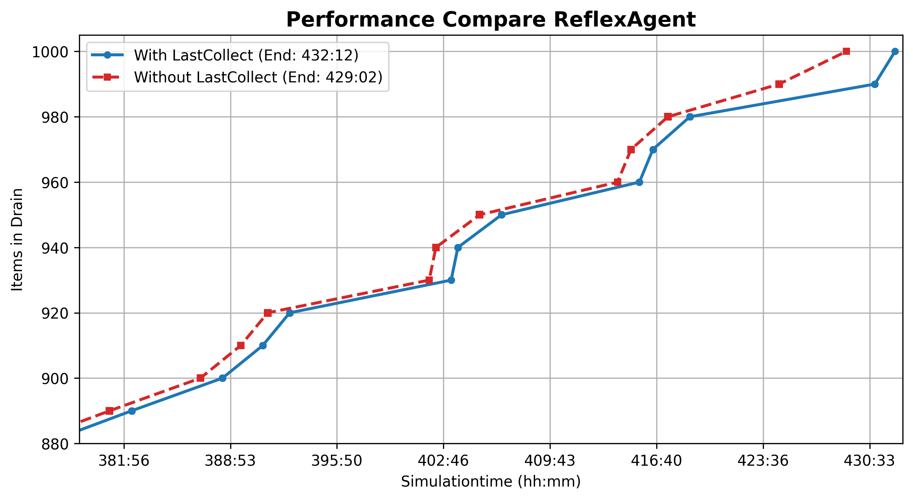
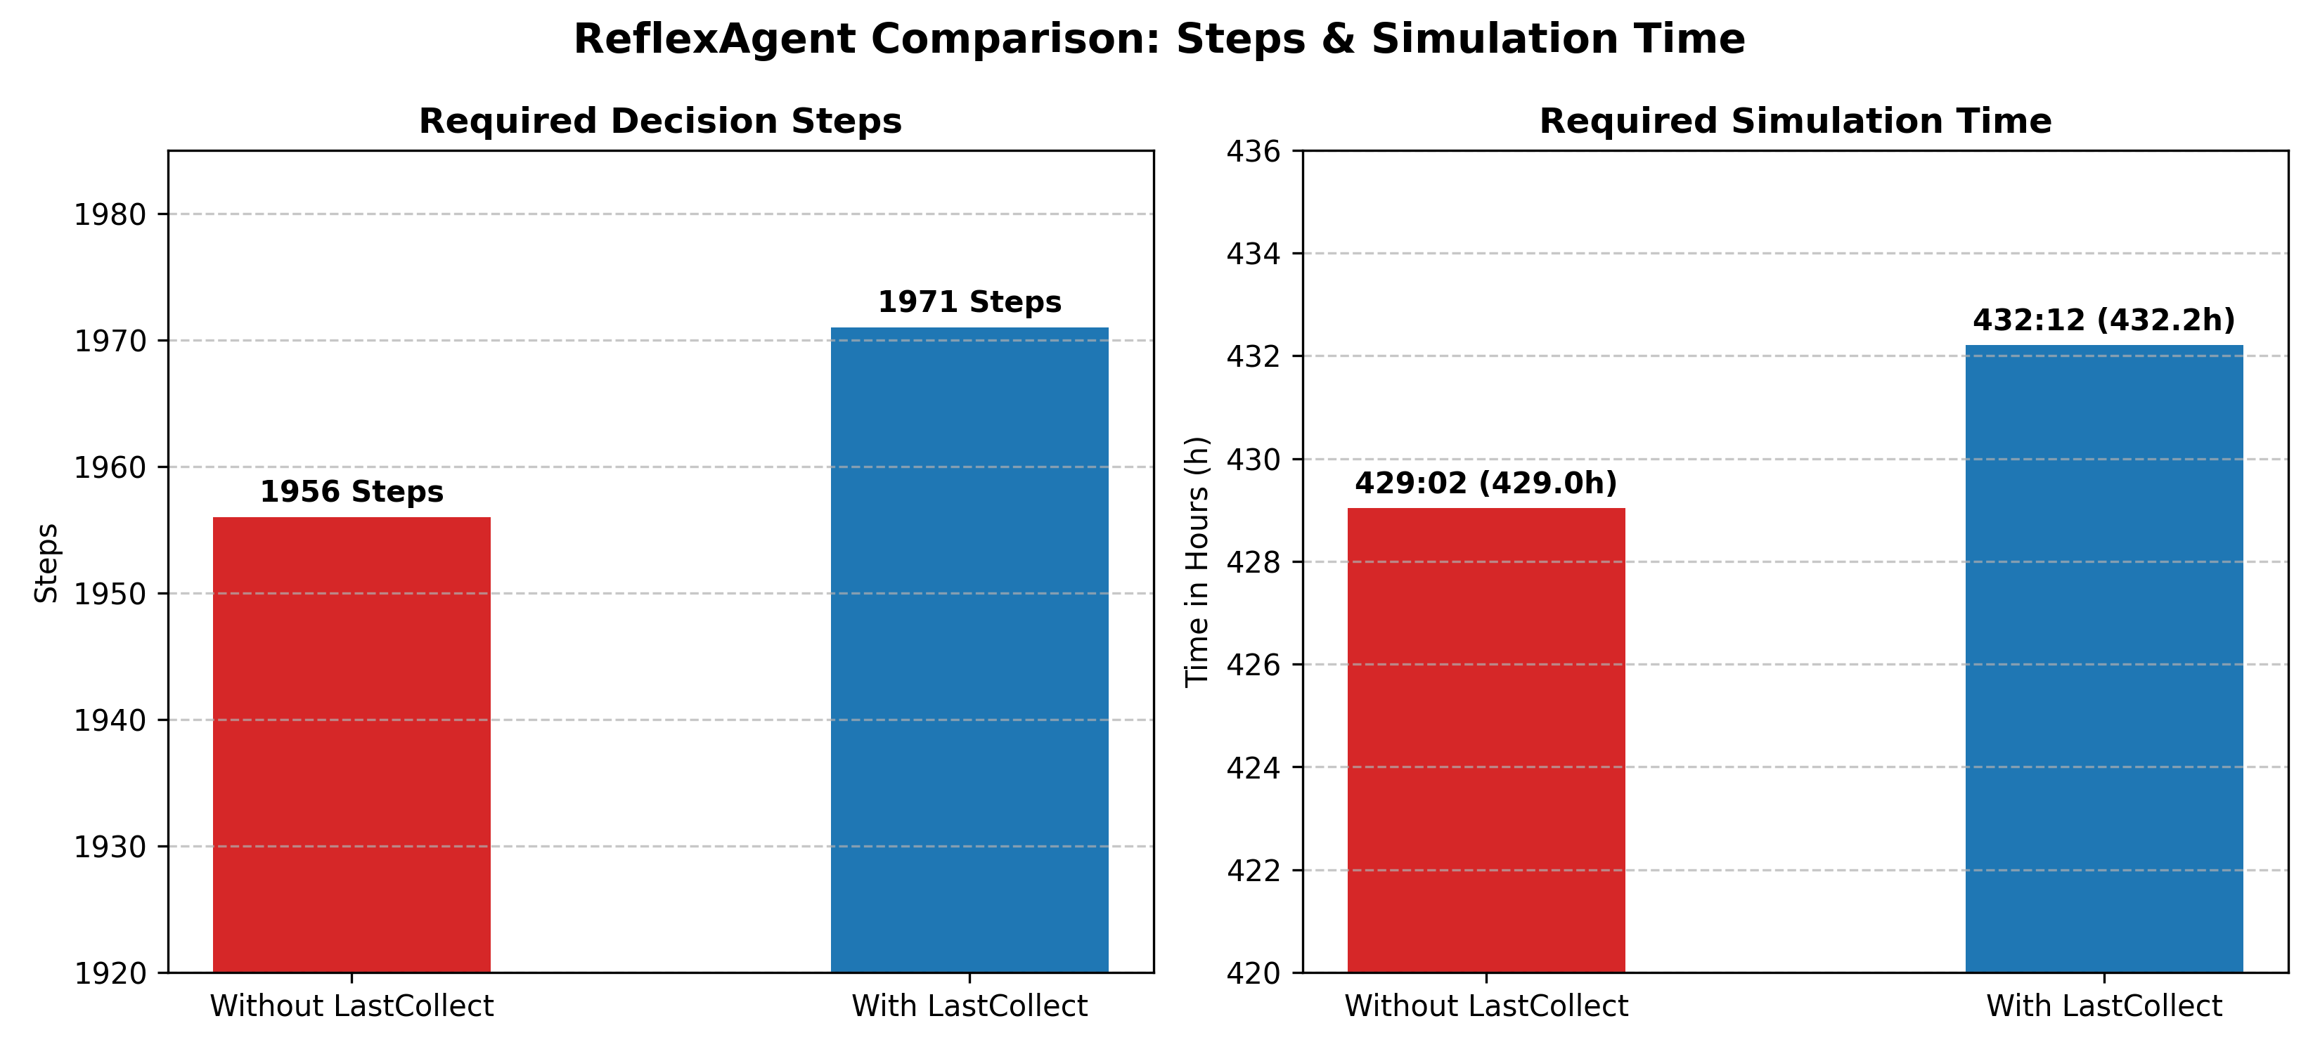
Validation Last Collected learning
Policy comparison (Simple Reflex Agents):
Agent 1: Immediately fills any free buffer.
Agent 2: Waits for a game different from the last collected.
Waiting for a non-lastcollect type only increases runtime. Ignoring lastcollect during Q-learning is therefore optimal, not a flaw.

Slide 15
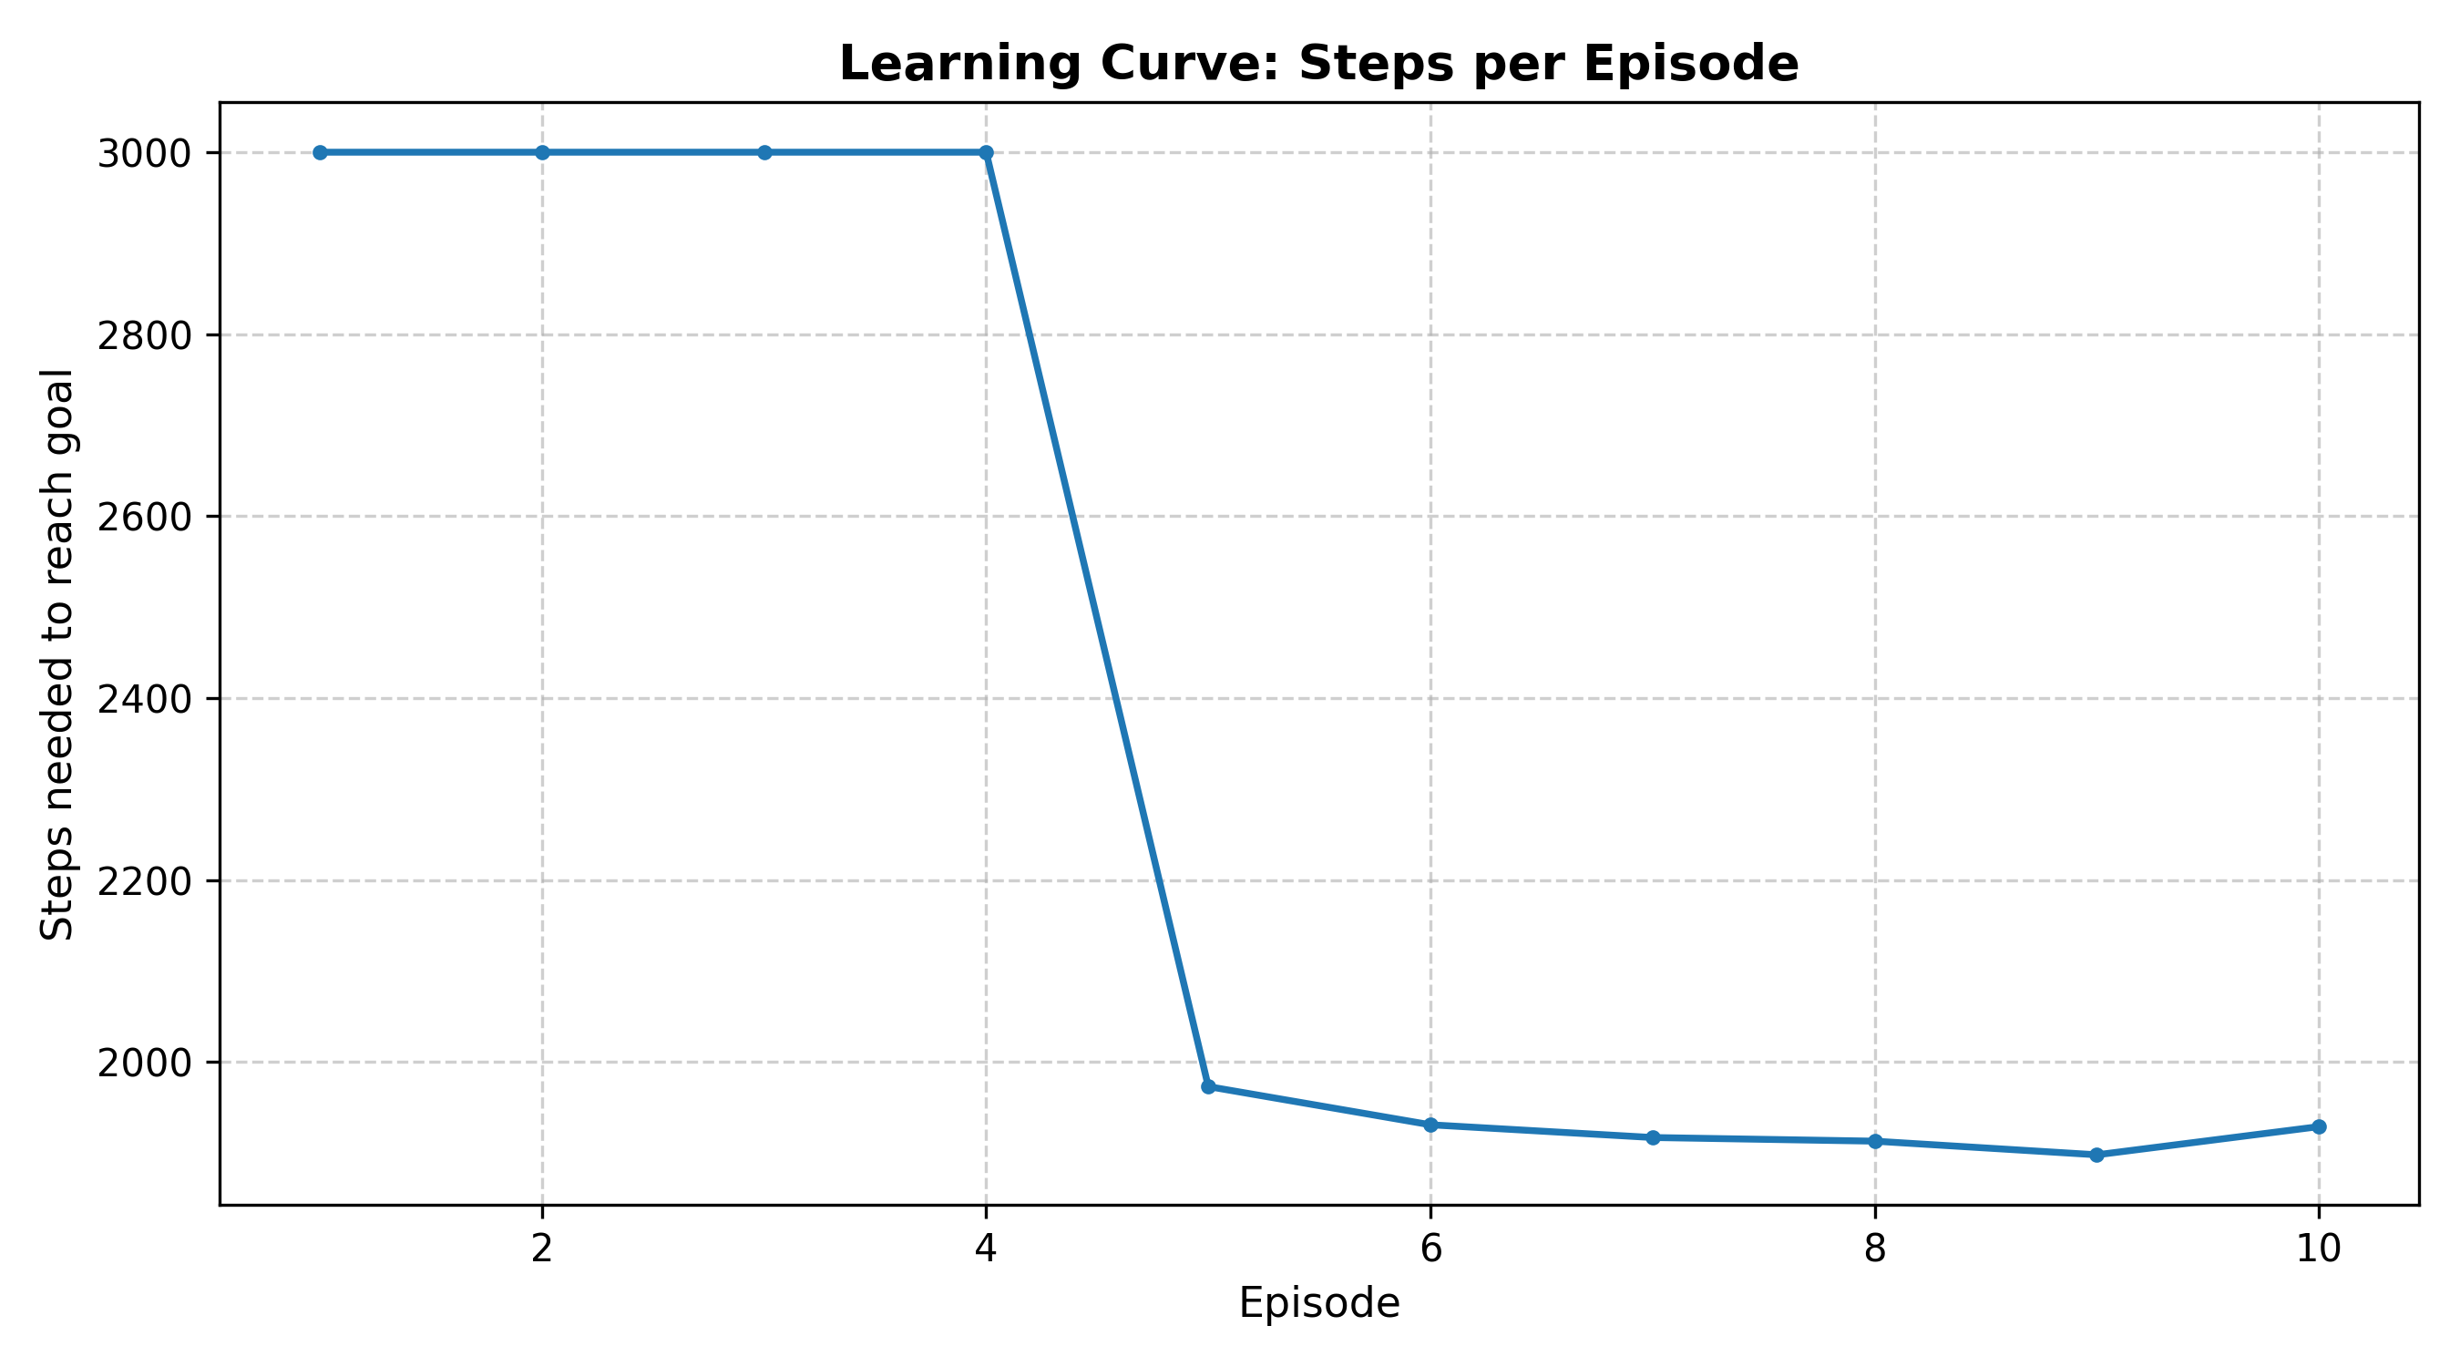
Learning Minimal Konfiguration
State Design:
Buffer1Typ: 3 [empty; match; dismatch]
Buffer1Typ: 3 [empty; match; dismatch]
Learning status | Number of states | Percent
Fully explored | 9 | 100%
Partially explored | 0 | 0%
Not explored | 0 | 0%
physically possible | 9 | 100%

Slide 16
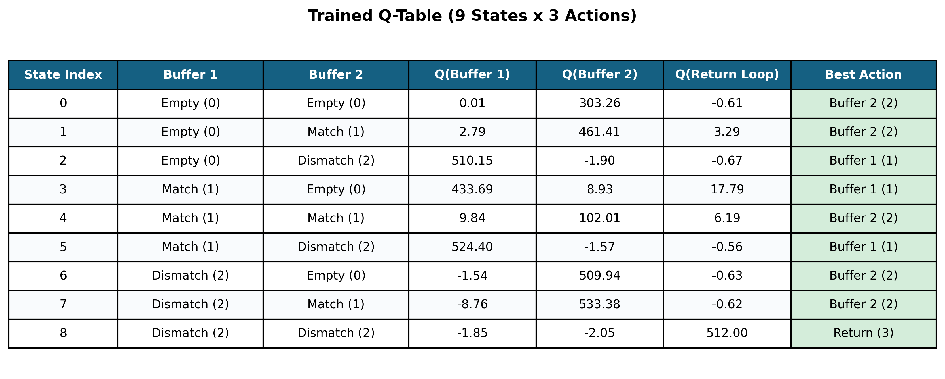
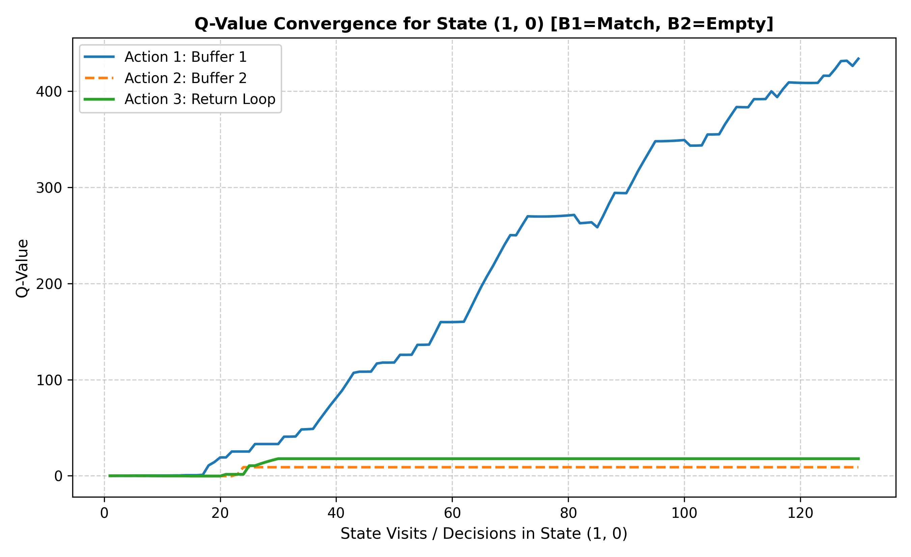
Learning Minimal Konfiguration

Slide 17
Conclusion & Key Takeaways
Key Findings & Optimization
Maximum Efficiency through Minimalism: A compact state space using relative states achieves a stable baseline of 1,850–1,900 steps per 1,000 games.
No Added Value from History: Tracking lastcollect merely inflates dimensionality without providing any runtime advantage.
Core Takeaway: Targeted domain-specific feature engineering beats brute-force state expansion.
Limits & Future Work
Performance Ceiling Reached: Within the current action space, the policy is already optimal.
Levers for Further Speedups: Reducing steps further requires additional degrees of freedom for the agent:
Prioritizing items between the production line and the return loop for the pick-and-place robot.
Dynamically controlling conveyor belt speeds.

