Slide 1
Life is extremely simplified

Slide 2
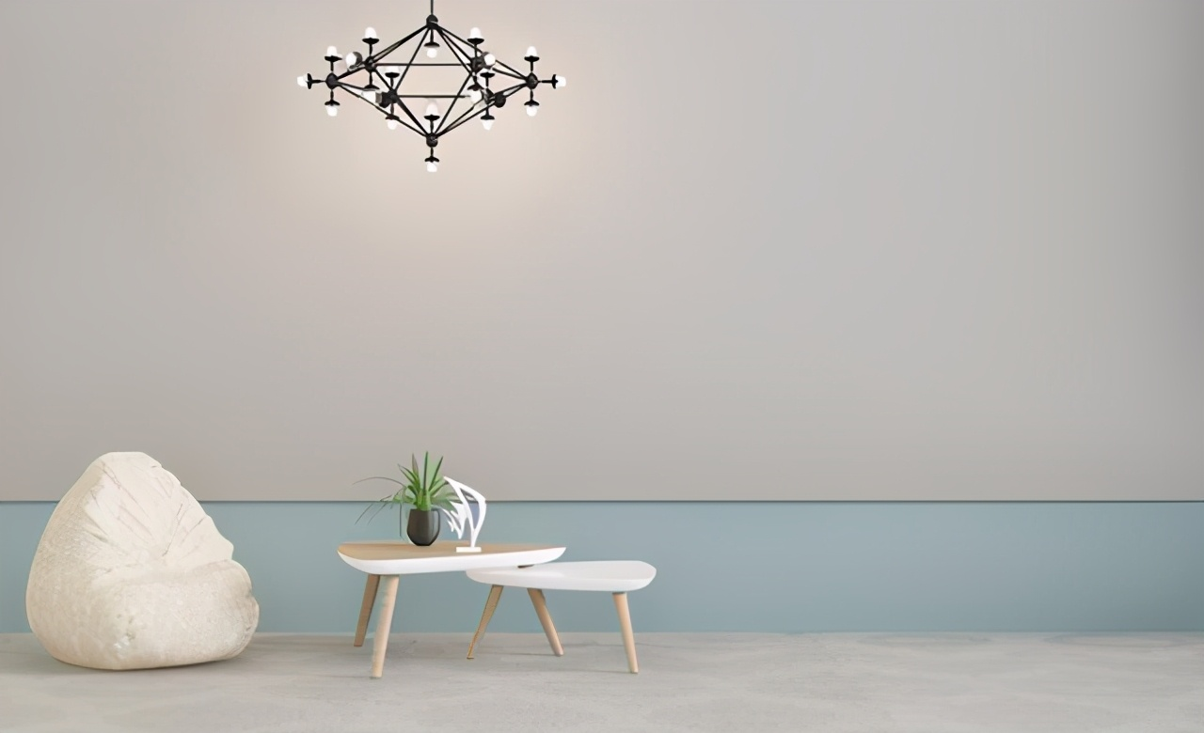
simple
light
what is it

Slide 3
how
1. Define what is most important to you
2. Focus on what is most important to you
principle

Slide 4
how
1. Face your goals.
2. Review your time.
3. Use mobile phones and computers properly.
4. Simplify your goals.
5. Learn to refuse.
6. Law of life.

