Slide 1
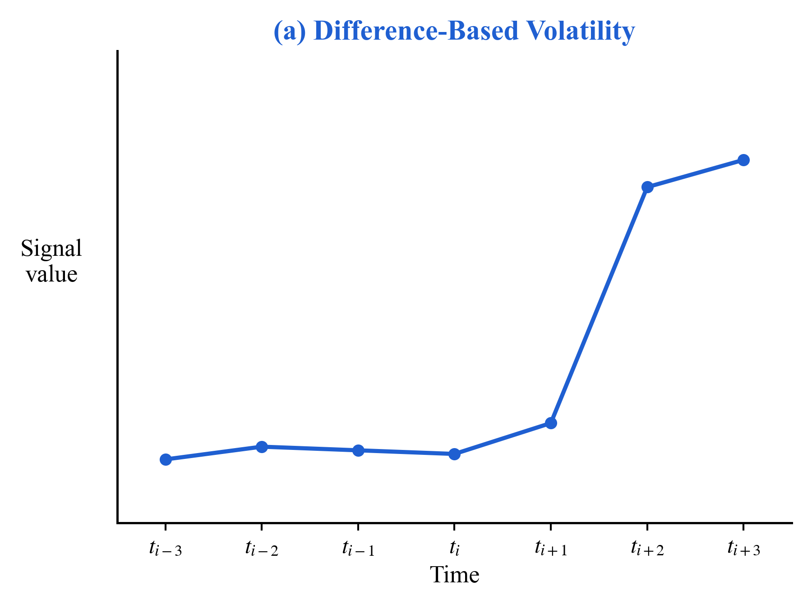
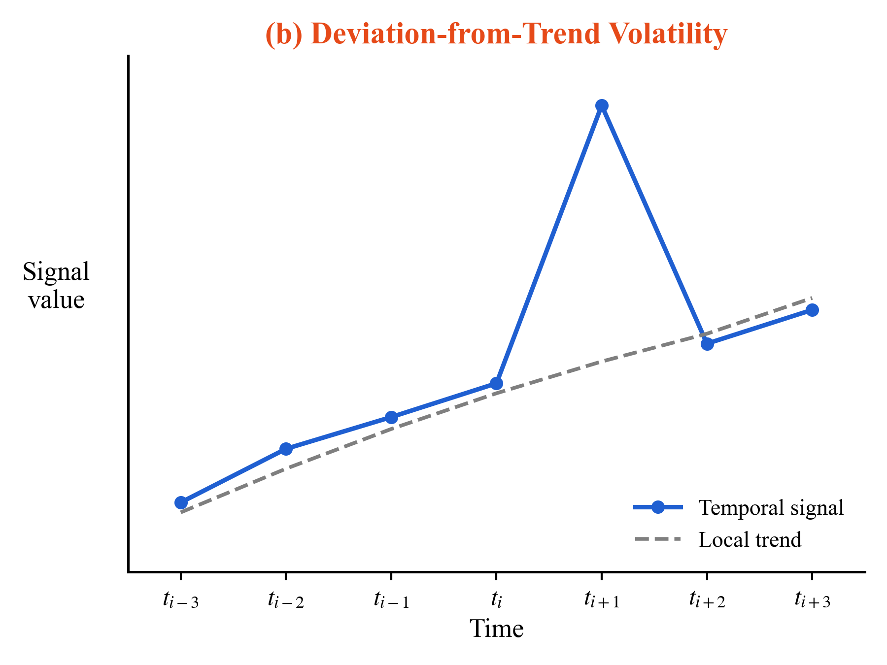


Measures how much the current step changes from the previous step.
Measures how far the current step deviates from nearby temporal context.

Slide 2

Scenario: Non-stationary traffic flow dynamics
Challenge: Learning fluctuation-aware temporal representations from high-dimensional spatio-temporal features while preserving trend continuity and abrupt-change responsiveness.
Volatility-aware Feature Enhancement
Overlapped Trend-Event Temporal Fusion
Temporal Feature Refinement
Q1: Volatility information is hidden in high-dimensional features and is difficult to directly exploit.
Q4: During temporal sequence modeling, the attention points in preceding and subsequent segments should be handled in a targeted manner.
Q5: The fused temporal features may still be discontinuous and insufficiently expressive.
Stage 1-1: Extract latent volatility features from raw high-dimensional representations
Stage 3: Further compensate for temporal continuity through full-domain temporal convolution and temporal feature refinement. The final output is an enhanced representation with improved distance-trend modeling, abrupt-change perception, and temporal stability.
Stage 2-1: Overlapped temporal segmentation and identity annotation.
Q2: Volatility magnitude alone is insufficient and is susceptible to noise, local trends, and instantaneous changes.
Stage 2-2:
a. Model stable trends and abrupt changes separately with different receptive fields.
b. Dynamically adjust the contributions of the two patterns.
Stage 1-2: Generate volatility scores and volatility masks to characterize volatility intensity and key fluctuation locations, respectively.
Output: Volatility-aware spatio-temporal features.
Q3: After detecting volatility, how can volatility information be further fed back into feature representations?
Stage 2-3: Address the fusion of dual-branch features from Stages 2-1 and 2-2, especially in the overlapped regions of the two branches.
Stage 1-3: Inject volatility locations, volatility intensity, and correction information into the original temporal features.
Problem
Solution

Slide 3
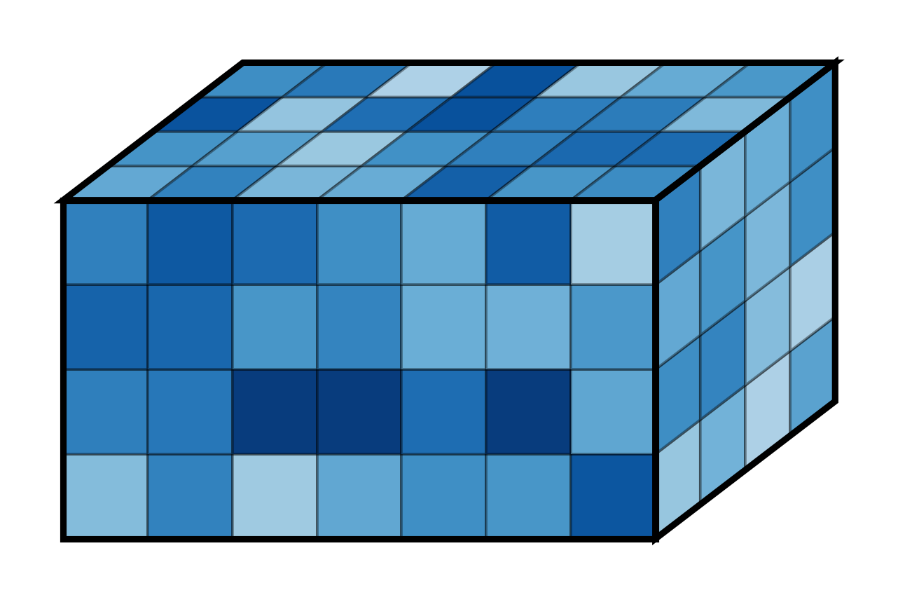
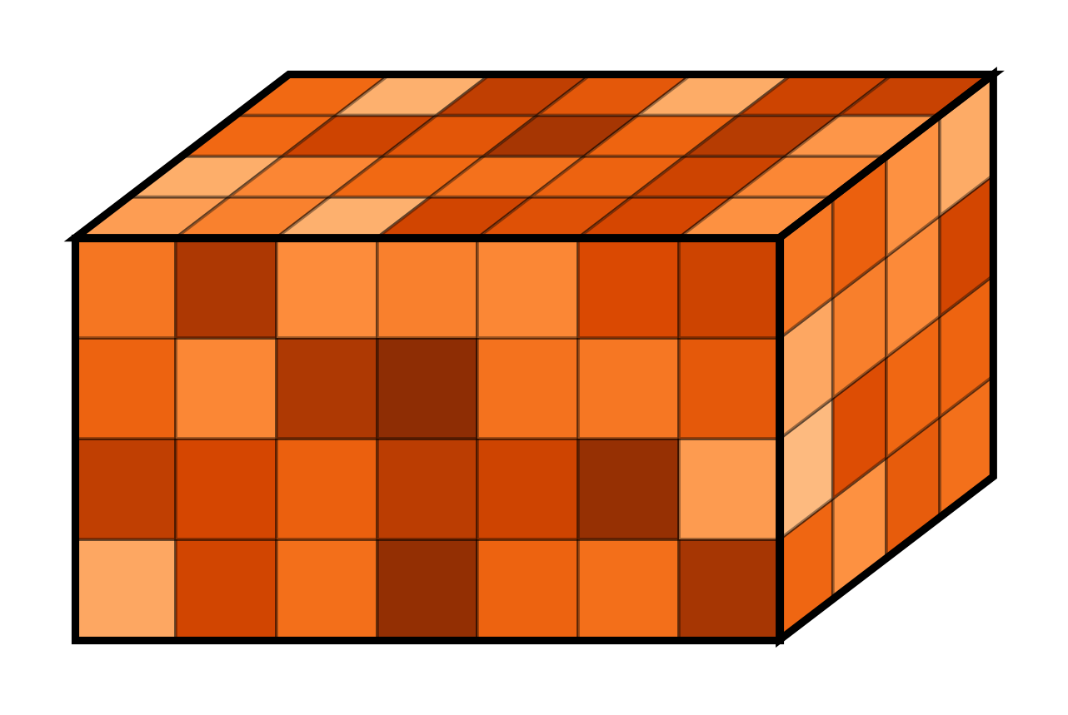















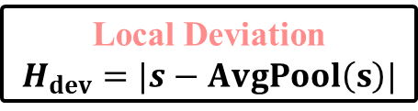
















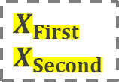






























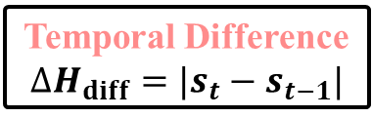











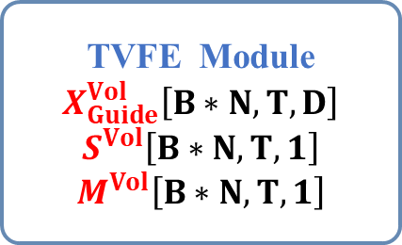


















TVFE Module Temporal Volatility-aware Feature Enhancement
VOT-RCF Module
Volatility-guided Overlapped Temporal Recurrent-Convolutional Fusion Module
Stage 1-1: Volatility Encoding
Extract complementary volatility cues
Stage1: Volatility Preprocessing
Stage2-1: Overlapped Segmentation with Branch Embedding
$$X$$
$$X_{Guide}^{Vol}$$
$$T_{1}$$
$$T_{2}$$
$$X_{First}$$
$$X_{Second}$$
$$\overline{H}$$
$$[B,T,N,D]$$
Overlapped Time Split
$$H^{T}$$
LayerNorm & squeeze
$$φ_{s}$$
$$X_{Score}$$
LayerNorm
$$[B∗N,T,D]$$
Example(T=12)
$$[B,T,N,D]$$
$$[B,T,N,1]$$
$$First Segment:t_{1}→t_{8} X_{First}:[B∗N,T_{1}=8,D]$$
$${ID}_{Embedding}^{First}$$
squeeze(-1)$→$permute$→$reshape
TVFE Module
$$X_{Guide}^{Vol}\left[B∗N,T,D\right]$$
$$S^{Vol}\left[B∗N,T,1\right]$$
$$M^{Vol}\left[B∗N,T,1\right]$$
$$t_{1}$$ | $$t_{2}$$ | $$t_{3}$$ | $$t_{4}$$ | $$t_{5}$$ | $$t_{6}$$ | $$t_{7}$$ | $$t_{8}$$ | $$t_{9}$$ | $$t_{10}$$ | $$t_{11}$$ | $$t_{12}$$
$$⊕$$
$$[B∗N,T,1]$$
Overlapping Area
$$S$$
$$Second Segment:t_{5}→t_{12} X_{Second}:[B∗N,T_{2}=8,D]$$
$${ID}_{Embedding}^{Second}$$
Temporal Difference
$$∆H_{diff}=|s_{t}−s_{t−1}|$$
Local Deviation
$$H_{dev}=|s−AvgPool\left(s\right)|$$
$$⊕$$
$$t_{1}$$ | $$t_{2}$$ | $$t_{3}$$ | $$t_{4}$$ | $$t_{5}$$ | $$t_{6}$$ | $$t_{7}$$ | $$t_{8}$$ | $$t_{9}$$ | $$t_{10}$$ | $$t_{11}$$ | $$t_{12}$$
$$⊕$$
Stage2-2: Trend-Event Dual-branch Modeling & Volatility-driven Branch Recalibration
Stage 1-2: Volatility Scoring
Generate volatility scores and masks
$$S^{Vol}$$
Trend Branch CNN
$$[B∙N,T_{1},D]$$
Shared
GRU-First
Conv1D
Kernal_size=5
GELU
& Dropout
$$[B∙N,T,1]$$
avg
pool1d
$$H_{BaseVol}$$
max
pool1d
Overlapped Time Split & MeanPool & abs
$$X_{First}$$
$$[B∗N,T,1]$$
$$H_{VolAvg}$$
$$H_{VolMax}$$
$$[B∙N,T_{1},D]$$
$$X_{First}^{Trend}$$
$$η_{Fist}^{VolScore}$$
$$η_{Second}^{VolScore}$$
$$softmax(ρ_{1},ρ_{2},ρ_{3})$$
Input
$$H_{Vol}=ρ_{1}H_{BaseVol}+ρ_{2}∗H_{VolAvg}+ρ_{3}∗H_{VolMax}$$
Event Branch CNN
Concat
$$[B∙N,1]$$
$$[B∙N,1]$$
Shared
GRU-Second
Conv1D
Kernal_size=3
Dilation=2
GELU
& Dropout
$$X_{Second}$$
Dynamic Weight MLP
reshape$→$permute
$$[B∙N,T_{2},D]$$
$$[B∙N,T_{2},D]$$
$$X_{Second}^{Event}$$
$$W_{Weight}^{Vol}$$
$$[B∙N,2]$$
Compute
$$S^{Vol}$$
$$H_{Vol}$$
Compute
$$M^{Vol}$$
$$[B,T,N]$$
$$[B,T,N,1]$$
$$X_{First}^{Trend}$$
$$W_{Weight}^{Vol}$$
$$X_{First}^{Trend}$$
$$[B,T,N,1]$$
$$X_{Norm}$$
$$[B,T,N,D]$$
$$[B∙N,0:1]$$
$${\hat{X}}_{First}$$
Concat
$$X_{Second}^{Event}$$
$$⨁$$
$$⨂$$
1
Unsqueeze(-1) & broadcast
[B,1]$→$[B,8,D]
$$[B,T_{1},D]$$
$$[B∙N,1:2]$$
$$⨁$$
$$⨂$$
$${\hat{X}}_{Second}$$
Stage 1-3: Guided Enhancement
Inject volatility-guided enhancement
$$W_{Weight}^{Vol}$$
$$W_{Weight}^{Vol}$$
$$[B,T_{2},D]$$
$$X_{Second}^{Event}$$
Stage2-3: Mask-gated Fusion
Stage3: Temporal Refinement
$$H_{Fusion}^{Vol}$$
Gate MLP
$$[B,T,N,D+2]$$
Bias MLP
$$H_{Fusion}$$
CNN
GELU
Trainable parameters: $α,β$
Position Mask Generator
$$X_{Gate}$$
$$X_{Bias}$$
Input
Kernal
$$[B,T,N,D]$$
$$[B,T,N,D]$$
$${\hat{X}}_{First}$$
$${\hat{X}}_{Second}$$
$$S^{Vol}$$
$$M^{Vol}$$
$$X_{Left}$$
$$⊗$$
Overlapping area gating fusion
$$M_{First}$$
$$(1+X_{VolMask})$$
$$X_{Update}=α∗(X_{Gate}∗\overline{H})+β∗X_{Bias}$$
$$X_{Mid}$$
$$⨁$$
$$H_{Fusion}$$
TFR-MLP
$$M_{Overlap}$$
DropOut
Residual
$$H^{T}$$
$$X_{Right}$$
DropOut
DropOut
Linear
$$⊕$$
Linear
$$M_{Second}$$
$$[X_{Guide}^{Vol}]$$
$$[B,T,N,D]$$
$$X$$
$$X_{Out}^{VOT−RCF}$$
TFR-MLP: Temporal Feature Refinement

Slide 4

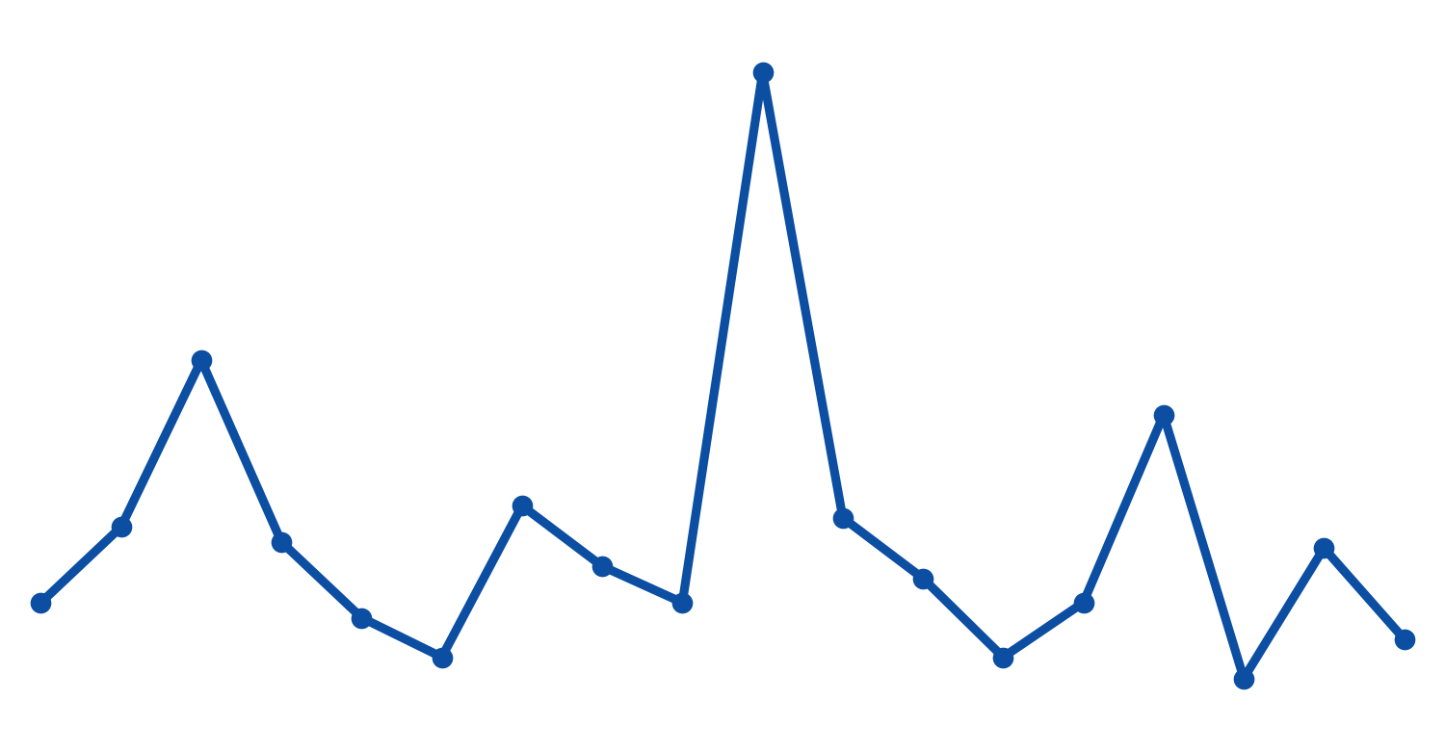
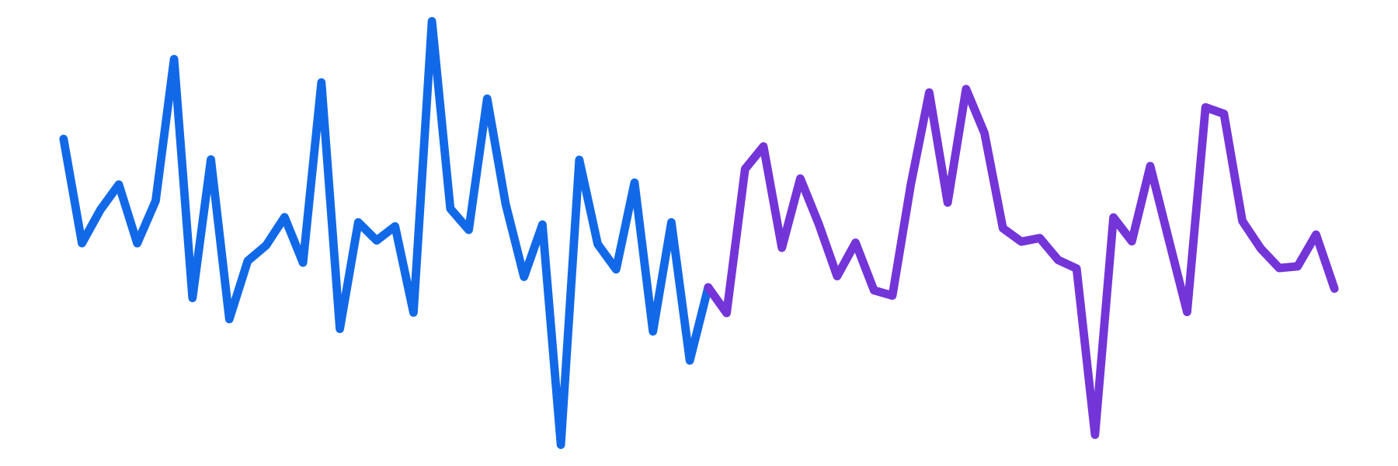

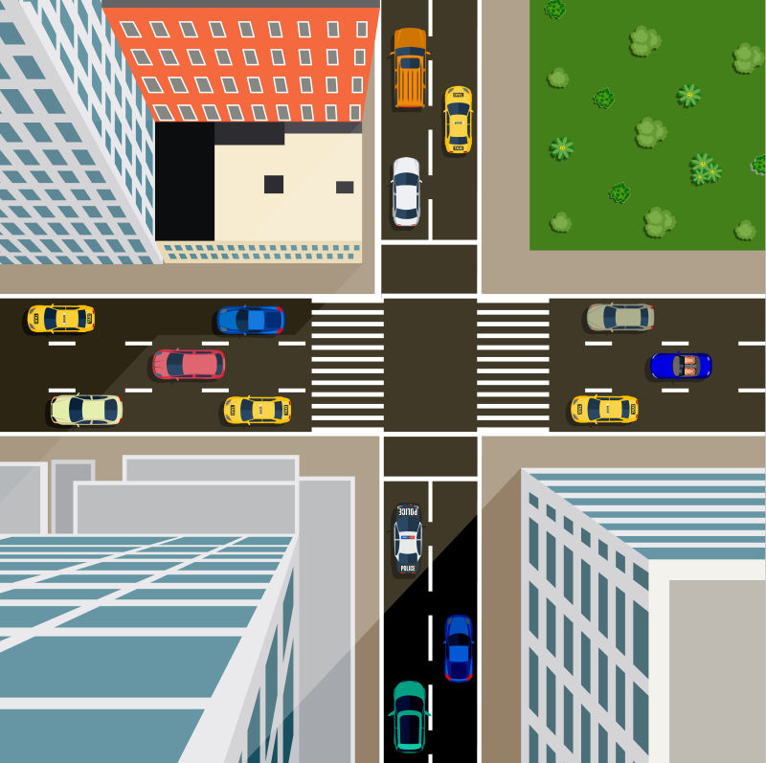
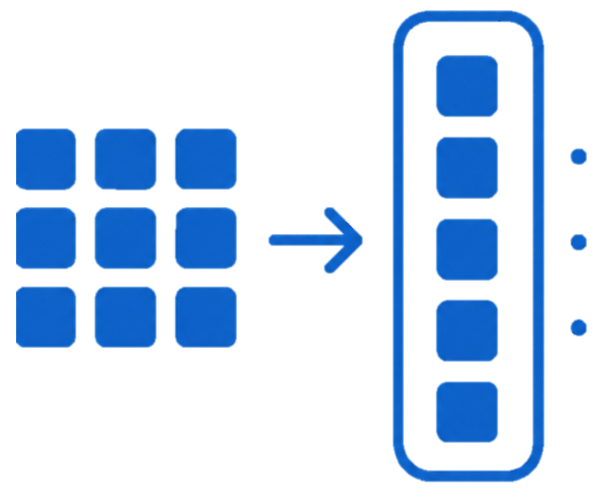


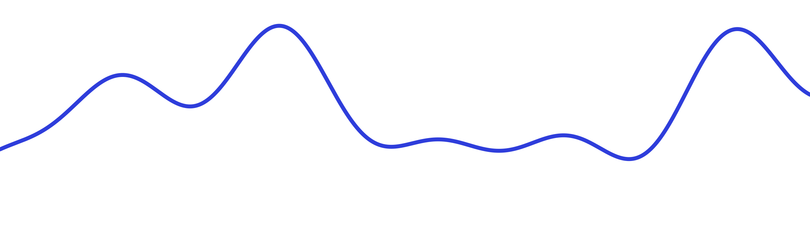
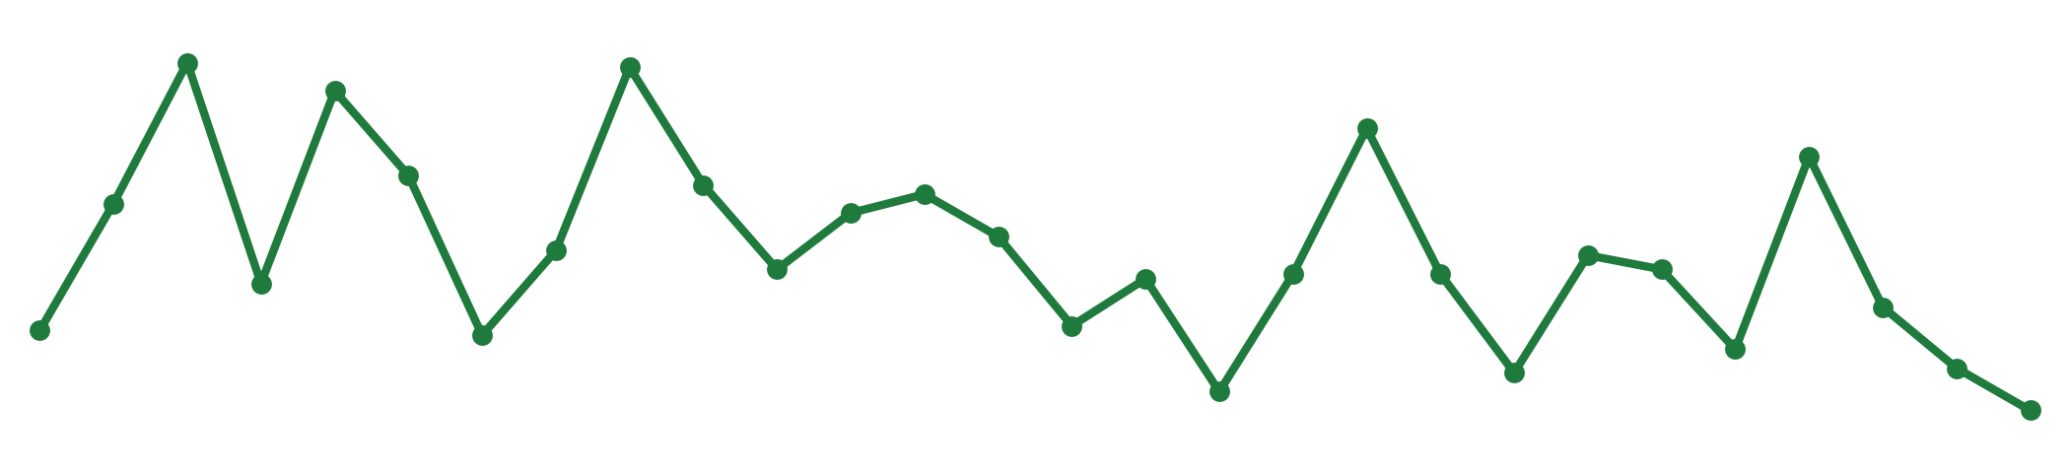
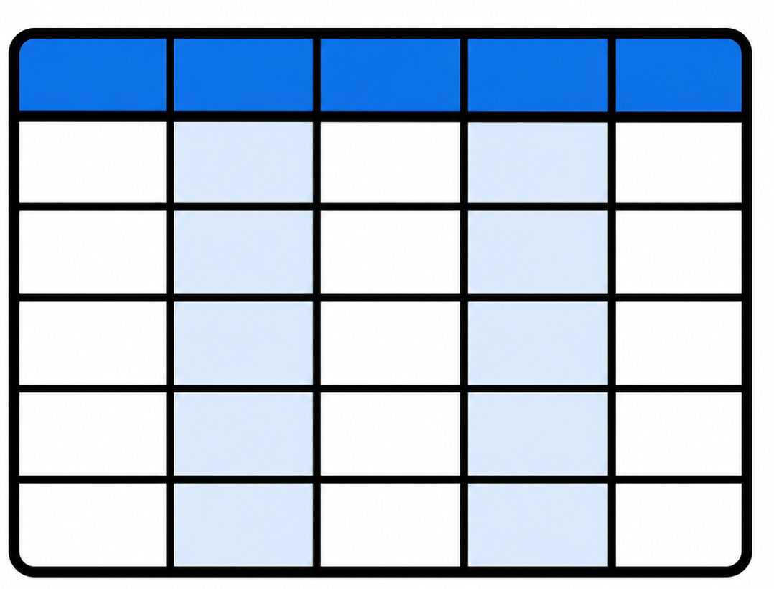
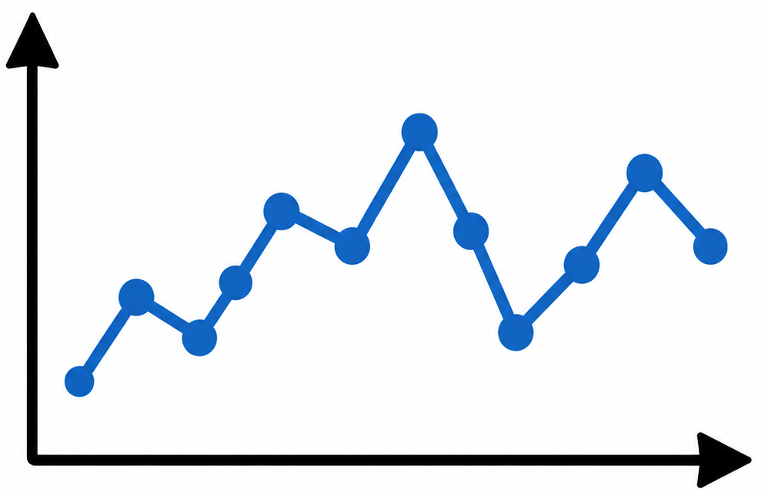

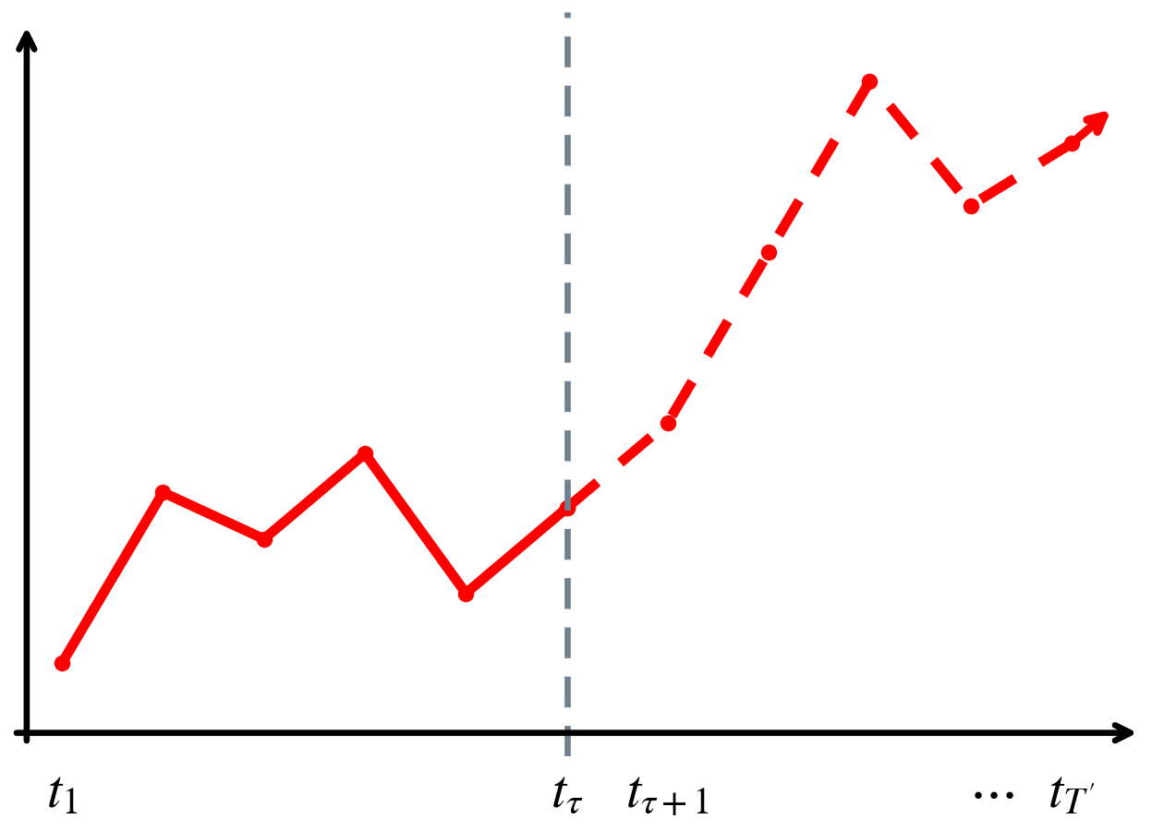
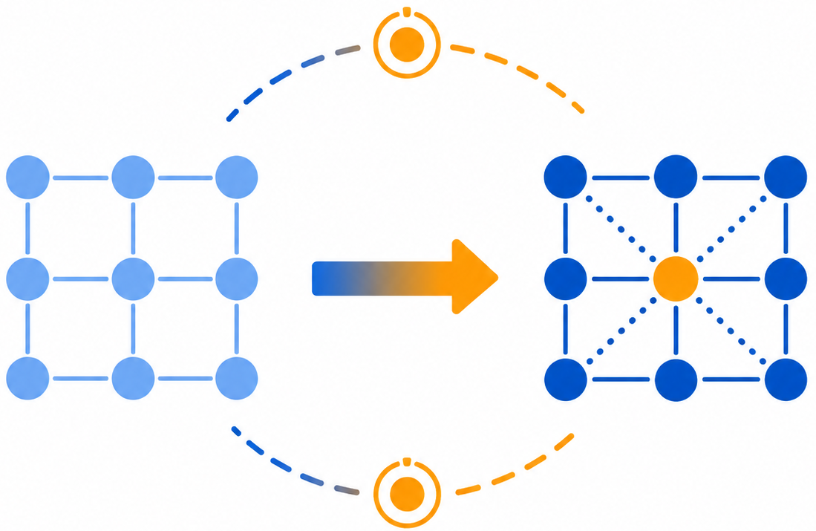









Overview of the Proposed VOTR-Former
A Volatility-Guided Overlapped Temporal Recurrent-Convolutional Transformer for Traffic Flow Forecasting
Stage3: Continuity Compensation &
Volatility Anchoring
Feature Traffic
Prediction
Raw Traffic Input
Embedding Layer
Stage1: Volatility-aware Feature Encoding
Feature
Embedding
time
Stage 1
Continuity compensation at breakpoints
Stage2: Overlapped Conv-Recurrent Modeling
Time-of-Day
Embedding
First segment
$$\hat{Y}$$
Fluctuation anchor point
Second segment
Day-of-Week
Embedding
stage 2-3
Stage 4
Temporal
Transformer Layer
Spatial
Transformer Layer
Adaptive
Embedding
$$t_{1}$$ | $$t_{2}$$ | $$t_{3}$$ | $$t_{4}$$ | $$t_{5}$$ | $$t_{6}$$
$$X∈R^{B×T×N×D}$$
$$t_{1}$$ | $$t_{2}$$ | $$t_{3}$$ | $$t_{4}$$ | $$t_{5}$$ | $$t_{6}$$
$${ n}_{1}$$
Embedding feature concatenation
 | $$n_{1}$$ | $$n_{2}$$ | $$n_{3}$$
$$n_{1}$$
$$n_{2}$$
$$n_{3}$$
$B:Batch Size$
$T:history time steps$
$N:Nodes$
$D:HiddenDim$
$${ n}_{2}$$
History
Forecast
$${ n}_{3}$$

Slide 5
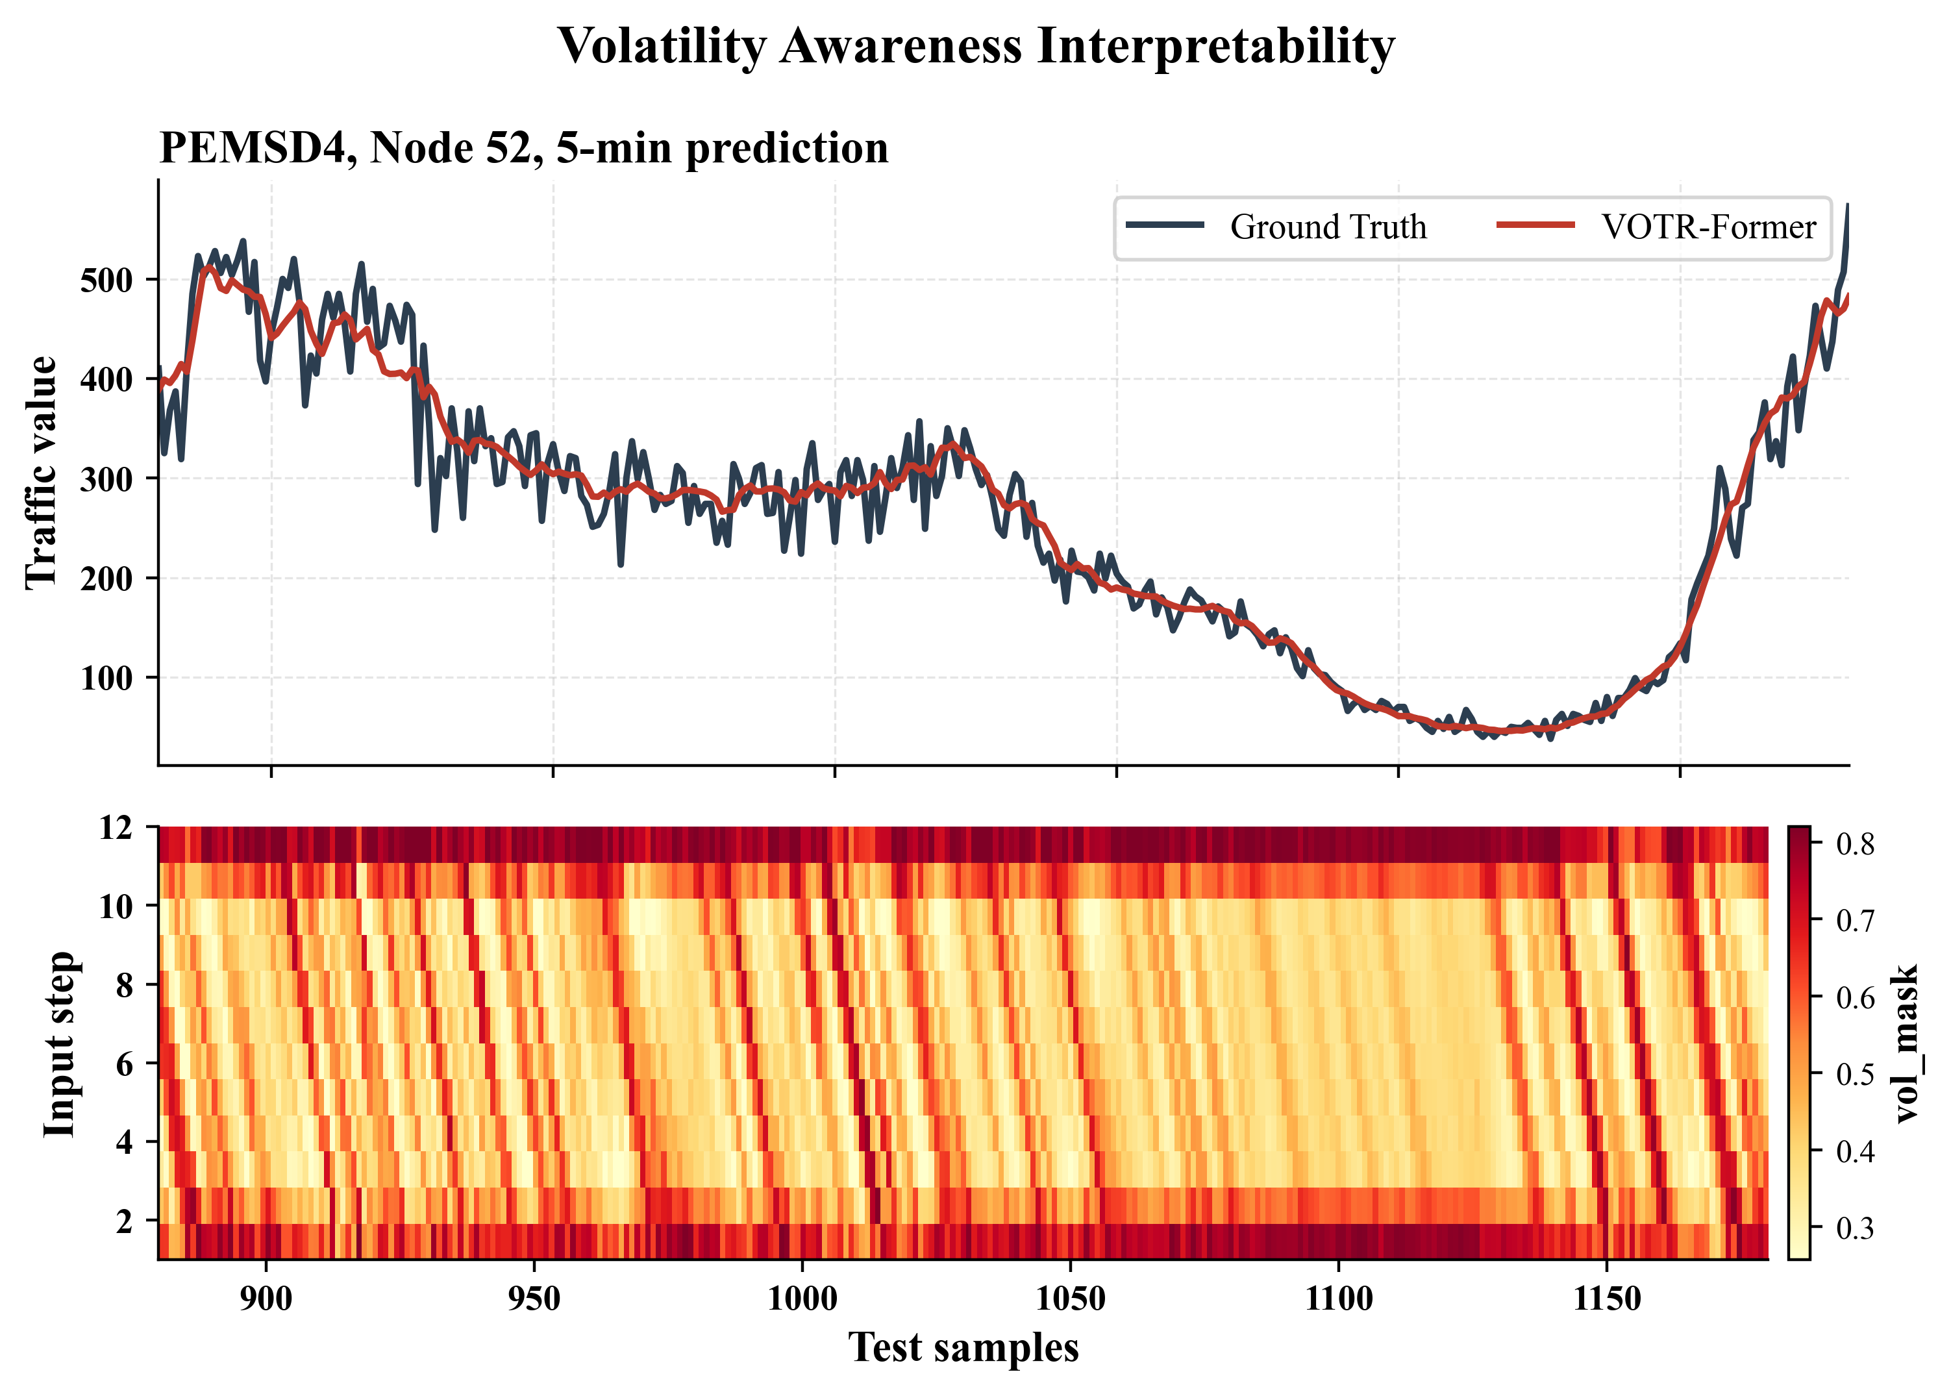
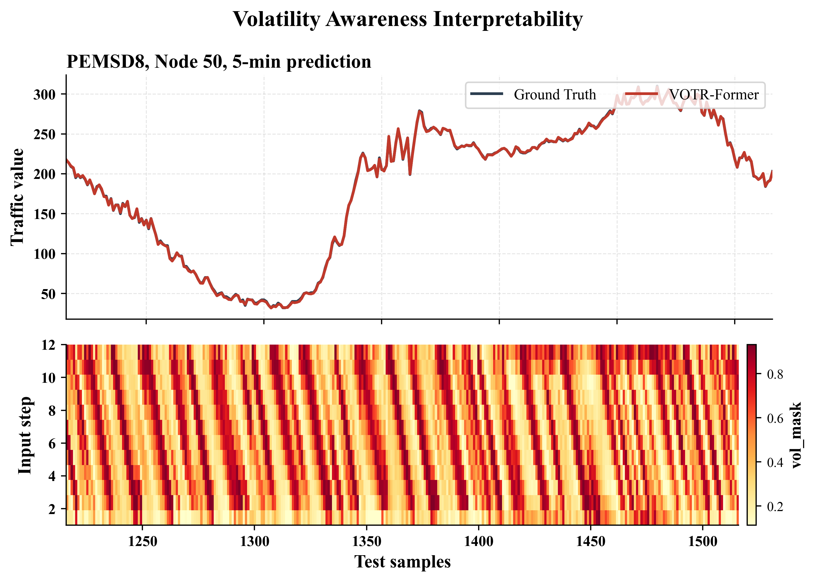
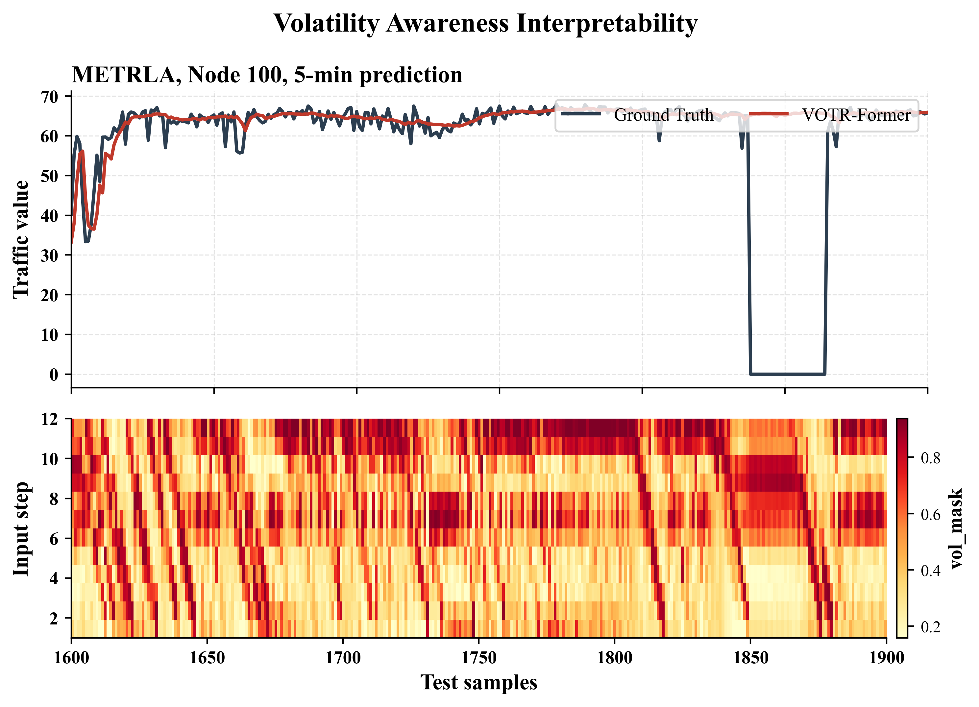
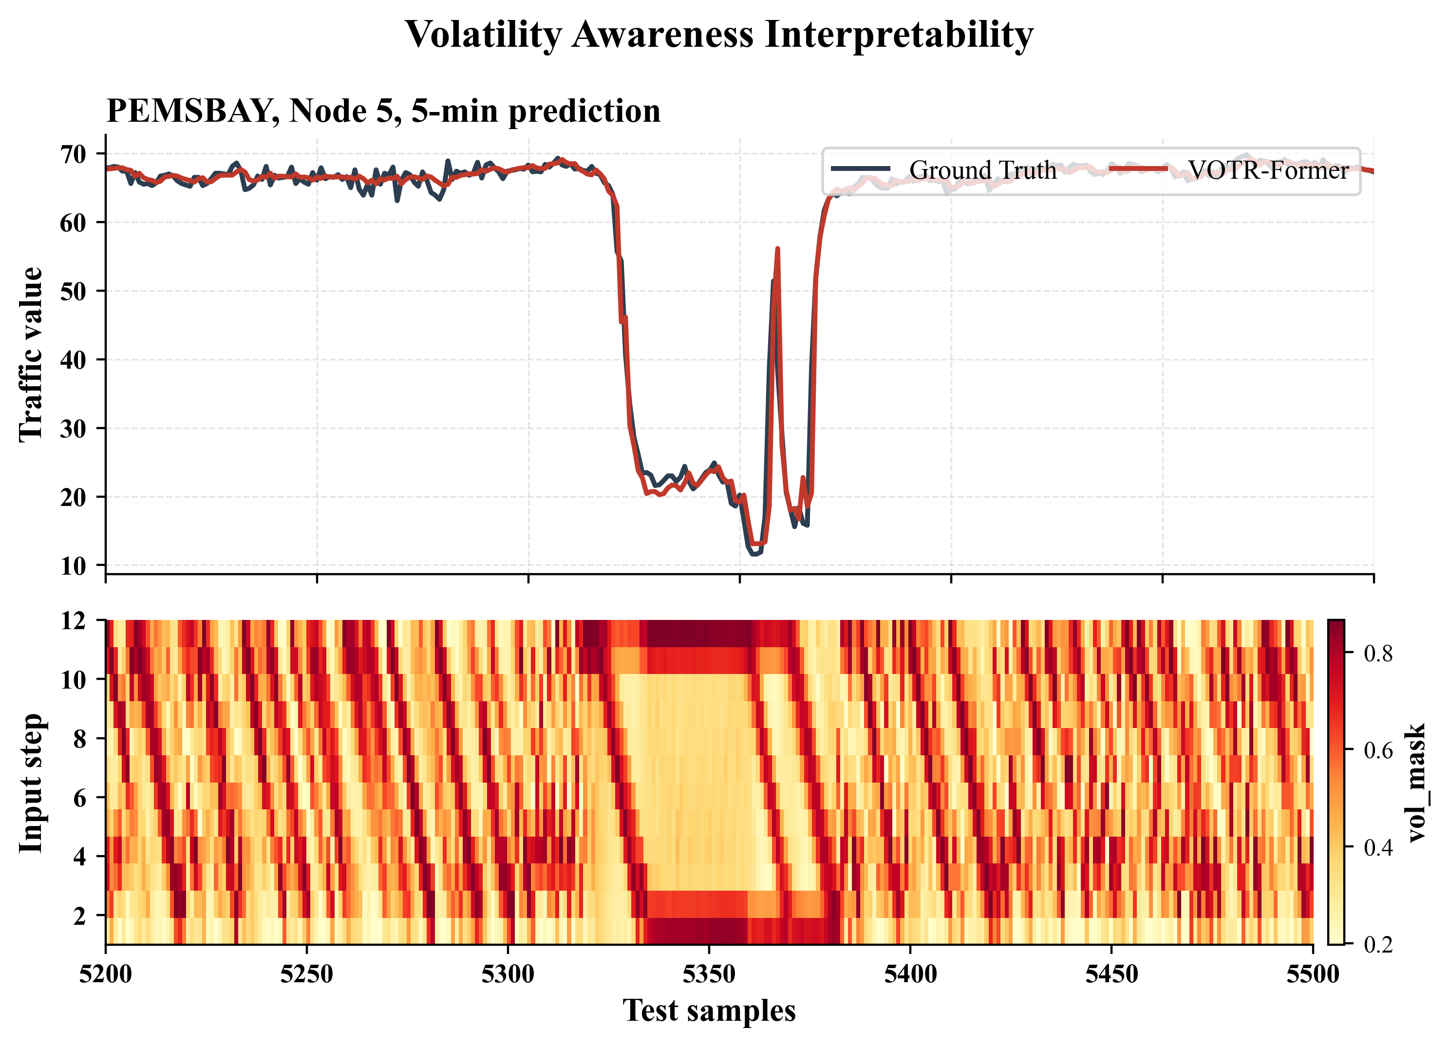

Slide 6


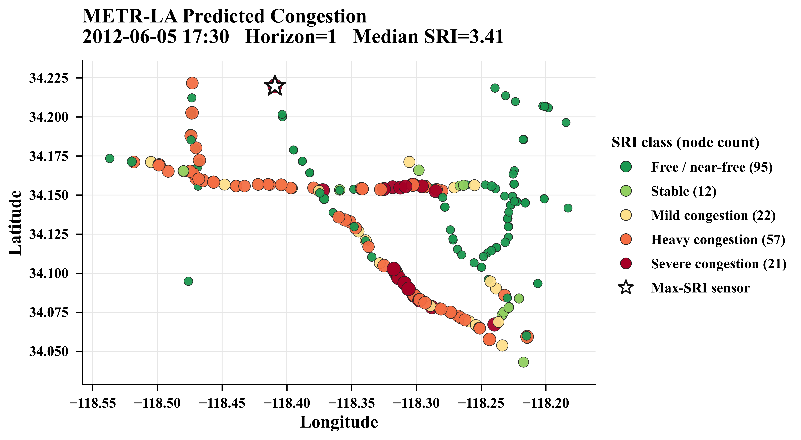
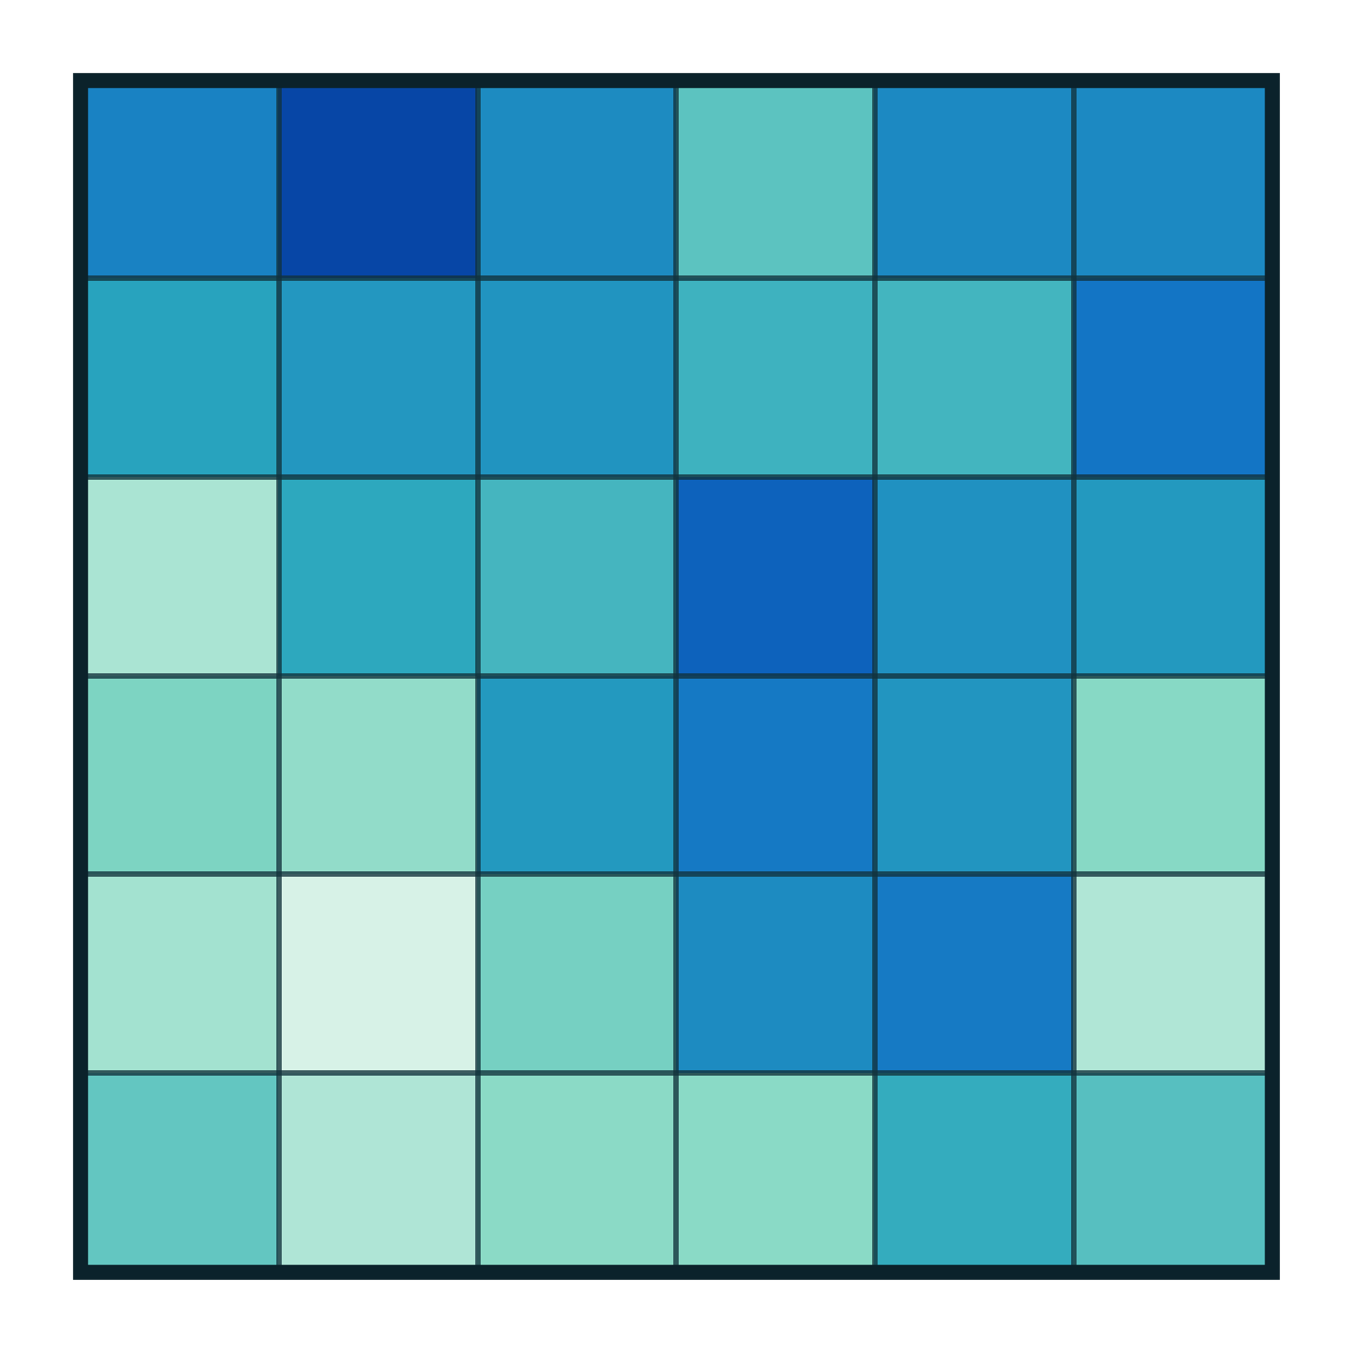








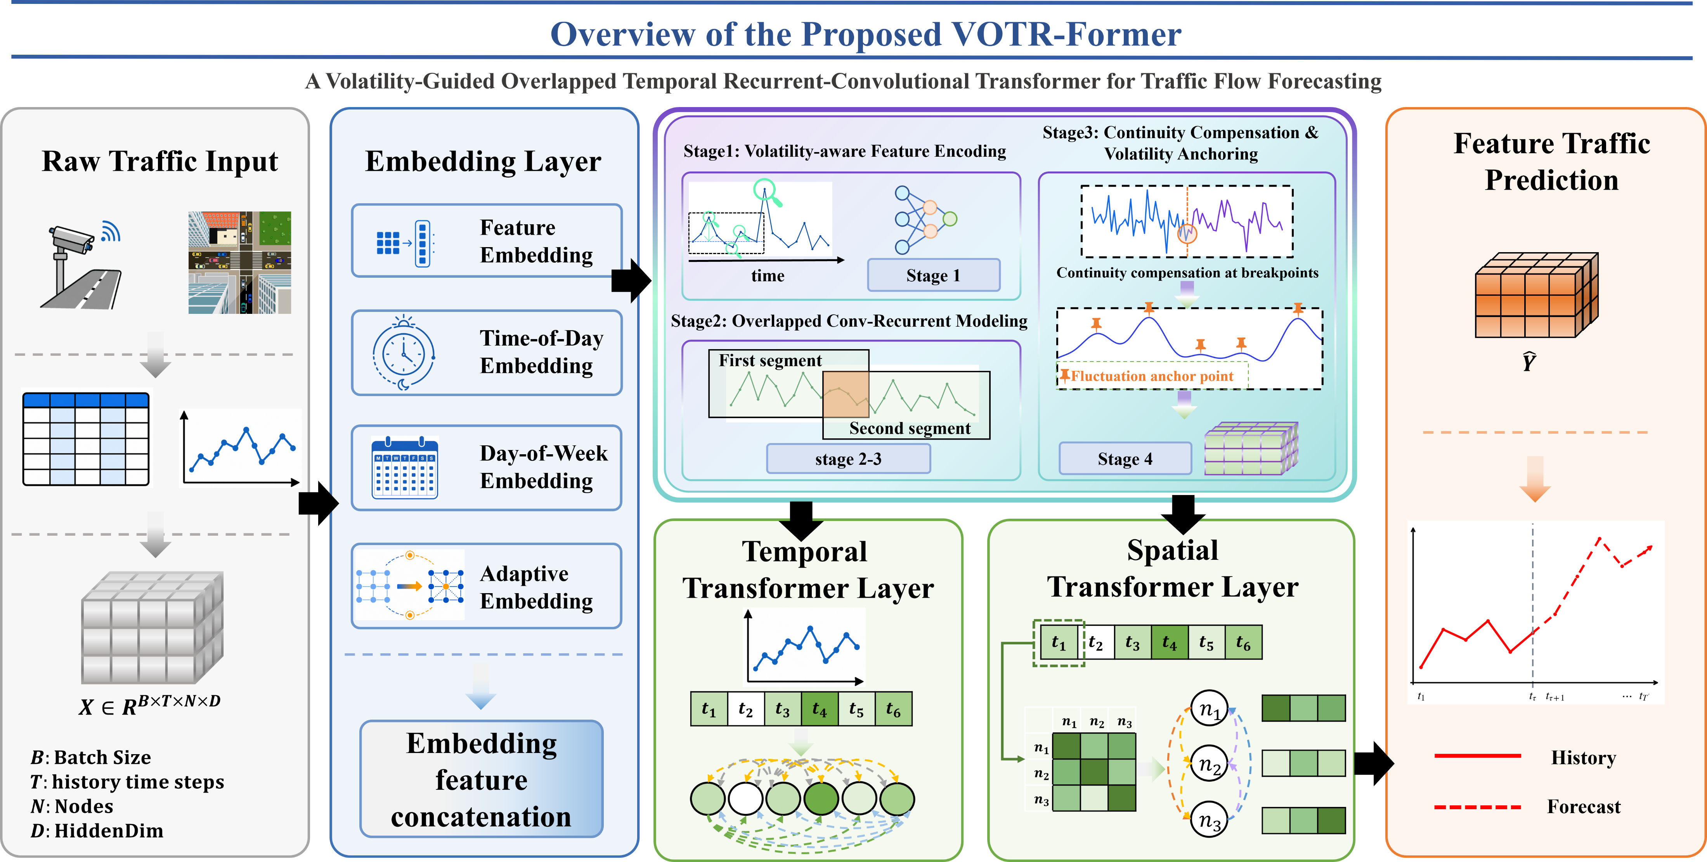
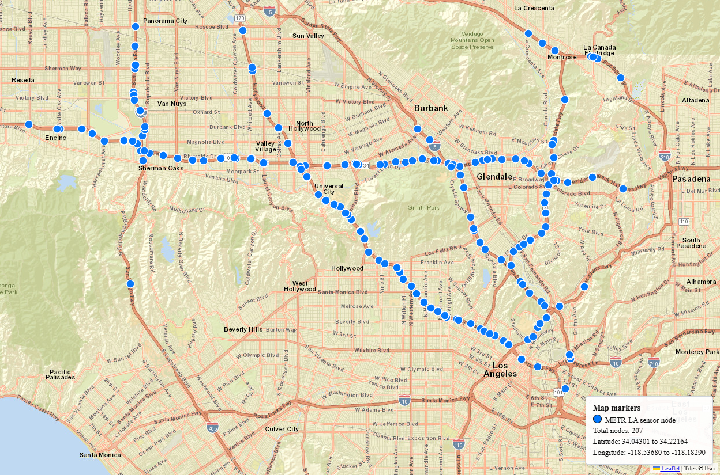



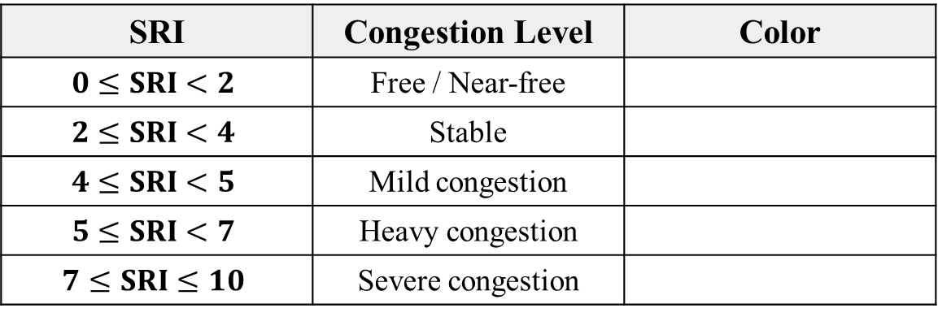
a. Traffic State Prediction
b. Roadside Sensor Localization and V2X Infrastructure
c. Free-flow Speed Estimation
e. Predicted Congestion Map and Autonomous Driving Applications
$$V_{ff, i}=P_{85\%}(v_{i,t}^{offpeak})$$
• Extract the long-term historical speed for each sensor.
• Select valid off-peak speeds and remove invalid values with speed $≤0$.
• Compute the 85th percentile of the filtered speed set.
• Use this percentile as the free-flow speed $V_{ff, i}$ of sensor $i$.
…
…
…
Sensors (N=207)
Time (T=12)
VOTR-Former (Our proposed)
Outputs future traffic speed
d. SRI Congestion Risk Quantification and Level Classification
Support V2X perception and road state mapping
$$SRI_{i}=\left(1−{\hat{v}}_{i}^{\left(h\right)}\right)∗10$$
• Obtain the predicted speed ${\hat{v}}_{i}^{\left(h\right)}$ of sensor $i$ at prediction step $h$.
• Use the free-flow speed $V_{ff, i}$ of sensor $i$ as the normal-flow baseline.
• Calculate the reduction ratio of the predicted speed relative to the free-flow speed.
• Scale the reduction ratio to the SRI range from 0 to 10.
• A larger SRI indicates a stronger speed reduction and a higher potential congestion risk
SRI | Congestion Level | Color
$$0≤SRI<2$$ | Free / Near-free
$$2≤SRI<4$$ | Stable
$$4≤SRI<5$$ | Mild congestion
$$5≤SRI<7$$ | Heavy congestion
$$7≤SRI≤10$$ | Severe congestion
Target time: 2012-06-05 17:30
Prediction step: horizon = 1 (5min)
Data Support: METR-LA (207 sensors, 5-min interval)
Data Support: METR-LA (207 sensors, 5-min interval)
Application Support: Autonomous Driving in Complex Scenarios

