Slide 1
Analysis of Body Gestures and Detecting Psychological Distress
COURSE : TARP CSE1901
TEAM MEMBERS
Nishant Chaturvedi 19BAI1109
Sagnik Chatterjee 19BAI1153

Slide 2
Outline
Abstract
Motivation
Literature Survey
Design of the Project
Module description
Conclusion

Slide 3
Abstract
Psychological distress is a significant and growing issue in society. Automatic detection, assessment, and analysis of such distress is an active area of research. Compared to modalities such as face, head, and vocal, research investigating the use of the body modality for these tasks is relatively bare. This is, in part, due to the limited available datasets and difficulty in automatically extracting useful body features. Recent advances in pose estimation and deep learning have enabled new approaches to this modality and domain. For this project, we will collect and analyze a new dataset containing full body videos for example short interviews and self-reported distress labels.
This project will take a step forward to investigate body gesture analyzing methods and develop a program that bridges the daily human life habits and mental health issues.

Slide 4
MOtivation
Psychological distress and mental disorders are significant threats to global health. According to the World Health Organization (WHO), an estimated 450 million people around the world suffer from neuropsychiatric conditions, with depression and anxiety being the most common mental disorders.
Despite existing strategies for the treatment of distress, such as depression, it is estimated that nearly two-thirds of people suffering distress have never received help from a health professional.
Early detection of distress is consistently noted as a key factor in treatment and positive outcomes. Early detection requires an ongoing assessment to identify distress when it begins. Currently, the most effective automated distress detection approaches utilize multi-modal machine learning.

Slide 5
Literature survey
PAPER 1
A Framework for Whole-Body Gesture Recognition
from Video Feeds
PAPER 2
Robo-Nanny: ConvNets for Intelligent Baby Monitoring
PAPER 3
A Study of Vision based Human Motion Recognition and Analysis

Slide 6
Robo-Nanny: Conv-Nets for Intelligent Baby Monitoring
Literature Survey
. In this paper they have applied supervised learning techniques on state-of-the-art deep convolutional neural networks (CNN) to infer a baby’s status inside a crib using a baby monitor video feed.
A dataset of 2500 images assigned to 5 predefined classes was used for training and hyper parameter tuning. After comparing different model architectures, the best class-weighted accuracy of 96.7% on test set was achieved on pre-trained ResNet18.
A Nest IP Camera was placed over a baby crib and a continuous stream of frames were captured at a rate of 1 frame per 10 seconds. Two techniques were briefly tested in order to efficiently extract salient images from the video feed: image subtractions. Optical Flow.

Slide 7
A Framework for Whole-Body Gesture Recognition from Video Feeds
Literature Survey
As technology advances, both hardware and software become more affordable and accessible, allowing for the development of new applications. In recent years, there has been a significant increase in the number of computer vision and image processing applications. Automated identification of objects in real-time or recorded video streams, as well as analysis of these recognised items, are two areas of interest in vision and image processing. The identification of humans and the interpretation of their behaviours are major research topics in this area. Human motion detection and video processing have been employed in high-tech applications involving trained human professionals, such as vital crime investigations.
Despite the fact that the technology has various applications that can be implemented in everyday activities, it has not been used to its full potential due to technological requirements, human talent, and expensive implementation costs. This paper describes a system that uses video as input to process and recognise motions of items of interest as part of a project named moveIt (movements interpreted) (the human whole body). The system's basic operation is to take a video stream as input and output gesture analysis of each item via a stepped process of object identification, tracking, modelling, and recognition of gestures as intermediate phases.

Slide 8
A Study of Vision based Human Motion Recognition and Analysis
Literature Survey
. This paper discusses applications, general framework of human motion recognition, and the details of each of its components. The paper emphasizes on human motion representation and the recognition methods along with their advantages and disadvantages.
Human motion can be either directly recognized from image sequences, or it can be done in a multiple layer process. Generally, for simple actions, motion is recognized directly from image sequences and they can be viewed as single layer approaches.
For baby monitoring system we will using computer vision to detect activity or motion of baby. So basically, detect baby motion is similar to human motion detection. By using this research, we will get idea about different data set and different method to detect human activity and detection.

Slide 9
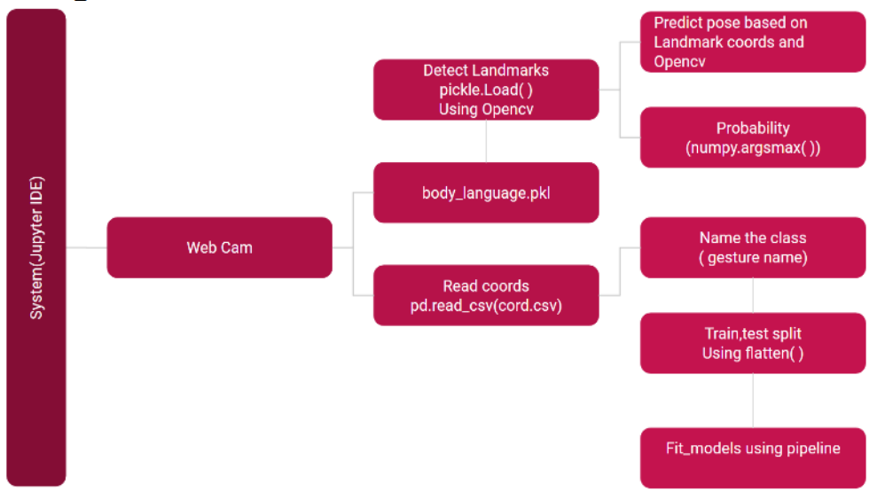
Design of the project
In design we include flow diagram and gantt chart for this project.

Slide 10
Working
The Basic functional design of this project follows:
(a) Import dependencies: In this step mediapipe, opencv, pandas and scikit-learn are installed and imported.
(b) Perform some detections: Using cv2, a webcam window is opened, and specifications such as the colour and thickness of our face, as well as hand and pose landmarks, are mentioned/modified.
(c) Capture landmarks and export to CSV: Various facial expressions and body gestures are captured and exported to a csv file called coords.csv.
(d)Training using Scikit-learn: Here, the collected data is read and processed in order to train our machine learning classification model.
After that, the model is evaluated and serialised.
(e) Make detections with the model: When the code is run, the trained model can now predict the user's gestures.

Slide 11
Module Description
1.1 Face Detection
This software shall utilize a face detection system to filter out faces from the video capturing device. By applying face detection, the system can identify the region where the face is located and thus helping in capturing emotions. The face detection unit will be implemented with the help of OpenCV.
1.2 Skin Detection Module
This software shall perform skin color detection and filter out all objects that do not contain the color of skin. By filtering object of non-skin colored, the system can then use its remaining resources and focus on body detection and gesture recognitions.

Slide 12
Module Description
1.3 Filtered Object Detection
Once the program has filtered out most of the unwanted parts of the picture after using the skin detection module, the software shall read and recognize “clusters” skin colored objects also known as “blobs”.
1.4 Object Location
Upon detection, the system shall be able to compute the location of the object using simple trigonometry math.
1.5 Body Calibration
Depending on user’s preferences, the system shall perform adjustments according to user’s body.

Slide 13
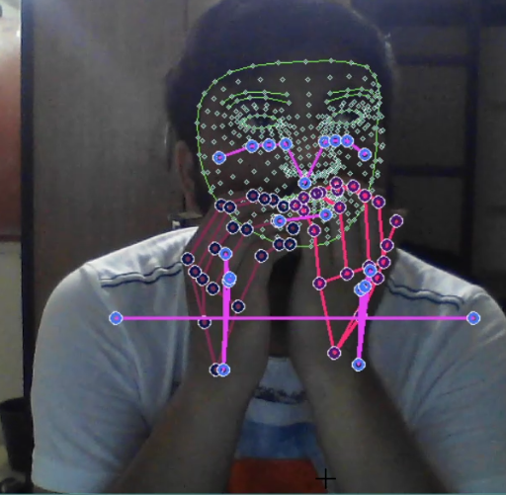
Training And dataset creation sample
Labels used:
Angry
Anxiety
Normal
Fatigue

Slide 14
Modules
STAGE 01
Here we see various research works and work in this domain that would help us to create a framework and avoid future problems for our idea.
Dataset Exploration
STAGE 03
Pre-Processing
STAGE 02
STAGE 04
STAGE 05
Testing & Deploying
Research
Here we see various datasets and try to create a dataset of our own that we can use in this domain that would help us to create a working model for our idea.
In this we process our dataset using various techniques and algorithms in this domain that would help us to create our model and process the videos to our desired forms.
Here train our model that would help us to recognize gesture and classify which is followed by evaluation of various scores.
In this we test our model that we created in our previous stage with various video feeds and then deploy it that would work for any video that is feeded to it.
Training
Sagnik | Nishant | Both | Nishant | Sagnik

Slide 15
Conclusion
Early detection of distress is consistently noted as a key factor in treatment and positive outcomes. Early detection requires an ongoing assessment to identify distress when it begins.
This project will take a step forward to investigate body gesture analyzing methods and develop a program that bridges the daily human life habits and mental health issues.
Our objectives for this project is to evaluate the different object detection techniques and filtering algorithms to perform body gesture analysis. Upon successful detection, we would develop software solution that will take the detection results and convert them to psychological distress labels.

