Slide 1

Volunteer management
By Team Rocket @ Oracle Cerner ShipIT
Built for

Slide 2


The WHY
Volunteer data
Reports used for:
Plan and manage future actions more efficient
Increased volunteer management
Government audits
Stakeholders

Slide 3
Technologies & assignments
Poza cu echipa
Adi & Alexandra – Backend C#, ado.net Framework, Windows Form, Password data encryption
Stefan – Unity (SQL did not work in WebGL)
Iulia – SQL, Presentation
Client requirements gathering

Slide 4
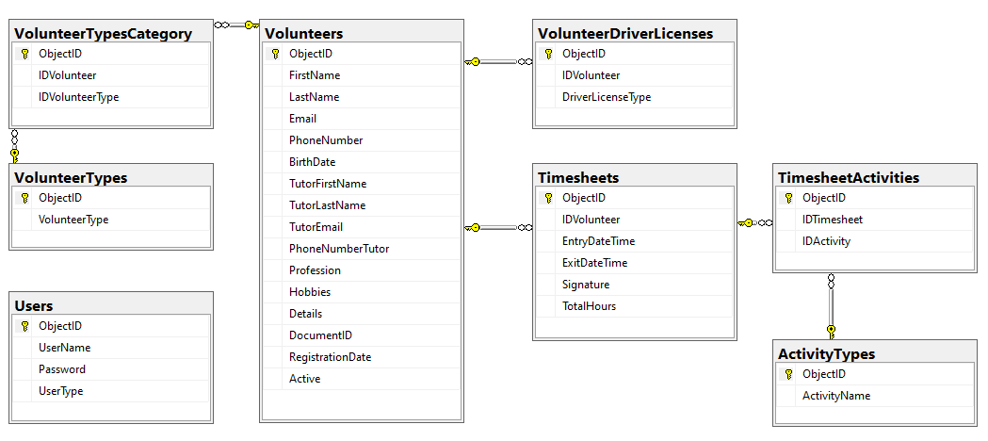
Database view

Slide 5
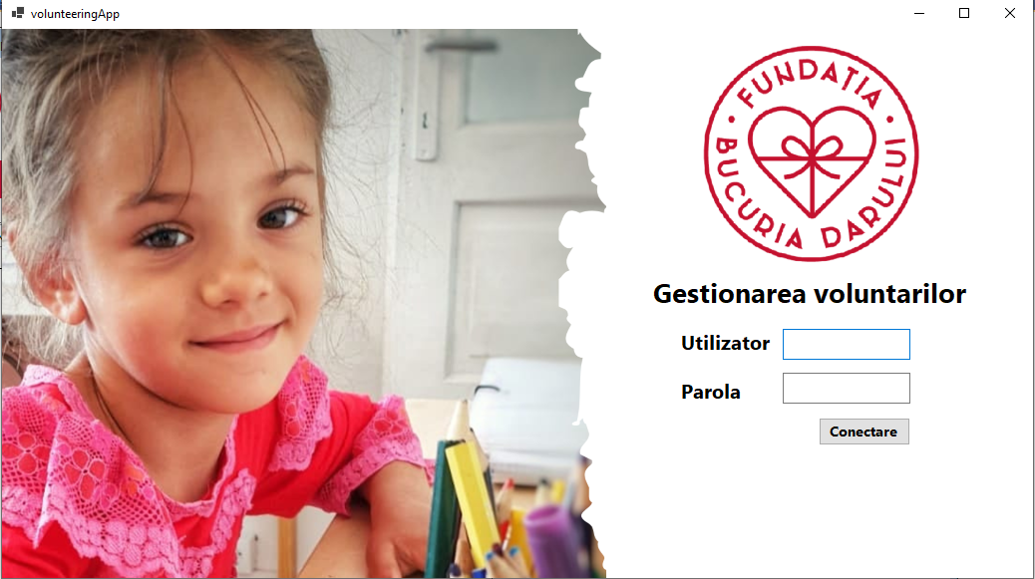

Demo

Slide 6
Current state & Next steps
Iteration 1
100%
Complete & usable for the client
Future iterations
Expand volunteer information
Extend filter/sorting options
Government reports
Store and auto-generate documents: GDPR, Job description, Contract)
0%

Slide 7

Together we multiply the joy.
THANK YOU!

