Slide 1
B&B and Relaxation
AI LAB
Shay Bushinsky

Slide 2
Branch and Bound
Iterate between two steps –
Branching – split the problem into a number of sub-problems (search space)
Bounding – find an optimistic estimate of the best solution to the sub-problem for maximization: upper bound
for minimization: lower bound

Slide 3
Relaxation
A technique to find admissible (optimistic) heuristics for solving problems using search
The general principle is to derive the heuristic by neglecting-ignoring key problem constraints

Slide 4
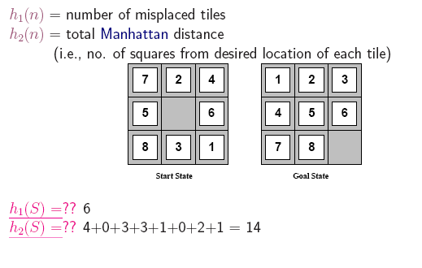
Relaxation examples: ignore blocking tiles: n-puzzle

Slide 5
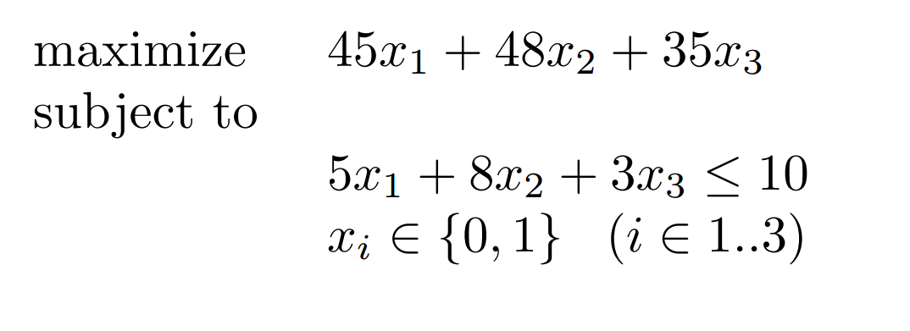
Knapsack problem

Slide 6
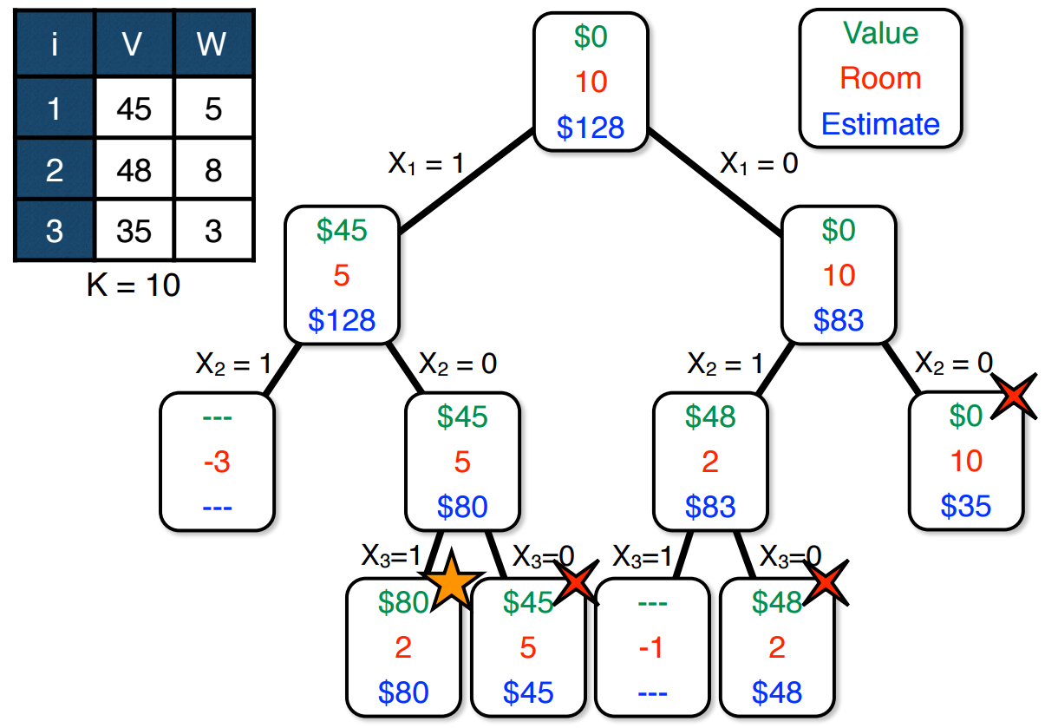
1. Relaxing Knapsack Capacity

Slide 7
2. Relaxing Integral item sizes
Select the items while the capacity is not exhausted – select a fraction of the last item filling the knapsack
Order the items by decreasing value of Vi/Wi – “most value per weight” - a notion of “density”

Slide 8
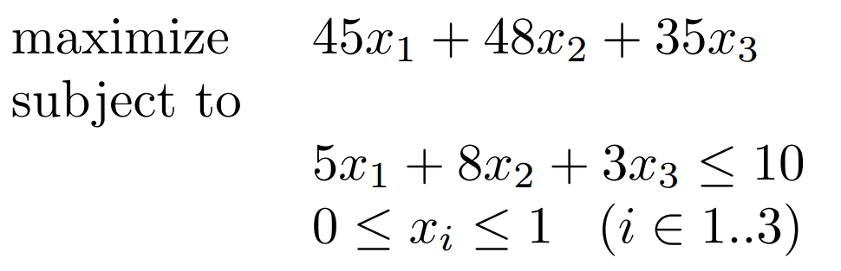
Reformulation

Slide 9
Solution
V1/W1 = 9, V2/W2 = 6, V3/W3 = 11.7
select items 3 and 1
select 1/4 of item 2
estimation: 92

Slide 10
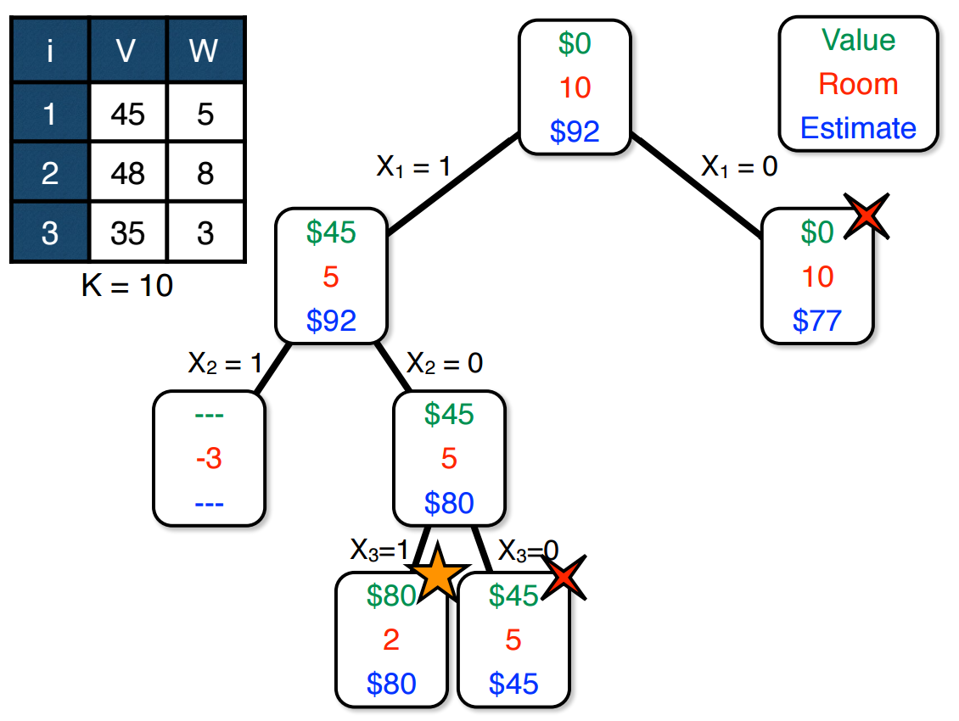
Results in more aggressive pruning

