Slide 1
The evolution of Intelligence By Shay Bushinsky
Experiments on the Baldwin effect with evolutionary computation:
the synergy between learning and evolution

Slide 2
Genetic learning capability
James Baldwin, 19th century psychologist
Research subject: Learning capability evolutionary advantages
How does learning capability facilitate the survival of the fittest?

Slide 3
The trivial explanation
He who learns avoids repeating mistakes
Thus survives longer
Thus has more chances to bread
Thus passes his “learning genes” to his successors
Too simplistic…

Slide 4
Genetics vs. Learning
There are toxic insects that use colors to warn predators.
Ver. 1: A bird avoids eating colorful insects because it is genetically programmed not to
Ver. 2: A bird links pain with eating colorful insects thus avoids eating them
(requires a learning experience…)

Slide 5
Genetics seems better
Learning experience can cause death
Learning requires energy – adding weight to the bird’s brain – making it more vulnerable
Genetics means automatic avoidance

Slide 6
But learning is more flexible…
He who is learning apt can better adjust to new circumstances
There is so much to learn…
Still, doesn’t it pay off to genetically code against toxic colorful birds?
Facts of life tend to remain constant across generations

Slide 7
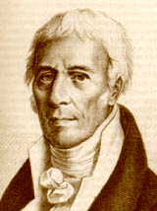
Lamarckian Evolution
Published Philosophie Zoologique, 1809
Inheritance of acquired characteristics i.e. Phenotypic changes passed to successive generations
Example: long legs and webbed feet of wading birds
Clearly a theory formulated in ignorance of genetic principles
Jean Baptiste Lamarck
1744-1829

Slide 8
Lamarck theory of evolution
Use and disuse – Individuals lose characteristics they do not require (or use) and develop characteristics that are useful.
Inheritance of acquired traits – Individuals inherit the traits of their ancestors

Slide 9
Lamarck’s conjecture
Lamarck proposed “one generation learning transfer” i.e. parent experiences are genetically coded and passed to the next
If it would be true, the next generation would’ve enjoyed all benefits of being able to cope with parent experience plus being able to cope with new experiences
Darwin believed in Lamarkian evolution although gave more weight to his own “natural selection” theory

Slide 10
"Lamarckism” examples
Giraffes stretching their necks to reach leaves high in trees (especially Acasias), strengthen and gradually lengthen their necks. These giraffes have offspring with slightly longer necks (also known as "soft inheritance").
A blacksmith, through his work, strengthens the muscles in his arms. His sons will have similar muscular development when they mature.

Slide 11
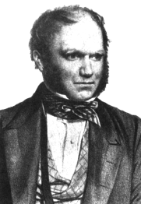
Darwinian Evolution
Published The Origin of Species, 1859
Acquired characteristics are not inherited by offspring
Evolution by natural selection: mutations in genotype, selection on phenotype
Theory has survived (though much has been added) because of basic foresight into correct genetic principles
Darwin
1809-82

Slide 12
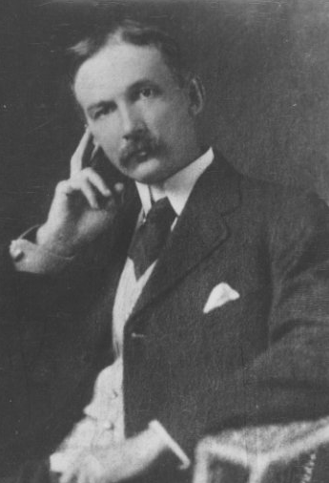
The Baldwin Effect
Discovered independently by Morgan, Osborn, and Baldwin in 1896
Experimental psychologist Baldwin was the only to follow up theory with devoted research
Suggested that an individual’s lifetime learning can guide evolution
After biology’s “rediscovery” of Mendelian Genetics in 1900, Baldwin Effect put on scientific back-burner
James Mark Baldwin
1861-1934

Slide 13
Baldwin effect on birds
1896 James Mark Baldwin - ‘A New Factor in Evolution’ – Lamarckian Inheritance is an illusion
A population of birds migrates to a new area where a toxic insect exists
If the birds hadn’t any learning capability – they would all perish
The learning capability “buys them time”
by facilitating that few of the birds survive

Slide 14
Phenotype and Genotype
Synergistic effect between organism’s flexibility (local) and evolution of population (global)
Concerned with the benefits and costs of lifetime learning in an evolving population
Baldwin Effect is purely Darwinian, but resembles Lamarkian evolution

Slide 15
Confirming the Baldwin Effect
The Hinton – Nowlan experiment (1987)
Demonstrated that:
“Learning alters the shape of the search space in which evolution operates and thereby provides good evolutionary paths”

Slide 16
Experiment principle
Allow changing the fitness of an individual without changing its genetic structure
Fitness is changed via local search

Slide 17
The Experiment
Built a simple “Neural Network” with 20 potential connections i.e. just above 1M possible connections
Every new creature was a 010001001…
Attempting to guess/evolve into the target creature “NN”
Each instance had 1000 attempts

Slide 18
Population of creatures
Neural net with 20 possible connections
Each organism has 20 genes representing connections:
0 = no connection
1 = connection
? = undetermined - learnable
Net only works in one exact configuration
Without Baldwin effect, GA performs no better than random search

Slide 19
Hinton & Nowlan Experiment Parameters
Used Holland’s GA
Population of 1000 organisms
Each allele randomly initialized with:
0.5 probability for ?
0.25 probability for 1 and 0
Each organism performs 1000 learning trials, stopping if correct net is found

Slide 20
Local Search
at each iteration, and for each individual, we conduct 1000 ‘local searches’ – each local search consists of copying the individual’s fixed bits to a new string, and filling in random bits where the unfixed ‘?’ characters are in the individual’s string. The resulting string is then compared to the target string – if they are equal, we stop our local searches, otherwise we continue.

Slide 21
Positive Fitness
After the search has stopped by exhaustion of our 1000 tries or by success, we count the number 𝑛 of tries we didn’t use – such that if an individual was able to guess the target string after 300 tries, 𝑛 would be 700, and if it wasn’t able to in all 1000 attempts, 𝑛 would be 0. We then assign the individual a fitness rating given by: 𝑓=1+(19𝑛/1000)

Slide 22
Learning effects selection
Next generation created with 1000 matings;
parents chosen with probability of selection proportional to:
1+(19*n/1000)
where n is number of remaining learning trials
Therefore, immediate learners (n=1000) are 20 times as likely to be chosen than non-learners by RWS

Slide 23
Example
Set n the number of iterations you didn't need to find the target now f = 1 + (19 * n / 1000)
so an extremely quick learner didn't use the entire 1000 and thus n = 1000 and his f =20
A medium learner found it after 400 tries and thus n = 600 and f = 11.4

Slide 24
The Baldwin effect observed
After 50 generations: the correct fixed 25% has risen to 60%
The incorrect fixed connections dropped from 25% to 0
The average creature survival had risen from a low to 90%

Slide 25
Example
if our target were ‘000111’ then the string ‘0??011’ will have a correct fixed position percentage of 3/6=50% and an incorrect fixed position percentage of 1/6=16.67%

Slide 26
The virtual Baldwin effect
Learning facilitated evolution
The number of “learnable connections” decreased over generations

