Slide 1
Genetic Algorithms
Evolutionary Methods
By Shay Bushinsky

Slide 2
SELECTION STRATEGIES

Slide 3
Selection
Selection occurs in two places:
Selection from current generation to take part in mating (parent selection)
Selection from parents + offspring to go into next generation (see survivor selection section)

Slide 4
Selection Pressure
There are two competing factors that need to be balanced in the selection process, the selection pressure and genetic diversity.
Selection pressure, the tendency to select only the best members of the current generation to propagate to the next, is required to direct the GA to an optimum.

Slide 5
Genetic Diversity
Genetic diversity, the maintenance of a diverse solution population, is also required to ensure that the solution space is adequately searched, especially in the earlier stages of the optimization process.

Slide 6
The tradeoff
Too much selective pressure can lower the genetic diversity so that the global optimum is overlooked and the GA converges to a local optimum. Yet, with too little selective pressure the GA may not converge to an optimum in a reasonable time.
A proper balance between the selective pressure and genetic diversity must be maintained for the GA to converge in a reasonable time to a global optimum.

Slide 7
Naïve Parent Selection
As in coded example: take parents from upper half of the population
Also dubbed: Truncation Selection

Slide 8
Major Selection Strategies
Fitness proportional
Tournament
Threshold selecting

Slide 9
1. Fitness proportional (parent) selection methods

Slide 10
RWS - ROULETTE WHEEL SELECTION

Slide 11
Parent selection
Expected number of copies of an individual i:
E( n_{i} ) = μ • f(i) / <f>
(μ = pop.size, f(i) = fitness of i, ⟨f⟩ avg. fitness in pop.)

Slide 12
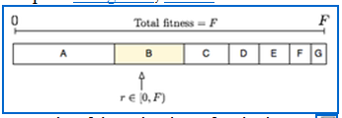
Roulette wheel algorithm
Also known as FPS – Fitness Proportional Selection
Given a probability distribution, spin a 1-armed wheel n times to make n selections
No guarantees on actual value of n_{i}

Slide 13
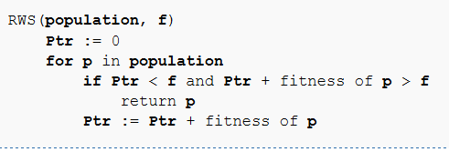
RWS
Inefficient code for illustration:

Slide 14
RWS problems
One highly fit member (“super hero”) can rapidly take over if rest of population is much less fit:
Premature Convergence
At end of runs, when the fitness of genes become similar, lose selection pressure
Highly susceptible to function transposition

Slide 15
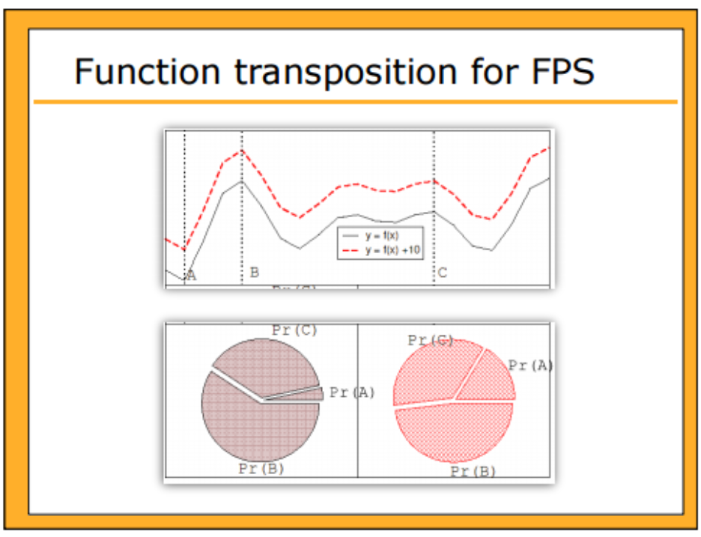

Slide 16
FITNESS PROPORTIONAL SCALING METHODS

Slide 17
Scaling can fix last two RWS problems
Windowing : For each subject, reduce its fitness by the fitness of the worst subject.
This permits to strengthen the strongest subject and to obtain a zero based fitness distribution.
  Windowing: f’(i) = f(i) - β ^{t}
    where β is worst fitness in this (last n) generations

Slide 18
Exponential scaling
Exponential: This method, proposed by S.R. Ladd, consists in taking the square roots of the fitness plus one.
This permits to reduce the influence of the strongest subjects – hence reduce selection pressure.

Slide 19
Sigma scaling motivation
Sigma scaling: Like rank selection (explained later), Sigma Scaling attempts to moderate selection pressure over time so that it is not too strong in early generations and not too weak once the population has stabilized and fitness differences are smaller.

Slide 20
Sigma scaling
The standard deviation of the population fitness is used to scale the fitness scores so that selection pressure is relatively constant over the lifetime of the evolutionary program.
Sigma Scaling:
f’(i) = max( f(i) – ⟨ f ⟩ / c • σf , 1.0)
    where c is a constant, usually 2.0

Slide 21

Sigma scaling example
The expected value of an individual i at time t as a function of its fitness, the population’s mean fitness at time t and the populations standard deviation at time t

Slide 22
Linear transformation
Linear Transformation: Apply a linear transformation to each fitness, i.e. f ' = a*f + b. The strongest subjects are once again reduced.
a and b are constants defined by the user. Values of a and b are usually tied to specific characteristics of the population e.g. min/max fitness.

Slide 23

Top scaling
Top scaling is probably the most simple scaling method. Using this approach, several of the top individuals have their fitness set to the same value (which is proportional to the population size), with all remaining individuals having their fitness values set to zero. This simple concept yields

Slide 24
Top scaling
Where s is some proportionality constant, c is the number of individuals that will be scaled up, and N is the size of the population.
Since this gives several individuals identical fitness levels, regardless of how different their raw scores might be, the diversity of the succeeding generations is increased.

Slide 25
Summary of proportional scaling methods
Scaling is needed to increase gene diversity (differentiate between similar genes)
Linear: according min/max fitness
Sigma truncated: use the population variance (zeroing weak genes)
Top + Sharing: (fitness sharing) weaken fitness of similar genes

Slide 26
SUS - STOCHASTIC UNIVERSAL SAMPLING

Slide 27
SUS Motivation
If we have an individual that occupies 4.5% of the wheel and we select 100 individuals, we would expect on average for that individual to be selected between four and five times.
Stochastic Universal Sampling guarantees this. The individual will be selected either four times or five times, not three times, not zero times and not 100 times…

Slide 28
SUS Explained
Works by making a single spin of the roulette wheel.
This provides a starting position and the first selected individual. The selection process then proceeds by advancing all the way around the wheel in equal sized steps, where the step size is determined by the number of individuals to be selected

Slide 29
SUS Explained
So if we are selecting 30 individuals we will advance by 1/30 x 360 degrees for each selection. Note that this does not mean that every candidate on the wheel will be selected. Some weak individuals will have very thin slices of the wheel and these might be stepped over completely depending on the random starting position.

Slide 30
Baker’s SUS algorithm
A FPS method
One spin instead of N (1 sample)
Reduces bias by giving weaker members a chance to be chosen

Slide 31
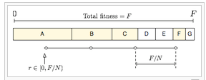
Baker’s SUS algorithm
SUS starts from a small random number, and chooses the next candidates from the rest of population remaining, not allowing the fittest members to saturate the candidate space (N = number of offsprings to keep)

Slide 32
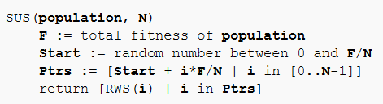
Baker’s SUS algorithm
  n evenly spaced arms on wheel and spin once
  Guarantees floor(E( n_{i} ) ) ≤ n_{i} ≤ ceil(E( n_{i} ) )
Stochastic universal sampling
Notes:
Less stochasticness

Slide 33
2. TOURNAMENT SELECTION

Slide 34
Tournament selection
Informal Procedure:
  Pick k members at random then select the best of these
  Repeat to select more individuals

Slide 35
Tournament selection
Probability of selecting member i depends on:
  Rank of i
  Size of sample k
    A higher k increases selection pressure
  Whether contestants are picked with replacement
    Picking without replacement increases selection pressure
  Whether fittest contestant always wins (deterministic) or this happens with probability p
For k = 2, time for fittest individual to take over population is the same as linear ranking with s = 2 • p

Slide 36
Tournament selection cons
Relies on global population statistics
  Could be a bottleneck especially in parallel implementation
  Relies on the presence of an external fitness function which might not exist: e.g. evolving game players

Slide 37
FITNESS RANKING

Slide 38
Linear normalization
Linear normalization : Fitness are linearized. For example over a population of 10 subjects, the first will get 100, the second 90, 80 ... The last will get 10.

Slide 39
Linearization = Ranking
Even if the differences between the subjects are very strong, or weak, the difference between probabilities of reproduction depend only on the ranking of the subjects

Slide 40
Ranking
Attempt to remove problems of FPS by basing selection probabilities on relative rather than absolute fitness
Rank population according to fitness and then base selection probabilities on rank where fittest has rank μ and worst rank 1
This imposes a sorting overhead on the algorithm, but this is usually negligible compared to the fitness evaluation time

Slide 41
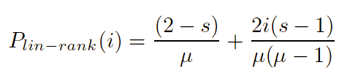
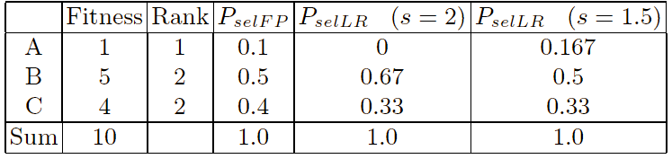
Linear Ranking
Parameterized by factor s: 1.0 < s ≤ 2.0
  measures the advantage of best individual
  in SGA this is the number of children allotted to it
A simple 3 member example:
021

Slide 42
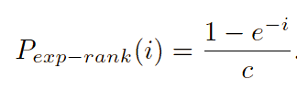
Exponential ranking
Linear Ranking is limited to selection pressure
Exponential Ranking can allocate more than 2 copies to fittest individual
Normalize constant factor c according to population size

Slide 43
Summary of effects
Windowing eliminates the weakest subject - the probability comes to zero - and stimulates the strongest ones (the best one jumps from 50% to 67%).
Exponential flattens the distribution. It's very useful when a super-subject induces an excessively fast convergence.
Linear transformation plays slightly the same role as exponential.
Linear normalization is neutral towards the distribution of the fitness and only depends on the ranking. It avoids as well super-subjects as a too homogeneous distribution.

Slide 44
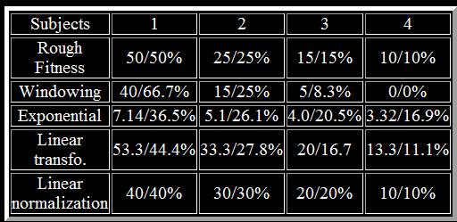
Example

Slide 45
3. Threshold selecting

Slide 46
Threshold selecting algorithm
Uniform probabilities are assigned to a group of the best individuals of the population
Probabilities equal to zero to individuals with fitness ranks higher than a fixed cutoff γ, which is equal to a certain rank in the sorted fitness vector
Note: the cutoff ranks γ to be used is not known a priori

Slide 47
Finding γ
Perform numerical experiments comparing different possible distributions empirically
Introduce a schedule on the cutoff rank γ, narrowing the rectangular distribution during the optimization process and thus increase the evolutionary pressure gradually

Slide 48
Survivor Selection Methods

Slide 49
Survivor selection
Two approaches:
  Age-Based Selection
    e.g. SGA
    In SSGA can implement as “delete-random” (not recommended) or as first-in-first-out (a.k.a. delete-oldest)
  Fitness-Based Selection
    Using one of the FPS selection methods or Elitism

Slide 50
AGING Model
A concept of age of individuals for measuring their suitability for participation in genetic operations
Effective fitness of an individual depends both on its functional value and age.
Age of a newly generated individual is taken as zero and every iteration is increased by one

Slide 51
AGING: Seniors fit for reproduction
As in nature, adult individuals are considered more fit for genetic operations, compared to young and old ones.
The model aims to emulate the natural genetic system in a more natural way.

Slide 52
Replacement strategies
Replace most similar gene
Replace worst genes

Slide 53
Fitness-Based Survivor Selection
Elitism
  Widely used in both population models (SGA, SSGA)
  Moto: always keep at least one copy of the fittest solution so far

Slide 54
GENITOR
Reproduction produces one offspring at a time
The offspring is immediately placed back into the population replacing the least fit member
Fitness is computed according to rank rather than proportional to maintain constant selection pressure

Slide 55
Fitness-Based Survivor Selection
GENITOR: a.k.a. “delete-worst”
  From Whitley’s original Steady-State algorithm (he also used linear ranking for parent selection)
  Rapid takeover : use with large populations or “no duplicates” policy

Slide 56
Diversity Quality tradeoff
De Jong strategy: newborns replace the most similar genes to them
Derating – reduce the fitness of similar genes

Slide 57
ALGORITHM OBJECTIVES

Slide 58
Aspirations
Optimality (find global optima)
Completeness (find all solutions)
Fast convergence
Reasonable running time

Slide 59
FIGHTING LOCAL OPTIMA

Slide 60
Local optima signals
Diversity is important since crossing over a homogeneous population does not yield new solutions.
The remedy is problem dependent.
Signals:
  Gene similarity
  Generation fitness average and standard deviation
Notes:
Diversity is not a great factor in Evolutionary Strategies because they have greater reliance on the mutation operator.

Slide 61
Combat early convergence
Triggered hyper-mutation - increase the probability of mutation when the solution quality drops
Use selection techniques
impose a "niche penalty", individuals of sufficient similarity (niche radius) have a penalty added
Random immigrants -occasionally introducing entirely new, randomly generated elements into the gene pool
Exaptation (or preadaptation) - evolution may progress through a multi fitness landscape (“wings for cooling later for flying”)

Slide 62
MUTATION STRATEGIES

Slide 63
MUTATION CONTROL
Basic mutation operator: Change each individual gene value according to a certain probability. The method is easy for operating, but it cannot effective control to mutation result.
Non-uniform mutation: Mutation probability is greater early in the evolution, with the evolution advancing mutation probability appropriate to reduce.

Slide 64
MUTATION CONTROL
Adaptive Mutation: An individual with high fitness correspond to a smaller mutation probability, and individuals with low fitness corresponds to a high mutation probability. This method can effectively protect the excellent individuals, but it is easy to fall into local convergence.

Slide 65
TECHNIQUE 3 NICHING

Slide 66
Fitness Sharing
Transforms the raw ﬁtness of an individual into the shared one (usually lower).
Motivation: there is only limited and ﬁxed amount of “resources” (i.e. ﬁtness value) available at each niche.
Individuals occupying the same niche will have to share the resources.

Slide 67
Distance between instances
The similarity between two individuals is deﬁned by the distance between them – denoted dij.
For example, the similarity between two binary strings can be deﬁned by their Hamming distance

Slide 68
σ Sharing Radius parameter
Sharing radius, σ-share, deﬁnes the niche size. Individuals within this radius will be regarded as being similar to each other and thus need to share ﬁtness.

Slide 69
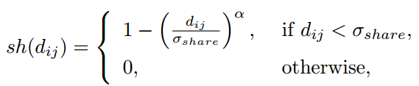

Sharing function and shared fitness
Define a sharing function:
Based on it the shared fitness is defined as:
Where μ denotes the population size
α is a constant – usually equals 1
Notes:
dij is a matrix on the entire population

Slide 70
The Sharing effect
Discourage convergence to a single region of the fitness function. The more individuals try to move in, the worse off they all are.
If the GA converges to a single local optimum somewhere, the fitness of that optimum decreases because of the increased competition within the niche.
Eventually, another region of the fitness landscape becomes more attractive, and individuals migrate over there.
The idea is to reach a steady state -- a fixed point in the dynamics -- where an appropriate representation of each niche is maintained.

Slide 71
Critique
Sharing is hard because of the need to manually set the niche radius, and the algorithm is quite sensitive to this choice

Slide 72
Deterministic Crowding
Instead of dealing with an explicit radius, we work by limiting the set of individuals that a new offspring can replace to some set of similar solutions
For example an offspring might be allowed to replace only one of its parents.
The effect is to try to prevent replacing a unique individual with one that is very similar to a dozen others in the population and thus to preserve diversity that way.

Slide 73
Technique 4 Random immigrants
No. of individuals undergoing migration
Frequency of migrations
Policy of selecting immigrants
Immigrant replacement policy
Topology of communication amongst islands
Nature of island communication (synchronous / asynchronous)

Slide 74
Multi objective functions
Multi-objective optimization problems involve two and three objectives
Optimal decisions need to be taken in the presence of trade-offs between two or more conflicting objectives.
Ex: Minimizing cost while maximizing comfort while buying a car

Slide 75
Pareto Optimal
For a nontrivial multi-objective optimization problem, there does not exist a single solution that simultaneously optimizes each objective.
In that case, the objective functions are said to be conflicting, and there exists a (possibly infinite) number of Pareto optimal solutions.
A solution is called Pareto Optimal, if none of the objective functions can be improved in value without degrading some of the other objective values.
Without additional subjective preference information, all Pareto optimal solutions are considered equally good (as vectors cannot be ordered completely).

Slide 76
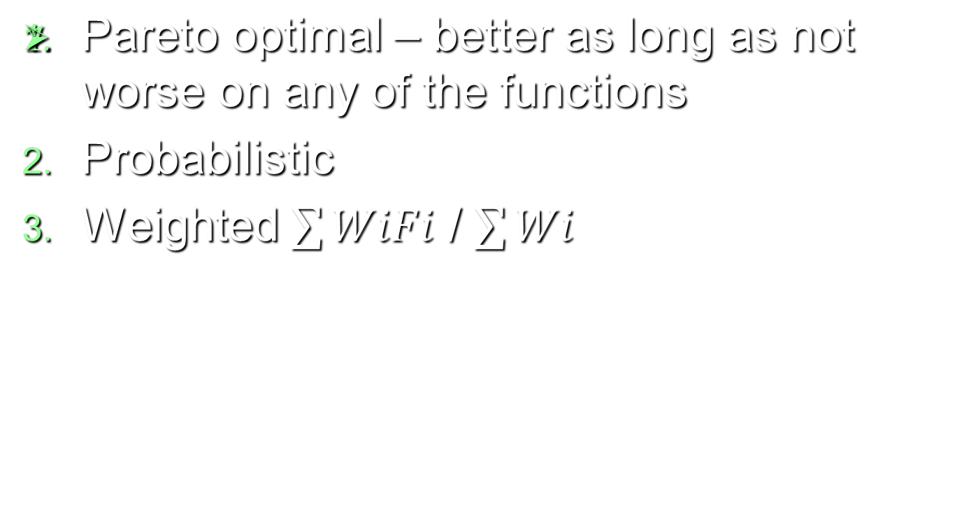
Technique 5 Multiple Objective functions

Slide 77
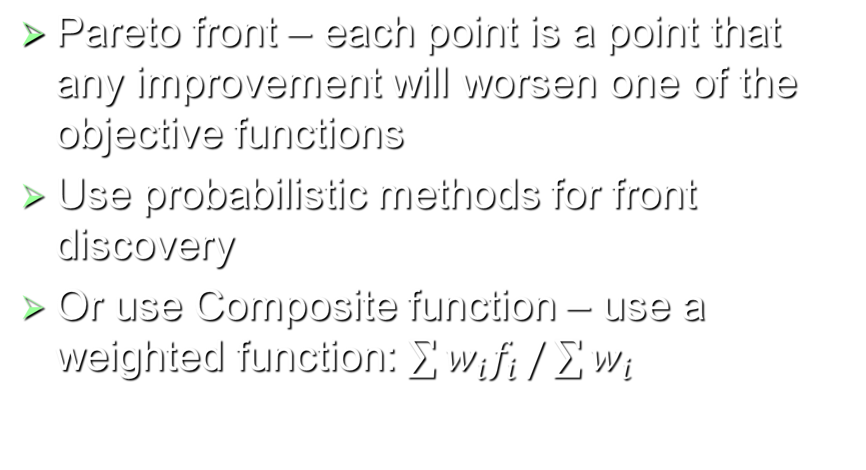
Technique 5 Multiple Objective functions

