Slide 1

Local Search Algorithms
Iterative Improvement Search
Notes:
Copyright © Shay Bushinsky

Slide 2
Iterative Improvement Search
Another approach to Search:
  Start with some guess about the goal
  Continue to improve it until real goal is reached
  OR: Start with a sub optimal solution and strive to reach an optimal one

Slide 3
CSP
Start with a non feasible configuration and strive to reach a feasible one

Slide 4
Typical Problems
Intended for NP-Complete problems:
  Large combinatorial solution space
  No apparent algorithm
  Easy to verify the solution correctness
Discrete optimization problems:
  Graph coloring
  TSP
  Scheduling
  Resource optimization
Effective in spaces with a lot of local optima

Slide 5
Candidate Problems for Local Search
Problems that may not have an obvious “goal test” or “path cost”
In some problems the “path to the goal” is not important - optimization problems – the goal is important

Slide 6
Real Local search problems
N-Queens
VLSI circuit planning
Job Shop Scheduling
Optimizing Communications
Portfolio Management

Slide 7
Local search benefits
Little memory consumption – current best state or few states only
Cope better with large problem spaces where systematic search does not lead anywhere
suitable for online as well as offline search

Slide 8
Configuration states
state space = set of “complete” configurations;
find optimal configuration, e.g., TSP
find configuration satisfying constraints, e.g., timetable, i.e. CSP

Slide 9

The hill climbing family
Classical hill climbing
Steepest ascent
Stochastic hill climbing

Slide 10
Hill Climbing Algorithm
Add a heuristic to “generate and test:”
1 Evaluate the initial state - if it is goal state quit, otherwise current state is initial state.
2 repeat :
  3 select a new operator for this state and generate a new state.
  4 evaluate the new state
    A) if it is closer to a goal state than current state, make it the current state
    B) if it is no better – ignore it
5 until the current state is a goal state or no new operators available

Slide 11
Steepest Ascent Hill Climbing
This algorithm differs from the basic Hill climbing algorithm by choosing the best successor rather than the first successor that is better.
This indicates that it has elements of the breadth first algorithm.

Slide 12
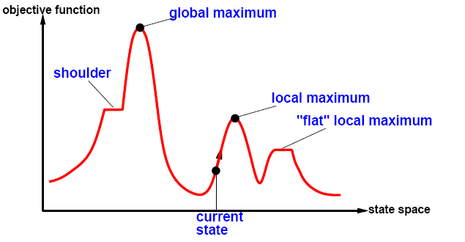
Iterative improvement methods
Employing a global search heuristic function on the search space

Slide 13
Definition of Local Minima
A sub-optimal (or in-feasible) state in the search space which cannot be improved
Let c be a configuration
Let N(c) be a neighborhood of c
Let f be an objective function or a constraint minimization function (we strive for f(x)->0), C is local minima iff for every nἐN(c) f(n)>=f(c)

Slide 14
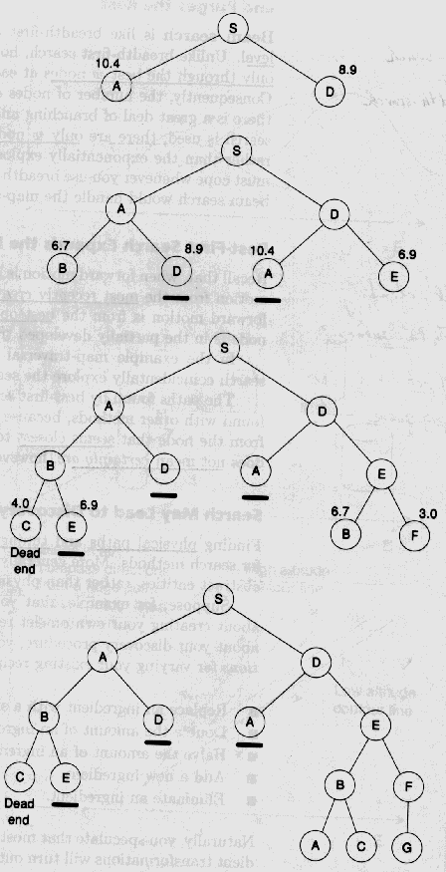
Hill Climbing Beam Search
Keep track of K states rather than just one
Their heuristic value reflects how close is the node to target
• Start with K randomly generated states
• Stop if any goal state
• Multiple Successors generated for each of the k states
• Choose top K successor states in next cycle
• Example with k=2 - strives to find goal G where numbers denote distance to goal

Slide 15
Overcoming Greed
Beam search is rather fast o(b*d) economic in space o(k) but not complete nor optimal
Susceptible to local optima
Solution: add non determinism to encourage diversity

Slide 16
Stochastic Beam Search
Like beam search, but probabilistically choose the k nodes at the next generation.
The probability that a neighbor is chosen is proportional to its heuristic value.
Like asexual reproduction: each node gives its mutations and the fittest ones survive.

Slide 17
GENETIC ALGORITHMS

Slide 18
Discrete Optimization problems
A set of parameters – genomes or chromosomes
A function combining them to a single value – the fitness function
A set of constraints on the parameters – incorporated in the fitness function
Goal: find the parameters that maximize / minimize the fitness function subject to the constraints

Slide 19
Extending Beam Search
Like stochastic beam search, but pairs of nodes are combined to create the offspring:
For each generation:
  Randomly choose pairs of nodes where the fittest individuals are more likely to be chosen.
  For each pair, perform a cross-over: form two offspring each taking different parts of their parents:
  Mutate some values
  Report best node found.

Slide 20
Genetic Algorithms
The Key Questions:
  –What is the fitness function?
  –How is an individual represented?
  –Which individuals survive?
  –How are individuals selected?
  –How do individuals reproduce?

Slide 21
Representations
Fixed length string
  Bit string (over a binary alphabet)
    mapping of the SAT problem
    Graph coloring – 2 bits represent a color
  Over a small alphabet
    A string over {C,G,A,T}
Variable length string
  Rules
Vector of real numbers
  Optimize f(x) – find a solution x=0.B1B2B3…Bn e.g. maximize f(x)=sin(2Pix^3)sin(25x) 0<x<1
Permutations
  N queens
  TSM cities
Lists
Trees
  Lisp programs
Notes:
Biological terminology is often used for this representation.
A locus is a string position, and an allele is the symbol in that string position.

Slide 22
LIFE
Depends on 20 proteins – amino acids
Each human cell needs protein which is encoded in its DNA and produced by its Ribosome
Each cell nucleolus consists of 23 chromosomes that form the genome of the individual: genotype
Each chromosome encodes four amino acids {A, C, G, T}

Slide 23
Typical representation
Find the maximum of the parabolic function: 31p-p^2 0<p<31
Genome: p’s range can be represented by 5 bits: 0-31
The function gets its maximum at 15 and 16 coded 10000 and 01111

Slide 24
Random initial population
Genome | P | fitness
10110 | 22 | 198
00011 | 3 | 84
00010 | 2 | 58
11001 | 25 | 150
The average population fitness is 128.5 which is pretty close to the goal but will be improved in future generations

Slide 25
Lists representation
Lists data structure for genes:
  Mutations: add/delete a node in the list
  Recombination: exchange a node sequence:
  Single point/uniform crossover

Slide 26
GA parameters
Reproduction:
  Single offspring
  Two children
Persistency:
  None
  Elitist survival
Population ranking:
  Fitness ranking – skewed by super heroes
  Ordinal ranking – a more even distribution
Selection method:
  Roulette (proportional)
  Tournament - select randomly k individuals from the population and compare their fitness. The one with the best fitness is allowed to mate

Slide 27
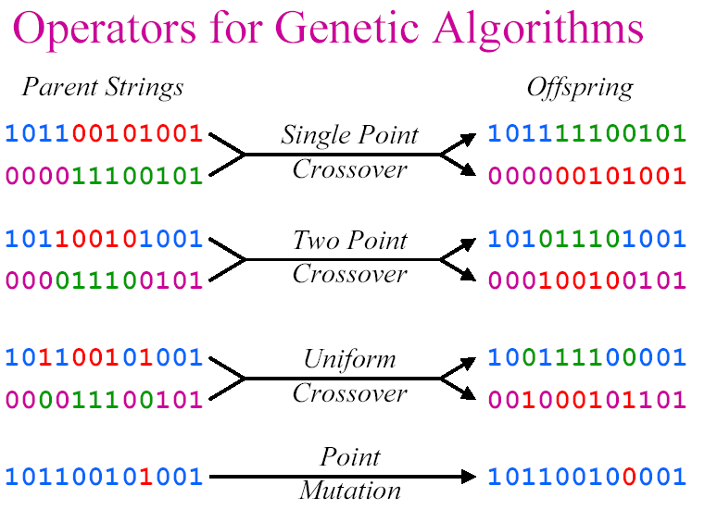
Reproduction Operators

Slide 28
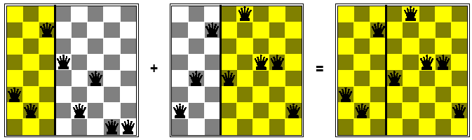
Single point cross over

Slide 29
The Genetic Algorithm Input
The fitness function
A threshold defining an acceptable level of fitness for terminating the algorithm
The size of the population
Generation parameters
  the fraction of the population that reproduces
  the mutation rate

Slide 30
Population size (p)
The population size value indicates the number of chromosomes in the first generation.
This number is constant through out the run of the program.
A small population size value will run faster in real time, but will take more generations to properly evolve.

Slide 31
Crossover rate (r)
Crossover rate can be defined as the percentage specifying the fraction of
selected pairs that undergo crossover.
In most applications, this rate is very high, over 2/3rds. Or less than 1/3rd move on to the next generation…
A 100% crossover rate, means that crossover always takes place.

Slide 32
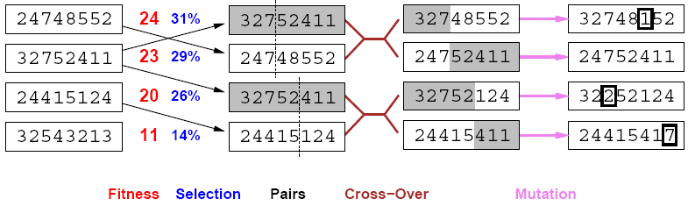
stochastic local beam search + generate successors from pairs of states

Slide 33
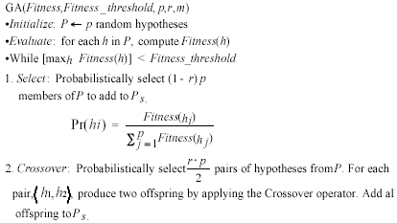
The Genetic Algorithm

Slide 34
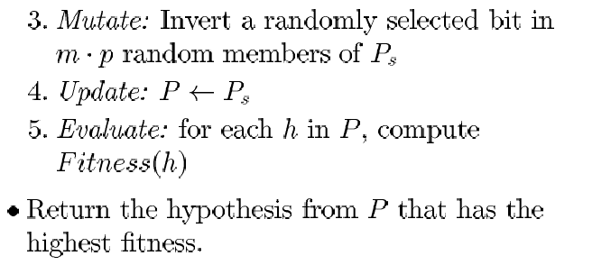
The Genetic Algorithm

Slide 35
Termination Criteria
A solution is found that satisfies minimum criteria
Fixed number of generations reached
Allocated budget (computation time/money) reached
The highest ranking solution's fitness is has reached a plateau
Manual inspection
Combinations of the above

