Slide 1

uBox
Yuval Alfassi Ilan Godik

Slide 2


Nowadays Cloud Services
Size Limitations
Server failures and DDos vulnerability

Slide 3


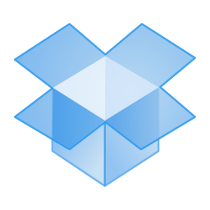
The Solution - uBox
Peer to peer
No central server
Torrent like protocol

Slide 4
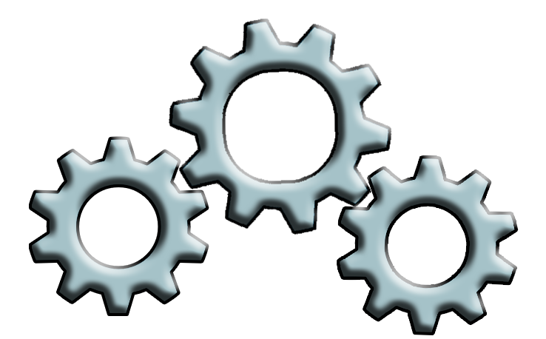
Technique
Windows Explorer
User
IPFS

Slide 5
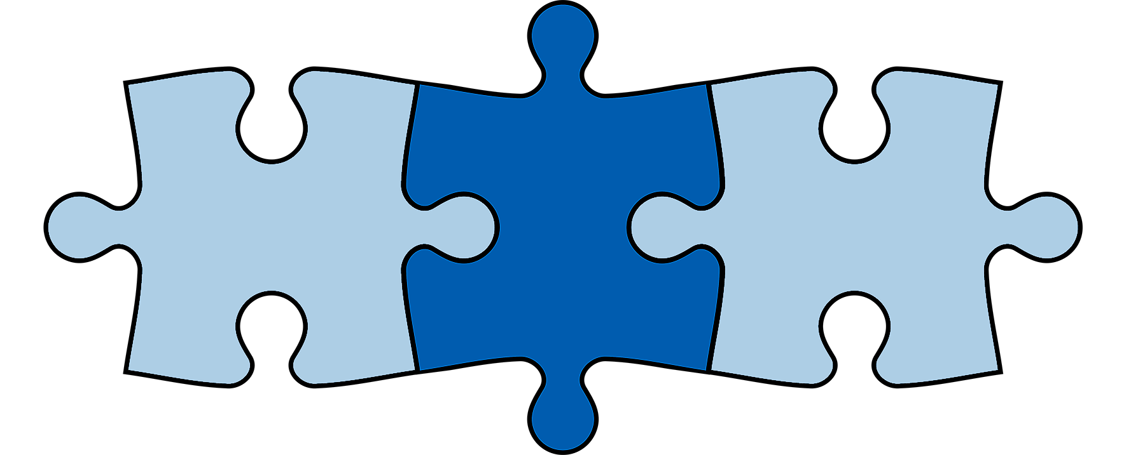
User Experience
Windows explorer drive
Can follow or clone other drives
Taskbar icon

Slide 6

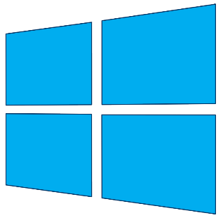
Technologies
IPFS
WPF
Windows
Dokan

Slide 7

Challenges
Concurrency Race Conditions
Interprocess Communication
Registry Manipulations
Notes:
Concurrency race conditions – it can come from nowhere - corrupted data.. multidimantionality
Interprocess communictation – lots of processes running – used TCP on LocalHost
Registry manipulation – right click, taskar icon, icon overlay
------------
Blue screen of death story. Buggy code causes blue screen. Formatted computer twice. Advice: Implement on Virtual Machine

Slide 8
Questions?
?

Slide 9
Peer to peer Explanation

Slide 10
Screenshots of GUI
(זכוכית מגדלת לדברים הרלוונטיים)

Slide 11
סרטון הדגמה אם יש או מעבר לדוגמית הרצה

Slide 12
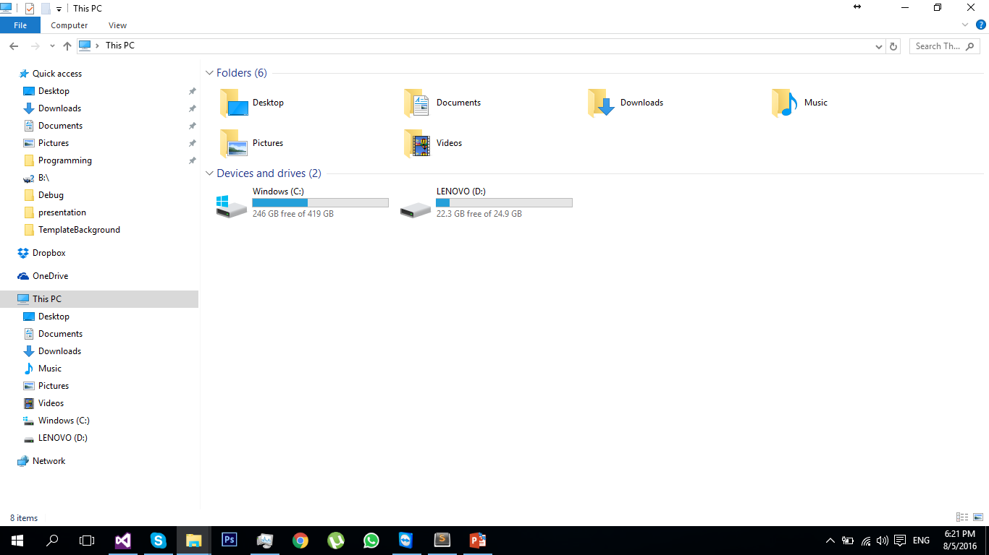
Only C and D drives exist

Slide 13
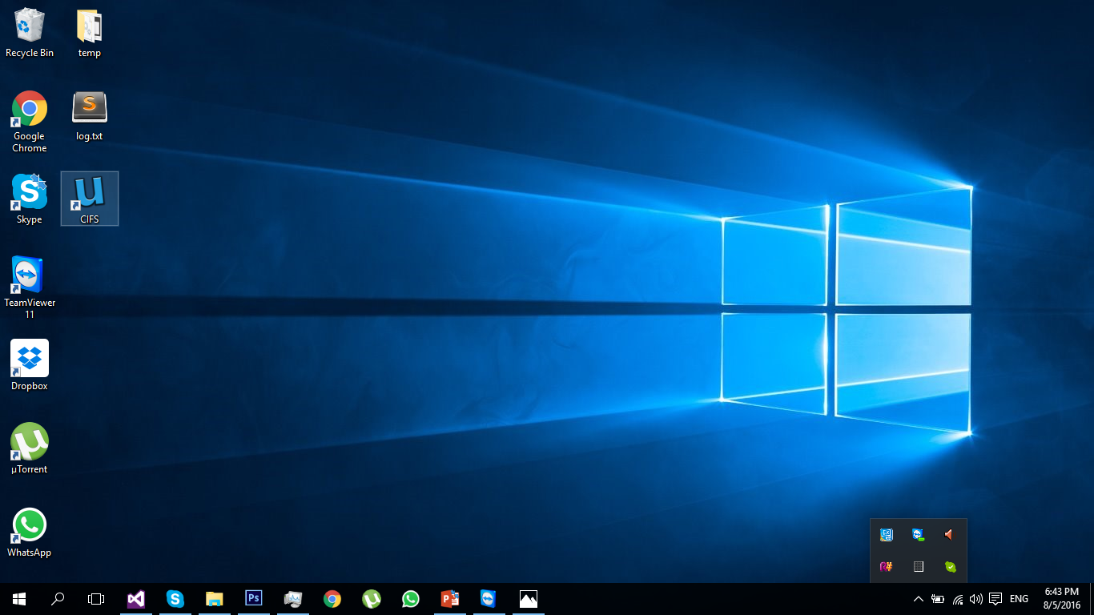
Window’s Desktop
Double-Click uBox’ icon

Slide 14
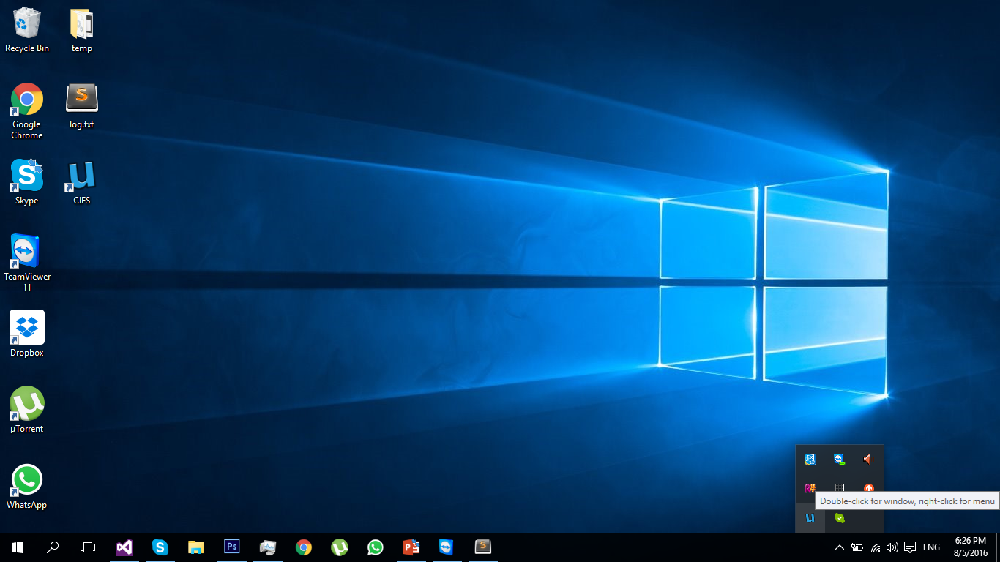
uBox’ taskbar icon have appeared. Click it

Slide 15
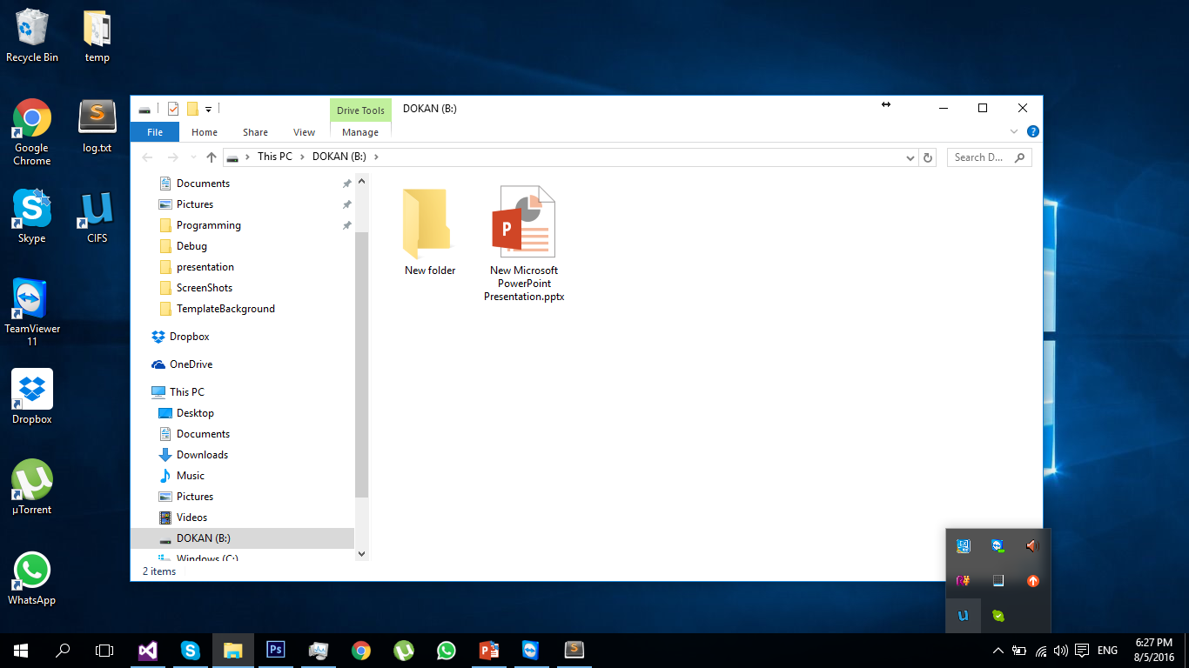
uBox’ drive have appeared

Slide 16
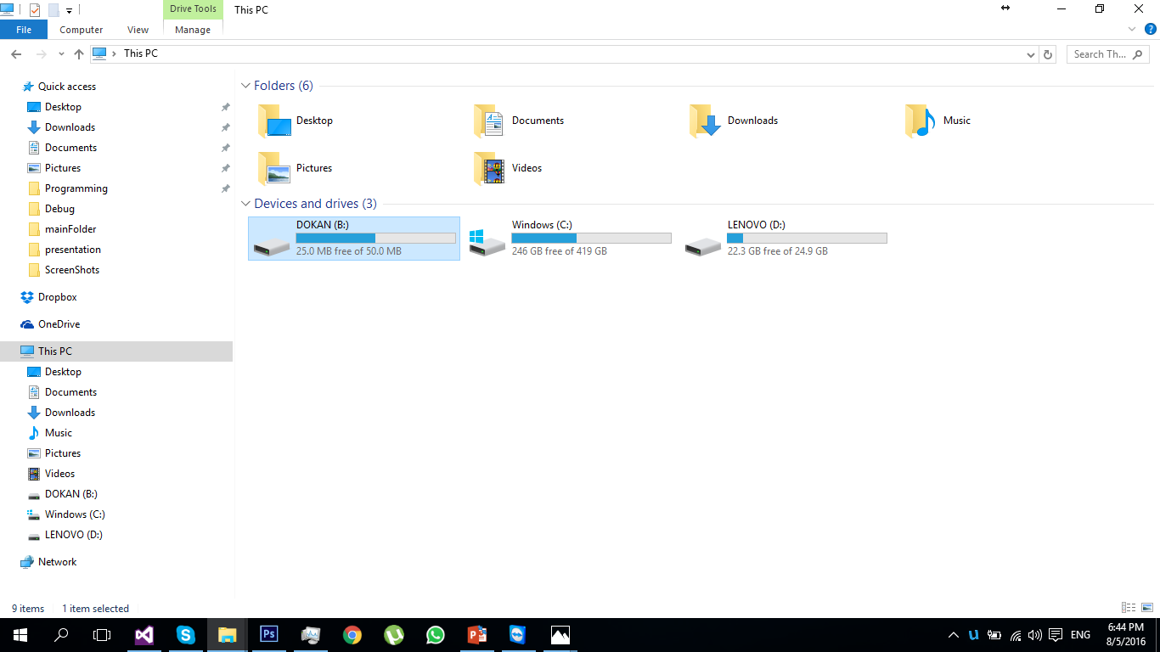
uBox drive

Slide 17
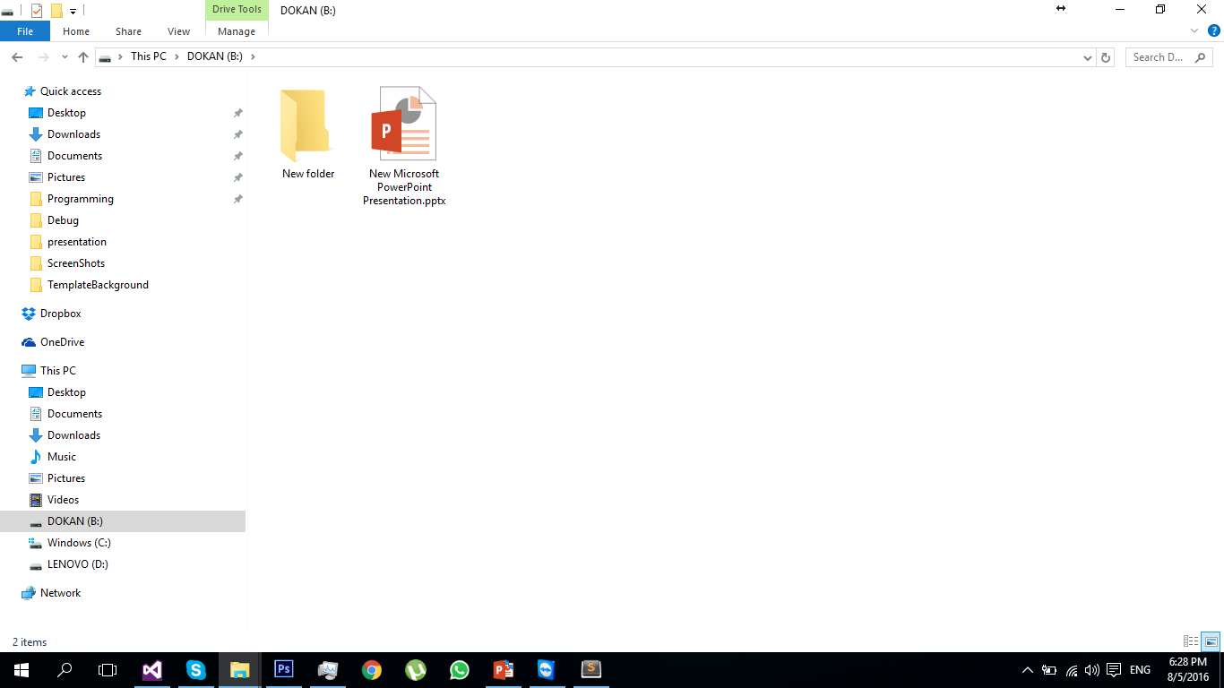
Files are automatically synced

Slide 18
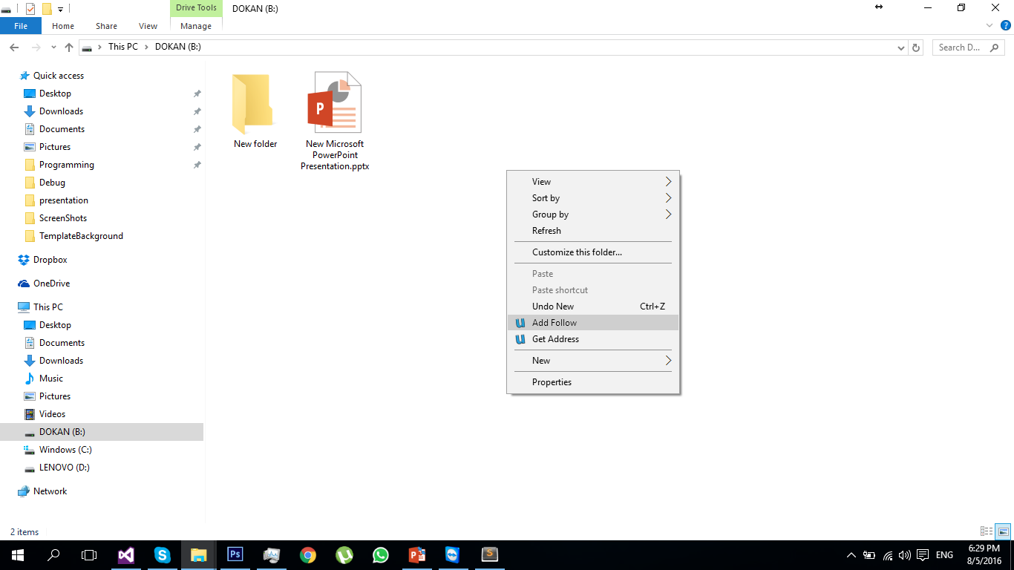

Left click $→$ Add follow

Slide 19
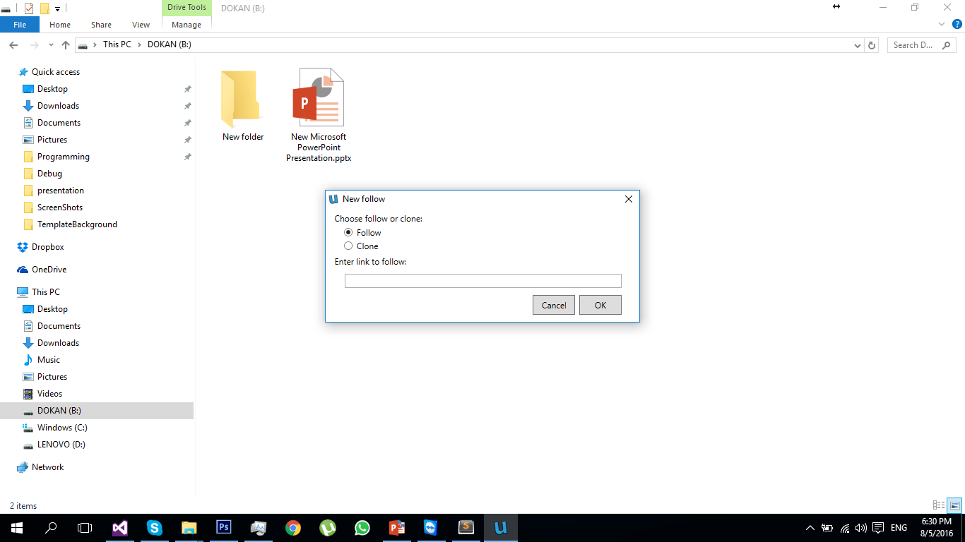
Clone or follow other drives

Slide 20
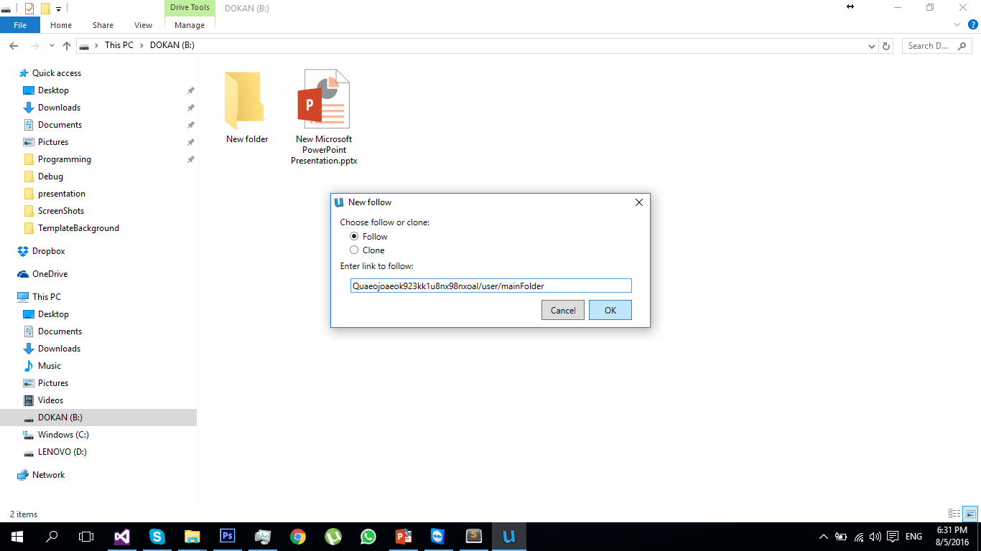
Clone or follow other drives

Slide 21
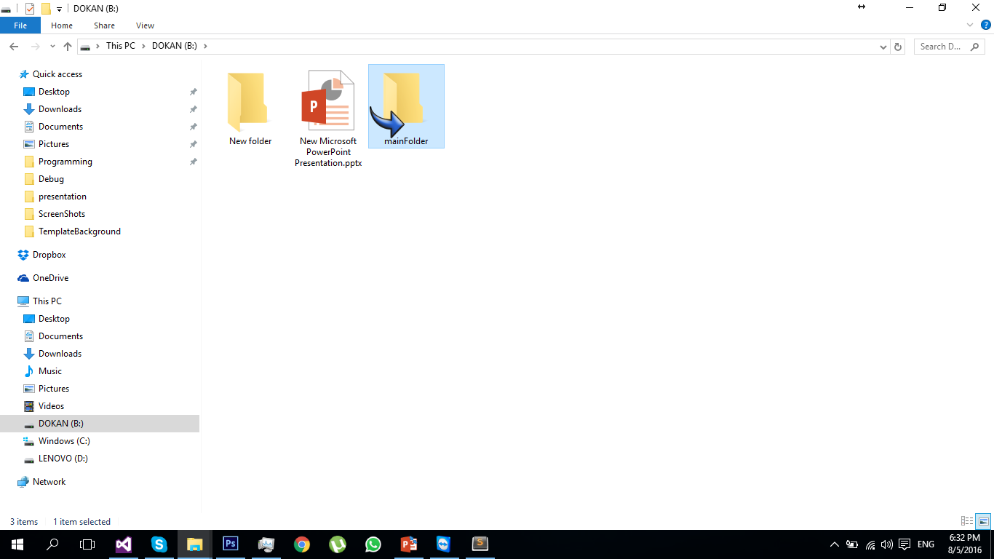
Followed folders are read-only

Slide 22
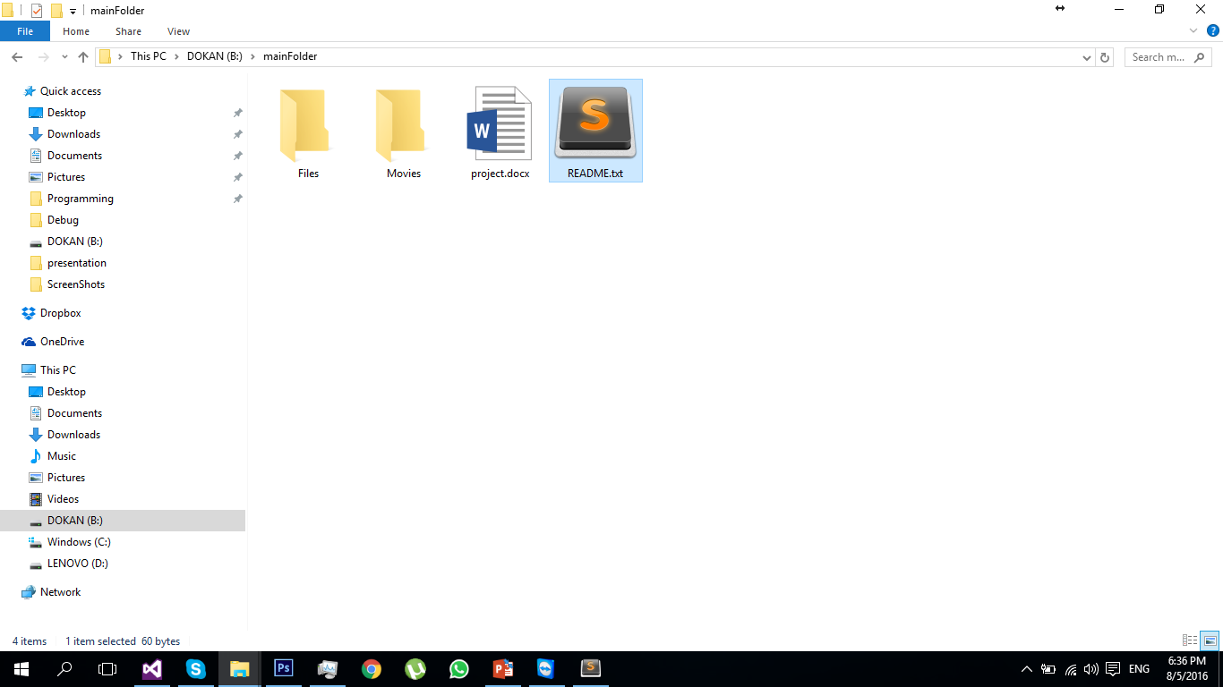
Open README.txt

Slide 23
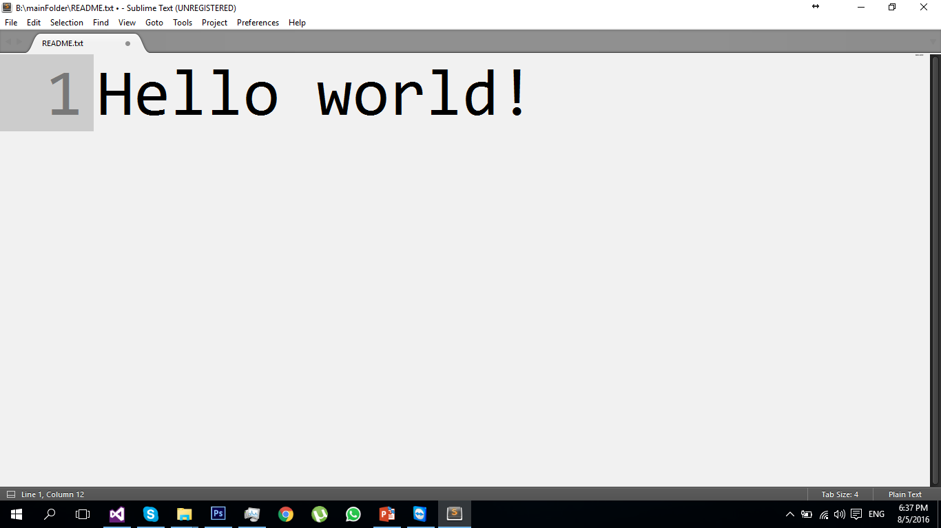
The data is not stored on the disk!

Slide 24
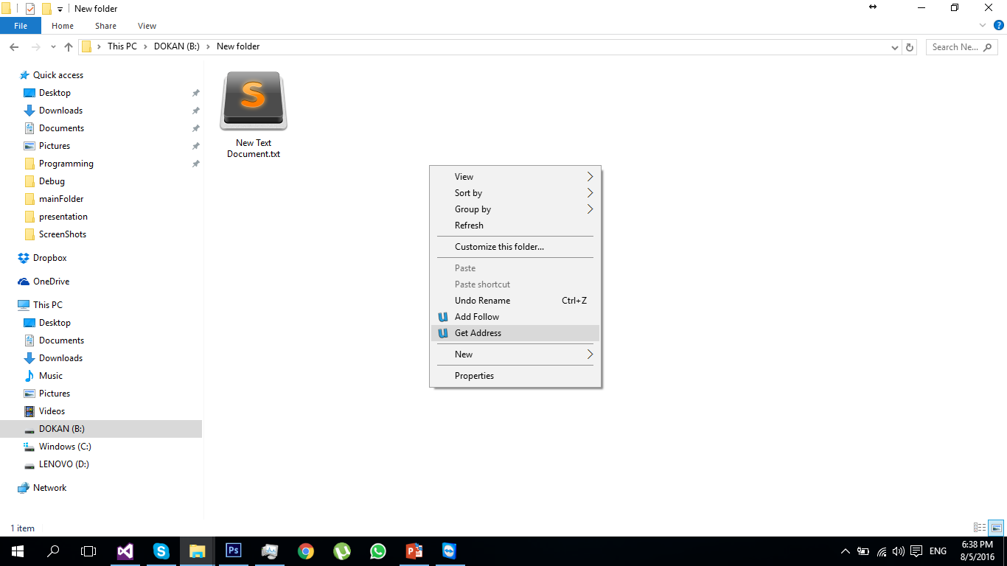
Share your own folder

Slide 25
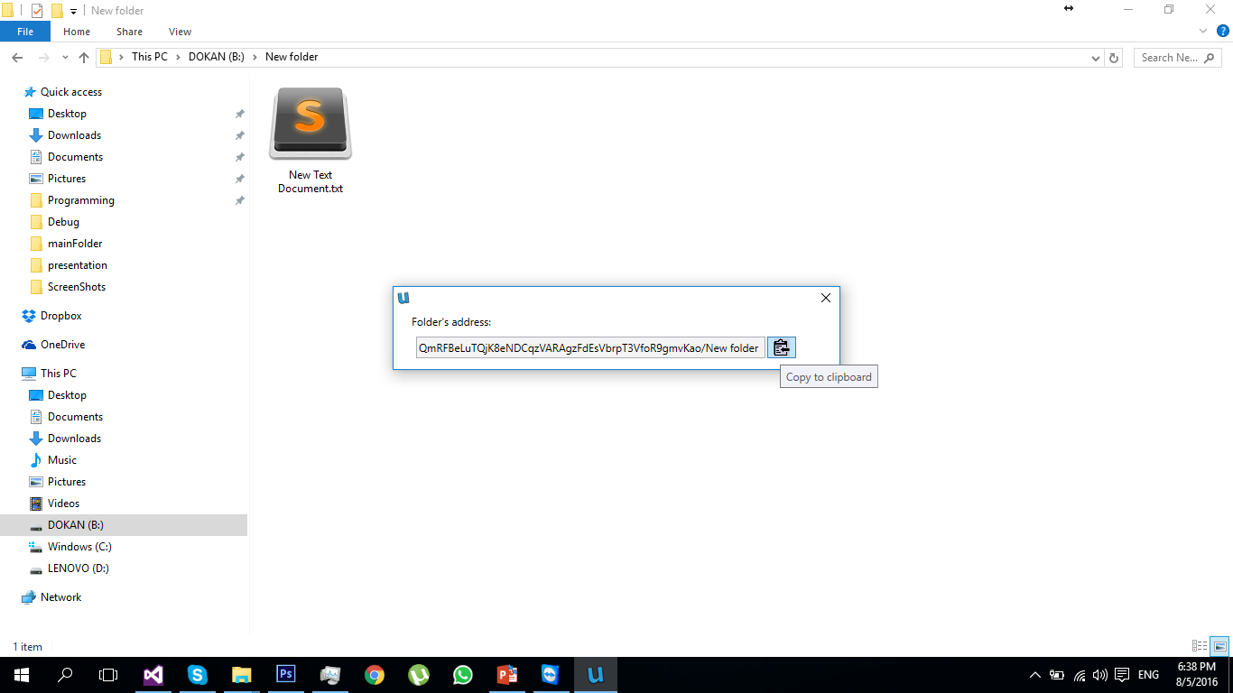
Copy address to clipboard

Slide 26
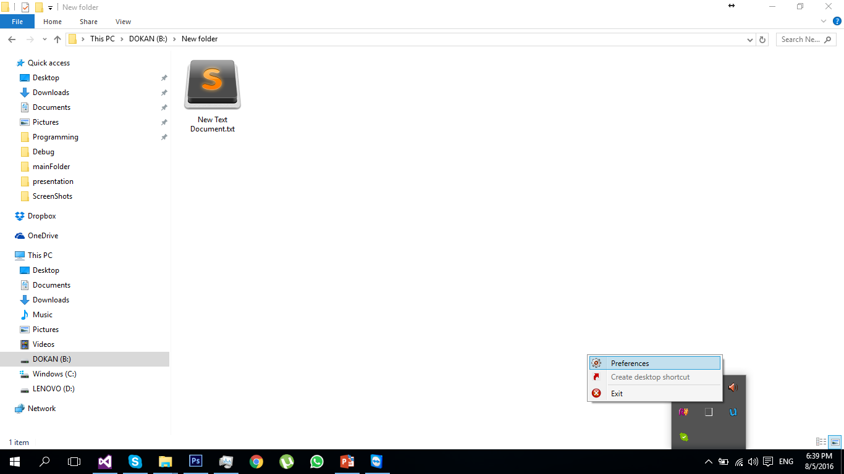
Edit folder’s settings

Slide 27
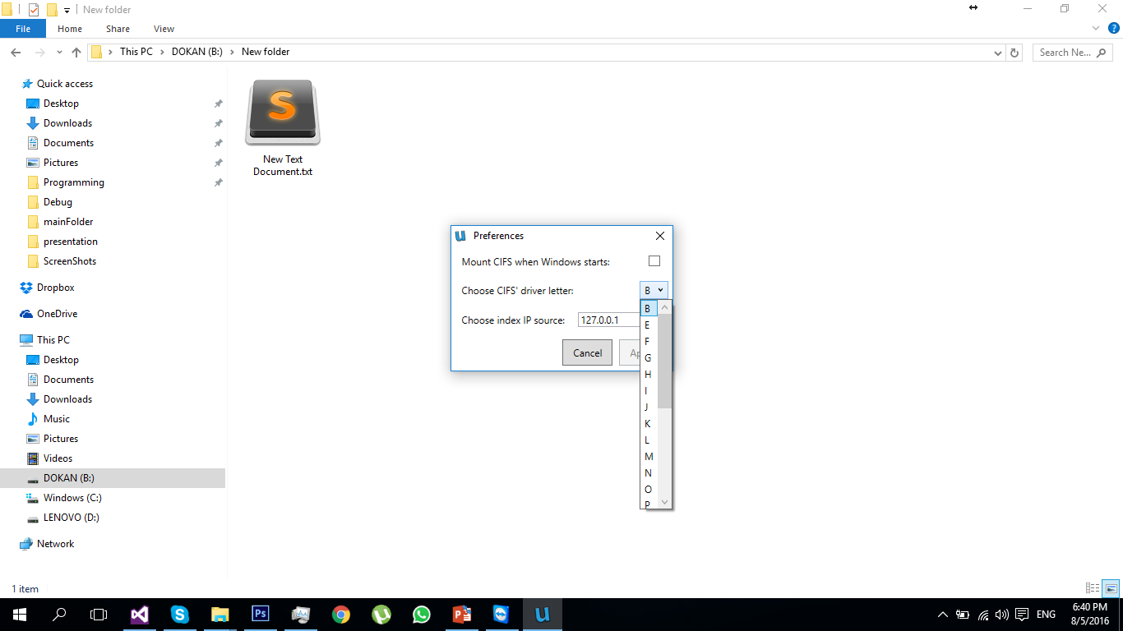
Edit folder’s settings

Slide 28
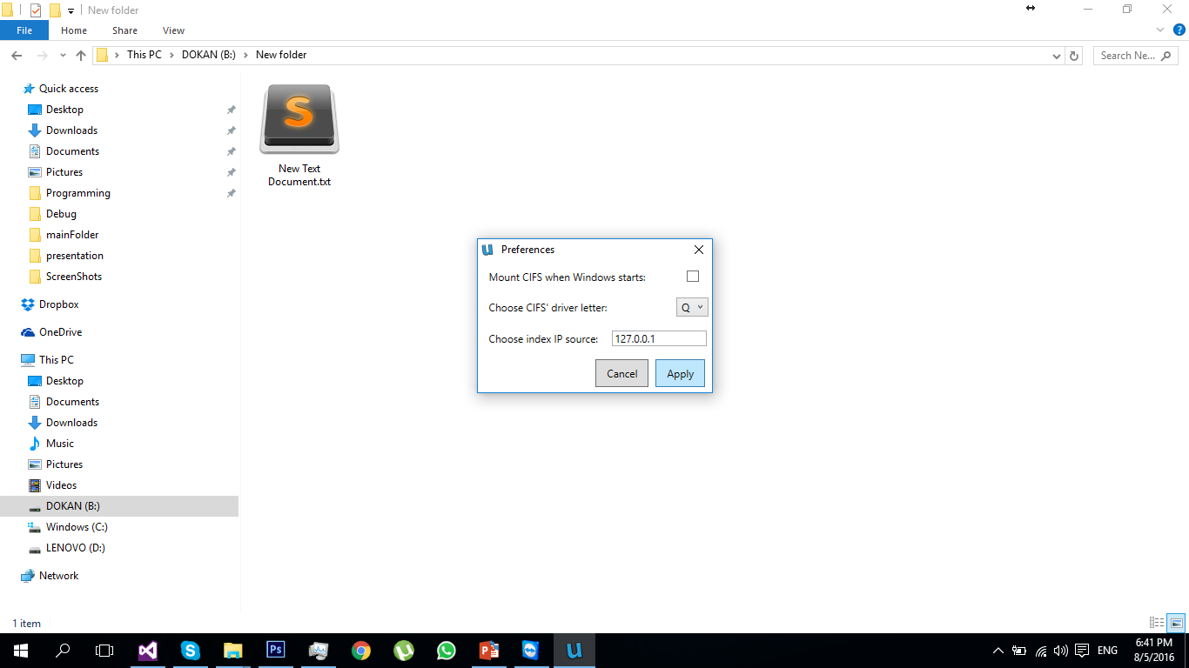

Slide 29
