Slide 1

uBox
Yuval Alfassi Ilan Godik

Slide 2



Nowadays Cloud Services
Size Limitations
Server failures and DDos vulnerability

Slide 3



The Solution - uBox
Peer to peer
No central server
Torrent like protocol

Slide 4

Technique
Windows Explorer
User
IPFS

Slide 5
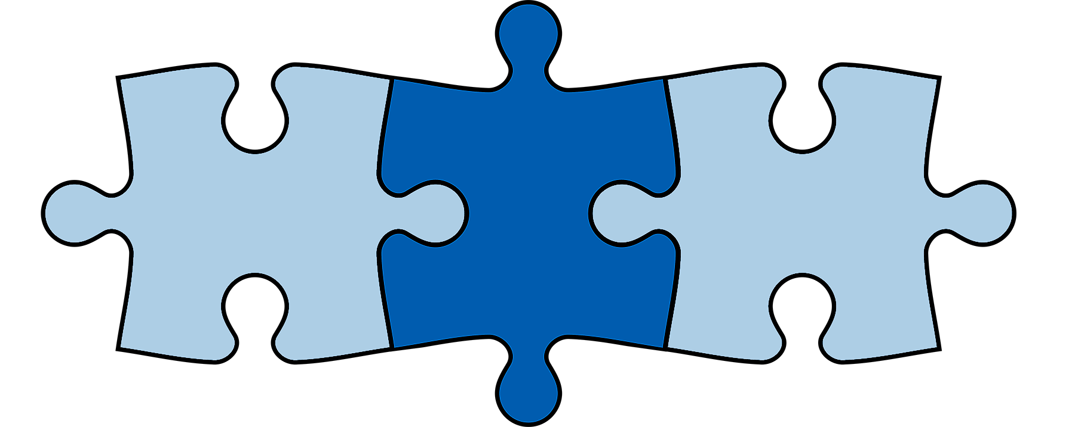
User Experience
Windows explorer drive
Can follow or clone other drives
Taskbar icon

Slide 6

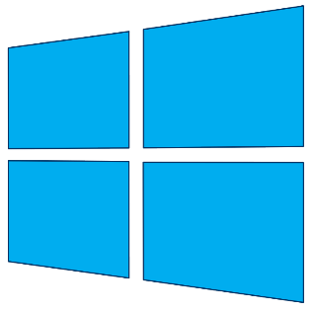
Technologies
IPFS
WPF
Windows
Dokan

Slide 7

Challenges
Concurrency Race Conditions
Interprocess Communication
Registry Manipulations
Notes:
Concurrency race conditions – it can come from nowhere - corrupted data.. multidimantionality
Interprocess communictation – lots of processes running – used TCP on LocalHost
Registry manipulation – right click, taskar icon, icon overlay
------------
Blue screen of death story. Buggy code causes blue screen. Formatted computer twice. Advice: Implement on Virtual Machine

Slide 8
Questions?
?

Slide 9
Peer to peer Explanation

Slide 10
Screenshots of GUI
(זכוכית מגדלת לדברים הרלוונטיים)

Slide 11
סרטון הדגמה אם יש או מעבר לדוגמית הרצה

