Slide 1
FIRST REVIEW
Explainable chest X-ray classification
A DenseNet-121 trained on NIH ChestX-ray14, and three tests of whether its explanations can be trusted
Prepared by [team names] for [mentor name]
September 2026
Notes:
We built the working system for this paper: the trained model, the explanation layer on top of it, and the results. The writing, the framing and where it gets submitted are your call. We'll go through the data, the network layer by layer, what came out, what broke along the way, and what we think should happen next. Every number on these slides comes from the saved runs.

Slide 2
THE BRIEF
Explanations first, localisation second
1
2
3
Explain every prediction
Localise the finding
Stay comparable
Show which part of the X-ray drove each finding, and measure how far that picture can be trusted.
Turn the same maps into boxes and rough zones, and score them against boxes drawn by radiologists.
A working model whose numbers sit next to published ones on the official test split. Making it better comes later.
Research prototype on one public dataset. Not a diagnostic tool.
2
Notes:
The order of priorities matters. Explainability comes first: for every prediction we show which part of the X-ray drove it, and then we test whether that picture deserves trust. Localisation comes second, and most of it falls out of the same maps. The third point is scope. For this stage we wanted a working model whose numbers can sit next to published ones, and improving it comes after.

Slide 3
SUMMARY
Where things stand
0.816
2.4×
No single best
Mean AUROC over 14 findings on NIH's official test split. Repeat runs gave 0.819 and 0.816. Published DenseNet-121 results: 0.807 to 0.822.
How much more often the best method's hottest point lands in the radiologist's box than a random map's (0.544 against 0.228).
Grad-CAM++ localises best but changes least when the model is scrambled. CAM and Grad-CAM are the most faithful.
Still wrong Probabilities are not calibrated, pneumothorax maps point away from the radiologist's box, and one of four random test images puts its evidence on the shoulder.
3
Notes:
If there's one slide to remember, it's this one. Classification is in line with published work on the official split, not better than it. The explanations point at the radiologist's box well over twice as often as a random map does. And the three ways of testing an explanation don't agree on which method is best, which we think is the most interesting result for a paper. The last line lists what's still wrong; each of those gets its own slide later.

Slide 4
DATASET
NIH ChestX-ray14
112,120
30,805
14
984
frontal chest X-rays, 1024 × 1024 PNG, about 45 GB
patients, and every split is made by patient
findings. One X-ray can have several, or none.
radiologist boxes on 880 test images, covering 8 findings
split | images | where it comes from
train | 78,327 | NIH's official train and validation list, 90% of its patients
validation | 8,197 | the same list, the other 10% of patients (seed 1337)
test | 25,596 | NIH's official test list, untouched. All 984 boxes are in it.
Findings range from Infiltration, in 24% of test images, to Hernia, in 0.3% (86 images). We resize every image to 512 × 512.
4
Notes:
ChestX-ray14 is the standard public chest X-ray benchmark. Two things matter most for us: the official split by patient, which makes our numbers comparable with published ones, and the 984 radiologist boxes, which let us grade the explanations. We carved validation out of the official training list by patient, and the code fails loudly if any patient ends up in two splits. Notice the imbalance: Hernia has 86 positive images in a test set of 25,596.

Slide 5
DATASET
Why this dataset
What it gives us
What it costs us
An official test split made by patient, so our numbers line up with published ones
Radiologist boxes, all on test images, so explanations are graded on cases the model never trained on
No access agreement. It asks only for attribution: cite Wang et al. 2017 and credit the NIH Clinical Center
The most used benchmark for this task since CheXNet
Labels were text-mined from radiology reports, so some of them are wrong
Boxes exist for 8 of the 14 findings, on under a thousand images
Every image comes from one hospital
VinDr-CXR was our first plan. Cleaner labels and far more boxes, but few published results on a fixed split to compare against, and access needs signed agreements. It stays on the list as a second test set.
5
Notes:
Three reasons: comparable numbers, an answer key for the explanations that the model never trained on, and no access agreement, so we could start straight away. The costs are real too. The labels come from text mining of reports, so some are wrong, and every paper on this dataset shares that problem. The boxes are few, and it's all one hospital. VinDr-CXR was our first choice. It has better labels and many more boxes, but there's little published work on a fixed split to compare with, and access needs signed agreements. We'd like it as the second test set.

Slide 6
MODEL
DenseNet-121, pretrained on ImageNet
121
Why this network
It is the most common network in published work on this dataset, from CheXNet to XProtoNet, so our numbers are easy to place
Its head is one average pool and one linear layer, which makes the class activation map add up exactly to the prediction
Explanation-focused papers on this dataset use it at 512 px too (Hermoza 2020, XProtoNet 2021), and it fits our 16 GB GPU at batch 32
layers with weights
7.0 M
weights, of which 14,350 are new
Why 512 px and not 224
The 1000-class ImageNet output is replaced by 14 outputs, one per finding, each through its own sigmoid.
The last feature grid becomes 16 × 16 instead of 7 × 7, so explanation maps are finer, at about five times the compute per image. It scores higher too: 0.816 against 0.802 at 224 px, same recipe and seed.
What it costs: it isn't the strongest backbone today. A newer one might score higher, but it would break the comparison with published work.
6
Notes:
DenseNet-121 is the network CheXNet used and the usual baseline on this dataset, so anyone reading can place our numbers. The bigger reason is explainability. The head is one average pool and one linear layer, and with that head the class activation map is exact rather than approximate. Slide 10 shows why. We train at 512 pixels instead of CheXNet's 224, which makes the last feature grid 16 by 16 instead of 7 by 7. That costs about five times the compute but fits on our 16 GB card. A newer backbone might score higher, but it would break the comparison, so it's on the later list.

Slide 7
ARCHITECTURE
From a 512 px X-ray to 14 probabilities
Input
Stem
Dense
block 1
Dense
block 2
Dense
block 3
Dense
block 4
Pool and
linear
Sigmoid
3 × 512 × 512
grey X-ray as 3 channels
64 × 128 × 128
7×7 conv, max pool
256 × 128 × 128
6 layers
512 × 64 × 64
12 layers
1024 × 32 × 32
24 layers
1024 × 16 × 16
16 layers; maps are taken here
1024 → 14
average each map, then weight
14
one probability per finding
Each arrow between dense blocks is a transition layer: a 1 × 1 convolution and a 2 × 2 average pool that halve both the channel count and the grid.
7
Notes:
Read it left to right. The X-ray comes in at 512 by 512. The stem shrinks it to 128 by 128. Then come four dense blocks, and between each pair a transition layer halves the grid and the number of channels. Box heights follow the grid size. By the end of dense block 4 we have 1024 channels on a 16 by 16 grid, and every explanation map is taken from there. Pooling and one linear layer turn that into 14 scores, and a sigmoid turns each score into its own probability, because findings aren't mutually exclusive.

Slide 8
ARCHITECTURE
Layer by layer
stage | layers | what it does | output
Input |  | Grey X-ray as 3 channels, ImageNet normalisation | 3 × 512 × 512
Stem | 7×7 conv and 3×3 max pool, both stride 2 | Early edges and texture; 512 → 128 per side | 64 × 128 × 128
Dense block 1 | 6 dense layers | Each dense layer adds 32 channels | 256 × 128 × 128
Transition 1 | BN · ReLU · 1×1 conv · 2×2 avg pool | Halves the channels and the grid | 128 × 64 × 64
Dense block 2 | 12 dense layers |  | 512 × 64 × 64
Transition 2 | same as transition 1 |  | 256 × 32 × 32
Dense block 3 | 24 dense layers |  | 1024 × 32 × 32
Transition 3 | same as transition 1 |  | 512 × 16 × 16
Dense block 4 | 16 dense layers | Last features. Explanation maps are taken here | 1024 × 16 × 16
Final BN · ReLU |  |  | 1024 × 16 × 16
Average pool | over the 16 × 16 grid | One number per channel | 1024
Linear | 1024 → 14 | One score per finding | 14
Sigmoid |  | Turns each score into its own probability | 14
121 = 1 stem conv + 58 dense layers × 2 convs + 3 transition convs + 1 linear layer. 6,968,206 weights in total.
8
Notes:
Same path as the previous slide, with exact output sizes. We checked the sizes by passing a 512 pixel image through our model, not by copying them from the paper. The 121 counts layers that have weights: the stem convolution, two convolutions in each of the 58 dense layers, three transition convolutions and the final linear layer. In total about 7.0 million weights. Only the 14,350 in the new output layer start from scratch; the rest start from ImageNet.

Slide 9
ARCHITECTURE
Inside a dense block
Every earlier feature map in the block, stacked
Each layer reads every earlier feature map in its block, not only the one just before it
The 1 × 1 convolution squeezes that stack to 128 channels, so the 3 × 3 convolution stays cheap
Each layer adds 32 channels, called the growth rate
Features are reused instead of relearned, so the whole network needs about 7 million weights. ResNet-50 needs about 25 million.
BN · ReLU · 1 × 1 conv → 128 channels
BN · ReLU · 3 × 3 conv → 32 channels
Append the 32 new channels to the stack
Channels in block 1, one layer at a time
64 → 96 → 128 → 160 → 192 → 224 → 256
9
Notes:
Inside a block, each layer takes every earlier feature map in that block as its input, stacked together. A 1 by 1 convolution squeezes that stack to 128 channels, then a 3 by 3 convolution makes 32 new channels, which join the stack for the next layer. That is why block 1 grows from 64 to 256 channels in steps of 32. Because layers can reuse what earlier layers already found, the network gets by with far fewer weights than a ResNet-50: about 7 million against 25 million.

Slide 10
ARCHITECTURE
Why the last two layers make the explanation exact
1
Dense block 4 ends with 1024 feature maps, each 16 × 16.
score_{c} = Σ_{k} w_{ck} · mean(F_{k}) + b_{c}
score_{c} = mean( Σ_{k} w_{ck} F_{k} ) + b_{c}
CAM_{c} = Σ_{k} w_{ck} F_{k}
a 16 × 16 map for finding c. F_{k} is feature map k, w_{ck} its weight for finding c.
2
Average pooling turns each map into one number.
3
The linear layer scores each finding as a weighted sum of those 1024 numbers, plus a bias.
Weighting and averaging can swap places, so the map's average plus the bias is the score. CAM splits the prediction across the image instead of estimating it, and a unit test checks the equality.
One map cell covers 32 × 32 px of the 512 px input, or 64 × 64 px of the original image. That limit comes back with nodules.
10
Notes:
This is the main reason we picked this network. The score for a finding, before the sigmoid, is a weighted sum of the 1024 pooled feature maps plus a bias. Pooling is just an average, so you can apply the weights first and average afterwards and get exactly the same number. Before averaging, that weighted sum is a 16 by 16 map, the class activation map. Its average plus the bias is the score, so CAM splits the prediction across the image rather than estimating it. A unit test checks the equality. The other methods estimate similar maps in other ways, which makes CAM a natural reference point.

Slide 11
TRAINING
How it was trained
Loss | Binary cross-entropy for each finding. Positives weighted by √(negatives ÷ positives), so Hernia gets 25× instead of 626×.
Optimiser | AdamW, peak learning rate 1e-4, weight decay 1e-5, one-cycle schedule with a 5% warm-up.
Stopping | Up to 12 epochs. Stop after 3 epochs without a better validation mean AUROC, and keep the best epoch.
Augmentation | Rotation up to 7°, shift up to 5%, zoom within 5%. No horizontal flip: it puts the heart on the wrong side, and we report left and right.
Validation | 10% of the official training list, split by patient. A check fails loudly if a patient lands in two splits.
Hardware | RTX 5070 Ti, 16 GB. bfloat16 mixed precision, batch 32, about 12 GB in use. 10.4 min for the first epoch, then about 7.5 min each.
Checkpoints | Everything needed to resume is saved every epoch, added after three power cuts.
11
Notes:
Most of this is standard. Two choices deserve a sentence. The positive-class weight uses the square root of the imbalance ratio. The full ratio would weight Hernia about 626 times, which makes a very noisy loss; the square root gives 25. And we don't flip images left to right, because a flipped chest X-ray puts the heart on the wrong side and our localisation reports left and right. Each run took about an hour on the RTX 5070 Ti.

Slide 12
RESULTS
Three runs, one recipe, three seeds
Validation mean AUROC after each epoch. Highlighted: the epoch whose weights were kept.
seed | epoch 1 | 2 | 3 | 4 | 5 | 6 | 7 | 8 | test AUROC
1337 | 0.8138 | 0.8335 | 0.8490 | 0.8533 | 0.8514 | 0.8525 | 0.8510 |  | 0.8158
2024 | 0.8077 | 0.8325 | 0.8430 | 0.8327 | 0.8479 | 0.8438 | 0.8409 | 0.8321 | 0.8190
7 | 0.8161 | 0.8380 | 0.8469 | 0.8479 | 0.8483 | 0.8463 | 0.8404 | 0.8353 | 0.8164
0.8171
0.0032
4 or 5
mean test AUROC of the three runs
spread between the lowest and highest test score
best epoch in every run. Early stopping ended each run three epochs later.
A seed changes the new output layer's starting weights, the shuffling, the augmentation and which patients are held out for validation. The test set never changes.
12
Notes:
One run gives one number and no idea how much of it is luck, so we trained the same recipe three times with different seeds. Each row is a run, each column is the validation score after that epoch, and the highlighted cell is the epoch whose weights we kept. All three peak at epoch 4 or 5, and early stopping ends each run three epochs later. The test scores land within 0.0032 of each other.

Slide 13
RESULTS
Why we keep the weights we keep
1
Inside a run, validation picks the epoch
All three runs peak at epoch 4 or 5 and slip after that, while training loss keeps falling (seed 1337: 0.331 at epoch 4, 0.271 at epoch 7). That is the start of overfitting, so the later epochs are not used.
2
Across runs, validation cannot pick a winner
Seed 1337 has the best validation score (0.8533) and the lowest test score (0.8158). Each run also validates on different patients, so those scores are not strictly comparable.
3
We report seed 1337, and the spread
It was fixed as the main run before the other two existed. Picking seed 2024 now because it tests best would mean choosing on the test set, which the official split exists to prevent.
The number to quote: 0.817 on average, between 0.816 and 0.819 across runs.
13
Notes:
Inside a run, validation decides. We keep the best epoch, and the later ones show the start of overfitting: training loss keeps falling while validation slips. Across runs, validation can't decide. The run with the best validation score has the worst test score, and each run validated on different patients anyway. So we report the first run, which was fixed as the main one before the other two existed, and we quote the spread. Choosing seed 2024 because it tests best would mean choosing on the test set.

Slide 14
RELATED WORK
What published work uses, and what we picked
 | published work on ChestX-ray14 | our choice
Network | DenseNet-121 in most papers, from CheXNet to XProtoNet. ResNet-50 in the original baseline. Swin and ViT transformers since 2022. | DenseNet-121: easy to compare, and its head makes CAM exact
Pretraining | ImageNet in most papers, none in Yao 2018, and self-supervised on 0.3 to 0.5 million X-rays in the newest transformer papers | ImageNet: standard, and needs no extra data
Input size | 224 px in CheXNet, SwinCheX and the MAE papers. 512 px in Yao 2018, Hermoza and XProtoNet. 1024 px in Wang and Guendel. | 512 px, like the papers that study explanations: 16 × 16 maps
Split | The official patient-wise split, so numbers compare. CheXNet and Yao 2017 used their own random splits. | The official split, untouched
Metrics | Mean AUROC nearly everywhere. Localisation papers add box accuracy on the 984 boxes. None of the papers we checked report AUPRC. | AUROC and AUPRC, box accuracy, faithfulness and the randomisation check
The papers closest to ours in purpose, Hermoza et al. 2020 and XProtoNet 2021, made the same four choices: DenseNet-121, ImageNet weights, 512 px and the official split.
14
Notes:
Most work on this dataset builds on DenseNet-121 with ImageNet weights. The recent top scores come from transformers pretrained on hundreds of thousands of chest X-rays, which is a different and much bigger kind of project. Input size falls into three groups: 224 pixels for CheXNet and the transformer papers, 512 for the papers that study explanations and localisation, and the full 1024 for the original baseline and Guendel and colleagues. We picked what the explanation-focused papers use, Hermoza and colleagues and XProtoNet, which also keeps our numbers directly comparable. Links for every paper are on the last slide.

Slide 15
RESULTS
Where 0.816 sits among published results
work | network and input | mean AUROC
Wang et al. 2017 | ResNet-50, 1024 px | 0.745
Yao et al. 2018 | ResNet + DenseNet, 512 px, no pretraining | 0.761
This project, 1 run | DenseNet-121, 224 px | 0.802
Baltruschat et al. 2019 | ResNet-38, 448 px + metadata | 0.806
Guendel et al. 2018 | DenseNet-121, 1024 px | 0.807
Taslimi et al. 2022, SwinCheX | Swin-L, 224 px | 0.810
Guan and Huang 2020 | DenseNet-121 with category-wise attention | 0.816
Ma et al. 2019 | two DenseNet-121s with cross-attention | 0.817
This project, 3 runs | DenseNet-121, 512 px | 0.816 to 0.819
Goel et al. 2024 | DenseNet-121, 224 px | 0.8202
Hermoza et al. 2020 | DenseNet-121, 512 px | 0.821
Kim et al. 2021, XProtoNet | DenseNet-121, 512 px | 0.822
Goel et al. 2024 | DenseNet-121 + low-rank features, 224 px | 0.8235
Xiao et al. 2023 | ViT-B, MAE on 0.5M X-rays, 224 px | 0.830
DenseNet-121 results on this split run from 0.807 to 0.822. Ours sit inside that range, a little below its top.
The same recipe at 224 px scores 0.802, clearly below all three 512 px runs, so the larger input helps accuracy as well as the maps.
Goel et al. get 0.820 from DenseNet-121 at 224 px, so the rest of the gap is in our training recipe.
Transformers pretrained on half a million chest X-rays reach 0.830.
CheXNet's 0.841 used its own random split, so it isn't in this table.
Mean AUROC over 14 findings on NIH's official test split.
15
Notes:
Every figure here was checked against the table in the paper itself, and all of them are on the official test split. DenseNet-121 results run from 0.807 to 0.822. Ours sit in that range, a little below the two best DenseNet-121 results, Hermoza and colleagues and XProtoNet, which also train at 512 pixels. The strongest numbers come from transformers pretrained on hundreds of thousands of chest X-rays. We also trained our exact recipe at 224 pixels, with the same seed, to see whether resolution matters for accuracy. It scored 0.802, well outside the spread of the 512 pixel runs, so the larger input helps the score as well as the maps. One trap: CheXNet's 0.841 is often quoted, but it was measured on its own random split, and Baltruschat and colleagues showed that the split alone moves results, so it doesn't belong in this table.

Slide 16
RESULTS
Finding by finding, against the strongest papers
finding | Wang 2017 | Hermoza 2020 | XProtoNet 2021 | ours, 3 runs
Atelectasis | 0.700 | 0.775 | 0.780 | 0.775
Cardiomegaly | 0.810 | 0.881 | 0.887 | 0.879
Effusion | 0.759 | 0.831 | 0.835 | 0.832
Infiltration | 0.661 | 0.695 | 0.710 | 0.701
Mass | 0.693 | 0.826 | 0.831 | 0.817
Nodule | 0.669 | 0.789 | 0.804 | 0.775
Pneumonia | 0.658 | 0.741 | 0.734 | 0.717
Pneumothorax | 0.799 | 0.879 | 0.871 | 0.878
Consolidation | 0.703 | 0.747 | 0.747 | 0.745
Edema | 0.805 | 0.846 | 0.840 | 0.852
Emphysema | 0.833 | 0.936 | 0.941 | 0.935
Fibrosis | 0.786 | 0.833 | 0.815 | 0.839
Pleural thickening | 0.684 | 0.793 | 0.799 | 0.790
Hernia | 0.872 | 0.917 | 0.909 | 0.903
mean of 14 | 0.745 | 0.821 | 0.822 | 0.817
Ours beats Wang et al.'s original baseline on 14 of 14 findings.
Ours is the best of the four on edema and fibrosis.
The widest gaps to the best paper are nodule (0.775 against 0.804) and pneumonia (0.717 against 0.741).
AUROC per finding, NIH's official test split. Published values as printed in Kim et al. 2021, Table 1.
16
Notes:
Here are the per-finding AUROCs for the original baseline and for the two best DenseNet-121 papers on this split, both of which also train at 512 pixels, next to the average of our three runs. The highlighted value is the best of the four in each row. We beat the original baseline everywhere and hold our own on most findings. The clearest gaps are on the small or subtle findings, so that's where a better recipe would have to earn its improvement.

Slide 17
RESULTS
AUROC flatters the rare findings
finding | share of test | AUROC | AUPRC
Infiltration | 23.9% | 0.699 | 0.393
Effusion | 18.2% | 0.830 | 0.511
Atelectasis | 12.8% | 0.772 | 0.341
Pneumothorax | 10.4% | 0.873 | 0.424
Consolidation | 7.1% | 0.741 | 0.160
Mass | 6.8% | 0.811 | 0.299
Nodule | 6.3% | 0.777 | 0.225
Pleural thickening | 4.5% | 0.791 | 0.150
Emphysema | 4.3% | 0.937 | 0.451
Cardiomegaly | 4.2% | 0.880 | 0.329
Edema | 3.6% | 0.857 | 0.195
Pneumonia | 2.2% | 0.711 | 0.048
Fibrosis | 1.7% | 0.841 | 0.113
Hernia | 0.3% | 0.900 | 0.389
mean of 14 |  | 0.816 | 0.288
0.048
AUPRC for pneumonia, against an AUROC of 0.711. At 2.2% prevalence the model is close to useless for it in practice.
A random guess scores AUROC 0.5 on every finding, but its AUPRC equals the prevalence. So 0.048 is only about twice chance.
A table with AUROC alone would hide this.
17
Notes:
AUROC can look fine for a rare finding while the model is of little practical use for it. Pneumonia is the example: 0.711 AUROC but 0.048 AUPRC. A random guess gets an AUPRC equal to the prevalence, 0.022, so the model is only about twice as good as chance at picking out pneumonia. Hernia looks good, but it rests on 86 test cases, and its AUPRC interval runs from 0.28 to 0.52. All the intervals are in the per-class results file.

Slide 18
EXPLANATIONS
Four ways to explain a prediction, plus a control
CAM | The model's own map. Exact for this network, and free to compute.
Grad-CAM | Weights each of the 1024 feature maps by the average gradient of the score, then keeps the positive part. The usual choice in medical imaging papers.
Grad-CAM++ | Grad-CAM with a finer, per-location gradient weighting, meant for findings that show up in more than one place.
EigenCAM | The first principal component of the last layer's activations. Uses no gradients and ignores which finding you ask about.
Random map | The control. Any score a random map also earns proves nothing.
All five give a 16 × 16 map, stretched to the size of the image. Score-CAM, Integrated Gradients and occlusion are written and unit-tested, but not scored yet.
18
Notes:
We run several methods because they rest on different assumptions and fail in different ways. CAM is exact for this network. Grad-CAM and Grad-CAM++ are what most medical imaging papers use. EigenCAM uses no gradients and ignores which finding you ask about, so it points at the same place whatever the question. The random map is the control: if it also does well on a test, the test proves nothing. Three more methods are written and unit-tested but not yet scored, so we don't report them.

Slide 19
EXPLANATIONS
Three questions for every explanation
1
2
3
Does it point where the radiologist did?
Is it faithful to the model?
Does it depend on the model at all?
Pointing game: is the hottest point inside the box? Also the overlap (IoU) and Wang et al.'s T(IoBB). 984 boxes, all on test images.
Deletion: blank the pixels the map ranks highest and watch the score fall. Insertion: add them to a blank image and watch it rise. 50 images per method.
Adebayo's check: scramble the network one layer at a time, from the top. If the map barely changes, it was describing the image, not the model. 242 steps.
Arun et al. (2021): all eight saliency methods they tested on chest X-rays failed at least one trust test. Saporta et al. (2022): on CheXpert, saliency maps' hit rate was on average 29.4% worse than radiologists'.
19
Notes:
Each question catches a different failure. A map can point at the right place for the wrong reason, so pointing alone isn't enough. A map can be faithful to the model and still land where no radiologist would look. And a map can look sensible while having nothing to do with the model, just following edges in the image, which is what Adebayo's randomisation check catches. Arun and colleagues found that every saliency method they tried on chest X-rays failed at least one trust test, so we measure instead of just showing pictures.

Slide 20
EXPLANATIONS
No method wins all three tests
method | pointing game ↑ | IoU ↑ | insertion − deletion ↑ | similarity after scrambling ↓
Grad-CAM++ | 0.544 | 0.212 | 0.391 | 0.199
Grad-CAM | 0.496 | 0.182 | 0.431 | 0.052
CAM | 0.493 | 0.176 | 0.430 | 0.009
EigenCAM | 0.479 | 0.190 | 0.306 | 0.152
Random map | 0.228 | 0.091 | 0.033
Pointing and IoU over 984 boxes. Faithfulness over 50 images. Similarity: mean absolute rank correlation with the original map over the last 20 of 242 scrambling steps.
Every method at least doubles the random map on pointing, so the test is not trivially easy.
Grad-CAM++ localises best, and its map stays the most similar when the model is scrambled.
CAM and Grad-CAM are the most faithful and depend most on the model, but localise a little worse.
A paper that reports one test for one method is picking its answer. This is the angle we would suggest.
20
Notes:
Read it column by column. Grad-CAM++ localises best. Grad-CAM and CAM are the most faithful. In the last column lower is better, because a map should change when the model is scrambled: CAM changes the most, Grad-CAM++ the least. So which method looks best depends on which test you run. Every method at least doubles the random map on pointing, so the test isn't trivial. We think this disagreement is the most useful result for a paper, since reporting one test for one method amounts to picking an answer.

Slide 21
LOCALISATION
The finding matters more than the method
Pointing game by finding: share of cases whose hottest point is inside the box
finding | boxes | CAM | Grad-CAM++ | random map
Cardiomegaly | 146 | 0.87 | 0.81 | 0.35
Pneumonia | 120 | 0.53 | 0.72 | 0.28
Infiltration | 123 | 0.49 | 0.66 | 0.25
Effusion | 153 | 0.56 | 0.56 | 0.23
Mass | 85 | 0.44 | 0.54 | 0.22
Atelectasis | 180 | 0.39 | 0.43 | 0.21
Nodule | 79 | 0.20 | 0.23 | 0.11
Pneumothorax | 98 | 0.27 | 0.22 | 0.07
Cardiomegaly is large and always in the same place, so every method finds it.
Pneumothorax is the weakest finding the measure can judge. Even the best method's hottest point misses the box in about four cases out of five.
Nodules also score low, for a different reason: the measure cannot see them. Next slide.
21
Notes:
The gaps between findings are much bigger than the gaps between methods. Cardiomegaly is large and always in the same place, so everything finds it. Pneumothorax is the weakest: even with the best method, the hottest point misses the box in about four cases out of five. Nodules score low too, but for a different reason, which is the next slide.

Slide 22
LOCALISATION
A nodule is smaller than one cell of the map
70 × 68 px
12×
0 of 79
median nodule box in the 1024 px image. One map cell is 64 × 64.
how much larger than the nodule a box drawn from any map ends up
nodule cases where any placement of that box could reach T(IoBB) 0.5, for any method
So we asked a question the grid can answer: does the box drawn from the map contain the nodule's centre?
Grad-CAM++ | 61%
CAM | 59%
Grad-CAM | 57%
EigenCAM | 37%
Random map | 13%
The maps find nodules far more often than chance; the standard box scores cannot show it at this resolution. The containment check is ours and has not been validated elsewhere.
22
Notes:
A nodule box is about the size of one cell of the 16 by 16 map. So any box drawn from a map comes out around twelve times larger than the nodule, and the standard overlap score can't reach 0.5 no matter where the map points. That held in all 79 cases. So we asked a question the grid can answer: does the box from the map contain the nodule's centre? Grad-CAM++ manages that 61% of the time, a random map 13%. The maps do find nodules; the standard score just can't see it. The containment check is our own and hasn't been validated anywhere else, so a paper would need to treat it carefully.

Slide 23
LOCALISATION
Localisation against published numbers
 | Atelectasis | Cardiomegaly | Effusion | Infiltration | Mass | Nodule | Pneumonia | Pneumothorax | mean
Box counts if IoBB is at least 0.5 (Wang et al.'s measure)
Wang et al. 2017 | 0.19 | 0.95 | 0.42 | 0.65 | 0.31 | 0.00 | 0.48 | 0.27 | 0.41
Ours, Grad-CAM++ | 0.10 | 0.83 | 0.39 | 0.58 | 0.20 | 0.00 | 0.56 | 0.16 | 0.35
Box counts if IoU is at least 0.3 (Hermoza et al.'s measure)
Wang et al. 2017 | 0.24 | 0.46 | 0.30 | 0.28 | 0.15 | 0.04 | 0.17 | 0.13 | 0.22
Hermoza et al. 2020 | 0.37 | 0.99 | 0.37 | 0.54 | 0.35 | 0.04 | 0.60 | 0.21 | 0.43
Ours, Grad-CAM++ | 0.19 | 0.16 | 0.42 | 0.46 | 0.27 | 0.01 | 0.56 | 0.13 | 0.28
On Wang et al.'s own measure we're a little below them (0.35 against 0.41), with the same pattern: cardiomegaly easiest, nodules at zero.
On IoU, Grad-CAM++ beats the original baseline (0.28 against 0.22) but sits well below Hermoza et al. (0.43), a method built to localise.
Most of that gap is cardiomegaly (0.16 against 0.99). Our box comes from the hottest 5% of the map, much smaller than an enlarged heart.
Not like for like: Wang et al. can place several boxes on one image and count the wrong ones separately, while we place one.
23
Notes:
These are the published localisation results on the same radiologist boxes that we can compare with. On Wang and colleagues' own measure, a box counts when at least half of it lies inside the radiologist's box. There we're a little below their original numbers, with the same easy and hard findings. On IoU, which also punishes a box of the wrong size, Grad-CAM++ beats the original baseline but sits well below Hermoza and colleagues, whose method is built to localise. Most of that gap is cardiomegaly: our box comes from the hottest 5% of the map, which is much smaller than an enlarged heart, so the overlap stays low even when the box sits inside it. Neither comparison is exactly like for like, because Wang and colleagues can place several boxes on one image.

Slide 24
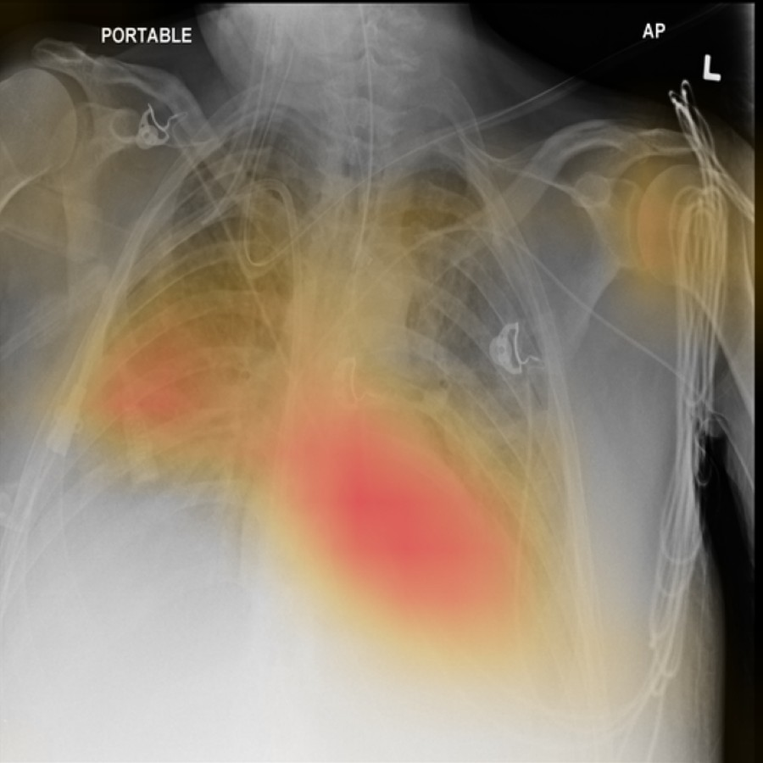
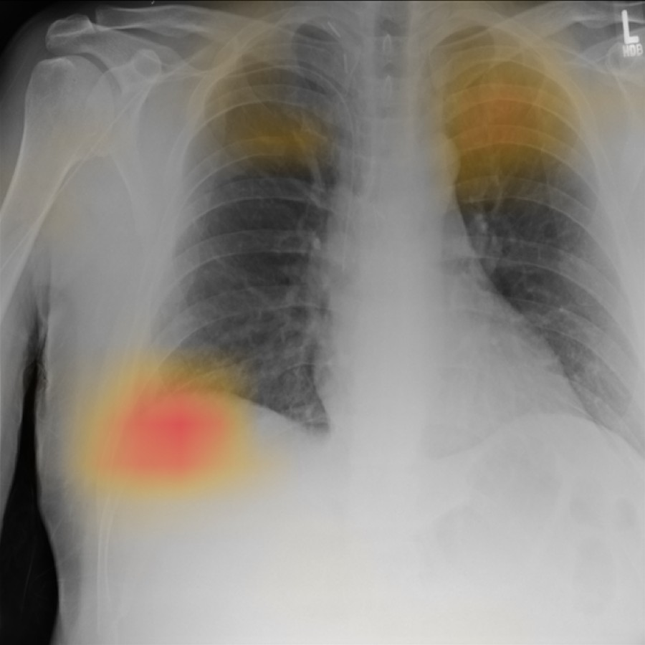
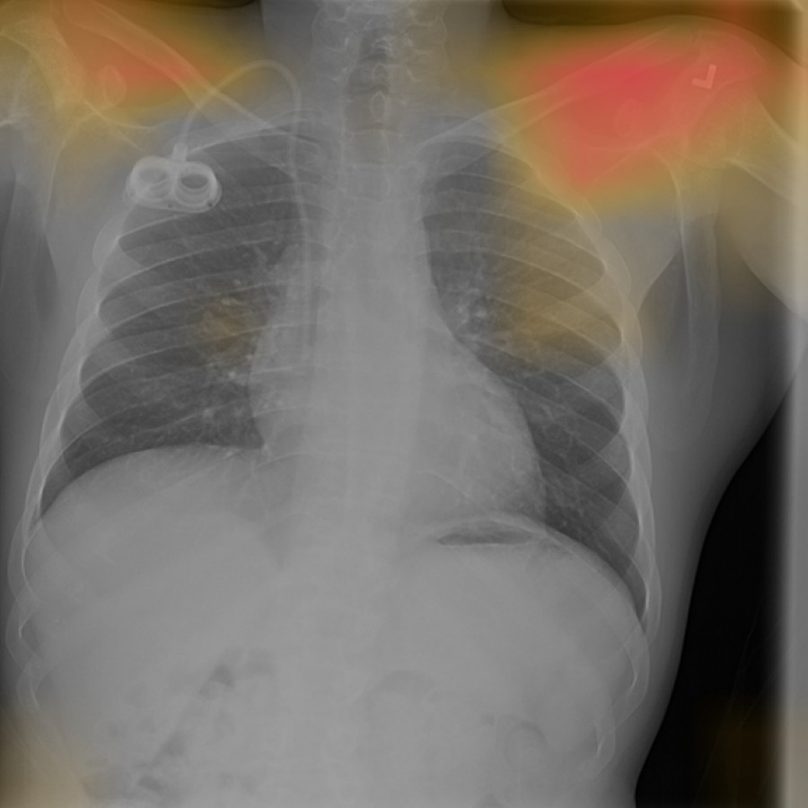
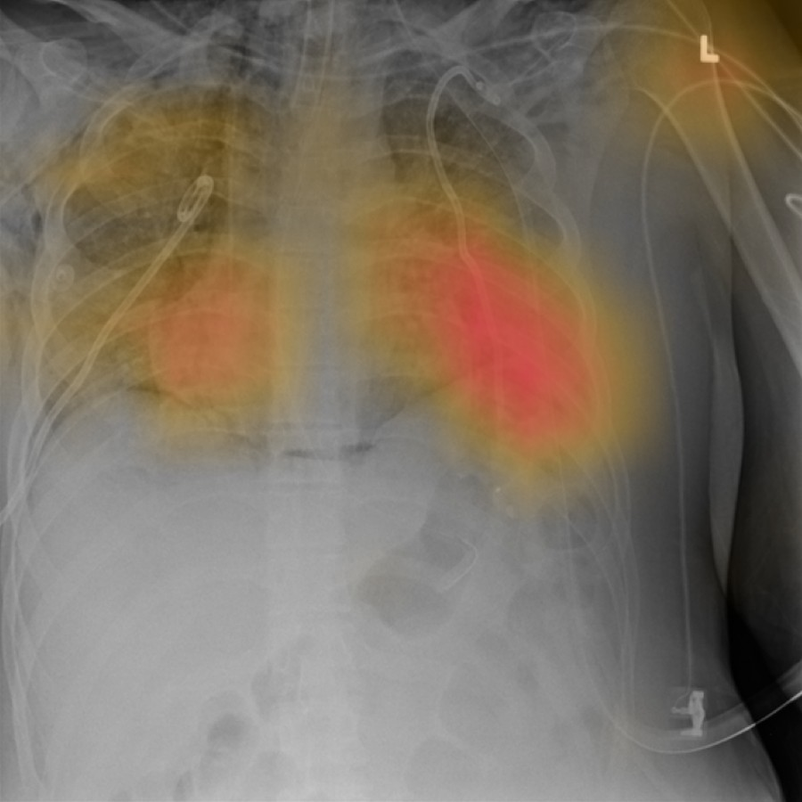
EXAMPLES
Four test images, picked at random
00027726_012 · NIH label: Infiltration
Effusion 0.73
next: Infiltration 0.57
evidence: centre, middle third
00001900_005 · NIH label: No Finding
Atelectasis 0.18
next: Infiltration 0.12
evidence: right middle zone
00028462_000 · NIH label: No Finding
Infiltration 0.33
next: Pleural thickening 0.09
evidence: left shoulder, outside the lungs
00015530_062 · NIH label: No Finding
Infiltration 0.64
next: Pneumothorax 0.46
evidence: left middle zone
CAM maps from the seed 1337 model. Zones come from position in the image, not anatomy. The labels were text-mined and the probabilities are not calibrated, so neither the label nor 0.5 settles who is right.
24
Notes:
These four were drawn at random from the test set, not picked to look good. Two things stand out. First, the NIH label and the model often disagree, and neither is automatically right: the labels were text-mined and the probabilities aren't calibrated. The last image is labelled No Finding, yet it's an AP film with several lines and tubes, and the model gives Infiltration 0.64. Second, the third image. It's labelled No Finding, and the model's evidence for Infiltration sits over the left shoulder, around the L marker, outside the lungs. That's the kind of shortcut DeGrave and colleagues found in COVID-19 models. One image proves nothing, so the next step is to measure this over the whole test set.

Slide 25
BUGS WE HIT
What the data and the machine threw at us
what happened | what we changed
The PC slept for nine hours mid-download, then came three power cuts | Downloads resume from partial files. Training saves weights, optimiser, schedule and random state every epoch and carries on after a restart. Tested by killing a run on purpose.
NIH's Box folder began answering 404 part-way through the 45 GB download | Switched to Box's direct link for each archive, after checking every size against NIH's own listing and that downloads could resume.
NIH's box file says Infiltrate, its label file says Infiltration | A plain match on names would silently drop those 123 boxes. Added the alias, and a check that stops on any label it cannot map.
Batch 48 ran out of GPU memory without any error | On Windows the NVIDIA driver spills into system RAM instead of failing, and training ran over 20 times slower. We stayed at batch 32.
The test pass crashed right after training finished | Train and validation loaders kept their workers alive: 27 Python processes, 95.9 of 96 GB of memory committed. The weights were safe. Loaders are now freed first, and one-off passes use fewer workers.
25
Notes:
None of these came from the model. The download took the most time: 45 GB over a slow connection, a PC that slept for nine hours in the middle, three power cuts, and NIH's Box folder starting to return 404 errors. Everything now resumes from where it stopped. The label mismatch is in NIH's own files and would have quietly dropped 123 boxes. The GPU memory one is worth knowing on Windows: the driver doesn't fail when memory runs out, it just gets twenty times slower. The last one cost a re-run of the test pass, but the trained weights were never at risk.

Slide 26
BUGS WE HIT
Traps in checking the explanations
what happened | what we changed
The randomisation check returned NaN for every method | Scrambling a layer's weights leaves BatchNorm's running mean and variance alone, because they are not weights. Those stale statistics pushed activations to infinity across the network. They are now reset too, and 242 of 242 correlations come back finite.
EigenCAM crashed the whole faithfulness run | Its SVD does not converge on a scrambled network, and one crash threw away the four methods that had worked. Methods now run independently, and a failure is recorded as a result.
Boxes drawn from Grad-CAM maps covered the whole X-ray | Grad-CAM sets negative values to zero, so on a mostly empty map the 95th percentile is 0, and 'at or above the threshold' selects every pixel. The cut-off is now strict and a flat map gives no box.
All three were caught before any number was reported. The third is the dangerous kind: its wrong numbers would have looked normal.
26
Notes:
These are traps anyone implementing these checks can walk into. The BatchNorm one is the subtle one. Scrambling a network's weights isn't enough, because BatchNorm keeps running statistics outside the weights, and with scrambled layers those statistics push activations to infinity. Before the fix, every method came back as NaN, which could easily have been read as every method failing the test. The threshold bug would have made boxes the size of the whole X-ray, which ruins every overlap score. Unit tests caught that one before any result was reported.

Slide 27
OPEN PROBLEMS
What is still wrong
Probabilities are not calibrated
Pneumonia is close to useless
Across the boxed findings, the median true positive scores anywhere from 0.24 to 0.67, so 0.5 means little. Ranking works: boxed cases sit at the 75th to 97th percentile.
AUPRC 0.048 at 2.2% prevalence, about twice chance.
Pneumothorax maps point elsewhere
A possible shortcut
Pointing game 0.22 even with the best method. First check: whether the maps land on chest drains.
One of four random images puts its evidence on the shoulder. One image proves nothing; it needs a check over the whole test set.
Validation does not rank runs
Limits of the data
The run with the best validation score tested worst of the three.
Text-mined labels, boxes for 8 findings only, one hospital. On this dataset these can be stated, not fixed.
27
Notes:
This is the honest list. Calibration is the cheapest fix and matters most for a demo, since right now 0.5 means something different for every finding. For pneumothorax, Oakden-Rayner and colleagues found models on this dataset leaning on chest drains, the tubes put in to treat it, so that's the first thing we'd check. The shoulder example needs the test-set-wide measurement before we say anything about shortcuts. The data limits can't be fixed on this dataset, only stated.

Slide 28
WHERE THIS GOES
Where this is headed
Do the explanations that medical imaging papers rely on agree with the radiologist, with the model, and with each other?
WHAT OUR FIRST RESULTS SAY
With the radiologist | More than twice as often as a random map. Weakest on pneumothorax, and not measurable on nodules at this resolution.
With the model | All four pass the faithfulness test and the randomisation check, CAM and Grad-CAM by the widest margin.
With each other | No single method comes out best on all three tests.
A measurement paper like this needs a classifier that matches published work, not one that beats it. We have that.
28
Notes:
This is our suggestion for the paper's angle, and it's yours to judge. Many medical imaging papers show a few Grad-CAM pictures and move on. On a model that matches the literature, we can show that the standard tests of an explanation disagree about which method to trust, and where each method breaks down: pneumothorax, nodules at this resolution, and possibly shortcuts. That's a measurement paper, and it doesn't need a better classifier to stand.

Slide 29
WHERE THIS GOES
How we plan to get there
Now
Next
Later
with what we have
make it hold up
bigger changes
Calibrate the probabilities
Temperature scaling on validation, a threshold per finding, calibration error before and after.
A second hospital
The frozen model and every method on VinDr-CXR or CheXlocalize annotations.
Explanations built into the model
An attention-pooling head or a prototype network, judged by the same three tests.
Measure the shortcut
How much of each map falls outside the chest or on the border, over all 25,596 test images, against a random map.
Finer maps for nodules
Maps from the 32 × 32 grid of dense block 3, or a larger input, then rerun the nodule check.
A better recipe, then backbone
Close the gap to the best DenseNet-121 results (0.822) first, then try a transformer pretrained on X-rays (0.830 to 0.834).
Score the other three methods
Score-CAM, Integrated Gradients and occlusion through the same three tests.
A closer look at pneumothorax
Check whether its maps land on chest drains.
A radiologist's view
A radiologist rates a sample of the maps.
29
Notes:
The first column is cheap work on what we already have: calibration, the shortcut measurement and the three unscored methods. All of it runs on our GPU in hours. The second column is what would make a paper stronger: a second hospital, finer maps so nodules get a fair test, and a proper look at pneumothorax. The last column is bigger changes and outside help. NIH's download page also offers re-extracted labels called MAPLEZ, which could help with label noise; we haven't looked at them closely yet. The order after the first column depends on your answers on the next slide.

Slide 30
FOR OUR MENTOR
Questions for you
1
Which venue or format do you have in mind? It decides how many extra experiments are worth running.
2
Should the first version include a second hospital's test set, or should that wait for a follow-up?
3
With the same seed, our recipe scored 0.802 at 224 px and 0.816 at 512 px. Should the paper report both?
4
Does the department need ethics paperwork, even for public, de-identified data?
Everything shown is saved and scripted: four runs with weights, history and test scores (three seeds at 512 px, one at 224 px), the explanation tables, and 40 passing unit tests.
30
Notes:
These four decide what we do next, so it would help to settle them today if possible. Everything shown is saved and scripted: all four runs with weights, per-epoch history and test scores, the explanation tables, and 40 passing unit tests. If you like, we can run the model on any test X-ray you pick.

Slide 31
REFERENCES
Papers compared in this deck
Wang et al. 2017, ChestX-ray8 | arxiv.org/abs/1705.02315
Rajpurkar et al. 2017, CheXNet | arxiv.org/abs/1711.05225
Yao et al. 2017 | arxiv.org/abs/1710.10501
Yao et al. 2018 | arxiv.org/abs/1803.07703
Guendel et al. 2018 | arxiv.org/abs/1803.04565
Baltruschat et al. 2019 | nature.com/articles/s41598-019-42294-8
Ma et al. 2019 | doi.org/10.1007/978-3-030-32226-7_81
Guan and Huang 2020 | doi.org/10.1016/j.patrec.2018.10.027
Hermoza et al. 2020 | arxiv.org/abs/2005.10550
Kim et al. 2021, XProtoNet | arxiv.org/abs/2103.10663
Taslimi et al. 2022, SwinCheX | arxiv.org/abs/2206.04246
Xiao et al. 2023, MAE for X-rays | arxiv.org/abs/2210.12843
Goel et al. 2024, low-rank features | arxiv.org/abs/2404.18933
Huang et al. 2017, DenseNet | arxiv.org/abs/1608.06993
Adebayo et al. 2018, sanity checks | arxiv.org/abs/1810.03292
Arun et al. 2021, saliency trust | doi.org/10.1148/ryai.2021200267
DeGrave et al. 2021, shortcuts | doi.org/10.1038/s42256-021-00338-7
Saporta et al. 2022, CheXlocalize | doi.org/10.1038/s42256-022-00536-x
31
Notes:
Every number quoted from these papers was checked against the paper's own table. The links open the paper or its publisher page.

