Slide 1
PORTFOLIO CREATION PROJECT
Bonera Michele, 890256
Pasinato Alessio, 887000

Slide 2
INTRODUCTION
The aim of the project is to evaluate the behaviour of different portfolio strategy and how the structural characteristics of the risk affect the real portfolios.

Slide 3
Dataset
Stoxx Europe 600 is an index composed by 600 of the major European market capitalization companies across 17 European countries, covering about the 90% of the market capitalization of the European stock market.
For our project, we consider the daily prices of the index since 2013 to 2018.

Slide 4
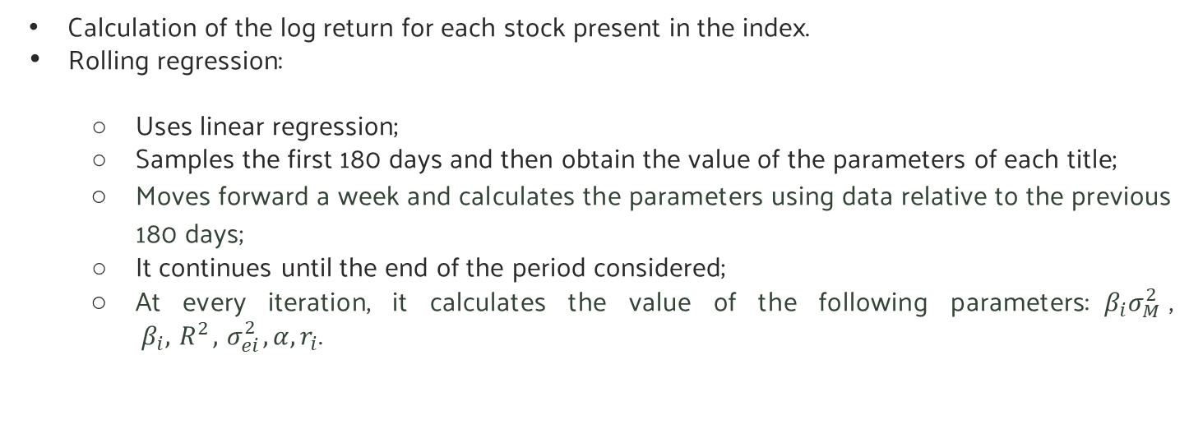
Rolling regression
Calculation of the log return for each stock present in the index.
Rolling regression:
Uses linear regression;
Samples the first 180 days and then obtain the value of the parameters of each title;
Moves forward a week and calculates the parameters using data relative to the previous 180 days;
It continues until the end of the period considered;
At every iteration, it calculates the value of the following parameters:${ β}_{i}σ_{M}^{2}$, ${ β}_{i}, { R}^{2},{ σ}_{ei}^{2}, α, r_{i}$.

Slide 5

Ranking titles and parameters
To build our portfolio we ordered the stocks with respect to several parameters. Then we selected the 10% of the upper or lower quantile.
The parameters used to select the stocks are:
High $R^{2}$;
High$β_{i}σ_{M}^{2}$;
Low and High $β$;
High $σ_{ei}^{2}$;
Absolute return ($r_{i}$);
High $α$

Slide 6
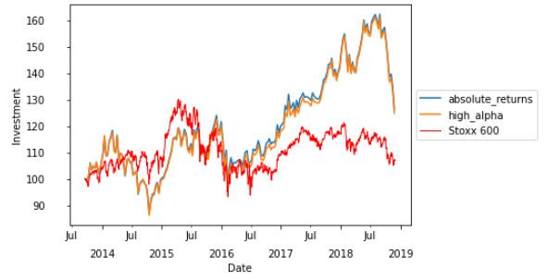
Overperforming portfolios
Portfolios composed by high alpha stocks and titles with high absolute returns achieve higher performance compared to the index

Slide 7
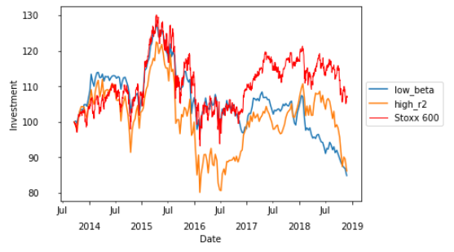
Portfolios similar to the index
Portfolios composed by stocks with low beta and high $R^{2}$have a similar trend of STOXX 600 index

Slide 8
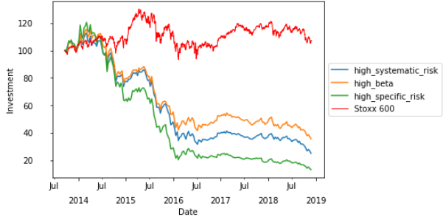
Underperforming portfolios
Portfolios composed by stocks with high beta, systematic and specific risk have a similar trend of STOXX 600 index

Slide 9
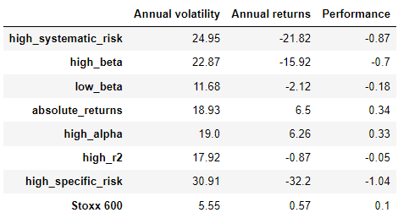
Overall results

Slide 10
Conclusions
Thanks to our study we have:
discovered the various behaviours of stocks with different characteristics
this analysis could not be implemented in the real world as it doesn’t consider taxes and commission fees
Future developments:
Momentum strategy

Slide 11
Thank you!

