Slide 1
Time Series Modeling Manish Gupta
http://www.itl.nist.gov/div898/handbook/pmc/section4/pmc4.htm

Slide 2
Definitions, Applications
Time Series: An ordered sequence of values of a variable at equally spaced time intervals.
Application: Fit a model and proceed to forecasting and monitoring.
Domains
Economic Forecasting
Sales Forecasting
Budgetary Analysis
Stock Market Analysis
Yield Projections
Process and Quality Control
Inventory Studies
Workload Projections
Utility Studies
Census Analysis
…

Slide 3
NAÏVE MODELS
They are based solely on the most recent information available.
Is sometimes called the “no change” forecast.
Suitable for very small data sets.
The simplest model is:

Slide 4
Trend Component
Overall Upward or Downward Movement
Data Taken Over a Period of Years
Sales
Upward trend
Time

Slide 5
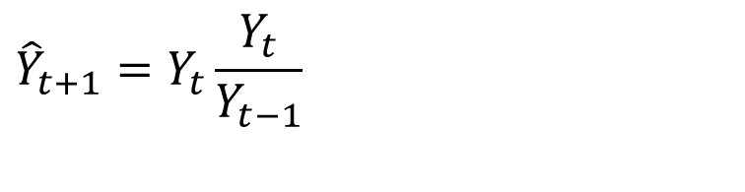
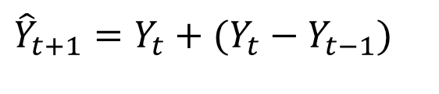
The technique can be adjusted to take trend into consideration:
$${\hat{Y}}_{t+1}=Y_{t}+(Y_{t}−Y_{t−1})$$
The rate of change might be more appropriate than the absolute amount of change:
$${\hat{Y}}_{t+1}=Y_{t}\frac{Y_{t}}{Y_{t−1}}$$

Slide 6
Simple Averages
Uses the mean of all the relevant historical observations as the forecast of the next period.
New observation is added:

Slide 7
Moving Averages
A moving average of order k is the mean value of the k most recent observations.
K = number of terms in the moving average.
The method does not handle trend or seasonality very well, although it does work better than the simple average method.

Slide 8
Use 5 week moving average (last data)
Week t | Purchases | Week t | Purchases | Week t | Purchases
1 | 275 | 11 | 302 | 21 | 310
2 | 291 | 12 | 287 | 22 | 299
3 | 307 | 13 | 290 | 23 | 285
4 | 281 | 14 | 311 | 24 | 250
5 | 295 | 15 | 277 | 25 | 260
6 | 268 | 16 | 245 | 26 | 245
7 | 252 | 17 | 282 | 27 | 271
8 | 279 | 18 | 277 | 28 | 282
9 | 264 | 19 | 298 | 29 | 302
10 | 288 | 20 | 303 | 30 | 285

Slide 9
Results
Week Purchases AVER1 RESI1
1 275 * *
2 291 * *
3 307 * *
4 281 * *
5 295 289.8 *
6 268 288.4 -21.8
7 252 280.6 -36.4
8 279 275.0 -1.6
9 264 271.6 -11.0
10 288 270.2 16.4
11 302 277.0 31.8
12 287 284.0 10.0
13 290 286.2 6.0
14 311 295.6 24.8
15 277 293.4 -18.6
16 245 282.0 -48.4
17 282 281.0 0.0
18 277 278.4 -4.0
19 298 275.8 19.6
20 303 281.0 27.2
21 310 294.0 29.0
22 299 297.4 5.0
23 285 299.0 -12.4
24 250 289.4 -49.0
25 260 280.8 -29.4
26 245 267.8 -35.8
27 271 262.2 3.2
28 282 261.6 19.8
29 302 272.0 40.4
30 285 277.0 13.0
$$\frac{275+291+307+281+295}{5}=289.8$$

Slide 10
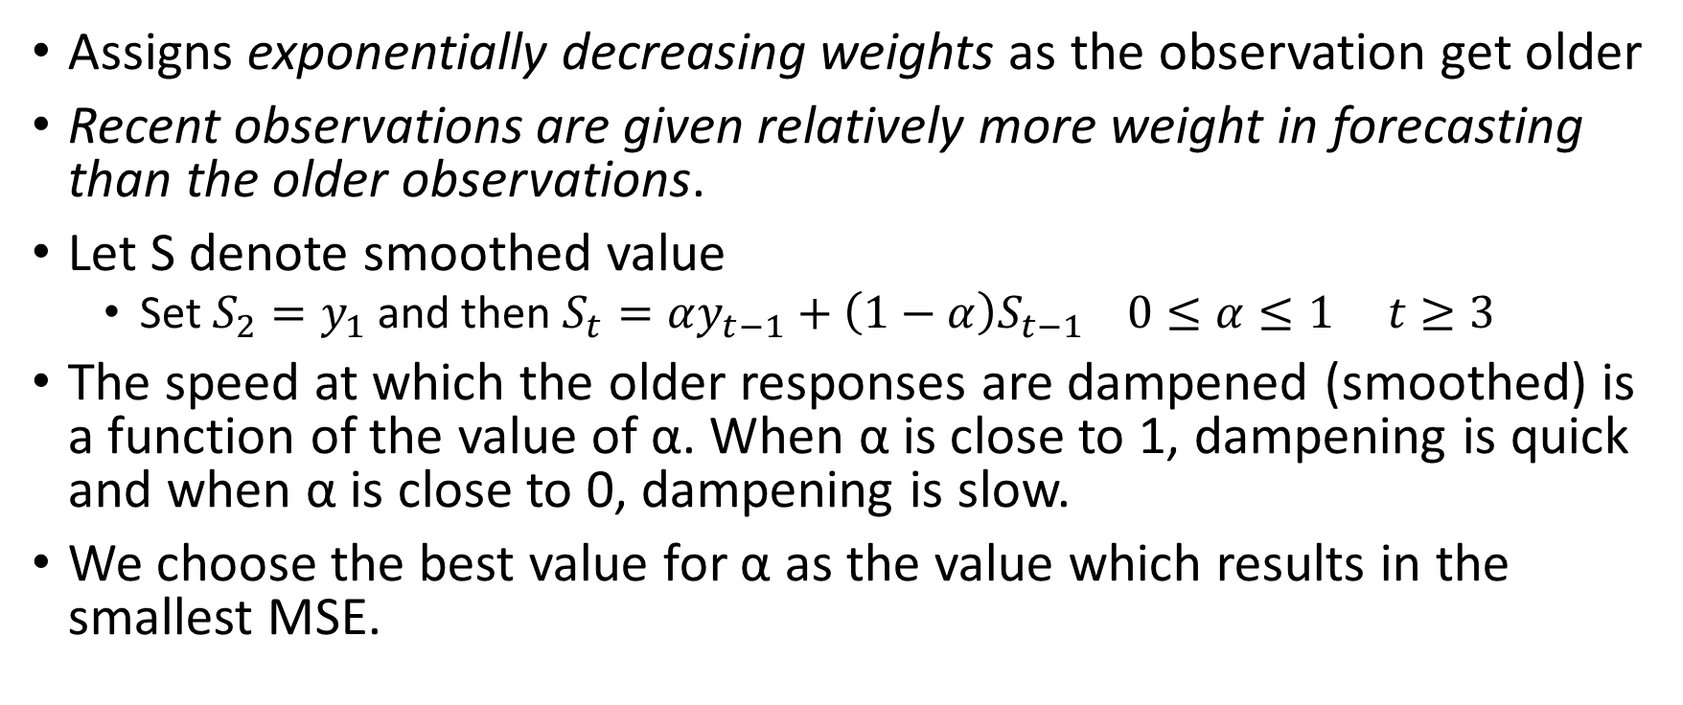
Exponential smoothing
Assigns exponentially decreasing weights as the observation get older
Recent observations are given relatively more weight in forecasting than the older observations.
Let S denote smoothed value
Set $S_{2}=y_{1}$ and then $S_{t}=αy_{t−1}+\left(1−α\right)S_{t−1} 0≤α≤1 t≥3$
The speed at which the older responses are dampened (smoothed) is a function of the value of α. When α is close to 1, dampening is quick and when α is close to 0, dampening is slow.
We choose the best value for α as the value which results in the smallest MSE.

Slide 11
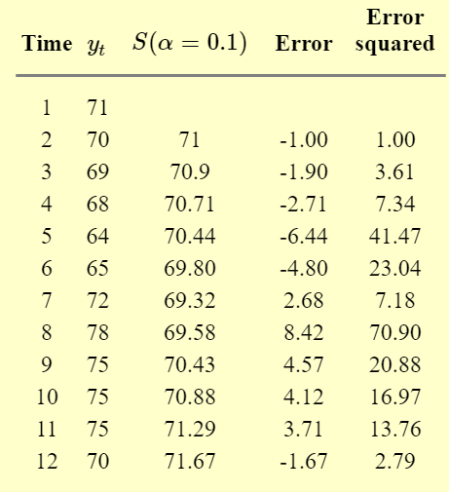
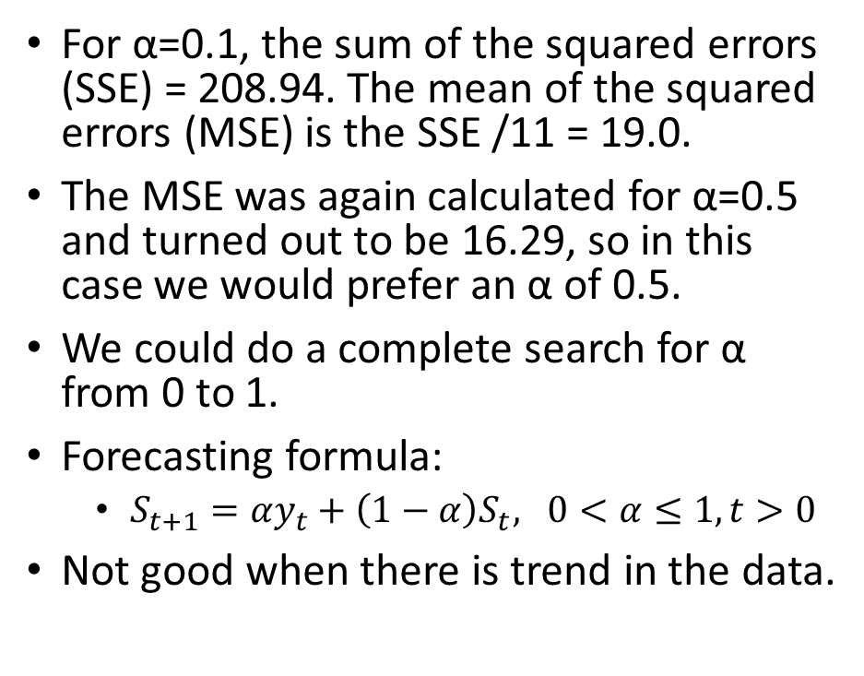
Exponential smoothing
For α=0.1, the sum of the squared errors (SSE) = 208.94. The mean of the squared errors (MSE) is the SSE /11 = 19.0.
The MSE was again calculated for α=0.5 and turned out to be 16.29, so in this case we would prefer an α of 0.5.
We could do a complete search for α from 0 to 1.
Forecasting formula:
$S_{t+1}=αy_{t}+\left(1−α\right)S_{t}, 0<α≤1, t>0$
Not good when there is trend in the data.

Slide 12
Seasonality
By seasonality, we mean periodic fluctuations.
For example, retail sales tend to peak for the Christmas season and then decline after the holidays. So time series of retail sales will typically show increasing sales from September through December and declining sales in January and February.
If seasonality is present, it must be incorporated into the time series model.
Techniques for detecting seasonality.
A run sequence plot will often show seasonality.
The autocorrelation plot can help identify seasonality: If there is significant seasonality, the autocorrelation plot should show spikes at lags equal to the period.

Slide 13
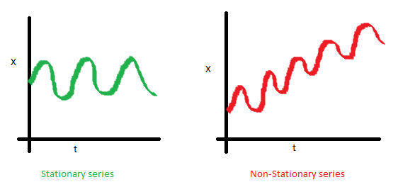
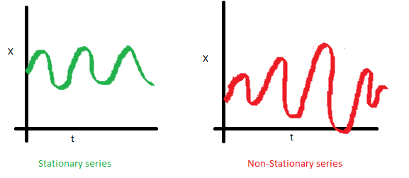
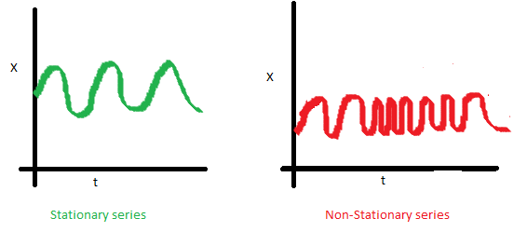
Stationary series
The mean of the series should not be a function of time rather should be a constant.
The variance of the series should not a be a function of time. This property is known as homoscedasticity.
The covariance of the i th term and the (i + m) th term should not be a function of time.
A stationary process has the property that the mean, variance and autocorrelation structure do not change over time.

Slide 14
Why care about stationarity of a time series?
Until unless your time series is stationary, you cannot build a good time series model.
In cases where the stationary criterion are violated, the first requisite becomes to stationarize the time series and then try models to predict this time series.
There are multiple ways of bringing this stationarity. Some of them are Detrending, Differencing etc.

Slide 15
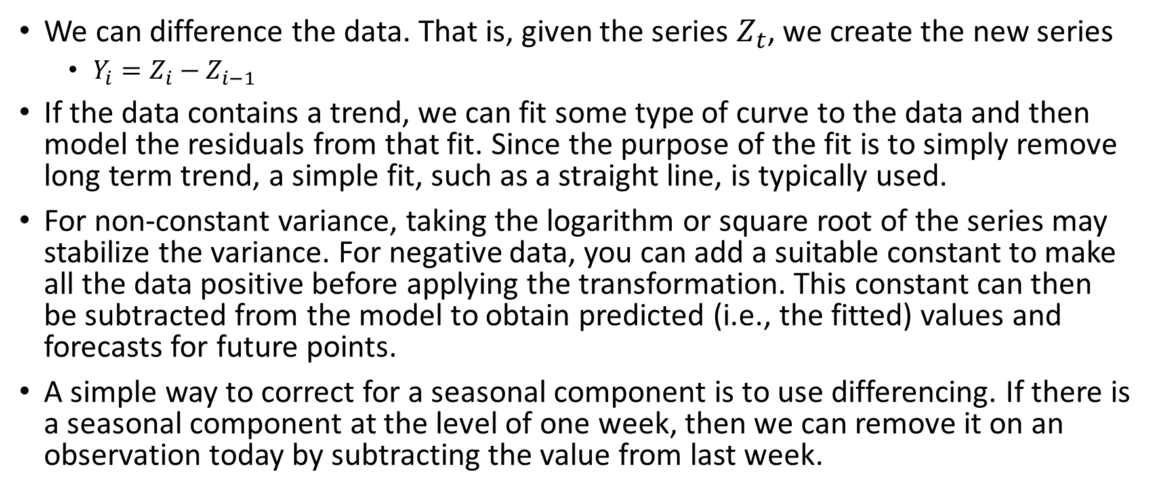
Making a series stationary
We can difference the data. That is, given the series $Z_{t}$, we create the new series
$Y_{i}=Z_{i}−Z_{i−1}$
If the data contains a trend, we can fit some type of curve to the data and then model the residuals from that fit. Since the purpose of the fit is to simply remove long term trend, a simple fit, such as a straight line, is typically used.
For non-constant variance, taking the logarithm or square root of the series may stabilize the variance. For negative data, you can add a suitable constant to make all the data positive before applying the transformation. This constant can then be subtracted from the model to obtain predicted (i.e., the fitted) values and forecasts for future points.
A simple way to correct for a seasonal component is to use differencing. If there is a seasonal component at the level of one week, then we can remove it on an observation today by subtracting the value from last week.

Slide 16
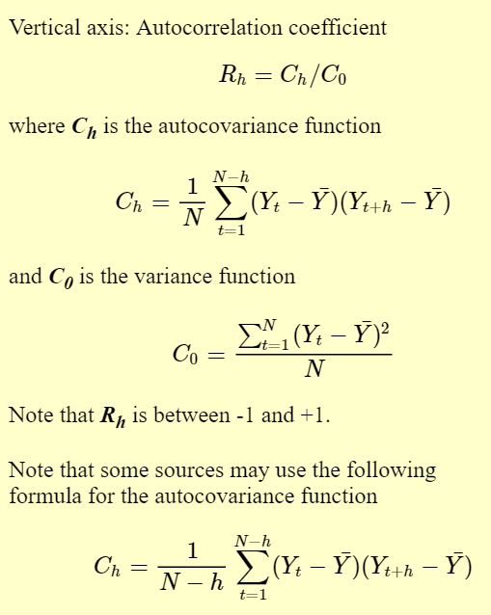
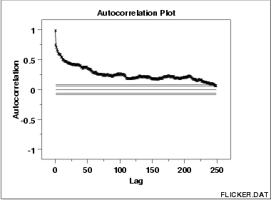
Autocorrelation Plot
Autocorrelation plots are a commonly-used tool for checking randomness in a data set. This randomness is ascertained by computing autocorrelations for data values at varying time lags. If random, such autocorrelations should be near zero for any and all time-lag separations. If non-random, then one or more of the autocorrelations will be significantly non-zero.
This sample autocorrelation plot shows that the time series is not random, but rather has a high degree of autocorrelation between adjacent and near-adjacent observations.

Slide 17
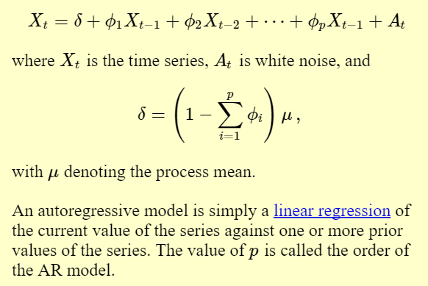
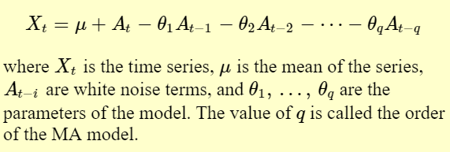
Approaches for Univariate time series models
Decompose into trend, seasonal and residual components.
AR (auto-regressive) models
MA (moving average) models
A moving average model is conceptually a linear regression of the current value of the series against the white noise or random shocks of one or more prior values of the series.
Box and Jenkins popularized an approach that combines the moving average and the autoregressive approaches.

Slide 18

Box-Jenkins Models
The Box-Jenkins ARMA model is a combination of the AR and MA models. Doing so produces an ARIMA model, with the "I" standing for "Integrated".
The Box-Jenkins model assumes that the time series is stationary.
Primary stages in building a Box-Jenkins time series model.
Establish stationarity
Estimation p and q.
Typically, effective fitting of Box-Jenkins models requires at least a moderately long series. Chatfield (1996) recommends at least 50 observations. Many others would recommend at least 100 observations.

Slide 19
Box-Jenkins Model Identification
Step 1: determine if the series is stationary and if there is any significant seasonality that needs to be modeled.
Box and Jenkins recommend the differencing approach to achieve stationarity. However, fitting a curve and subtracting the fitted values from the original data can also be used in the context of Box-Jenkins models.
The next step is to identify the order (i.e., the p and q) of the autoregressive and moving average terms.

Slide 20
Box-Jenkins Model Identification
Order of Autoregressive Process (p): For an AR(1) process, the sample autocorrelation function should have an exponentially decreasing appearance. However, higher-order AR processes are often a mixture of exponentially decreasing and damped sinusoidal components.
For higher-order autoregressive processes, the sample autocorrelation needs to be supplemented with a partial autocorrelation plot. The partial autocorrelation of an AR(p) process becomes zero at lag >=p+1.
Order of Moving Average Process (q): The autocorrelation function of a MA(q) process becomes zero at lag >=q+1.

Slide 21
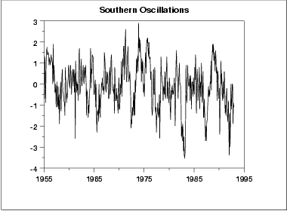
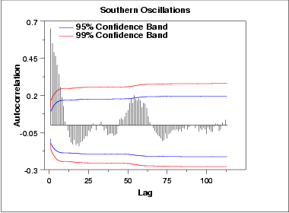
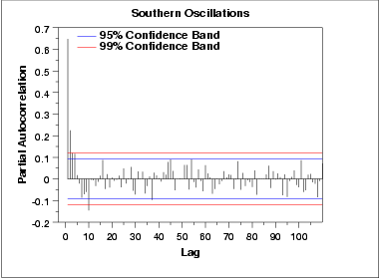
Model Identification example
run sequence plot indicates stationarity
The autocorrelation plot shows a mixture of exponentially decaying and damped sinusoidal components. This indicates that an autoregressive model, with order greater than one, may be appropriate for these data.
The partial autocorrelation plot suggests that an AR(2) model might be appropriate.

Slide 22
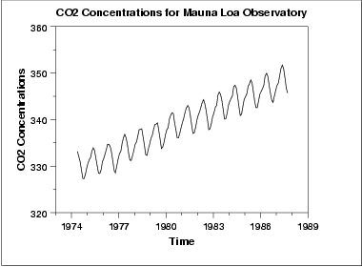
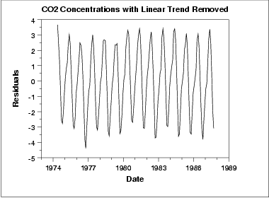
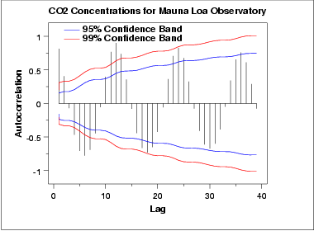
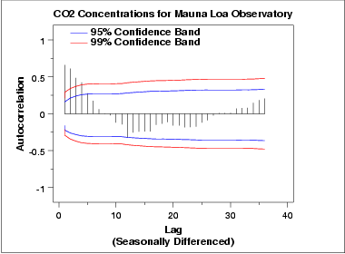
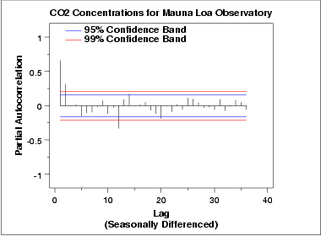
Model Identification example
run sequence plot of the data indicates a rising trend. simple linear fit should be sufficient to remove this upward trend.
This plot contains the residuals from a linear fit to the original data. But it has seasonality. To know the period draw autocorrelation plot.
The autocorrelation plot shows an alternating pattern of positive and negative spikes. It also shows a repeating pattern every 12 lags, which indicates a seasonality effect.
autocorrelation plot on seasonally differenced data shows a mixture of exponential decay and a damped sinusoidal pattern.
The partial autocorrelation plot suggests that an AR(2) model might be appropriate since the partial autocorrelation becomes zero after the second lag.

Slide 23
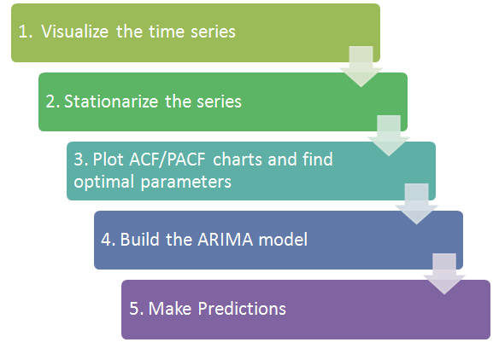
Framework of ARIMA Time series modeling
Detrending: remove the trend component from the time series. For instance, the equation of my time series is:
x(t) = (mean + trend * t) + error
Remove the part in the parentheses and build model for the rest.
Differencing : This is the commonly used technique to make series stationary. Here we try to model the differences of the terms and not the actual term. For instance,
x(t) – x(t-1) = ARMA (p , q)
This differencing is called as the Integration part in AR(I)MA.
This is followed by fixing parameters p and q, learning the model and then using the model for forecasting.

Slide 24
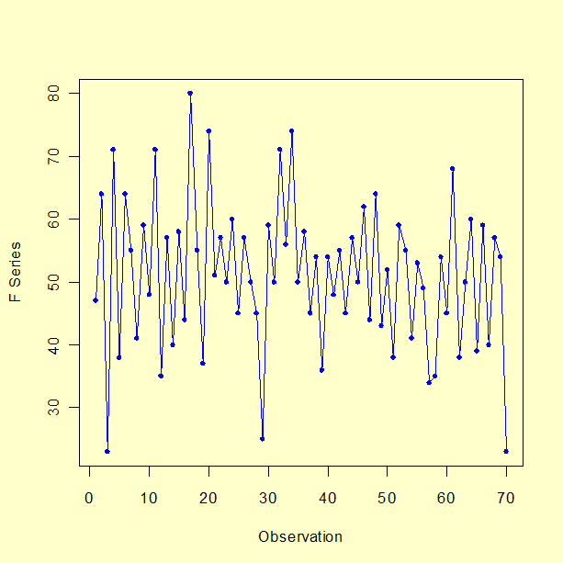
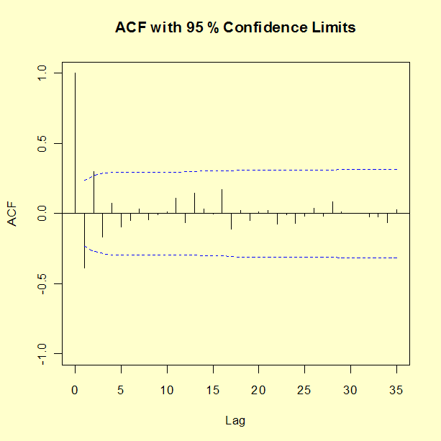
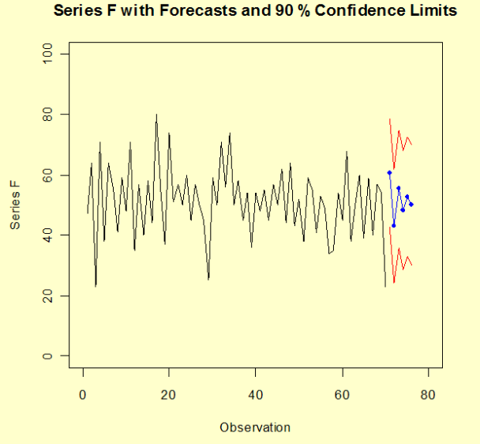
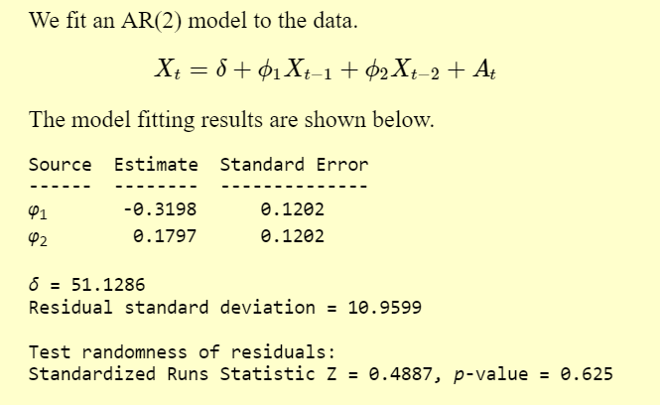
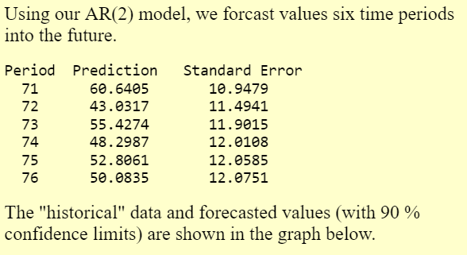
Univariate Box-Jenkins Analysis example
Run sequence plot shows no seasonal component or a noticeable trend. We compute the autocorrelation function (ACF) of the data for the first 35 lags to determine the type of model to fit to the data.
The ACF values alternate in sign and decay quickly after lag 2, indicating that an AR(2) model is appropriate for the data.

