Slide 1
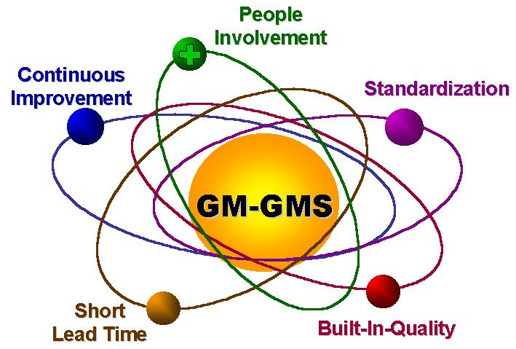
AMS
总装长沙工厂生产管理模式
AMS
概述
Notes:
Speaker’s Notes
순서 조정 필요
Vision GMDAT / DIMC ---------- Plant Manager
Strategy GMDAT / DIMC
Value GMDAT / DIMC
Mission – M.O.
GMS Structure, History ----------- Prod. Director
Introduction to People Involvement ---- Admin Director
GMS Calibration & Organization -------- GMS / COE
Need to agree between Y.K.Lee & Nancy

Slide 2
顾客满意是远远不够的!!!
我们工作是为了什么?
顾客满意
顾客热忱
Notes:
Speaker’s Notes
Cover the left side of the slide.
Say: A while ago we (GM) were talking about customer satisfaction. We were pretty sure that customer satisfaction was the key to sales. That is what our competitors are aiming for. However. . .uncover the right side of the slide.. . . .we now know that customer satisfaction is not enough. Customer enthusiasm is what we need to strive for.
What is the difference?
-When a customer is satisfied, it means we have met his/her expectations.
-When a customer is enthusiastic it means we have met and exceeded his/her expectations.
When a customer is satisfied, he is not necessarily full of praise, because we have delivered only what is expected. But when he is enthusiastic, the feeling is more emotional, and he will be so pleased with the entire buying and ownership experience that he will tell his friends.
It is like when you go to a restaurant. If the food is hot, and tastes good. You are satisfied. You might go back, but you might not. However, if when you walked in the door, the chef personally came out to greet you, they gave you a free appetizer and the food was fantastic. You would be more than satisfied, you would be enthusiastic. You will want to share the discovery with your friends, and convince them to try the restaurant. That is the reaction we would like from our customers.
If our customers are satisfied, they will become repeat buyers and loyal to our brand. Moreover they will tell their friends about their experience, and that is the best form of advertisement for us.
The converse is also true, and the consequences more severe. If there is a single defect, even a very minor one, such as a cosmetic defect, the customer will be dissatisfied, and will then tell his friends about his negative experience. This is the worst kind of publicity!!

Slide 3
谁是顾客?
外部顾客
(买车的人)
顾客热忱
内部顾客
(你!)
Notes:
Speaker’s Notes
Before we go on to talk about how we, the plant, contributes to customer enthusiasm it is important to say that when we say customer enthusiasm, we are also talking about the internal customers! You the team members of the plant, are the internal customers. You also must have job enthusiasm, and you will learn about how we try to achieve this as well.

Slide 4
如何实现顾客热忱?
顾客热忱
良好的
用户体验
+
良好的
工作体验
=
设计
工程
制造
售后
市场
销售
Notes:
Speaker’s Notes
If we look at what is actually required for customer enthusiasm, we see that it is a good buying experience followed by a good ownership experience.
Ask: What is a good buying experience?
A good buying experience is when the customer goes into the dealer, and is greeted by friendly, helpful, honest people. His car is ready, and is exactly what he has ordered, and the cost is equivalent to the value he is receiving. He is pleasantly surprised by how smoothly everything goes, and how good he feels. (This part of the equation is primarily but not entirely, sales & marketing driven)
A good ownership experience refers to the point from which he takes possession of the car. First and foremost, it must be a safe product! In addition, the quality of the product is very important to our customer. Cost (over time for service, etc. and long-term value) is also a key factor in creating a good ownership experience, and of course the service relationship when he takes it in for a check-up etc. is important. (This part of the equation is primarily, but not entirely manufacturing driven)
Show the “Opel Difference” video:
This video compares a company that cares about customer enthusiasm to a company that doesn't care. It starts by showing a man and his dog, who go into a dealer to pick up his car. Nobody cares about him, and he stands there trying to find out why his car isn't there. We then see footage of people making phone calls to the plant etc. to find out what happened to the guy's car, and nobody knows. This is all punctuated with shots of a soccer team, playing really badly in a game. In contrast, we are shown the "right" way to achieve customer enthusiasm. This time the man and his dog come in and are greeted by smiling faces. The car comes immediately, and we see shots of the people who made it all possible (in the plant etc.) This time we see shots of the same soccer team exhibiting good team work to deliver the car.

Slide 5
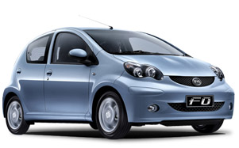
我们需要什么以实现顾客热忱?
安全，整洁和健康的工作环境
以人为本的组织
有吸引力，高质量的产品
以顾客为导向
较高的客户价值
VW
Toyota
GM
BYD
Notes:
Speaker’s Notes
To summarize, here are our goals. But the goals of our company and our competitors are the same! We all strive for safe work, attractive products, competitive cost, good customer response, and people-oriented policies.
However, the road we take will be different. To set us apart from our competitors we have developed a system to reach our goals! There are five principles which drive everything we do, in order to focus our activities to achieve our goals.

Slide 6
为什么需要AMS？
AMS
一个完整的制造体系
是实现我们所有愿景的关键！
“一个体系”
统一的‘语言’
统一的组织架构
统一的部门文化
统一的思维模式

Slide 7
AMS的创立
VDA(德国汽车工业协会标准)
比亚迪的生产模式
GMS
（通用汽车）
ISO/TS
16949
TPS
(丰田汽车)
AMS 不是“总装” 独创的体系，而是源自对丰田等先进生产方式的效仿和比亚迪现有管理模式的总结。
AMS (2012)
AMS的建立是为吸收先进的精益理念的战略性需求，是打造一个新总装的必然结果。

Slide 8
精益思想
大规模生产 vs. 精益生产
库存式的生产过程可以免于不可预期的质量问题、停产和高比例的缺勤等因素的影响。
通过全员参与减少浪费和过程质量控制，精益生产实现无间断的生产流程。
1800 (手工制造)
1900 (大规模生产)
2000 (精益生产)
制造体系 | 批量 或 大规模生产 (“福特式”) | 精益生产 (丰田)
库存 & 浪费 | 高 | 低
标准化 | 高，通过管理控制 | 高，通过组员实现
可控的管理范围 | 狭隘的 | 适中的
计划 & 问题解决 | 低 (被动的) | 高 (积极主动的)
质量（问题发生的概率） | 高（基于检查的质量） | 低 (全面质量管理)
团队合作 & 授权 | 低 | 高
风险 | 低 | 高

Slide 9
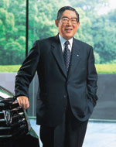

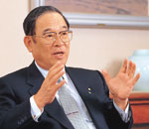
丰田管理哲学
强大的企业文化
过程和结果的平衡
保持学习的精神
所有的员工都理解并执行丰田制造体系
实现管理职能和层级的无边界合作
关注长期目标
对人性的尊重和通过消除浪费以持续改进是丰田生产方式的基础。

Slide 10
总结：什么是AMS
AMS：Assembly Manufacture System
一套标准的、系统的管理方法
覆盖生产制造相关的所有流程范围，不涉及研发及销售流程
涵盖安全、质量、效率、成本等职能，即是质量管理体系的扩展
参考了GMS（通用汽车的全球制造系统）、TPS（丰田生产方式）等先进生产体系
以总装长沙工厂为试点，是符合比亚迪特色及现状的生产方式的总结与实践

