Slide 1
Character Handling Functions in C

Slide 2
Program Overview
Takes a string input by the user and performs various transformations and checks on the string
Key Features:
Character type checks: blanks, digits, letters, etc.
String transformations: uppercase/lowercase conversion.
User-friendly menu interface.

Slide 3
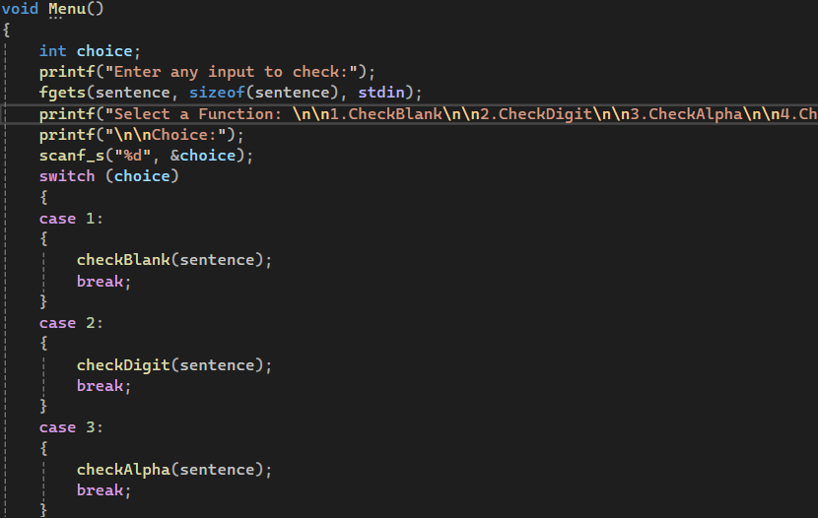
Input and Menu Structure
User Input
Reads string up to 100 characters using fgets, and scanf for user choice.
Menu Design
Presents 14 options for different string operations.
Validates user choices using a switch-case structure.

Slide 4
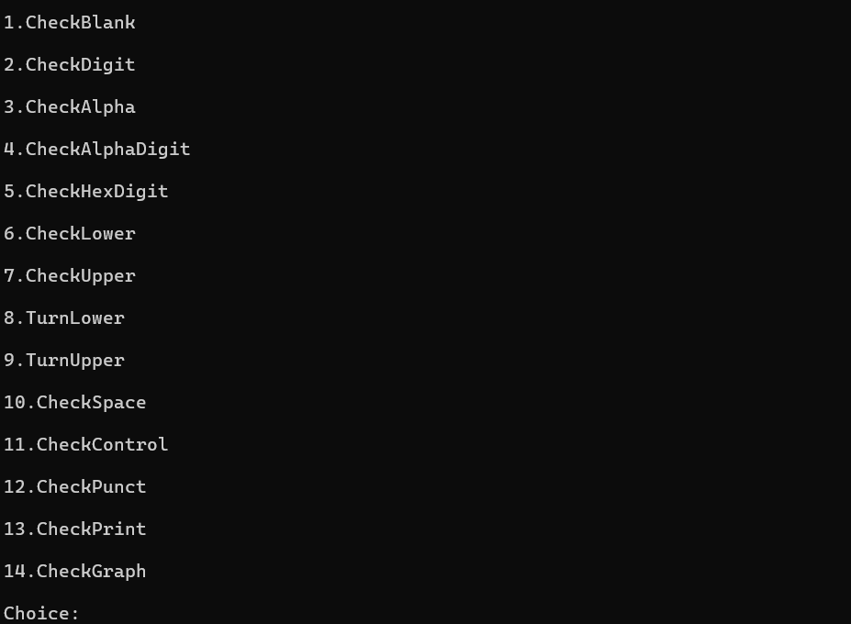
Menu Design
Once a string is entered the user will be taken to this menu:

Slide 5
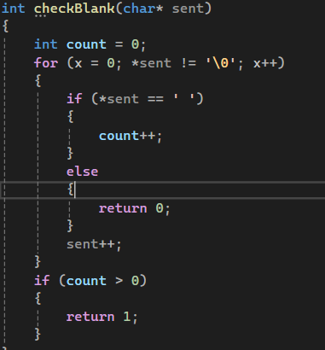
Blank Space check (checkBlank)
Functionality:
Checks if all characters in the string are spaces.
Logic:
Iterates through the string and counts spaces.
Returns 1 if all characters are spaces, 0 otherwise

Slide 6
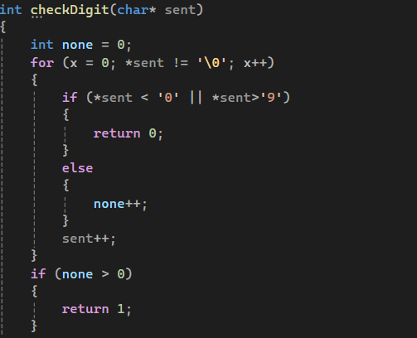
Numeric Check (checkDigit)
Functionality:
Validates if the string consists only of numeric characters.
Logic:
Iterates through the string to check for characters ‘1’ through ‘9’
Returns 1 if all characters are numbers, 0 otherwise

Slide 7
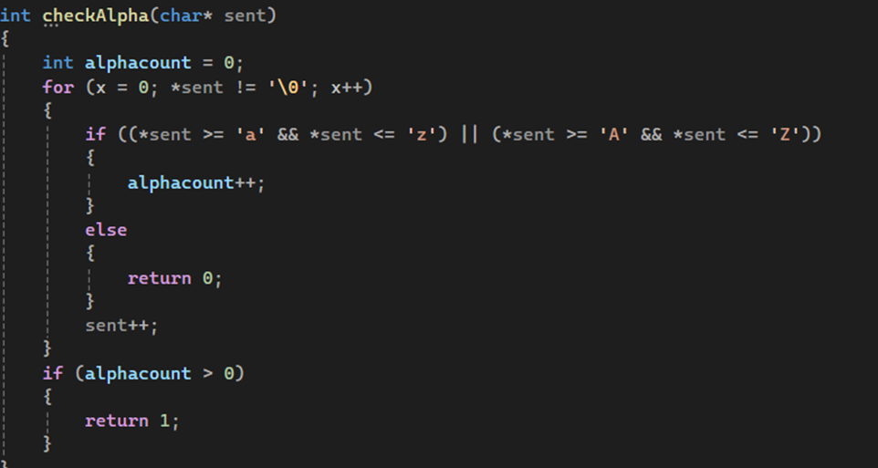
Alphabetic check (checkAlpha)
Functionality:
Validates if the string consists only of alphabetic characters.
Logic:
Iterates through the string to check for alphabetic characters ‘a-z’, ‘A-Z’
If an alphabet is detected, int alphacount++, and if alphacount is greater than 0, the function returns 1.
If no alphabet is detected the function returns 0.

Slide 8
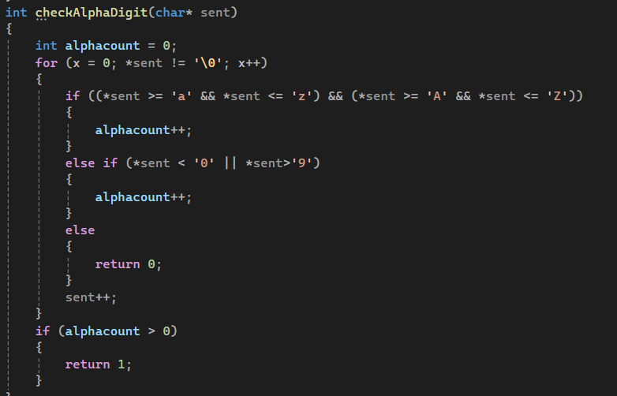
Alphanumeric check (checkAlphaDigit)
Functionality:
Validates if the string consists only of alphanumeric characters.
Logic:
Iterates through the string to check for alphabetic characters ‘a-z’, ‘A-Z’ ‘0-9’
If an alphanumeric character is detected, int alphacount++, and if alphacount is greater than 0, the function returns 1.
If no alphabet is detected the function returns 0.

Slide 9
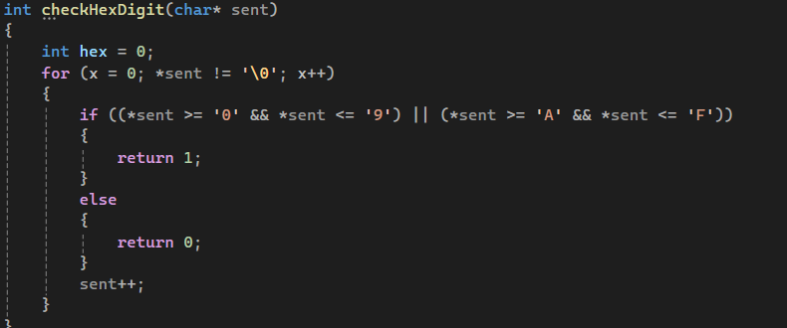
Hexadecimal Check (checkHexDigit)
Functionality:
Validates if the string consists only of hexadecimal characters: ‘0-9’ ‘A-Z’
Logic:
Iterates through the string to check for characters ‘0-9’ ‘A-Z’
Returns 1 if a hexadecimal character is detected, 0 otherwise

Slide 10
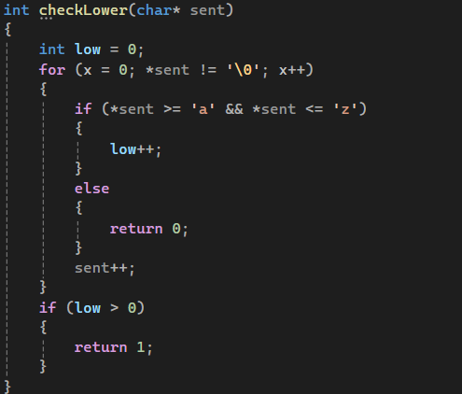
Lowercase check (checkLower)
Functionality:
Validates if the string consists only of lowercase alphabetic characters.
Logic:
Iterates through the string to check for lowercase characters ‘a-z’
If a lowercase alphabet is detected, int low++, and if low is greater than 0, the function returns 1.
If no lowercase alphabet is detected the function returns 0.

Slide 11
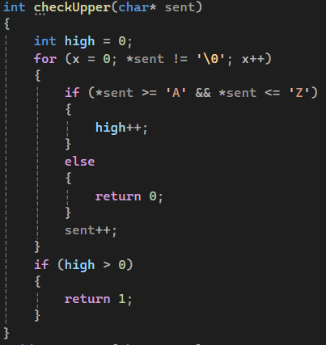
Uppercase check (checkUpper)
Function:
Validates if the string consists only of uppercase alphabetic characters.
Logic:
Iterates through the string to check for uppercase characters ‘A-Z’
If an uppercase alphabet is detected, int high++, and if high is greater than 0, the function returns 1.
If no uppercase alphabet is detected the function returns 0.

Slide 12
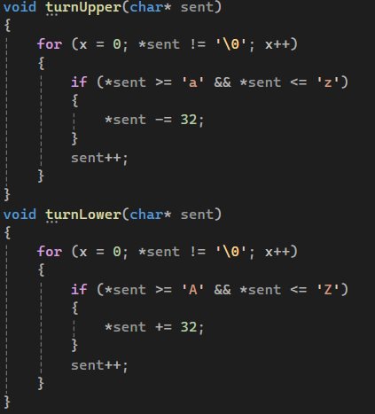
Transformation Functions (turnUpper) (turnLower)
For (turnUpper), if a lowercase character is detected it is transformed:
The difference in ASCII values for a corresponding lowercase and uppercase letter is 32, so 32 is subtracted from the character value to transform it to uppercase
Similarly for (turnLower), if an uppercase letter is detected 32 is added to its character value to transform it to lowercase

Slide 13
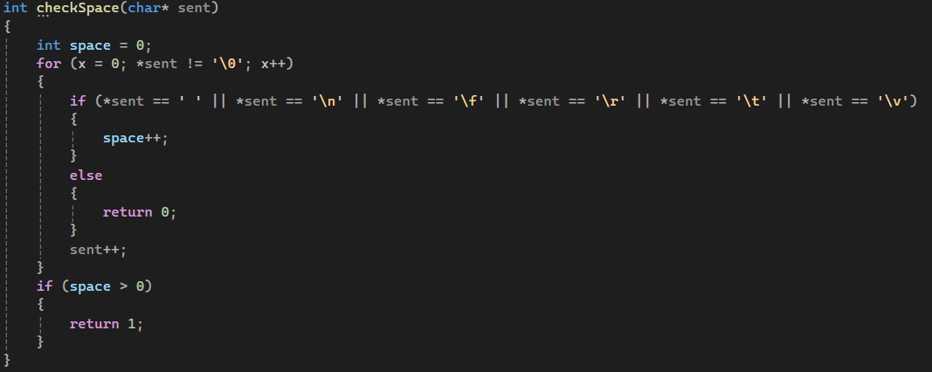
Space check (checkSpace)
Function:
Validates if there is any whitespace in the string
Logic:
Iterates through the string to check for whitespace characters
If whitespace is detected, int space++, and if space is greater than 0, the function returns 1.
If no whitespace is detected the function returns 0

Slide 14
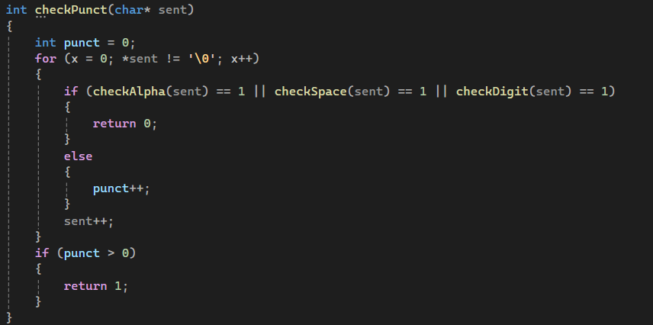
Punctuation check (checkPunct)
Function:
Checks if any punctuation characters are present in the string. (. , ; etc)
Logic:
If the string is validated by the functions checkAlpha(), checkSpace(), and checkDigit() it is not punctuation and returns 0
If it is not validated it returns 1

Slide 15
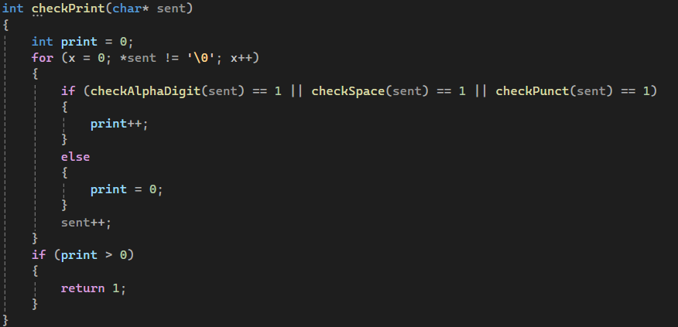
Printable check (checkPrint)
Function:
Checks the string to see if there are any printable character.
Logic:
If the string is validated by the functions checkAlphaDigit(), checkSpace(), and checkPunct() it is printable and returns 1
If it is not validated it returns 0

Slide 16
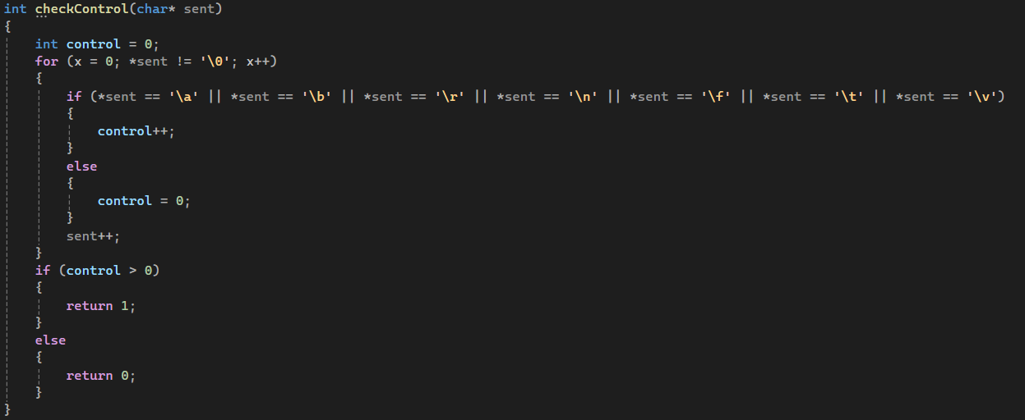
Control check (checkControl)
Purpose:
Determines if there are any control characters in the string: ‘/a’, ‘/n’ etc.,
Logic:
Iterates through the string to check for control characters
If a control character is detected, int control++, and if control is greater than 0, the function returns 1.
If no control character is detected the function returns 0.

Slide 17
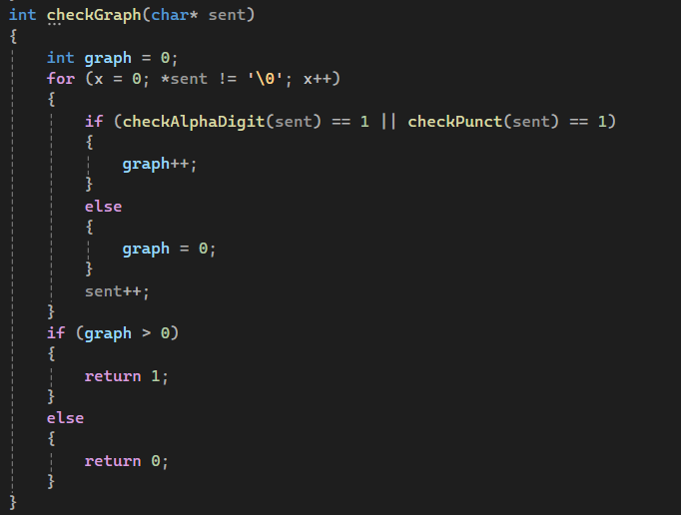
Graphical check (checkGraph)
Purpose:
Determines if there are any graphical characters in the string
Logic:
If the string is validated by the functions checkAlphaDigit(), and checkPunct() it is Graphical and returns 1
If it is not validated it returns 0

Slide 18
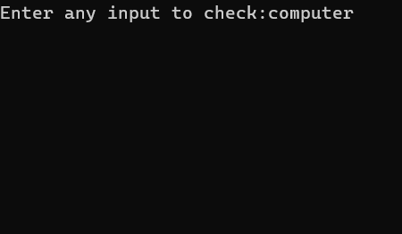
Sample Run
The string ‘computer’ will be entered by the user:

Slide 19
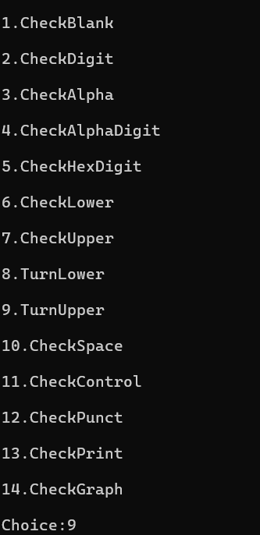
Sample Run
The user will then be taken to the menu and asked to input their choice on which function they would like to use on the string. In this instance, the user wants to turn transform their string into uppercase letters, so they choose ‘TurnUpper’ and input 9:

Slide 20
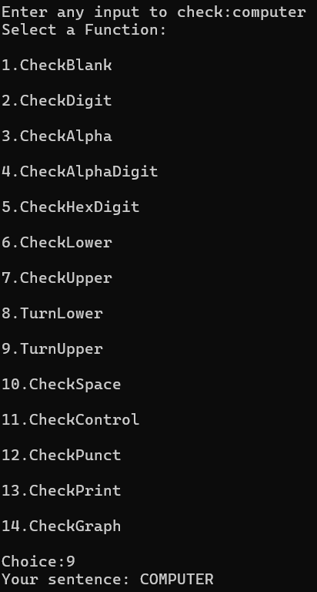
Sample Run
The program calls the turnUpper() function and converts all the letters in the string to uppercase letters:

