Slide 1
Introduction to PostgreSQL

Slide 2
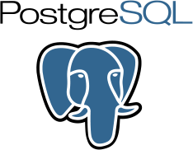
What is PostgreSQL?
PostgreSQL is an advanced, enterprise-class, and open-source relational database system. PostgreSQL supports both SQL (relational) and JSON (non-relational) querying.
PostgreSQL is a highly stable database backed by more than 20 years of development by the open-source community.
PostgreSQL is used as a primary database for many web applications as well as mobile and analytics applications.

Slide 3
Installation
Let’s Install
Connect to database

Slide 4
POSTGRESQL FUNDAMENTALS
Create Database
Create Tables
Insert data in tables

