Slide 1
FINTECHATHON 2026 · INTERNATIONAL TRACK · TOPIC F
AI is beginning to control money. Who makes sure it acts correctly?
QED is an AI treasury in which every payment and every trade carries a proof that the blockchain checks before any money moves.
QED
AI can decide. QED makes it prove.
Apurv Chauhan · Lakshya Goswami · St. Xavier's College, Mumbai
Notes:
Good morning. I'm Apurv, and with Lakshya from St. Xavier's College, Mumbai, we built QED. AI agents are starting to hold money: they pay suppliers, top up reserves and convert currencies, often with nobody watching each transaction. So our question is simple: when an AI moves money, who makes sure it acted correctly? QED is an AI treasury in which every payment and every trade carries a proof, and the blockchain checks that proof before any money moves. In one line: AI can decide. QED makes it prove.

Slide 2
THE PROBLEM
AI can follow every rule and still give you a poor rate.
An AI treasury holds dollars and must pay a euro invoice. It converts. Did it get a good price? Today, nothing checks.
01
02
03
A minimum is not the best
Checked too late
Unchecked discretion
A slippage floor only says “not worse than X”. A route 33 bps worse than the best still passes a 1% floor.
Execution quality is reviewed after settlement, when the money has already moved.
The agent decides when and how much to convert, and nobody re-checks the decision.
Brokers owe clients best execution by law. An AI agent owes it to no one.
Routes that clear a 1% floor still give up a median 14–32 bps (1,000 seeded markets, benchmarks/)
2 / 12
Notes:
Here is the problem. An AI treasury holds dollars and has to pay a euro invoice, so it converts. Did it get a good price? Today, nothing checks. First, a minimum is not the best: wallets only enforce a slippage floor, so a route 33 basis points worse than the best still passes a one percent floor. Across a thousand test markets, routes that clear the floor still give up a median of 14 to 32 basis points. Second, quality is checked too late, after the money has moved. Third, the agent decides when and how much, and nobody re-checks it. Brokers owe their clients best execution by law. An AI agent owes it to no one.

Slide 3
THE IDEA · PROOF-CARRYING TRANSACTIONS
Don't trust the agent's decision. Make the chain verify its quality.
1 · PROPOSES
2 · RE-DERIVES
3 · VERIFIES
4 · OUTCOME
AI agent
Independent co-signer
Smart contract
Settles, or reverts
Reads the instruction, plans the trade, builds the proof. Holds no key that can pay alone.
Owner's signed mandate, caps, protected liabilities, and the best-execution proof, in one transaction.
Every check passes and money moves. Any check fails and nothing moves.
→
Separate process, own key. Recomputes the decision from the chain; signs only what the owner allowed.
→
→
The AI can be wrong, manipulated or stolen. The money still moves only with a valid proof.
QED · proof-carrying autonomy for AI treasuries
3 / 12
Notes:
Our idea: don't trust the agent's decision; make the chain verify its quality. In QED, the AI proposes: it reads the instruction and plans the trade, but it holds no key that can pay alone. An independent co-signer, a separate process with its own key, re-derives the decision from the chain and signs only what the owner allowed. Then the smart contract verifies everything: the owner's signed limits, the protected funds, and a mathematical proof of quality. If any check fails, the transaction reverts and nothing moves. So the AI can be wrong, manipulated, even stolen, and the money still only moves with a valid proof.

Slide 4
THE BREAKTHROUGH · CERTIFIED BEST EXECUTION
The contract checks one inequality, inside the trade itself.
output ≥ (1 − τ) · B
B = the most any route through the owner's approved venues could return, from their live reserves. τ = one part per million.
1
2
3
The owner approves the venues the agent may use.
The agent picks any route and sends one price per token as its certificate.
The contract recomputes B, rounding against the agent. A worse route reverts.
Why B can't be faked: any prices give a valid upper bound (weak duality). Derivation: appendix A1
4 / 12
Notes:
The new part is that quality proof: certified best execution. The owner approves a set of trading venues. From their live reserves, QED computes B, the most that any route through them could possibly return. The agent proves its trade with one price per token, and here is the key: any prices give a valid upper bound, so a cheating agent cannot fake a flattering one. The contract recomputes B inside the trade, rounding against the agent, and accepts only if the output is within one part per million of B. A worse route doesn't settle. It reverts.

Slide 5
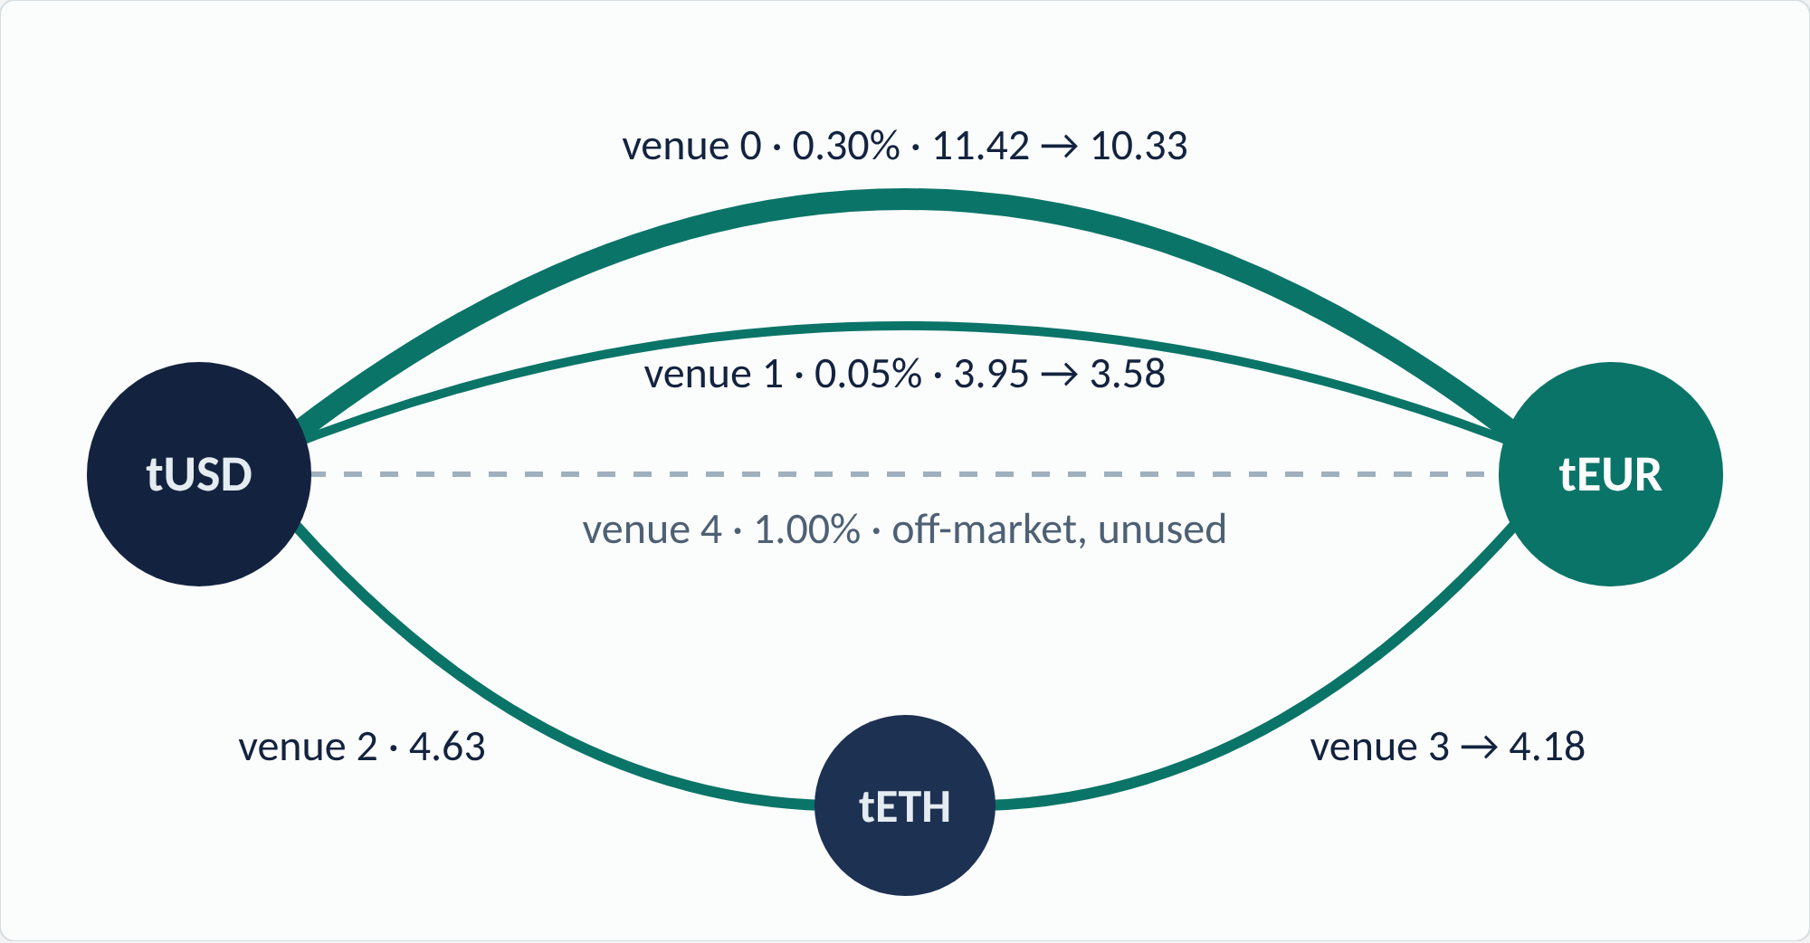
THE BREAKTHROUGH, LIVE · SEPOLIA TRANSACTION E1
20 tUSD in, 18.086846 tEUR out. The chain's own bound: 18.086849.
0.17 ppm
from the most any route through the owner's five venues could have returned
The proof
three prices: ν(tUSD) 0.891672 · ν(tETH) 2,724.50 · ν(tEUR) 1
Checked by
QEDExecution, same transaction
Transaction
0x56f798cd…9690
Amounts in tUSD → tEUR · block 11,952,708 · 1,122,781 gas
5 / 12
Notes:
And this is not a simulation. This is transaction E1 on Ethereum Sepolia, a public test network. Twenty test dollars in, 18.086846 test euros out. The chain's own bound, computed in that same transaction: 18.086849. A gap of 0.17 parts per million. The agent split the trade across venues, including a two-hop path, because that is what the optimum needed; the contract only cared that no route could have done meaningfully better. All 196 of our transactions can be re-verified by anyone with one command and no keys.

Slide 6
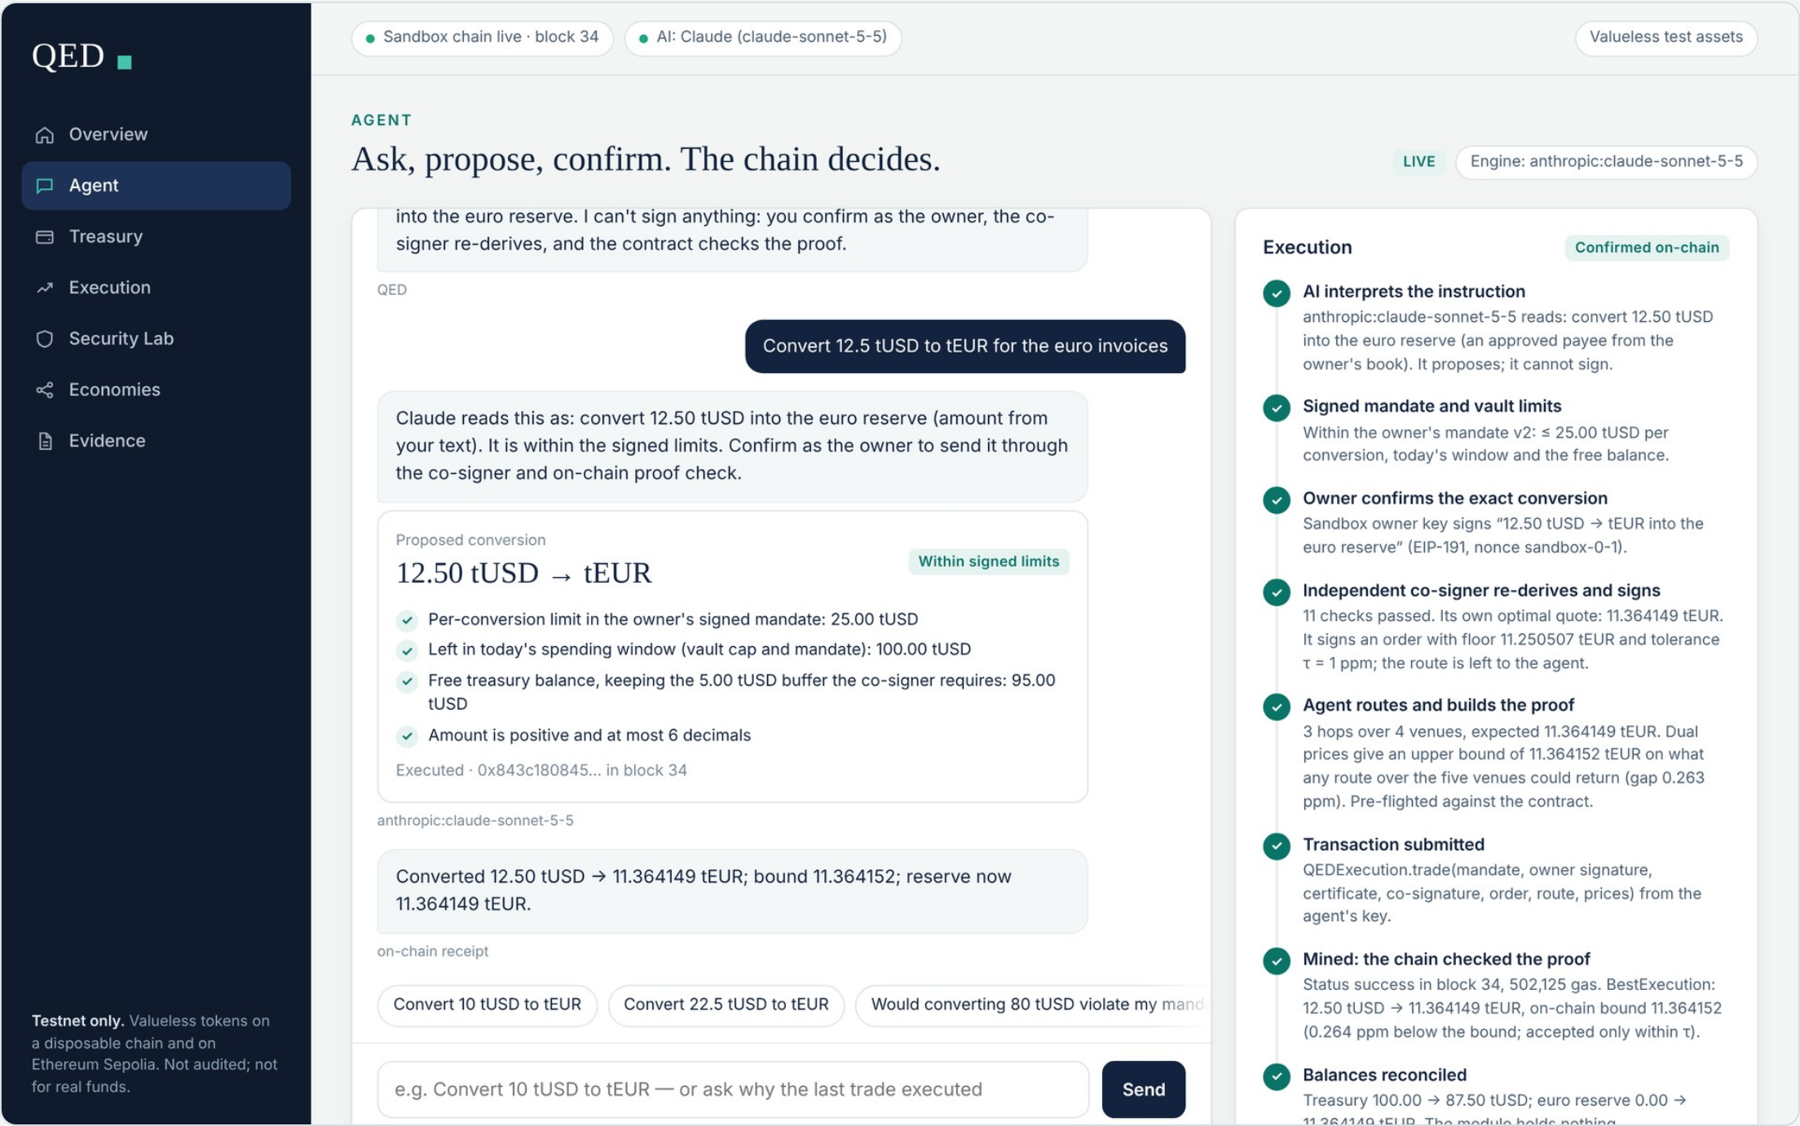
THE PRODUCT · LIVE NOW
Type an instruction. Watch it get proved.
1 · YOU ASK
“Convert 12.5 tUSD to tEUR for the euro invoices.”
2 · THE AI PROPOSES
It shows the signed limits it checked. It cannot sign.
3 · YOU CONFIRM AS OWNER
The co-signer re-derives and signs an order.
4 · THE CHAIN DECIDES
Proof checked, transaction mined, balances reconciled: 0.26 ppm from the bound.
Real QED contracts on a testnet sandbox chain · valueless tokens · no wallet needed · screenshot of the app
6 / 12
Notes:
You can try it yourself; the link is on the last slide. This is the QED app. You type an instruction, like convert 12.5 dollars to euros for the invoices. The AI interprets it and proposes, and shows which of the owner's limits it checked; it cannot sign. You confirm as the owner. The co-signer re-derives and signs, the contract checks the proof, and on the right you watch every step: the real transaction, the bound, and the balances reconciled. Ask for 80 dollars and it's refused before anything is signed, because the limit is 25. It runs the real contracts on a test chain, so you need no wallet.

Slide 7
AUTONOMY · SEPOLIA RUNS 4C AND 4D
The owner sets the goal. The agent decides how much, and when to stop.
Free tEUR in the reserve · target 45
STANDING POLICY · SIGNED ONCE BY THE OWNER
Keep at least 45 tEUR free in the euro reserve. Tranches of 2–25 tUSD. At most 150 bps cost each.
45.00
45.00
37.52
Tick 1
Short 24.30 tEUR. Converts 19.54 tUSD, limited by market impact.
PE1
Tick 2
Short 7.48 tEUR. Converts 8.84 tUSD, limited by need.
PE2
20.70
Tick 3
Target met. Sends nothing.
Start
After tick 1
After tick 2
Tick 3: stops
With both hot keys stolen, the on-chain policy still refused over-conversion (QA2) · try it in the app: Treasury
7 / 12
Notes:
So far the owner chose the amount. Here the agent decides. The owner signs one policy: keep at least 45 euros free in the reserve, in tranches of 2 to 25 dollars, at no more than 150 basis points of cost. On tick one the reserve is 24 euros short; the agent converts 19.5 dollars, limited by what the market can absorb. On tick two it converts 8.8, exactly what is still needed. On tick three the target is met, and it stops. On Sepolia the policy then became a contract that refused over-conversion even with both hot keys stolen.

Slide 8
SECURITY UNDER ATTACK · PUBLIC SEPOLIA RECEIPTS
We attacked it with stolen keys. The chain said no.
ATTACK 1
ATTACK 2
ATTACK 3
A worse route
Pay the attacker
Convert too much
A compromised agent routes through the direct pools only: 33 bps below the bound, yet above a 1% slippage floor.
Both hot keys stolen, the agent's and the co-signer's. The attacker tries to pay itself.
Both hot keys stolen again. The attacker converts more of the treasury than the policy needs.
Stopped by QEDVault · owner's signed payee list
Stopped by QEDExecution · best-execution inequality
PayeeNotInMandate
Stopped by QEDTreasuryPolicy · over-conversion clause
X6 · 0xf9a023d7…29c63c018
NotBestExecution
OverConversion
EA1 · 0xccd07d17…cd9b54937
QA2 · 0xb49d0c4f…cd23f9f3
48 attacks on Sepolia, 48 reverts, 0 tUSD to the attacker. Six run live in the app's Security Lab.
Every attack and its custom error: docs/EVIDENCE.md · appendix A12
8 / 12
Notes:
We attacked it ourselves, on the public chain. Three examples. A compromised agent takes a route 33 basis points worse: it clears a slippage floor, but the bound catches it and it reverts. With both hot keys stolen, the attacker tries to pay itself: the vault refuses, because the owner never approved that payee. And it tries to convert more than the policy needs: the policy contract refuses. In total: 48 attacks, 48 reverts, zero test dollars to the attacker. Six of them run live in the app.

Slide 9
WHY IT MATTERS · WHO WOULD PAY
Best execution becomes a precondition, not a quarterly report.
Agent treasuries
Regulated firms
Solvers and intents
Businesses, DAOs and AI services that hold one currency and owe another can delegate conversion, including when and how much, without trusting the agent's routing.
A per-trade record anyone can recompute from public state, for the best-execution duty firms already carry under MiFID II and FINRA rules.
A filler can attach the proof and be accepted on it; a protocol can settle on the proof instead of after-the-fact monitoring.
BUSINESS MODEL · A HYPOTHESIS
NOT YET VALIDATED
A verification layer: a fee per certified trade, or a licence for custodians and agent platforms.
No users, revenue or partners yet. Unaudited, testnets only. No market size is claimed.
Hypotheses, not traction · market sizing not claimed
9 / 12
Notes:
Who needs this? Autonomous treasuries: businesses, DAOs and AI services that can delegate conversions without trusting the agent's routing. Regulated firms: a best-execution record anyone can recompute. And agent-to-agent services, where a provider is paid on a proof instead of being monitored afterwards. Our business model is a hypothesis: a verification layer, charged per certified trade or licensed to custodians and agent platforms. To be clear: we have no users or revenue yet, it is unaudited, and it runs on test networks.

Slide 10
DEFENSIBILITY · PRIOR ART
Every ingredient is known. The guarantee is not.
Closest work | What it does | What it leaves open
Intents and aggregators: UniswapX, 1inch Fusion, ERC-7683 | Enforce a minimum output | Leak up to the tolerance
CoW Protocol, EBBO rule | Compare fills with baseline pools after settlement | Social, after the fact
A²MM (2021); on-chain one-hop routing (FC 2026) | Compute a split on-chain for parallel pools | Approximate, one pair, no bound
Certified routing (arXiv 2607.22540) | Off-chain KKT certificate for a router | Execution guarded by slippage
Angeris et al., EC 2022 | CFMM routing is convex; duality | Theory; routes solved off-chain
QED | Verifies any route over any owner venues, in the trade's transaction, to 1 ppm | Inside an agent's mandate, money on it
We found no prior system that makes the optimality of an executed route an on-chain condition of the trade.
Sources and the full comparison: docs/PRIOR_ART.md §0 · searched 20 Oct 2026
10 / 12
Notes:
Is it new? Every ingredient is known, and we cite them. Aggregators enforce a minimum output; CoW Protocol checks fills after settlement; research certifies routers off-chain. What we did not find is a system that makes the optimality of the executed route a condition of the trade itself, checked in the same transaction, inside an agent's spending limits. And we scope it honestly: the guarantee covers the owner's approved venues, not all of DeFi.

Slide 11
TEAM AND NEXT STEPS
Built by two students. Ready for a pilot.
Apurv Chauhan
Lakshya Goswami
WHAT WE ARE LOOKING FOR
St. Xavier's College, Mumbai
St. Xavier's College, Mumbai
1
A treasury team or agent platform to run a pilot with
24
196
145 + 60
2
An independent security audit of the contracts
3
Partners to extend the proof to more venue types
contracts verified on Sourcify
real Sepolia transactions
tests passing in CI
Open source: github.com/Nightcore709/qed-agent-wallet
11 / 12
Notes:
We are two students from St. Xavier's College, Mumbai, and everything you have seen is built and public: 24 verified contracts, 196 real transactions, and 205 tests passing. What we are looking for next: a treasury team or agent platform to pilot with, an independent security audit, and partners to extend the proof to more kinds of venues.

Slide 12
QED
AI can decide. QED makes it prove.
Verifiable financial constraints should be a precondition for autonomous execution, not an audit after the fact.
Try it: the live app, on a testnet sandbox chain (no wallet, no keys)
qed-judges-preview-production.up.railway.app
Sepolia proof ledger
Code, evidence, docs
nightcore709.github.io/qed-agent-wallet
github.com/Nightcore709/qed-agent-wallet
Apurv Chauhan · Lakshya Goswami · St. Xavier's College, Mumbai
12 / 12
Notes:
Agents will hold the money. The only question is whether they must prove they acted correctly before it moves, or we find out afterwards. QED makes it a precondition. AI can decide. QED makes it prove. The live app, the proof ledger and the code are at these three links. Thank you.

