Slide 1
FINTECHATHON 2026 · INTERNATIONAL TRACK · TOPIC F
AI is beginning to control money. Who makes sure it acts correctly?
QED is an AI treasury in which every payment and every trade carries a proof that the blockchain checks before any money moves.
QED
AI can decide. QED makes it prove.
Notes:
AI agents are starting to hold money. They pay suppliers, top up reserves and convert currencies, often with nobody watching each transaction. So here is our question: when an AI moves money, who makes sure it acted correctly? Today the answer is usually a spending limit and a hope. QED is an AI treasury in which every payment and every trade carries a proof, and the blockchain checks that proof before any money moves. In one line: AI can decide; QED makes it prove. In the next nine minutes: the problem, the idea, the proof on a public chain, and the product you can try right now.

Slide 2
THE PROBLEM
An agent that converts money can leak a little on every trade, and nothing checks it.
A floor, not a proof
Checked afterwards
Unseen discretion
Wallets and intents accept any route above a slippage limit. The agent keeps the difference.
Solver auctions compare fills with baseline pools after settlement and punish by vote.
Whether, when and how much to convert is the agent's call. Today a human approves each trade, or nobody does.
Routes that clear a 1% floor still give up a median 14–32 bps (1,000 markets).
CoW's best-price rule is “not enforced by the smart contract”.
Brokers owe clients best execution by law (MiFID II art. 27, FINRA 5310). An AI agent owes it to no one.
QED · proof-carrying autonomy for AI wallets
2 / 11
Notes:
Take a concrete case. An AI treasury holds dollars and has to pay a euro invoice, so it converts. How do you know it got a good price? Today's wallets and intent systems check one thing: did the trade clear a minimum, a slippage floor of, say, one percent. Everything above that floor is the agent's discretion. A compromised or simply careless agent can leak a little on every trade, and every trade still looks fine. On a thousand seeded markets, routes that clear a one percent floor still give up a median of 14 to 32 basis points. Auction systems compare after settlement, when the money has already moved. In traditional finance, brokers owe clients best execution by law. An AI agent owes it to no one.

Slide 3
THE IDEA · PROOF-CARRYING TRANSACTIONS
Don't trust the agent's decision. Make the chain verify its quality.
1 · PROPOSES
2 · RE-DERIVES
3 · VERIFIES
4 · OUTCOME
AI agent
Independent co-signer
Smart contract
Settles, or reverts
Reads the instruction, plans the trade, builds the proof. Holds no key that can pay alone.
Owner's signed mandate, caps, protected liabilities, and the best-execution proof, in one transaction.
Every check passes and money moves. Any check fails and nothing moves.
→
Separate process, own key. Recomputes the decision from the chain; signs only what the owner allowed.
→
→
The AI can be wrong, manipulated or stolen. The money still moves only with a valid proof.
QED · proof-carrying autonomy for AI treasuries
3 / 11
Notes:
Our idea is simple: don't trust the agent's financial decision; make the chain verify its quality. Here is how money moves in QED. The AI proposes: it reads your instruction and plans the trade, but it holds no key that can pay alone. An independent co-signer, a separate process with its own key, re-derives the decision from the chain and signs only what the owner allowed. Then the contract verifies everything: the owner's signed mandate, the caps, the protected liabilities, and a mathematical proof of quality. If any check fails, the transaction reverts and nothing moves. The AI can be wrong, manipulated, even stolen, and the money still only moves with a valid proof.

Slide 4
THE BREAKTHROUGH · CERTIFIED BEST EXECUTION
The contract checks one inequality, inside the trade itself.
output ≥ (1 − τ) · B
B = the most any route through the owner's approved venues could return, from their live reserves. τ = one part per million.
1
2
3
The owner approves the venues the agent may use.
The agent picks any route and sends one price per token as its certificate.
The contract recomputes B, rounding against the agent. A worse route reverts.
Why B can't be faked: any prices give a valid upper bound (weak duality). Derivation: appendix A1
4 / 11
Notes:
The new part is that quality proof, which we call certified best execution. The owner approves a set of trading venues. For those venues QED can compute an upper bound, B: the most that any route through them could possibly return, given their live reserves. The agent proves its trade with one price per token, a dual certificate in optimisation terms, and the key property is that any prices give a valid upper bound, so a cheating agent cannot fake a flattering one. The contract recomputes B in the same transaction, rounding against the agent, and accepts only if the output is within tau, one part per million, of B. A worse route does not settle; it reverts. The full derivation is in appendix A1.

Slide 5
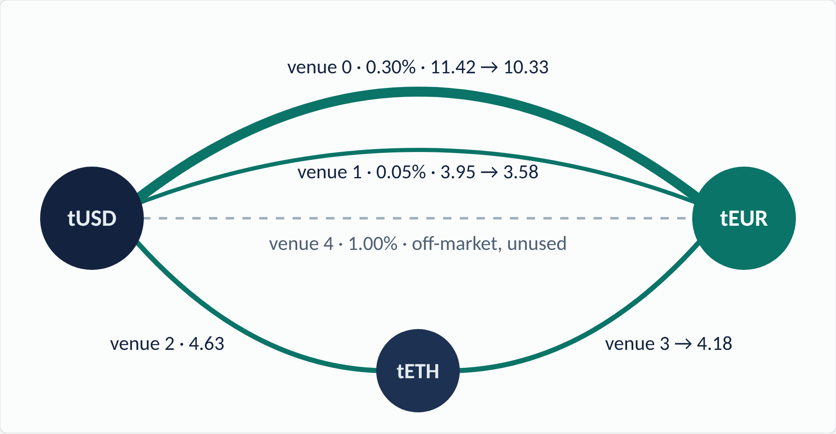
THE BREAKTHROUGH, LIVE · SEPOLIA TRANSACTION E1
20 tUSD in, 18.086846 tEUR out. The chain's own bound: 18.086849.
0.17 ppm
from the most any route through the owner's five venues could have returned
The proof
three prices: ν(tUSD) 0.891672 · ν(tETH) 2,724.50 · ν(tEUR) 1
Checked by
QEDExecution, same transaction
Transaction
0x56f798cd…9690
Amounts in tUSD → tEUR · block 11,952,708 · 1,122,781 gas
5 / 11
Notes:
This is not a simulation. This is transaction E1 on Ethereum Sepolia, a public test network. Twenty test dollars in, 18.086846 test euros out. The chain's own bound, computed in that same transaction from five venues' live reserves, was 18.086849. The gap is 0.17 parts per million. Look at the route: the agent split the trade across venues, including a two-hop path through test ether, because that is what the optimum required. The contract did not care which route the agent chose; it cared that no route could have done meaningfully better. All 196 of our Sepolia transactions, this one included, can be re-verified by anyone with one command and no keys.

Slide 6
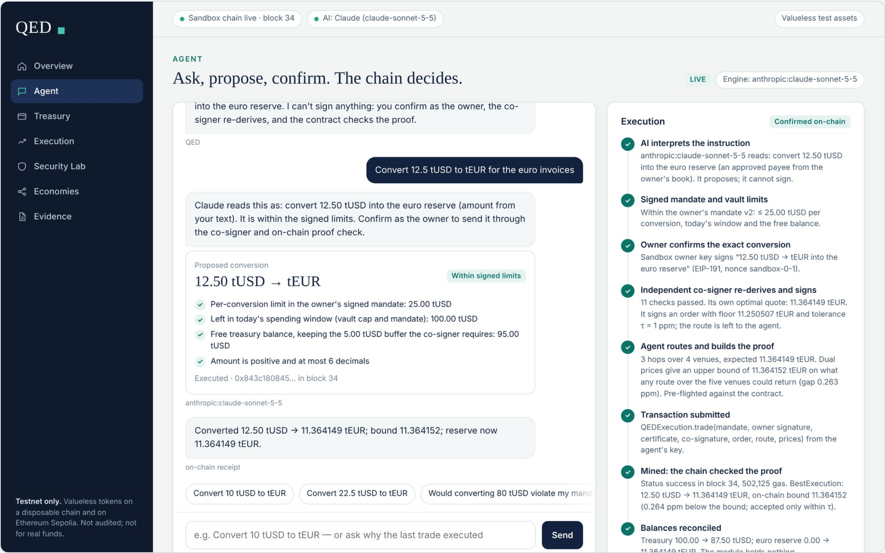
THE PRODUCT · LIVE NOW
Type an instruction. Watch it get proved.
1 · YOU ASK
“Convert 12.5 tUSD to tEUR for the euro invoices.”
2 · THE AI PROPOSES
It shows the signed limits it checked. It cannot sign.
3 · YOU CONFIRM AS OWNER
The co-signer re-derives and signs an order.
4 · THE CHAIN DECIDES
Proof checked, transaction mined, balances reconciled: 0.26 ppm from the bound.
Real QED contracts on a testnet sandbox chain · valueless tokens · no wallet needed · screenshot of the app
6 / 11
Notes:
And you can try it yourself. This is the QED app, live now; the link is on the last slide. You type an instruction, like convert 12.5 dollars to euros for the invoices. The AI interprets it and proposes; it shows you which of the owner's signed limits it checked, and it cannot sign anything. You confirm as the owner. The co-signer re-derives and signs an order, the agent builds the route and the proof, and the contract checks it. On the right you watch every step: the real transaction, the bound, a 0.26 parts-per-million gap, and the balances reconciled. Ask for 80 dollars and it is refused before anything is signed, because the mandate says 25. The app runs the real QED contracts on a sandbox test chain with valueless tokens, so you need no wallet.

Slide 7
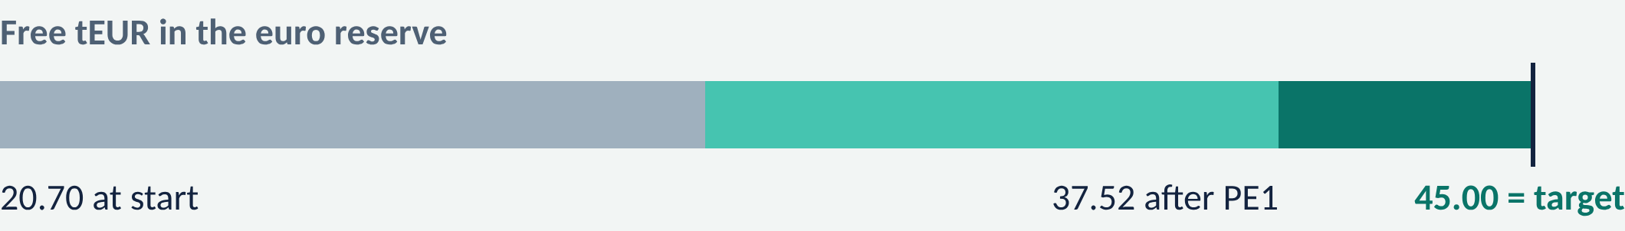
AUTONOMY · SEPOLIA RUNS 4C AND 4D
One signed policy. The agent decided when and how much.
STANDING POLICY · SIGNED ONCE
Tick 0
An over-eager agent asks for 25 tUSD at once
refused: co-signer allows 19.54, 180 bps > 150 (PA1)
Keep at least 45 tEUR free in the euro reserve. Tranches of 2–25 tUSD. At most 150 bps execution cost each.
Tick 1
Short 24.30 tEUR → convert 19.54 tUSD, limited by market impact
PE1 · 16.816098 tEUR · 0.18 ppm
Each tick the agent converts
Tick 2
Short 7.48 tEUR → convert 8.84 tUSD, limited by need
PE2 · 7.484336 tEUR · 0.40 ppm
X = min(need, impact, policy cap, mandate cap, free funds)
Tick 3
Reserve free: 20.70 → 37.52 → 45.00 tEUR. Target met.
nothing sent
and waits if X < 2 tUSD. The co-signer re-derives X before it signs; since Run 4d a contract refuses any tranche the policy does not need.
Runs with dev keys too: npm run local:execute reproduces PE1 and PE2 to the raw unit
7 / 11
Notes:
So far the owner chose the amount. Here the agent decides. The owner signs one standing policy: keep at least 45 euros free in the reserve, convert in tranches of 2 to 25 dollars, and pay at most 150 basis points each time. Each tick the agent takes the smallest of five limits: what covers the shortfall, what the market can absorb within the cost limit, two caps, and the free funds. Over-eager, it first asked for 25; the co-signer recomputed the rule and refused. Then it converted 19.5, limited by market impact. Then 8.8, limited by need. Then it stopped: target met. On Sepolia the policy then became a contract, which refused over-conversion even with both hot keys stolen. In the app you can sign your own target and watch the agent stop.

Slide 8
SECURITY UNDER ATTACK · PUBLIC SEPOLIA RECEIPTS
We attacked it with stolen keys. The chain said no.
ATTACK 1
ATTACK 2
ATTACK 3
A worse route
Pay the attacker
Convert too much
A compromised agent routes through the direct pools only: 33 bps below the bound, yet above a 1% slippage floor.
Both hot keys stolen, the agent's and the co-signer's. The attacker tries to pay itself.
Both hot keys stolen again. The attacker converts more of the treasury than the policy needs.
Stopped by QEDVault · owner's signed payee list
Stopped by QEDExecution · best-execution inequality
PayeeNotInMandate
Stopped by QEDTreasuryPolicy · over-conversion clause
X6 · 0xf9a023d7…29c63c018
NotBestExecution
OverConversion
EA1 · 0xccd07d17…cd9b54937
QA2 · 0xb49d0c4f…cd23f9f3
48 attacks on Sepolia, 48 reverts, 0 tUSD to the attacker. Six run live in the app's Security Lab.
Every attack and its custom error: docs/EVIDENCE.md · appendix A12
8 / 11
Notes:
We attacked it ourselves, on the public chain. Three examples. A compromised agent routes through the direct pools only, 33 basis points worse: that would clear a one percent slippage floor, but the bound catches it and the trade reverts with NotBestExecution. With both hot keys stolen, the agent's and the co-signer's, the attacker tries to pay itself: the vault refuses, because the owner never approved that payee. And with both keys stolen again, it tries to convert more than the policy needs: the policy contract refuses. In total: 48 attacks, 48 reverts, zero test dollars to the attacker. Six of them run live in the app's Security Lab.

Slide 9
WHY IT MATTERS · WHO WOULD PAY
Best execution becomes a precondition, not a quarterly report.
Agent treasuries
Regulated firms
Solvers and intents
Businesses, DAOs and AI services that hold one currency and owe another can delegate conversion, including when and how much, without trusting the agent's routing.
A per-trade record anyone can recompute from public state, for the best-execution duty firms already carry under MiFID II and FINRA rules.
A filler can attach the proof and be accepted on it; a protocol can settle on the proof instead of after-the-fact monitoring.
BUSINESS MODEL · A HYPOTHESIS
NOT YET VALIDATED
A verification layer: a fee per certified trade, or a licence for custodians and agent platforms.
No users, revenue or partners. Unaudited, testnet only. Next: audit, more venue types, a pilot with a treasury team.
Hypotheses, not traction · market sizing not claimed
9 / 11
Notes:
Who would need this? First, autonomous treasuries: businesses, DAOs and AI services that hold one currency and owe another can delegate conversion, even its timing, without trusting the agent's routing. Second, regulated firms: a per-trade best-execution record that anyone can recompute from public state. Third, agent-to-agent services: a solver or provider can be paid on a proof instead of being monitored afterwards. Our business model is a hypothesis: a verification layer, with a fee per certified trade or a licence for custodians and agent platforms. To be clear about where we are: no users, no revenue, no partners; it is unaudited and runs on testnets. The next steps are an audit, more venue types, and a pilot with a treasury team.

Slide 10
DEFENSIBILITY · PRIOR ART
Every ingredient is known. The guarantee is not.
Closest work | What it does | What it leaves open
Intents and aggregators: UniswapX, 1inch Fusion, ERC-7683 | Enforce a minimum output | Leak up to the tolerance
CoW Protocol, EBBO rule | Compare fills with baseline pools after settlement | Social, after the fact
A²MM (2021); on-chain one-hop routing (FC 2026) | Compute a split on-chain for parallel pools | Approximate, one pair, no bound
Certified routing (arXiv 2607.22540) | Off-chain KKT certificate for a router | Execution guarded by slippage
Angeris et al., EC 2022 | CFMM routing is convex; duality | Theory; routes solved off-chain
QED | Verifies any route over any owner venues, in the trade's transaction, to 1 ppm | Inside an agent's mandate, money on it
We found no prior system that makes the optimality of an executed route an on-chain condition of the trade.
Sources and the full comparison: docs/PRIOR_ART.md §0 · searched 20 Oct 2026
10 / 11
Notes:
Is this new? Every ingredient is known, and we cite them. Intent systems and aggregators enforce a minimum output. CoW Protocol compares fills after settlement. Some research computes routes on-chain for one pair, or certifies a router off-chain. Angeris and colleagues gave us the duality. What we did not find, after searching, is a system that makes the optimality of the executed route a condition of the trade itself, checked in the same transaction, inside an agent's spending mandate. And the claim is scoped honestly: the guarantee covers the owner's approved constant-product venues, not all of DeFi.

Slide 11
QED
AI can decide. QED makes it prove.
Verifiable financial constraints should be a precondition for autonomous execution, not an audit after the fact.
Try it: the live app, on a testnet sandbox chain (no wallet, no keys)
qed-judges-preview-production.up.railway.app
Sepolia proof ledger
Code, evidence, docs
nightcore709.github.io/qed-agent-wallet
github.com/Nightcore709/qed-agent-wallet
QED · FinTechathon 2026 · International Track · Topic F
11 / 11
Notes:
Agents will hold the money. The question is whether they must prove they acted correctly before it moves, or whether we find out afterwards. QED makes it a precondition: who may pay, what may never be spent, whether a trade got the best price, each one checked by the chain. AI can decide. QED makes it prove. The live app, the Sepolia proof ledger and all the code are at these three links. Thank you.

Slide 12
THE INSIGHT
A price vector is a proof.
For any prices ν, no route through the owner's venues can return more than
B(ν) = ν_{s}A + Σ_{venues} [ (√(ν_{b}R_{b}) − √(ν_{a}R_{a}/γ))₊² + (√(ν_{a}R_{a}) − √(ν_{b}R_{b}/γ))₊² ]
A is the input, R_{a}, R_{b} a venue's live reserves, 1 − γ its fee. Each term is the most that venue can add at prices ν, in closed form.
Unforgeable
Tight
Exact on-chain
Weak duality: every ν gives a valid upper bound. A dishonest agent cannot fake a proof; it can only fail to have one.
Strong duality: at the right ν the bound meets the optimum. Our solver finds it in a median 3.3 ms.
Every rounding step goes up, so the theorem survives integer arithmetic. The check costs O(venues).
Notes:
The key idea: routing through constant-product pools is a convex problem, so it has a dual. Pick any price for each token, and the value of every possible route is bounded by this sum, one closed-form term per pool from its live reserves and fee. Three properties follow. Unforgeable: every price vector gives a valid bound, so an agent can't fake a proof, only fail to have one. Tight: at the right prices the bound equals the optimum, and our solver finds them in milliseconds. Exact: we round every step upward, so it survives the EVM. The contract checks one inequality.

Slide 13
THE MECHANISM · QEDEXECUTION.TRADE
The agent routes freely. The contract checks one inequality.
1 · Order
2 · Bound
3 · Funding
The co-signer's certificate commits to hash(order): recipient in the owner's mandate, its own floor, τ, the venue set.
B̂(ν) from the live reserves of every owner venue, not only those used, every step rounded up.
The unchanged QEDVault pays exactly A: mandate, co-signature, caps and solvency all still apply.
4 · Route
5 · Nothing left
6 · Two checks
Up to 32 hops of any shape: splits, multi-hop, the same pool twice.
No intermediate token may stay behind; unspent input goes back to the vault.
out ≥ floor (market risk) and out·10⁶ ≥ B̂·(10⁶ − τ) (best execution), out measured as a balance change.
Every accepted trade delivered at least (1 − τ)·OPT on the state it executed against, whatever route the agent chose.
Proof: docs/ALGORITHMS.md §12 · contract: contracts/src/QEDExecution.sol
Appendix A2
Notes:
In one transaction the contract checks the order the independent co-signer certified: recipient, the co-signer's own floor, the venue set. It computes the bound over every venue the owner allows, rounding up. Funds come through the original QED vault, so mandate, caps and solvency still apply. The agent's route runs, any shape, and nothing may be left behind. What actually arrived must clear the floor and be within tau of the bound. Whatever route the agent picks, the result is near-optimal.

Slide 14
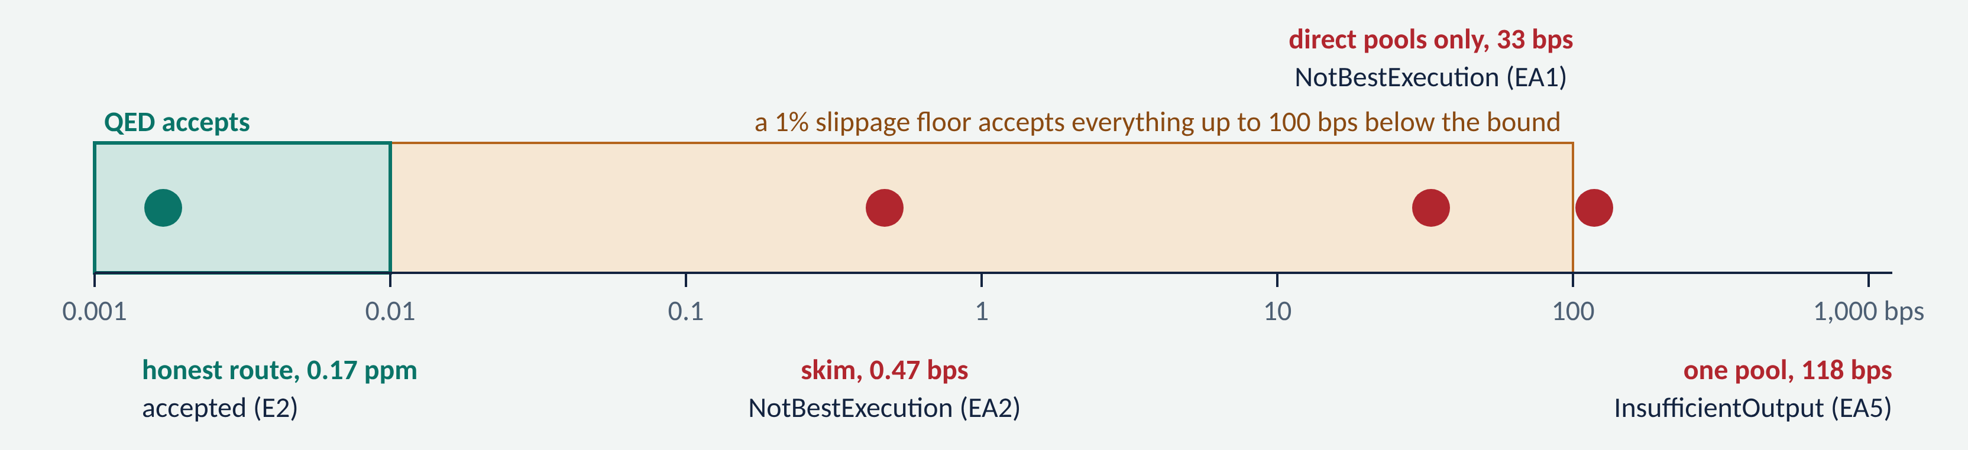
A COMPROMISED AGENT, ONE CO-SIGNED ORDER
Every leak a slippage limit allows, refused on-chain
“Forged” prices to bless a bad route → NotBestExecution (EA3)
Strand the bridge token → Leftover (EA4)
Redirect the output to Mallory → OrderMismatch (EA6)
Call without the agent key → NotOperator (EA7)
Front-run the signed order → InsufficientOutput (EA8)
Then the agent re-plans and declines to trade into the moved market (A10)
All on Sepolia under one genuine co-signed order; the honest route then went through with the same certificate
Appendix A3
Notes:
Now we attack it. A compromised agent gets a genuine co-signed order and tries every leak a slippage limit allows. The axis is distance below the bound, log scale. Orange is what a one-percent floor accepts; green is what QED accepts. A direct-pools-only route, 33 basis points short, would pass any one-percent wallet: here it reverts with NotBestExecution. A half-basis-point skim: rejected. Prices chosen to bless a bad route: rejected. Stranding the bridge token, redirecting the output, calling without the key: rejected. A front-run hit the co-signed floor, and our agent then declined to trade into the moved market.

Slide 15
TOPIC F · THE FOUR REQUIRED OUTCOMES
Each outcome is a public transaction you can open.
# | Outcome | Evidence on Ethereum Sepolia
O1 | A separate AI-agent key acts under an independent policy certificate | L4 0x56a2334e… payment · E1 0x56f798cd… trade · PE1 0xaaa0bacd… and QE1 0x12739525… agent-initiated
O2 | Paid work ends in a real escrow settlement | L6 0x4166253f… 15 tUSD on an optimality proof · Z3 0xbb619bf0… 12 tUSD on a zero-knowledge proof
O3 | An adversary cannot breach a liability or tamper with signed terms | 48 attacks, 48 reverts, 0 tUSD to the attacker; e.g. EA1 0xccd07d17…, and P3 0x9f4a753c…: the creditor paid during a pause
O4 | A reviewer can reproduce everything | npm run verify: every claim re-derived from a public RPC, no keys, in CI daily; 24 contracts verified on Sourcify
Built on QED's earlier proofs, unchanged:
owner mandate × co-signer
ring-fenced solvency
paid work on a KKT proof
bounded loss
proven clearing
zero-knowledge optimality
All 196 transactions with blocks and errors: docs/EVIDENCE.md · backup slides B1–B8
Appendix A4
Notes:
Topic F's four outcomes, each a transaction. One: a separate agent key under an independent certificate: L4 for a payment, E1 for a trade, PE1 for a trade the agent started itself. Two: paid work settled through escrow, on an optimality proof and on a zero-knowledge proof. Three: 48 attacks, 48 reverts, nothing to the attacker. Four: one command re-derives every claim, with no keys, daily in CI.

Slide 16
EVALUATION · 1,000 SEEDED MARKETS
What the proof buys, including where it buys little
Median shortfall below the optimum, bps
14–32 bps
median a hostile agent keeps per trade while still clearing a 1% floor (max 99.9). With QED: ≤ 0.01.
0.075 ppm
median gap between our route and its own bound; 92.3% within 1 ppm; solver 3.3 ms median.
3.2 bps
Honest limit: for trades under 0.5% of depth a good router is already this close. There the proof buys the guarantee, not the average.
benchmarks/run.ts · fixed seeds, re-run and diffed in CI · baselines are simple policies, not production aggregators
Appendix A5
Notes:
Does it matter? On a thousand seeded markets, routing policies without a proof fall a median 34 to 117 basis points short of the optimum. The security reading: among routes that still clear a one-percent floor, a hostile agent keeps a median 14 to 32 basis points per trade. Under QED, at most one part per million. Our own routes land a median 0.075 parts per million from their bound. And honestly: for small trades in deep markets a good router is already within about three basis points, so there QED adds the guarantee, not the average.

Slide 17
FALSIFIABLE, FOR MONEY
Beat the bound and the contract pays you 1,000 tUSD.
3,000 tUSD
EXECUTIONBOUNTY · 0X3148…19C4
Runs your route on its own funds and compares the output with the deployed QEDExecution's bound. No judge, no owner, no withdrawal.
unclaimed across three theorems: best execution, portfolio optimality, clearing maximality. Checked daily in CI.
6,000
XA1
the optimal route itself → TheoremHolds
XA2
prices lowered 3% to shrink the bound → TheoremHolds
fuzzed routes, prices and claims never beat the bound; weak duality also holds on 12,000 route–price pairs off-chain.
XA3
the whole 1,000 tUSD in one trade → TheoremHolds
Positive control
against a bound understated by 0.1%, the bounty pays the first real refutation, so the check is not vacuous.
145 Solidity + 60 TypeScript tests · contracts/test/QEDExecution.t.sol
Appendix A6
Notes:
A claim like this should be falsifiable, so we put money on it. ExecutionBounty holds a thousand test dollars. Give it any route and prices: it runs your route on its own funds, compares with the deployed bound, and pays you if you beat it. No judge. On Sepolia, three attempts, including the whole pool in one trade, reverted with TheoremHolds. Six thousand fuzzed attempts never beat the bound, and a positive control shows the bounty does pay when a bound is wrong.

Slide 18
CHECK US · AND OUR LIMITS
Don't trust the slides. Re-derive them.
What QED does not do
npm run verify
The proof is about the state a trade executes on: a front-run smaller than the 1% co-signed floor is not caught.
every claim from a public Sepolia node, no keys: bytecode, receipts, replayed reverts, each bound recomputed, routes replayed
QED_OFFLINE=1 npm run local:execute
Venues must be honest constant-product pools the owner names; concentrated liquidity is not covered yet.
the whole best-execution economy and the policy loop with dev keys; PE1 and PE2 reproduce to the raw unit
The policy contract enforces safety, not liveness: a slow or idle agent is not caught.
forge test · npm run test:ts
145 + 60 tests; 24 contracts verified on Sourcify; all of it in CI on every push
Testnet, valueless tokens, not audited.
docs/REPRODUCIBILITY.md · docs/KNOWN_LIMITATIONS.md · docs/SECURITY.md K1–K29
Appendix A7
Notes:
Please don't trust these slides. One command re-derives every claim from a public Sepolia node with no keys: bytecode, receipts, replayed attacks, each bound recomputed, each route replayed. Another runs the whole economy and the autonomous policy on a laptop and reproduces the Sepolia trades to the last unit. The limits, plainly: a front-run smaller than the one-percent floor isn't caught; venues must be honest constant-product pools; the policy contract enforces safety, not liveness; and this is an unaudited testnet prototype.

Slide 19
PROOF 1 · AUTHORITY
The AI’s key can pay only under two signatures it doesn’t hold.
The owner’s mandate
Signed once, off-chain, with a cold key. Names the payees, the caps and an expiry.
ON SEPOLIA · TRANSACTION L4
0x56a2334e…83b6
The co-signer’s certificate
Sent by
the AI agent’s key 0x2A10…d0Bb
A separate process with its own key runs 12 checks, then signs the exact recipient, amount, date, a single-use id and the hash of its decision record.
Mandate signer
the owner 0xb7Ed…97f7
Certificate signer
the co-signer 0xf1F8…2402
The vault’s own rules
Evidence hash
0xb0dd4c99… = keccak256 of the published record, 12 of 12 checks
Payee in the mandate, caps, no replay, solvency. Change one signed byte and the payment reverts.
Paid
6 tUSD to Helix Data for a licensed risk model
QED before the upgrade, unchanged and still live
Appendix A8
Notes:
Proof one answers the first rubric question. In transaction L4 the sender is the AI agent’s own key. The vault recovered the owner’s signature on the mandate and the co-signer’s signature on a certificate binding the exact recipient, amount and a single-use id. The certificate also carries the hash of the co-signer’s decision record, all 12 checks, which is published in our repository, so anyone can see exactly why this payment was allowed. Change any signed field and it reverts.

Slide 20
PROOF 2 · SOLVENCY
Money owed to a creditor can only ever reach that creditor.
70 tUSD ring-fenced for CloudCo’s compute bill
30 tUSD free
B ≥ P
Who can move it?
Pause stops the AI, not the creditors
Not the AI. Not the co-signer. Not even the owner. Only settlement to the creditor, or the creditor releasing its own claim.
On Sepolia the vault was paused, then the attacker’s own address called settle(). CloudCo received exactly 70 tUSD (P3).
Balance covers every ring-fenced liability at every block. Proved by induction; fuzzed with both hot keys stolen.
QED before the upgrade, unchanged and still live
Appendix A9
Notes:
Proof two covers the protected-liability question. The owner ring-fenced 70 of 100 for CloudCo’s compute bill. Those 70 can now reach CloudCo and nobody else: not the AI, not the co-signer, not even the owner. Every outflow is checked against the free balance, which we proved by induction and fuzzed with an attacker holding both hot keys. And pausing stops the AI, never the creditor: on Sepolia, during a pause, the attacker’s own address triggered settlement and the money still went to CloudCo.

Slide 21
PROOF 3 · CORRECTNESS
The escrow pays for a proof, not a promise.
minimise ½ wᵀΣw s.t. Σw_{i} = 1, w ≥ 0
DELIVERED AND VERIFIED ON SEPOLIA · L6
The AI solves it off-chain and submits the portfolio with its multipliers and a factor L. The contract checks, in exact integers:
US Treasuries 7–10y
80.81%
Global Equities
16.32%
Condition | What it rules out
w ≥ 0, weights sum to 1 | short selling, leverage
μ ≥ 0 | fake multipliers
Σw = ν + μ, within τ | any portfolio that isn’t stationary
Σ wᵢμᵢ ≤ τ | a duality gap: suboptimal work
Σ = LLᵀ, within τ | a non-convex trick
Gold
2.87%
Bitcoin, IG credit, REITs: 0%, each with μ > 0, which proves adding them would raise risk.
f(w) − f* ≤ (2n + 3 + |ν|)·τ ≈ 1.5 × 10⁻⁸
Residual 0 · duality gap 0 · about 0.3 M gas to check
QED before the upgrade, unchanged and still live
Appendix A10
Notes:
Proof three. Escrow today needs a human or an oracle to accept work; we replaced acceptance with a theorem. The client buys a minimum-variance portfolio. The AI solves it off-chain and must attach a Karush–Kuhn–Tucker certificate. The contract checks it in exact integers, which is cheap, while solving would be expensive. We prove that passing the check puts the portfolio within 1.5 times ten to the minus eight of the optimum. The escrow pays for a proof, not a promise.

Slide 22
OUTCOME 2 · PAID WORK, SETTLED BY PROOF
One business cycle, end to end, on Sepolia
1
2
3
4
5
6
Request
Quote
Escrow
Buy data
Solve
Settle
A robo-advisor agent asks for an optimal portfolio, budget 20 tUSD
QED prices it at 15 (cost 6) and signs the terms
The client locks 15 tUSD with the signed quote (L2)
The AI key pays 6 tUSD for the risk model, co-signed (L4)
1.7 ms to the exact optimum and its proof
The chain checks the proof; 15 tUSD lands in the vault (L6)
Meanwhile, a cheaper rival bid 9 tUSD and tried to cut corners
Lazy 1/N portfolio → DualityGapTooLarge, gap 0.0191 (X17)
Optimum nudged 0.01% → StationarityViolated (X18)
Deadline passed → the client got all 9 tUSD back (X19)
Result: +9 tUSD margin for QED, the ring-fence untouched, the dishonest provider paid nothing.
QED before the upgrade, unchanged and still live
Appendix A11
Notes:
The live run answers the second rubric question. A robo-advisor agent asked for an optimal portfolio. QED priced it at 15, cost 6, and signed the quote; the client locked 15 in escrow. The agent bought the risk model it needed with its own key and a co-signed certificate, solved in two milliseconds and delivered the proof. The contract checked it and released 15. A cheaper rival’s lazy answer and near miss were rejected, and the client was refunded.

Slide 23
OUTCOME 3 · ADVERSARIES
19 attacks on the public chain. 19 reverts. 0 tUSD to the attacker.
Tx | Attempt | Reverted with
X2 | Edit price in signed quote | BadProviderSignature
X3 | Redirect quote’s payee | BadProviderSignature
X5 | Stolen AI key, forged co-sign | BadCosignerSignature
X6 | Both hot keys pay attacker | PayeeNotInMandate
X7 | Self-signed mandate | BadOwnerSignature
X8 | Real cert, amount 6 → 9 | BadCosignerSignature
X9 | Real cert, new recipient | BadCosignerSignature
X10 | Replay a real certificate | IntentAlreadyUsed
X11 | Both keys overdraw free funds | SolvencyViolation
X12 | Both keys exceed the 24 h cap | ExceedsDailyCap
Tx | Attempt | Reverted with
X13 | AI key calls withdraw() | NotOwner
X14 | AI key voids creditor’s claim | NotCreditor
X15 | AI key lifts its own cap | NotOwner
X17 | Lazy 1/N portfolio | DualityGapTooLarge
X18 | Optimum nudged 0.01% | StationarityViolated
H4 | Published keys pay attacker | PayeeNotInMandate
H5 | Published keys take 50 | ExceedsPerPaymentCap
H6 | Published keys withdraw() | NotOwner
P2 | Valid payment while paused | VaultPaused
Run 1 only; 29 more in runs 2–4 (48 in all): docs/EVIDENCE.md
Appendix A12
Notes:
The third rubric question: can an adversary break a protected liability or tamper with signed terms? We broadcast 19 attacks to the public chain so the failures are permanent receipts. The attacker edited signed quotes and certificates, replayed them, stole the AI key and then the co-signer key, and tried to pay herself, overdraw and burst the daily cap. She tried owner powers and cancelling the creditor’s claim. Every one reverted with exactly the designed error. She received zero.

Slide 24
PROOF 4 · BOUNDED LOSS
We published the AI’s keys. The money stayed put.
WORST CASE IF BOTH HOT KEYS ARE STOLEN
BR(h) = min( free, cap left + k·D )
HONEYPOT VAULT 0XE5B3…7F04
Published
its AI key and co-signer key, in our repo
Zero while paused. Computed on-chain by QEDLens.blastRadius() at any block, and fuzzed as an upper bound.
Ring-fenced
90 tUSD for CloudCo until 30 Jun 2027
The keys can
pay CloudCo up to 1 tUSD a day (H3)
Loss to any address the owner didn’t approve: exactly 0.
The keys can’t
pay anyone else (H4), take more (H5) or withdraw (H6)
Check it
live on the dashboard, any block
QED before the upgrade, unchanged and still live
Appendix A13
Notes:
Proof four: risk is a number. QEDLens computes, at any block, the most that could leave if both hot keys were stolen: zero while paused, and only ever to payees the owner approved. To make it concrete, we published a second vault’s AI key and co-signer key in our repository. Anyone can try. With both keys you can pay the approved creditor one token a day, nothing else. Its 90 ring-fenced tokens are protected by the contract, not by secrecy.

Slide 25
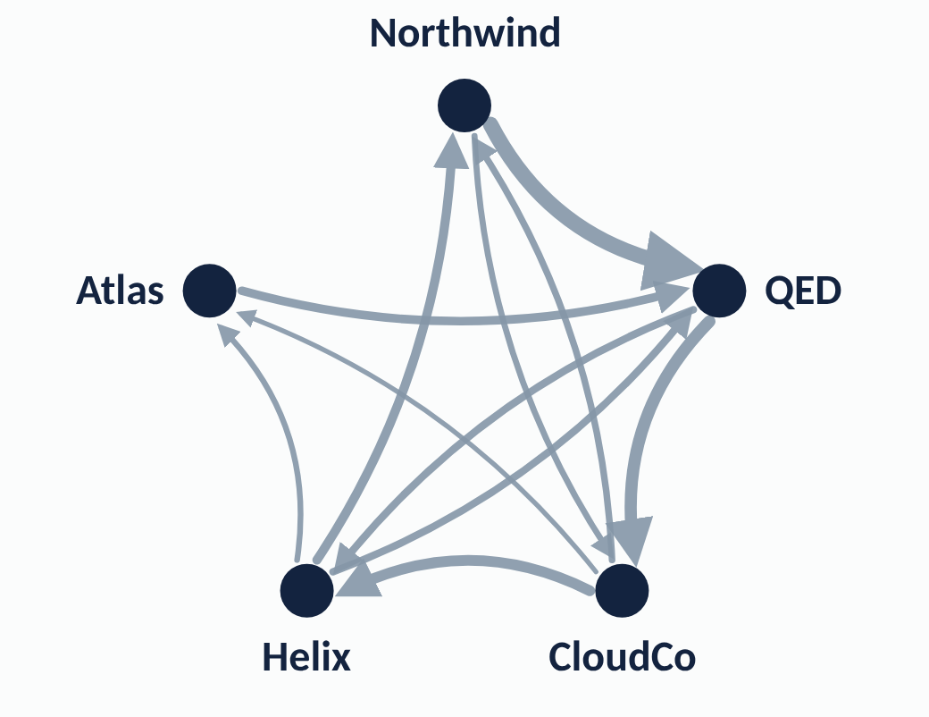
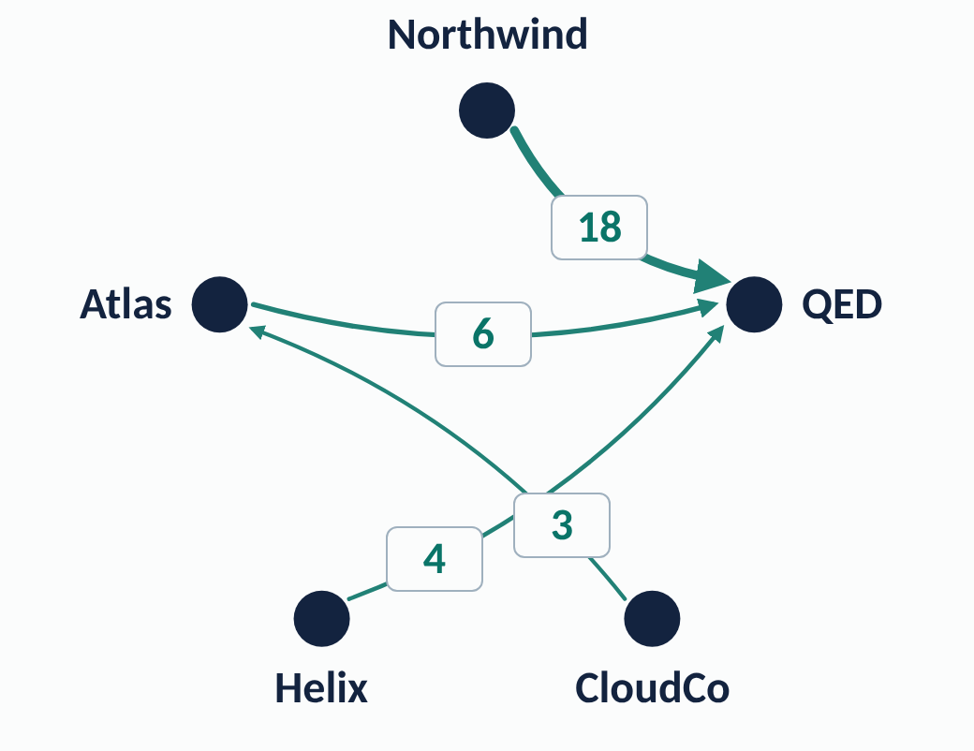
RUN 2 · CERTIFIED CLEARING
A gridlocked agent economy, cleared by proof
Before · 200 tUSD in 11 debts
After the proven netting · 31 in 4
Gross debt
200
Northwind
Northwind
11 debts, 5 AI businesses
Cash they hold
28
18
paying gross reverts (G1)
Atlas
QED
Atlas
6
QED
Naive netting
162
NotProvablyMaximal (N1)
4
3
Proven netting
169
certificate holds (N6)
Helix
CloudCo
Helix
CloudCo
Paid in tokens
31
net debits only (S1–S4)
max Σx (net positions fixed) = min Σd·y s.t. πᵤ − πᵥ + y ≥ 1
exact integers · 6 more attacks refused
QED before the upgrade, unchanged and still live
Appendix A14
Notes:
Run two scales this to an economy of agents. Five AI businesses owe each other 200 but hold only 28, so paying gross fails: transaction G1. Our clearing contract executes a netting only if every net position is unchanged and a linear-programming duality certificate proves no larger netting exists, in exact integers. A rival’s shortest-cycles-first netting cancels 162: refused. Ours cancels the provable maximum, 169. The last 31 settles in tokens. Six more attacks, six reverts.

Slide 26
RUN 3 · ZERO-KNOWLEDGE OPTIMALITY
Paid for a proof about data nobody saw
Groth16 statement
12,569
ON-CHAIN, PUBLIC
NEVER ON-CHAIN
the full KKT certificate
Data commitment, signed by Helix
Covariance model, 21 entries
Proved in
1.5 s
0x0ec5…6983
by the QED agent, one CPU
Portfolio commitment
Portfolio weights, 6 sleeves
Paid by job #1’s escrow
12 tUSD
0x0577…ba68
unchanged contract (Z3)
Certified variance
KKT multipliers ν, μ
0.0015702689
Refused
3 / 3
Proof bound to
copied proof, lower variance, self-attested data (ZA1–ZA3)
Convexity witness L
QED agent
Accepted ⇒ ½wᵀΣw ≤ OPT + 1.5 × 10⁻⁹, for the model the vendor signed, and the chain learns nothing else.
QED before the upgrade, unchanged and still live
Appendix A15
Notes:
Proving an AI decision correct has meant showing its inputs; confidentiality has meant hiding them. QED does both. Helix signs only a commitment to its private model. Our agent proves, inside a zero-knowledge SNARK, the same optimality certificate the chain checked in public, in a second and a half. The escrow that paid job one pays this job unchanged, and never sees the data or the answer. A copied proof, a lower variance and self-attested data: all refused.

