Slide 1
Catan
Green team: Chase, aaron, Ramez, Kelvin

Slide 2
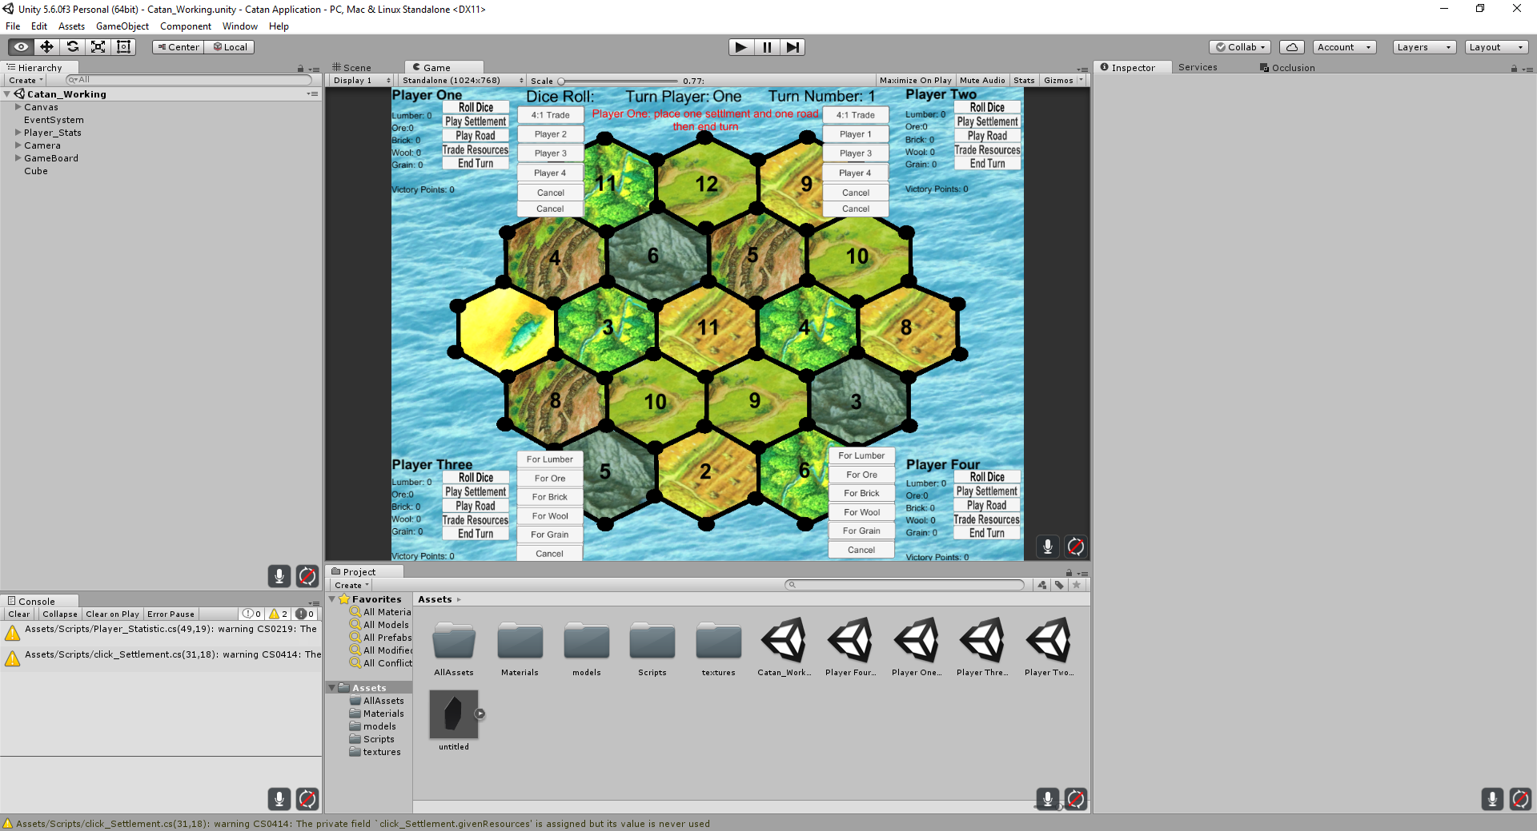
Development
For developing the application, the group used the C# language paired with a program called Unity.
Also using GitHub for sharing the files for multiple people to access easily

Slide 3
Functionality
Starting the game begins with letting each player place one settlement and one road and then pass the turn. After this is done twice then the actual game sequence would begin, giving the players resources based on where they placed their settlements.

Slide 4
Functionality Cont.
During the actual game sequence you take your turn as normal, hitting the roll dice button and deciding whether to build, trade, or pass the turn.

Slide 5
Functionality Cont.
When it comes to building settlements or roads, there are prerequisites, primarily if there is already a settlement or road built adjacent. Unless the requirement is met, the spaces for roads and settlements will be colored black.

Slide 6
Functionality Cont.
Trading can consist of trading with the bank as well as other players, bringing up there own UI components for each instance then hiding those components.

Slide 7
Functionality Cont.
To minimize how much space is taken at a given time, the only UI components that are shown on screen are the active players’
And when the game is complete, each player has their own victory screen.

Slide 8
