Slide 1



P1 – Mitigating Public Transit Unreliability in Malaysia through Deep Learning Analytics and Ridership Forecasting
Master of Artificial Intelligence
Student: Yip Zi Xian (24202141)
Supervisor: Prof. Ts. Dr. Rafidah binti Md Noor

Slide 2
Contents of the Session
01
02
03
Literature Review
Gapping the Problem
05
How I Execute
Research Questions & Objectives
06
What I Contribute
04
Research Scope
07
Results & Findings
08
Discussions

Slide 3

Research Background
Public transportation is essential for urban mobility, economic growth, and environmental sustainability.
Rapid urbanization in Malaysia increases demand for efficient public transit systems.
Reliable public transit, such as buses and rails, improves accessibility and quality of life by being punctual and efficient.

Slide 4

01
Literature Review

Slide 5
Public Transport Reliability & Demand Dynamics
J. Articles | Focus | Method | Dataset | Strength | Weakness
Ibrahim et al. (2022) | Investigate service quality factors influencing user satisfaction with LRT in Klang Valley. | Factor analysis, correlation, and Artificial Neural Network (ANN). | 417 LRT riders in Klang Valley, Malaysia. | Uses ANN for non-linear modeling; local Malaysian context. | Focuses on satisfaction/perceptions, not operational ridership management.
Mee & Subramaniam (2022) | Examine willingness to use public transport in KL and Manila. | Purposive sampling survey; PLS-SEM analysis. | 209 respondents from KL and Manila. | Comparative city analysis; identifies key behavioral drivers. | Small sample size; focus on "willingness" rather than actual ridership data.
Rezapour & Ferraro (2021) | Impact of rail delays and real-time info accuracy on passenger psychology. | Survey-based; Factor Analysis and SEM. | 396 KTM rail passengers at Serdang station, Malaysia. | Links psychological impact to information systems; local KTM context. | Subjective measures; does not propose operational management strategies.
Ubaidillah & Syafiq (2022) | Impact of bus service quality on satisfaction in a developing city. | SERVQUAL model; PLS-SEM analysis. | 300 bus users in Kota Samarahan, Sarawak, Malaysia. | Focuses on a developing city context with high car ownership. | Relies on self-reported data; no integration of actual ridership metrics.

Slide 6
Transit Data Ecosystems & Anomalies
J. Articles | Focus | Method | Dataset | Strength | Weakness
Keller et al. (2022) | Potential of data science for sustainable public transport. | Systematic review and expert interviews. | Global/Germany; Multi-source big data (AFC, APC, GPS). | Comprehensive taxonomy of data sources and use cases. | Generic framework; lacks specific application to the Malaysian context.
Liu et al. (2025) | Survey of vehicle trajectory data processing and analytics. | Systematic review of collection and processing methods. | Global (China, US, SE Asia); Taxi, bus, and truck trajectories. | Deep dive into trajectory collection and privacy-preserving methods. | Survey-based; no direct implementation for Malaysian transit.
Lu et al. (2020) | Review of big data applications in urban transit systems. | Literature review of 95 global cases. | Global multi-source transit data (AFC, AVL, APC, GTFS). | Synthesizes heterogeneous data sources and their management roles. | Does not provide an empirical model or Malaysian case study.
Tu et al. (2021) | Review of transit data sources and their complementarity. | Literature review; Information management framework. | Global; AVL, AFC, APC, and exogenous data (weather). | Highlights the value of data fusion (e.g., weather + transit). | Conceptual; no direct implementation or Malaysian validation.

Slide 7
Evolution from Traditional to DL Models
J. Articles | Focus | Method | Dataset | Strength | Weakness
Jiang et al. (2021) | Survey and benchmark of deep learning for traffic prediction. | Survey and comparative experiments. | Global public traffic datasets (METR-LA, PEMS-BAY). | Comprehensive taxonomy and experimental benchmarking. | No direct application to public transit ridership or Malaysia.
Sangeetha & Kiros (2024) | GeoTemporal LSTM for predictive modeling of urban mobility. | GT-LSTM combining Attention and LSTM. | NYC Taxi, GTFS, and OSM data. | Innovative fusion of spatial and temporal features with attention. | High complexity; tested only on NYC data; not Malaysian-specific.
Sobrie et al. (2023) | Real-time train delay prediction using deep learning. | LSTM encoder-decoder with spatiotemporal features. | Belgian railway network; 3M+ signal passings/month. | Large-scale real-world operationalization; captures network complexity. | Belgium-specific; focus on delays rather than ridership volume.
Yin et al. (2021) | Deep learning on traffic prediction: Methods and analysis. | Survey and taxonomy of deep learning models. | Global traffic datasets; Road network topology. | Thorough analysis of spatio-temporal dependency modeling. | Survey-based; lacks specific transit ridership management focus.

Slide 8
AI-Driven Operational Strategies & Sustainability
J. Articles | Focus | Method | Dataset | Strength | Weakness
Gheorghe & Șoica (2025) | Review of AI, IoT, and predictive analytics in traffic control. | Systematic literature review (2020-2024). | Global; Smart city traffic management systems. | Up-to-date synthesis of adaptive traffic control technologies. | No empirical validation or data from Malaysia’s transit network.
Jevinger & Persson (2024) | AI for improving public transport: A mapping study. | Systematic mapping study of 111 primary studies. | Global; Bus, train, and multimodal systems. | Up-to-date synthesis of adaptive traffic control technologies. | Lacks localized solutions or models for the Malaysian context.
Sobrie et al. (2023) | Real-time train delay prediction comparing rule-based vs. deep learning models. | Customized LSTM encoder-decoder deep learning model. | Real-world network-wide Belgian railway data (Infrabel). | Demonstrates that DL superiority increases with system complexity; implemented as a real-world Proof of Concept. | High dependency on real-time data quality and lacks the transparency of rule-based models.
Son & Kim (2025) | Leveraging advanced technologies for transportation planning. | Systematic review using Sentence-BERT NLP. | Global (Urban, Rural, and Simulated contexts). | Innovative use of NLP for semantic analysis of research trends. | No primary data or application to Malaysia's transit network.

Slide 9
02
Gapping the Problem

Slide 10

Limited Integration of Multi-scale Spatio-temporal Features in Malaysia
Inadequate Quantification and Mitigation of Extreme Anomaly Bias
Lack of Comprehensive Benchmarking Across SOTA Architectures
Research Gaps are identified as below:

Slide 11
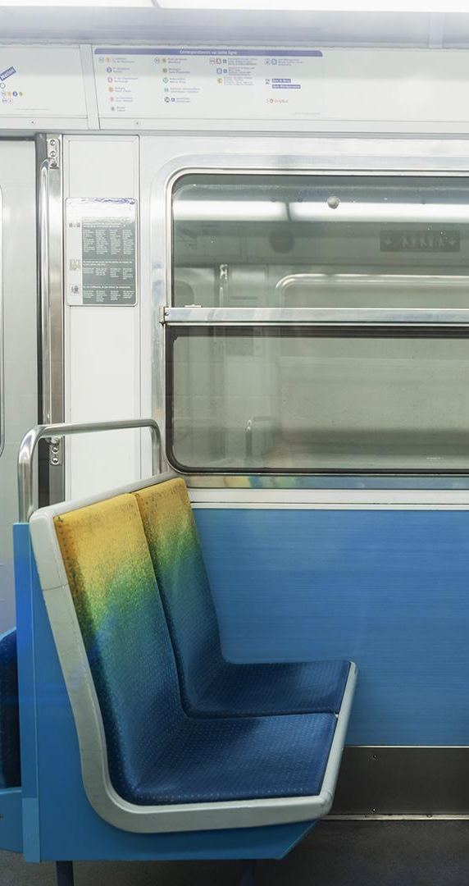
Research Problem Statement
The difficulty in accurately predicting daily ridership due to complex spatiotemporal factors (population density, weather, accessibility, etc.) (Amir et al., 2025).
This inability to predict ridership leads to critical bottlenecks in scheduling, routing, and service intervals during peak hours and holidays, harming system reliability and passenger satisfaction.
Historical ridership data is contaminated by the extreme 85–90% passenger drop caused by the MCO period (Amir et al., 2025). Training AI models on this data introduces severe predictive bias (Zhao & Lan, 2025) and prevents them from recognizing true ridership peaks after normal life resumes (Lv et al., 2021).

Slide 12
03
Research Questions & Objectives

Slide 13
Research Questions & Objectives
Research Questions | Research Objectives
What are the primary spatial and temporal factors (e.g. weather, POIs, population density) that heavily affect public transit ridership trends in Malaysia? | To identify and categorize the primary spatial and temporal factors affecting Malaysian public transit ridership through a systematic analysis of historical performance data.
How accurately and consistently can existing DL architectures (spatio-temporal, graph-based, and attention-based) compare against each other and proposed model in predicting Malaysia’s public transit ridership? | To develop Hybrid Multi-scale Temporal Spatio-Feature (HMT-TSF) Forecaster that integrates Malaysia’s spatial and temporal data to estimate future ridership trends.
How does the inclusion of extreme data anomalies, specifically the Malaysia’s MCO period, impact the predictive accuracy and bias of existing DL models and proposed model? | To benchmark the proposed model against existing baseline, spatio-temporal-based, graph-based and attention-based models using combined MAE, RMSE, MAPE, and R².
 | To evaluate and compare model performance across two distinct dataset segmentations (with and without MCO period) to determine the impact of extreme outlier data on predictive bias.

Slide 14
04
Research Scope

Slide 15
Research Scope
Models Compared
Evaluation Metrics
Baseline LSTM, 4 spatio-temporal models, 5 graph models, and 4 attention models.
Combined MAE, RMSE, and MAPE as overall accuracy metrics & R²
Geographical Focus
MCO Period Segmentation
Bus, urban rail, commuter transit networks with available data throughout whole Malaysia.
Without MCO segment: 1 Jan 2022 – 31 Dec 2025
With MCO segment: 1 Jan 2019 – 31 Dec 2025

Slide 16
05a
How I Execute

Slide 17
Data Sources
Data | Data Origin | Why Data? | References
Ridership | data.gov.my | Primary forecast target, provides 13 output variables (12 service lines + total) the models are trained to predict | Khalil et al., 2021; Amir et al., 2025
Fuel Price | data.gov.my | Demand drive, EDA confirms higher fuel prices correlate with increased transit use, capturing modal substitution behaviour | Ahmad et al., 2024; Cui et al., 2025
Holidays | timeanddate.com | Demand modifier, holidays cause systematic ridership drop, lead/lag features capture anticipation dips, post-holiday return surges | Chen et al., 2023; Song et al., 2024
Rainfall | data.humdata.org | Weather covariate, state-level daily precipitation adds a spatially-varying external signal that influences travel mode choice | Huang et al., 2022; Cui et al., 2025
Population Density | hub.worldpop.org | Spatial context, residential density is a static proxy for transit catchment potential and latent demand at each stop | Ahmad et al., 2024; Amir et al., 2025
GADM Boundaries | gadm.org | Spatial structure, state boundary polygons are used to spatially aggregate features by aggregate features by administrative region and derive inter-state adjacency weights | Jin et al., 2022; Hassan et al., 2025
GTFS Static | data.gov.my | Network topology, stop counts, route density, travel-time edges quantify transit supply and accessibility per region | Keller et al., 2022; Hassan et al., 2025
OSM POIs | overpass-api.de | Land-use context, POI category counts within a 500m catchment of each stop capture activity generators that drive trip origins and destinations | Shi et al., 2024; Amir et al., 2025

Slide 18
Data Understanding
Attribute | Detail
Data Range | 2019-01-01 to 2025-12-31 (Include MCO) 2022-01-01 to 2025-12-31 (Exclude MCO) (Lv et al., 2021; Zhao & Lan, 2025; Maria-Arribas et al., 2026)
Total Observations | 2,557 daily records with MCO 1,461 daily records without MCO
Total Features | 79 columns
Target Variables | 13 (12 transit service lines + total ridership)
Feature Sources | 8 (Ridership, fuel price, holiday/cyclical, rainfall, population density, GTFS transit network, OSM POI, GADM boundaries)

Slide 19
Data Understanding (con’t)
Group | Count | Description
Targets | 13 | 12 service lines + total ridership
Temporal | 16 | Holiday flags, lead/lag days, cyclical encoding, year, day-of-year
External | 30 | Fuel price levels & changes (15) + Rainfall per state (15)
Lag | 3 | Autoregressive lags at 7, 14, 28 days
Static | 17 | Population density, GTFS network states, OSM POI counts, GADM boundaries

Slide 20
Data Preprocessing
Per-source Cleaning
All data sources are filtered to 2019-01-01 – 2025-12-31; MCO flagging on ridership, compute total ridership; Weekly fuel price forward-fill as daily; Expand data range rows into one binary flag per calendar day, handle state-specific coverage; Retain final rainfall result; Compute state centroids; Deduplicate stops and trips; Clip density values at 99th percentile to reduce raster outliers; Deduplicate OSM element ID, map specific tags to 7 POI categories
Feature Alignment
Merged all cleaned data sources into 2019/2022-01-01 – 2025-12-31 (2,557 | 1,461 days) x 79 feature columns; Time-varying sources reindexed to daily master; Remaining gaps filled by forward-fill or linear interpolation; Static sources broadcast to every row.
Sequence Building
Sliding window sequences: (X shape: N, T_in, 79) – (y shape: N, 7) – for T_in in 14, 28, 56 look-back days.
Chronological 70/15/15 split – no shuffle
Special for graph models – build Pearson correlation adjacency on-the-fly from X_train

Slide 21
Notable Explanatory Data Analysis
MCO Collapse / Recover
Fuel Price Elasticity
Four change-point phases; 85-90% drop during MCO. Rail recovers slower than bus.
Post-MCO RON95-ridership r ~ +0.35; stronger above RM 2.20/L, lagged 1-3 days.
Northeast Monsoon
Holiday Anticipation
Wet/extreme days peak Nov-Jan; east coast > west coast. National totals mask regional effects.
~18% dip 1-2 days pre-holiday; spike on first workday back. Short holidays dip most.
Weather-Induced Surge
Feature Correlation
Light rain suppresses travel; heavy rain (>75th percentile) boosts ridership – modal substitution.
Ridership lags (7/14/28 days) explain ~72% of feature variance; static features show near-zero linear correlation.

Slide 22
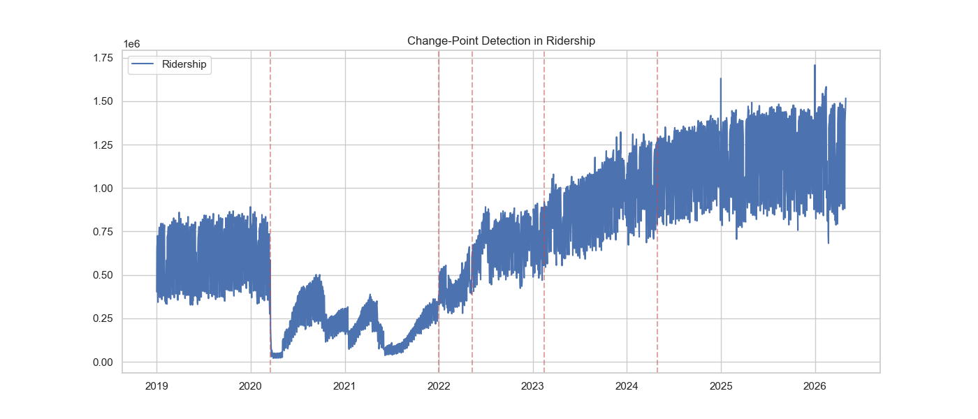

Slide 23
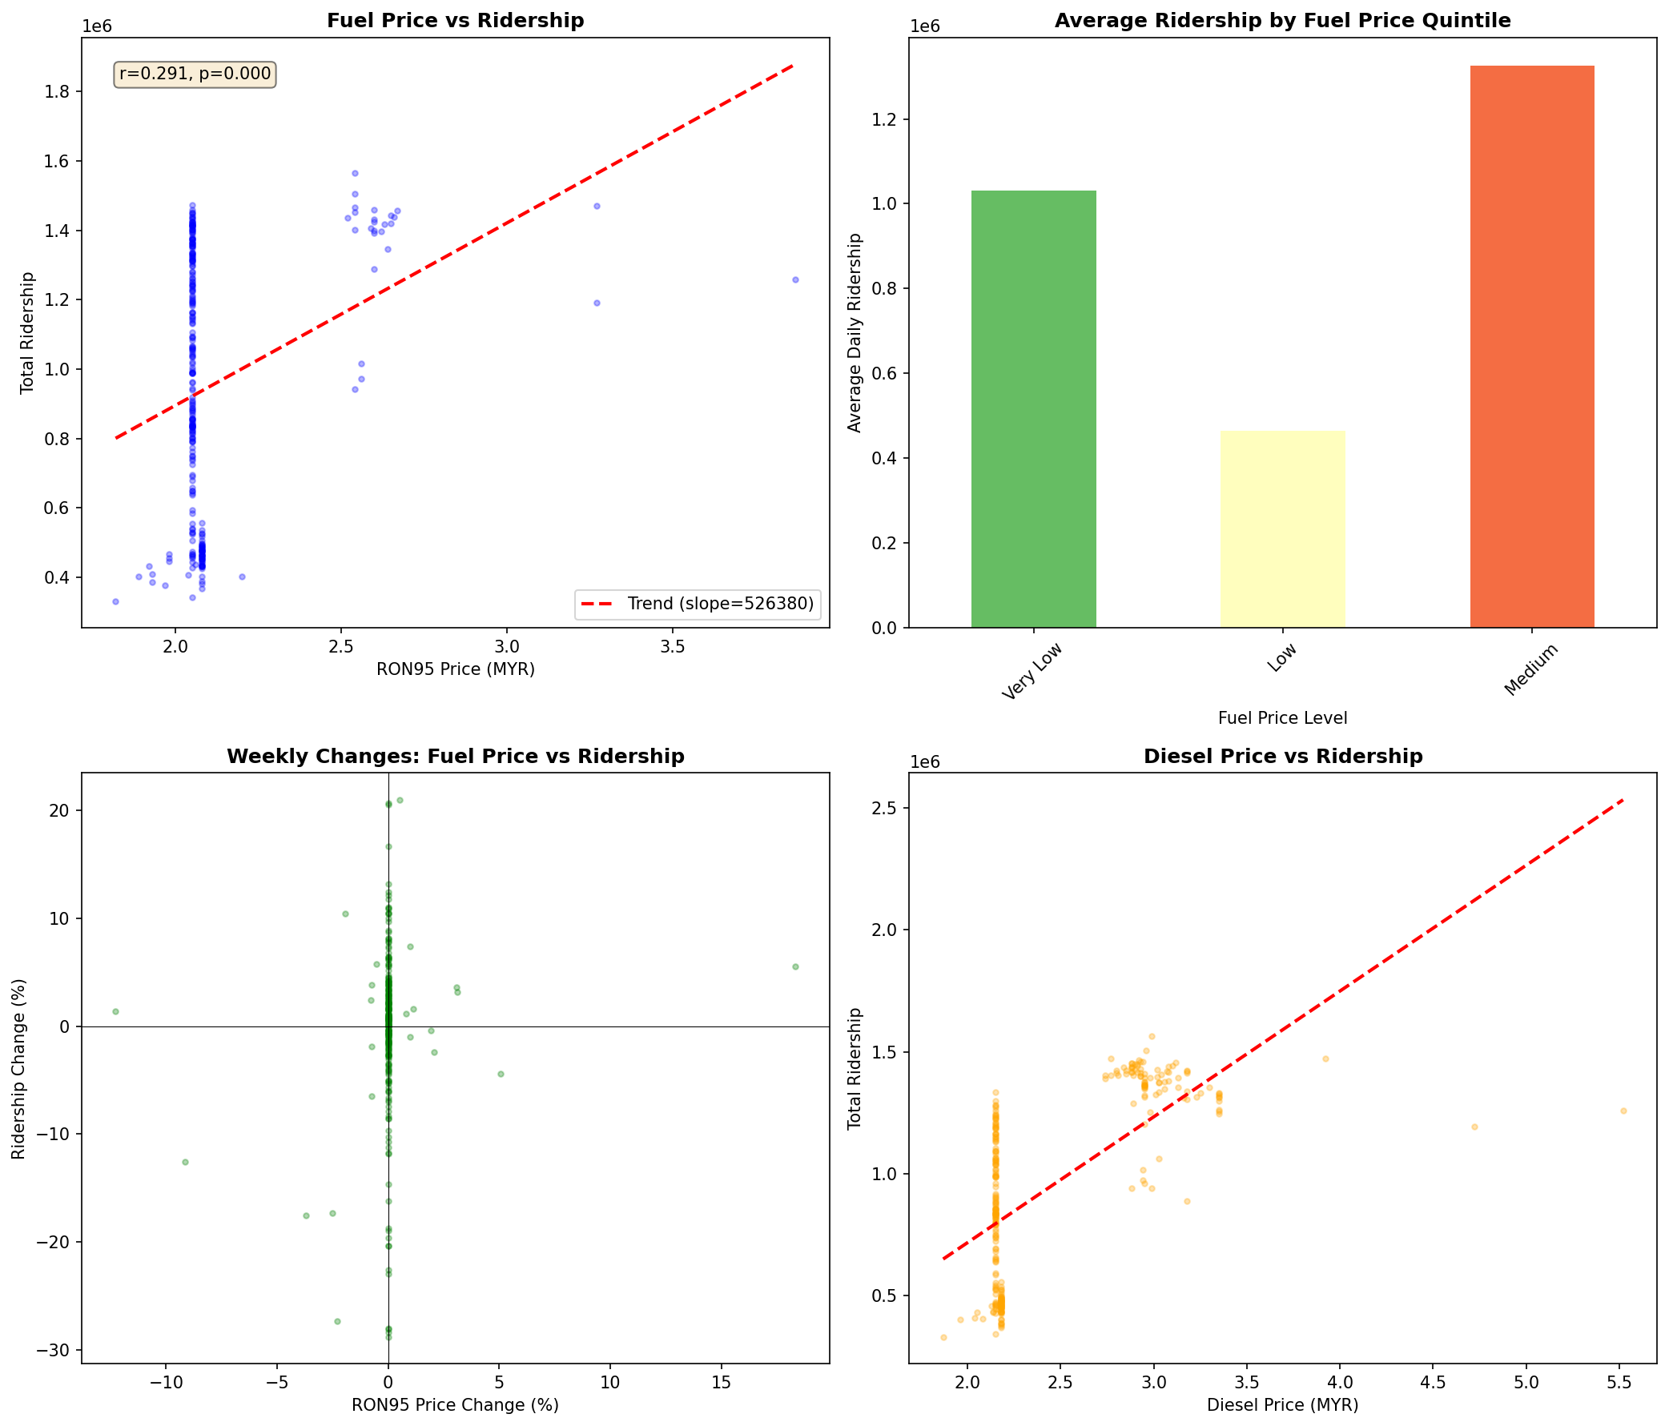

Slide 24
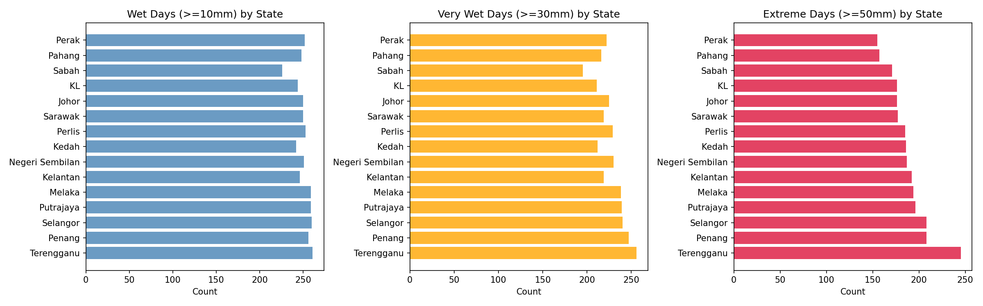

Slide 25
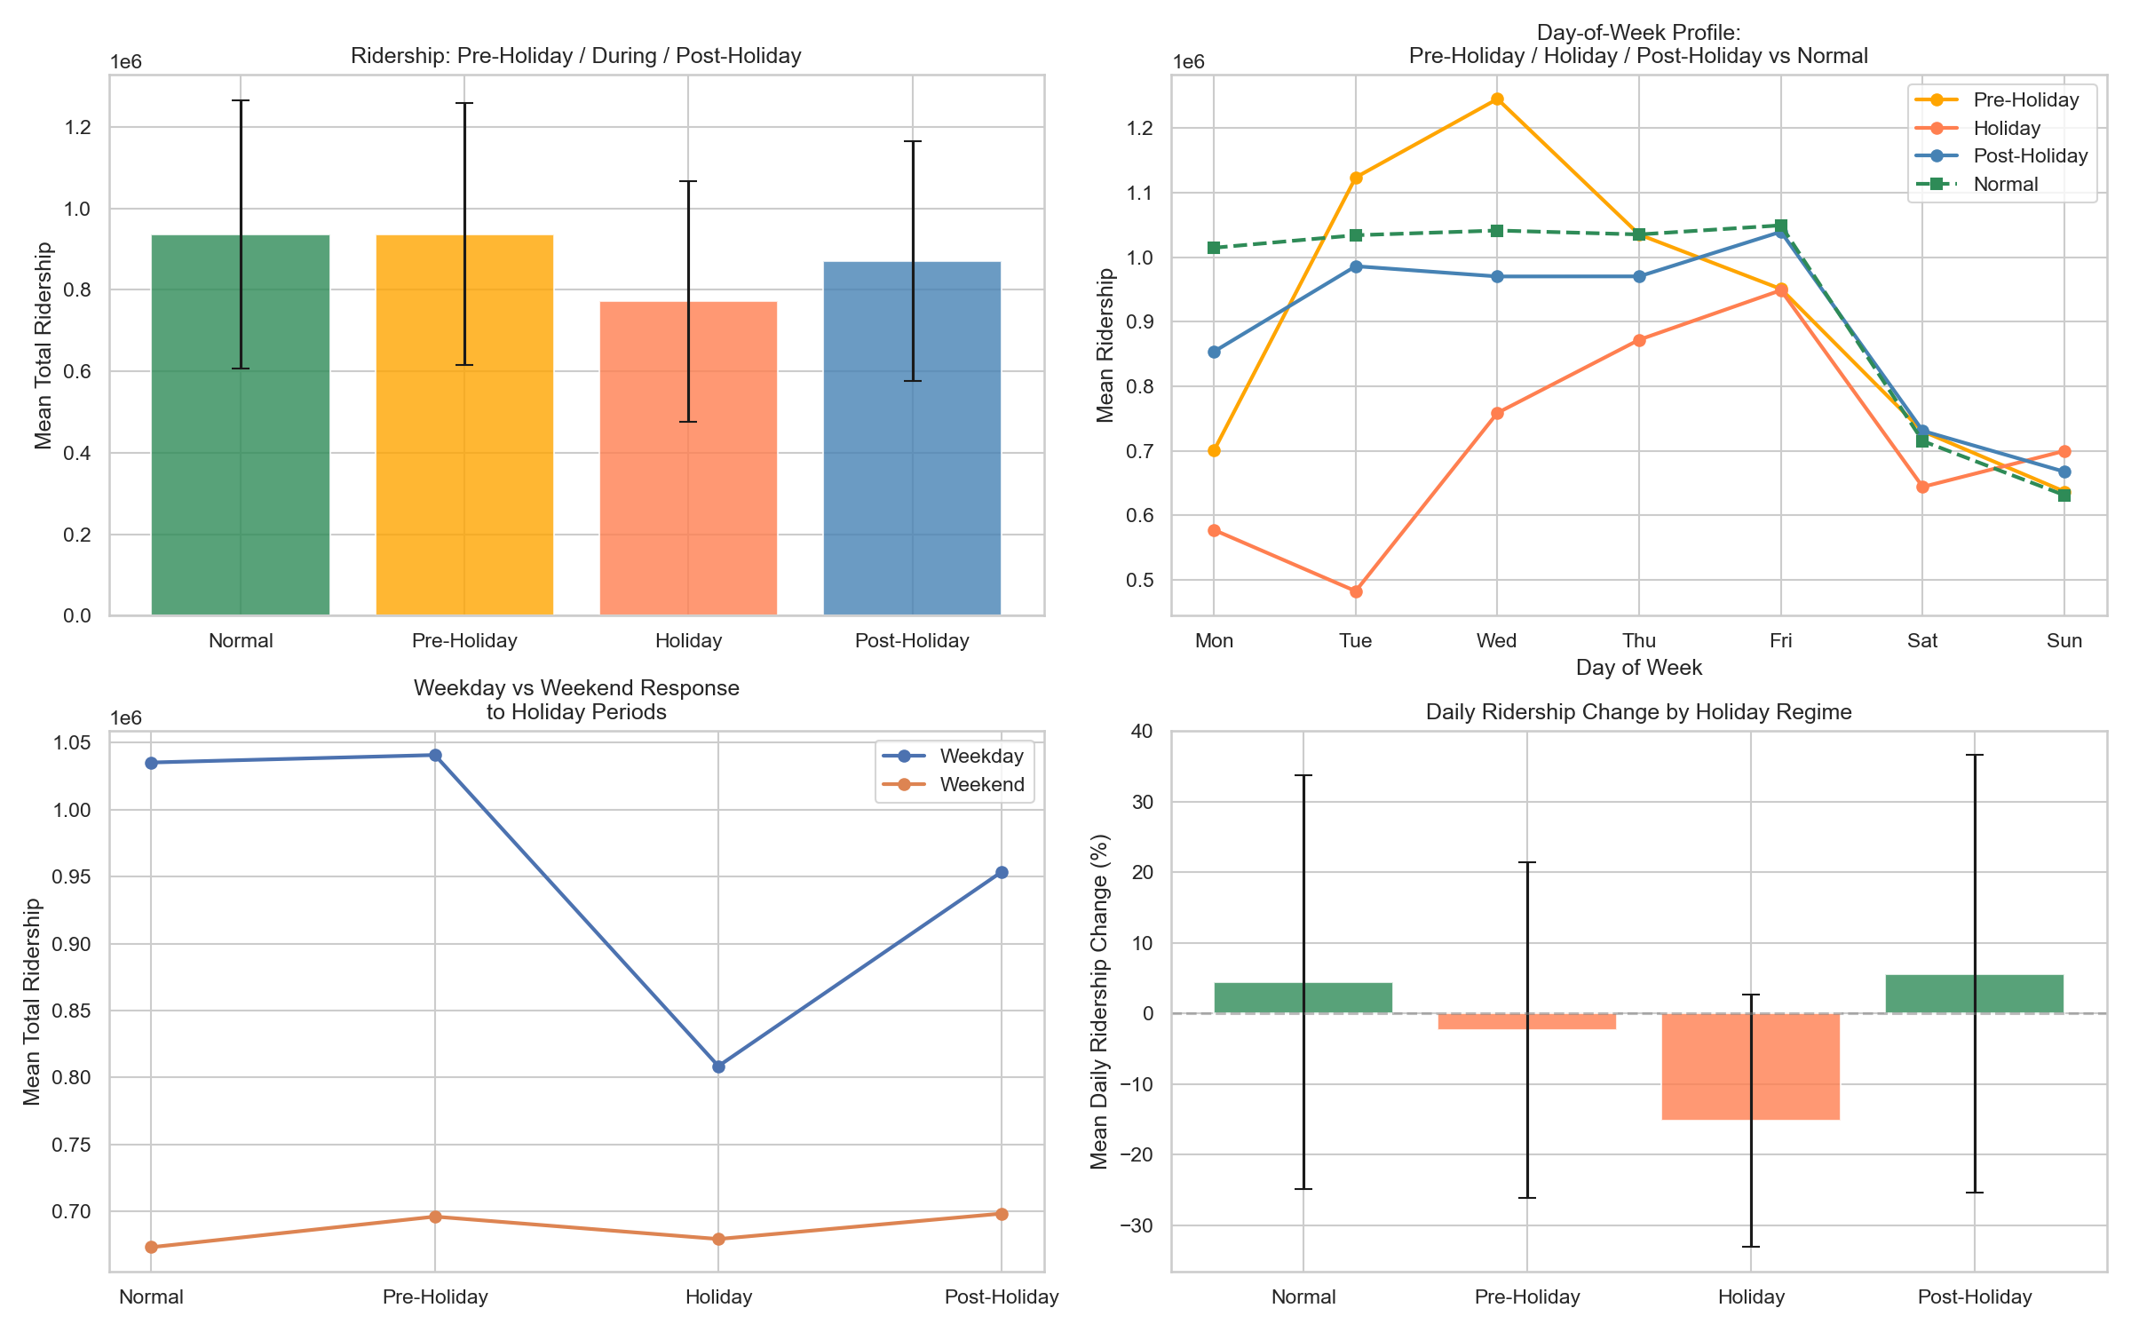

Slide 26
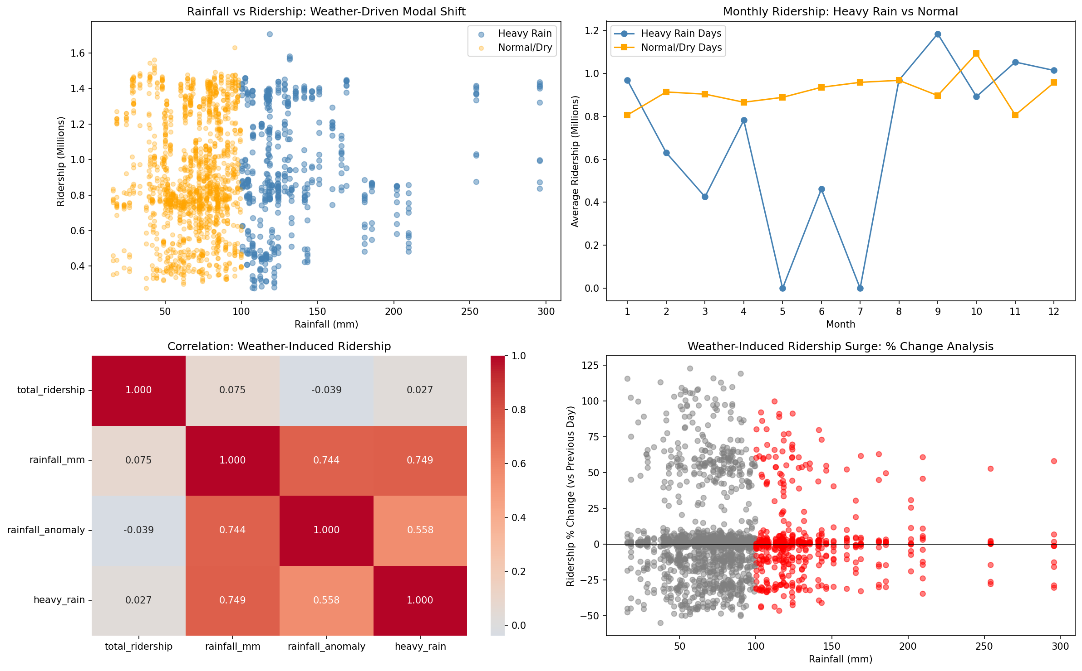

Slide 27
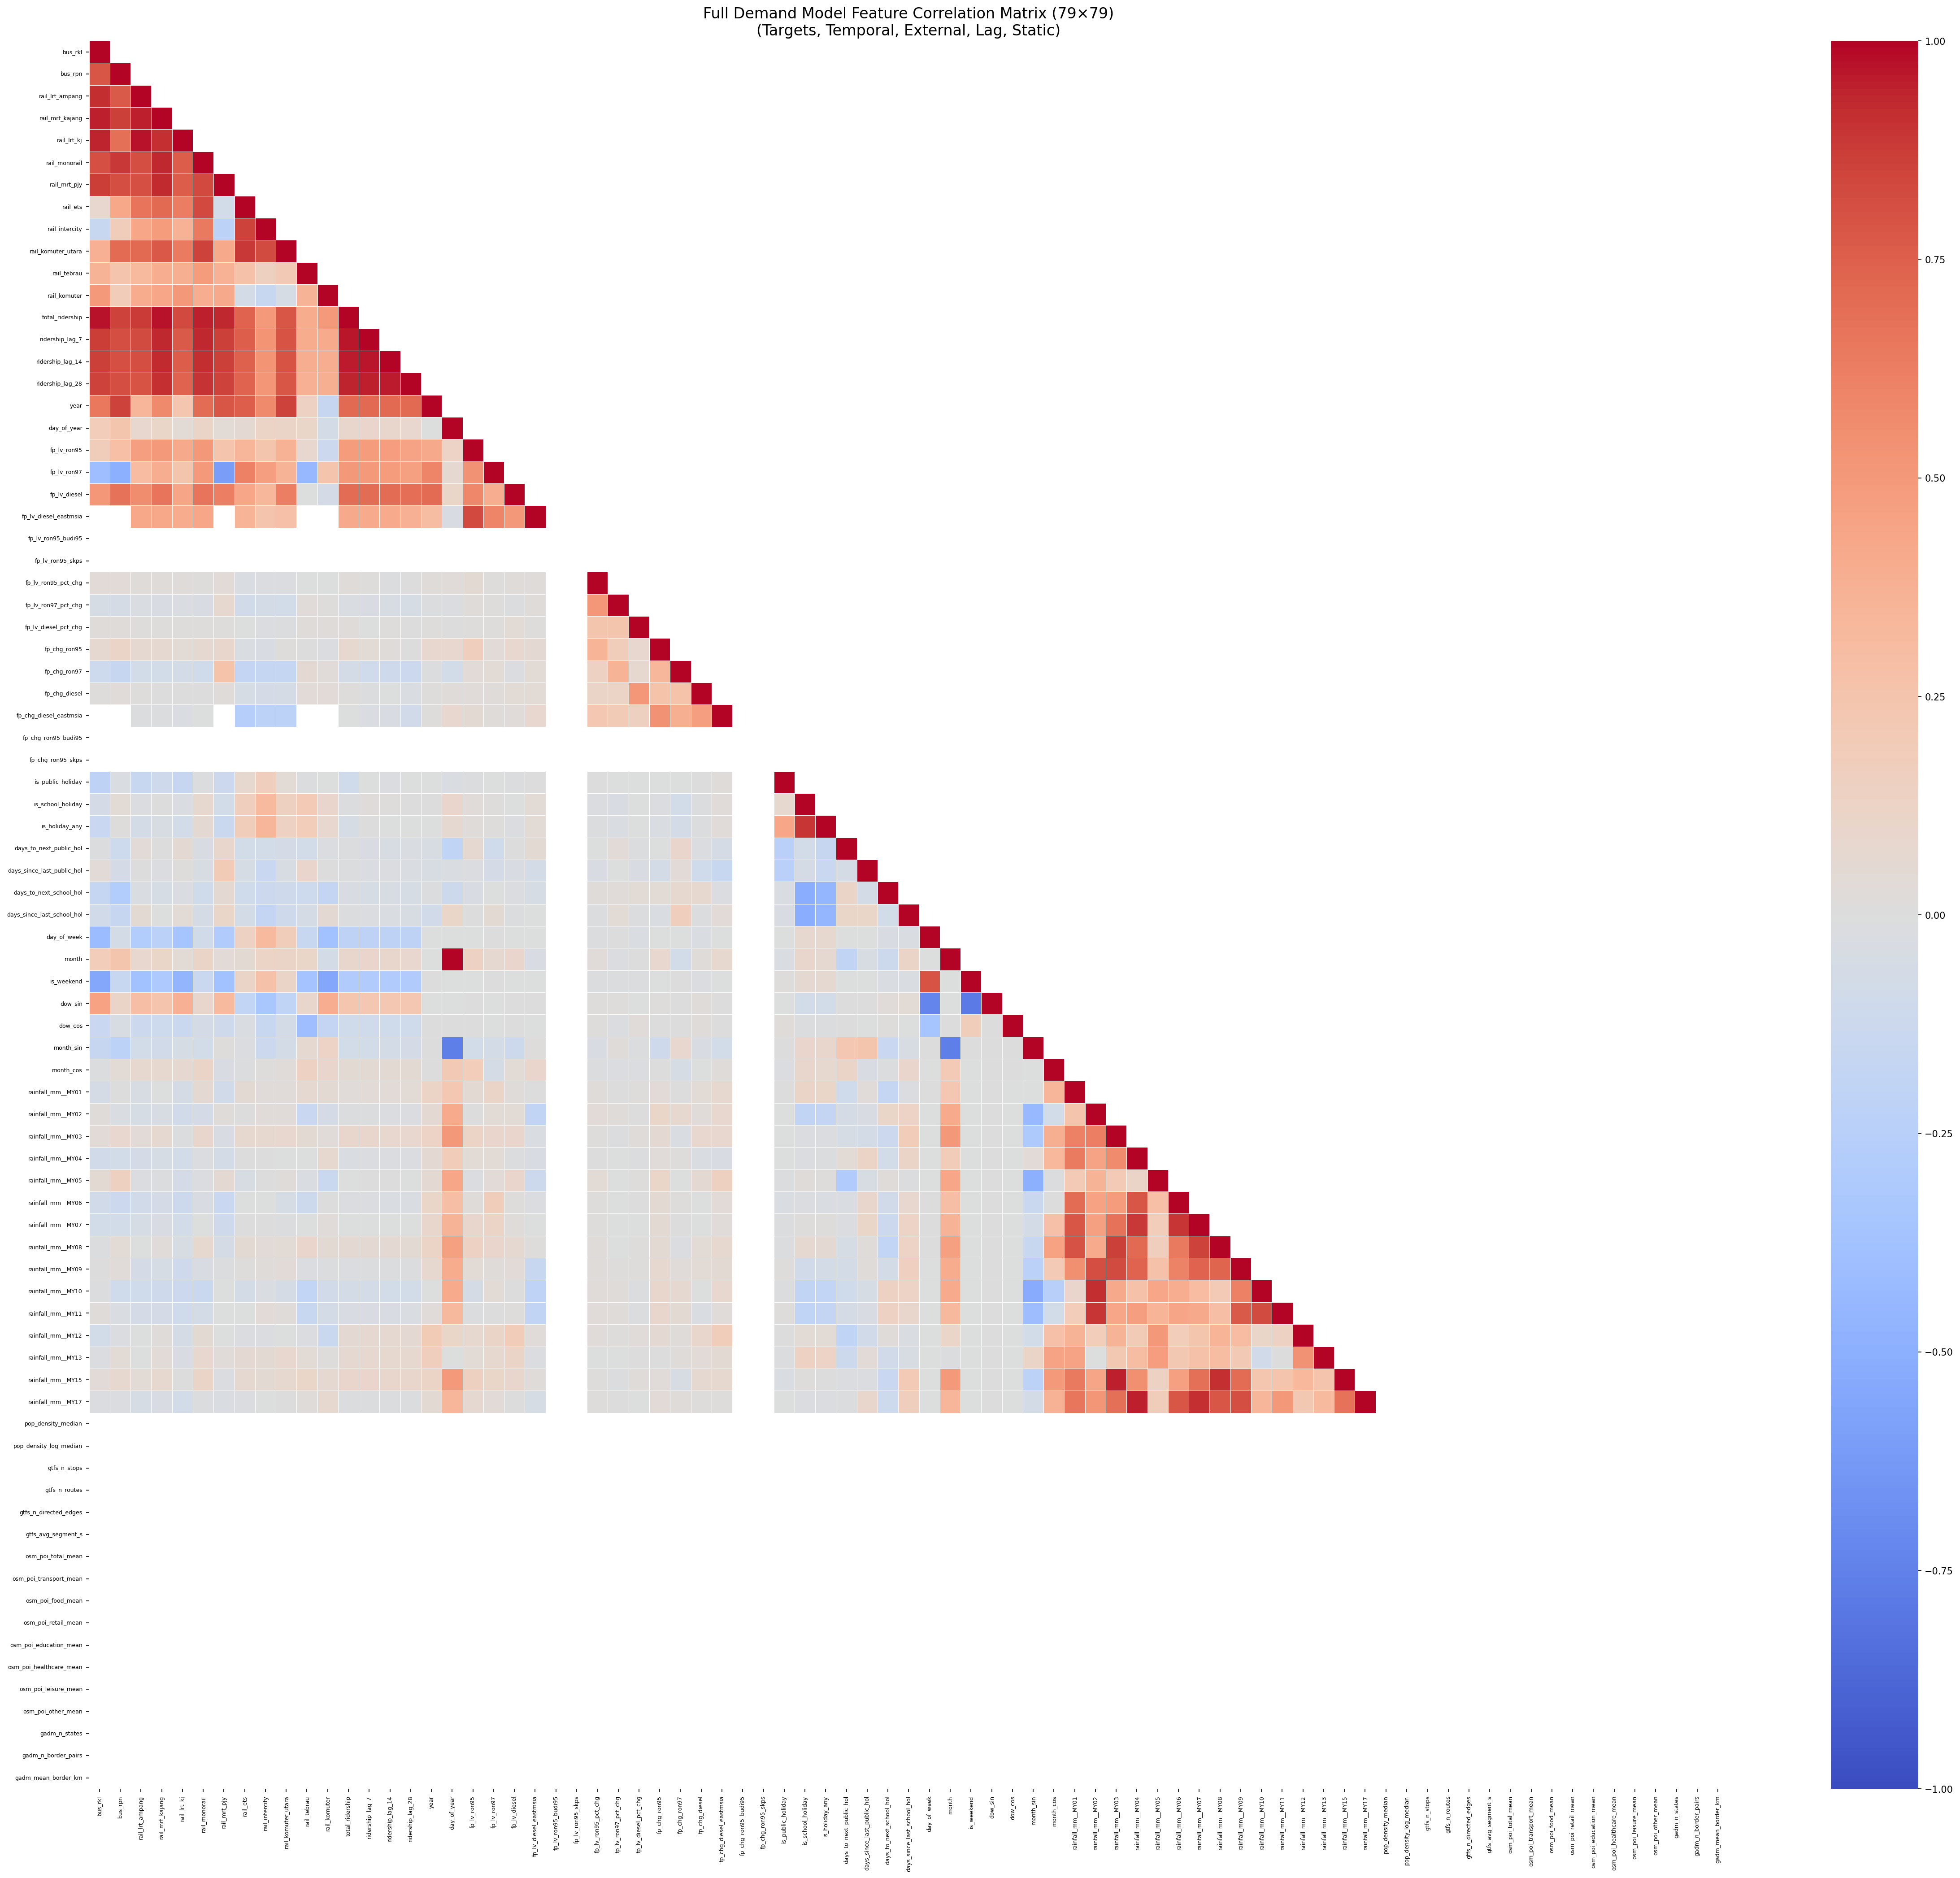

Slide 28
05b
Benchmark & Evaluation

Slide 29
Baseline LSTM
Uni-directional LSTM (64 hidden; 1 layer) to MLP
Simplest baseline, establishes performance floor, low parameter count
Single hidden vector at T is information bottleneck; no mechanism to identify which timesteps or features drive forecast

Slide 30
75% Combined Accuracy (CA) + 0.7 R²
CA % = MAE % + RMSE % + MAPE %

Slide 31
Why These Metrics?
Metrics | Role in Spatio-temporal Data | Strength | Limitations
MAE | Captures overall error across all locations and time steps | Simple, robust, same until as data | Does not emphasize large error
RMSE | Measure typical error magnitude while still penalizing spikes | Interpretable + sensitive to large deviations | Can still be dominated by others
MAPE | Compare errors across locations with different scales | Scale-independent, easy to interpret | Unstable when actual values = 0
R² | Evaluates how well the model explains spatial and temporal variance | Normalized score (up to 1), easy to compare across datasets | Heavily influenced by outliers, doesn’t reflect granular local accuracy well

Slide 32
05c
Comparatives & Proposed Models

Slide 33
Spatio-temporal-Based Models
Model | Key Architecture | Strengths | Weakness
BiLSTM | Bidirectional LSTM, concatenate forward + backward hidden states | Mid-window peaks and dips are visible from both temporal directions, richer positional context | No explicit attention/pattern extraction, already near capacity ceiling at base hyperparameters.
TPA-LSTM | LSTM, Conv1d on hidden-state matrix, temporal pattern attention | Discover which recurring temporal shapes matter most, attention weights are semi-interpretable | CNN filters are fixed per training, architecture still depends on LSTM hidden vector quality
CNN-LSTM | Conv1d layers (local extraction), LSTM, three modes, sequential, parallel, augmented | Hierarchical feature extract, augmented model (CNN, LSTM + raw skip connection) generalises best by preserving direct access to input features | CNN flattens the spatial dimension of features, mode selection adds experimental complexity
CNN-BiLSTM | Conv1d, BiLSTM | Two complementary inductive biases, strong on mid-window anomalies | Higher parameter count than CNN-LSTM, requires careful regularisation to avoid overfitting
ST-LSTM | Parallel temporal stream (LSTM, spatial stream (weight-shared MLP across time), Concat | Clean conceptual separation of “when” from “which features co-activate”, spatial encoder is weight-shared across timesteps | Spatial encoder mean-pools across the time dimension, losing temporal order, spatial and temporal streams are fused late without interaction during encoding

Slide 34
Graph-Based Models
Model | Key Architecture | Strengths | Weakness
STGCN | Interleaved temporal gated convolutions (GLU) and Chebyshev graph convolutions, fixed pre-computed Laplacian, 2 ST-Conv blocks | Computationally efficient, well validated on traffic benchmarks, interpretable static adjacency | Static graph can’t adapt to changing future correlations
MTGNN | End-to-end learnable asymmetric adjacency from node embeddings, multi-scale inception blocks with dilated kernels, skip connections | No pre-computed correlation needed, asymmetric graph allows directional feature influence | Graph learning adds parameters, asymmetric adjacency can overfit the training-period topology
STSGCN | Block-tridiagonal 3N x 3N spatial-temporal synchronous graph (STSG) ChebConv + GLU per layer, centre-node extraction | Unified single-pass encoding of spatial and temporal adjacency, avoids alternating ST modules, stable on long sequences | Each layer shrinks the temporal dimension by 2, limiting network depth
STFGNN | Dual static graph, spatial + temporal, per-layer learned gate blends spatial and temporal representations | Two complementary graph perspectives, gate is interpretable, LayerNorm + residual stabilises deep stacks | Over-regularisation at high dropout, high dropout coefficient suppresses useful signal
PDR-STGCN | Two-channel input: original signal + weekly lag-difference, mixed adjacency, static sym-norm Pearson + per-sample dynamic attention, learn scalar balances static vs dynamic | Only model with explicit seasonal encoding via lag-difference channel, dynamic relational graph adapts per input sample | Most complex baseline, highest number of parameters, training can be unstable

Slide 35
Attention-Based Models
Model | Key Architecture | Strengths | Weakness
ASTGCN | Multi-head spatial attention, Chebyshev GCN, multi-head temporal attention, repeated across n_blocks | Dual attention re-weights both spatial node relevance and temporal step relevance, transparent attention maps | Graph adjacency is still static, high parameter count per block
Autoformer | FFT-based auto-correlation discover periodic lags, explicit trend/seasonal decomposition via moving-average sub-layer throughout encoder and decoder | Sub-linear complexity, trend/seasonal decomposition aligns naturally with transit periodicity, self-correlation selects dominant lag periods automatically | FFT amplifies noise at longer sequences, sensitive to decomposition kernel width
Informer | ProbSparse self-attention, top-u queries selected by KL-divergence sparsity measure, others receive mean, sequence distlling halves T after each encoder layer, generative decoder | Graceful degradation to full attention for short sequences, generative decoder avoid autoregressive exposure bias | Sequence distilling discards some temporal resolution, many interacting hyperparameters, limited upside

Slide 36
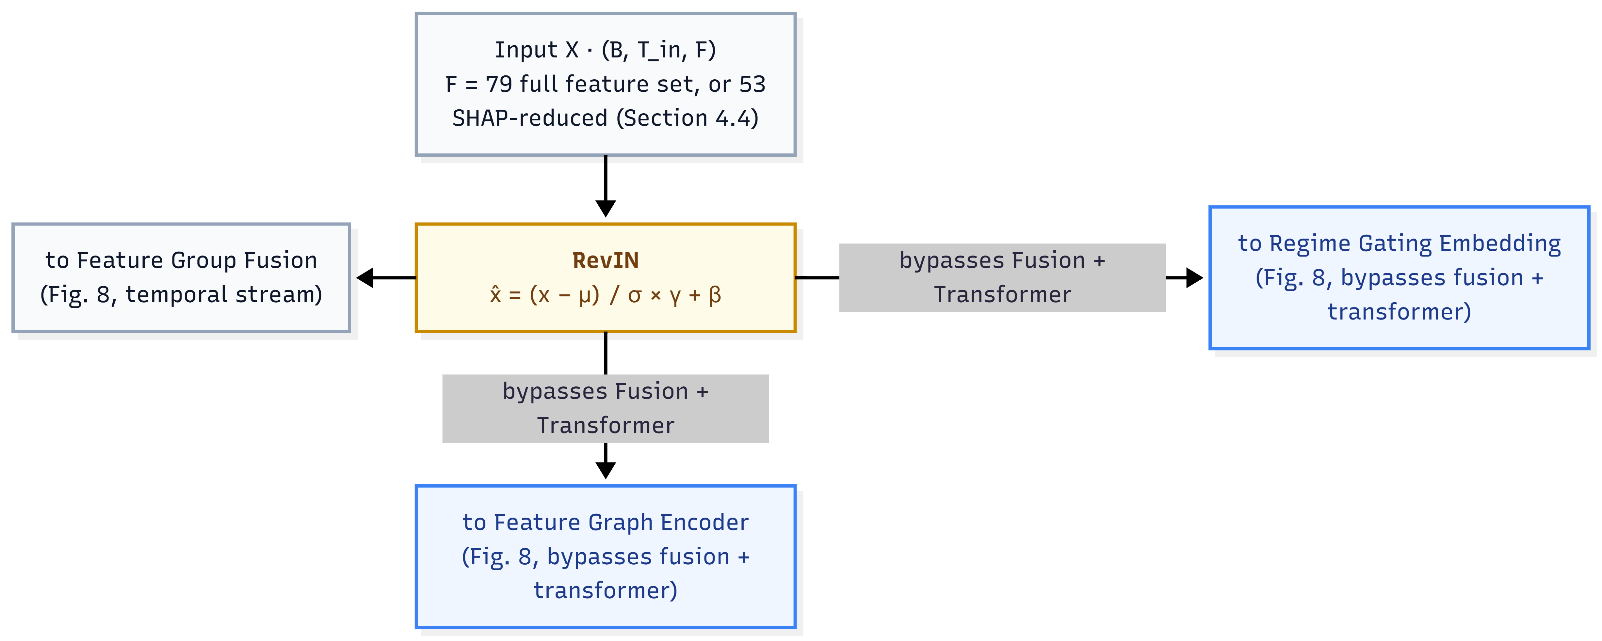
Hybrid Multi-scale Temporal Spatio-Feature (HMT-TSF) Forecaster

Slide 37
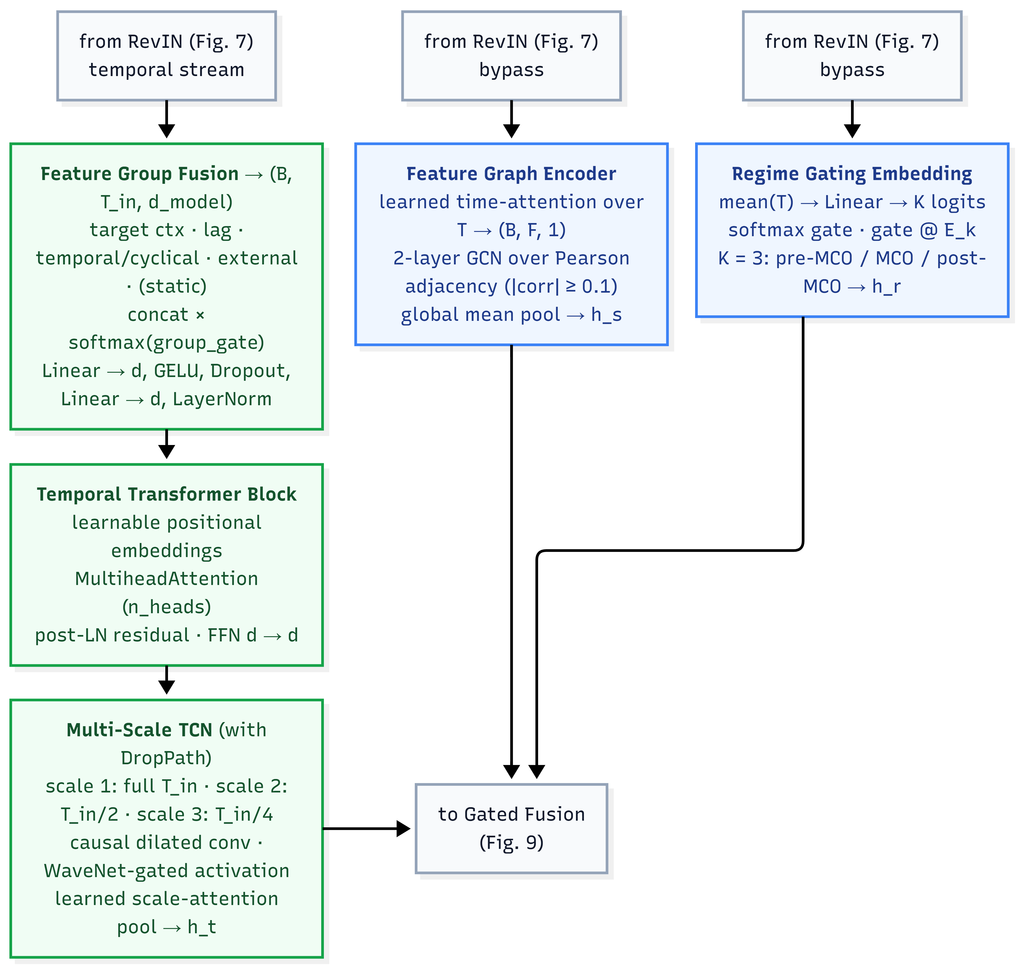
Hybrid Multi-scale Temporal Spatio-Feature (HMT-TSF) Forecaster

Slide 38
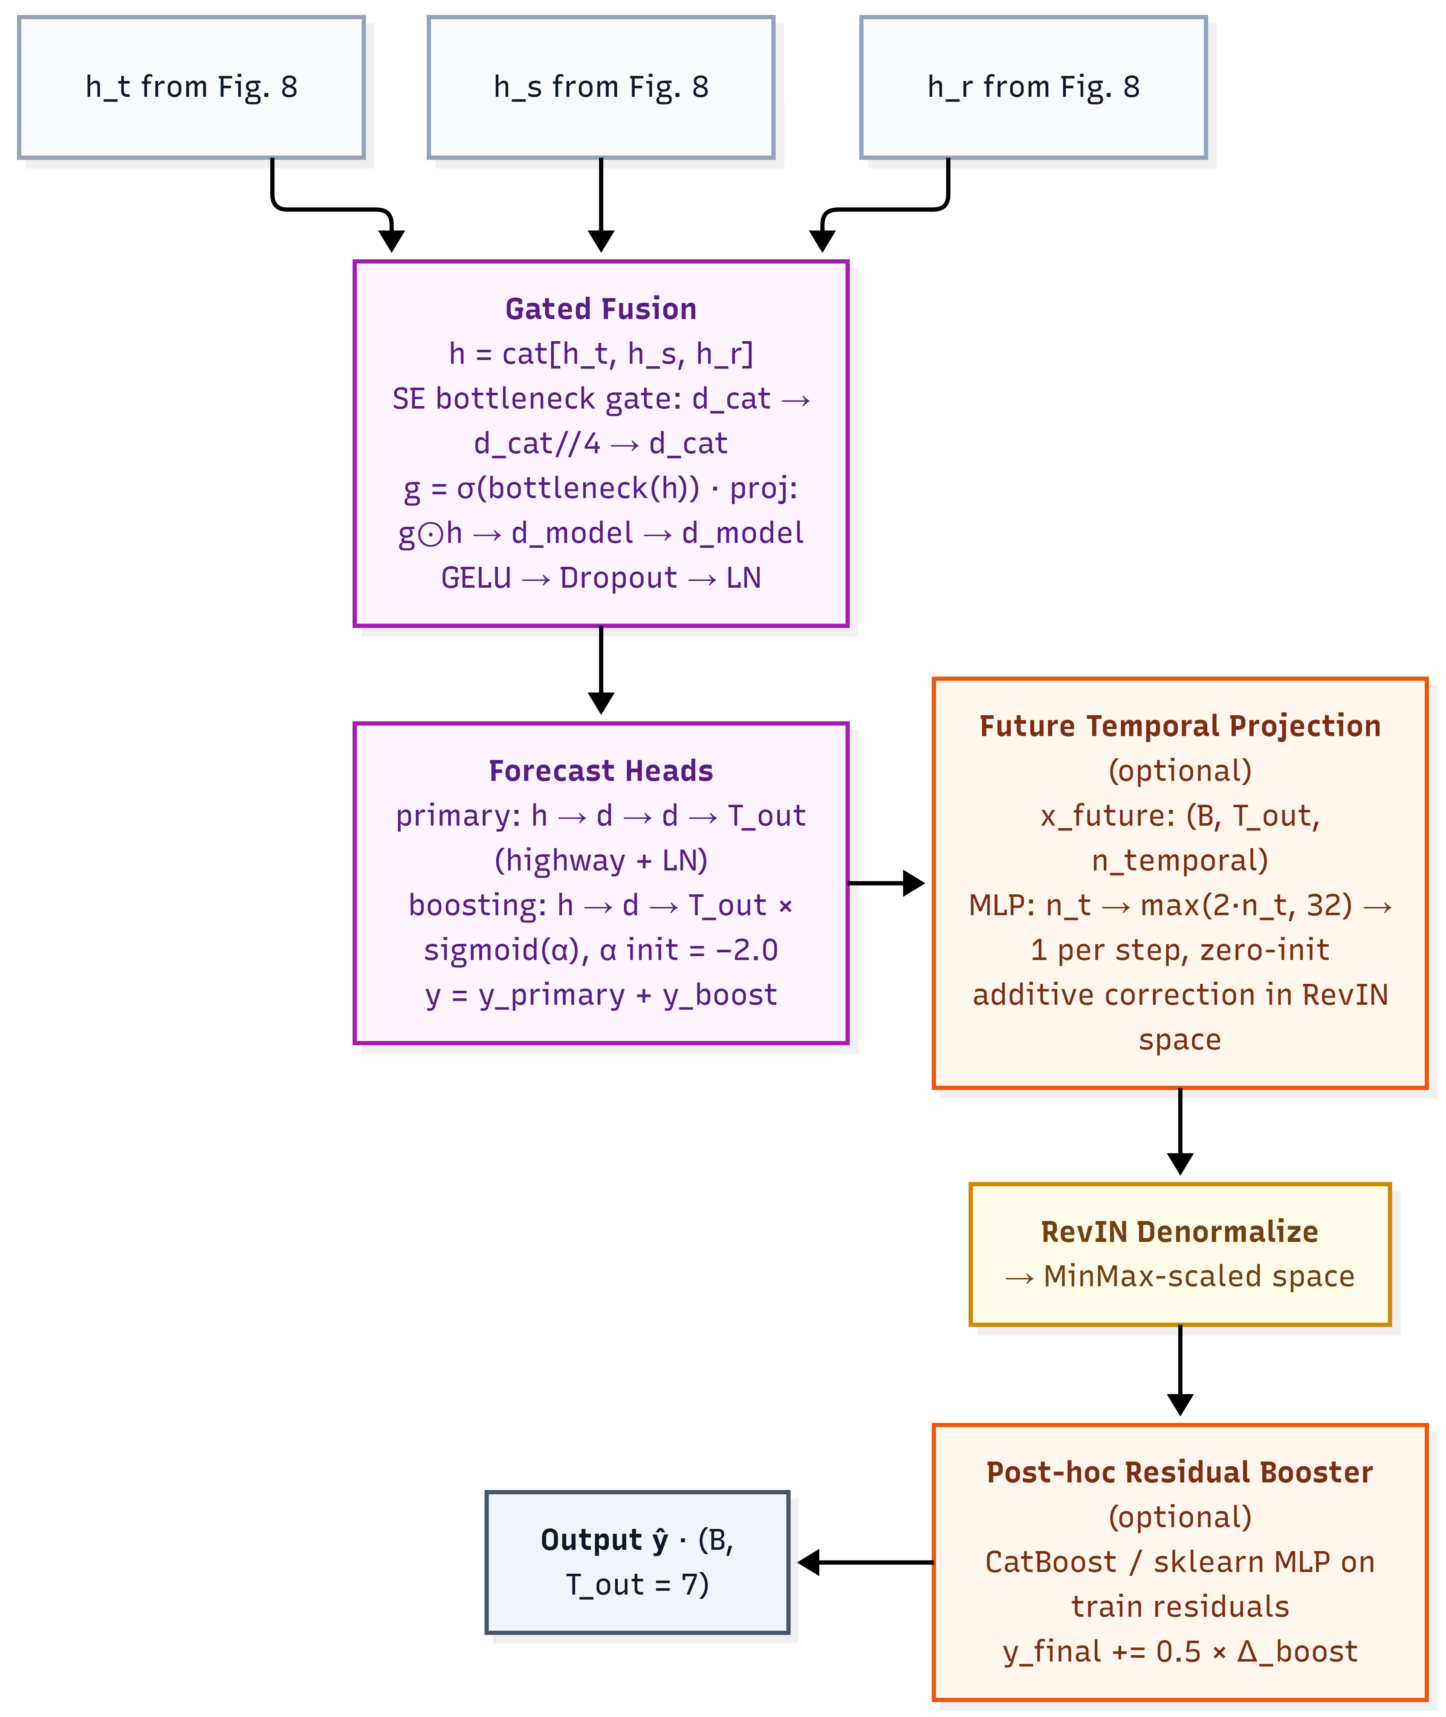
Hybrid Multi-scale Temporal Spatio-Feature (HMT-TSF) Forecaster

Slide 39
Model Selection Chronologically
LSTM & BiLSTM & TPA-LSTM
CNN-LSTM & CNN-BiLSTM
ST-LSTM
STGCN & ASTGCN
STSGCN & PDR-STGCN
MTGNN & STFGNN
Autoformer & Informer
HMT-TSF

Slide 40
06
What I Contribute

Slide 41

Expected Outcomes
Provide a detailed comparative analysis evaluating multiple deep learning models across distinct lookback windows, explicitly segmented by MCO periods.
Introduce a superior forecasting model that outperforms existing SOTA baselines across all lookback windows and MCO phases, accompanied by a reduced feature variant according to SHAP-based feature importance ranking, to determine the effect of the removal of near-zero important spatial and temporal features toward ridership prediction.
Develop a functional command-line interface (CLI) inference tool capable of predicting a 7-day ridership distribution horizon across all 12 distinct transit networks utilizing historical distribution percentages using the proposed model.

Slide 42
Project Timeline
Proposal
23th March 2026
Literature Review
30th March 2026
Methodology
1st May 2026
1st Proof of Concept
8th May 2026
Methodology Revision
22th May 2026
2nd Proof of Concept
29th May 2026
2nd Progress Meeting
4th June 2026
P1 Presentation
10th July 2026
1st Progress Meeting
10th April 2026
P2 Presentation
2nd Sept 2026

Slide 43
07
Results & Findings

Slide 44
Baseline Model Performance (base_nomco_lb14)
Model | Combined% | MAPE% | MAE% | RMSE% | R²
Informer | 79.13 | 6.59 | 5.53 | 8.76 | 0.772
BiLSTM | 79.04 | 6.52 | 5.77 | 8.67 | 0.776
TPA-LSTM | 78.67 | 6.62 | 6.04 | 8.67 | 0.776
CNN-BiLSTM | 78.18 | 6.81 | 6.12 | 8.89 | 0.764
LSTM | 78.13 | 6.71 | 6.18 | 8.98 | 0.760
ST-LSTM | 78.01 | 6.93 | 6.27 | 8.79 | 0.770
MTGNN | 77.93 | 6.91 | 6.47 | 8.69 | 0.775
CNN-LSTM | 77.64 | 6.92 | 6.32 | 9.12 | 0.752
STSGCN | 76.97 | 7.18 | 6.42 | 9.42 | 0.736
STGCN | 76.81 | 7.24 | 6.77 | 9.17 | 0.750
ASTGCN | 75.69 | 7.42 | 6.89 | 9.99 | 0.703
CNN-LSTM-Augmented | 75.36 | 7.77 | 7.19 | 9.68 | 0.721
Autoformer | 74.73 | 7.86 | 7.51 | 9.90 | 0.708
CNN-LSTM-Parallel | 74.18 | 8.18 | 7.68 | 9.97 | 0.704
STFGNN | 73.94 | 8.21 | 7.60 | 10.25 | 0.688
PDR-STGCN | 73.91 | 8.15 | 7.70 | 10.24 | 0.688

Slide 45
Tuned Model Performance (base_nomco_lb14)
Model | Based Combined% | Tuned Combined% | Difference
Informer | 79.13 | 79.99 | +0.86
TPA-LSTM | 78.67 | 79.95 | +1.28
BiLSTM | 79.04 | 79.44 | +0.40
ST-LSTM | 78.01 | 79.13 | +1.12
ASTGCN | 75.69 | 78.82 | +3.13
LSTM | 78.13 | 78.43 | +0.30
STGCN | 76.81 | 78.39 | +1.58
CNN-LSTM-Augmented | 75.36 | 77.10 | +1.74
PDR-STGCN | 73.91 | 75.56 | +1.65
Autoformer | 74.73 | 75.21 | +0.48
MTGNN | 77.93 | 76.40 | −1.54
CNN-BiLSTM | 78.18 | 76.12 | −2.06
STSGCN | 76.97 | 73.65 | −3.33
CNN-LSTM | 77.64 | 73.36 | −4.28
CNN-LSTM-Parallel | 74.18 | 72.53 | −1.65
STFGNN | 73.94 | 65.47 | −8.47

Slide 46
Lookback Sensitivity
Model | lb14 | lb28 | lb56 | Best
Informer | 79.13 | 78.63 | 77.17 | lb14
BiLSTM | 79.04 | 76.97 | 77.09 | lb14
TPA-LSTM | 78.67 | 79.08 | 76.36 | lb28
CNN-BiLSTM | 78.18 | 72.65 | 74.72 | lb14
LSTM | 78.13 | 77.48 | 75.98 | lb14
ST-LSTM | 78.01 | 78.86 | 75.60 | lb28
MTGNN | 77.93 | 78.11 | 77.76 | lb28
CNN-LSTM | 77.64 | 73.90 | 74.33 | lb14
STSGCN | 76.97 | 75.02 | 75.15 | lb14
STGCN | 76.81 | 77.68 | 74.93 | lb28
ASTGCN | 75.69 | 76.89 | 75.15 | lb28
CNN-LSTM-Augmented | 75.36 | 74.73 | 74.04 | lb14
Autoformer | 74.73 | 73.61 | 73.40 | lb14
CNN-LSTM-Parallel | 74.18 | 76.55 | 74.33 | lb28
STFGNN | 73.94 | 61.30 | 43.25 | lb14
PDR-STGCN | 73.91 | 72.35 | 72.20 | lb14

Slide 47
MCO Robustness (base_lb14) – Combined%
Model | nomco | mco | Difference | nomco R² | mco R²
Informer | 79.13 | 73.25 | −5.88 | 0.772 | 0.705
BiLSTM | 79.04 | 72.74 | −6.29 | 0.776 | 0.699
CNN-LSTM-Parallel | 74.18 | 66.89 | −7.29 | 0.776 | 0.577
TPA-LSTM | 78.67 | 71.05 | −7.61 | 0.764 | 0.669
STGCN | 76.81 | 68.55 | −8.27 | 0.760 | 0.615
MTGNN | 77.93 | 67.33 | −10.60 | 0.770 | 0.581
PDR-STGCN | 73.91 | 63.10 | −10.81 | 0.775 | 0.494
CNN-LSTM-Augmented | 75.36 | 64.50 | −10.86 | 0.752 | 0.531
ST-LSTM | 78.01 | 66.75 | −11.26 | 0.736 | 0.584
STSGCN | 76.97 | 64.20 | −12.77 | 0.750 | 0.531
ASTGCN | 75.69 | 61.69 | −14.00 | 0.703 | 0.471
CNN-BiLSTM | 78.18 | 60.59 | −17.59 | 0.721 | 0.427
LSTM | 78.13 | 58.92 | −19.21 | 0.708 | 0.390
Autoformer | 74.73 | 51.26 | −23.47 | 0.704 | 0.121
CNN-LSTM | 77.64 | 45.58 | −32.06 | 0.688 | −0.050
STFGNN | 73.94 | 41.00 | −32.94 | 0.688 | −0.306

Slide 48
HMT-TSF Model Performance (F = 79 with $X_{future}$)
Configuration | Combined% | MAPE% | MAE% | RMSE% | R²
nomco_lb7 | 84.88 | 4.74 | 4.25 | 6.13 | 0.888
nomco_lb14 | 85.78 | 4.39 | 3.97 | 5.87 | 0.897
nomco_lb28 | 84.23 | 4.94 | 4.55 | 6.28 | 0.883
nomco_lb56 | 82.53 | 5.52 | 5.11 | 6.84 | 0.859
nomco_lb84 | 77.68 | 6.99 | 6.59 | 8.73 | 0.773
mco_lb7 | 78.61 | 6.89 | 6.12 | 8.38 | 0.807
mco_lb14 | 81.99 | 5.68 | 5.18 | 7.15 | 0.859
mco_lb28 | 79.89 | 6.26 | 5.83 | 8.02 | 0.822
mco_lb56 | 79.47 | 6.68 | 5.91 | 7.95 | 0.825
mco_lb84 | 78.45 | 6.73 | 6.17 | 8.64 | 0.791

Slide 49
HMT-TSF Model Performance (F = 79 without $X_{future}$)
Configuration | Combined% | MAPE% | MAE% | RMSE% | R²
nomco_lb7 | 78.47 | 6.03 | 5.52 | 7.98 | 0.759
nomco_lb14 | 80.89 | 5.72 | 5.00 | 8.39 | 0.790
nomco_lb28 | 80.87 | 5.73 | 5.03 | 8.37 | 0.794
nomco_lb56 | 79.46 | 6.12 | 5.62 | 8.80 | 0.781
nomco_lb84 | 76.32 | 6.99 | 6.59 | 9.29 | 0.715
mco_lb7 | 74.60 | 7.41 | 6.79 | 9.20 | 0.697
mco_lb14 | 75.49 | 7.18 | 6.59 | 9.73 | 0.716
mco_lb28 | 74.84 | 7.32 | 6.74 | 9.10 | 0.704
mco_lb56 | 76.02 | 7.01 | 6.44 | 9.53 | 0.723
mco_lb84 | 74.82 | 7.12 | 6.58 | 9.50 | 0.705

Slide 50
HMT-TSF Model Performance (Feature-Reduced, F = 53)
Variant | X_future | nomco_lb14 Combined% | nomco_lb14 R² | nomco_lb14 MAE | Δ vs Informer (79.13%) | mco_lb14 Combined% | MCO Δ (nomco→mco)
HMT-TSF (full) | On | 85.78 | 0.897 | 49,897 | +6.65 | 81.99 | −3.79
HMT-TSF (full) | Off | 80.89 | 0.790 | 62,836 | +1.76 | 75.49 | −5.40
HMT-TSF-FR | On | 86.59 | 0.906 | 46,323 | +7.46 | 78.74 | −7.85
HMT-TSF-FR | Off | 81.23 | 0.802 | 62,547 | +2.10 | 74.01 | −7.22

Slide 51
08a
Discussions

Slide 52
Discussion of Key Findings
Hybrid Multi-modal Architectures outperform Single-paradigm Models.
Test-set Accuracy conceals Systematic Overfitting in recurrent baselines.
14-day lookback window is decisively optimal under normal conditions.
Structural Inductive Biases determine Robustness under Distributional Shifts.
Learned Feature Hierarchy is domain-consistent and enables Principled Feature Reduction.

Slide 53
08b
Implications

Slide 54
Implications
Graph Transfer to Multivariate Ridership exposes a transfer limitation: temporal-adjacency construction breaks down at long windows.
Fit Diagnostics as Necessary Complement.
Regime Gating + RevIN for Robustness.
Established networks can have phased integration: runs parallel to existing planning; forecast-informed decisions.
Developing corridors (Johor, East Malaysia): Proof-of-Concept for demand-responsive network design, planning new services around forecasts from the outset.

Slide 55
08c
Limitations

Slide 56
Limitations
Granularity — National daily level only; no station-level or intra-day crowd management
Single dataset — Temporal stability shown but cross-network validity untested
Batch-historical inputs — Errors/delays can be imputed, not prevented upstream
Limited regime diversity — Only one shock type (MCO) informs K = 3 regime gating
Single-seed results — No variance/significance testing; sub-1.5% gaps are indicative only
Demand-side only — Excludes supply-side disruptions (no public dataset exists)
Residual MCO leakage — Lingers via ridership_lag_{7,14,28} post-MCO
Confounded comparison — Only HMT-TSF gets X_future calendar input; no equivalent baseline

Slide 57
08d
Future Works

Slide 58
Future Works
Rerun on multiple seeds and retrain all models with no-future/future.
Obtain better and reliable supply-side data integration (station-level).
Real-time data integration.
Data integrity at the source (fare-collection).
Generalisation to new service lines and networks.
Regime modelling beyond MCO, fare reforms, new line openings

Slide 59

THANK YOU!

