Slide 1
Welcome to my presentation
Here is where I talk about my project

Slide 2
02.
About my project
04.
Benefits and limitations
Table of contents
01.
About me
03.
About my idea
05.
Future improvements
06.
Project demo
07
Question and Answer

Slide 3
01
About me

Slide 4
About me
My name is Huy, Trịnh Bảo Huy. I am 11 years old. I used to study in Lomonoxop Primary school, I will learn in
Nguyen Tat Thanh school after the summer holidays. I like to program, play video games, reading books …

Slide 5
02
About my project

Slide 6

About my project
My project called Summer Journey. Here, people can find places in Vietnam for their summer vacation. They can also share about their wonderful summer. My project has basic and some advance functions. But it still don’t have much, I will improve it in the future.

Slide 7
03
About my idea

Slide 8
About my idea
How I have it?
On summer vacation, people will have wonderful moments. So I came up with a website that let people share the vacations.

Slide 9
04
Benefits and limitations

Slide 10
Benefits and limitations
Benefits
limitations
Has basic and some advance function
Pretty and high contrast interface
Too less pages
Have some problem
Some functions are limited

Slide 11
05
Future improvements

Slide 12
Future improvements
Add more pages
Better and fully functions
Can talk with other accounts
Like, love and answer post
Add emojis list for chat
Has dark/light mode
Can change languages

Slide 13
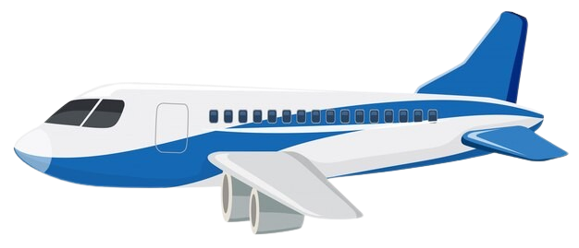
06
Project demo
Let’s go!

Slide 14
06
Project demo
Let’s go!

Slide 15
07
Q & A
You can ask any question!

Slide 16
Q & A
07
You can ask any question!

Slide 17
Thanks!
For listening and
question me!

