Slide 1

ART GALLERY MANAGEMENT SYSTEM
BUAN 6320
GROUP 5
nxs230038 | sxg230007 | sxa230000 | nxk230008

Slide 2

OBJECTIVE
The central aim of this project is to develop an integrated database system that acts as the foundation for overseeing the management of various entities such as Artists, Artwork, Display, Exhibitions, Booking, and Visitors. This database is designed to foster a seamless connection between artists, exhibitions and visitors.

Slide 3
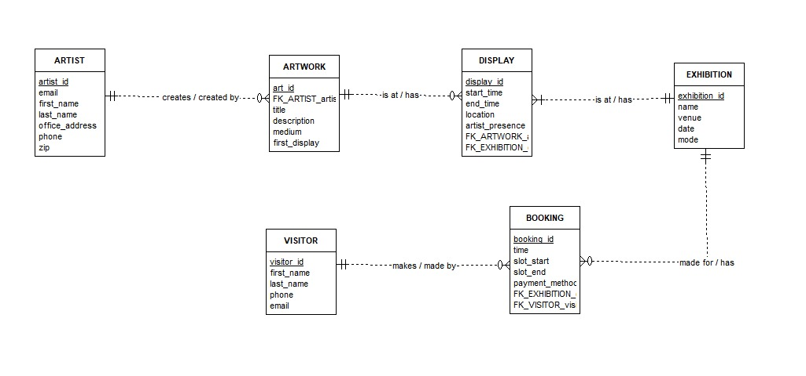
ENTITY RELATIONSHIP DIAGRAM

Slide 4
BUSINESS RULES
Each Artist creates zero or more artworks.
Every artwork is created by only one artist. However, the artist information may be disclosed or not.
Each artwork can be at zero or many displays.
Every display is associated to only one artwork.
Each exhibition has at least one display.
Every display is associated to only one exhibition.
Each exhibition has zero or more bookings.
Every booking is associated with only one exhibition.
Each visitor can make zero or multiple bookings.
Every booking is associated to only one visitor.

Slide 5
TRIGGERS
-- Business purpose: The TRG_CHECK_DATE trigger automatically checks the integrity of the database by verifying if the display is on or after the first_display date of the particular ARTWORK
CREATE OR REPLACE FUNCTION TRG_FUN_CHECK_DATE()
RETURNS TRIGGER AS $$
BEGIN
IF (SELECT date FROM exhibition WHERE exhibition_id = NEW.exhibition_id) < (SELECT first_display FROM artwork WHERE art_id = NEW.art_id) THEN
RAISE EXCEPTION 'exhibition_date must be on or after first_display';
END IF;
RETURN NEW;
END;
$$ LANGUAGE plpgsql;
CREATE TRIGGER TRG_CHECK_DATE
BEFORE INSERT OR UPDATE ON display
FOR EACH ROW
EXECUTE FUNCTION TRG_FUN_CHECK_DATE();

Slide 6
TRIGGERS
-- Business purpose: The TRG_ARTWORK trigger automatically assigns a sequential art_id to a new artwork in the ARTWORK table and assigns appropriate values to the created_by and date_created fields also, If the record is being inserted or updated, appropriate values are assigned to the modified_by and modified_date fields. Further, if there is no reference to any artist, we have it refer to the UNKNOWN/ANONYMOUS ARTIST entry.
CREATE OR REPLACE FUNCTION TRG_FUN_ARTWORK()
RETURNS TRIGGER AS $$
BEGIN
IF TG_OP = 'INSERT' THEN
IF NEW.art_id IS NULL THEN
NEW.art_id := nextval('SEQ_ARTWORK_art_id');
END IF;
IF NEW.artist_id IS NULL THEN
NEW.artist_id := (select artist_id from artist where first_name = 'UNKNOWN/ANONYMOUS');
END IF;
IF NEW.created_by IS NULL THEN
NEW.created_by := CURRENT_USER;
END IF;
IF NEW.date_created IS NULL THEN
NEW.date_created := CURRENT_DATE;
END IF;
END IF;
IF TG_OP = 'INSERT' OR TG_OP = 'UPDATE' THEN
NEW.modified_by := CURRENT_USER;
NEW.date_modified := CURRENT_DATE;
END IF;
RETURN NEW;
END;
$$ LANGUAGE plpgsql;
CREATE TRIGGER TRG_ARTWORK
BEFORE INSERT OR UPDATE ON artwork
FOR EACH ROW
EXECUTE FUNCTION TRG_FUN_ARTWORK();

Slide 7
SEQUENCE
CREATE SEQUENCE SEQ_VISITOR_visitor_id
INCREMENT BY 1
START WITH 1;
CREATE SEQUENCE SEQ_DISPLAY_display_id
INCREMENT BY 1
START WITH 1;

Slide 8
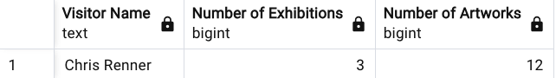
ADVANCED QUERIES
Find out the visitor who can visit the maximum number of artworks across all exhibitions. Display visitor_id, visitor name, Number of artworks they could visit and the number of exhibitions that facilitate this.
SELECT
v.first_name || ' ' || v.last_name AS "Visitor Name",
COUNT(DISTINCT(b.exhibition_id)) AS "Number of Exhibitions",
COUNT(art_id) AS "Number of Artworks"
FROM booking b
JOIN display d USING (exhibition_id)
JOIN visitor v USING (visitor_id)
WHERE
slot_start < end_time AND slot_end > start_time
GROUP BY
v.visitor_id, v.first_name || ' ' || v.last_name
ORDER BY COUNT(art_id) DESC
LIMIT 1;

Slide 9
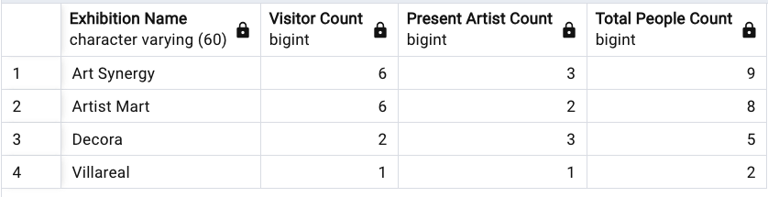
ADVANCED QUERIES
Display the Exhibition name, number of visitors for each exhibition and the number of artists that were present to display their work in the exhibitions. Order the exhibitions by total people who were present at some point in the exhibition
SELECT
name AS "Exhibition Name",
COUNT(DISTINCT(visitor_id)) AS "Visitor Count",
COUNT(DISTINCT(artist_id, exhibition_id)) AS "Present Artist Count",
COUNT(DISTINCT(visitor_id)) + COUNT(DISTINCT(artist_id, exhibition_id)) AS "Total People Count"
FROM booking
JOIN exhibition e USING (exhibition_id)
JOIN display USING (exhibition_id)
JOIN artwork USING (art_id)
WHERE artist_presence = TRUE
GROUP BY e.name
ORDER BY COUNT(DISTINCT(visitor_id)) + COUNT(DISTINCT(artist_id, exhibition_id)) DESC;

Slide 10
CHALLENGES
Identifying which relationship mechanism works the best while also conveying the meaning without any compromise.
Identifying appropriate data points to illustrate the functionality and use case of Queries and Triggers.

Slide 11
THANK YOU

