Slide 1
Building a REST API Using Django & Django REST Framework
Kenny Yarboro
http://github.com/kennyncsu/drf-restaurant-api

Slide 2

Getting Started
Quick Introductions
REST Architecture Overview
Django
Django REST Framework
Necessary Setup
Start Project

Slide 3
REST Architecture¹
Alternative Approach to Web Services
SOAP
Typically HTTP-based
Standard HTTP Methods
GET
PUT
POST
DELETE

Slide 4
REST Architecture¹
Client-Server Model
Stateless
Links Determine State
Cacheable
Define Cacheable or Not
Layered System
Client Not Necessarily Communicating with End Server

Slide 5
REST Architecture¹
Uniform Interface
Identification of Resources
Hypermedia as the Engine of App. State
HATEOAS
‘Plug-and-Play’ Services

Slide 6

2
High-level Python Web Framework
Quickly Develop Applications
Built-In Security
Scalable
Built-In Administrative Interface

Slide 7
2
MVC vs MTV
Model = Model
View = Template
Controller = View

Slide 8

3
Extension Based on Django
Toolkit to Easily Build Web APIs
Built-In Web Browsable API
Customizable
Basic Features
Enhanced Features

Slide 9
Necessary Setup
Python 2 vs 3
Python 2.x
Supported by More Libraries
2.7 Pre-Loaded on Mac
Python 3.x
Continually Building Support

Slide 10
Necessary Setup
pip
https://bootstrap.pypa.io/get-pip.py
Windows: Add to System Path: C:\<path_to_python>\Scripts
python get-pip.py
virtualenv
pip install virtualenv
cd <folder_to_use_for_project>
virtualenv venv
. venv/bin/activate
Windows: venv\Scripts\activate
deactivate

Slide 11
Necessary Setup
Django
pip install django==1.8.4
Django REST Framework (DRF)
pip install djangorestframework==3.2.2

Slide 12
Client
URLs
Django
Admin
View/ViewSet
Serializer
Model
Validator

Slide 13
Start Project
Use Django to Create Project
django-admin.py/exe startproject tutorial .
Several Files Created
manage.py - runs the project
tutorial Folder (change to this directory)
settings.py - configuration of project
urls.py - define addresses for resources
wsgi.py - default WSGI configuration for web server

Slide 14
Start Project
Use Django to Create Application
django-admin.py/exe startapp restaurantapi
Several Files Created
restaurantapi Folder
admin.py - set up Admin views
models.py - define data objects
views.py - callable functions or classes
Take Request, Return Response
migrations Folder - think version control for models

Slide 15
Client
URLs
Django
Admin
View/ViewSet
Serializer
Model
Validator

Slide 16
Start Project
Create Initial Database
python manage.py migrate
New File: db.sqlite3
Create Superuser
python manage.py createsuperuser
Start Project
python manage.py runserver --noreload
http://localhost:8000

Slide 17
Restaurant Menu
Restaurant Menu API Requirements
Building the Application
Create the Database
Generating Data for the Application

Slide 18
Restaurant Menu API Requirements
Types of Users
Components of Menu
Menu Actions

Slide 19
Types of Users
Administrator/Manager
Manage the Application
Maintain Menu
Maintain Users & Permissions
Chef
Maintain Menu
Customers (Other)
View Menu

Slide 20
User & Group Models
Default Models in Django
Benefits
User Management
Password Encryption
Authentication
Group Permissions

Slide 21
Menu Model
id - unique numeric value
name - text
description - text
chef - ForeignKey: User
available - boolean

Slide 22
Menu Item Model
id - unique numeric value
name - text
description - text
cost_to_make - Real number
sale_price - Real number
available - boolean
menu - ForeignKey: Menu

Slide 23
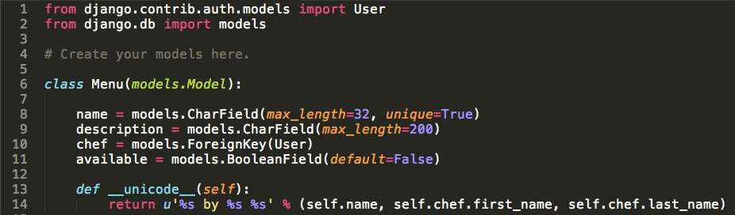
Build Models models.py
Add Menu Model

Slide 24
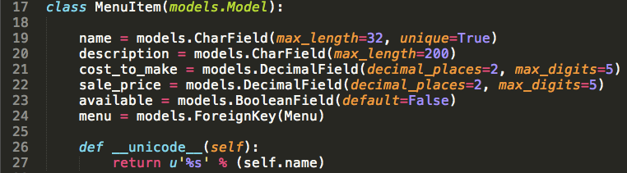
Build Models models.py
Add Menu Item Model

Slide 25
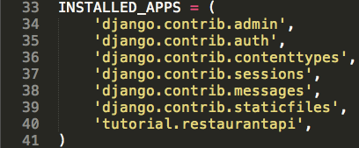
Modify Settings settings.py
Add Application to Installed Apps

Slide 26
Create the Database
Create Migrations for New Models
python manage.py makemigrations
Commit New Migrations
python manage.py migrate
Start Project
python manage.py runserver --noreload

Slide 27
Generating Data for the Application
Create Menu
Get ID of New Menu
Create Menu Item
Get ID of New Menu Item
Query Database for Data

Slide 28
Generating Data for the Application
Create More Menu Items
Create Menus
Query Database for Data

Slide 29
Client
URLs
Django
Admin
View/ViewSet
Serializer
Model
Validator

Slide 30
Code from Section 1
http://github.com/kennyncsu/drf-restaurant-api/blob/master/section1.zip

Slide 31
BREAK

Slide 32
Code from Section 1
http://github.com/kennyncsu/drf-restaurant-api/blob/master/section1.zip

Slide 33
Client
URLs
Django
Admin
View/ViewSet
Serializer
Model
Validator

Slide 34
Benefits of Admin Interface
Built-In
Immediately Available
Customizable
Supports Permissions
Potential User Interface

Slide 35
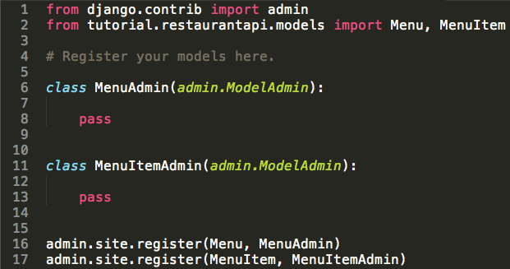
Build Menu Admin admin.py
Default Admin

Slide 36
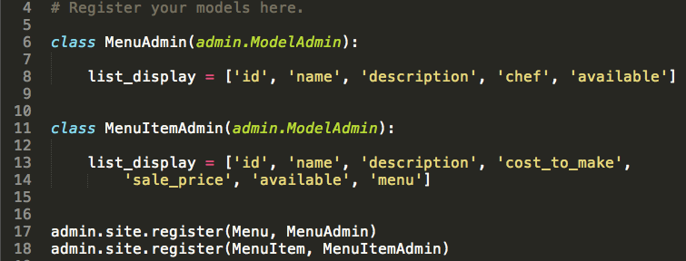
Build Menu Admin admin.py
Add Menu Fields to Admin List View
Add MenuItem Fields to Admin List View

Slide 37
Client
URLs
Django
Admin
View/ViewSet
Serializer
Model
Validator

Slide 38
TIME FOR REST (API)?

Slide 39
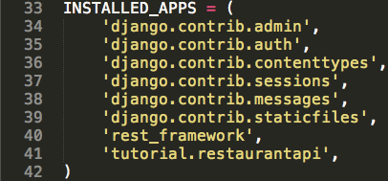
Modify Settings settings.py
Add DRF to Installed Apps

Slide 40
Serializers³
Complex Data to/from Python Datatypes
Generically Represent Output Data
JSON
XML
Validate Incoming Data
Customizable

Slide 41
Model Serializers³
Automatically Generate Model Fields
Automatically Generate Validators
Default Functions:
Create New Object
Update Existing Object
HyperLinked Model Serializer
HyperLink Represents Relationship

Slide 42
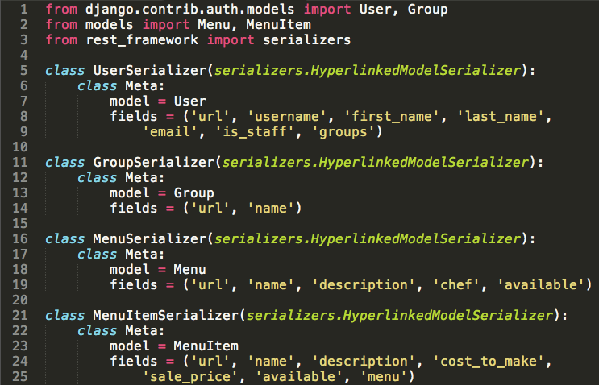
Create Serializers serializers.py

Slide 43
Client
URLs
Django
Admin
View/ViewSet
Serializer
Model
Validator

Slide 44
ViewSets
Single Class for Set of Related Views
Predefined or Build Your Own
Read vs Get
Update vs Put
Minimize Coding
Less Explicit

Slide 45
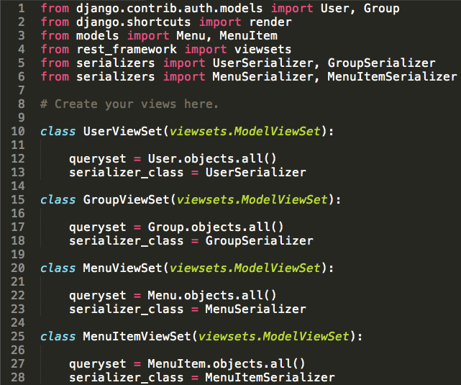
Add Viewsets views.py

Slide 46
Client
URLs
Django
Admin
View/ViewSet
Serializer
Model
Validator

Slide 47
Routers for URLs
Routers
Register ViewSets
Automatically Handles URL Config.
DefaultRouter
Customizable

Slide 48
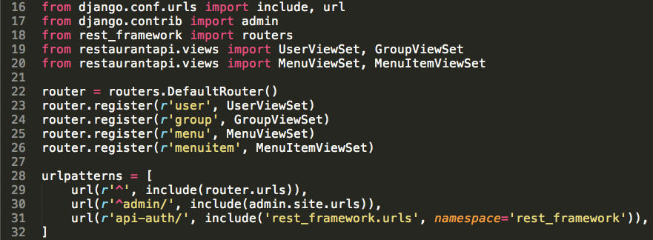
Add Router to URLs urls.py

Slide 49
Client
URLs
Django
Admin
View/ViewSet
Serializer
Model
Validator

Slide 50
TRY IT OUT

Slide 51
Usages
Browsable API
Customizable via Serializers
CURL
External Services

Slide 52
Using CURL
Get List of Services
curl http://localhost:8000/
Get List of Menus
curl http://localhost:8000/menu/

Slide 53
What’s Next?
No Permissions
Unable to Set User Password
No Validation
Enable XML
Public API

Slide 54
Adding API Permissions
Built-In Permission
Entire API
Specific API Endpoints
Custom Permission Check

Slide 55
Permission for Entire API
settings.py
Require Authenticated User

Slide 56
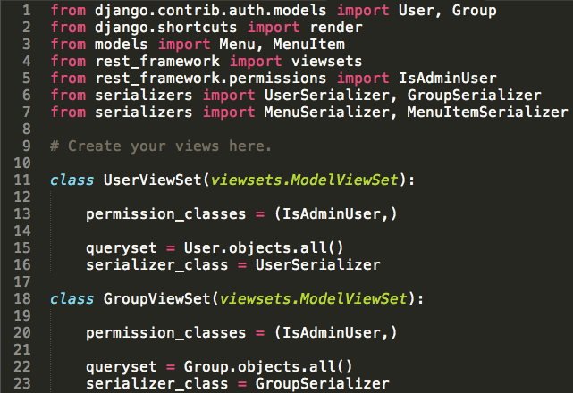
Permission for Specific API
views.py
Restrict Access to Users, Groups

Slide 57
Client
URLs
Django
Admin
View/ViewSet
Serializer
Model
Validator

Slide 58
Setting Password
Default Encryption
Enable Default Password

Slide 59
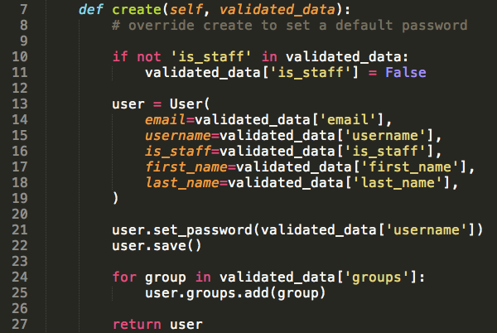
Set Default Password
serializers.py
Update UserSerializer

Slide 60
Client
URLs
Django
Admin
View/ViewSet
Serializer
Model
Validator

Slide 61
Validation
Validation
Forms
Models
Serializers
Views/ViewSets

Slide 62
Menu Item Validation
Validate Slug Field for Name (Built-In)
Letters
Numbers
Underscores
Hyphens
Validate Limit on Cost to Make (Custom)

Slide 63
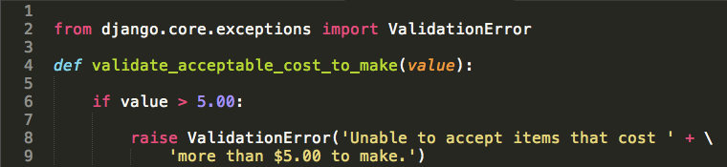
Custom Validator
validators.py
Validate Cost to Make Limit

Slide 64
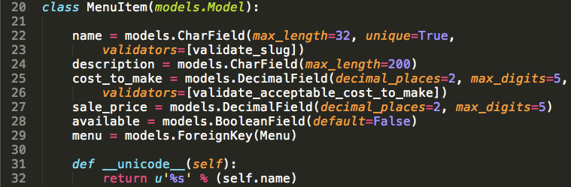
Menu Item Validation
models.py
Validate Slug Field for Name
Validate Limit on Cost to Make

Slide 65
Client
URLs
Django
Admin
View/ViewSet
Serializer
Model
Validator

Slide 66
Renderers³
Return Response of Specific Media Type
Content Negotiation:
Accept Header
URL Suffix such as .json
Built-In or Build Your Own
Enable Globally or Per View

Slide 67
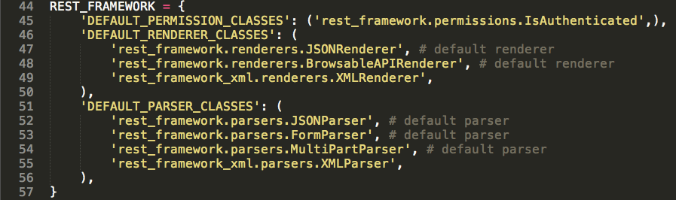
Enable XML Renderer settings.py
REST Framework XML
pip install djangorestframework-xml==1.2.0

Slide 68
Public API
Support GET Action
Customization Options
ViewSet
API Views
Mixins for List, Create, Etc.
Set No Permissions
Show All Available Menus

Slide 69
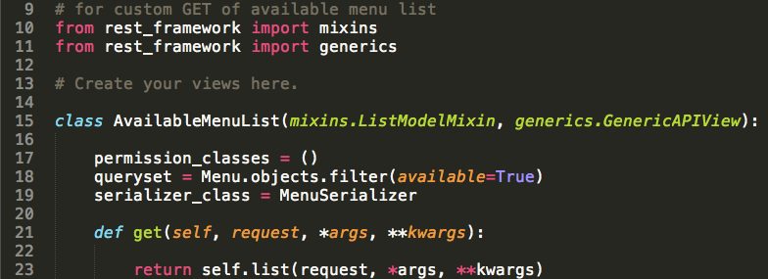
Using Mixins
views.py
Return List of Available Menus

Slide 70
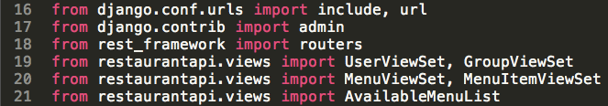
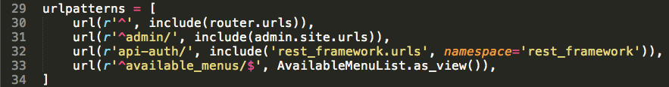
Using Mixins
urls.py

Slide 71
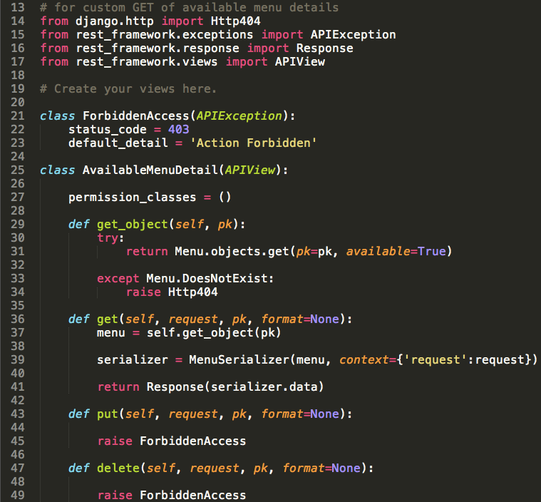
Using API View: views.py

Slide 72
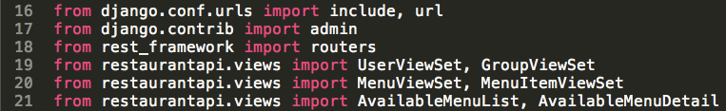
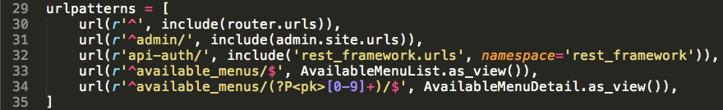
Using API View urls.py

Slide 73
Client
URLs
Django
Admin
View/ViewSet
Serializer
Model
Validator

Slide 74
Code from Section 2
http://github.com/kennyncsu/drf-restaurant-api/blob/master/section2.zip

Slide 75
Exploration
Enhance GET of Available Menus
Include Check on Available Menu Items
Add Ingredients for Menu Items
Add Availability
Add Additional Groups
Use More Validators
Build More Views

Slide 76
References
Representational State Transfer
Django
Django REST Framework

Slide 77
Thank you!
Email: kenny.yarboro@gmail.com
http://github.com/kennyncsu/drf-restaurant-api

