Slide 1
Chapter 2: Data Preprocessing
Why preprocess the data?
Descriptive data summarization
Data cleaning
Data integration and transformation
Data reduction
Discretization and concept hierarchy generation
Summary
Data Mining: Concepts and Techniques

Slide 2
Why Data Preprocessing?
Data in the real world is dirty
  incomplete: lacking attribute values, lacking certain attributes of interest, or containing only aggregate data
    e.g., occupation=“ ”
  noisy: containing errors or outliers
    e.g., Age=“-10”
  inconsistent: containing discrepancies in codes or names
    e.g., Age=“42” Birthday=“03/07/1997”
    e.g., Was rating “1,2,3”, now rating “A, B, C”
    e.g., discrepancy between duplicate records
Data Mining: Concepts and Techniques

Slide 3
Why Is Data Dirty?
Incomplete data may come from
  “Not applicable” data value when collected
  Different considerations between the time when the data was collected and when it is analyzed.
  Human/hardware/software problems
Noisy data (incorrect values) may come from
  Faulty data collection instruments
  Human or computer error at data entry
  Errors in data transmission
Inconsistent data may come from
  Different data sources
  Functional dependency violation (e.g., modify some linked data)
Duplicate records also need data cleaning
Data Mining: Concepts and Techniques

Slide 4
Why Is Data Preprocessing Important?
No quality data, no quality mining results!
  Quality decisions must be based on quality data
    e.g., duplicate or missing data may cause incorrect or even misleading statistics.
  Data warehouse needs consistent integration of quality data
Data extraction, cleaning, and transformation comprises the majority of the work of building a data warehouse
Data Mining: Concepts and Techniques

Slide 5
Multi-Dimensional Measure of Data Quality
A well-accepted multidimensional view:
  Accuracy
  Completeness
  Consistency
  Timeliness
  Believability
  Value added
  Interpretability
  Accessibility
Broad categories:
  Intrinsic, contextual, representational, and accessibility
Data Mining: Concepts and Techniques

Slide 6
Major Tasks in Data Preprocessing
Data cleaning
  Fill in missing values, smooth noisy data, identify or remove outliers, and resolve inconsistencies
Data integration
  Integration of multiple databases, data cubes, or files
Data transformation
  Normalization and aggregation
Data reduction
  Obtains reduced representation in volume but produces the same or similar analytical results
Data discretization
  Part of data reduction but with particular importance, especially for numerical data
Data Mining: Concepts and Techniques

Slide 7

Forms of Data Preprocessing
Data Mining: Concepts and Techniques

Slide 8
Chapter 2: Data Preprocessing
Why preprocess the data?
Descriptive data summarization
Data cleaning
Data integration and transformation
Data reduction
Discretization and concept hierarchy generation
Summary
Data Mining: Concepts and Techniques

Slide 9
Mining Data Descriptive Characteristics
Motivation
  To better understand the data: central tendency, variation and spread
Data dispersion characteristics
  median, max, min, quantiles, outliers, variance, etc.
Numerical dimensions correspond to sorted intervals
  Data dispersion: analyzed with multiple granularities of precision
  Boxplot or quantile analysis on sorted intervals
Dispersion analysis on computed measures
  Folding measures into numerical dimensions
  Boxplot or quantile analysis on the transformed cube
Data Mining: Concepts and Techniques

Slide 10
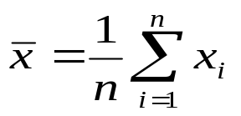

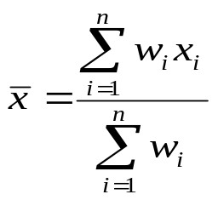
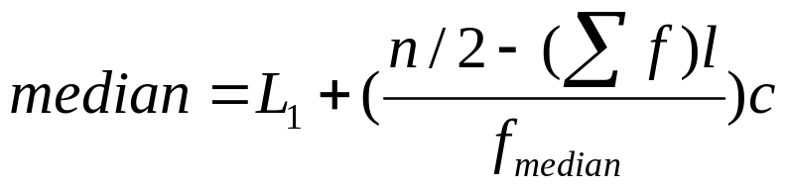
Measuring the Central Tendency
Mean (algebraic measure) (sample vs. population):
  Weighted arithmetic mean:
  Trimmed mean: chopping extreme values
Median: A holistic measure
  Middle value if odd number of values, or average of the middle two values otherwise
  Estimated by interpolation (for grouped data):
Mode
  Value that occurs most frequently in the data
  Unimodal, bimodal, trimodal
  Empirical formula:
Data Mining: Concepts and Techniques

Slide 11



Symmetric vs. Skewed Data
Median, mean and mode of symmetric, positively and negatively skewed data
Data Mining: Concepts and Techniques

Slide 12


Measuring the Dispersion of Data
Quartiles, outliers and boxplots
  Quartiles: Q₁ (25th percentile), Q₃ (75th percentile)
  Inter-quartile range: IQR = Q₃ – Q₁
  Five number summary: min, Q₁, M, Q₃, max
  Boxplot: ends of the box are the quartiles, median is marked, whiskers, and plot outlier individually
  Outlier: usually, a value higher/lower than 1.5 x IQR
Variance and standard deviation (sample: s, population: σ)
  Variance: (algebraic, scalable computation)
  Standard deviation s (or σ) is the square root of variance s² ⁽or σ²⁾
Data Mining: Concepts and Techniques

Slide 13
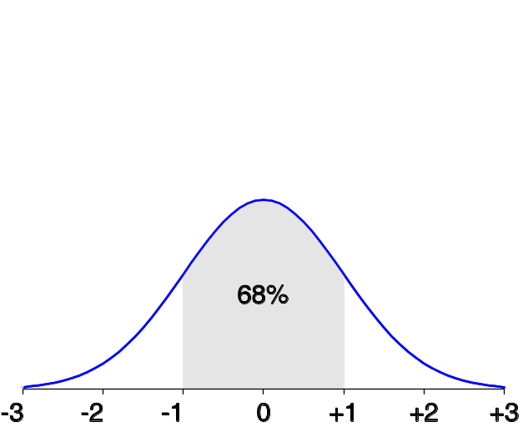
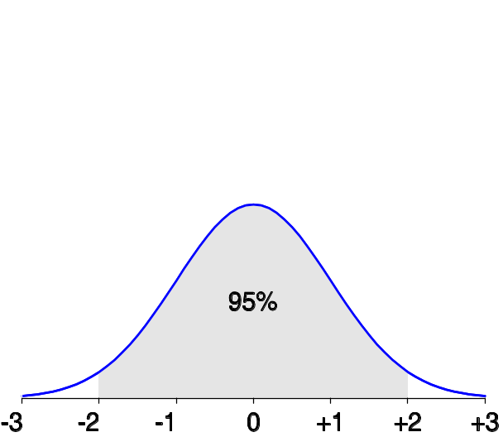
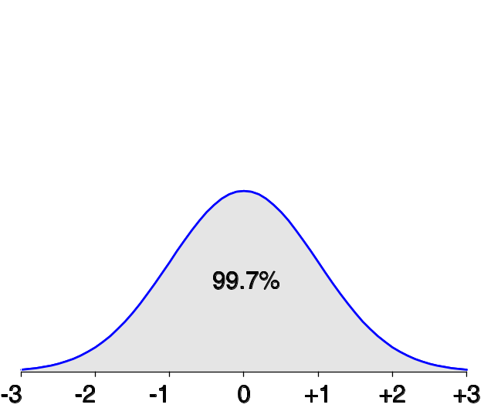
Properties of Normal Distribution Curve
The normal (distribution) curve
  From μ–σ to μ+σ: contains about 68% of the measurements (μ: mean, σ: standard deviation)
  From μ–2σ to μ+2σ: contains about 95% of it
  From μ–3σ to μ+3σ: contains about 99.7% of it
Data Mining: Concepts and Techniques

Slide 14
Chapter 2: Data Preprocessing
Why preprocess the data?
Descriptive data summarization
Data cleaning
Data integration and transformation
Data reduction
Discretization and concept hierarchy generation
Summary
Data Mining: Concepts and Techniques

Slide 15
Data Cleaning
Importance
  “Data cleaning is one of the three biggest problems in data warehousing”—Ralph Kimball
  “Data cleaning is the number one problem in data warehousing”—DCI survey
Data cleaning tasks
  Fill in missing values
  Identify outliers and smooth out noisy data
  Correct inconsistent data
  Resolve redundancy caused by data integration
Data Mining: Concepts and Techniques

Slide 16
Missing Data
Data is not always available
  E.g., many tuples have no recorded value for several attributes, such as customer income in sales data
Missing data may be due to
  equipment malfunction
  inconsistent with other recorded data and thus deleted
  data not entered due to misunderstanding
  certain data may not be considered important at the time of entry
  not register history or changes of the data
Missing data may need to be inferred.
Data Mining: Concepts and Techniques

Slide 17
Data Mining Cup 2004
425 students from 166 universities and 32 countries took part in the competition, which lasted from April 15, 2004 to May 13, 2004. 111 participants submitted solution models. The objective of data mining is to discover hidden relations, patterns, and trends in databases. This year's data mining task dealt with the issue of predicting the behavior of customers returning mail-order merchandise. Yuchun Tang's solution ranked 50th with 9559 points (the top-ranked solution received 10511 points)
Winner' presentation DMC 2004 (PDF)
Data Mining: Concepts and Techniques

Slide 18
How to Handle Missing Data?
Ignore the tuple: usually done when class label is missing (assuming the tasks in classification—not effective when the percentage of missing values per attribute varies considerably.
Fill in the missing value manually: tedious + infeasible?
Fill in it automatically with
  a global constant : e.g., “unknown”, a new class?!
  the attribute mean
  the attribute mean for all samples belonging to the same class: smarter
  the most probable value: inference-based such as Bayesian formula or decision tree
Data Mining: Concepts and Techniques

Slide 19
Noisy Data
Noise: random error or variance in a measured variable
Incorrect attribute values may due to
  faulty data collection instruments
  data entry problems
  data transmission problems
  technology limitation
  inconsistency in naming convention
Other data problems which requires data cleaning
  duplicate records
  incomplete data
  inconsistent data
Data Mining: Concepts and Techniques

Slide 20
How to Handle Noisy Data?
Binning
  first sort data and partition into (equal-frequency) bins
  then one can smooth by bin means, smooth by bin median, smooth by bin boundaries, etc.
Regression
  smooth by fitting the data into regression functions
Clustering
  detect and remove outliers
Combined computer and human inspection
  detect suspicious values and check by human (e.g., deal with possible outliers)
Data Mining: Concepts and Techniques

Slide 21
Simple Discretization Methods: Binning
Equal-width (distance) partitioning
  Divides the range into N intervals of equal size: uniform grid
  if A and B are the lowest and highest values of the attribute, the width of intervals will be: W = (B –A)/N.
  The most straightforward, but outliers may dominate presentation
  Skewed data is not handled well
Equal-depth (frequency) partitioning
  Divides the range into N intervals, each containing approximately same number of samples
  Good data scaling
  Managing categorical attributes can be tricky
Data Mining: Concepts and Techniques

Slide 22
Binning Methods for Data Smoothing
Sorted data for price (in dollars): 4, 8, 9, 15, 21, 21, 24, 25, 26, 28, 29, 34
* Partition into equal-frequency (equi-depth) bins:
- Bin 1: 4, 8, 9, 15
- Bin 2: 21, 21, 24, 25
- Bin 3: 26, 28, 29, 34
* Smoothing by bin means:
- Bin 1: 9, 9, 9, 9
- Bin 2: 23, 23, 23, 23
- Bin 3: 29, 29, 29, 29
* Smoothing by bin boundaries:
- Bin 1: 4, 4, 4, 15
- Bin 2: 21, 21, 25, 25
- Bin 3: 26, 26, 26, 34
Data Mining: Concepts and Techniques

Slide 23
Regression
y
Y1
Y1’
y = x + 1
X1
x
Data Mining: Concepts and Techniques

Slide 24
Cluster Analysis
Data Mining: Concepts and Techniques

Slide 25
Chapter 2: Data Preprocessing
Why preprocess the data?
Data cleaning
Data integration and transformation
Data reduction
Discretization and concept hierarchy generation
Summary
Data Mining: Concepts and Techniques

Slide 26
Data Integration
Data integration:
  Combines data from multiple sources into a coherent store
Schema integration: e.g., A.cust-id ≡ B.cust-#
  Integrate metadata from different sources
Entity identification problem:
  Identify real world entities from multiple data sources, e.g., Bill Clinton = William Clinton
Detecting and resolving data value conflicts
  For the same real world entity, attribute values from different sources are different
  Possible reasons: different representations, different scales, e.g., metric vs. British units
Data Mining: Concepts and Techniques

Slide 27
Handling Redundancy in Data Integration
Redundant data occur often when integration of multiple databases
  Object identification: The same attribute or object may have different names in different databases
  Derivable data: One attribute may be a “derived” attribute in another table, e.g., annual revenue
Redundant attributes may be able to be detected by correlation analysis
Careful integration of the data from multiple sources may help reduce/avoid redundancies and inconsistencies and improve mining speed and quality
Data Mining: Concepts and Techniques

Slide 28
Data Transformation
Smoothing: remove noise from data
Aggregation: summarization, data cube construction
Generalization: concept hierarchy climbing
Normalization: scaled to fall within a small, specified range
  min-max normalization
  z-score normalization
  normalization by decimal scaling
Attribute/feature construction
  New attributes constructed from the given ones
Data Mining: Concepts and Techniques

Slide 29





Data Transformation: Normalization
Min-max normalization: to [new_min_{A}, new_max_{A}]
  Ex. Let income range $12,000 to $98,000 normalized to [0.0, 1.0]. Then $73,000 is mapped to
Z-score normalization (μ: mean, σ: standard deviation):
  Ex. Let μ = 54,000, σ = 16,000. Then
Normalization by decimal scaling
Where j is the smallest integer such that Max(|ν’|) < 1
Data Mining: Concepts and Techniques

Slide 30
Chapter 2: Data Preprocessing
Why preprocess the data?
Data cleaning
Data integration and transformation
Data reduction
Discretization and concept hierarchy generation
Summary
Data Mining: Concepts and Techniques

Slide 31
Data Reduction Strategies
Why data reduction?
  A database/data warehouse may store terabytes of data
  Complex data analysis/mining may take a very long time to run on the complete data set
Data reduction
  Obtain a reduced representation of the data set that is much smaller in volume but yet produce the same (or almost the same) analytical results
Data reduction strategies
  Data cube aggregation:
  Dimensionality reduction — e.g., remove unimportant attributes
  Data Compression
  Numerosity reduction — e.g., fit data into models
  Discretization and concept hierarchy generation
Data Mining: Concepts and Techniques

Slide 32
Data Cube Aggregation
The lowest level of a data cube (base cuboid)
  The aggregated data for an individual entity of interest
  E.g., a customer in a phone calling data warehouse
Multiple levels of aggregation in data cubes
  Further reduce the size of data to deal with
Reference appropriate levels
  Use the smallest representation which is enough to solve the task
Queries regarding aggregated information should be answered using data cube, when possible
Data Mining: Concepts and Techniques

Slide 33
Attribute Subset Selection
Feature selection (i.e., attribute subset selection):
  Select a minimum set of features such that the probability distribution of different classes given the values for those features is as close as possible to the original distribution given the values of all features
  reduce # of patterns in the patterns, easier to understand
Heuristic methods (due to exponential # of choices):
  Step-wise forward selection
  Step-wise backward elimination
  Combining forward selection and backward elimination
  Decision-tree induction
Data Mining: Concepts and Techniques

Slide 34
Example of Decision Tree Induction
Initial attribute set:
{A1, A2, A3, A4, A5, A6}
A4 ?
A1?
A6?
Class 1
Class 2
Class 1
Class 2
>
Reduced attribute set: {A1, A4, A6}
Data Mining: Concepts and Techniques

Slide 35
Heuristic Feature Selection Methods
There are 2^{d} possible sub-features of d features
Several heuristic feature selection methods:
  Best single features under the feature independence assumption: choose by significance tests
  Best step-wise feature selection:
    The best single-feature is picked first
    Then next best feature condition to the first, ...
  Step-wise feature elimination:
    Repeatedly eliminate the worst feature
  Best combined feature selection and elimination
  Optimal branch and bound:
    Use feature elimination and backtracking
Data Mining: Concepts and Techniques

Slide 36
Dimensionality Reduction: Principal Component Analysis (PCA)
Given N data vectors from n-dimensions, find k ≤ n orthogonal vectors (principal components) that can be best used to represent data
Steps
  Normalize input data: Each attribute falls within the same range
  Compute k orthonormal (unit) vectors, i.e., principal components
  Each input data (vector) is a linear combination of the k principal component vectors
  The principal components are sorted in order of decreasing “significance” or strength
  Since the components are sorted, the size of the data can be reduced by eliminating the weak components, i.e., those with low variance. (i.e., using the strongest principal components, it is possible to reconstruct a good approximation of the original data
Works for numeric data only
Used when the number of dimensions is large
Data Mining: Concepts and Techniques

Slide 37
Principal Component Analysis
X2
Y1
Y2
X1
Data Mining: Concepts and Techniques

Slide 38
Chapter 2: Data Preprocessing
Why preprocess the data?
Data cleaning
Data integration and transformation
Data reduction
Discretization and concept hierarchy generation
Summary
Data Mining: Concepts and Techniques

Slide 39
Summary
Data preparation or preprocessing is a big issue for both data warehousing and data mining
Discriptive data summarization is need for quality data preprocessing
Data preparation includes
  Data cleaning and data integration
  Data reduction and feature selection
  Discretization
A lot a methods have been developed but data preprocessing still an active area of research
Data Mining: Concepts and Techniques

Slide 40
References
D. P. Ballou and G. K. Tayi. Enhancing data quality in data warehouse environments. Communications of ACM, 42:73-78, 1999
T. Dasu and T. Johnson. Exploratory Data Mining and Data Cleaning. John Wiley & Sons, 2003
T. Dasu, T. Johnson, S. Muthukrishnan, V. Shkapenyuk. Mining Database Structure; Or, How to Build a Data Quality Browser. SIGMOD’02.
H.V. Jagadish et al., Special Issue on Data Reduction Techniques. Bulletin of the Technical Committee on Data Engineering, 20(4), December 1997
D. Pyle. Data Preparation for Data Mining. Morgan Kaufmann, 1999
E. Rahm and H. H. Do. Data Cleaning: Problems and Current Approaches. IEEE Bulletin of the Technical Committee on Data Engineering. Vol.23, No.4
V. Raman and J. Hellerstein. Potters Wheel: An Interactive Framework for Data Cleaning and Transformation, VLDB’2001
T. Redman. Data Quality: Management and Technology. Bantam Books, 1992
Y. Wand and R. Wang. Anchoring data quality dimensions ontological foundations. Communications of ACM, 39:86-95, 1996
R. Wang, V. Storey, and C. Firth. A framework for analysis of data quality research. IEEE Trans. Knowledge and Data Engineering, 7:623-640, 1995
Data Mining: Concepts and Techniques

